Slide 1
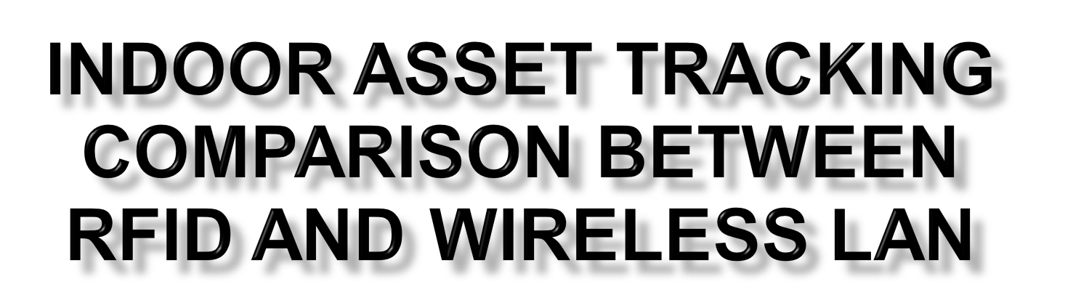
Collin Murray & Julian Hulme
Supervisor: Audrey Mbogho
Cosupervisor: Hanh Le

Slide 2

  Location-based Services (LBS) are becoming more and more popular
    GPS by far the most popular LBS
    Cellular based localization systems also popular
  Knowledge of location/position with regards to maps/environments is becoming important
  The is the key in asset tracking

Slide 3

Asset tracking is the physical locating objects using a wireless technology.
Wireless technologies such as Gps, sonar, rfid, wifi
Wireless technologies use triangulation to calculate location based on signal strength

Slide 4

Which technology is 'better' at indoor tracking?
Why?
In what respects?
Our question is this, which technology is better at indoor tracking.
Julian with the measurements.

Slide 5

Workload is an even split:
  RIFD - Collin
  WiFi - Julian
  GUI / Website - Both
Risks
Hardware failure/error:
  Spares
  Correct research
Time Management (systems design)
  Allowing extra time for hardware
  Ensure deadlines are met

Slide 6


  Radio Frequency, primarily a identification technology
  Active/passive tags
  signal strength based
  Tags are cheap, readers are not
  Locating requires triangulation

Slide 7
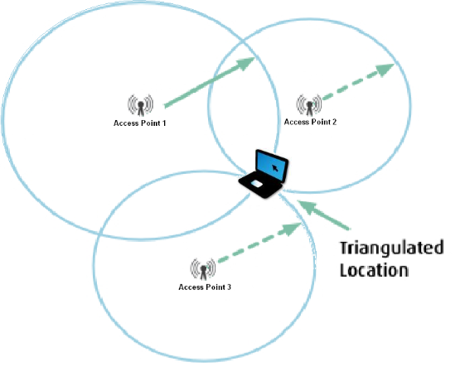
Triangulation

Slide 8

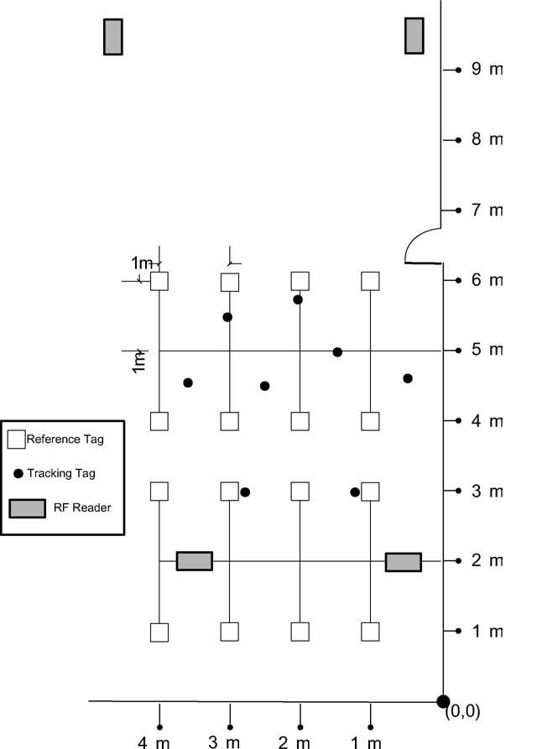
  Interference gives inaccurate readings
  The LandMarc reference system
  Reference tags hold position location
  Error correction can be done

Slide 9

  Wireless Networking
    Primary purpose to connect device with Wireless network card to network via access points
  Incidentally
    Access points can be used to triangulate nodes location

Slide 10

Past experiments showed the value of calibration
  Map the environment with reference points for localization

Slide 11

Both systems will undergo the same tests:
  Accuracy (meters)
  Required time to calibrate (hours)
  Cost to impliment (R)
  And more factors still to be realised

Slide 12

Step 1
  Setup the system hardware
Step 2
  Calibrate the environment
Step 3
  Do testing for static device
Step 4
  Do testing for moving device

Slide 13

Software to visually locate assets on a map of the environment
A compilation of scenarios which presents pros and cons

Slide 14

Can assets be tracked in environments where GPS is not feasible
Which is better, RFID or WLAN?
  Accuracy
  Implementation
  Costs

