Slide 1
Indoor Asset tracking comparison between RFID and Wireless LAN
Collin Murray & Julian Hulme
Supervisor: Audrey Mbogho
Cosupervisor: Hanh Le

Slide 2
Introduction
Location-based Services (LBS) have been predicted to be huge market share in upcoming future
GPS by far the most popular LBS
Cellular based localisation systems also popular
Knowledge of location/position with regards to maps/environments is becoming important

Slide 3
Research Question
Which technology is 'better' at indoor tracking?
Why?
In what respects?
Our question is this, which technology is better at indoor tracking.
Julian with the measurements.

Slide 4
Asset tracking
Asset tracking is the physical locating objects using a wireless technology.
Wireless technologies such as Gps, sonar, rfid, wifi
Wireless technologies use triangulation to calculate location based on signal strength

Slide 5

RFID description
Radio Frequency, primarily a identification technology
Active/passive tags
signal strength based
Tags are cheap, readers are not
Locating requires triangulation

Slide 6
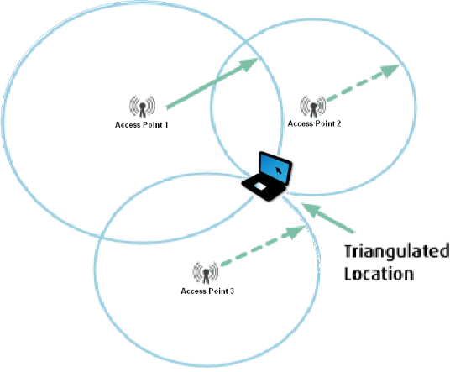
Triangulation

Slide 7
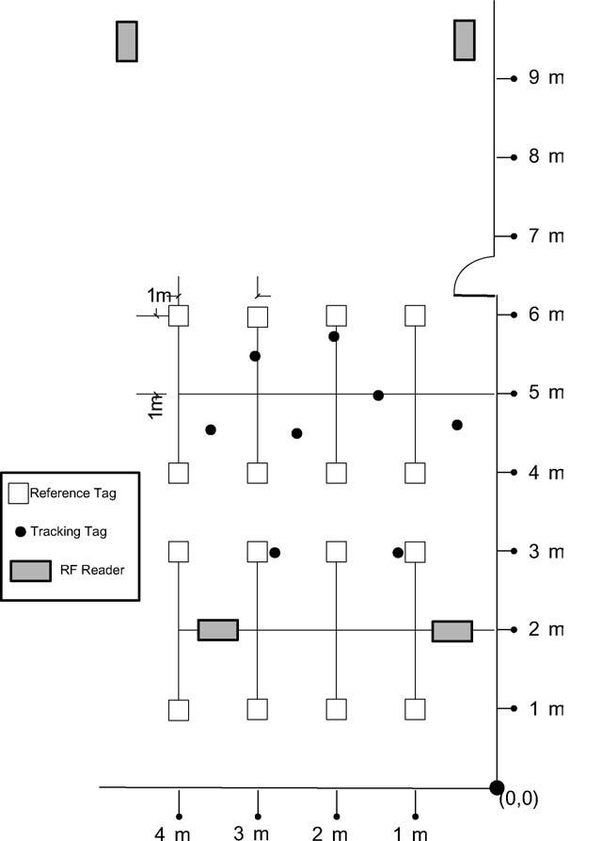
The problem of Interference
Interference gives inaccurate readings
The LandMarc reference system
Reference tags hold position location
Error correction can be done

Slide 8
Wireless LAN System (WLAN)
Wireless Networking
Primary purpose to connect device with Wireless network card to network via access points
Incidently
Access points can be used to triangulate nodes location

Slide 9
Calibration
Past experiments showed the value of calibration
Map the environment with reference points for localization

Slide 10
Experiment
Both systems will undergo the same tests:
Accuracy (meters)
Required time to calibrate (hours)
Cost to impliment (R)
And more factors still to be realised

Slide 11
Procedure
Step 1
Setup the system hardware
Step 2
Calibrate the environment
Step 3
Do testing for static device
Step 4
Do testing for moving device

Slide 12
Outcomes
Software to visually locate assets on a map of the environment
A compilation of scenarios which presents pros and cons

Slide 13
Conclusion
Can assets be tracked in environments where GPS is not feasible
Which is better, RFID or WLAN?
Accuracy
Implementation
Costs

