Slide 1

AE COURSE PROJECT
Problem Statement:
Traffic Light and Sign Board Detection
Team members details:
NAME | USN | DIV
Ananth Choudhary | 01fe21bec191 | D
Lokesh Pandey | 01fe21bec195 | D

Slide 2
Introduction
In the era of smart transportation and autonomous driving, the ability to accurately detect and interpret traffic lights and signboards is paramount. These technologies are essential for ensuring the safety, efficiency, and reliability of modern transportation systems. Traffic light and signboard detection systems utilize advanced computer vision (CV), artificial intelligence (AI), and machine learning (ML) algorithms to identify and interpret traffic signals and road signs in real time. This capability is critical for the functionality of autonomous vehicles, advanced driver-assistance systems (ADAS), and intelligent transportation systems (ITS).
The growing demand for safer and more efficient transportation has driven significant advancements in these detection technologies. Autonomous vehicle manufacturers like Tesla and Waymo have integrated sophisticated detection systems into their vehicles, leveraging deep learning and sensor fusion to navigate complex traffic environments. ADAS providers such as Mobileye and Bosch have developed camera-based solutions that enhance driver safety by recognizing traffic signals and signs, providing timely alerts and assistance to drivers.
Additionally, aftermarket solutions like Comma.ai's Comma Two offer the benefits of traffic light and signboard detection to existing vehicles, making advanced driver assistance more accessible. Furthermore, companies specializing in traffic management and ITS, such as Siemens Mobility and Kapsch TrafficCom, utilize AI-powered detection systems to optimize traffic flow and improve urban mobility.

Slide 3
Literature survey
Methodology | Approach
Color Thresholding | Early image processing technique using color
Edge Detection and Template Matching | Early image processing technique using edges and templates
Support Vector Machines (SVM) | Machine learning classification using SVM and feature extraction like HOG
Convolutional Neural Networks (CNNs) | Deep learning for detection and classification tasks
Region-Based CNN (R-CNN) | Deep learning with region proposals and CNNs
You Only Look Once (YOLO) | Deep learning framing object detection as regression
Single Shot MultiBox Detector (SSD) | Deep learning for object detection in a single shot
Transfer Learning | Leveraging pre-trained models for fine-tuning
Data Augmentation | Increasing training data diversity artificially

Slide 4
Market survey
Autonomous Vehicle Manufacturers
- Tesla Autopilot: Utilizes CV, NN, and sensor fusion for real-time detection and continual updates.
- Waymo: Employs deep learning, LIDAR, and high-def cameras for advanced perception.
- Cruise Automation: Integrates CV, deep learning, and sensor fusion for real-time detection and classification.
Advanced Driver-Assistance Systems (ADAS)
- Mobileye: Monocular camera-based systems with CV and deep learning for real-time TSR and TLD.
- Bosch: Camera-based systems and ML for integration with navigation systems.
- Continental AG: Uses stereo cameras and deep learning for enhanced driver safety.
Aftermarket Solutions
- Comma.ai: Comma Two offers open-source driver assistance with traffic light and sign recognition.
- Cognitive Pilot: Combines neural networks and CV for real-time alerts and integration with other ADAS features.
Traffic Management and ITS
- Siemens Mobility: Sitraffic Symphony utilizes AI and CV for traffic monitoring and management.
- Kapsch TrafficCom: EcoTrafix integrates sensor data and AI for traffic signal control and sign detection.
Research and Open-Source Solutions
- OpenPilot by Comma.ai: Open-source driving agent with CV and deep learning for traffic sign and light detection.
- Berkeley DeepDrive (BDD): Provides datasets and benchmarks supporting research in autonomous driving and traffic management.

Slide 5
Datasets Available
German Traffic Sign Recognition Benchmark (GTSRB)
Description: Contains over 50,000 images of traffic signs with 43 different classes.
Belgium Traffic Sign Dataset (BelgiumTSC)
Description: Includes images of traffic signs in Flanders, Belgium, with 62 different classes.
LISA Traffic Sign Dataset
Description: Comprises images collected from the United States, featuring various traffic signs and annotations
Swedish Traffic Signs Dataset (STSD)
Description: Contains images of traffic signs from Sweden, with 20000 images and 20 different classes.
TT100K (Tsinghua-Tencent 100K)
Description: A large-scale dataset with 100,000 images and 45,000 annotated traffic signs from China.
Mapillary Traffic Sign Dataset
Description: Part of the Mapillary Vistas dataset, contains diverse images of traffic signs from around the world.
Chinese Traffic Sign Database (CTSD)
Description: A comprehensive dataset featuring Chinese traffic signs.
The Russian Traffic Sign Detection Benchmark (RTSD)
Description: Provides images and annotations of Russian traffic signs.

Slide 6
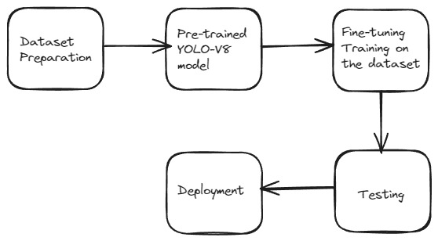
Methodology

Slide 7
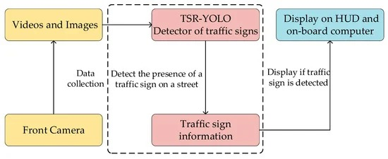
Flowchart

Slide 8
Implementation – (Fine-tuning YOLOv8 for sign detection)
Forward Pass:

Slide 9
Fine-tuning for YOLO
Training (Fine-Tuning)Forward Pass: The model processes input images to make predictions. It tries to identify and locate objects (traffic signs) in each image.
Loss Calculation: The model calculates how far off its predictions are from the actual labels (ground truth).
The loss has three parts:
Localization Loss: Measures errors in predicting the exact positions of the bounding boxes.
Confidence Loss: Measures how confident the model is that an object is present.Classification
Loss: Measures errors in predicting the correct class of the object.
Backward Pass: The model calculates how to adjust its internal settings (parameters) to reduce the loss. This step involves computing gradients, which are like directions on how to adjust parameters to improve predictions.
Parameter Update: The model updates its parameters using an optimization algorithm (like Adam optimizer) based on the computed gradients. This is like fine-tuning the settings to improve performance. Hyperparameters Learning Rate: Determines how much to adjust the model's parameters during training. Too high can cause instability, too low can make training slow.
Batch Size: Number of images processed at once. Larger batches can be more stable but require more memory.
Number of Epochs: Number of times the entire training dataset is passed through the model. More epochs mean more training but can lead to overfitting if too many.

Slide 10
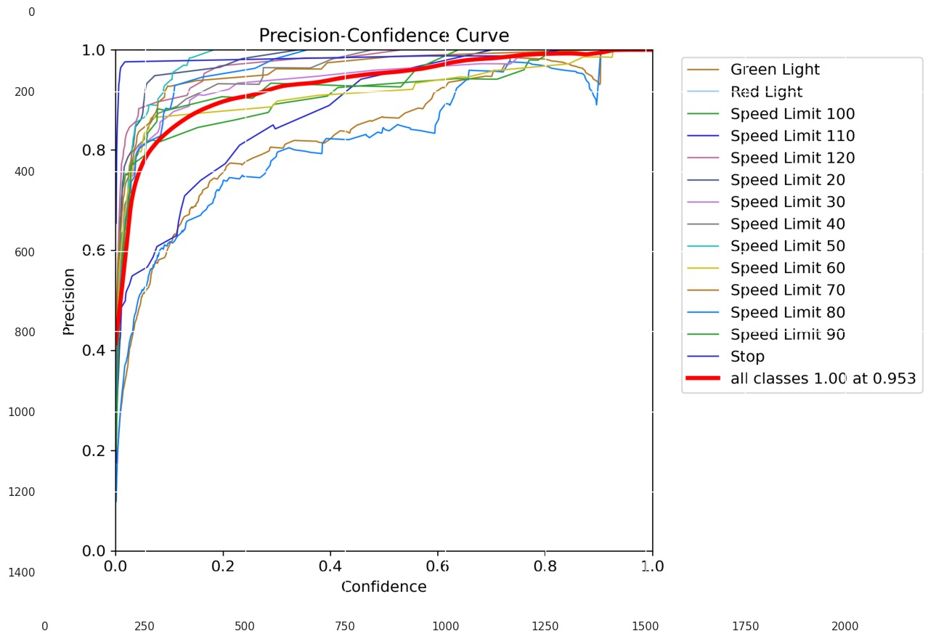
Results

Slide 11
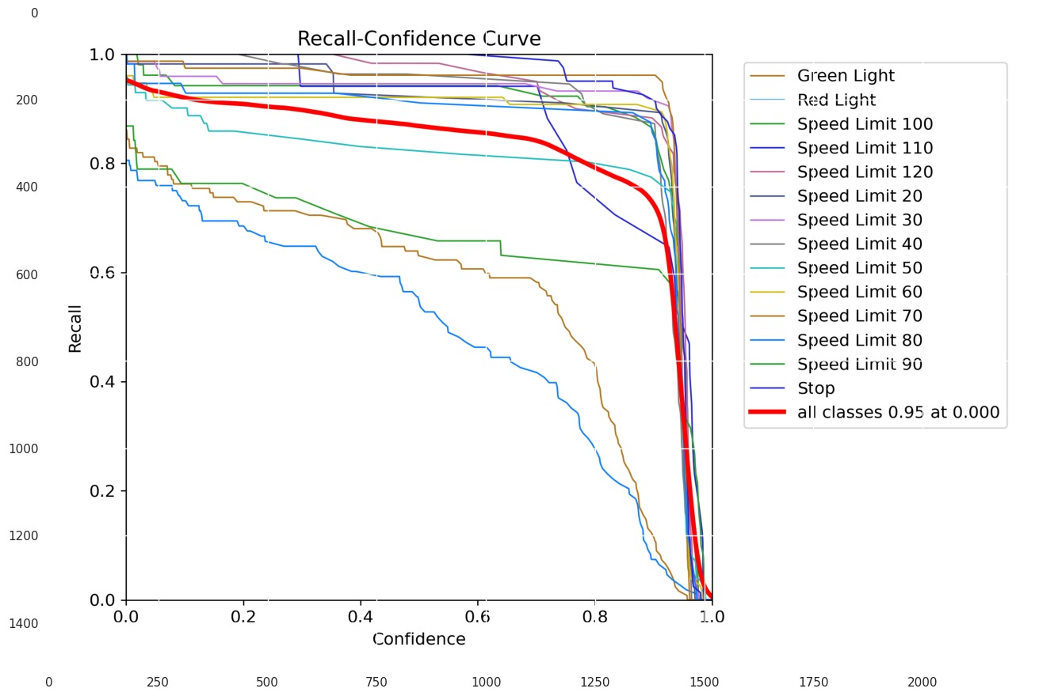
Results

Slide 12
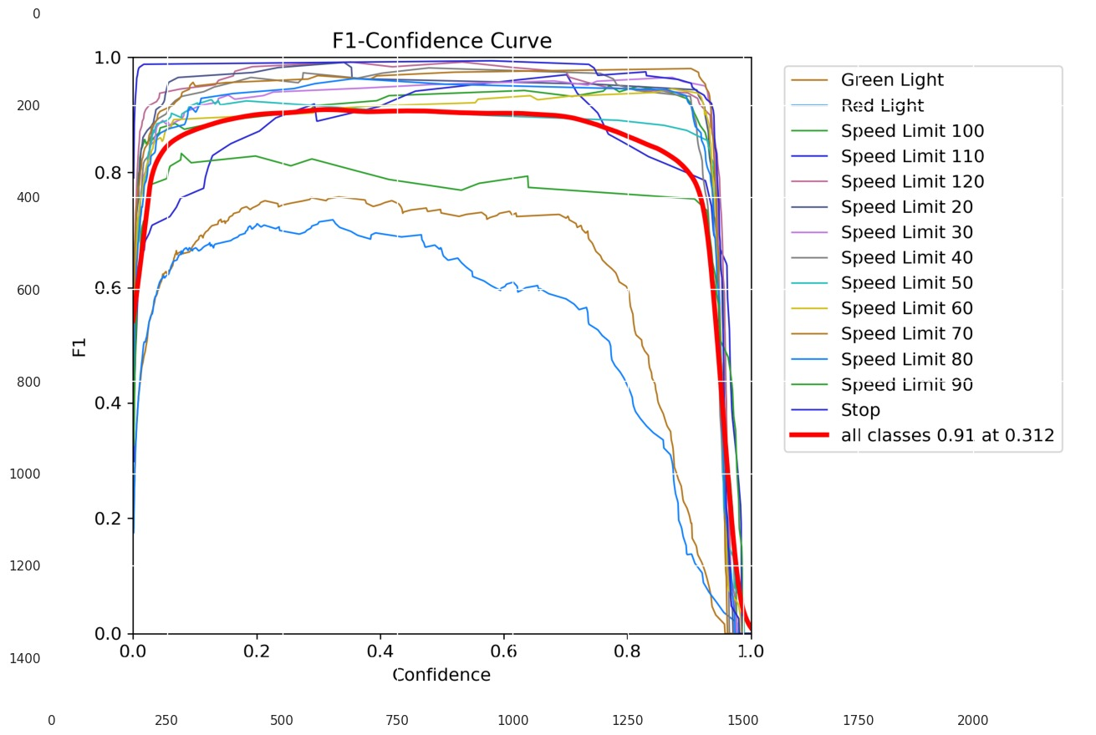
Results

Slide 13
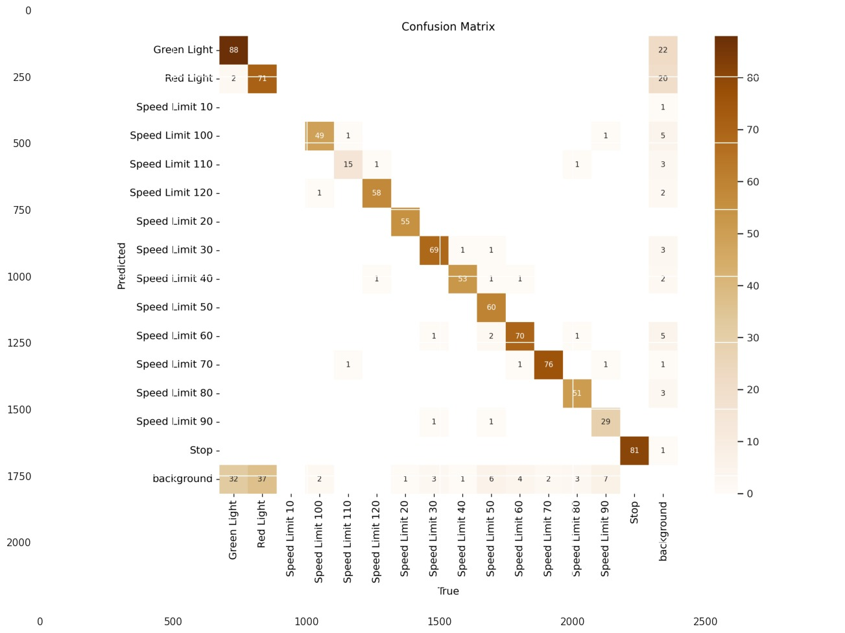
Results

Slide 14
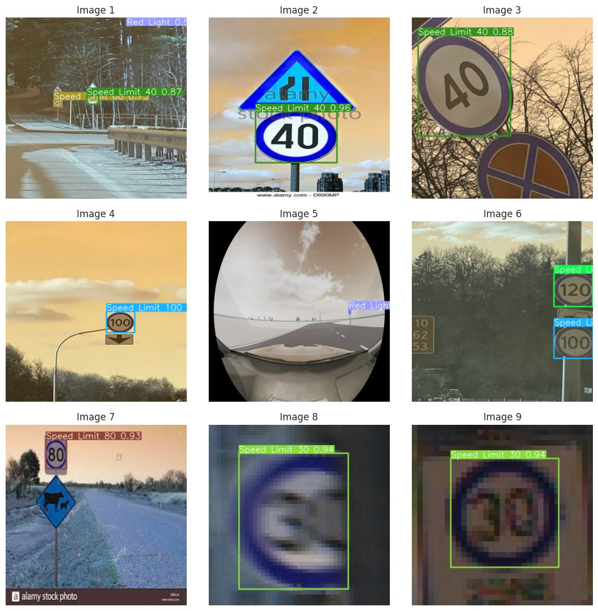
Results

Slide 15
Results

Slide 16
Challenges and Future Direction
Despite significant progress, several challenges remain:
Variability in Lighting and Weather Conditions: Detection algorithms must be robust to changes in lighting, shadows, and adverse weather conditions.
Real-Time Processing: Ensuring real-time performance without sacrificing accuracy is crucial for practical deployment in autonomous vehicles.
Occlusion and Degradation: Traffic signs and lights may be partially occluded or degraded, posing challenges for detection.
Future research directions include the development of more robust models, leveraging newer architectures like transformers, and creating more comprehensive and diverse datasets.

Slide 17
Thank You

