Slide 1
Converting
Regex to
Natural Language
April 2022
CS 4TB3 Winter 2022
Group 14
A project by: Anant, Kuber and Bilaval

Slide 2
What’s Regex?
(Reg)ular (Ex)pressions are sequence of characters that specifies a search pattern in text.
Usually, they are made up of letters, digits and some symbols
Examples:
([A-Z] {2,4})$(.*)
[a-b]+(ab*)(cd)?(ef|gh)
[a-zA-Z0-9]+@[a-zA-Z]+\.com
As seen above, Regex is hard to read and understand for humans.

Slide 3
Currently Available Tools
Online applications exist such as:
https://regexr.com/
https://regex101.com/
https://www.dcode.fr/regular-expression-simplificator
http://ivanzuzak.info/noam/webapps/regex_simplifier/
http://xenon.stanford.edu/~xusch/regexp
These tools:
Only provide lexical breakdown and no pattern analysis
Do not provide random samples of acceptable inputs for the regex
Do provide the ability to test an input against a regex
Mostly available as web applications so cannot be used by other external applications (via API calls)

Slide 4
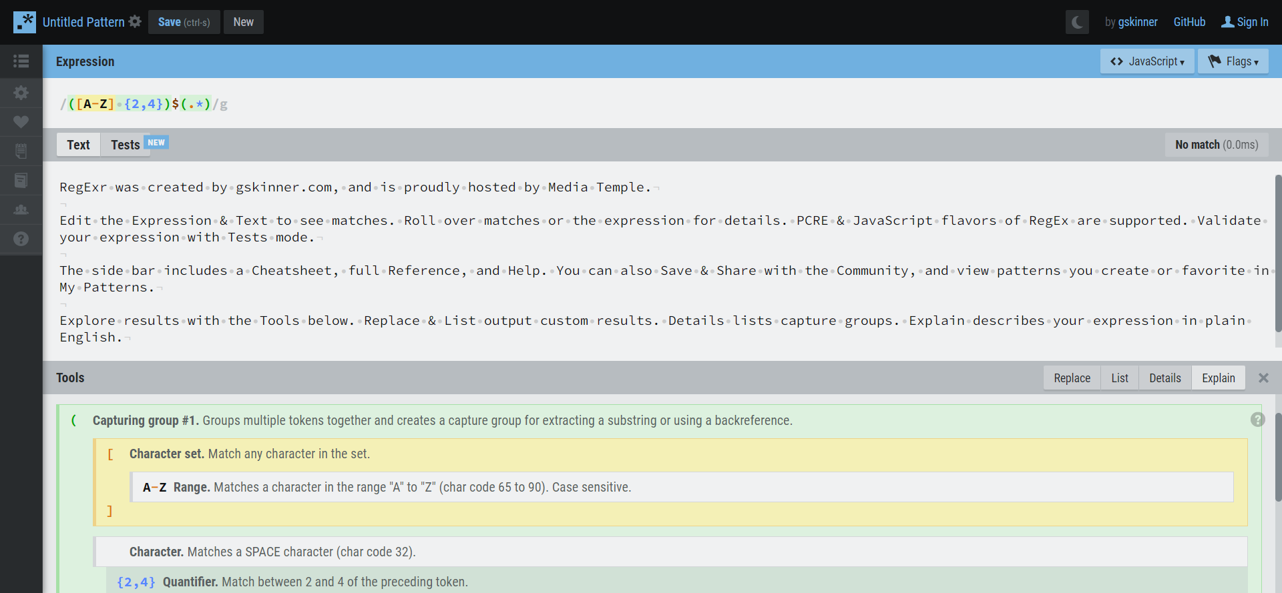
Currently Available Tools
https://regexr.com/

Slide 5
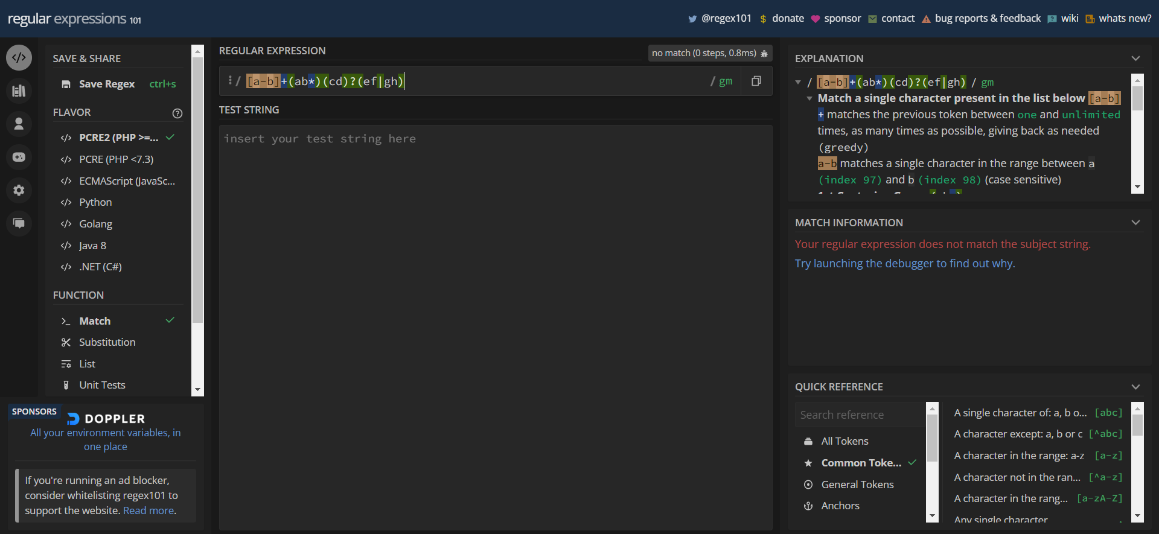
Currently Available Tools
https://regex101.com/

Slide 6
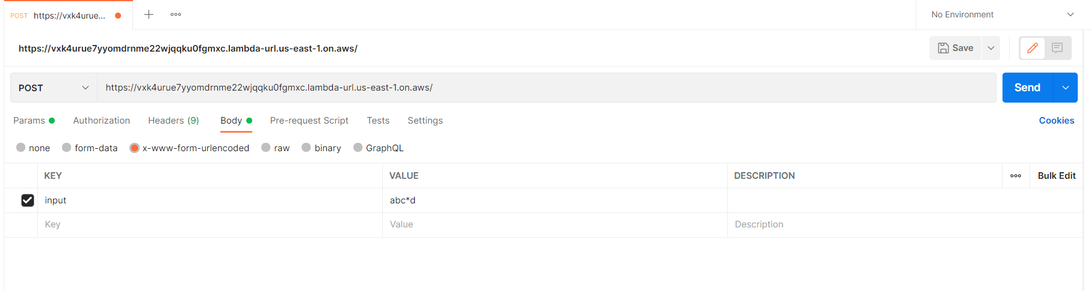
How It Works?
Step 1
User uses Front-end (Jupyter Notebook) or sends a POST request to API with Regex.
Example Depicting Post Request (via Postman)

Slide 7
How It Works?
Step 2
Regex is converted into AST and processed into suitable outputs
This step includes:
Text output generation
Permutations Generation
Random : Slow, but diverse results for all inputs
Procedural : Very fast, but similar results for complex inputs (inaccurate pattern analysis)
Solution : Few procedural and few random results combined
Pattern Analysis:
Preceding and Proceeding Characters
Odd and Even Characters
Minimum Length of Generated Output

Slide 8
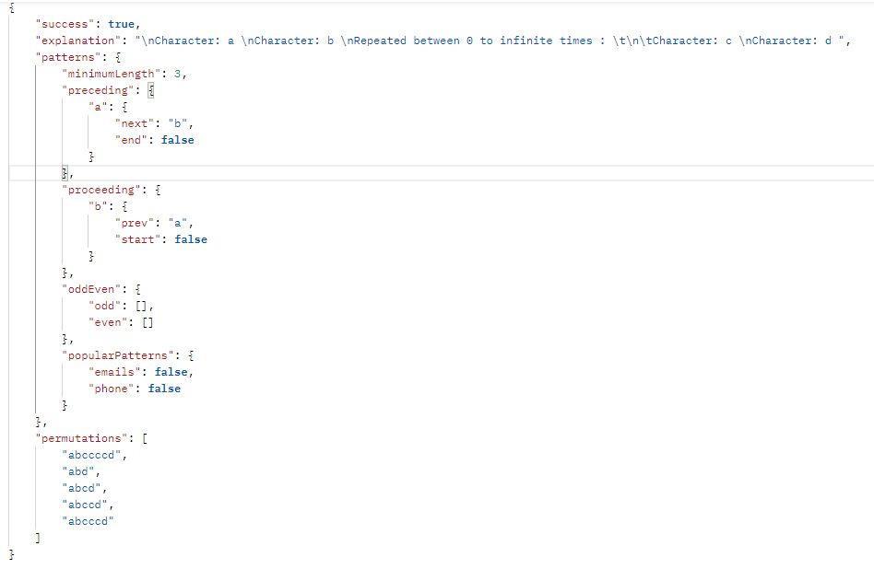
How It Works?
Step 3
Converting API call’s result into visual information (on Front-end)

Slide 9

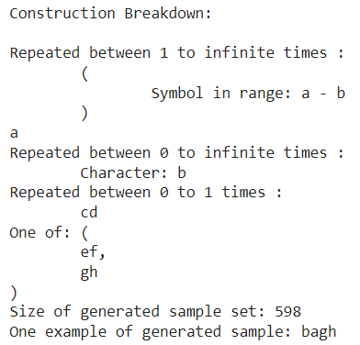
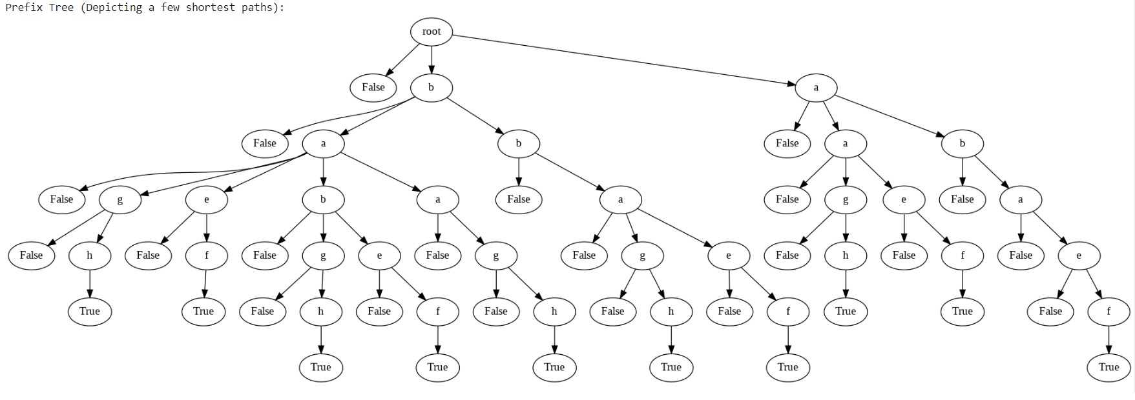
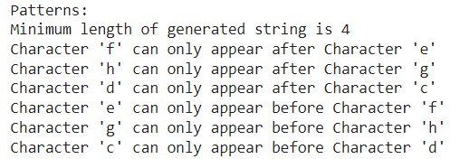

Slide 10
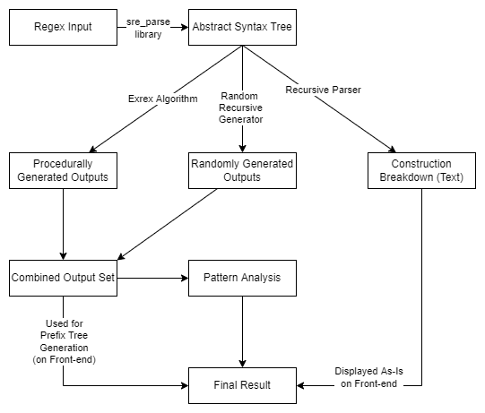
How We Did It? (Back-end)

Slide 11


Platforms Used
Backend
Frontend
Cache
Public API
AWS Lambda
Google Colab
Python Code
Jupyter Notebook

Slide 12
Backend
Backend is written in Python
Multiple libraries available to work with regular expressions
Same language as Front-end (Jupyter Notebook)
Hosted on AWS Lambda
Increases scalability of the application due to inbuilt auto scaling
Reduces cost of hosting due to pay as per usage model
1 Million Calls Up to 3.2 Million Seconds for Free (12 Months)
Cheap operational expenses after free trial ends
Provides easy interface for back-end as an HTTP API

Slide 13
Frontend
Used Google Collab and Jupyter Notebooks for frontend of the project
No set up required
Integrates directly with Github and Auto deployment (Push to Deploy)
Free of cost
Integrated execution/runtime environment (via GCP)
Sharing features available
Could have also been deployed as a web application
Requires dedicated front-end web development (HTML, React, Vue, Angular, etc)
Additional operational expenditures (hosting)

Slide 14
Testing, Documentation and Issues Faced
Testing :
No standardized way of testing outputs as there are multiple ways to interpret a regex
We have included few test cases with the use of Pytest library
Documentation :
Design decisions and details about code have been stored in Readme.md as a markdown file
Comments have been added within code files for citations and additional details
Some user information has been provided at the front end (in Google Colab via Jupyter Notebook)
Issues Faced :
Permutation generation algorithm was initially slow as a brute force approach was utilized
Managing indentation and spacing during text generation turned out to be a challenge
Visual Trie generation on back-end was a challenge

Slide 15
Demo
bit.ly/regexNL

Slide 16
Stats
~450
7
0
6
Lines of Code
Seconds
Maximum Compute Time*
~300
Convert Regex to NL
~150
Pattern Recognizer
Cost
Test Cases
Highly scalable API
*: for Regexes with acceptable complexity level

Slide 17
Thank You
Any Questions?
April 2022
A project by: Anant, Kuber and Bilaval
Demo Available at : bit.ly/regexNL

