Slide 1

Hand Drawn Electric Circuit Diagram Understanding
Department of Computer Science & Engineering, IIT Jodhpur
Anant Kumar Singh – B15CS007
Bhargav Kansagara – B15CS022
Faculty Advisor: Chiranjoy Chattopadhyay

Slide 2
Problem Statement
Automatic Localization and Recognition of various circuit elements in hand drawn Electric Circuit.
Input: An Image having hand drawn electric circuit diagram.
Output: Another image with
The electrical components highlighted by a bounding box.
Each bounding box will be labeled.
Textual description of connections between these components.
Deliverables
A command line based tool
Programming: Python, OpenCV, Tensorflow.

Slide 3

Localization of Components
Slice of an input image

Slide 4
















Localization of Components
Green blocks depict existence of some part of component.
Red blocks depict existence of wire or blank image.

Slide 5

Encoding of component images into array
Fig. 1
Length of green bar = distance between first and last black pixel in that column.
Value of ith index of encoded array is the length of ith green bar from the left.

Slide 6
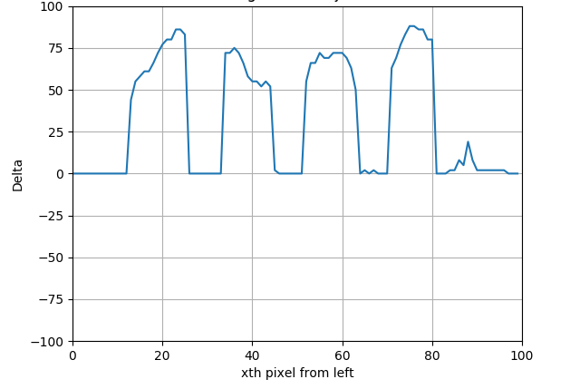

Encoding of a sample Inductor

Slide 7
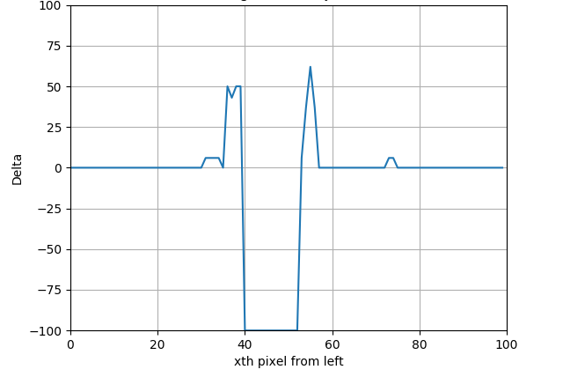

Encoding of a sample Capacitor

Slide 8
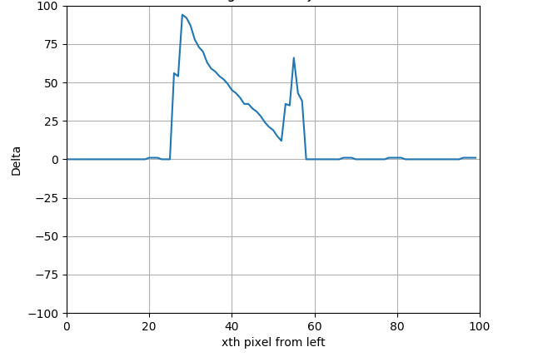

Encoding of a sample Diode

Slide 9
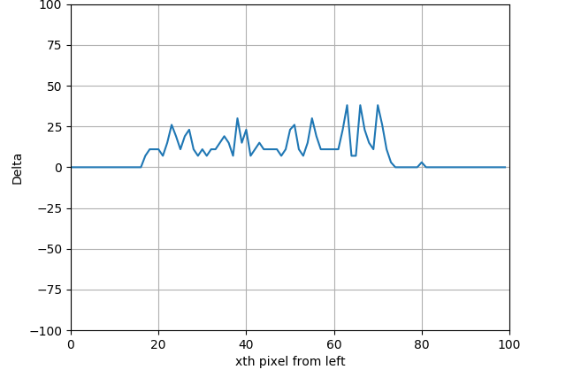

Encoding of a sample Resistor

Slide 10
Classification using Neural Nets
Input : Encoded array of size 100
Output : Binary array of size 4 with exactly 1 bit set.
Layers :
Layers | # of Nodes
Input Layer | 100
Hidden Layer 1 | 10
Hidden Layer 2 | 10
Output Layer | 4
Cost Function : Softmax Cross Entropy
Optimizer : Adam Optimizer

Slide 11
Analysis
Train Data Set = 760 images (190 images for each component class)
Test Data Set = 40 images
No. of Hidden Layers | Accuracy
One | 77.5% (31 correct out of 40)
Two | 92.5% (37 correct out of 40)
Three | 80.0% (32 correct out of 40)

Slide 12
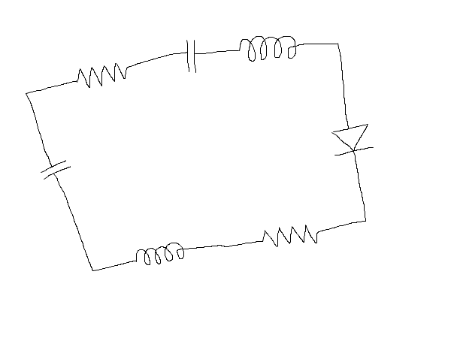
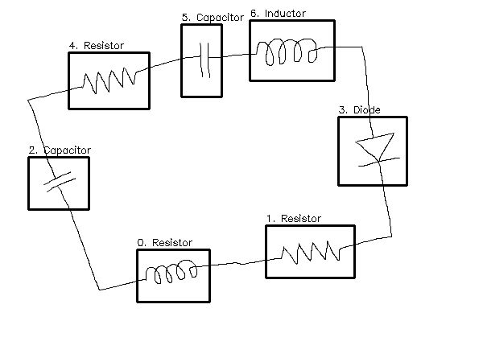
Sample Output
Fig. Input Image
Fig. Output Image
Output Connections:
(according to index of components in image):
[(1, 0), (2, 0), (3, 1), (4, 2), (5, 4), (5, 6), (6, 3)]

Slide 13
Thank you

