Slide 1
These slides are my notes for Linear Algebra. They are not meant to cover all of the Linear Algebra but are more inclined towards the Linear Algebra required in the context of Machine Learning.
Imp links:
https://www.fast.ai/2019/06/17/latex-ppt/

Slide 2
Linear Algebra
Branch of mathematics.
Deals with vectors, matrices, spaces
Transformation of space using matrix

Slide 3
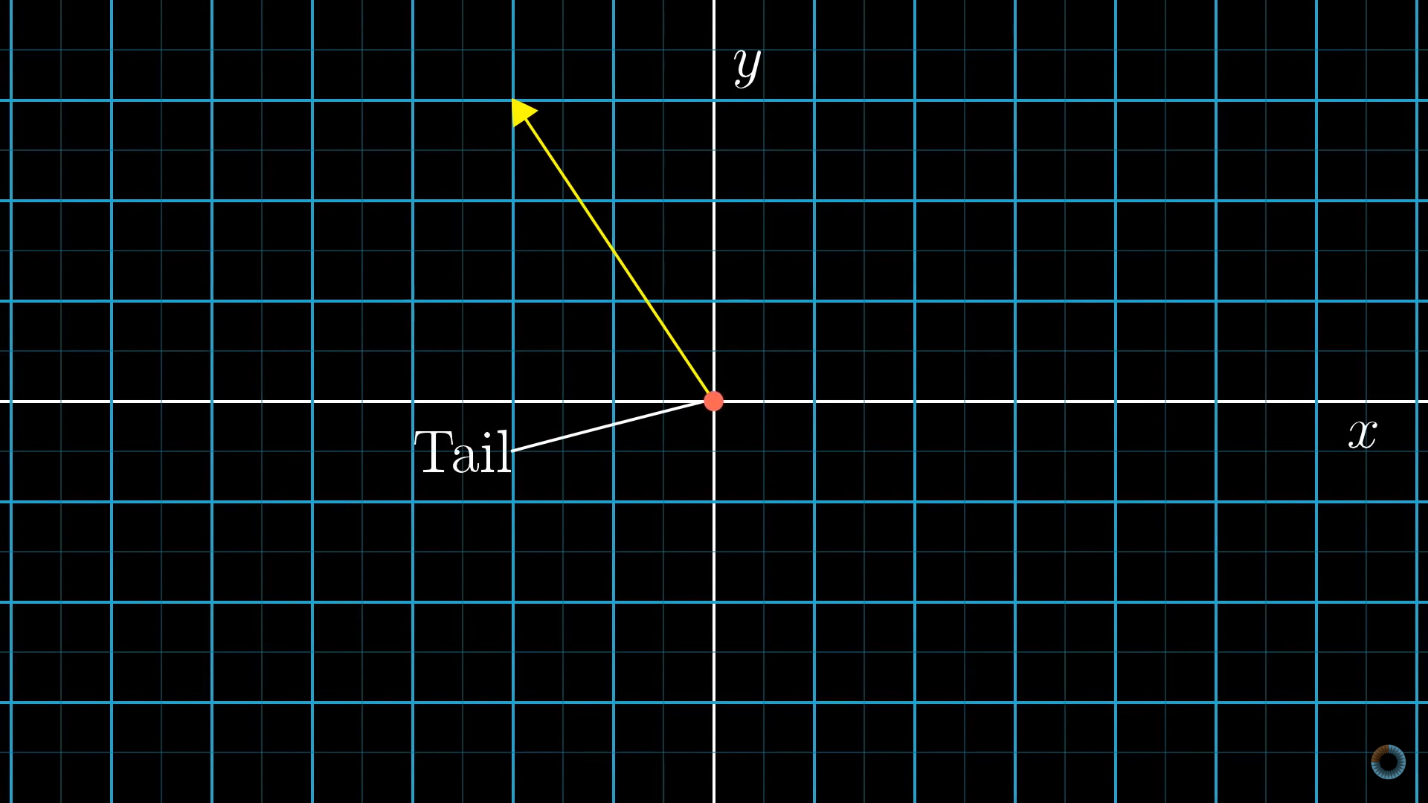
Vectors

Slide 4
Vectors
Vectors can be thought of in a variety of different ways - some geometrically, some algebraically, some numerically. In this way, there are a lot of techniques one can use to deal with vectors.
Following are some of the use cases where the object under consideration can be represented as vectors:
A list of numbers
Position in three dimensions of space and in one dimension of time.
Something which moves in a space of fitting parameters.

Slide 5
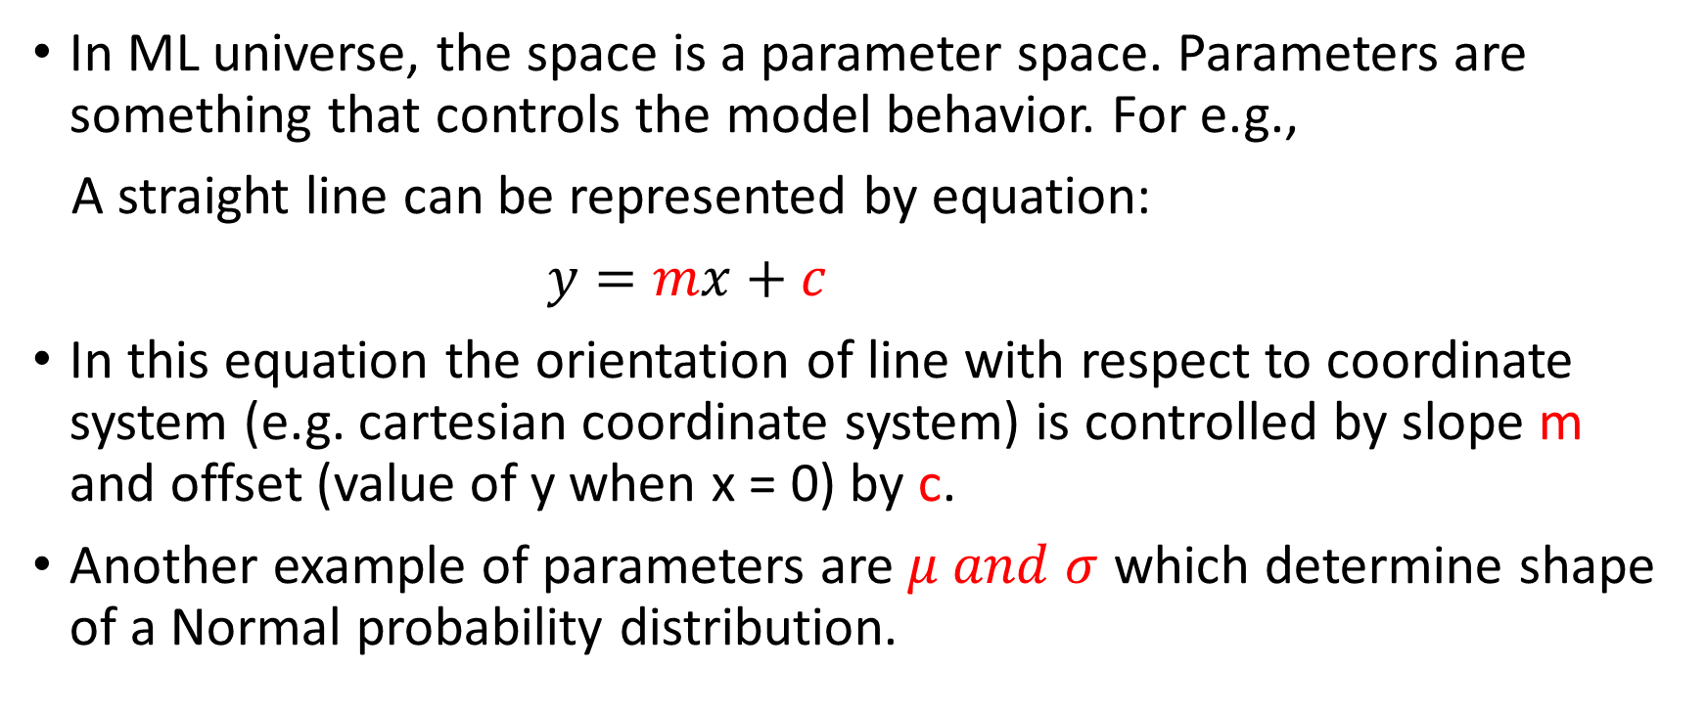
Vectors…cont.
In ML universe, the space is a parameter space. Parameters are something that controls the model behavior. For e.g.,
A straight line can be represented by equation:
$y=mx+c$
In this equation the orientation of line with respect to coordinate system (e.g. cartesian coordinate system) is controlled by slope m and offset (value of y when x = 0) by c.
Another example of parameters are $μ and σ$ which determine shape of a Normal probability distribution.

Slide 6
Vectors…cont.

Slide 7
Vector valued function
https://en.wikipedia.org/wiki/Vector-valued_function
A function whose input is a scalar or vector but output is a vector.

