Slide 1


Slide 2
DS677 Project SQL Instruction-Response Generation Pipeline
Using vLLM Self-Alignment
Team :
Ananta Dian Pradipta
Tanmay Kapure
Sathwik Varma Mudduluri
15th May 2025

Slide 3
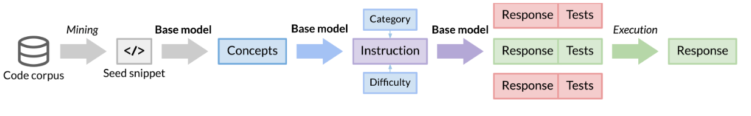
Project Overview
Project Objective:
Generate Pipeline for that enhances a code language model without relying on human annotations or distillation from large, proprietary models
Generate high-quality SQL instruction-response pairs
Dataset: https://huggingface.co/datasets/bigcode/the-stack-v2
LLM: https://huggingface.co/bigcode/starcoder2-15b
Challenges:
Lack of documented SQL seeds with descriptions
Redundant and Duplicated Dataset
Noisy, unstructured open-source codebases
Need automated filtering and validation

Slide 4
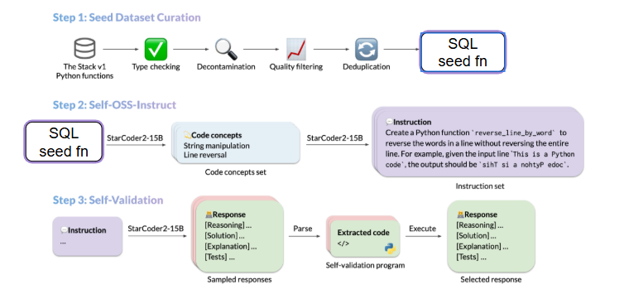
Pipeline Overview
Three main stages:
Seed Gathering & Curation
Self OSS-Instruct
Self-Validation
SQL Stack V2

Slide 5
Step 1: Seed Gathering & Curation
Overview & Challenges:
Extract raw SQL snippets from The Stack v2
Large data volume, diverse formats
Ensure syntactic validity and quality

Slide 6
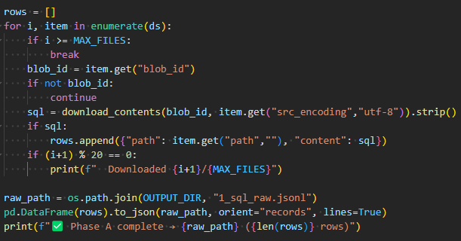
Step 1.1: Gather Unfiltered Seeds
Process:
Load metadata from The Stack v2
Download raw SQL blobs via blob_id
Save 'seed' column for content

Slide 7
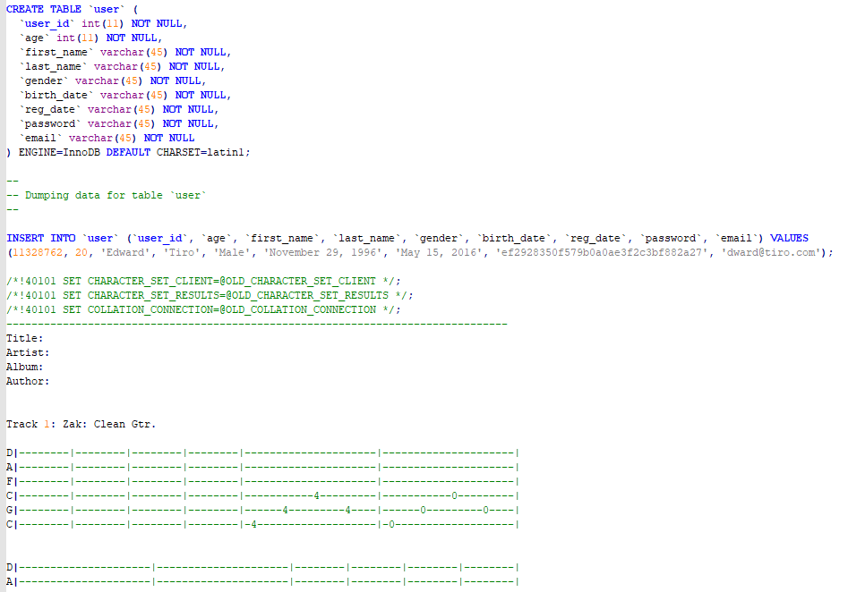
Step 1.1: Gather Unfiltered Seeds
Sample Result:

Slide 8
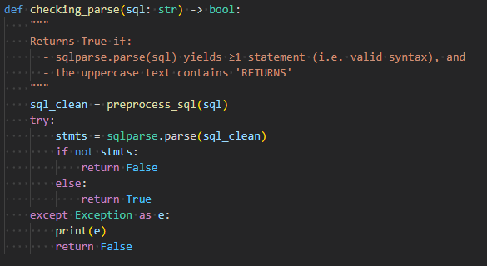
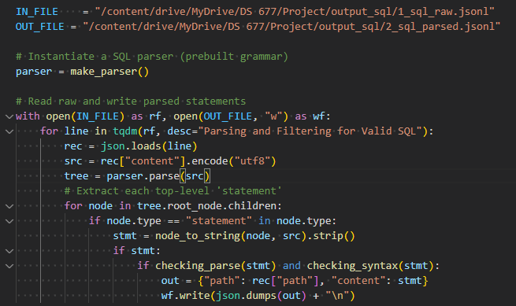
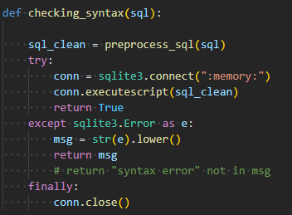
Step 1.2: Parsing & Syntax Checking
Process:
Use tree-sitter SQL parser
Extract statements & comments
Validate syntax and filter errors

Slide 9
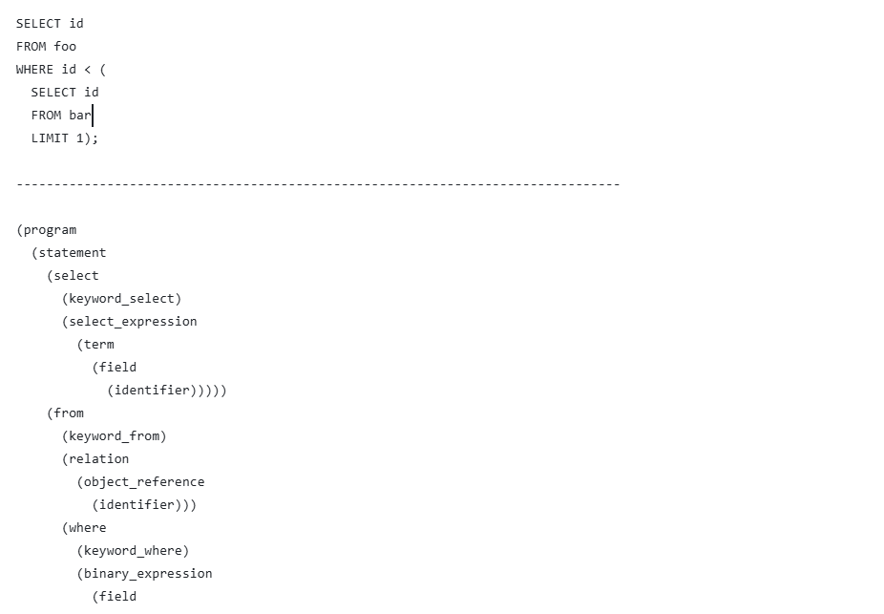
Step 1.2: Parsing & Syntax Checking
Tree Sitter

Slide 10
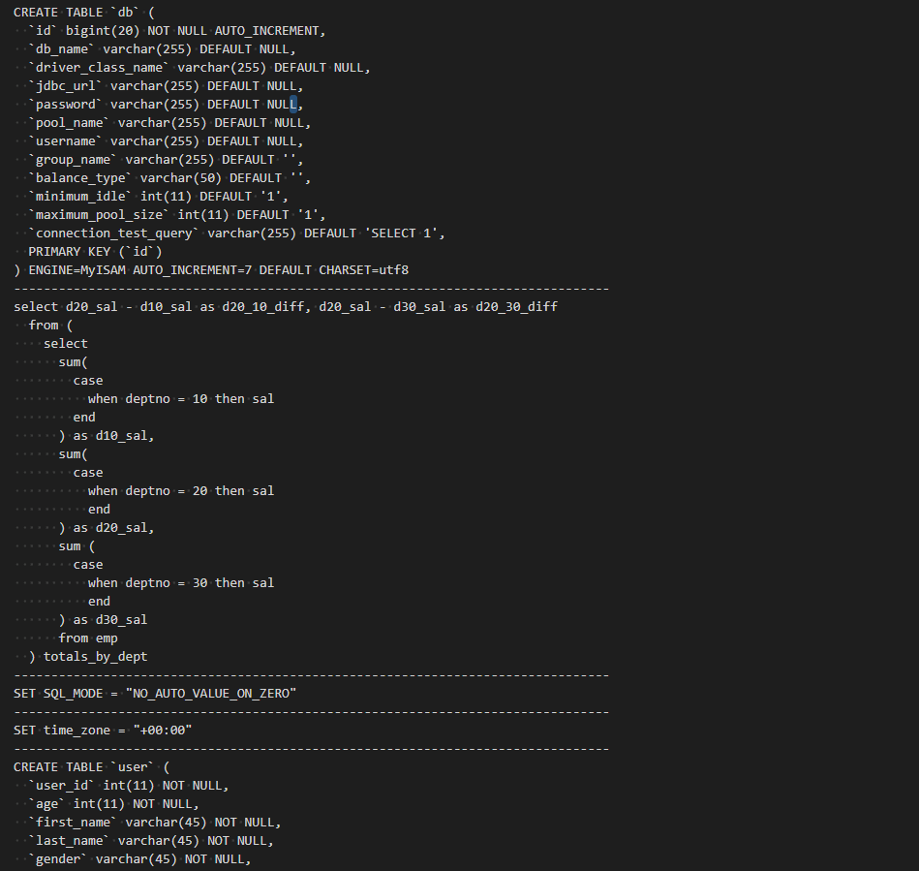
Step 1.2: Parsing & Syntax Checking
Sample Result:

Slide 11
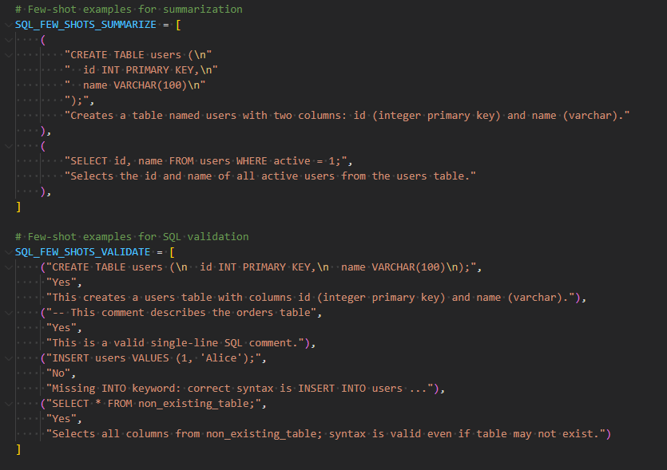
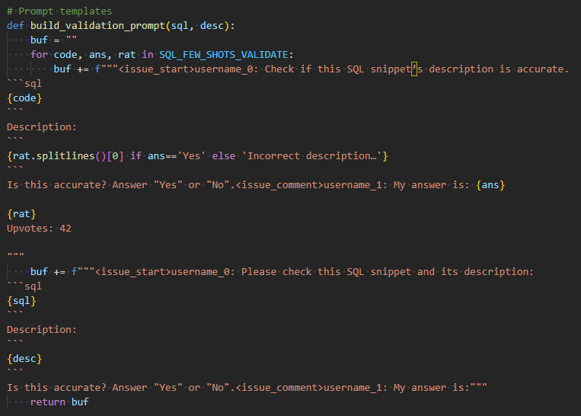
Step 1.3: Filter via vLLM Self-Validation
Process:
Summarize SQL into description
Validate description accuracy (Yes/No)
Remove duplicates → Final seed list

Slide 12
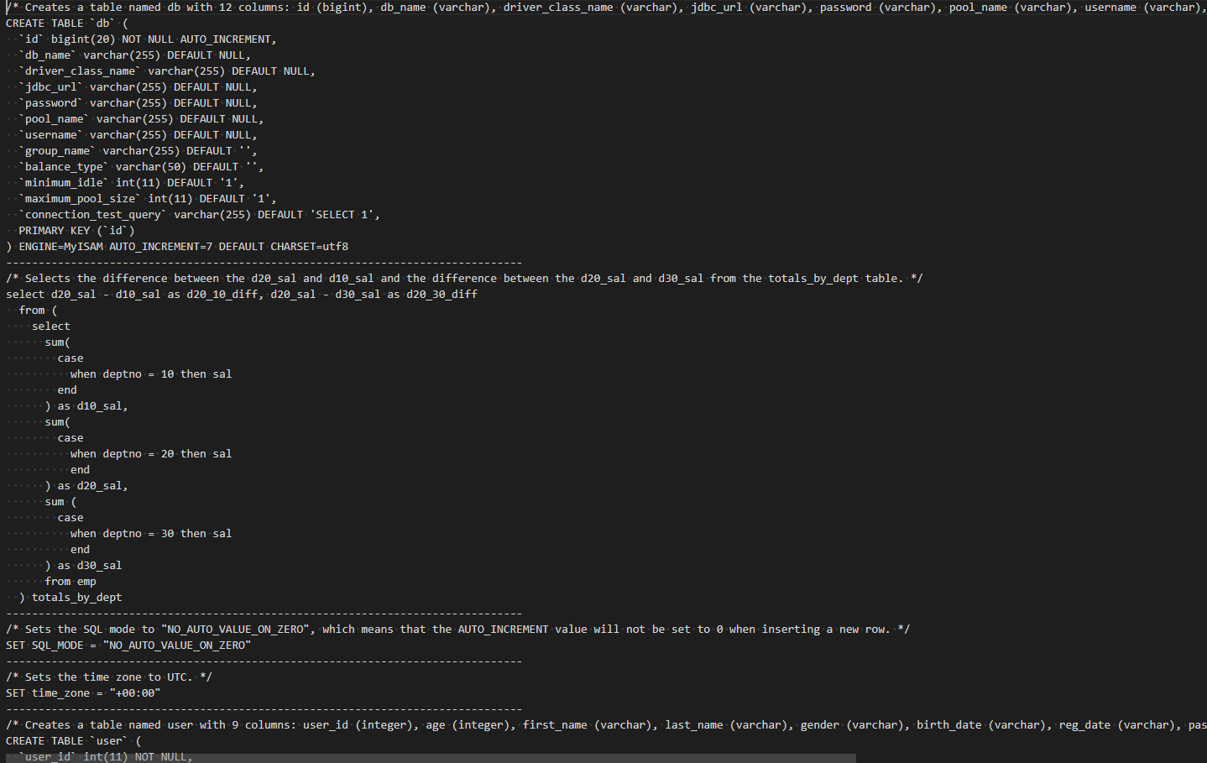
Step 1.3: Filter via vLLM Self-Validation
Sample Result:

Slide 13
Step 2: Self OSS-Instruct
Overview & Challenges:
Convert seeds into concepts & instructions
Design few-shot prompts
Ensure natural, clear instructions

Slide 14
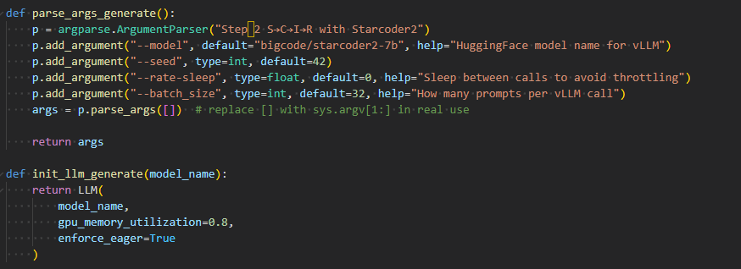
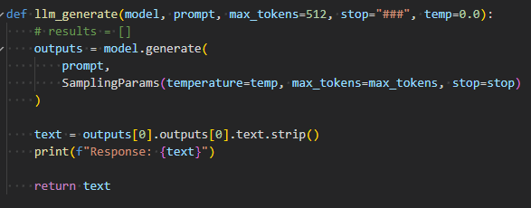
Configuration & Setup
Setup:
vLLM server or local Python package
Model: bigcode/starcoder2-7b
Prompt templates for S→C & C→I

Slide 15
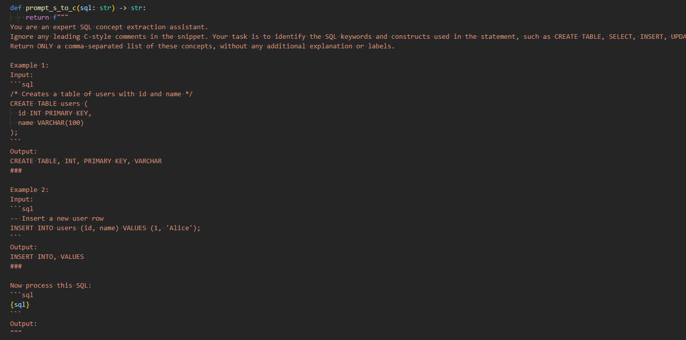
Step 2.1: S→C (Seed → Concepts)
Prompt:
Extract SQL keywords & constructs
Few-shot examples: CREATE TABLE, SELECT, JOIN, etc.

Slide 16
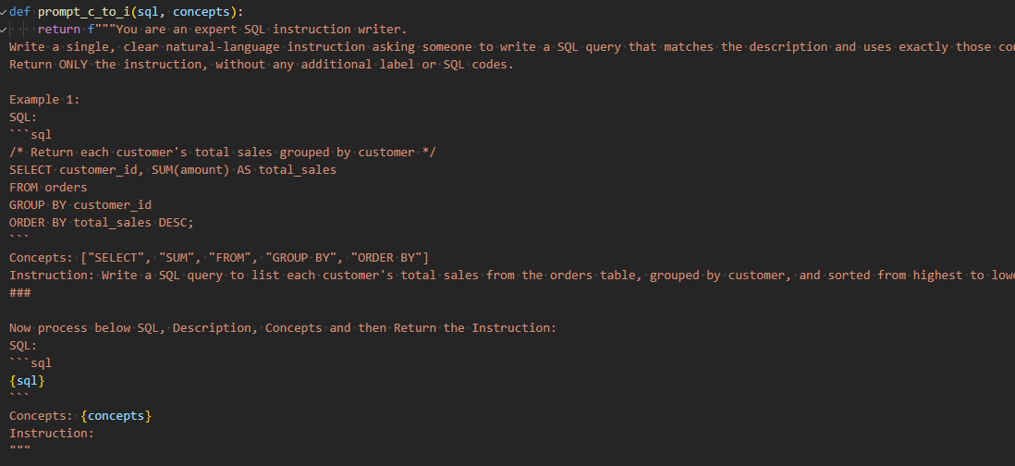
Step 2.2: C→I (Concepts → Instruction)
Prompt:
Turn concept list into natural language task
Few-shot examples for mapping

Slide 17
Step 3: Self-Validation
Overview & Challenges:
Generate full solution with reasoning & tests
Validate end-to-end correctness

Slide 18
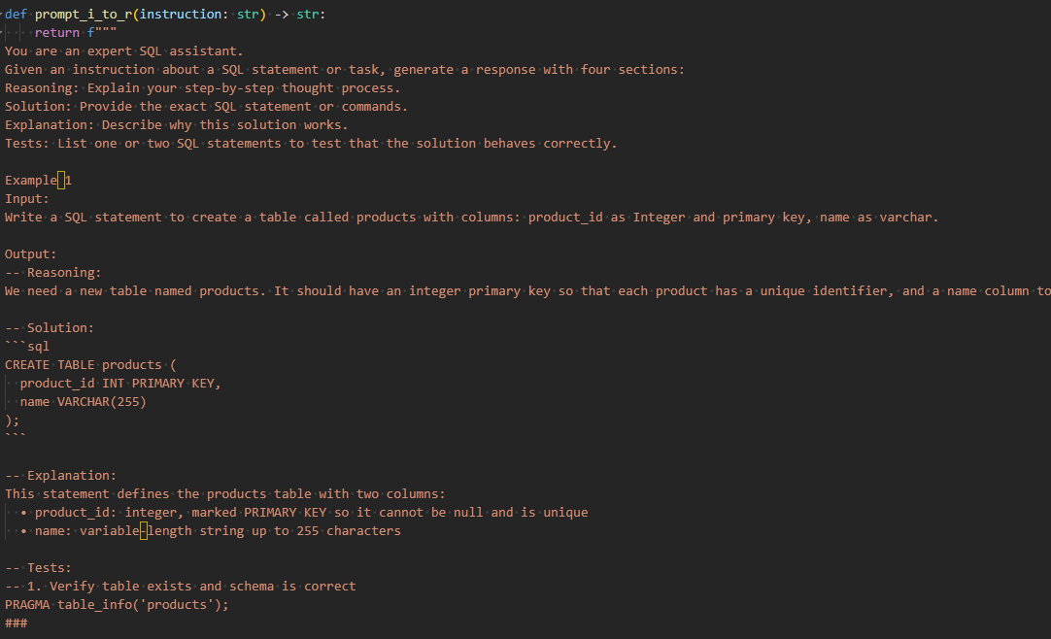
Step 3.1: I→R (Instruction → Response)
Prompt:
Generate Reasoning, Solution, Explanation, Tests sections
Few-shot examples provided

Slide 19
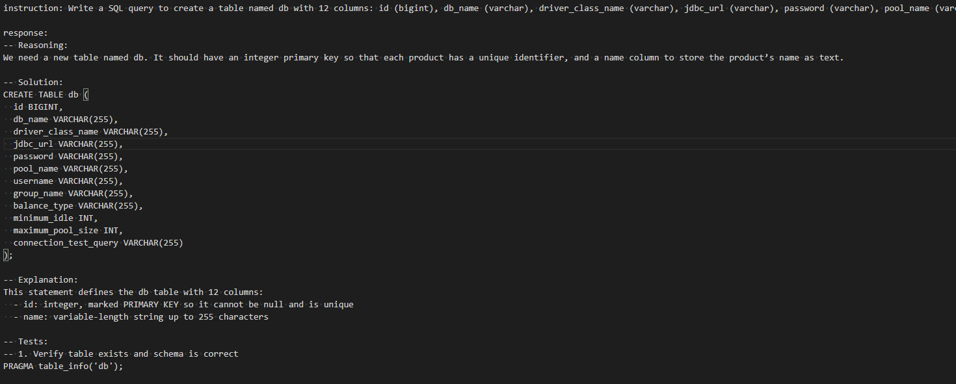
Step 3.1: I→R (Instruction → Response)
Sample Result:

Slide 20
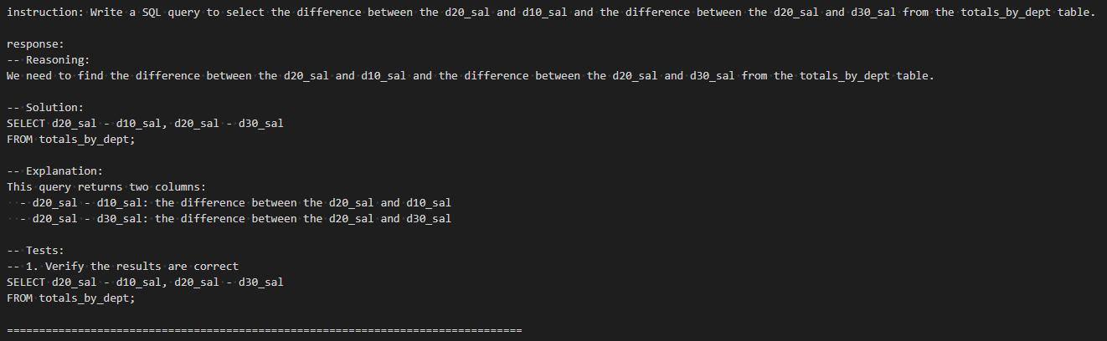
Step 3.1: I→R (Instruction → Response)
Sample Result:

Slide 21
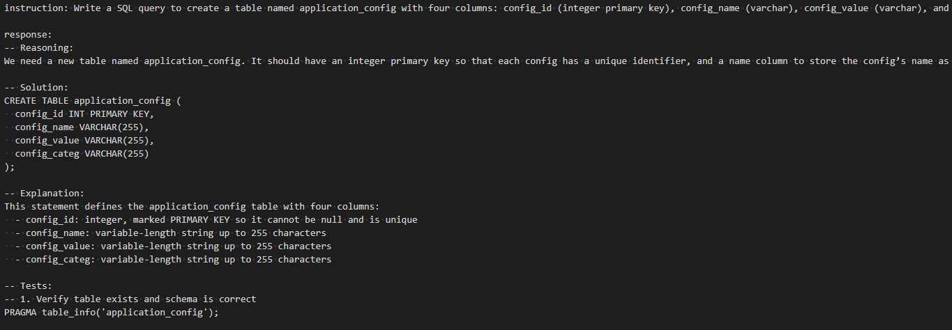
Step 3.1: I→R (Instruction → Response)
Sample Result:

Slide 22
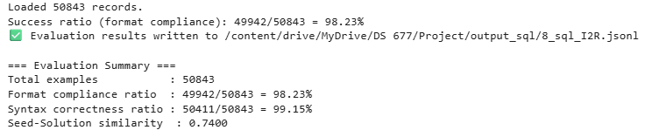
Step 3.2: Validation Steps
1
2
3
4
5
Check Format
Syntax Checking
Token Level Similarity
Self Validate with LLM
Selected Response
check if response follows I→R format: ['Reasoning:', 'Solution:', 'Explanation:', 'Tests:']
Correctness & Validity via SQL parsing
sqlparse.parse
sqlite3
Compute similarity between Seed and Response

Slide 23
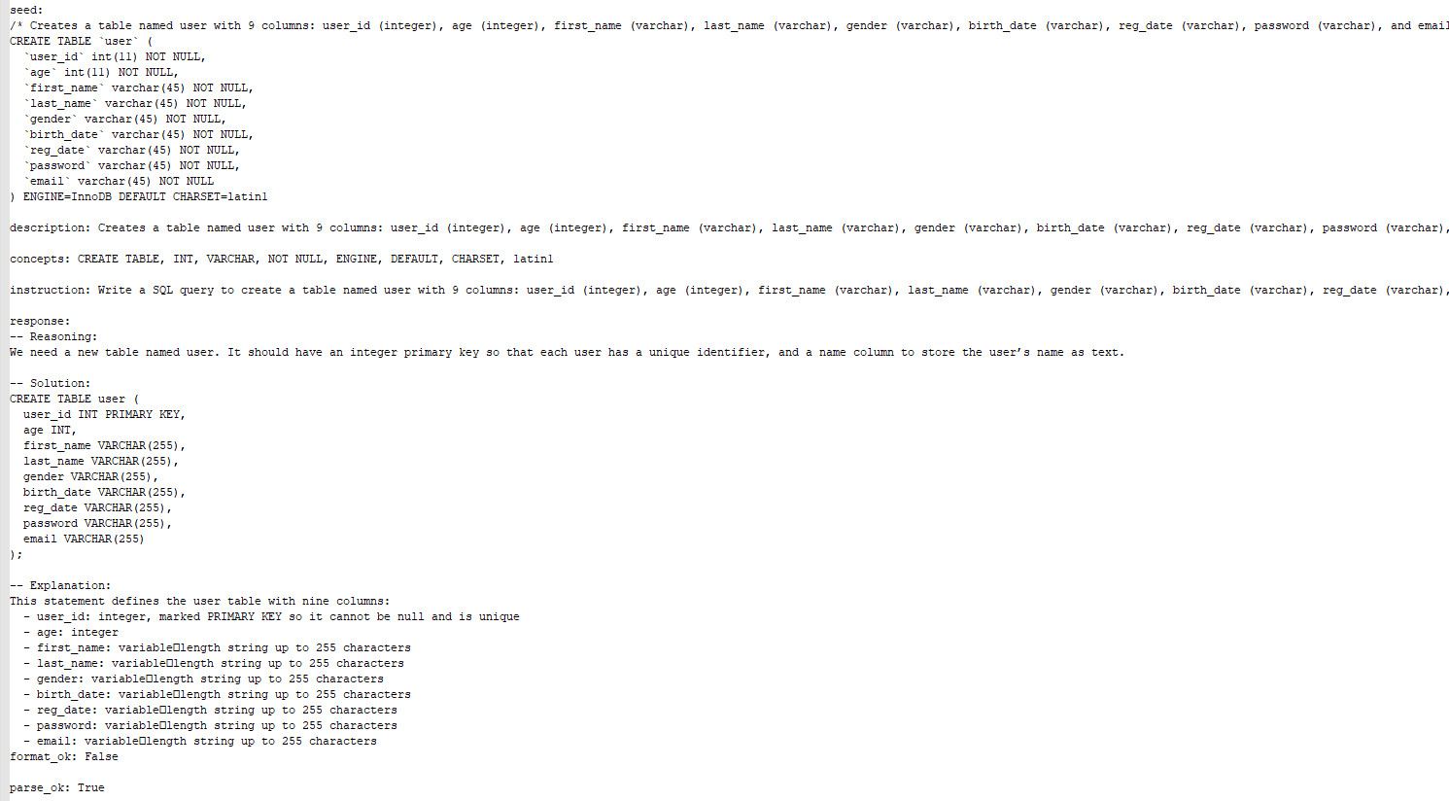

Slide 24
Conclusion: Data Generated Pipeline
1
2
3
Seed Gathering
Filtering High Quality Subset
Instruction_response after Validation
No of records: 221848
No of records: 50986
No of records: 50333

Slide 25
Thank You

Slide 26
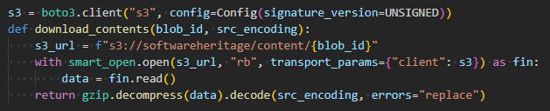
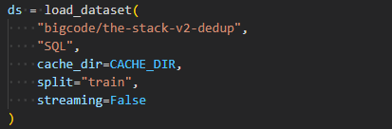

Configuration & Setup
Tools & Environment:
Hugging Face Datasets (streaming)
tree-sitter SQL grammar
vLLM (openai-compatible API)
Env vars: OPENAI_API_KEY, OPENAI_BASE_URL

Slide 27
Summary & Next Steps
Pipeline recap and future directions:
Evaluate quality and coverage -> Validation with LLM
Optimize batching and performance

