Slide 1
Information Theory and Coding Module 4

Slide 2
Channel Coding
The use of channel coders with source coders in a modern digital communication system to provide efficient and reliable transmission of information in the presence of noise.
The channel coder performs a simple mapping operation from the input L-bit message to the corresponding N-bit bit code word where N >L. The rationale behind this mapping operation is that the redundancy introduced by the extra N-L bits can be
used to detect the presence of bit errors or indeed identify which bits are in error and
correct them (by inverting the bits).
The key idea is that a bit error will change the code word to a non-code word which can then be detected. It should be obvious that this is only N >L

Slide 3
Channel Coding
The channel decoder has the task of detecting that there has been a bit error and, if possible, correcting the bit error. The channel decoder can resolve bit errors by two different systems for error-control.
ARQ: If the channel decoder performs error detection then errors can be detected and a feedback channel from the channel decoder to the channel encoder can be used to control the retransmission of the code word until the code word is received without detectable errors.
FAC: If the channel decoder performs error correction then errors are not only detected but the bits in error can be identified and corrected (by bit inversion).

Slide 4

CRC Numerical
Q: A codeword received as 1100 1001 01011. Check whether there are error in the received codeword. If divisor is 10101.

Slide 5
CRC Numerical
Q: Generate the CRC Code for the dataword 1100 1010 1. The divisor is 10101.

Slide 6
CRC Numerical
Q: A message 1001001010 is to be transmitted in a CRC code with the generator polynomial x²+1. What is the encoded message?

Slide 7
CRC Numerical
Q: What is the encoded message for the following 8-bit dataword using following CRC generator polynomial?
x⁴ + x³ + x⁰
11001100
01011111

Slide 8
CRC Numerical
Q: Consider the following set of codeword
C = {000000, 110011, 011101, 111111}.
Is C a linear block code ? Justify you answer
Q: In block coding, if n = 5, the maximum Hamming distance between two codewords can ________.

Slide 9
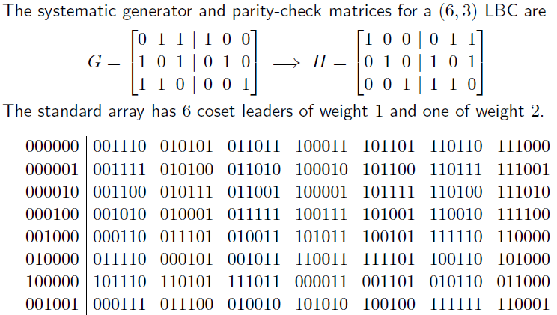
Standard Array
Syndrome table decoding can also be described using the standard array.

Slide 10
Standard Array
Properties of standard array
The first row is the code C, with the zero vector in the first column.
Every vector appears exactly once in the array.
No two vectors in the same row of a std array are identical.
Every other row is a coset. There are exactly 2^{(n-k)} cosets.
first column of a row is called the coset leader. We usually choose the coset leader to be the most plausible error
pattern, e.g., the error pattern of smallest weight.
All vectors in a row of the standard array have the same syndrome.
Each 2^{(n-k)} cosets leaders have different syndrome.
Thus there is a one-to-one correspondence between the rows of the standard array and the syndrome values.
Decoding using the standard array is simple: decode received r to the codeword at the top of the column that contains r.
Decoding is correct iff error pattern is a coset leader. There are 2^{(n-k)} coset leaders ad all are correctable patterns.
The error pattern that are more likely will be chosen as a coset leader. These patterns will have least hamming weight.

Slide 11
LBC: Example
Q1:
Find the encoding table for the linear block code.
What is the minimum distance dmin of the code. How many errors can the code detect. How many errors can the code correct.
Draw the hardware encoder diagram.
Find the decoding table for the linear block code.
Draw the hardware syndrome generator diagram.
Suppose v =1 1 1 0 0 0 is sent and r = 1 1 1 0 0 1 is received. Show how the code can correct this error.

Slide 12
Example
a)
v₀
v₁
v₂
v₃
v₄
v₅
v₆
v₇

Slide 13
Example
b)

Slide 14
Example
c)
Draw the hardware encoder diagram.

Slide 15
Example
d)
Find the decoding table for the linear block code.

Slide 16
Example
e)
Draw the hardware syndrome generator diagram.

Slide 17
Example
f)
Suppose v =1 1 1 0 0 0 is sent and r = 1 1 1 0 0 1 is received. Show how the code can correct this error.

