Slide 1

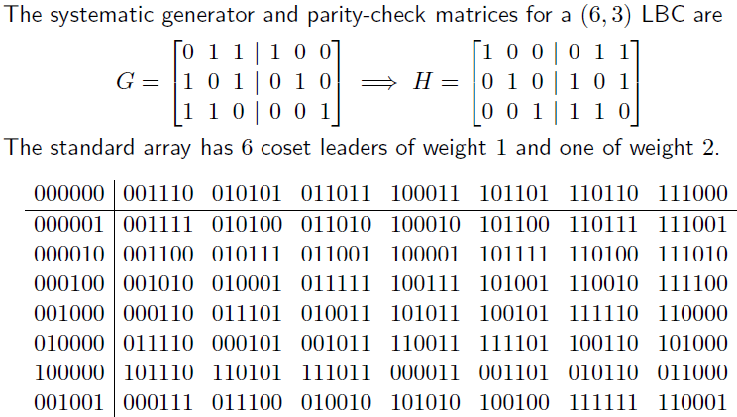
Standard Array
Syndrome table decoding can also be described using the standard array.
[M1 M2 M2][H]=

Slide 2
Standard Array
Properties of standard array
The first row is the code C, with the zero vector in the first column.
Every vector appears exactly once in the array.
No two vectors in the same row of a std array are identical.
Every other row is a coset. There are exactly 2^{(n-k)} cosets.
first column of a row is called the coset leader. We usually choose the coset leader to be the most plausible error
pattern, e.g., the error pattern of smallest weight.
All vectors in a row of the standard array have the same syndrome.
Each 2^{(n-k)} cosets leaders have different syndrome.
Thus there is a one-to-one correspondence between the rows of the standard array and the syndrome values.
Decoding using the standard array is simple: decode received r to the codeword at the top of the column that contains r.
Decoding is correct iff error pattern is a coset leader. There are 2^{(n-k)} coset leaders ad all are correctable patterns.
The error pattern that are more likely will be chosen as a coset leader. These patterns will have least hamming weight.

Slide 3
LBC: Example
Q1:
Find the encoding table for the linear block code.
What is the minimum distance dmin of the code. How many errors can the code detect. How many errors can the code correct.
Draw the hardware encoder diagram.
Find the decoding table for the linear block code.
Draw the hardware syndrome generator diagram.
Suppose v =1 1 1 0 0 0 is sent and r = 1 1 1 0 0 1 is received. Show how the code can correct this error.

Slide 4
Example
a)
v₀
v₁
v₂
v₃
v₄
v₅
v₆
v₇

Slide 5
Example
b)

Slide 6
Example
c)
Draw the hardware encoder diagram.

Slide 7
Example
d)
Find the decoding table for the linear block code.

Slide 8
Example
e)
Draw the hardware syndrome generator diagram.

Slide 9
Example
f)
Suppose v =1 1 1 0 0 0 is sent and r = 1 1 1 0 0 1 is received. Show how the code can correct this error.

Slide 10
Example
Q2: Consider a (7,4) linear block code defined by the generator matrix
(a) Find the parity check matrix H of the code in systematic form.
(b) Find the encoding table for the linear block code.
(c) What is the minimum distance d_{min} of the code. How many errors can the code detect.
How many errors can the code correct.
(d) Draw the hardware encoder diagram.
(e) Find the decoding table for the linear block code.
(f) Draw the hardware syndrome generator diagram.
(g) Suppose v =1 0 0 1 0 1 1 is sent and r = 1 1 0 1 0 1 1 is received. Show how the code can
correct this error.

