Slide 1
EVALUATING BRANCH PREDICTION STRATEGIES
Ananth Sankarasubramanian
Sowmya Muralidharan
Govindan Vedanarayanan

Slide 2
BRANCHES
Branches alter the flow of instruction execution in a program
Branch Prediction:
Resolving a branch hazard by predicting which path will be taken and proceed under that assumption
If the prediction is wrong - flush the wrong-path instructions from the pipeline & fetch the right path
Branch Prediction Strategies – Static and Dynamic

Slide 3
WHY IS BRANCH PREDICTION IMPORTANT?
Conditional branches comprise about 20% of instructions
Pipelines are deeper and mis-prediction penalty greater
Cycle times smaller: more emphasis on throughput/performance
Increases the number of instructions available for the scheduler to issue. Increases instruction level parallelism (ILP)
Allows useful work to be completed while waiting for the branch to resolve

Slide 4
DIRECTIONS IN BRANCH PREDICTION
Improve Prediction
Using correlated or hybrid predictors
Determine the target earlier
Using BTB (Pentium Pro)
Reduce mis-prediction penalty
By fetching instructions from both streams

Slide 5
Simplescalar
Simulator suite for many different parts of an architecture.
Simulators for caches, out of order simulation, branch prediction
Benchmarks Used
GCC
Anagram
Compress95
GO

Slide 6
IN-BUILT PREDICTORS
SimpleScalar is capable of simulating two static and three dynamic predictors
Taken
Not Taken
Bimodal
2 Level
Combination - bimodal and 2-level adaptive

Slide 7
PERFORMANCE COMPARISON
 | Taken | Not taken | Bimodal | 2 Level | Combination
GCC | 35.33 | 35.33 | 94.98 | 88.84 | 95.77
Anagram | 32.37 | 32.37 | 80.47 | 75.27 | 82.48
Compress 95 | 2.86 | 2.86 | 97.18 | 97.43 | 97.49
Go | 35.85 | 35.85 | 90.14 | 70.36 | 92.87

Slide 8
Strategies We Implemented
Strategy 6 – James Smith (JS6)
Strategy 7 – James Smith (JS7)
Gshare – McFarling
BiMode Directional – Lee, Cheng and Mudge

Slide 9
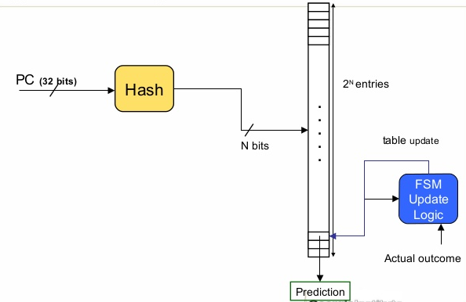
STRATEGY 6 – JAMES SMITH(1)
1 Bit Counter
Hash the branch instruction address to m bits and use this index to address a RAM containing the outcome of the most recent branch instruction indexing the same location. Predict that the branch outcome will be the same.

Slide 10
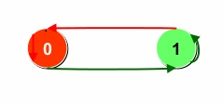
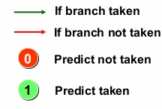
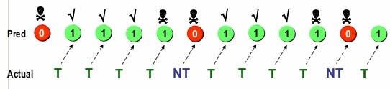
STRATEGY 6 – JAMES SMITH (2)
for (i = 0; i < 4; i++){
…
}

Slide 11
STRATEGY 7 – JAMES SMITH(1)
2 Bit Counter
Use strategy 6 with twos compliment counts instead of a single bit. Predict that the branch will be taken if the sign bit is 1. Increment the count when a branch is taken; decrement it when a branch is not taken

Slide 12
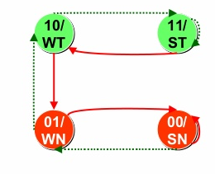
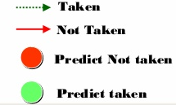
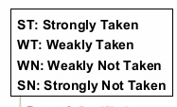
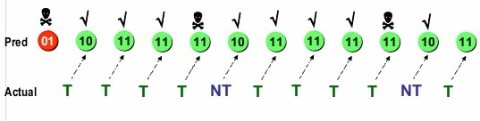
STRATEGY 7 – JAMES SMITH (2)
for (i = 0; i < 4; i++){
…
}

Slide 13
GSHARE – ANTI ALIASING PREDICTOR(1)
Reduce aliasing by randomizing the index
Idea is to add more context information to the global predictor to take into account which branch is being predicted
GHR hashed (XORed) with the Branch PC

Slide 14
GSHARE – ANTI ALIASING PREDICTOR(2)
Global Shift Register
Branch Address
XOR
Pattern History Table
PREDICTION

Slide 15
BIMODE DIRECTIONAL PREDICTOR(1)
Global History scheme still limited by destructive aliasing
Gshare only provides limited improvement
Bi-mode predictor provides neutral aliasing in the place of destructive aliasing
Uses a 2 bit counter to predict
Improved prediction accuracy

Slide 16
BIMODE DIRECTIONAL PREDICTOR(2)
Global History Register
Taken Predictor
Not Taken Predictor
XOR
MUX
Prediction
Branch Address
Choice Selector

Slide 17
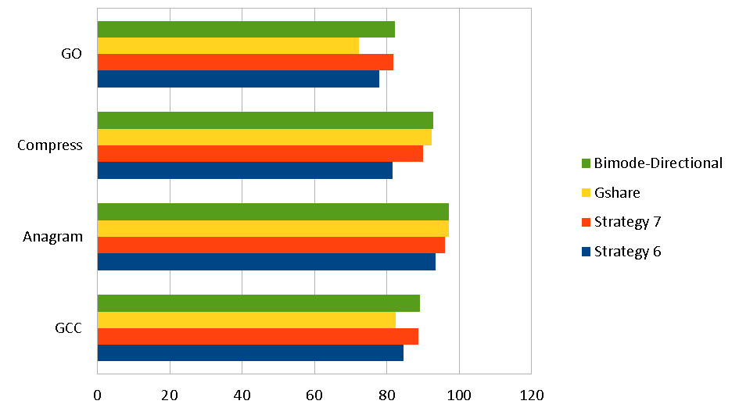
PERFORMANCE COMPARISON
 | Strategy 6 | Strategy 7 | Gshare | Bimode-Directional
GCC | 84.66 | 88.79 | 82.37 | 89.09
Anagram | 93.35 | 96.14 | 97.2 | 97.18
Compress | 81.63 | 89.92 | 92.43 | 92.73
GO | 77.91 | 81.75 | 72.31 | 82.09

Slide 18
CONCLUSION
On comparing, Strategy 6 and Strategy 7 (James Smith), it is seen that Strategy 7 performs better across all benchmarks.
Gshare performs better than both JS6 and JS7 for anagram and compress95.
Bi-mode Direction Predictor performs best across all benchmarks, except on anagram.

Slide 19
REFERENCES
Lee, I-Cheng K. Chen, and N. Mudge, “The B&Mode Branch Predictor”, University of Michigan
J. E. Smith, “A study of branch prediction strategies,” in 25 years of the international symposia on Computer architecture (selected papers), ser. ISCA ’98. New York, NY, USA: ACM, 1998, pp. 202–215.
S. McFarling, “Combining branch predictors,” June 1993.
E. Landry, A. Schmid, A. Beck, A. Malishevsky, Dynamic Branch Prediction, Electrical and Computer Engineering, Oregon State Universiy. http://web.engr.oregonstate.edu/~benl/Projects/branch_pred/
http://www.slideshare.net/HsienHsinLee/lec5-computer-architecture-by-hsienhsin-sean-lee-georgia-tech-branch-predictor
https://www.ece.cmu.edu/~ece447/s13/lib/exe/fetch.php?media=onur-447-spring13-lecture11-branch-prediction-afterlecture.pdf
onur-447-spring13-lecture11-branch-prediction-afterlecture.pdf

Slide 20
THANK YOU

