Slide 1


GLOBAL JOB MARKET AND OPPURTUNITIES
ANANTHA KRISHNA
HUMEERA
SHRAVANI
NISHA

Slide 2
1 INTRODUCTION
2 DATASET
3 EDA ANALYSIS​
AGENDA
4 MODELLING​
5 EVALUATION
6 CONCLUSION

Slide 3
DATASET OVERVIEW
WORK YEAR
THE DATASET CONTAINS 1O FEATURES WHICH PLAY KEY ROLE IN DETERMING SALARY
FEATURES LIKE SALARY CURRENCY AND SALARY DO NOT CONSTITUTE ANY ROLE IN DETERMINING SALARY.
DATA SET SIZE IS OF 3755 ROWS AND
11 COLUMNS
EMPLOYMENT TYPE
COMPANY LOCATION
EXPERIENCE LEVEL
REMOTE RATIO
SALARY DATASET
JOB TITLE
EMPLOYEE RESIDENCE
SALARY
SALARY CURRENCY
SALARY
IN
USD

Slide 4
PRE-PROCESSING
PERFORMING EDA
REMOVING
DUPLICATE
VALUES
3
RENAMING FEATURES
8
FILLING
NULL
VALUES
2
6
1
REMOVING
NULL VALUES
4
7
Milestone
DEFINING
VALUES
FINDING OUTLINERS
DROPPING COLUMNS
5

Slide 5



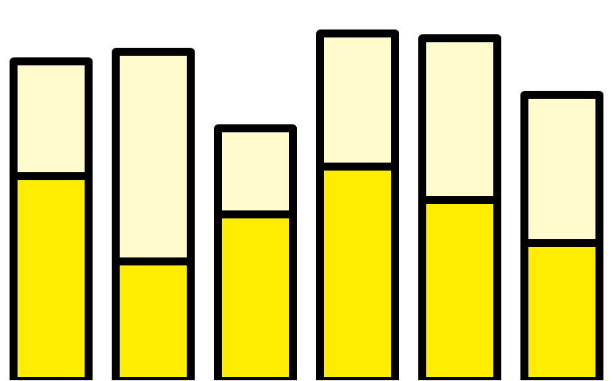
Global Markets. Avg Salary
21.4%
8.52%
3.04%
67%
$37570
SENIOR
MID-LEVEL
JUNOR
DIRECTOR
Data Scientist
ML Engineer
Analytics
Enginner
Data Analyst
Data
Engineer
Data Arthictect
412000
430967
219320
324000
289076
221000
THE PERCENTAGE OF JOBS IN THE FIELD OF DATA SCIENCE
AVERAGE SALARIES BY JOB TITLE
AVERAGE GLOBAL MARKET DATA SCIENTIST SALARY

Slide 6
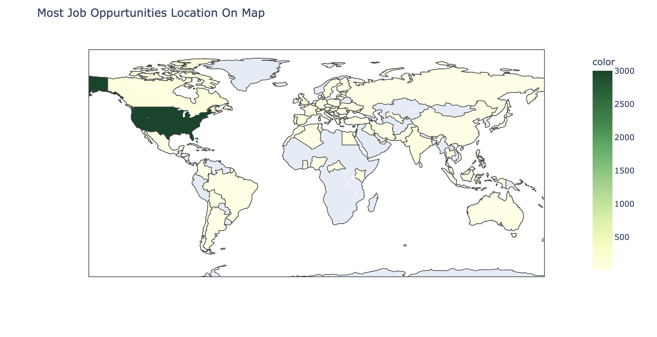

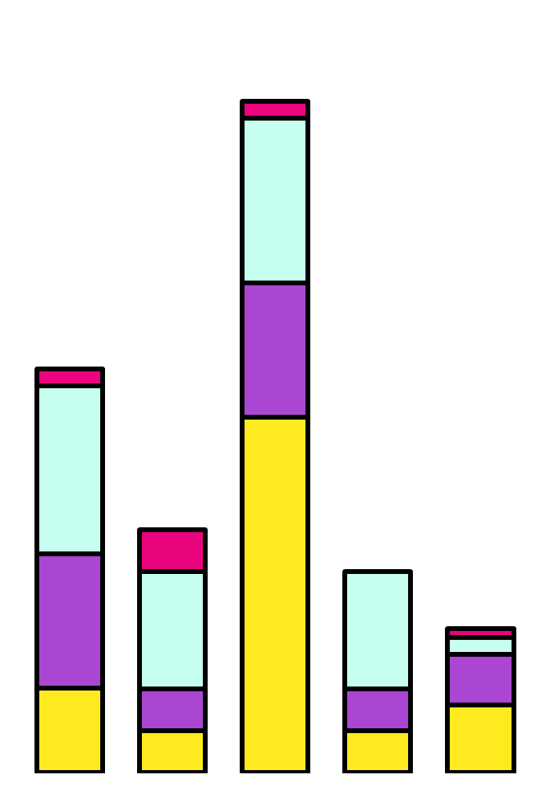
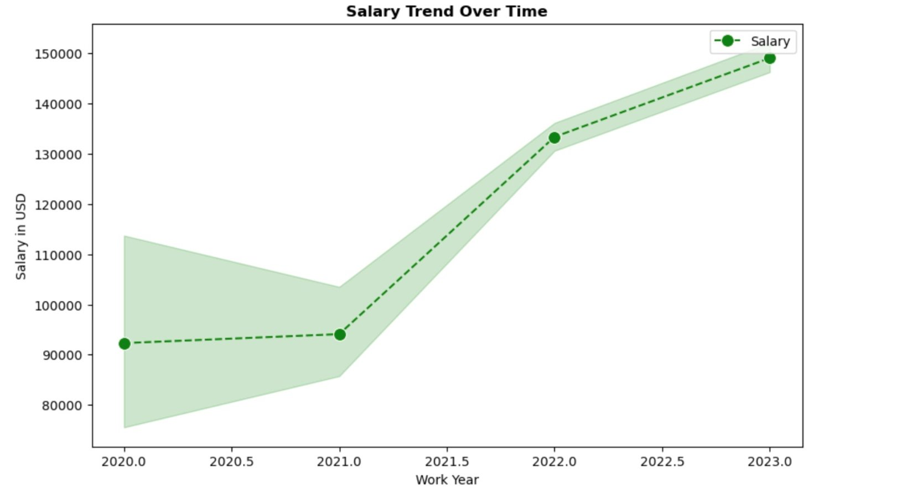
Experience level vs Year of Work
Director
Midlevel
Junior
Senior
2019 2020. 2021. 2022 2023

Slide 7
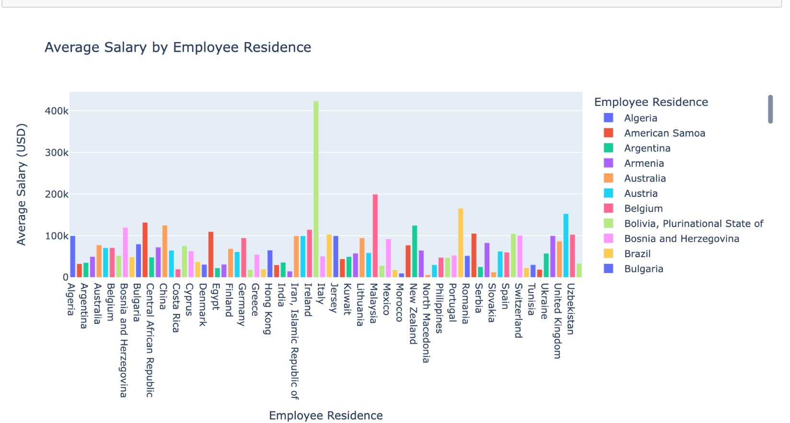
Focus on gaining experience and .Seek internships in companies based in locations with high job densities to improve employment prospects. Practical experience is crucial and can significantly enhance a resume. ​
Consider relocation to countries with higher average salaries and more job opportunities if feasible.
The United States shows the highest concentration of job opportunities, indicating a robust job market for data professionals.

Slide 8
FINDINGS
POSITION | SALARY
DATA ANALYST | 430967
DATA SCIENTIST | 412000
DATA ENGINEER | 324000
ML ENGINEER | 289076
Senior professionals at 67%, Mid-level professionals at 21.4%, Junior positions at 8.52%, Directors at 3.04%.
If experience is high, salary and job oppurtunities are high
The data shows a growing number of mid-level and senior roles over the years, with junior and director roles increasing slightly less proportionally
Junior and mid-level roles demonstrate a much tighter salary range, indicating less variability in salaries among these groups.
Suggestions
Data Analysts, Data Engineers, and Data Scientists lead in opportunity count, making these roles highly relevant for students to consider.
Given the prominence of Data Analyst, Data Engineer, and Data Scientist roles, students should consider specializing in these areas.

Slide 9
MODELLING
RANDOM FOREST
Random Forest is an ensemble machine learning algorithm that builds multiple decision trees during training and classifies or the predicts (regression) individual trees.
It is known for its high accuracy, robustness to overfitting, and ability to handle large datasets with complex variable interactions effectively.
Model Suitability: Random Forest is ideal for the Data Science Salaries dataset due to its robustness against overfitting and ability to handle mixed data types
Feature Importance: This model excels in identifying the key factors influencing salary outcomes, such as job title and geographic location
Metric | Value
Mean Square Error | 55448338.48
Mean Absolute Error | 1287.29
R Squared Error | 0.985
RMS Error | 7446.36

Slide 10
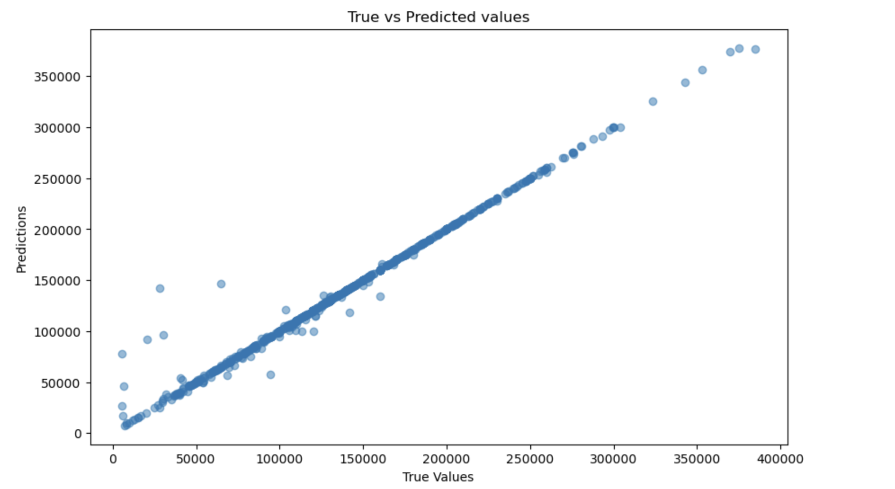
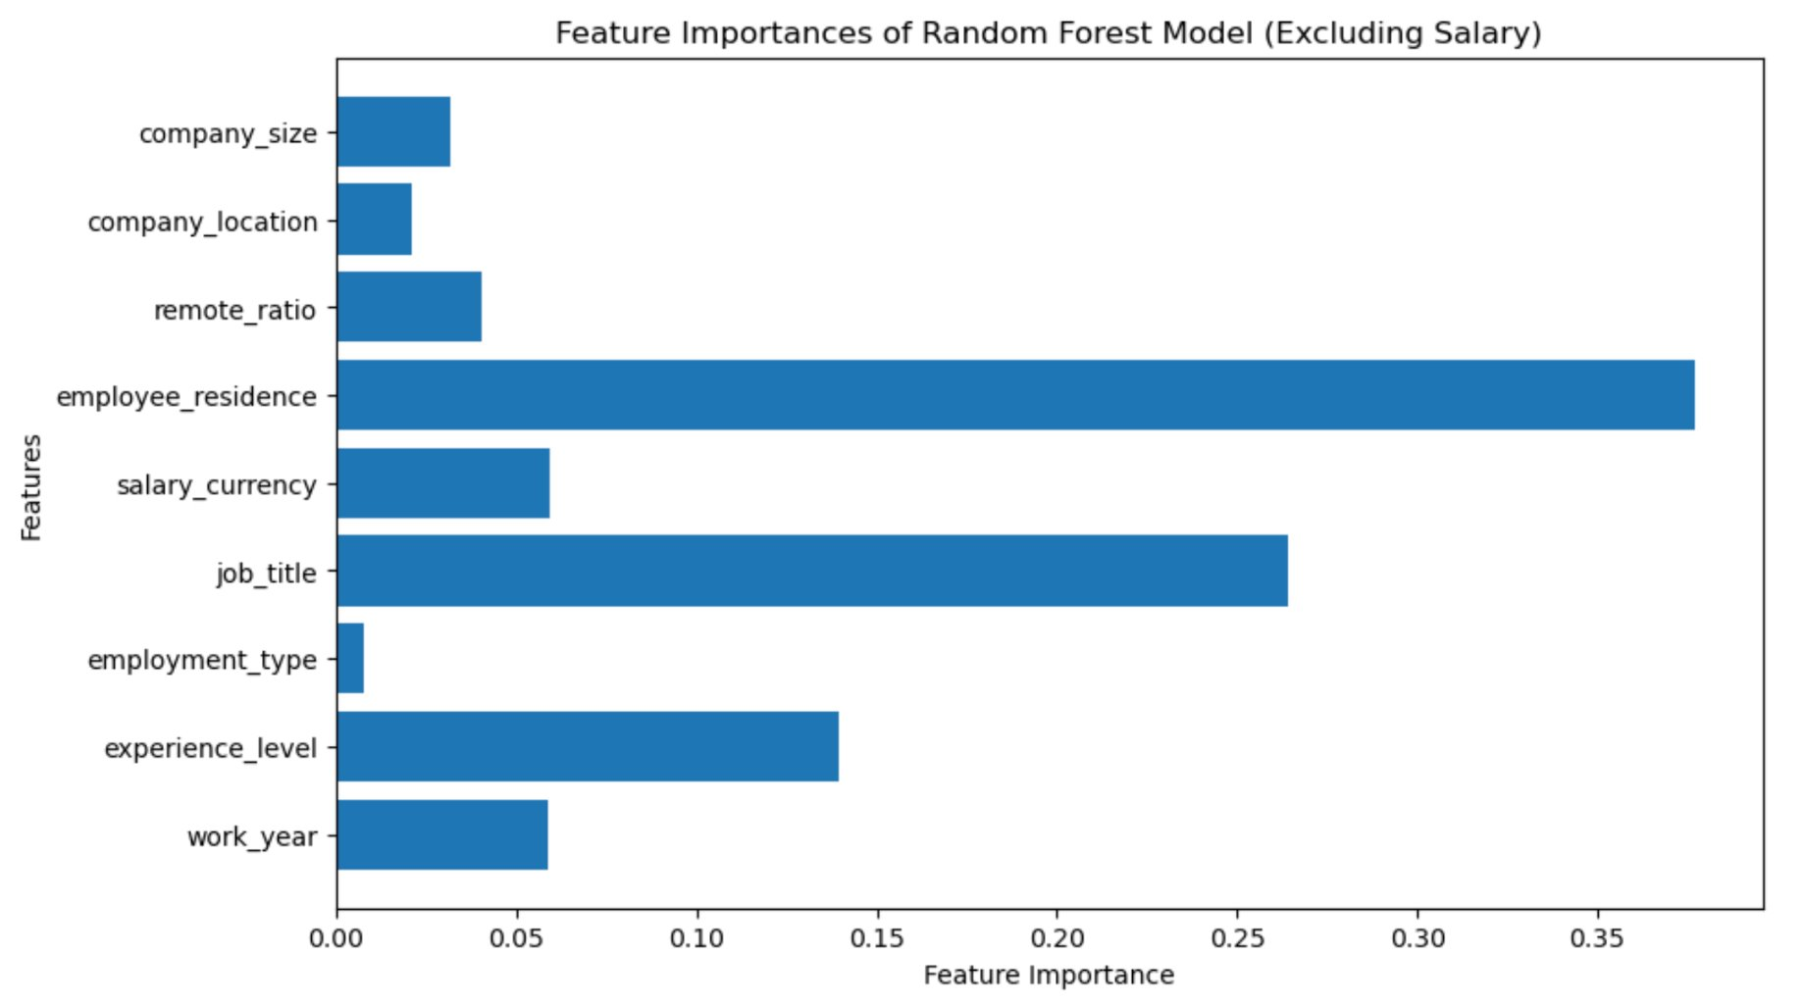
EVALUATION
The predictive model demonstrates an R-squared value of 0.986, indicating an exceptionally high degree of variance in salaries accurately captured by the model, which can be vital for students to estimate potential earnings in various data science roles.
The Mean Absolute Error (MAE) and Root Mean Squared Error (RMSE) are relatively low, at 1287.29 and 7446.36 respectively, suggesting that the model's salary predictions are close to actual values, providing reliable guidance for students assessing job offers.

Slide 11
CONCLUSION
The Students who are trying to have a career in Data Related Field should consider the following factors.
Geographical Focus: The vast majority of data science job opportunities are concentrated in the United States, indicating that students aiming for abundant opportunities should consider prioritizing this region for employment and potentially for higher education choices.
Career Path and Specialization: Data Analyst, Data Engineer, and Data Scientist roles dominate job listings, suggesting these areas as vital specializations. Students should focus on developing relevant skills in these specific roles to enhance employability.
Leveraging Predictive Analytics: Students should utilize predictive salary models to inform their career decisions, helping them understand potential earnings across different regions and roles, thus strategically planning their education and career paths to maximize future salary potential.
This information would help students in taking a wise decision.
THANK YOU

