Slide 1


BEYOND CRICKET
Bet Out Of Box
Our Model Your Prediction
ADTA 5340
Team Members
Chilappagari Anantha Krishna
ShivaKumar Dasari
Sai Swetha Kancharlapalli

Slide 2

Business Understanding
Introduction
Deployment
Data Understanding
Agenda
Problem Statement
Evaluation
Data Preparation
Summary

Slide 3
Introduction
In the realm of fantasy cricket, our aim is to decode player performance using historical data, enabling informed decisions. Through data-driven analysis, we unravel batting intricacies, seeking patterns that drive success. Our goal isn't just prediction but understanding, empowering millions of enthusiasts to make strategic choices.
The impact goes beyond entertainment, shaping how users engage with fantasy platforms. By blending data insights with the thrill of cricket, we aim to equip users with strategic tools, elevating their experience and decision-making in this exhilarating sport. This presentation showcases our commitment to data-driven methodologies and their profound influence on fantasy cricket enthusiasts' choices.

Slide 4
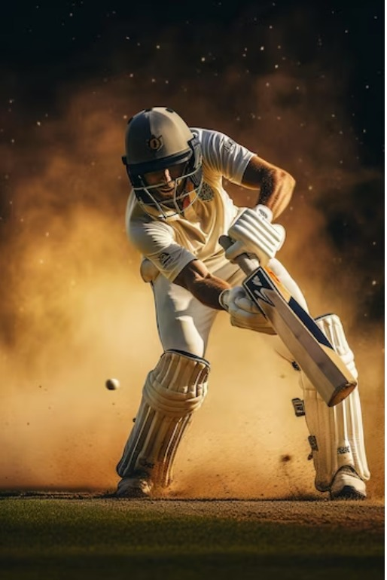
Problem Statement
To analyze Batsman performance and create predictive models using historical data to aid in decision-making for fantasy cricket enthusiasts.

Slide 5
Business Understanding : Enhancing Cricket Fantasy Insights Using ML
Understanding the intricate dynamics of fantasy cricket is vital for crafting an enriching user experience. Our focus lies in decoding user behavior and preferences within the realm of fantasy platforms, acknowledging strategic acumen of cricket enthusiasts.
Our mission centers on leveraging historical cricket data to unravel the tapestry of player performance, guiding users towards informed decisions. We recognize the inherent desire for engagement that surpasses mere entertainment, delving into the core of cricket fandom's aspirations for strategic mastery.
Our mission encapsulates the fusion of analytical prowess and cricketing passion to redefine the way enthusiasts engage with fantasy cricket platforms.

Slide 6
Dataset
BATSMAN
Provided By
Crick Info

Slide 7
Data Understanding
Player
Country
Innings
Run-scored
Balls-Fasced
Name of the Player
Country of the player
Number of Innings palyed
Number of Runs Scored
Number of Balls-fasced
7

Slide 8
Data Explanation
6s
4s
Match Date
Opposition
Ground
Number of 6s hit by each player
Number of 4s hit by each player
Date of the match held
Opposition country against which the game palyed players
Where the Games played by the players

Slide 9
Data Preparation
Filled Null Values
Removed Duplicate Values
Feature Engineered Strike Rate

Slide 10
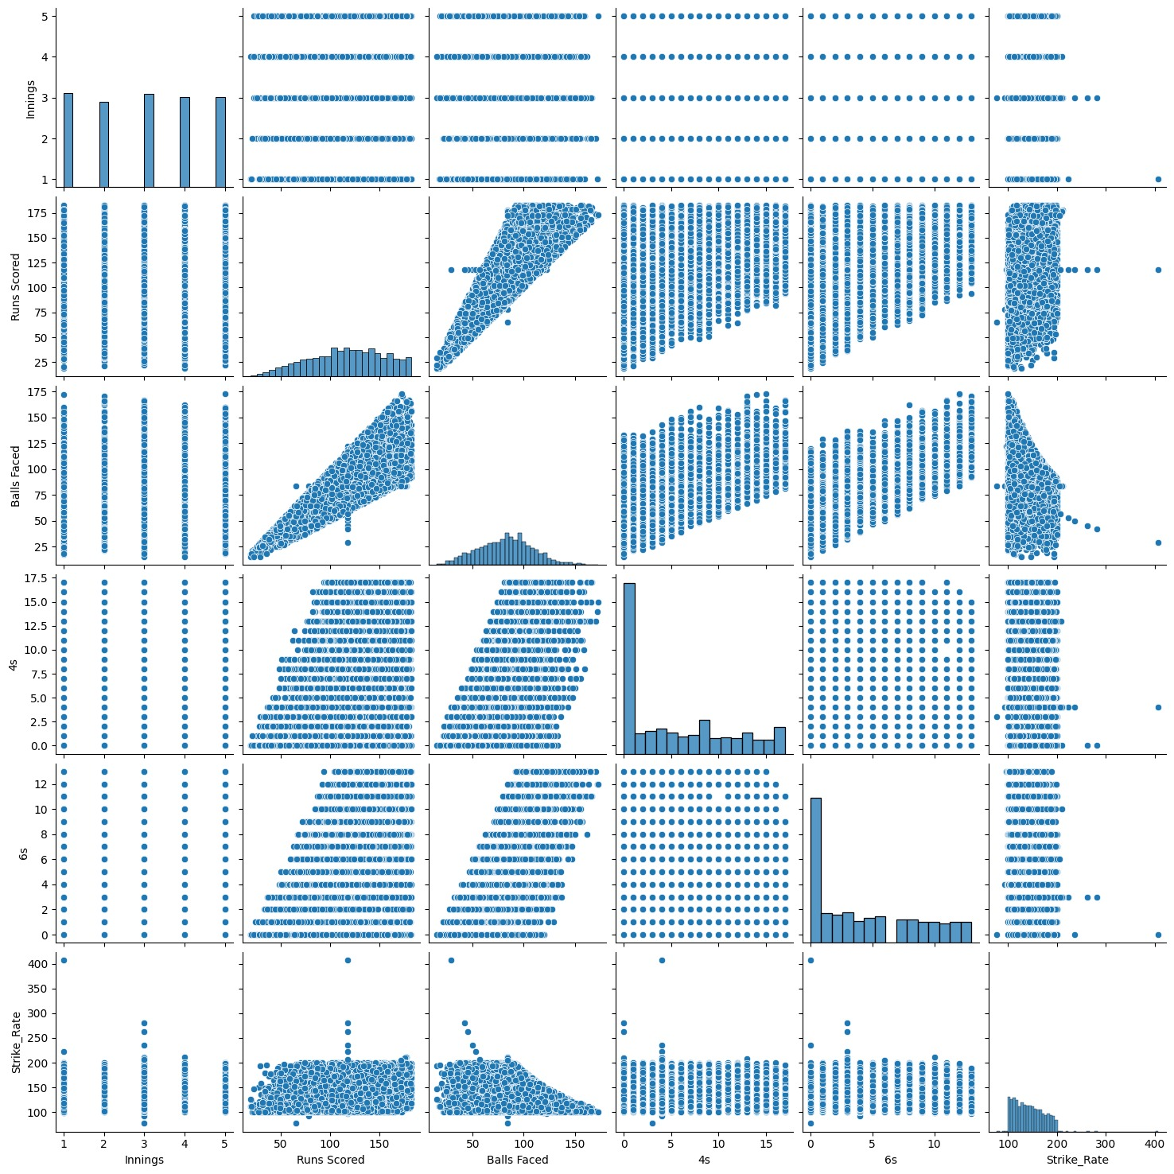
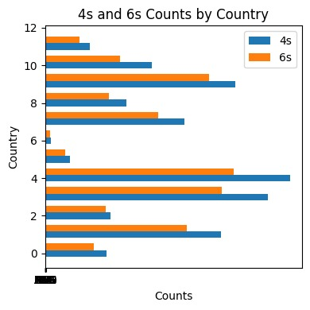
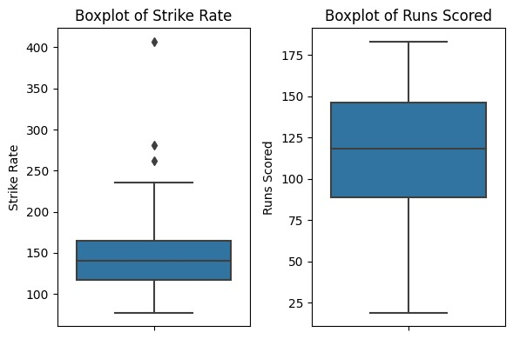
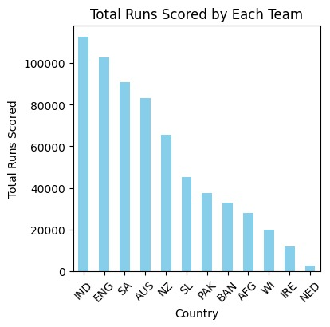
Exploratory Data Analytics
Pair Plots
Grouped Barchart
Boxplot
Histogram

Slide 11
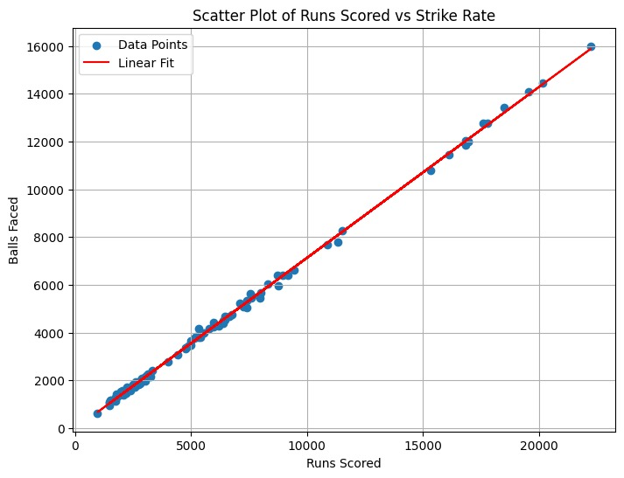
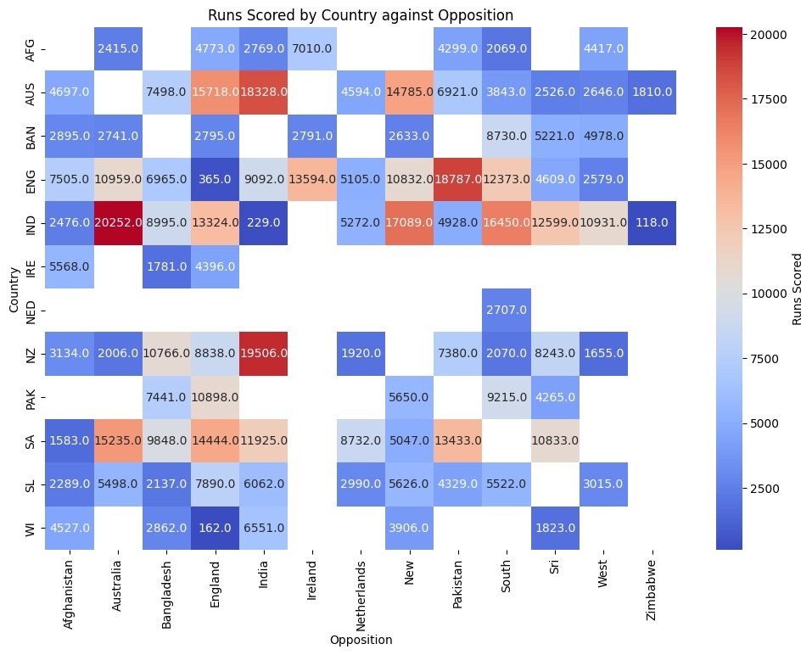
Scatter Plot
Heat Map

Slide 12


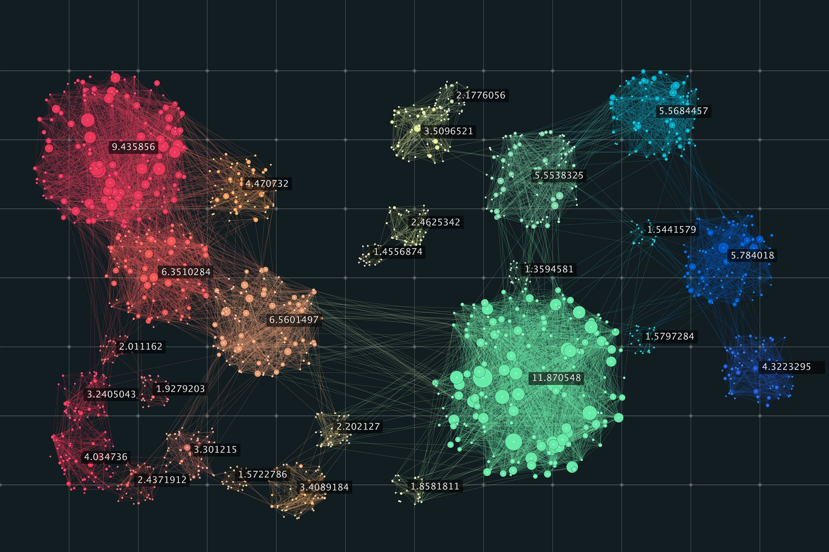
Algorithms Used
Linear Regression: (Supervised)
Linear regression models the relationship between variables, enabling predictions based on observed data using a linear equation.
K-means: (Unsupervised)
K-Means is a clustering algorithm assigning data points to 'k' groups, optimizing similarity within groups and dissimilarity between them.

Slide 13
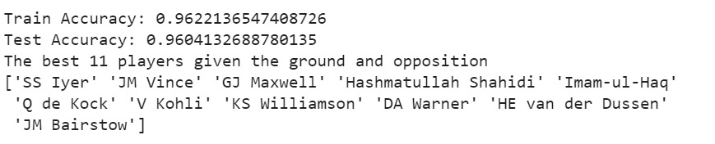
Modeling
Linear Regression:
We employed Supervised Learning techniques such as Linear Regression to predict who’s the best pick given opposition and Ground based on the training data. Our model performed best with better accuracy in predicting player names when asked.
X = data[['Balls Faced', '6s', '4s', 'Strike_Rate']] y = data['Runs Scored’]

Slide 14
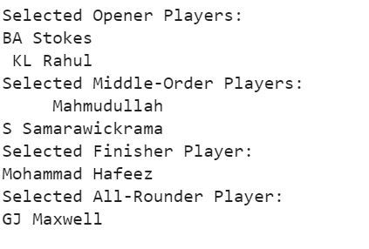
Modeling
K-means:
We Employed K-Means Clustering as part of Unsupervised Learning, where We decided number of clusters based on Elbow Method, which proved to be 4 clusters, Clustering players into Openers, Middle Order, All rounders and Finishers. This provides more insights to users who want to bet on the best given the Situation
K=4

Slide 15
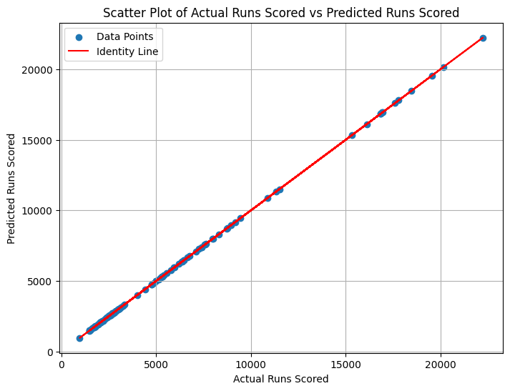
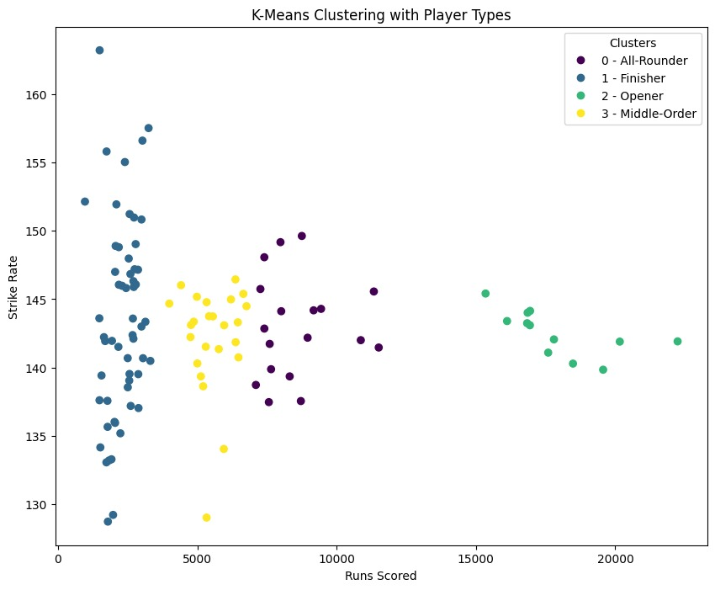
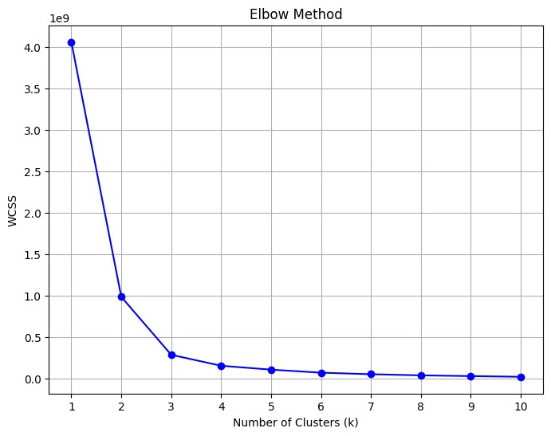
Linear Reg
Evaluation
K-Means
Elbow Method

Slide 16
Conclusion:
The Linear Regression model emerges as the optimal choice among supervised models,
offering the best accuracy. K-Means clustering successfully categorizes players,
providing valuable insights for fantasy cricket enthusiasts. Further research and optimization efforts are advised to continually improve model performance and enhance predictive capabilities.

Slide 17
THANK YOU
Any Questions?

