Slide 1
Predictive Supervisory Control of Semiconductor CMP
Interim scientific demonstration through WP10 Semifab CMP Predictive-Control PoC

Slide 2
Status of this demonstration
Interim scope: validated synthetic plant, standalone CMP physics, and declared utility-to-CMP coupling through WP10.
Predictive warning, root-cause classification, controller comparison, and independent safety filtering are not yet implemented.
PHM 2016 integrity and preprocessing are audited, but public-data model performance is still pending.
No physical-defect, yield, equipment-protection, real-fab, or production-control claim is made.

Slide 3
Research question
Can a predictive supervisory layer detect an upcoming simulated average-MRR excursion caused by electrical and UPW disturbances, then reduce it relative to no intervention and fixed-threshold control without violating predefined simulation constraints?
Current evidence answers only the prerequisite question:
Can the simulator propagate a declared disturbance through a defensible, explicit topology while preserving structural negative controls?

Slide 4
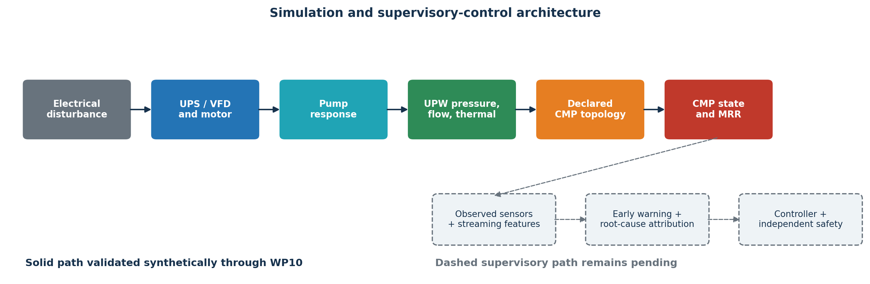
Architecture and completion boundary
Solid path is validated synthetically through WP10; dashed supervisory path is pending.

Slide 5
Two evidence planes remain separate
Public-data plane
User-supplied PHM 2016 archive; exact checksums and schema audit
1,981/424/424 train/test/validation wafer-stage records
Native, source-undeclared target unit; no silent SI conversion
Virtual-metrology fitting and held-out metrics pending
Synthetic simulator plane
Canonical SI units and declared component equations
Latent state separated from observed sensor state
Simulator states support internal causal-chain testing only

Slide 6
WP08: reduced-order CMP physics
The normalized generalized-Preston model is
$$R_{eq}=χ_{p}R_{0}Φ_{PV}m_{s}m_{T}m_{pad}m_{recipe},$$
with
ΦPV=1AA​PP0αvRV0βdA.
Explicit PREPARE, POLISH, DRESS, HOLD, RECOVER, COMPLETE modes
Dynamic pressure, signed spindles, slurry, pad, dresser, and temperature
Cumulative removal and active-polish time prevent hold-based metric gaming
Nominal synthetic reference: 100 nm/min

Slide 7
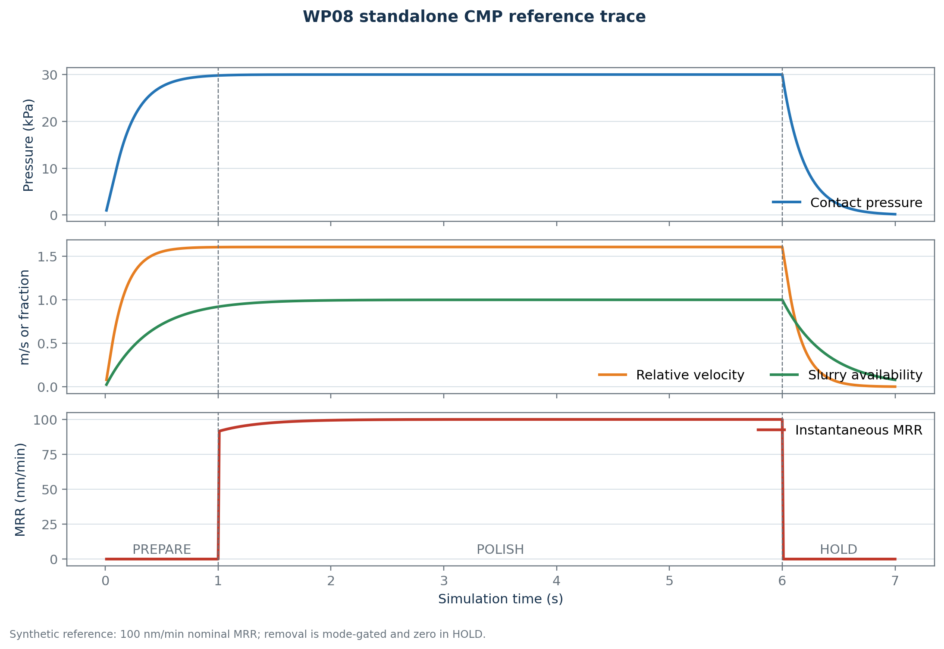
WP08 deterministic reference
Synthetic standalone CMP trace.

Slide 8
WP10: coupling without a hidden MRR gain
For normalized pressure $p$ and flow $q$,
$$a_{h}=\text{min}\{R(p;p_{0},p_{1}),R(q;q_{0},q_{1})\}, a_{eff}=1−λ(1−a_{h}).$$

Slide 9
Topology | Boundary effect
NO_CONNECTION | Exact neutral default
DRESSING_WATER_SUPPORT | Changes conditioning during DRESS
THERMAL_LOOP | Changes coolant boundary/conductance
SYNTHETIC_SLURRY_SUPPORT | Explicit artificial structural case

Slide 10
Every numerical coupling coefficient is a synthetic assumption.

Slide 11
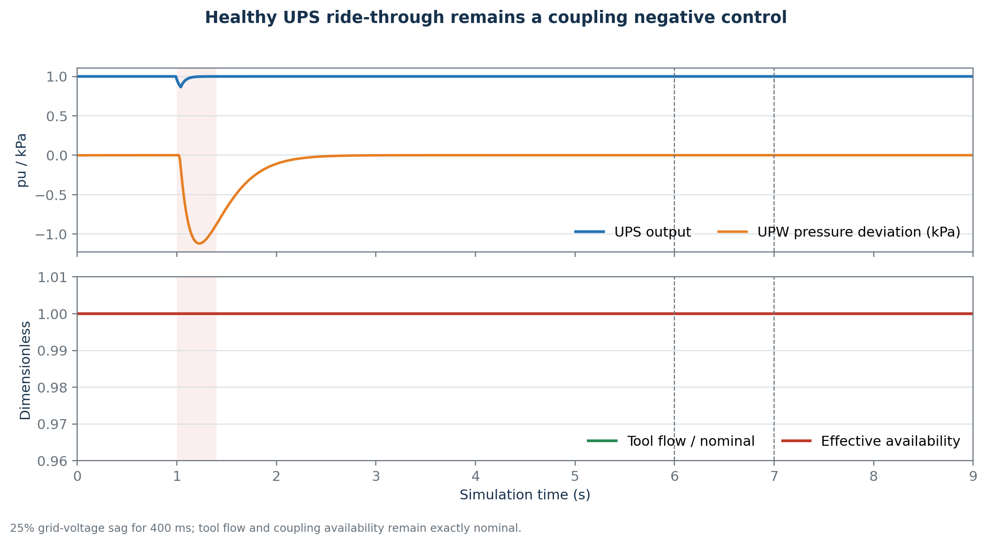
Negative control: healthy UPS ride-through
The 25%/400 ms sag leaves tool flow and effective availability at one.

Slide 12
Minimum UPS output: 0.865536 pu
Maximum pressure deviation: approximately 1.12 kPa
Tool flow unchanged
Connected and no-connection CMP traces exactly identical

Slide 13
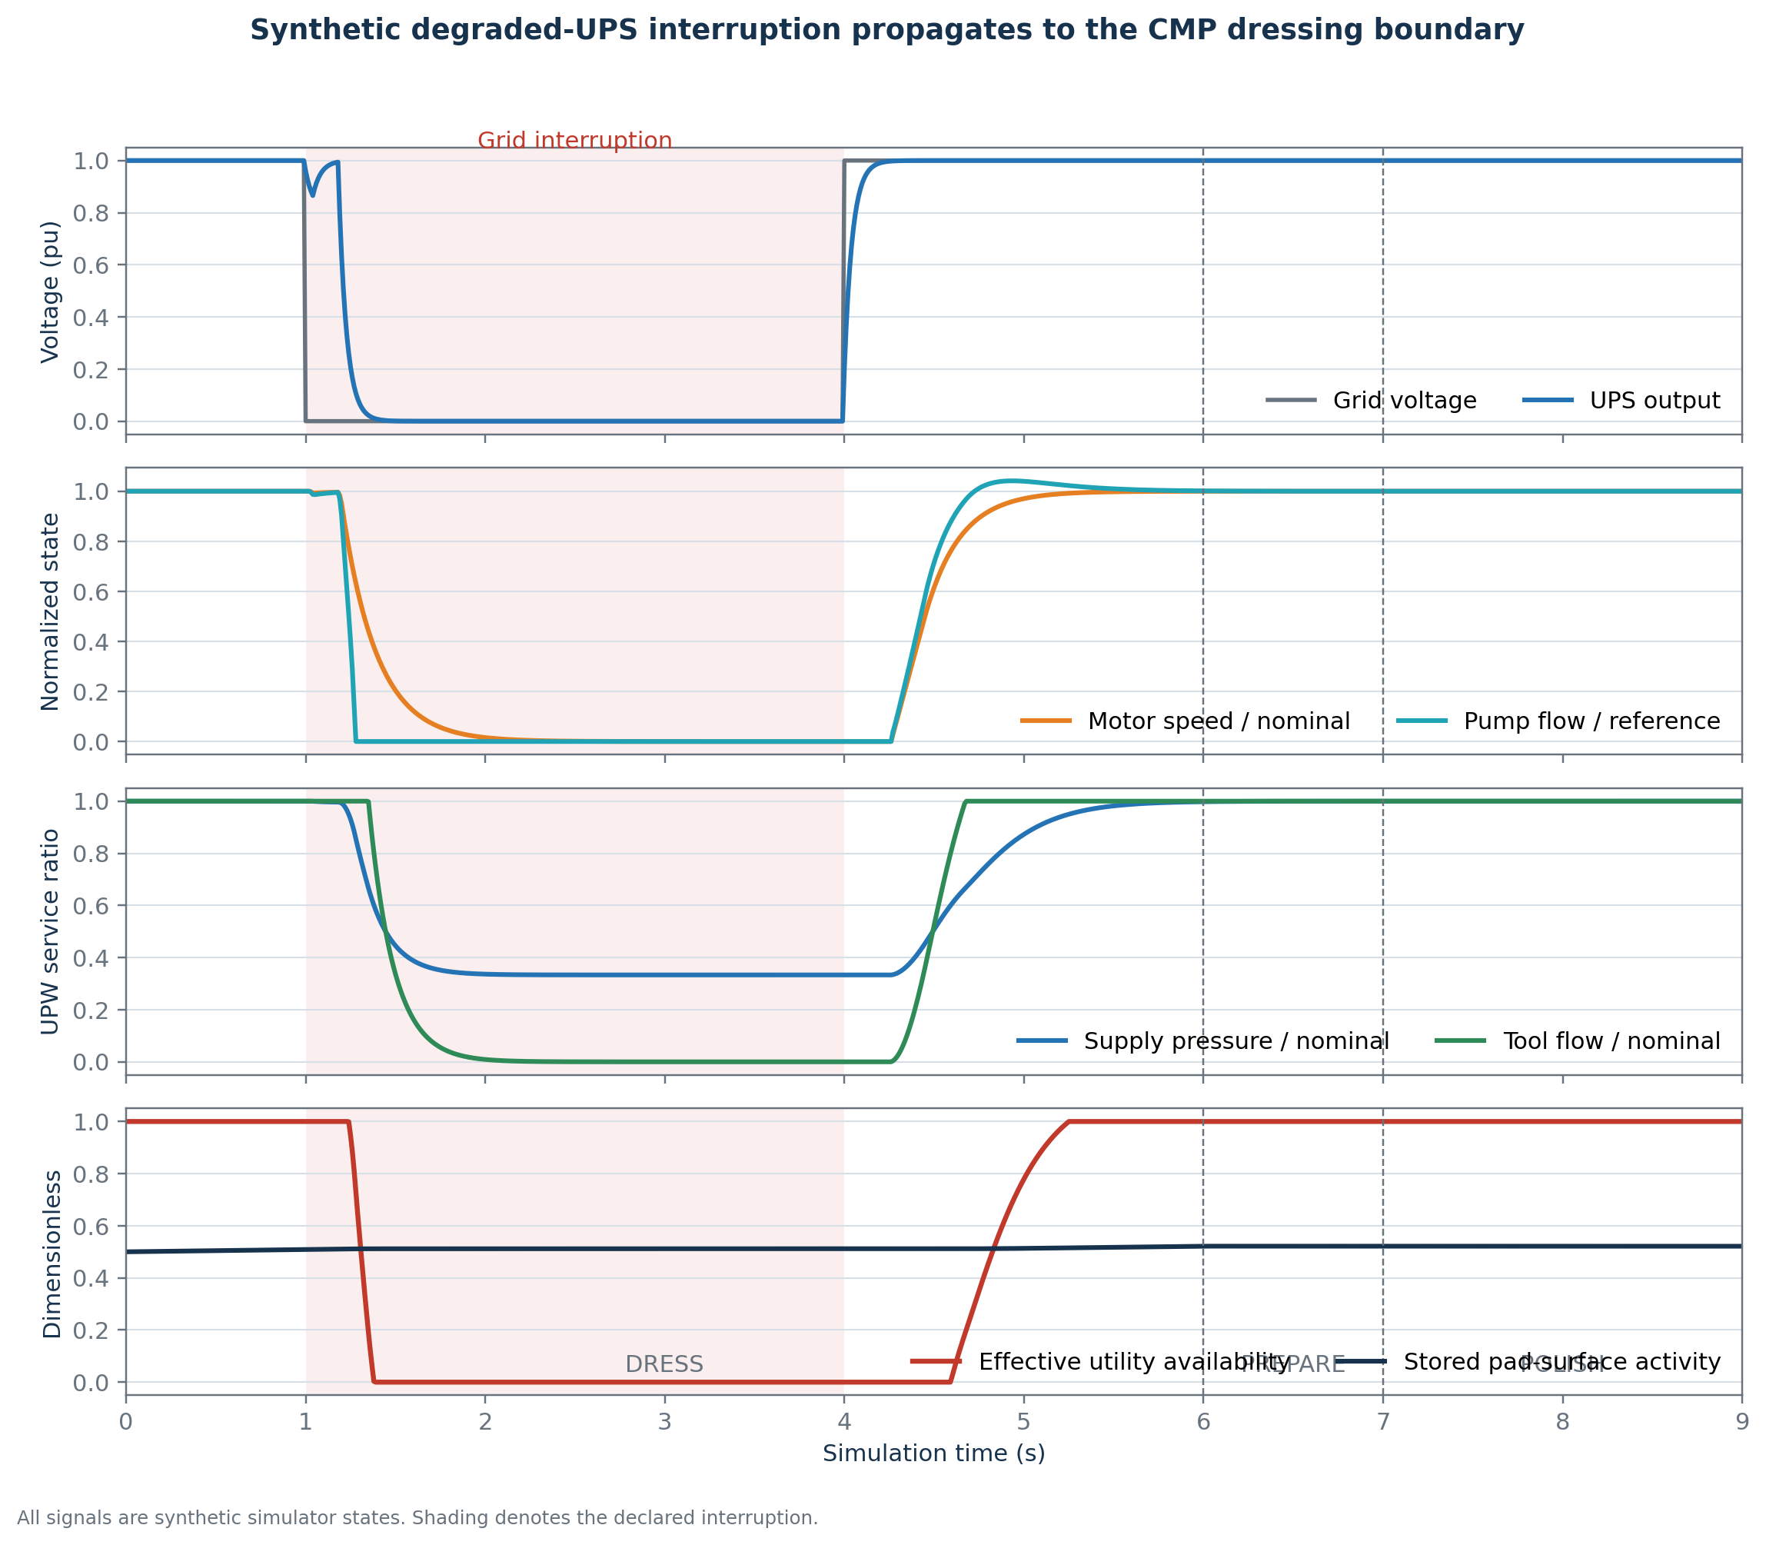
Positive declared chain
Synthetic degraded-UPS interruption during DRESS.

Slide 14
The positive case is a deliberately degraded 500 J UPS stress test—not a real UPS specification.

Slide 15
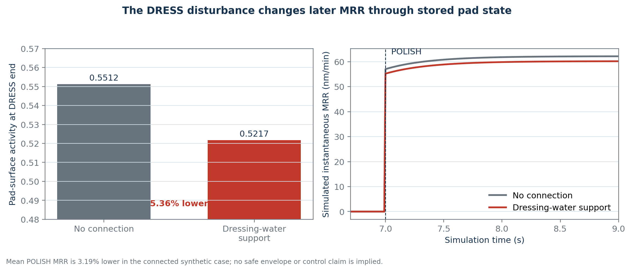
Delayed pad-memory result
MRR remains zero during DRESS; the later difference is mediated by stored pad state.

Slide 16
End-of-DRESS pad activity: 5.36% lower
Mean subsequent simulated MRR: 3.19% lower
No safe MRR envelope is frozen; this is not a controlled excursion or quality outcome.

Slide 17
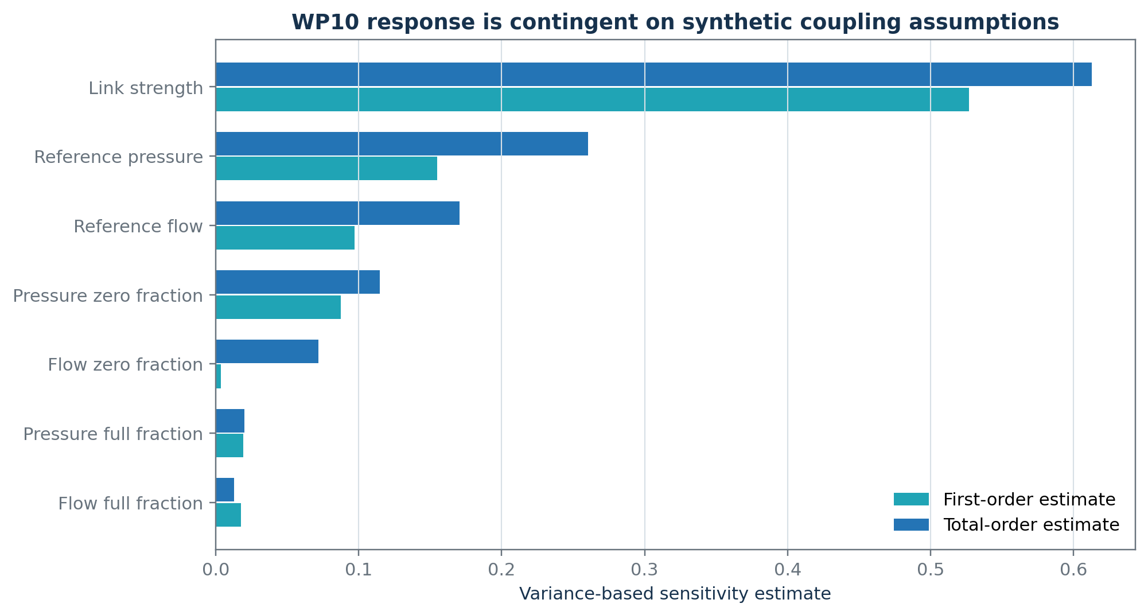
Sensitivity is part of the result
Variance-based sensitivity for the selected topology, state, output, and ranges.

Slide 18
Saltelli pick-freeze: 4,096 base samples; 36,864 seeded evaluations; zero link recovers no connection.
Interpretation: the ranking is conditional—not empirical importance or causal proof.

Slide 19
Validation inventory
154/154 complete repository tests passed
50/50 WP10-impacted tests passed
Exact no-connection, zero-link, nominal-service, and default thermal-MRR nulls
Pump-curve residual $<6×{10}^{−11}$ Pa
Hydraulic mass residual $<{10}^{−12}$ m$​^{3}$/s
R3/R4/WP08 historical artifacts reproduced exactly
Schema/interface: 2.4.0/3.2.0; DynamicSubsystem remains 2.0.0

Slide 20
What is not shown yet
PHM virtual-metrology baseline and hybrid-model results (WP09)
Frozen MRR envelope, warning horizon, censoring, and uncertainty calibration (WP12)
Root-cause attribution including UNKNOWN and compounds (WP13)
No-action and threshold baselines (WP14)
Predictive bounded controller objective/actions (WP15)
Independent safety filter and restart rules (WP16)
Three-controller paired evaluation and final demonstration (WP17–WP18)

Slide 21
Phase 3 roadmap
Freeze safe MRR envelope, persistence, horizon, feature cutoff, and uncertainty
Complete PHM virtual metrology and synthetic early warning
Freeze and evaluate attribution policy
Freeze controller objective, action grid, and latency budget
Freeze independent safety and restart constraints
Close Phase 3 and switch to routine Phase 4 integration if stable

Slide 22
Takeaway
WP10 establishes a scientifically controlled simulation foundation:
The utility-to-CMP connection is explicit and typed.
Healthy ride-through remains a negative control.
The positive effect is delayed through pad-state memory.
Structural and parameter uncertainty are visible rather than hidden.
Predictive-control efficacy remains the next research result—not a completed claim.

Slide 23
Selected technical sources
Preston (1927), empirical pressure–velocity polishing relation
White, Melvin & Boning (2003), DOI: 10.1149/1.1560642
Kim et al. (2005), DOI: 10.1016/j.mee.2005.07.080
Mudhivarthi et al. (2006), DOI: 10.1149/1.2177007
Chang et al. (2007), DOI: 10.1016/j.mee.2006.11.011
Bahr et al. (2017), DOI: 10.3390/mi8060170
Full provenance and claim limitations are recorded in the repository.

