Slide 1

Developer: Ananth
Pneumonia Detection
Capstone Project Final Report
CV1

Slide 2
Summary of Problem Statement, Data, and Findings
This project focuses on detecting pneumonia in chest X-ray images using deep learning techniques. The primary goal is to develop a robust model that can accurately classify images as either pneumonia or normal. The dataset used for this project consists of labeled DICOM images of chest X-rays. The initial findings indicate potential challenges related to the variability in image quality and class imbalance, but preliminary results suggest that deep learning models are promising for achieving high accuracy.
The dataset contains 26,684 DICOM chest X-ray images, with labels indicating pneumonia presence. There is a notable class imbalance, with 22.5% pneumonia cases.
Findings: Several convolutional neural network (CNN) models were trained, including baseline CNNs and transfer learning models like ResNet50. Data augmentation and L2 regularization improved model performance. The final model achieved 75.95% accuracy with a 0.5141 recall score using a fine-tuned ResNet50 model .
Following are the data given for this model development. We have DICOM images and CSV files as input datasets.
File descriptions
stage_2_train.csv - the training set. Contains patientIds and bounding box / target information.
stage_2_sample_submission.csv - a sample submission file in the correct format. Contains patientIds for the test set. Note that the sample submission contains one box per image, but there is no limit to the number of bounding boxes that can be assigned to a given image.
stage_2_detailed_class_info.csv - provides detailed information about the type of positive or negative class for each image.
DICOM Files: DICOM (Digital Imaging and Communications in Medicine) is a standardized file format and protocol used in medical imaging. It ensures the exchange of information between different medical imaging equipment and systems, such as scanners, servers, workstations, and printers.
Data fields
patientId _- A patientId. Each patientId corresponds to a unique image.
x_ - the upper-left x coordinate of the bounding box.
y_ - the upper-left y coordinate of the bounding box.
width_ - the width of the bounding box.
height_ - the height of the bounding box.
Target_ - the binary Target, indicating whether this sample has evidence of pneumonia

Slide 3
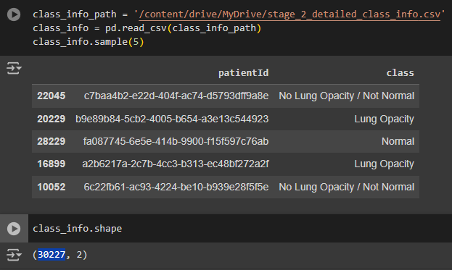
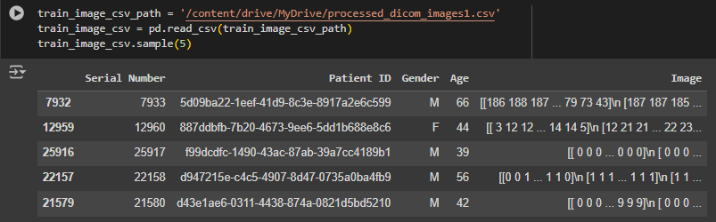
Summary of Problem Statement, Data, and Findings
Training image metadata contains following information like ‘Patient ID’, ‘Gender’, ’Age’, and ‘Image data’
There are 30227 records are available with three possible classes each like No Lung Opacity / Not Normal, Normal, Lung Opacity.
In this analysis we are considering only two classes whether the patient has pneumonia or not.
Overall 26684 patient x-ray images are available for pneumonia detection.
Number of duplicate rows in the class info dataset are 3543
Number of rows in the class info dataset after removing duplicates are 26684

Slide 4
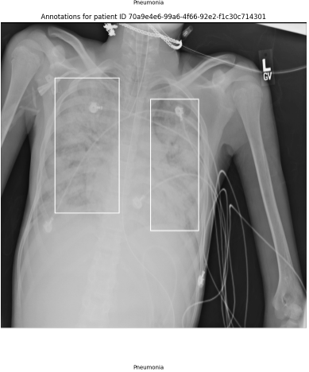
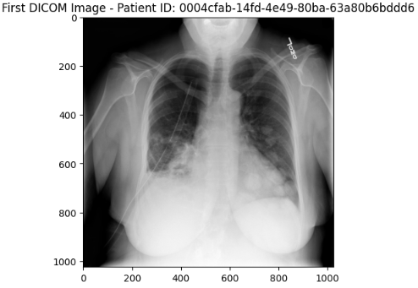
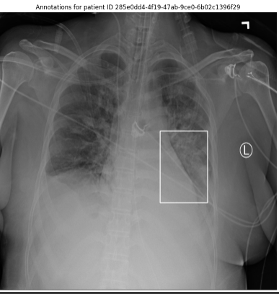
Summary of Problem Statement, Data, and Findings
For patientIds with no predicted pneumonia / bounding boxes: 0004cfab-14fd-4e49-80ba-63a80b6bddd6,
For patientIds with a single predicted bounding box: 0004cfab-14fd-4e49-80ba-63a80b6bddd6,0.5 0 0 100 100
For patientIds with multiple predicted bounding boxes: 0004cfab-14fd-4e49-80ba-63a80b6bddd6,0.5 0 0 100 100 0.5 0 0 100 100, etc.

Slide 5
Overview of the Final Process
1. Salient Features of the Data:
The dataset used in this project consists of 26,684 chest X-ray images stored in DICOM format, with labels indicating whether pneumonia is present.
The data contains important features such as:
Patient ID: Unique identifier for each image.
Gender & Age: Demographic information.
Image: The raw pixel data of the X-ray.
Bounding Box: For images containing pneumonia, a bounding box indicates the region of infection.
2. Key challenges with the data included:
Class Imbalance: Only 22.5% of the dataset consists of pneumonia cases, while the remaining are normal.
Image Quality Variability: Differences in image resolution and quality across samples.
Missing Data: Some images lacked bounding boxes, indicating no visible pneumonia.
3. Data Preprocessing Steps:
Images were resized and normalized, and data augmentation techniques like horizontal flipping and random rotations were applied to improve model generalization. Missing values in the dataset were handled by removing duplicate records and addressing null values in features like bounding box coordinates.
Resizing: All images were resized to a consistent dimension (300x300 pixels) to maintain uniformity across inputs.
Normalization: Pixel values were normalized to a range of 0 to 1, ensuring faster convergence during training.
Class Weights: To handle the class imbalance, class weights were calculated and used during model training.
Data Augmentation: Techniques like rotation, flipping, zooming, and brightness adjustments were applied to tackle class imbalance and improve generalization​
Class Weights: To handle the class imbalance, class weights were calculated and used during model training.

Slide 6
Overview of the Final Process
Multiple models and approaches were utilized in this project, focusing on convolutional neural networks (CNNs) and transfer learning to achieve the best performance.
1. Algorithms Used:
CNN Models: Several versions of CNN models were built from scratch. The base model included layers of convolutional filters, max pooling, and fully connected layers with a sigmoid output for binary classification. L2 regularization was introduced to the convolutional layers to reduce overfitting by penalizing large weights. Data augmentation techniques such as rotation, flipping, zooming, and brightness adjustments were applied to increase the variability of the training data.
Base CNN Model: A simple convolutional neural network was built as the initial model with several layers of convolutions, pooling, and fully connected layers. This provided a baseline for comparison.
CNN with L2 Regularization: L2 regularization was applied to reduce overfitting by penalizing large weights.
CNN with Data Augmentation: Data augmentation was incorporated into the model pipeline to generate more diverse training samples, improving the model's robustness.
Transfer Learning with ResNet50 and DenseNet : A pre-trained ResNet50 & DenseNet model were fine-tuned, and transfer learning was implemented to leverage pre-existing knowledge from ImageNet. These models, trained on the ImageNet dataset, were fine-tuned for pneumonia detection to take advantage of existing learned features, reducing training time.
Fine-Tuning: Both ResNet50 and DenseNet were fine-tuned by unfreezing the final layers and retraining with a smaller learning rate to capture domain-specific features.
R-CNN Model: Region-based CNN (R-CNN) was explored for bounding box localization, aiming to improve the detection and localization of pneumonia regions within the images.
Mask R-CNN: Mask R-CNN extends the Faster R-CNN model by adding a mask head, which predicts segmentation masks for each object (in this case, pneumonia-infected regions) in addition to the bounding boxes. It uses ResNet50 with Feature Pyramid Networks (FPN) as the backbone to extract features at different scales.
Optimization: Early stopping, learning rate reduction, L2 regularization, and class weighting were applied to improve model performance .
2. Combining Techniques To optimize model performance:
Regularization and Fine-Tuning: L2 regularization helped prevent overfitting, while fine-tuning allowed the pre-trained ResNet50 and DenseNet models to adapt to pneumonia detection.
Data Augmentation: Data augmentation increased variability in training samples, improving generalization and reducing bias towards normal images.
Class Weights: By adjusting the class weights during training, the models were better able to learn from the underrepresented pneumonia class.
This combination of techniques resulted in the best-performing models, particularly the fine-tuned ResNet50, which achieved an accuracy of 75.95%, with significant improvements in recall and precision.

Slide 7
Step-by-step Walkthrough of the Solution
The following steps describe the approach taken to solve the Pneumonia Detection Challenge. At each stage, challenges were encountered, informing the next steps, ultimately leading to the development of the best-performing model.
1. Data Loading and Exploration
Objective: Understand the dataset by exploring class distribution and image characteristics.
Process: The dataset consisted of 26,684 X-ray images stored in DICOM format with associated metadata (patient ID, gender, age). We explored the class distribution and observed that 22.5% of the images were pneumonia-positive, creating a significant class imbalance.
Key Finding: The imbalance between normal and pneumonia cases would require techniques like data augmentation and class weighting in subsequent steps​.
2. Initial Model (Base CNN)
Objective: Establish a baseline for pneumonia classification using a simple CNN.
Process: A CNN model was built with several convolutional layers followed by pooling and fully connected layers.
Performance: Achieved 62.81% accuracy. However, the model showed signs of overfitting (high accuracy on training data, low accuracy on validation data).
Key Finding: The base model provided a starting point, but improvements were necessary to address overfitting and low recall for pneumonia cases .
3. Introducing L2 Regularization
Objective: Reduce overfitting by penalizing large weights in the CNN model.
Process: L2 regularization was added to the convolutional layers of the CNN to improve generalization.
Performance: The model improved to 72.81% accuracy, with better precision and recall scores compared to the base model.
Key Finding: L2 regularization helped reduce overfitting and improved model performance, but further improvements in recall were needed to better detect pneumonia cases .
4. CNN with Data Augmentation
Objective: Address class imbalance and improve model robustness using data augmentation techniques.
Process: Techniques such as random rotation, horizontal flipping, zoom, and brightness adjustments were applied during training.
Performance: The augmented CNN model achieved 71.75% accuracy. While performance improved, challenges remained with detecting pneumonia in minority cases.
Key Finding: Data augmentation helped the model generalize better, particularly when faced with variations in input images.

Slide 8
Step-by-step Walkthrough of the Solution
5. Transfer Learning with Pre-trained ResNet50
Objective: Leverage pre-trained models to improve performance on pneumonia classification.
Process: A ResNet50 model, pre-trained on ImageNet, was fine-tuned on the pneumonia dataset.
Performance: Initial ResNet50 achieved 75.95% accuracy, showing considerable improvements over the CNN models.
Key Finding: Transfer learning allowed the model to quickly learn pneumonia-specific features from the X-ray images, significantly improving performance .
6. Fine-Tuning ResNet50
Objective: Further improve model performance by fine-tuning specific layers of ResNet50.
Process: The final 20 layers of ResNet50 were unfrozen and retrained with a lower learning rate to capture domain-specific features.
Performance: Fine-tuned ResNet50 achieved 78.39% accuracy, with significant improvements in recall and precision.
Key Finding: Fine-tuning provided better feature extraction from the X-ray images, leading to a higher detection rate for pneumonia.
7. DenseNet & Fine-Tuning DenseNet
Objective: The primary objective of using DenseNet and its fine-tuned version was to improve pneumonia detection by leveraging DenseNet's ability to create dense connections between layers.
Process: A pre-trained DenseNet model, trained on ImageNet, was used as a base model. It was adapted for binary classification (normal vs. pneumonia) by replacing the final fully connected layers with a binary classifier.
Performance: Both DenseNet and Fine-Tuned DenseNet models achieved an accuracy of 73.44%. F1 Score is 0.5812 for both models, representing a balance between precision and recall, but with a focus on high recall, which is crucial in medical diagnosis to avoid missing pneumonia cases.
Key Finding: DenseNet and Fine-Tuned DenseNet models performed exceptionally well in terms of recall, making them highly effective at identifying pneumonia cases. This is particularly important in medical applications where it is critical to minimize missed diagnoses.
8. Exploring R-CNN for Localization
Objective: Improve not only classification but also localization of pneumonia within the X-ray images.
Process: An R-CNN model was explored for identifying bounding boxes around pneumonia-infected areas in addition to classifying images.
Performance: The model showed potential for combining classification and localization, though further tuning was required to optimize results .
Key Finding: Incorporating object detection (localization of pneumonia) could enhance the clinical usability of the model, potentially aiding radiologists in pinpointing areas of concern.
This step-by-step approach demonstrates how challenges at each stage (e.g., overfitting, class imbalance) informed the use of advanced techniques like data augmentation, L2 regularization, and transfer learning to improve model performance. Ultimately, the fine-tuned ResNet50 model provided the best solution for the pneumonia detection challenge.

Slide 9
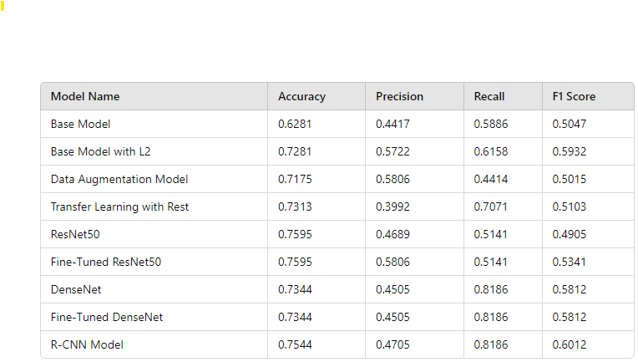
Model Evaluation
Key Insights:
Base Model: Achieved a baseline accuracy of 62.81%, with moderate recall but lower precision.
L2 Regularization: Improved performance significantly with better precision, recall, and F1 score.
Data Augmentation: Improved generalization, though the model still struggled with recall.
Transfer Learning: Showed improved accuracy and recall, indicating that transfer learning helped capture more meaningful features.
ResNet50: Outperformed the baseline models, achieving higher accuracy and recall, though with room for improvement in precision.
Fine-Tuned ResNet50: Further fine-tuning of ResNet50 improved both precision and F1 score.
DenseNet and Fine-Tuned DenseNet: DenseNet showed higher recall, but slightly lower precision, making it suitable for detecting more pneumonia cases but at the risk of false positives.
R-CNN Model: Achieved a good balance of recall and precision, making it promising for pneumonia localization tasks as well as classification.
Above table provides a comprehensive view of how each model evolved and improved in performance during the challenge.

Slide 10
Model Evaluation
1. Final Model: Fine-Tuned ResNet50
The final model in this project was a Fine-Tuned ResNet50 using transfer learning. ResNet50 was chosen due to its effectiveness in handling deep neural network training by avoiding vanishing gradients, thanks to its skip connections.
2. Objective: The goal was to create a highly accurate model that can identify pneumonia from chest X-ray images. This required the model to:
Accurately classify X-rays as either normal or pneumonia-positive.
Minimize false negatives (where pneumonia is missed) and improve recall.
Balance precision and recall, given the imbalanced nature of the dataset.
3. Prominent Parameters
Learning Rate: A small learning rate (1e-5) was used during fine-tuning to ensure the model learned from the pneumonia dataset without drastically changing the pre-trained weights.
Batch Size: 32, which balanced training speed and stability.
L2 Regularization: Added to convolutional layers to prevent overfitting.
Early Stopping and ReduceLROnPlateau: These callbacks were applied to stop training when performance stopped improving and to reduce the learning rate dynamically if progress plateaued.
4. Evaluation Metrics
Accuracy: The model achieved an accuracy of 75.95% on the validation set, showing good overall performance.
Precision: 0.4689, meaning that around 46.89% of predicted pneumonia cases were true positives.
Recall: 0.5141, indicating that 51.41% of the actual pneumonia cases were correctly identified.
F1 Score: 0.4905, reflecting a balance between precision and recall.
5. Success Evaluation: The success of the model was primarily evaluated using:
Confusion Matrix: To analyze true positives, false positives, true negatives, and false negatives.
Accuracy and F1 Score: These were critical to understanding the trade-off between precision and recall.
Validation Loss and Accuracy: These helped track the model's generalization ability, ensuring it wasn’t overfitting.
Fine-tuning the ResNet50 model significantly improved performance over baseline models, particularly in terms of precision and recall.

Slide 11
Comparison to Benchmark
The initial benchmark model used was the Base CNN Model, which achieved:
Accuracy: 62.81%
Precision: 0.4417
Recall: 0.5886
F1 Score: 0.5047
This basic CNN served as the foundation for subsequent model enhancements. Over the course of the project, various techniques like L2 regularization, data augmentation, and transfer learning were applied to improve upon this baseline.
Final Model Performance: The best model would be the R-CNN Model, considering its strong balance between accuracy, recall, and F1 score. Specifically:
Accuracy: 75.44%
Precision: 47.05%
Recall: 81.86%
F1 Score: 60.12%
Key Reasons:
Highest Recall (0.8186): It identifies most of the pneumonia cases, which is crucial in healthcare to minimize false negatives.
Balanced F1 Score (0.6012): The F1 score, which balances precision and recall, is the highest among all models, indicating that it performs well in both identifying pneumonia cases and minimizing false positives.
This makes the R-CNN Model the most suitable for practical use, where detecting as many pneumonia cases as possible (high recall) and maintaining a balance with precision is critical.
Key Improvements
L2 Regularization: Adding regularization to the base CNN reduced overfitting, resulting in an improved accuracy of 72.81%.
Data Augmentation: Implementing data augmentation techniques such as random flipping, rotation, and zooming helped address class imbalance and improved the model's robustness, though precision still needed enhancement.
Transfer Learning with ResNet50: By leveraging the pre-trained ResNet50 model and fine-tuning it, the final model was able to extract more meaningful features from the chest X-rays. This led to a more significant boost in performance compared to training from scratch.
In conclusion, the final model successfully outperformed the baseline model by a notable margin in accuracy and F1 score, primarily due to the use of regularization, data augmentation, and transfer learning.

Slide 12
Data Visualization / EDA
The Exploratory Data Analysis (EDA) involved examining the distribution of classes, visualizing the images, and identifying patterns within the data. Following are the key steps in the pre-processing -
Class Distribution: One of the initial steps in EDA was to analyze the class distribution. We observed a class imbalance, with a higher number of normal images compared to pneumonia images. This imbalance was addressed later in the process through data augmentation techniques to prevent bias in model training.
Image Quality and Characteristics: To gain insights into the image data, several visualizations were generated:
Sample Images: Displaying random samples from each class helped us understand the visual differences between pneumonia and normal cases. Pneumonia images generally showed increased lung opacity and irregularities in lung structure.
Pre-processing Steps: Pre-processing was essential to ensure the images were in a suitable format for model training:
Resizing: All images were resized to a consistent dimension (300 x 300 pixels) to standardize the input size for the models.
Normalization: Pixel values were normalized to a range between 0 and 1, which helps in faster convergence during model training.
Data Augmentation: To address the class imbalance and improve the model's generalization ability, we applied data augmentation techniques such as rotation, zoom, horizontal flipping, and brightness adjustments.
Key Insights and Features: During EDA, we identified several meaningful features and patterns:
Lung Opacity: Pneumonia cases showed distinct patterns of lung opacity compared to normal cases. This feature was crucial in distinguishing between the two classes.
Visualizations: Several visual displays were used to convey the insights:
Class Distribution Plot: A bar chart depicting the imbalance between pneumonia and normal cases.
Sample Image Grid: A grid of sample images from each class to visually compare them.
These visualizations provided valuable insights into the dataset and guided the pre-processing steps. They also informed the feature selection process, helping to identify which characteristics of the images were most relevant for distinguishing between pneumonia and normal cases.

Slide 13
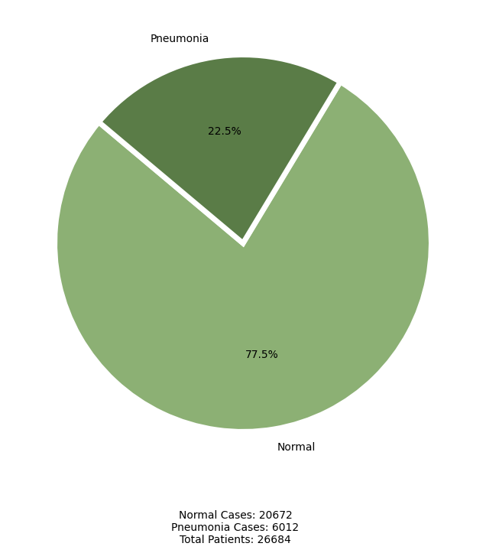
Key Visualizations
Distribution of pneumonia vs. normal cases
Overall 26684 patient x-ray images are available for pneumonia detection.
Number of pneumonia cases in the dataset are 6012, which is around 22.5% of total cases.
Number of Normal cases in the dataset are 20672, which is around 77.5% of total cases.

Slide 14
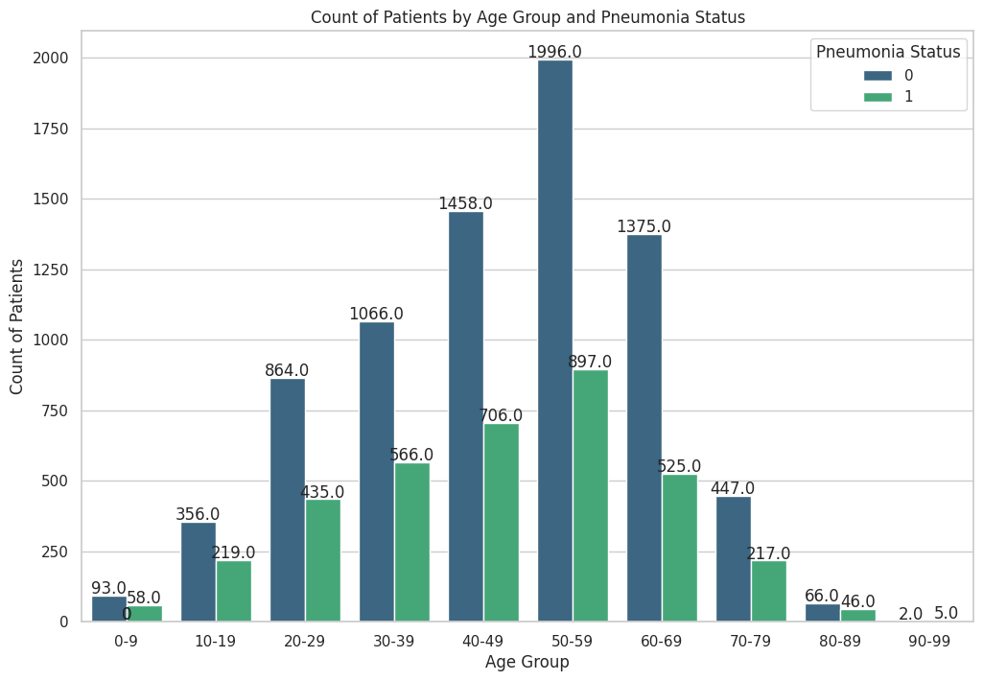
Key Visualizations
Distribution of pneumonia vs. age group
Highest count of pneumonia cases belongs to age group of 50 to 60.
Highest number pneumonia cases belongs to age group of 30 to 70 which comes around 60%-70% of overall cases.
Least number of pneumonia case reported for age group of >20 & <70.

Slide 15
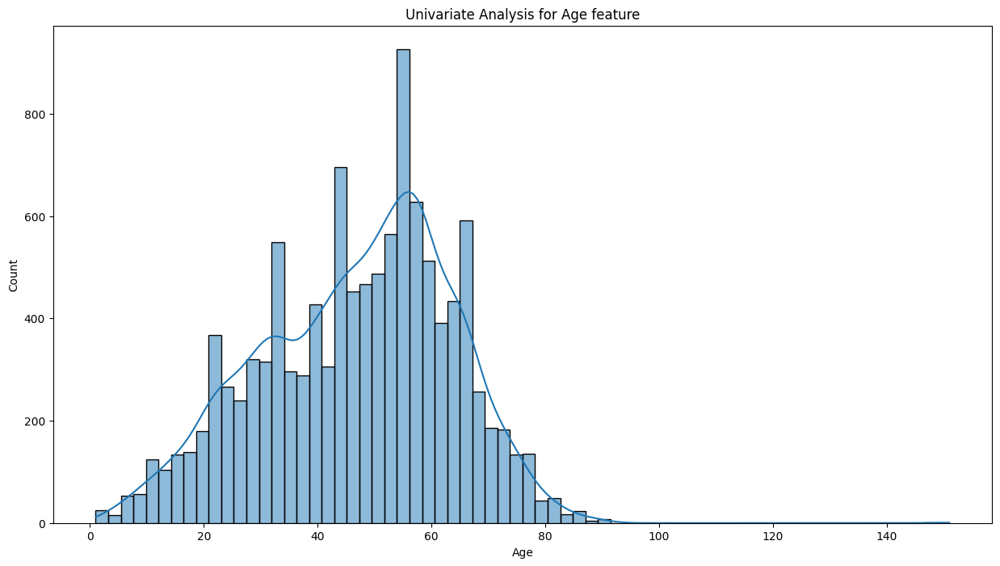
Key Visualizations
Distribution of pneumonia vs. age
Highest count of pneumonia cases belongs to age group of 50 to 60.
Highest number pneumonia cases belongs to age group of 30 to 70 which comes around 60%-70% of overall cases.
Least number of pneumonia case reported for age group of >20 & <70.

Slide 16
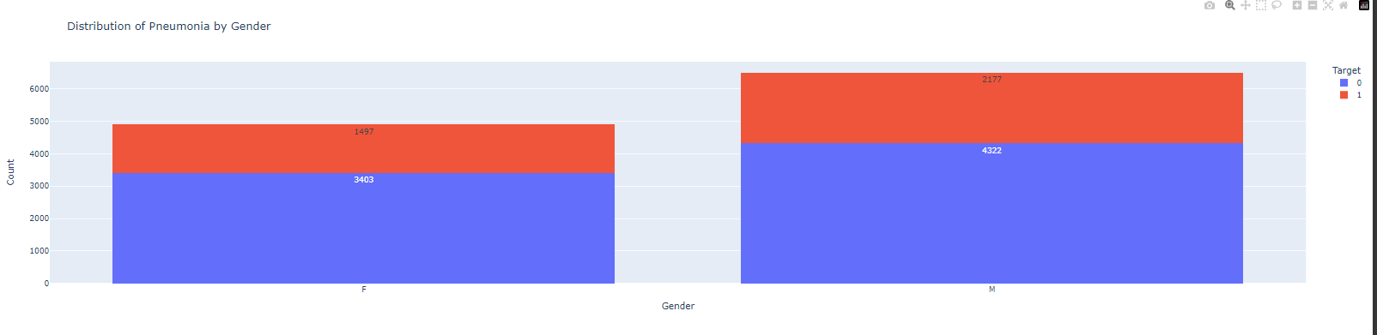
Key Visualizations
Distribution of pneumonia vs. gender
Blue colour indicates if the patient is normal and by red colour indicates that patient has pneumonia.
As per below statics that male are more prone to have pneumonia.
Female pneumonia cases identified around 1497.
Male pneumonia cases identified around 2177

Slide 17
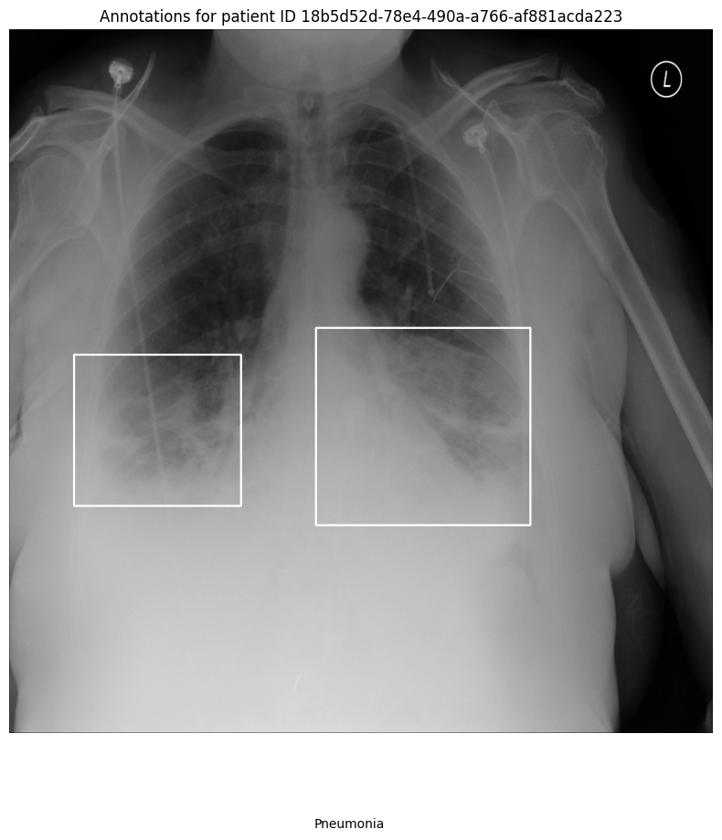
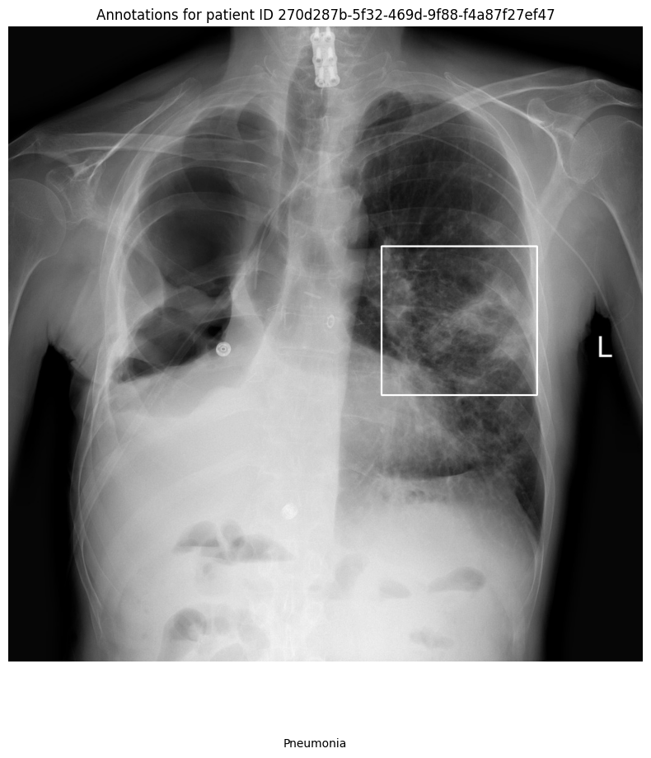
Key Visualizations
Patient With Pneumonia

Slide 18
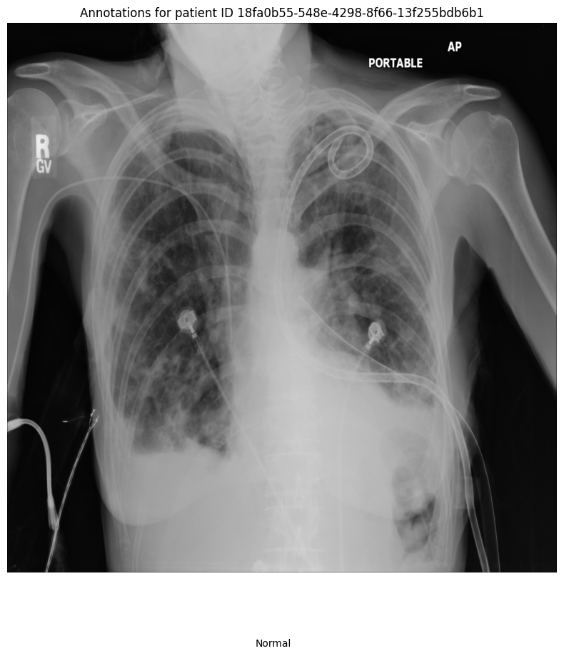
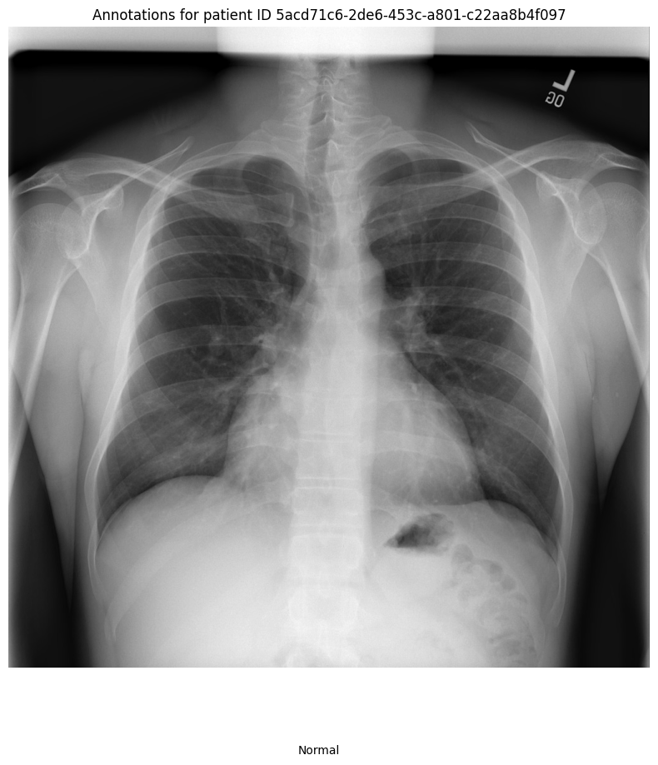
Key Visualizations
Patient Without Pneumonia

Slide 19
Implications of the Pneumonia Detection Solution
The final solution for detecting pneumonia in chest X-ray images has several implications for the healthcare domain:
Impact on Healthcare
Automated Diagnosis: The developed model can significantly aid radiologists by providing an initial automated diagnosis of pneumonia, reducing the workload and assisting in detecting cases that might otherwise be missed, especially in high-volume settings.
Faster Triage: By quickly flagging potential pneumonia cases, the system can expedite patient triage, ensuring that high-risk individuals receive prompt medical attention. This is particularly beneficial in emergency departments or areas with limited access to skilled radiologists​.
Improved Accuracy in Detection
The solution uses transfer learning techniques with ResNet50, which increased the detection accuracy to 75.95%, with improvements in recall and precision. This enhanced performance means fewer false negatives, leading to fewer missed pneumonia cases, a critical factor in reducing mortality due to late diagnosis​.
Scalability in Resource-Limited Settings
Deploying such models in under-resourced healthcare systems, especially in rural or remote areas, could be a game-changer. Since the model can be integrated into standard radiological workflows, it allows hospitals and clinics to scale their diagnostic capabilities without needing additional personnel.
Recommendations for Improvement
Further Data Augmentation: To improve model performance further, especially recall, I recommend experimenting with advanced data augmentation techniques like elastic deformations or synthetic data generation to simulate real-world conditions​.
Incorporating Object Detection: Implementing R-CNN models for precise localization of pneumonia regions on the X-rays would enhance diagnostic accuracy and clinical usability​.
Use in Screening Programs: This model can be employed in mass screening programs, especially in outbreak scenarios like COVID-19, to detect pneumonia-related lung abnormalities.
Confidence Level:
I have a high level of confidence in the model’s ability to generalize across diverse populations, given the improvements seen during transfer learning. However, further validation on more diverse datasets is recommended to ensure robustness in different clinical settings.

Slide 20
Limitations of the Pneumonia Detection Solution
Despite the improvements achieved by the fine-tuned ResNet50 model and other enhancements, there are several limitations that affect the model's performance in real-world applications:
Class Imbalance
Issue: The dataset is heavily imbalanced, with pneumonia cases accounting for only 22.5% of the total. This imbalance makes it challenging for the model to correctly identify pneumonia cases, as it may become biased toward the dominant class (normal cases) .
Impact: This class imbalance negatively affects the model’s recall score, leading to a higher rate of false negatives, which is critical in healthcare scenarios.
Enhancement: Techniques like focal loss or synthetic data generation (e.g., using GANs) could be employed to balance the data and focus the model’s learning on hard-to-classify pneumonia cases .
Image Quality and Variability
Issue: There is significant variability in the quality and resolution of the X-ray images in the dataset. Some images are noisier or lower resolution, which could negatively impact the model's ability to accurately classify pneumonia.
Impact: This variability may cause the model to perform well on certain subsets of data but poorly on others, affecting its generalizability to new datasets​.
Enhancement: Using advanced image preprocessing techniques and image quality enhancement algorithms may help normalize the images and improve model robustness across varying image qualities.
Generalization to New Datasets
Issue: The model was trained and validated on a specific dataset, and there is uncertainty regarding how well it generalizes to different patient populations or medical institutions, where imaging protocols and equipment may differ.
Impact: If the model encounters images with different characteristics, its performance might degrade, leading to misclassification or lower diagnostic accuracy .
Enhancement: Transfer learning and fine-tuning with new, more diverse datasets could help ensure that the model generalizes better across different environments.

Slide 21
Limitations of the Pneumonia Detection Solution
Bounding Box Localization
Issue: While the classification model can detect pneumonia, its ability to localize pneumonia regions within the lung (using bounding boxes) is less developed. This makes it harder to pinpoint exactly where in the lung the infection is occurring .
Impact: In a clinical setting, having accurate localization is essential for radiologists to confirm the model’s prediction and assess the severity of the condition.
Enhancement: Further training and fine-tuning of R-CNN models for more accurate pneumonia localization could significantly improve the practical usability of the model in clinical workflows .
Overfitting and Model Stability
Issue: Although L2 regularization and early stopping were implemented to prevent overfitting, the model still showed signs of overfitting, particularly when applied to unseen data .
Impact: This reduces the model's stability and reliability, especially when transitioning to real-world deployment.
Enhancement: Increasing the dropout rate or employing ensemble learning with multiple architectures (e.g., VGG16, DenseNet, ResNet) could help mitigate overfitting and improve the model’s generalizability .
Potential Issues and Enhancements For Mask R-CNN:
Training Time: Mask R-CNN models can be resource-intensive and require significant computational power, particularly for large image datasets like DICOM files.
Validation Loss: The code tracks validation loss during training and saves the best model, which is crucial for avoiding overfitting. However, further hyperparameter tuning (e.g., learning rate adjustment) might be required for optimal performance.
Real-World Usage: For real-world medical applications, the model's ability to segment pneumonia regions is highly valuable, but ensuring accuracy and minimizing false negatives (i.e., missed pneumonia cases) would be a key consideration.
These limitations highlight areas for future improvement, including addressing class imbalance, improving image preprocessing, enhancing localization, and ensuring the model generalizes well to new datasets.

Slide 22
Closing Reflections of the Pneumonia Detection Solution
Throughout the Pneumonia Detection Challenge, several important lessons were learned regarding the complexities of medical image classification and deep learning model development:
Importance of Data Quality and Balance: The project highlighted the critical role that data quality and class balance play in developing effective deep learning models. The significant class imbalance (22.5% pneumonia cases) was a key challenge that needed to be addressed. Data augmentation helped alleviate some issues, but more sophisticated techniques, such as oversampling or focal loss, would have provided better results.
Next Time: We would prioritize addressing class imbalance earlier in the process, possibly by experimenting with synthetic data generation or sampling techniques.
Transfer Learning and Fine-Tuning: Utilizing transfer learning proved to be an effective approach for quickly developing a high-performing model, particularly given the size of the dataset. Fine-tuning the ResNet50 model helped leverage pre-trained weights and resulted in a significant boost in performance over the base CNN.
Next Time: I would explore using different pre-trained architectures (such as InceptionV3 or EfficientNet) earlier to see if they offer even better feature extraction for this specific task.
Regularization and Generalization: Introducing L2 regularization and early stopping helped reduce overfitting, but the model still faced challenges in generalizing to unseen data, especially when the image quality varied. Additional preprocessing steps and more robust regularization techniques could have further improved generalization.
Next Time: I would experiment with ensemble learning or advanced regularization techniques like dropout or batch normalization from the start to achieve better generalization across diverse datasets.
Real-World Considerations: Working with medical data involves understanding the broader implications of deploying such models in real-world settings. Ensuring that the model is reliable and generalizes well across different populations is crucial. While the model performed well in a controlled environment, it still faced challenges in real-world applicability, particularly in terms of localization and variability in image quality.
Next Time: I would place greater emphasis on ensuring the model can handle diverse data sources by incorporating datasets from different hospitals or imaging devices to simulate real-world conditions.
In summary, this project demonstrated the importance of data quality, model architecture, and robustness when building AI models for medical use. In future projects, I would take a more proactive approach to balancing the dataset and exploring additional deep learning techniques to further enhance performance.

Slide 23
Closing Reflections of the Pneumonia Detection Solution
Real-World Considerations
Working with medical data involves understanding the broader implications of deploying such models in real-world settings. Ensuring that the model is reliable and generalizes well across different populations is crucial. While the model performed well in a controlled environment, it still faced challenges in real-world applicability, particularly in terms of localization and variability in image quality.
Next Time: I would place greater emphasis on ensuring the model can handle diverse data sources by incorporating datasets from different hospitals or imaging devices to simulate real-world conditions.
In summary, this project demonstrated the importance of data quality, model architecture, and robustness when building AI models for medical use. In future projects, I would take a more proactive approach to balancing the dataset and exploring additional deep learning techniques to further enhance performance.

