Slide 1

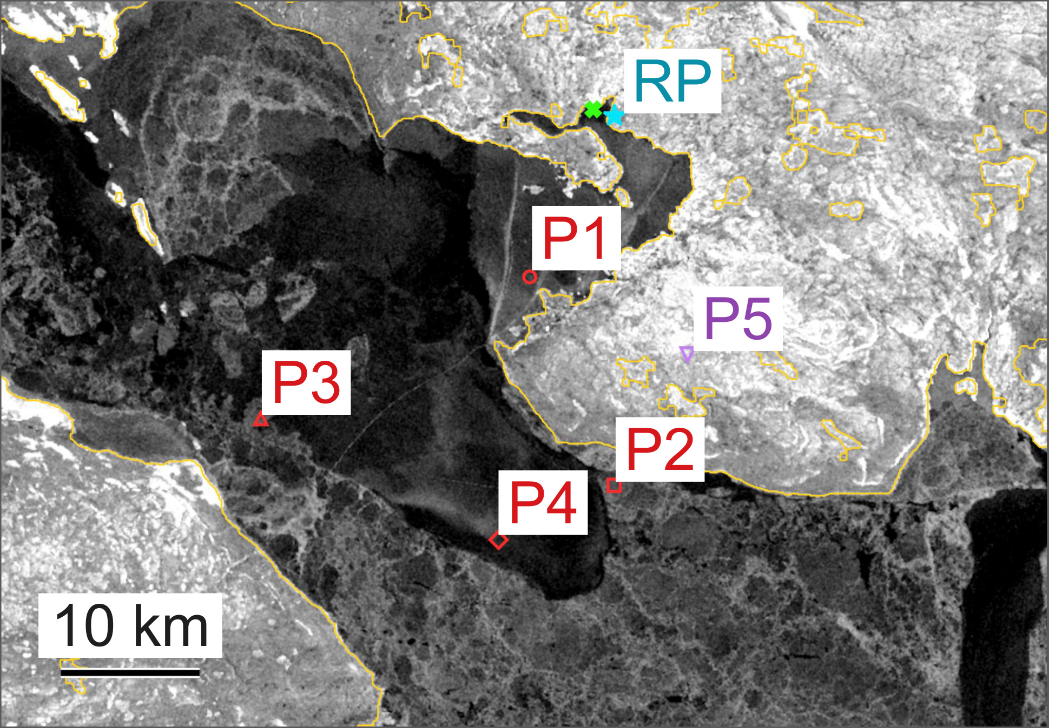
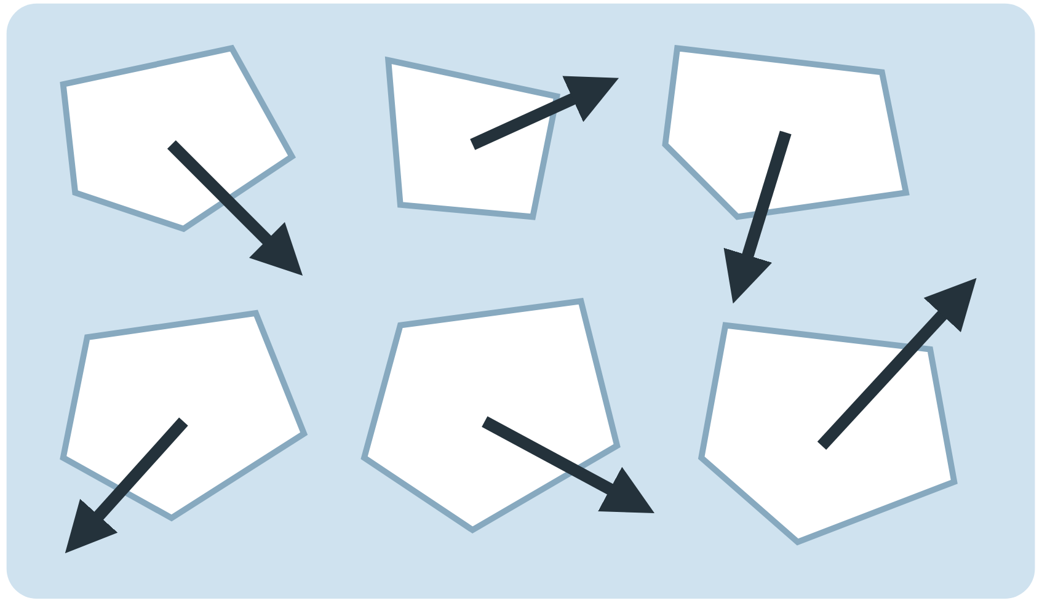
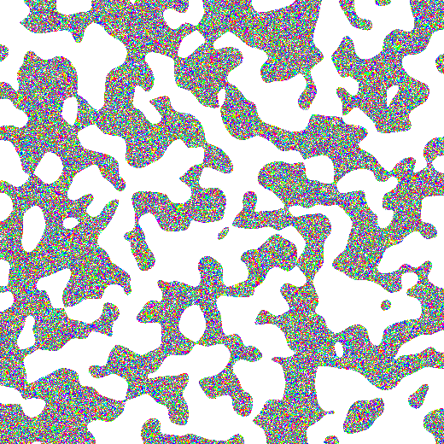
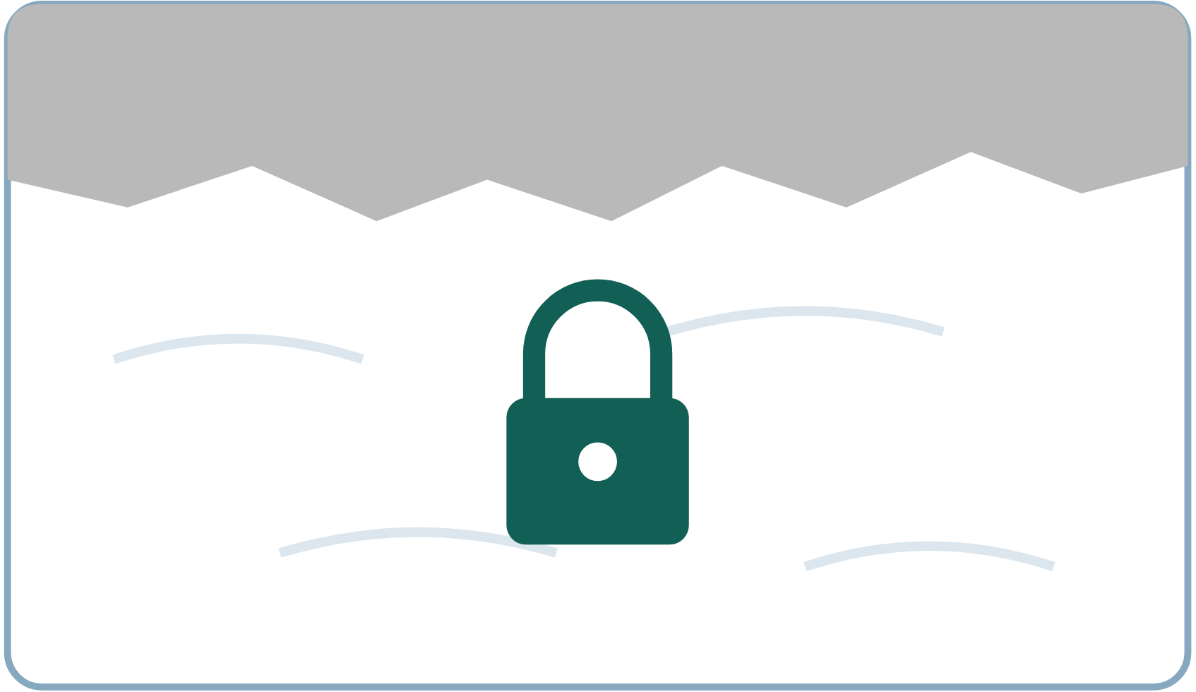

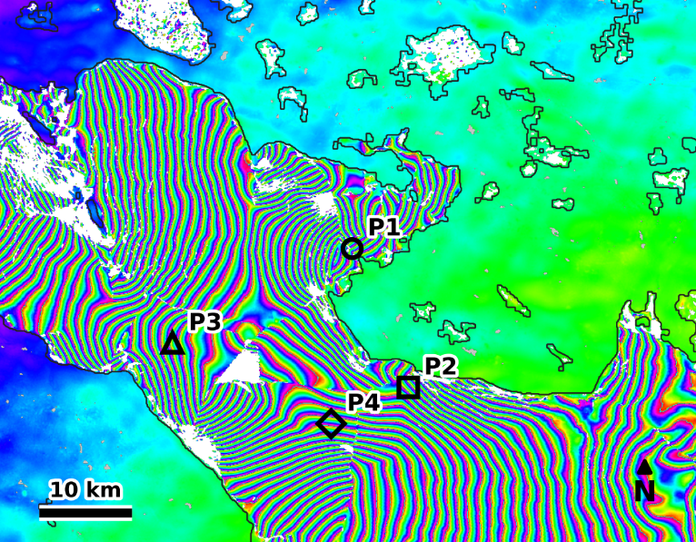
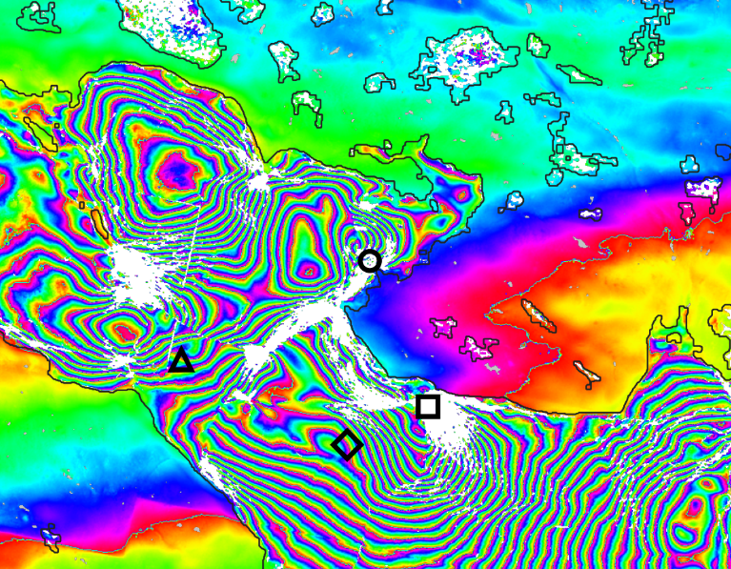
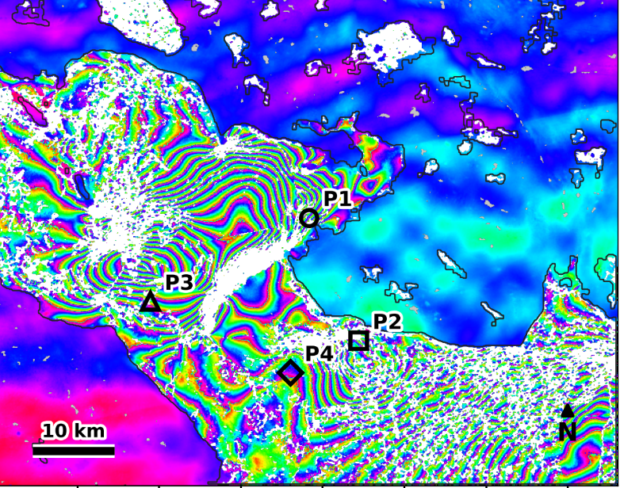
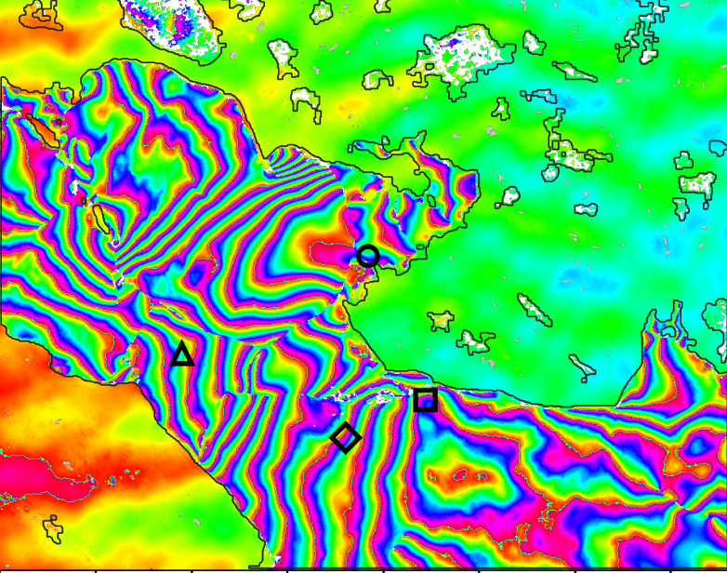
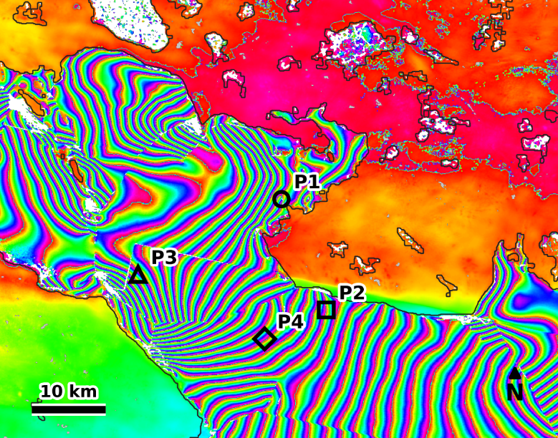
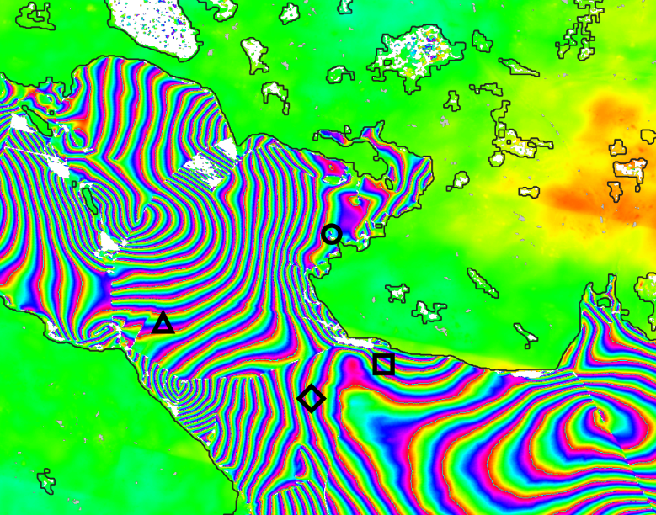
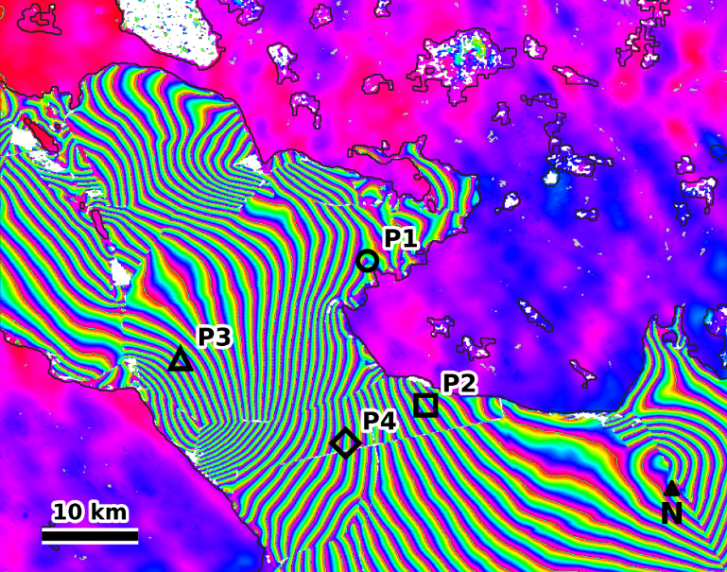
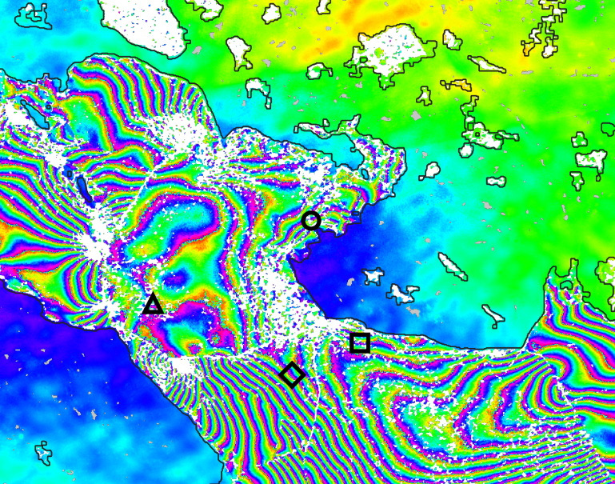
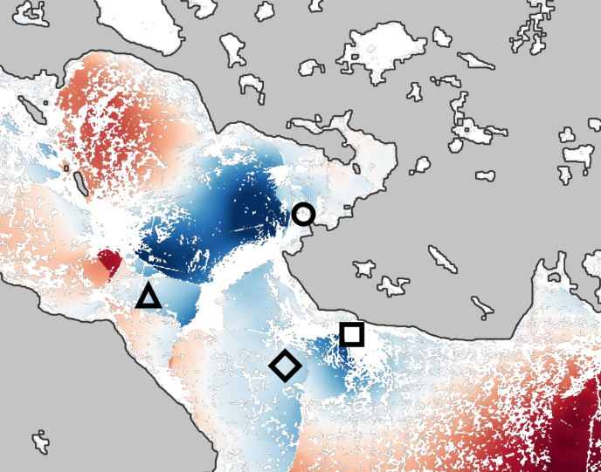
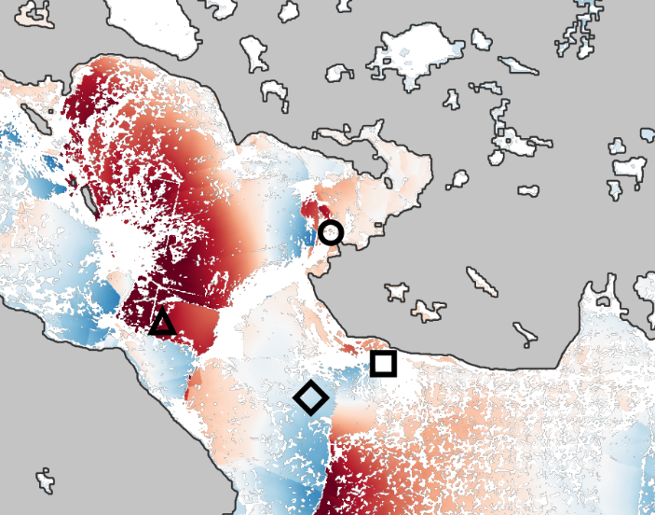
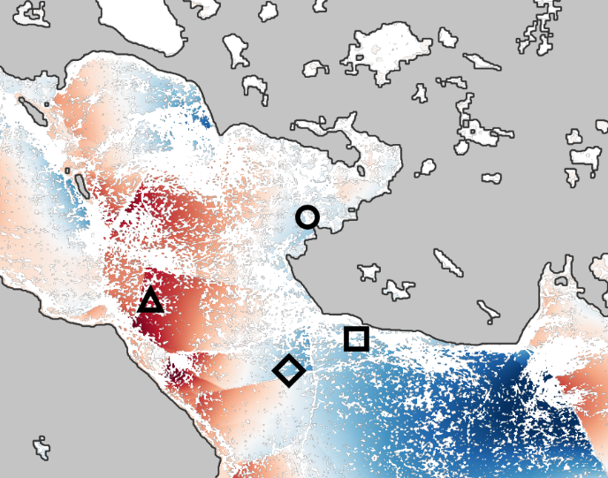
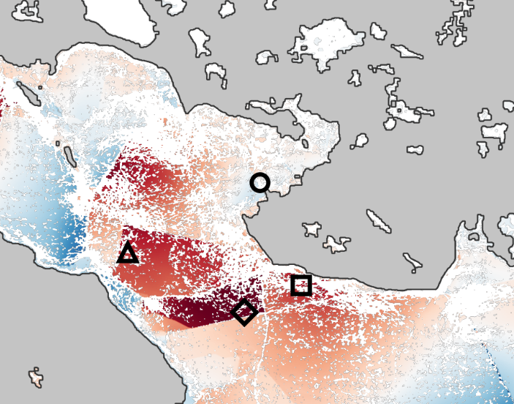
Coherence Onset and Two-Dimensional Deformation of Landfast
Sea Ice at Cambridge Bay, Nunavut
SESSION
S2
Ananthanarayanan B¹ and Shamjid P^{1,*}
SAR Remote Sensing
¹ School of Digital Sciences, Digital University Kerala, Thiruvananthapuram 695317, Kerala, India
Scan: abstract
* Corresponding author: shamjid.p@duk.ac.in · ananthanarayanan.ds25@duk.ac.in
KEY
MESSAGE
Free Sentinel-1 radar can date when coastal sea ice locks in place: 30 Jan in 2019, but 20 Mar in 2021 — 49 days later. The same data reproduce published ice-motion results within 2 cm.
INTRODUCTION & AIM
STUDY AREA & DATA
Why it matters
Dease Strait, Cambridge Bay, Nunavut
Landfast sea ice is sea ice frozen fast to the coast. Along the Canadian Arctic coast it is the winter travel surface and a key habitat. As the Arctic warms, the date it forms is shifting, so it must be measured, not assumed.
Sentinel-1 radar image, 17 Feb 2019
The idea: coherence works like an ice clock
P1–P4 points on the sea ice, 1.2–8.2 km offshore
InSAR has measured the 2-D motion of this ice at Cambridge Bay [1] and its year-to-year change [2], but used coherence only to select reliable pixels. Drifting ice loses coherence and fixed ice regains it, so coherence may show when the ice consolidated and whether it stayed that way.
RP fixed reference on land
P5 land check point (should not move)
Green ice profiler
→
→
Drifting ice changes between passes
→ low coherence
Landfast ice stays in place
→ high coherence
Sentinel-1 IW SLC data: consecutive 12-day pairs from two passes
Coherence (0 to 1) shows how alike two radar images taken 12 days apart are, so the date it rises and stays high is the date the ice locked in place.
Pass | ● Winter 2018–19 | ● Winter 2020–21
Descending (S1A, HH) | 17 Feb – 6 Apr · 4 pairs | 14 Mar – 7 Apr · 2 pairs
Ascending (S1B, VV) | 21 Feb – 17 Mar · 2 pairs | 18 Mar – 23 Apr · 3 pairs
Overlap used for 2-D motion | 21 Feb – 17 Mar (24 days) | 18 Mar – 7 Apr (20 days)
Aim: compare two contrasting winters (2018–19 vs 2020–21)
Q1
When did the ice become landfast? (dated from coherence)
Q2
How did it move: east–west and up–down?
METHOD: FOUR STEPS, FREE DATA AND FREE CLOUD PROCESSING
1
Make interferograms
2
Date the lock-in
3
Track motion over time
4
Split into 2-D motion
Each 12-day pair → one interferogram, processed free in the cloud (ASF HyP3).
Every 12 days: share of sea ice with coherence > 0.4. Onset = first date it stays above 50%.
SBAS time series [3], tied to fixed land (Arctic Research Station); ramps removed over stable land.
Descending looks west, ascending looks east; combining both gives east–west and up–down motion at P1–P4.
GAMMA · 20 × 4 looks (80 m) · GLO-30 DEM
RESULTS & DISCUSSION
Q1 · WHEN DID THE ICE LOCK IN?
WHAT DOES THE RAW RADAR SIGNAL SHOW? · BOTH WINTERS
In 2021 the ice locked in 49 days later than in 2019
Clear stripes from February in 2019, but only from mid-March in 2021
Descending pass (S1A, HH) · looks west
Ascending pass (S1B, VV) · looks east
17 Feb – 1 Mar 2019
1 – 13 Mar 2019
21 Feb – 5 Mar 2019
5 – 17 Mar 2019
14 – 26 Mar 2021
26 Mar – 7 Apr 2021
18 – 30 Mar 2021
30 Mar – 11 Apr 2021
●
2018–19 locked in on 30 Jan 2019 and stayed coherent until early April.
●
2020–21 locked in on 20 Mar 2021, 49 days later, after a break-up in early March (coherent ice 55% → 16%).
●
Only 12-day pairs work: coherence 0.78–0.81 at 12 days, but 0.54 at 24 days.
−π
0
+π
1 colour cycle = 2.8 cm toward or away from the satellite · tight stripes = fast motion · smooth colour = little motion (e.g. land) · white = not measurable
Q2 · HOW DID THE ICE MOVE? · FROM THE 8 INTERFEROGRAMS ABOVE
Offshore (P4), the ice moved west 2.7× faster and rose instead of sinking in the late winter (2020–21)
Sideways motion (east–west, cm)
Up–down motion (cm)
■ 2018–19 ■ 2020–21
40 east
10 up
Speed to the west (cm per day)
Up–down speed (cm per day)
2018–19
0
0
2.7× faster
sinking → rising
40 west
10 down
n/a
n/a
n/a
n/a
40 east
20 up
Gaps: P2 was not measurable in 2018–19; the 2020–21 value at P3 is anomalous and left out. Per-day speeds, because the two windows differ (24 vs 20 days).
2020–21
0
0
Can we trust the numbers? Within 2 cm of a published study
40 west
20 down
Compared: total line-of-sight motion (+ = toward the satellite), descending pass, 17 Feb – 6 Apr 2019
Each map = 20 days (2019: 21 Feb – 13 Mar; 2021: 18 Mar – 7 Apr). Grey = land; white = no data; ○ P1 near shore, ◇ P4 offshore.
Point | This study | Chen et al. [1] | Difference
P3 | +14.8 cm | +16.7 cm | 1.9 cm
P4 | −5.6 cm | −5.4 cm | 0.2 cm
Measured before splitting into horizontal and vertical; same dates as [1] (48 days).
Precision (land point P5): ±0.7–1.6 cm.
CONCLUSIONS & NEXT STEPS
REFERENCES
1
Coherence resolves not only when landfast ice forms but whether formation succeeds, capturing a mid-winter break-up and refreeze invisible to deformation measurements.
[1] Chen, Z., Montpetit, B., Banks, S., White, L., Behnamian, A., Duffe, J., & Pasher, J. (2021). InSAR monitoring of Arctic landfast sea ice deformation using L-band ALOS-2, C-band Radarsat-2 and Sentinel-1. Remote Sensing, 13(22), 4570. https://doi.org/10.3390/rs13224570
[2] Zhu, Y., Zhou, C., Zhu, D., Wang, T., & Zhang, T. (2023). Interannual variation of landfast ice using ascending and descending Sentinel-1 images from 2019 to 2021: A case study of Cambridge Bay. Remote Sensing, 15(5), 1296. https://doi.org/10.3390/rs15051296
[3] Berardino, P., Fornaro, G., Lanari, R., & Sansosti, E. (2002). A new algorithm for surface deformation monitoring based on small baseline differential SAR interferograms. IEEE Transactions on Geoscience and Remote Sensing, 40(11), 2375–2383. https://doi.org/10.1109/TGRS.2002.803792
2
The intermittent winter was also the more mobile, though two seasons cannot separate this from coincidence.
3
Snow metamorphism and early-growth dielectric change also cost coherence over immobile ice, so dates are late-biased; longer records and independent draft data are needed to bound this.
Next steps: L-band (ALOS-2) comparison, and deep-learning mapping of motion across the full Sentinel-1 archive (under way).
Coherence offers a free, repeatable way to monitor when coastal sea ice becomes landfast.
Acknowledgment: Copernicus Sentinel-1 data (ESA), processed with ASF HyP3 on OpenSARLab.
https://sciforum.net/event/ECRS2026

