Slide 1
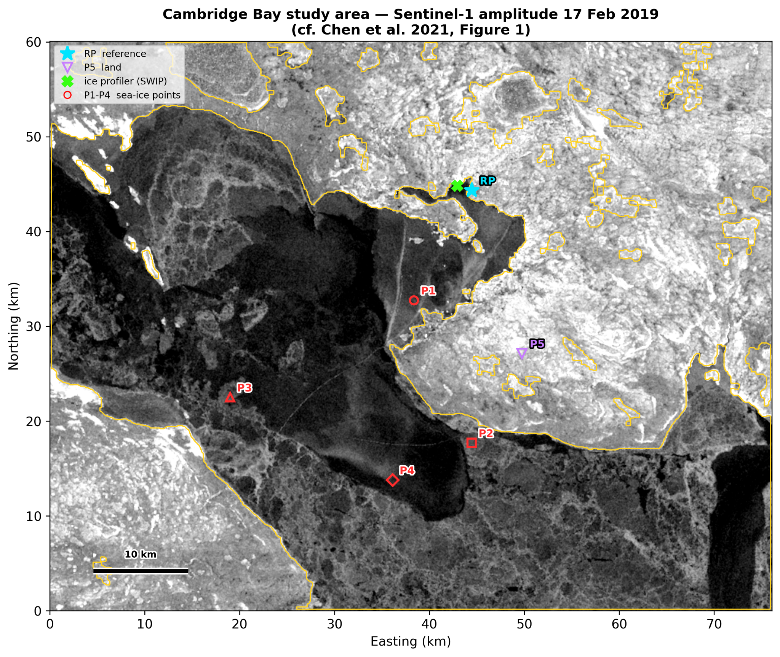
Coherence onset and two-dimensional deformation of landfast sea ice at Cambridge Bay, Nunavut
Sentinel-1 ascending + descending InSAR, winters 2018–19 and 2020–21
Ananthanarayanan B, Shamjid P*
School of Digital Sciences, Digital University Kerala
*shamjid.p@duk.ac.in
Notes:
Good morning. I am Ananthanarayanan from Digital University Kerala. This talk is about using Sentinel-1 radar interferometry, from both the ascending and descending orbits, to see when landfast sea ice at Cambridge Bay becomes fixed, and how it then deforms, in two contrasting winters.

Slide 2
Why the timing of landfast ice matters
A travel surface and a habitat: landfast ice carries winter travel and shapes nearshore ecology across the Canadian Arctic Archipelago.
Its calendar is shifting under Arctic amplification, so formation dates need measuring, not assuming.
InSAR at Cambridge Bay has retrieved 2-D displacement (Chen et al., 2021) and its interannual change (Zhu et al., 2023).
The idea
Coherence is normally used only to select measurable pixels.
But drifting ice loses coherence and fixed ice regains it: its seasonal course can record when the ice consolidated.
Drifting ice
Consolidation
Landfast ice
coherence lost between passes
coherence returns as the ice locks in place
coherent area stays above 50%: the onset date
Notes:
Landfast ice is ice frozen to the coast. Communities travel on it, and its timing is changing. InSAR has already been used here by Chen and by Zhu, but in both studies coherence was only a mask. Our idea: drifting ice decorrelates and fixed ice stays coherent, so coherence itself can date consolidation.

Slide 3
Study area and data
 | 2018–19 | 2020–21
Descending S1A, HH | 17 Feb – 6 Apr 4 pairs | 14 Mar – 7 Apr 2 pairs
Ascending S1B, VV | 21 Feb – 17 Mar 2 pairs | 18 Mar – 23 Apr 3 pairs
Coherence | 0.52 – 0.85 | 0.47 – 0.81
Sentinel-1 IW SLC, consecutive 12-day pairs, ASF HyP3 (GAMMA), 80 m
Coherence tracked every 12 days, mid-December to late April
Four sea-ice points 1.2–8.2 km offshore, identical in both winters
P1–P4 sea-ice points 1.2–8.2 km offshore, RP land reference, P5 land control
Notes:
Cambridge Bay sits on Dease Strait. We used Sentinel-1 interferometric wide-swath data, descending from Sentinel-1A and ascending from Sentinel-1B, processed in the free ASF HyP3 cloud. Four monitoring points sit at the same coordinates in both winters, with a land reference RP and a land control P5.

Slide 4
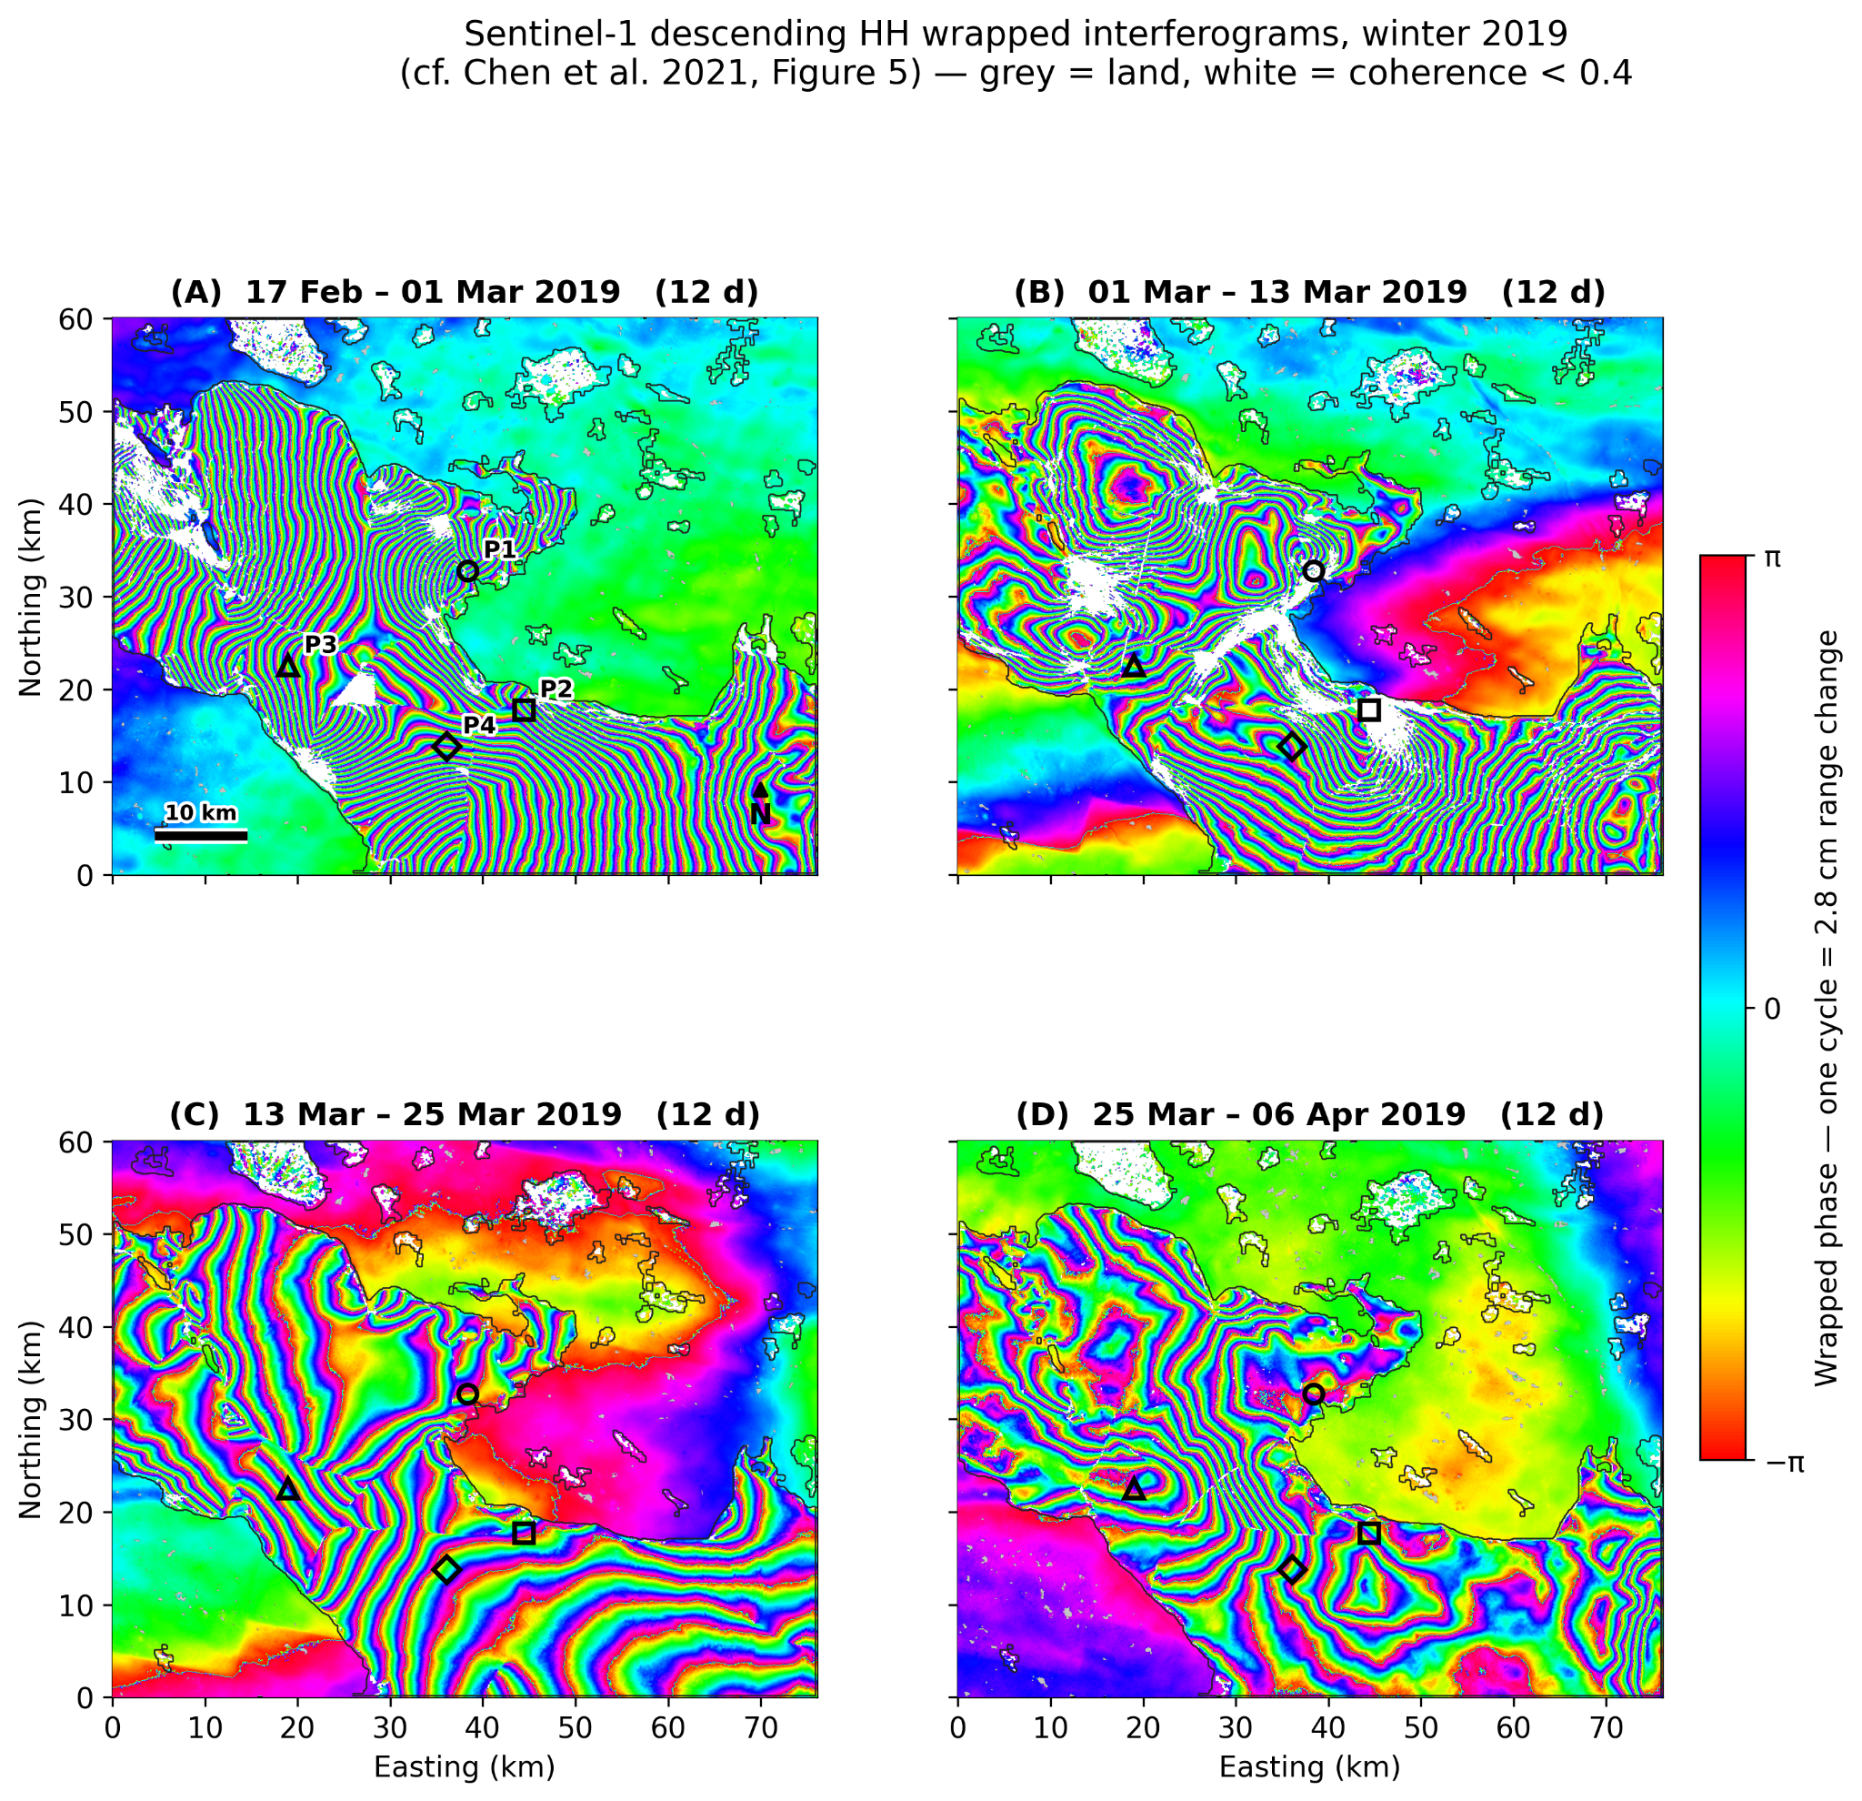
From radar pairs to 2-D motion
1
Coherence onset
coherent ice area every 12 days; onset = sustained above 50%
2
SBAS time series
ramps removed over land; referenced to fixed land
3
Asc + desc
two viewing directions solve for east–west and vertical motion
One fringe = 2.8 cm. Precision from a land control: ±1.6 cm (2018–19), ±0.7 cm (2020–21).
Descending interferograms, 17 Feb – 6 Apr 2019
Notes:
These are the raw measurements: descending interferograms from February to April 2019. One colour cycle is 2.8 centimetres of motion toward or away from the satellite; dense fringes mean fast deformation; white is where coherence is too low to measure. Three steps turn them into results: coherence gives the onset date, SBAS gives time series against fixed land, and combining ascending with descending separates east-west from vertical motion. Our error, from a land control point, is 0.7 to 1.6 centimetres.

Slide 5
Validated to within 2 cm
Point | This study | Chen et al. 2021 | Difference
P3 | +14.8 cm | +16.7 cm | 1.9 cm
P4 | −5.6 cm | −5.4 cm | 0.2 cm
≤ 2 cm
agreement with Chen et al. (2021) where directly comparable
Same dates and window as the published study: descending, 17 February – 6 April 2019 (48 days).
Within their own spread: Chen et al. report 2–44 cm differences between their sensors.
Free processing: ASF HyP3 instead of licensed GAMMA; polynomial ramp removal instead of split-spectrum.
±0.7–1.6 cm
precision from an independent land control point (P5)
Notes:
First, can free cloud processing reproduce the published result? Yes. At the two directly comparable points we agree with Chen et al. to within two centimetres, smaller than the spread between their own sensors. And the land control point bounds our precision at 0.7 to 1.6 centimetres.

Slide 6
Coherence dates the consolidation
30 Jan 2019
consolidated once; coherent to early April
50% onset threshold
20 Mar 2021
49 days later, after a failed first attempt
2020–21: 55% in late February, 16% in early March, 95% by mid-March; decay to 55% by late April. The late-December value is a single pair, not sustained.
Notes:
This is the central result. The share of the ice that stays coherent, every twelve days. In 2018-19, blue, the ice consolidated once, on 30 January, and stayed. In 2020-21, orange, it reached 55 percent in late February, collapsed to 16 percent in early March, and only consolidated on 20 March: 49 days later. Coherence caught a failed consolidation.

Slide 7
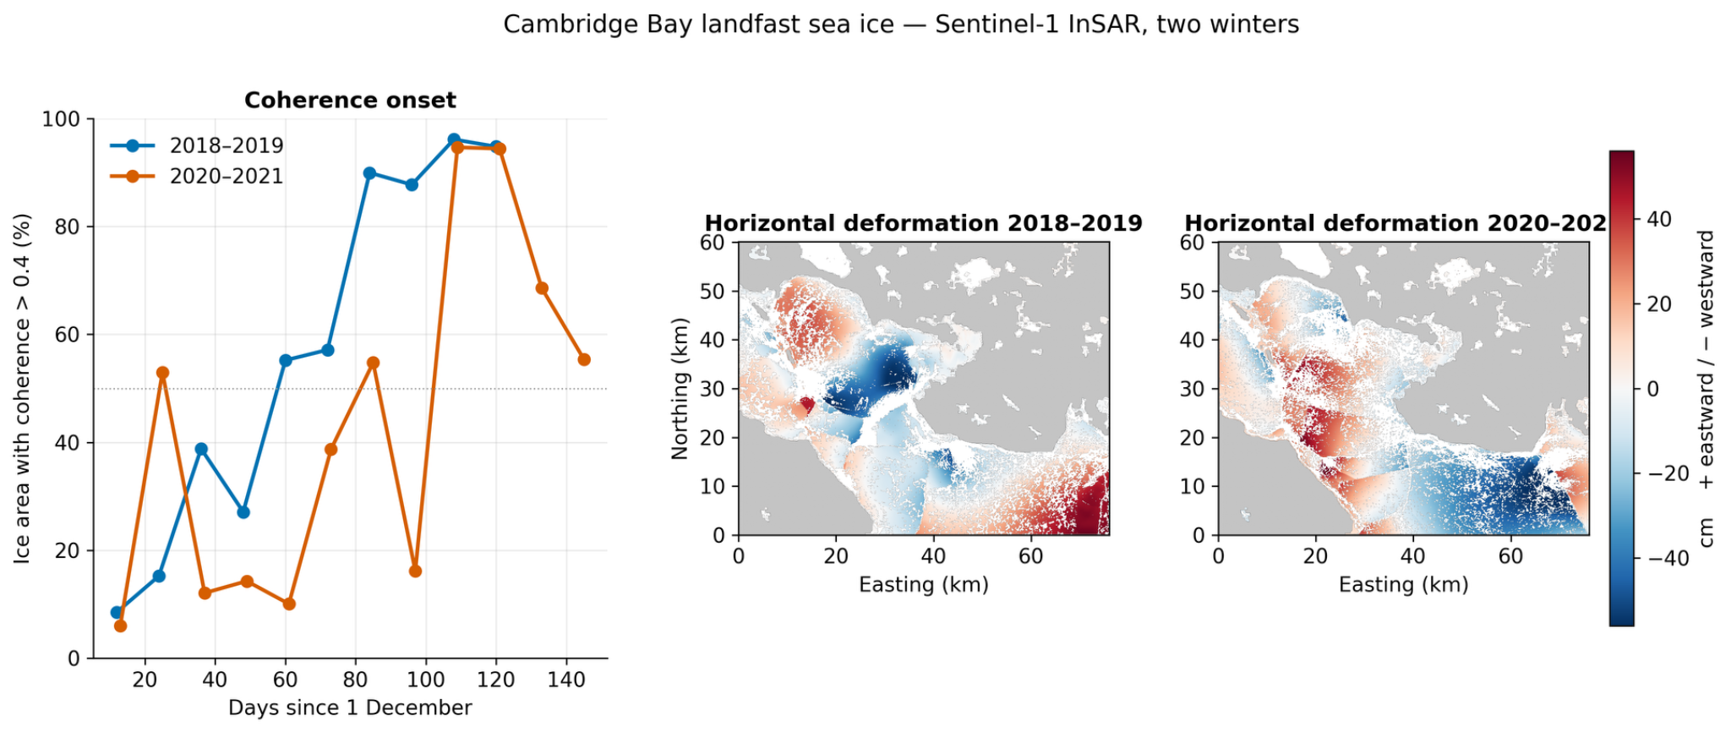
The late winter was more mobile
×2.7
horizontal rate at P4: −0.43 → −1.18 cm/day
Sign flip
vertical rate at P4: −0.18 → +1.42 cm/day
Onset (left) and horizontal deformation in both winters (right)
P4, 8.2 km offshore, is the outermost reliable point. Rates are compared because the windows differ (24 vs 20 days).
2018–19 (24 days)
horizontal −55 to +51 cm
vertical −11 to +21 cm
2020–21 (20 days)
horizontal −60 to +45 cm
vertical −16 to +29 cm
Notes:
Deformation: on the left the onset, on the right horizontal motion in both winters on a shared scale. Comparing rates at P4, the outermost reliable point, the horizontal rate nearly tripled and vertical motion reversed sign. The late, intermittent winter was the more mobile one.

Slide 8
Conclusions
1
Coherence dates consolidation and shows whether it succeeds, capturing a mid-winter break-up and refreeze invisible to deformation.
2
Free processing reproduces Chen et al. to within 2 cm, with 0.7–1.6 cm precision from a land control.
3
The late, intermittent winter was more mobile (×2.7 horizontal rate at P4); two winters cannot yet separate cause from coincidence.
Dates are late-biased (snow and ice-growth changes also cost coherence); longer records and ice-draft data are needed.
Notes:
Three messages. Coherence is not just a mask: it dates consolidation and reveals when it fails. Free cloud processing reproduces the published result within two centimetres. And the late, intermittent winter was the more mobile one, though two winters cannot yet separate cause from coincidence.

Slide 9
Thank you
49 days
later consolidation, after a failed first attempt
≤ 2 cm
agreement with Chen et al. (2021)
Questions and discussion welcome
×2.7
faster horizontal motion in the late winter
Ananthanarayanan B
ananthanarayanan.ds25@duk.ac.in
Corresponding author: shamjid.p@duk.ac.in
Notes:
Thank you. I am happy to take questions.

