Slide 1
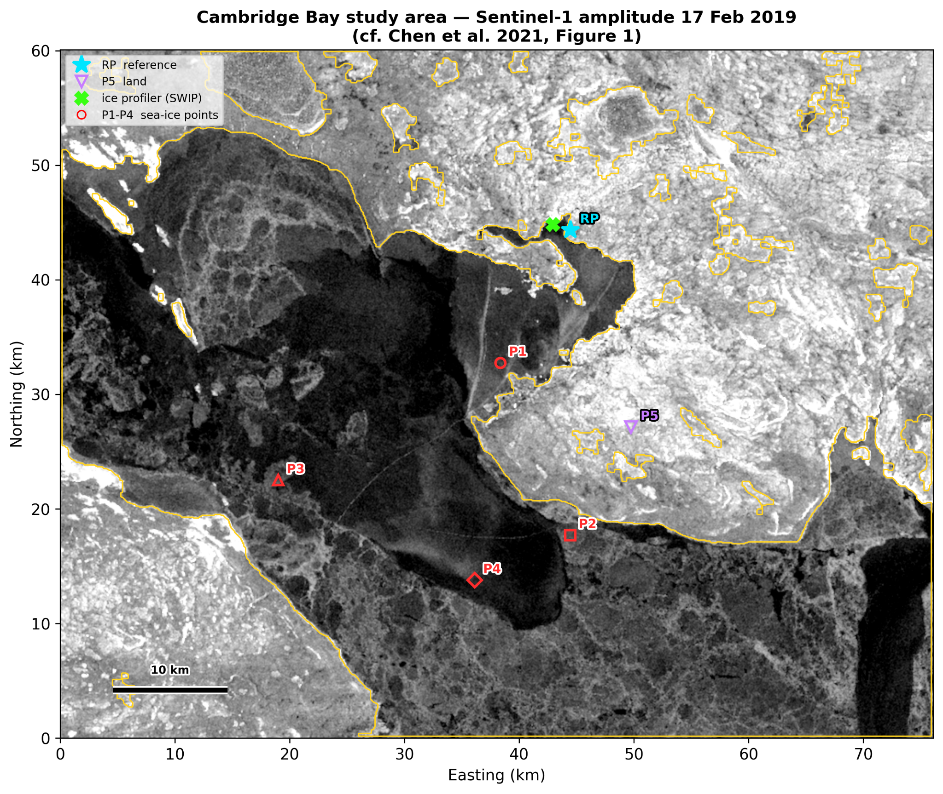
Coherence onset and two-dimensional deformation of landfast sea ice at Cambridge Bay, Nunavut
Sentinel-1 ascending + descending InSAR, winters 2018–19 and 2020–21
Ananthanarayanan B, Shamjid P*
School of Digital Sciences, Digital University Kerala
*shamjid.p@duk.ac.in
Notes:
Good morning. I am Ananthanarayanan from Digital University Kerala. This talk is about using Sentinel-1 radar interferometry, from both the ascending and descending orbits, to see when landfast sea ice at Cambridge Bay becomes fixed, and how it then deforms, in two contrasting winters.

Slide 2
Why the timing of landfast ice matters
A travel surface and a habitat: landfast ice carries winter travel and shapes nearshore ecology across the Canadian Arctic Archipelago.
Its calendar is shifting under Arctic amplification, so formation dates need measuring, not assuming.
InSAR at Cambridge Bay has retrieved 2-D displacement (Chen et al., 2021) and its interannual change (Zhu et al., 2023).
The idea
Coherence is normally used only to select measurable pixels.
But drifting ice loses coherence and fixed ice regains it: its seasonal course can record when the ice consolidated.
Drifting ice
Consolidation
Landfast ice
coherence lost between passes
coherence returns as the ice locks in place
coherent area stays above 50%: the onset date
Notes:
Landfast ice is ice frozen to the coast. Communities travel on it, and its timing is changing. InSAR has already been used here by Chen and by Zhu, but in both studies coherence was only a mask. Our idea: drifting ice decorrelates and fixed ice stays coherent, so coherence itself can date consolidation.

Slide 3
Study area and data
 | 2018–19 | 2020–21
Descending S1A, HH | 17 Feb – 6 Apr 4 pairs | 14 Mar – 7 Apr 2 pairs
Ascending S1B, VV | 21 Feb – 17 Mar 2 pairs | 18 Mar – 23 Apr 3 pairs
Coherence | 0.52 – 0.85 | 0.47 – 0.81
Sentinel-1 IW SLC, consecutive 12-day pairs, ASF HyP3 (GAMMA), 80 m
Coherence tracked every 12 days, mid-December to late April
Four sea-ice points 1.2–8.2 km offshore, identical in both winters
P1–P4 sea-ice points 1.2–8.2 km offshore, RP land reference, P5 land control
Notes:
Cambridge Bay sits on Dease Strait. We used Sentinel-1 interferometric wide-swath data, descending from Sentinel-1A and ascending from Sentinel-1B, processed in the free ASF HyP3 cloud. Four monitoring points sit at the same coordinates in both winters, with a land reference RP and a land control P5.

Slide 4
From radar pairs to 2-D motion
1
2
3
4
5
Interferograms
Coherence onset
Ramp removal
SBAS time series
2-D decomposition
HyP3 INSAR_GAMMA, 12-day pairs, 20 × 4 looks, GLO-30 DEM
coherent ice area every 12 days; onset = sustained above 50%
polynomial fit over stable land replaces split-spectrum
referenced to fixed land at the Arctic Research Station
ascending + descending → east–west and vertical
Precision from an independent land control (P5): ±1.6 cm (2018–19) and ±0.7 cm (2020–21), ±4 cm in the 2020–21 ascending series. Networks are consecutive, so phase closure is not available.
Notes:
Five steps. HyP3 makes the interferograms. Coherence gives the onset: the date the coherent ice area stays above fifty percent. We remove long-wavelength ramps over land, invert with SBAS against a fixed land reference, and combine the two orbits to separate east-west from vertical motion. P5, on land, tells us our error: 0.7 to 1.6 centimetres.

Slide 5
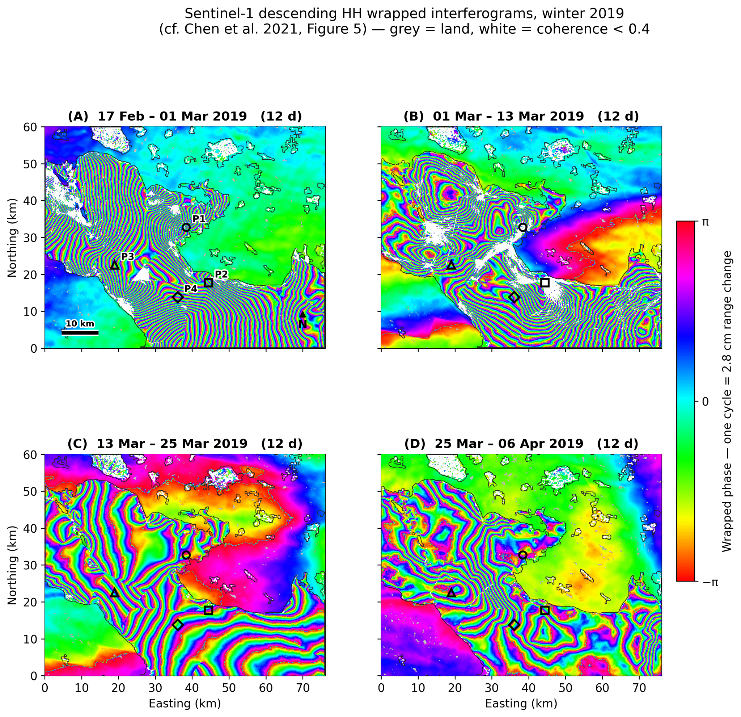
Interferograms: the raw signal
How to read them
One colour cycle = 2.8 cm
of line-of-sight change between the two passes
Dense fringes = fast motion
the landfast ice in Dease Strait deforms; the land around it stays smooth
White = not measurable
coherence below 0.4: ice that moved or changed too much
Pattern changes pair to pair
parallel fringes in February, more varied and partly closed by April
Descending (S1A, HH): four 12-day pairs, Feb–Apr 2019
Notes:
These are the raw measurements: four consecutive descending interferograms from February to April 2019. One colour cycle is 2.8 centimetres of motion along the line of sight. The sea ice in the strait carries dense fringes while the land around it stays smooth; white is where coherence falls below 0.4. Notice how the pattern changes from pair to pair: this is the signal we turn into time series and, with the second orbit, into east-west and vertical motion.

Slide 6
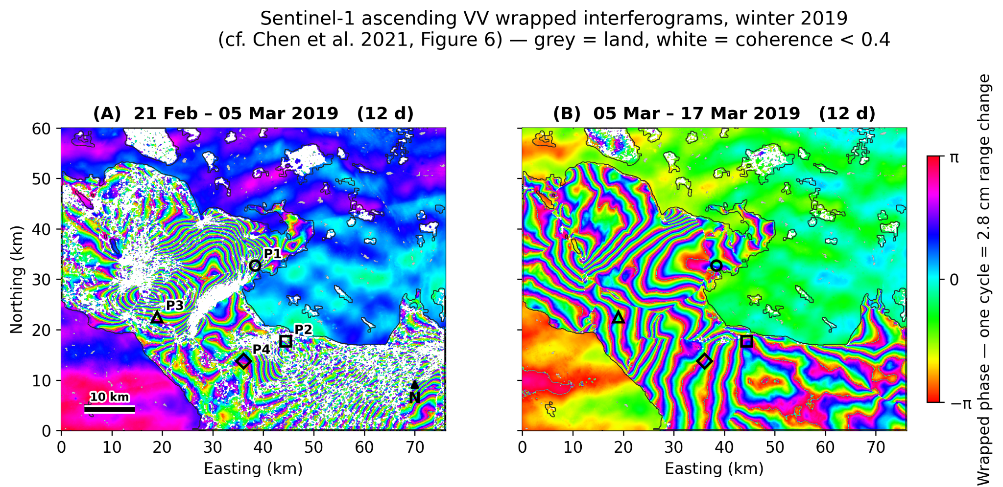
Two viewing directions, two motions
Ascending (S1B)
Descending (S1A)
landfast ice
Ascending (S1B, VV), 21 Feb – 17 Mar 2019: the same ice seen from the opposite side
One fringe = 2.8 cm of line-of-sight change. The orbits see east–west motion with opposite sign but vertical motion alike, so the two together resolve both (north–south assumed small).
Notes:
Here are the raw interferograms from both orbits. One colour cycle is 2.8 centimetres. A single orbit cannot tell sideways from up-down motion. But the two orbits look from opposite sides: east-west motion appears with opposite sign, vertical motion with the same sign. Two equations, two unknowns.

Slide 7
Validated to within 2 cm
Point | This study | Chen et al. 2021 | Difference
P3 | +14.8 cm | +16.7 cm | 1.9 cm
P4 | −5.6 cm | −5.4 cm | 0.2 cm
≤ 2 cm
agreement with Chen et al. (2021) where directly comparable
Same dates and window as the published study: descending, 17 February – 6 April 2019 (48 days).
Within their own spread: Chen et al. report 2–44 cm differences between their sensors.
Free processing: ASF HyP3 instead of licensed GAMMA; polynomial ramp removal instead of split-spectrum.
±0.7–1.6 cm
precision from an independent land control point (P5)
Notes:
First, can free cloud processing reproduce the published result? Yes. At the two directly comparable points we agree with Chen et al. to within two centimetres, smaller than the spread between their own sensors. And the land control point bounds our precision at 0.7 to 1.6 centimetres.

Slide 8
Coherence dates the consolidation
30 Jan 2019
consolidated once; coherent to early April
50% onset threshold
20 Mar 2021
49 days later, after a failed first attempt
2020–21: 55% in late February, 16% in early March, 95% by mid-March; decay to 55% by late April. The late-December value is a single pair, not sustained.
Notes:
This is the central result. The share of the ice that stays coherent, every twelve days. In 2018-19, blue, the ice consolidated once, on 30 January, and stayed. In 2020-21, orange, it reached 55 percent in late February, collapsed to 16 percent in early March, and only consolidated on 20 March: 49 days later. Coherence caught a failed consolidation.

Slide 9
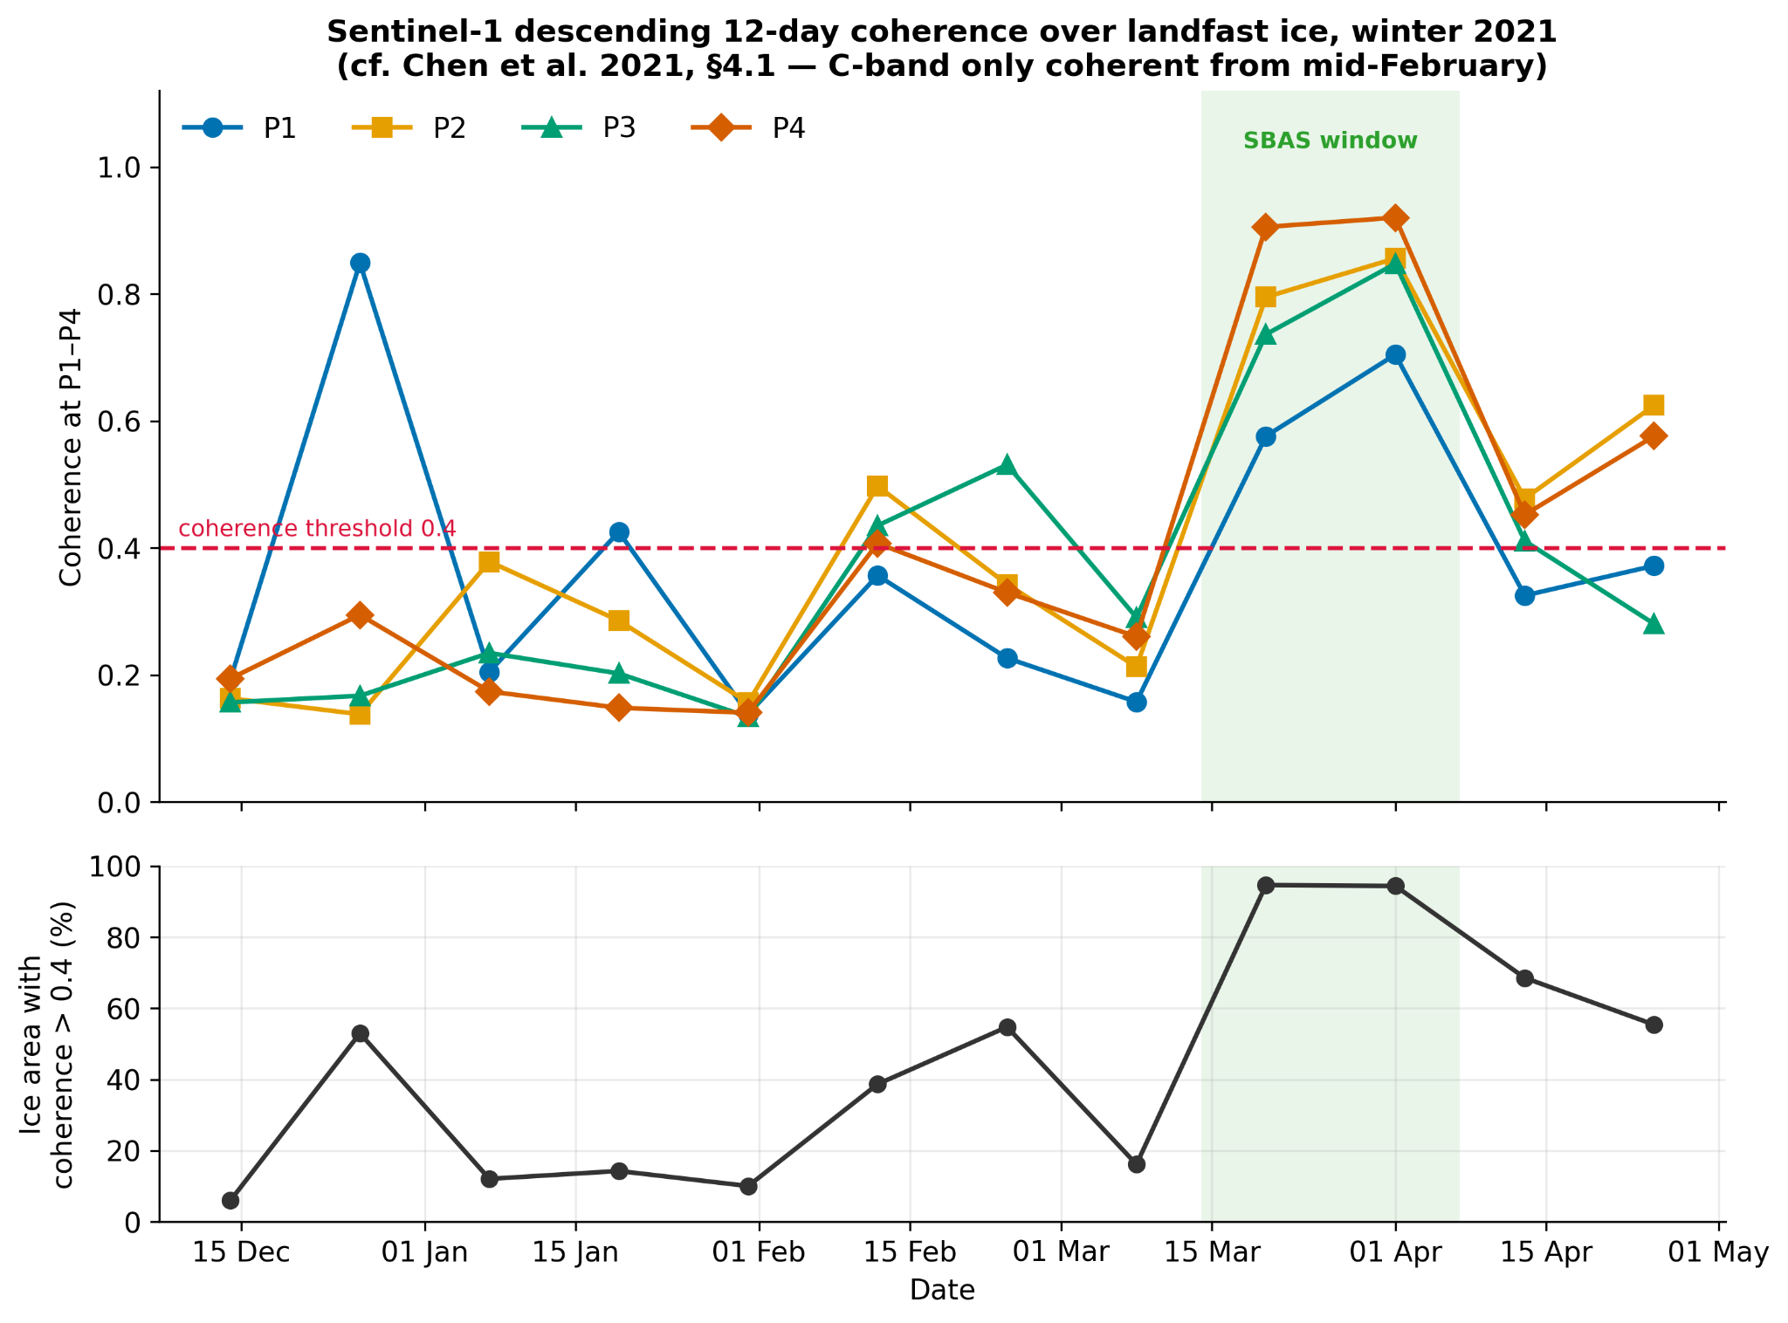
2020–21: a consolidation that failed
55% → 16%
coherent ice area, late February to early March
Repeat interval, 2020–21
 | 12-day | 24-day
Coherence | 0.78–0.81 | 0.54
Usable ice | 94–95% | 74%
C-band coherence over landfast ice holds only within the 12-day repeat.
Top: coherence at P1–P4. Bottom: share of the ice coherent (> 0.4), winter 2020–21
Notes:
The lower panel is the share of the ice that is coherent. It climbs to 55 percent in late February, collapses to 16 percent in early March, a mid-winter break-up and refreeze, and only after 20 March jumps to 95 percent and stays. That collapse is invisible to deformation measurements, which need coherence to exist at all. The same winter shows why we use 12-day pairs: at 24 days coherence drops to 0.54 and only three quarters of the ice is usable.

Slide 10
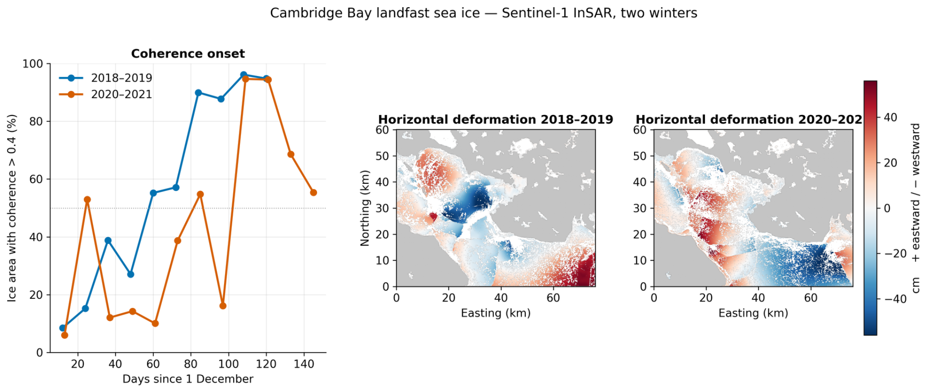
The late winter was more mobile
Left: coherence onset. Right: horizontal deformation in both winters, shared colour scale
2018–19 (24 days)
horizontal −55 to +51 cm, vertical −11 to +21 cm
2020–21 (20 days)
horizontal −60 to +45 cm, vertical −16 to +29 cm
Notes:
Side by side: on the left the onset, on the right the horizontal deformation of both winters on one colour scale. Ranges are similar to Chen et al. once you account for the shorter windows: 24 and 20 days here, 44 in their study. The later winter moved over a shorter window but just as far.

Slide 11
Rates at P4: faster and reversed
×2.7
horizontal rate at P4: −0.43 → −1.18 cm/day
Sign flip
vertical rate at P4: −0.18 → +1.42 cm/day
P4 (8.2 km offshore) is the outermost reliable point. P2 was not measurable in 2018–19; P3 in 2020–21 is anomalous and excluded.
Notes:
Because the windows differ, we compare rates. At P4, our outermost reliable point, the horizontal rate nearly tripled, from minus 0.43 to minus 1.18 centimetres per day, and the vertical motion reversed sign. The intermittent winter was the more mobile one.

Slide 12
Limits of this study
Two winters
Late-biased dates
No phase closure
cannot separate mobility from coincidence
snow metamorphism and early-growth dielectric change also cost coherence over fixed ice
consecutive 12-day networks; the 24-day check failed quality control
Ionosphere
One anomalous point
Sentinel-1 only
polynomial removal over land, not split-spectrum
P3 in 2020–21 excluded from interpretation
ALOS-2 and RADARSAT-2 comparisons not reproduced
What would bound them: longer records, independent ice-draft data, and L-band (ALOS-2) comparison.
Notes:
Some honest limits. Two winters cannot prove that late formation causes higher mobility. Snow and ice-growth changes also reduce coherence, so our dates are late-biased. Our networks are consecutive, so there is no phase-closure check, and we use polynomial ionosphere removal. Longer records and ice-draft data would bound these.

Slide 13
Conclusions
1
Coherence dates consolidation and shows whether it succeeds, capturing a mid-winter break-up and refreeze invisible to deformation.
2
Free processing reproduces Chen et al. to within 2 cm, with 0.7–1.6 cm precision from a land control.
3
The late, intermittent winter was more mobile (×2.7 horizontal rate at P4); two winters cannot yet separate cause from coincidence.
Notes:
Three messages. Coherence is not just a mask: it dates consolidation and reveals when it fails. Free cloud processing reproduces the published result within two centimetres. And the late, intermittent winter was the more mobile one, though two winters cannot yet separate cause from coincidence.

Slide 14
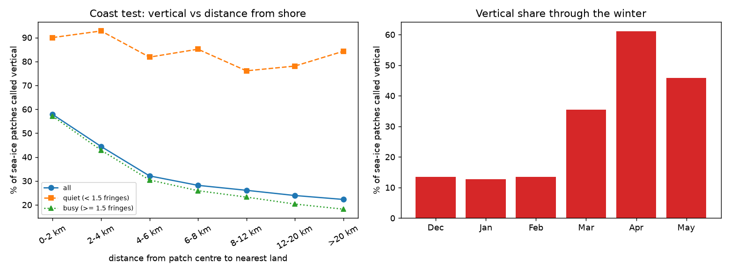
Ongoing: deep learning on sea ice
A CNN classifies each 7.7 km sea-ice patch of every interferogram as horizontal or vertical deformation, trained on human labels.
91%
horizontal vs vertical correct in winters the model never saw (333/367)
58% → 22%
vertical share from the coast to open ice: tidal bending along the shore
35,223 sea-ice patches in 65 interferograms; the model never sees position
Notes:
Where this is going. We are training a convolutional network to classify every sea-ice patch as horizontal or vertical deformation. Tested on winters it never saw, it is right 91 percent of the time. And without being told where the coast is, it finds vertical motion concentrated along the shore, as tidal bending predicts.

Slide 15
Thank you
49 days
later consolidation, after a failed first attempt
≤ 2 cm
agreement with Chen et al. (2021)
Questions and discussion welcome
×2.7
faster horizontal motion in the late winter
Ananthanarayanan B
ananthanarayanan.ds25@duk.ac.in
Corresponding author: shamjid.p@duk.ac.in
Notes:
Thank you. I am happy to take questions.

