Slide 1



A Forward Calorimeter (FoCal) in the ALICE experiment
By
Anantha Padmanabhan M Nair
Under the Guidance of :
Dr. Mriganka Mouli Mondal
Prof. Bedangadas Mohanty

Slide 2
Why Forward Calorimeter?
To measure the direct photon in p-Pb and pp collisions at forward rapidity to explore the small-x structure of the protons and nuclei at high energy.
The measurement of high transverse momentum of neutral pions in Pb-Pb collisions, and their modification relative to pp collisions. to probe the hot and dense strongly interacting medium away from midrapidity.
Source: https://inspirehep.net/files/cebba51760aff5f78e084d27e2b6772f

Slide 3
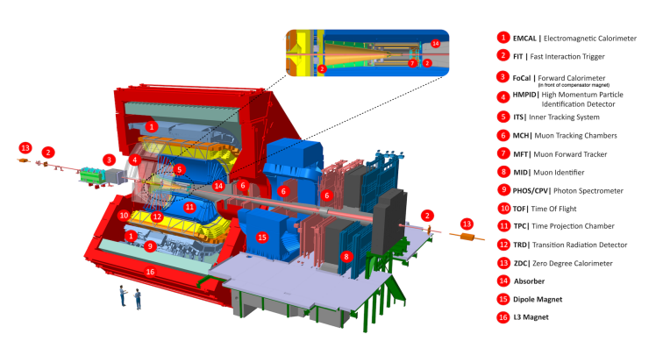
Where its going to be installed?
The Proposed FoCal is going to be installed a distance of 7 meter from the interaction point (compensator magnet) as in fig-1. Large rapidity measurements necessitate placing detectors close to the beam pipe to effectively capture the high particle density resulting from the kinematic boost of particles produced at a distance from the primary interaction vertex.
FOCAL
Figure-1 Position of the FOCAL
Source: https://inspirehep.net/files/cebba51760aff5f78e084d27e2b6772f

Slide 4
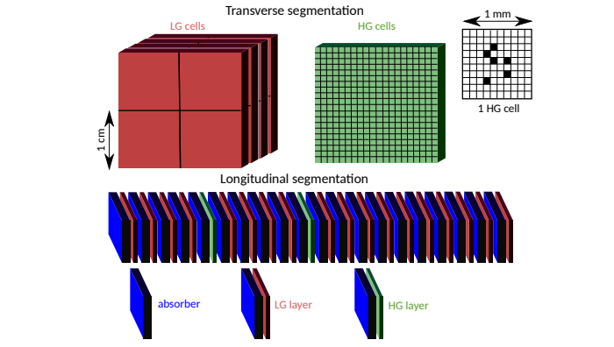
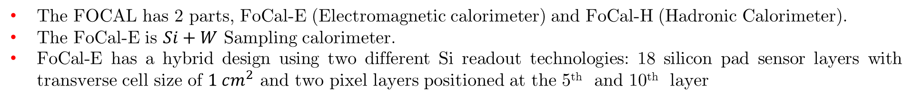
Geometry of FoCal detector
The FOCAL has 2 parts, FoCal-E (Electromagnetic calorimeter) and FoCal-H (Hadronic Calorimeter).
The FoCal-E is $Si+W$ Sampling calorimeter.
FoCal-E has a hybrid design using two different Si readout technologies: 18 silicon pad sensor layers with transverse cell size of $1 cm^{2}$ and two pixel layers positioned at the 5th and 10th layer
Figure-2: Geometry of the FoCal
Image/Info Source: https://inspirehep.net/files/cebba51760aff5f78e084d27e2b6772f

Slide 5
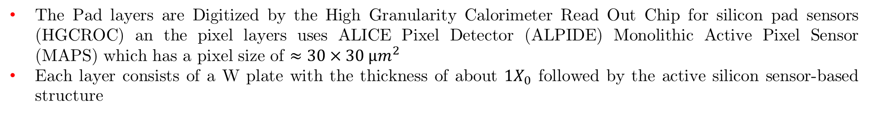
Geometry of FoCal detector
The Pad layers are Digitized by the High Granularity Calorimeter Read Out Chip for silicon pad sensors (HGCROC) an the pixel layers uses ALICE Pixel Detector (ALPIDE) Monolithic Active Pixel Sensor (MAPS) which has a pixel size of $≈30×30 µm^{2}$
Each layer consists of a W plate with the thickness of about $1X_{0}$ followed by the active silicon sensor-based structure
Figure-2: Geometry of the FoCal
Image/Info Source: https://inspirehep.net/files/cebba51760aff5f78e084d27e2b6772f

Slide 6
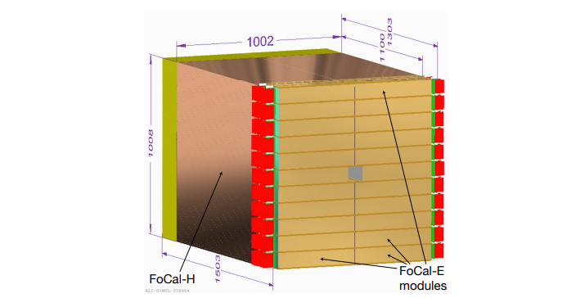
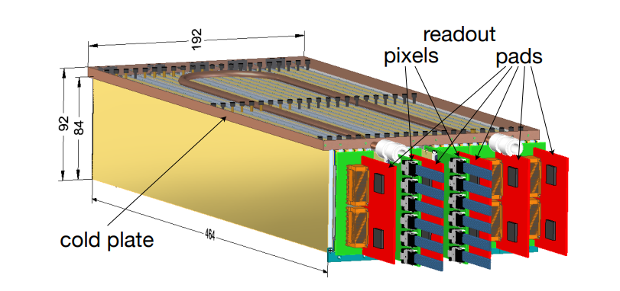
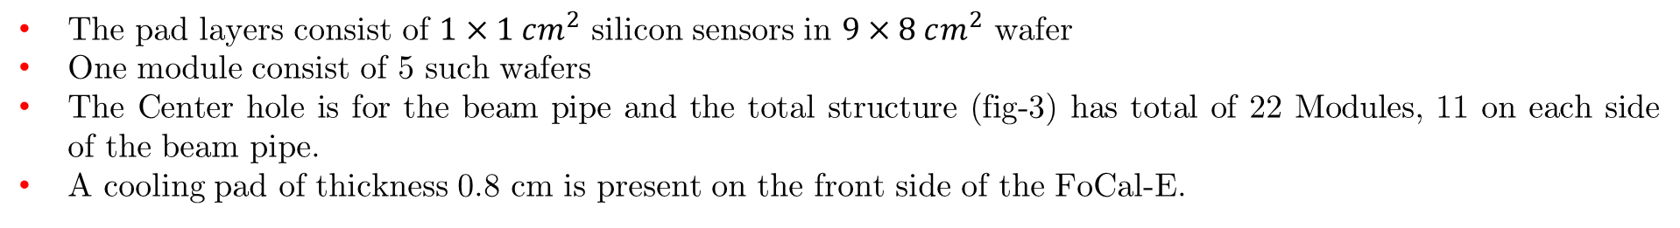
Geometry of FoCal-E detector
The pad layers consist of $1×1 cm^{2}$ silicon sensors in $9×8 cm^{2}$ wafer
One module consist of 5 such wafers
The Center hole is for the beam pipe and the total structure (fig-3) has total of 22 Modules, 11 on each side of the beam pipe.
A cooling pad of thickness 0.8 cm is present on the front side of the FoCal-E.
Figure-3: Layer by layer image
Figure-4: Detailed structure of One Module
Image/Info Source: https://inspirehep.net/files/cebba51760aff5f78e084d27e2b6772f, https://cds.cern.ch/record/2890281/files/ALICE-TDR-022.pdf

Slide 7
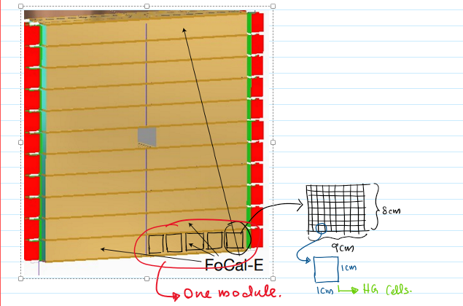
Geometry of FoCal-E Summarized
Image/Info Source: https://inspirehep.net/files/cebba51760aff5f78e084d27e2b6772f, https://cds.cern.ch/record/2890281/files/ALICE-TDR-022.pdf

Slide 8
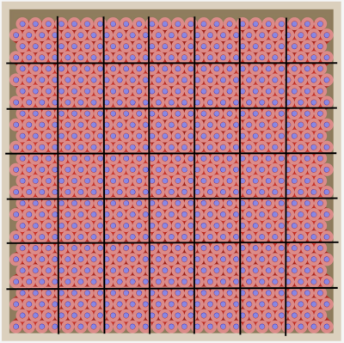
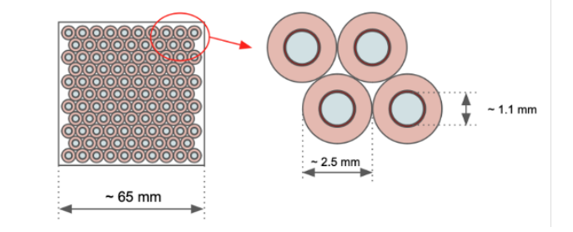

Geometry of FoCal-H
The FoCal-H consist of capillary tubes, Their dimensions are:
$R_{in} = 1.1 mm$
$R_{out} = 2.5 mm$
Length = 110 cm
Padding/wall thickness = 3 mm
Each Square in it represent 1 channel
One Module consist of $7×7$channels
The FoCal-H calorimeter is an array (15x15 - 1) array of 224 Modules.
The -1 from the 225 is for the passage of the beam pipe
Scintillating fiber is Luxium Solutions
Figure-6: Geometry of one FoCal-H Module
Figure-7: Geometry of one FoCal-H Channel
Image/Info Source: https://inspirehep.net/files/cebba51760aff5f78e084d27e2b6772f, https://cds.cern.ch/record/2890281/files/ALICE-TDR-022.pdf

Slide 9
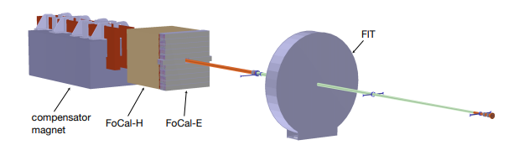
Simulation using GEANT3 and aliroot
Figure-6: Simulation Geometry of the FOCAL detector in GEANT3
Image/Info Source: https://inspirehep.net/files/cebba51760aff5f78e084d27e2b6772f, https://cds.cern.ch/record/2890281/files/ALICE-TDR-022.pdf

Slide 10
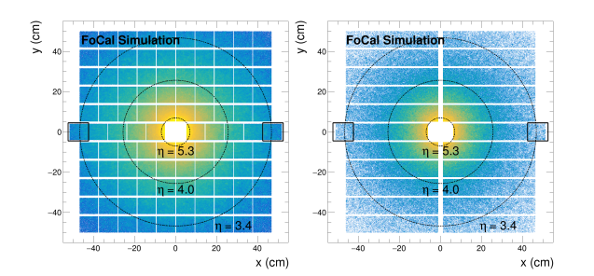
Simulation using GEANT3 and aliroot
Figure-7: Spatial Distribution of hits simulated in Geant4 Simulation of the FoCal (Left: Pad, Right: pixel)
Image/Info Source: https://inspirehep.net/files/cebba51760aff5f78e084d27e2b6772f, https://cds.cern.ch/record/2890281/files/ALICE-TDR-022.pdf

Slide 11
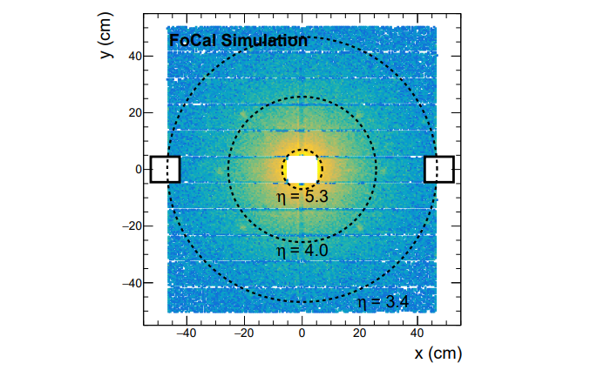
Simulation using GEANT3 and aliroot
Figure 8: Spatial distribution of reconstructed photon clusters in FoCal-E
Image/Info Source: https://inspirehep.net/files/cebba51760aff5f78e084d27e2b6772f, https://cds.cern.ch/record/2890281/files/ALICE-TDR-022.pdf

Slide 12
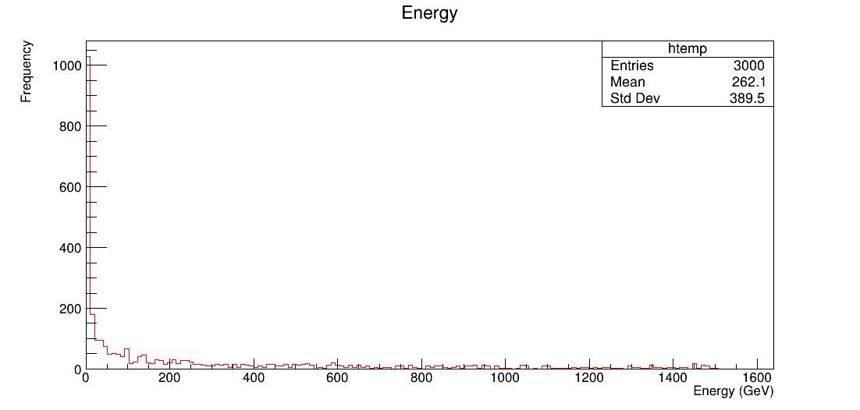
Results of the Simulation: Energy Distribution
Image/Info Source: https://inspirehep.net/files/cebba51760aff5f78e084d27e2b6772f, https://cds.cern.ch/record/2890281/files/ALICE-TDR-022.pdf

Slide 13
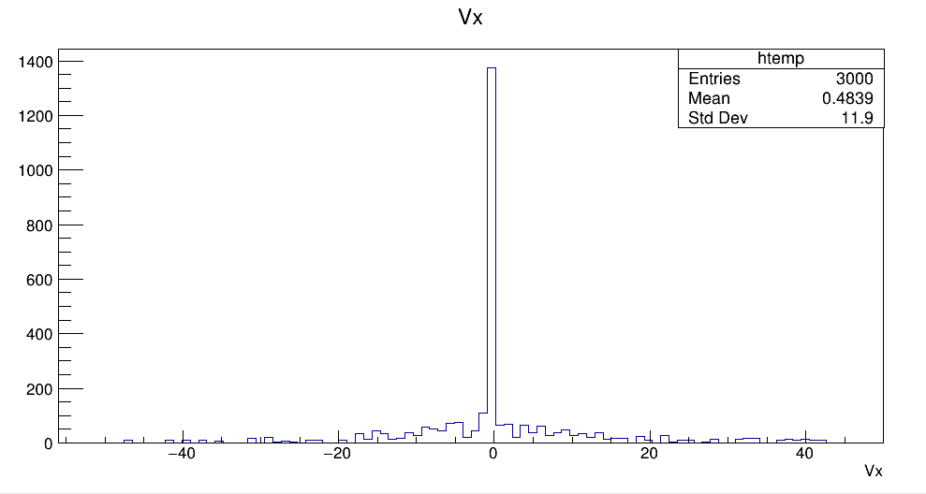
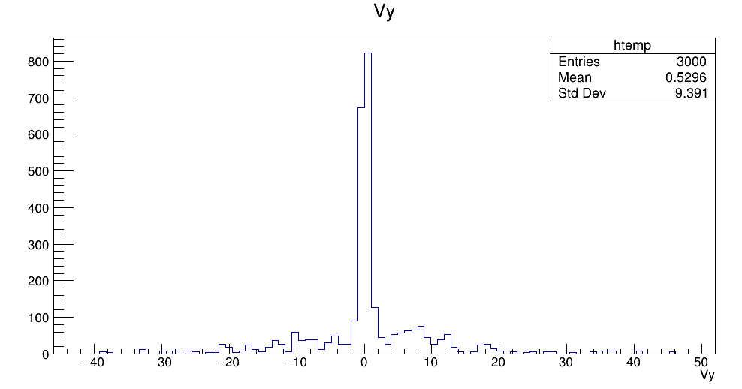
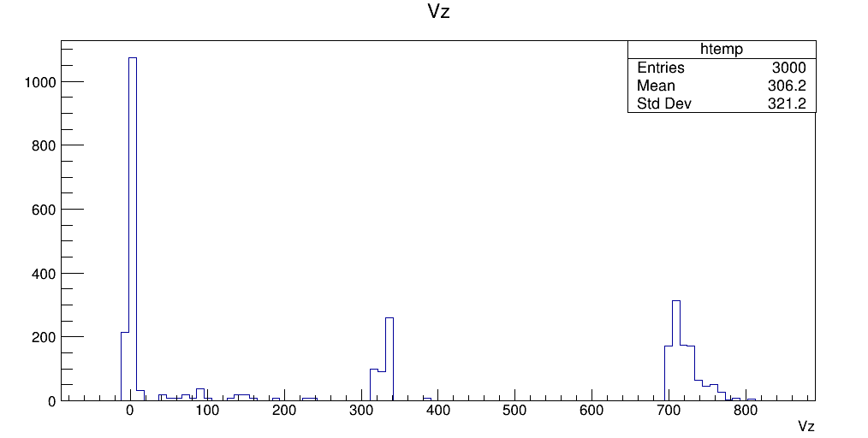
Results of the Simulation: Hits

