Slide 1
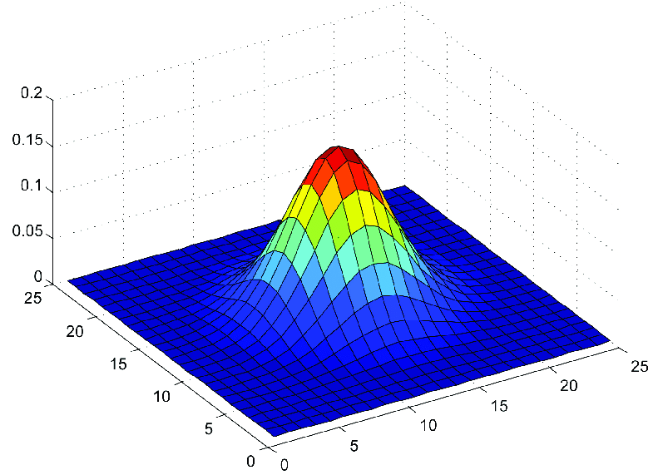
Numerical QM of QHO with soft coulomb and other effective Multi-Particle interaction
By
Anantha Padmanabhan M Nair
Under the Guidance of :
Dr. Prasanjit Samal
Course Instructor:
Dr. Subhasish Basak

Slide 2
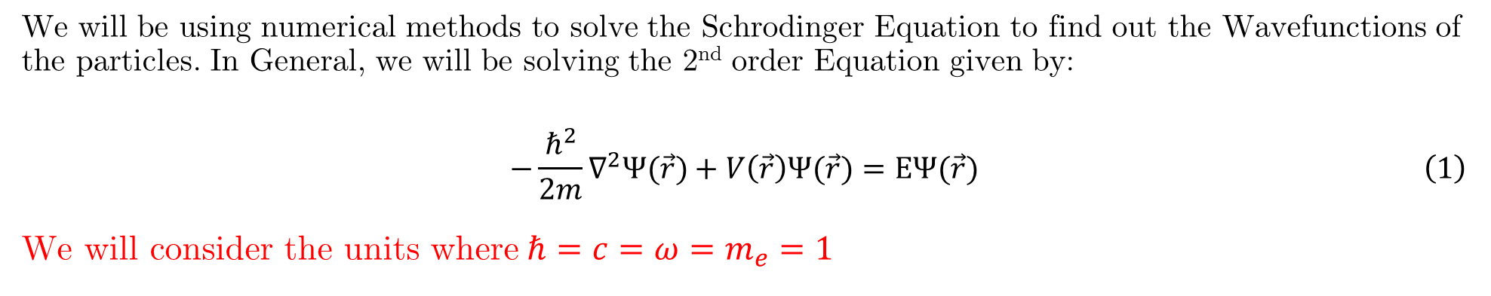
What's this about?
We will be solving:
Quantum Harmonic Oscillator (QHO)
QHO in Half Harmonic Potential
QHO + Soft Coulomb Potential
One Dimensional DFT Problem (Basically QHO with Hartree and Exchange Energy)
Two Dimensional Quantum Harmonic Oscillator
How?
We will be using numerical methods to solve the Schrodinger Equation to find out the Wavefunctions of the particles. In General, we will be solving the 2nd order Equation given by:
$$\begin{aligned}−\frac{ℏ^{2}}{2m}∇^{2}Ψ(\vec{r})+V\left(\vec{r}\right)Ψ(\vec{r})=EΨ(\vec{r})\#\left(1\right)\end{aligned}$$
We will consider the units where$ℏ=c=ω=m_{e}=1$

Slide 3

Numerical Methods Used:
For this project I have used the following algorithms:
Solving Eigenvalue equation using NumPy and Finite Difference Method
4th Order Runge-Kutta Method
Kohn-Sham Algorithm
How it’s Implemented?
All the numerical works are done in python-3.11.6. Also the open source libraries of python like NumPy, SciPy, Matplotlib, scienceplots etc. is used in most of the plots.

Slide 4
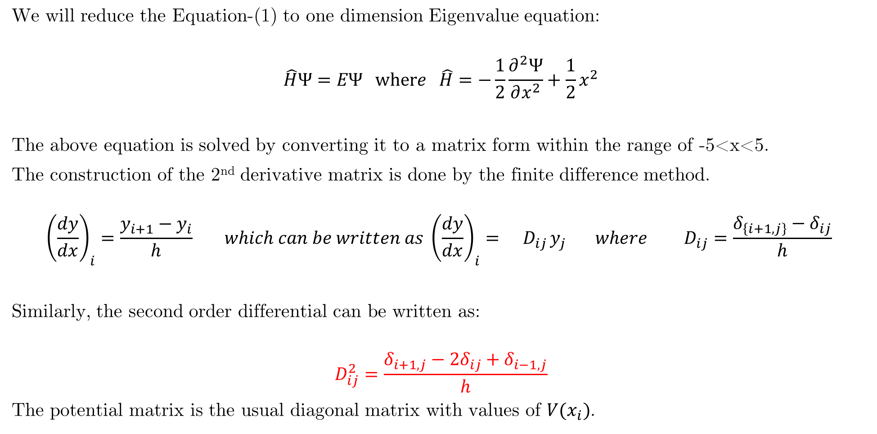
Solving the One Dimensional QHO
We will reduce the Equation-(1) to one dimension Eigenvalue equation:
$$\hat{H}Ψ=EΨ where \hat{H}=−\frac{1}{2}\frac{∂^{2}Ψ}{∂x^{2}}+\frac{1}{2}x^{2}$$
The above equation is solved by converting it to a matrix form within the range of -5<x<5.
The construction of the 2nd derivative matrix is done by the finite difference method.
$${\left(\frac{dy}{dx}\right)}_{i}=\frac{y_{i+1}−y_{i}}{h} which can be written as {\left(\frac{dy}{dx}\right)}_{i}={ D}_{ij}y_{j} where { D}_{ij}=\frac{δ_{\left\{i+1,j\right\}}−δ_{ij}}{h}$$
Similarly, the second order differential can be written as:
$$D_{ij}^{2}=\frac{δ_{i+1,j}−2δ_{ij}+δ_{i−1,j}}{h}$$
The potential matrix is the usual diagonal matrix with values of $V(x_{i})$.

Slide 5
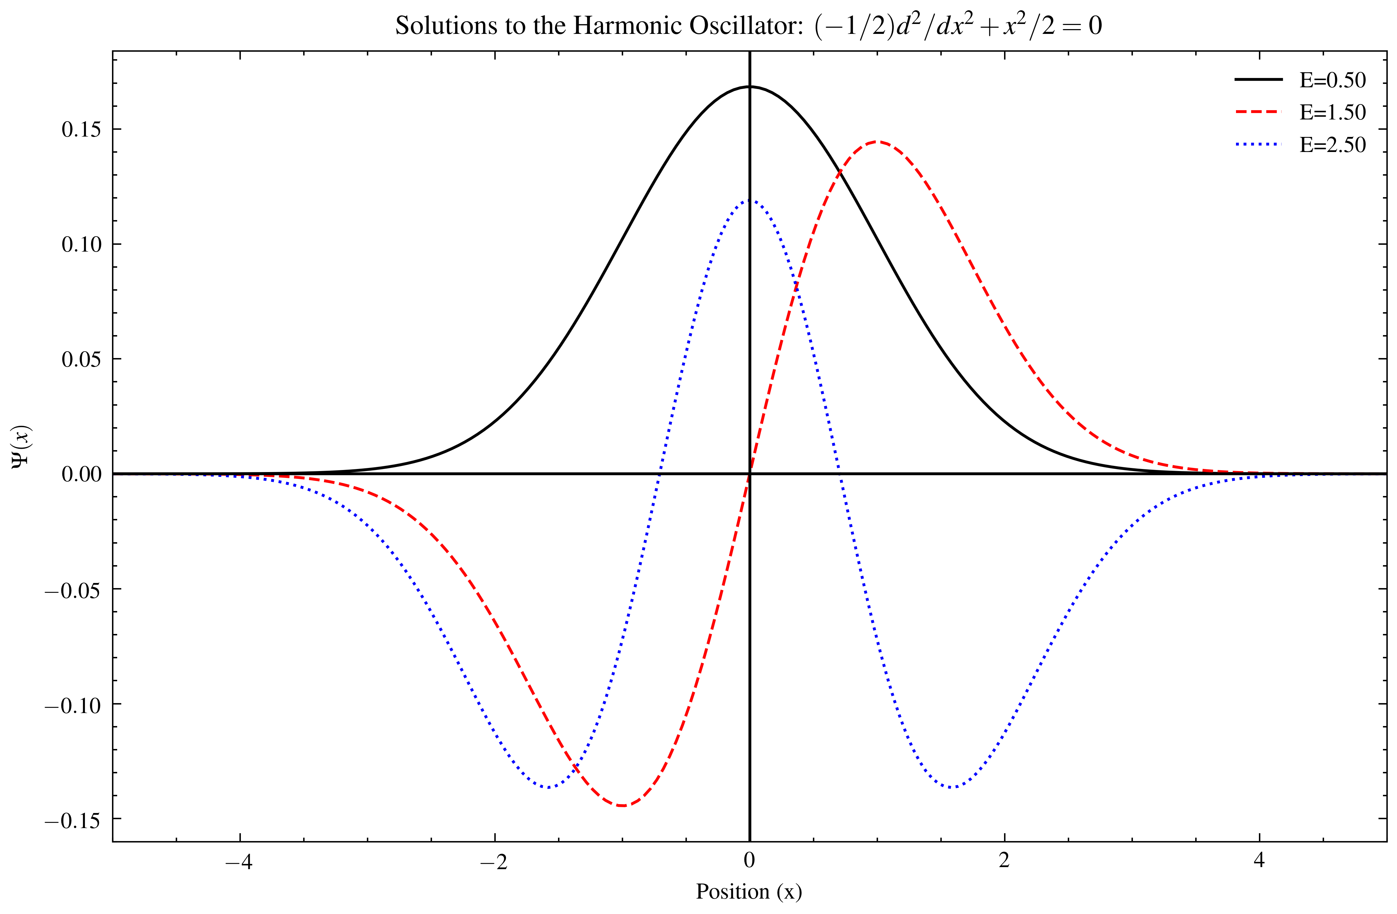

Slide 6
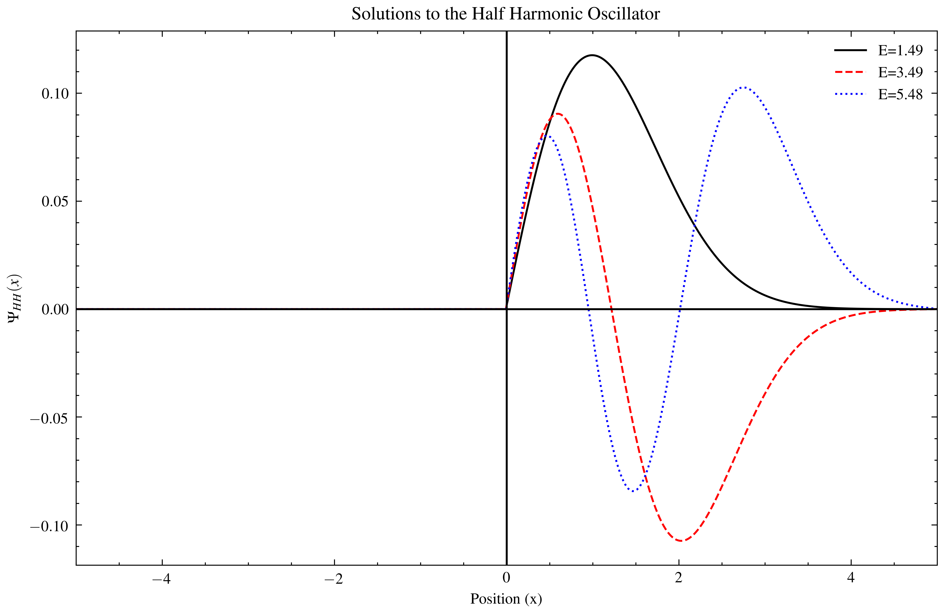
QHO with Half Harmonic Potential
Here the only change is with the potential matrix. Here the first half of the diagonal matrix will be 0.
The 2nd derivative matrix and all other stuff are same. The Obtained Solutions are shown below:

Slide 7
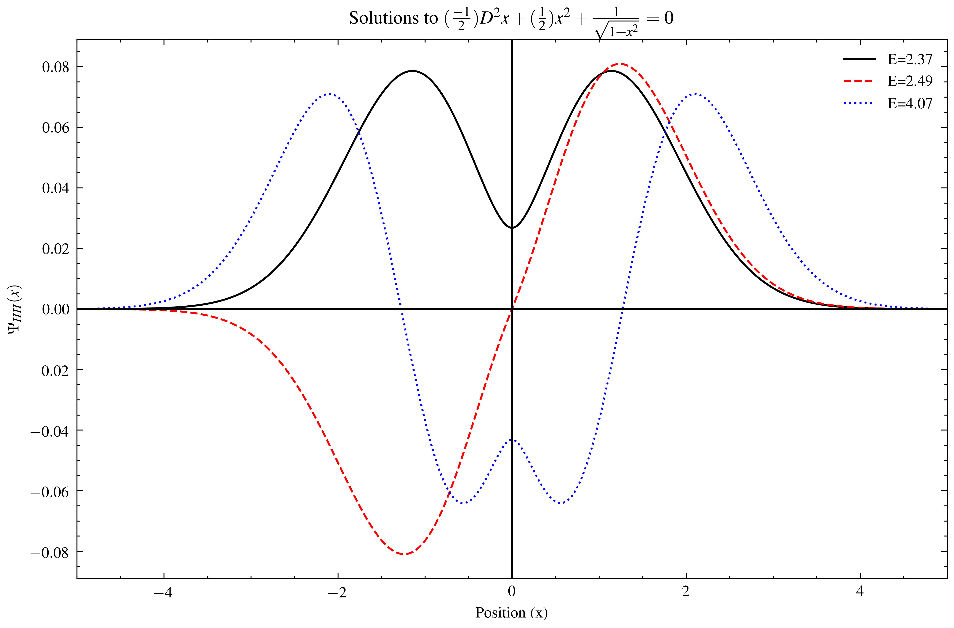

QHO with Soft Coulomb Potential
The diagonal elements of the potential matrix is calculated using the potential of the form:
$$V\left(x\right)=\frac{1}{\sqrt{1+x^{2}}}$$

Slide 8

One Dimensional DFT Code
Here the matrix representation will be same as above. The Hamiltonian that we will be using is given by:
$$\hat{H}=H_{QHO}+V_{X}^{LDA}\left(x\right)+V_{Ha}(x)$$
Where $V_{X}^{LDA}$ is the Exchange energy and $V_{Ha}$ is the Hartree potential. In order to find these potentials, we need to find the electron density n(x). The Density is given by:
$$n\left(x\right)=\sum_{n}{f_{n}{\left|Ψ_{n}\left(x\right)\right|}^{2}}$$
Where the $Ψ_{n}$ are the normalised eigenfunctions of the Hamiltonian. The Exchange Potential $V^{LDA}$ is:
$$V_{X}^{LDA}\left(x\right)=−{\left(\frac{3}{π }\right)}^{\frac{1}{3}}n{\left(x\right)}^{\frac{1}{3}}$$
And the Hartree/Coulomb Potential is given by:
$$V_{ha}\left(x\right)=\int{\frac{n\left(x^{′}\right)}{\sqrt{1+{\left(x−x^{′}\right)}^{2}}}dx^{′}}$$

Slide 9

One Dimensional DFT Code
The Self Consistency Loop in the KS-Method
The following steps in loops are used to find the KS Wavefunctions. The following are calculated in each loop:
Exchange Energy and Potential (We can start from 0)
Coulomb energy and potential from the density
Hamiltonian from kinetic operator and potentials
Wavefunctions and their energies from the Hamiltonian
Density from the normalized wavefunctions and occupations
These are done till the values of the energy falls within the tolerance. (In this I have set the tolerance to ${10}^{−6}$). The Obtained Solution of the QHO with the potentials and electron density are shown in the figure in next slide.

Slide 10
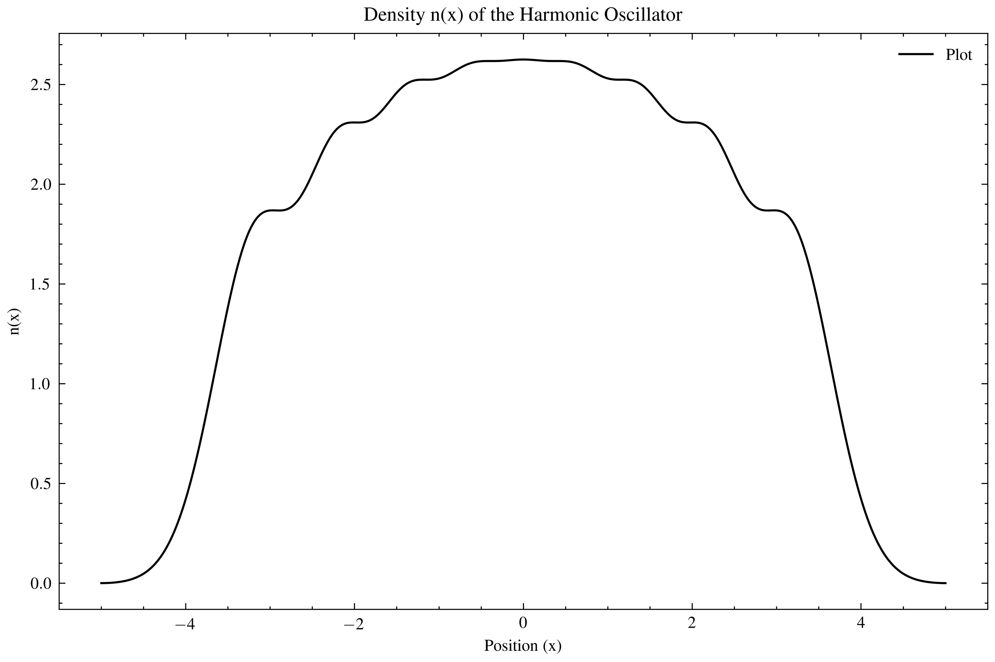

Slide 11
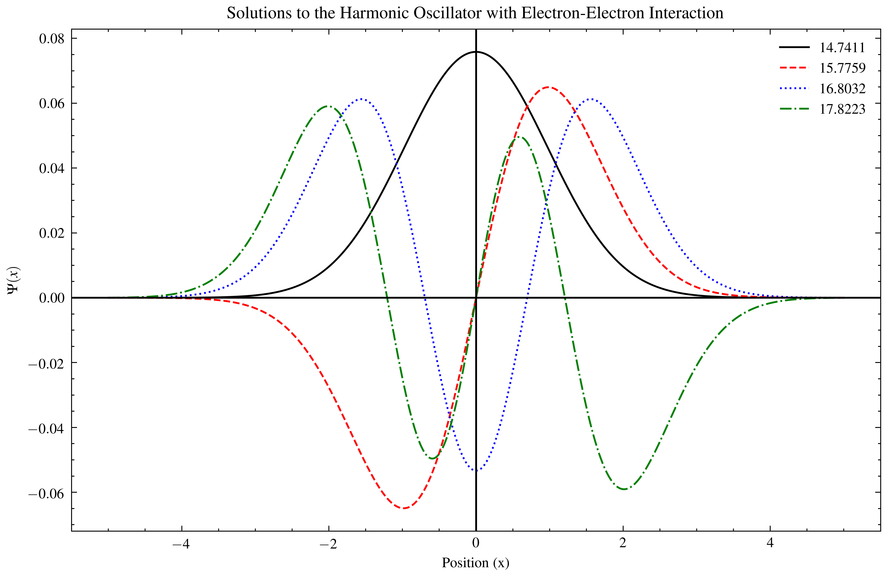

Slide 12

Two Dimensional QHO
Here we solve the Schrodinger equation in 2 Dimension which is given by:
$$−\frac{1}{2}\frac{d^{2}Ψ}{dx^{2}}−\frac{1}{2}\frac{d^{2}Ψ}{{dy}^{2}}+\frac{1}{2}x^{2}+\frac{1}{2}y^{2}={(E}_{x}+E_{y})Ψ where Ψ=Ψ(x,y)$$
By a little rearrangement and using the separation of variable, and using $Ψ\left(x,y\right)=X\left(x\right)Y\left(y\right)$we get:
$$\frac{1}{X}\frac{d^{2}X}{dx^{2}}+\left(x^{2}+2E_{x}\right)=k$$
$$\frac{1}{Y}\frac{d^{2}Y}{dy^{2}}+\left(y^{2}+2E_{y}\right)=−k$$
These equations again we will split into 1st order coupled equations so that we can use the RK4 Method. Since the harmonic oscillator has converging solution for only some allowed values of $E_{i}$, and the only condition is that the wavefunction vanishes at infinity, we have to initialize this by providing $Ψ=1$ at some point. The step size of position used is 0.001. The obtained heatmaps of wavefunctions are shown Below.

Slide 13
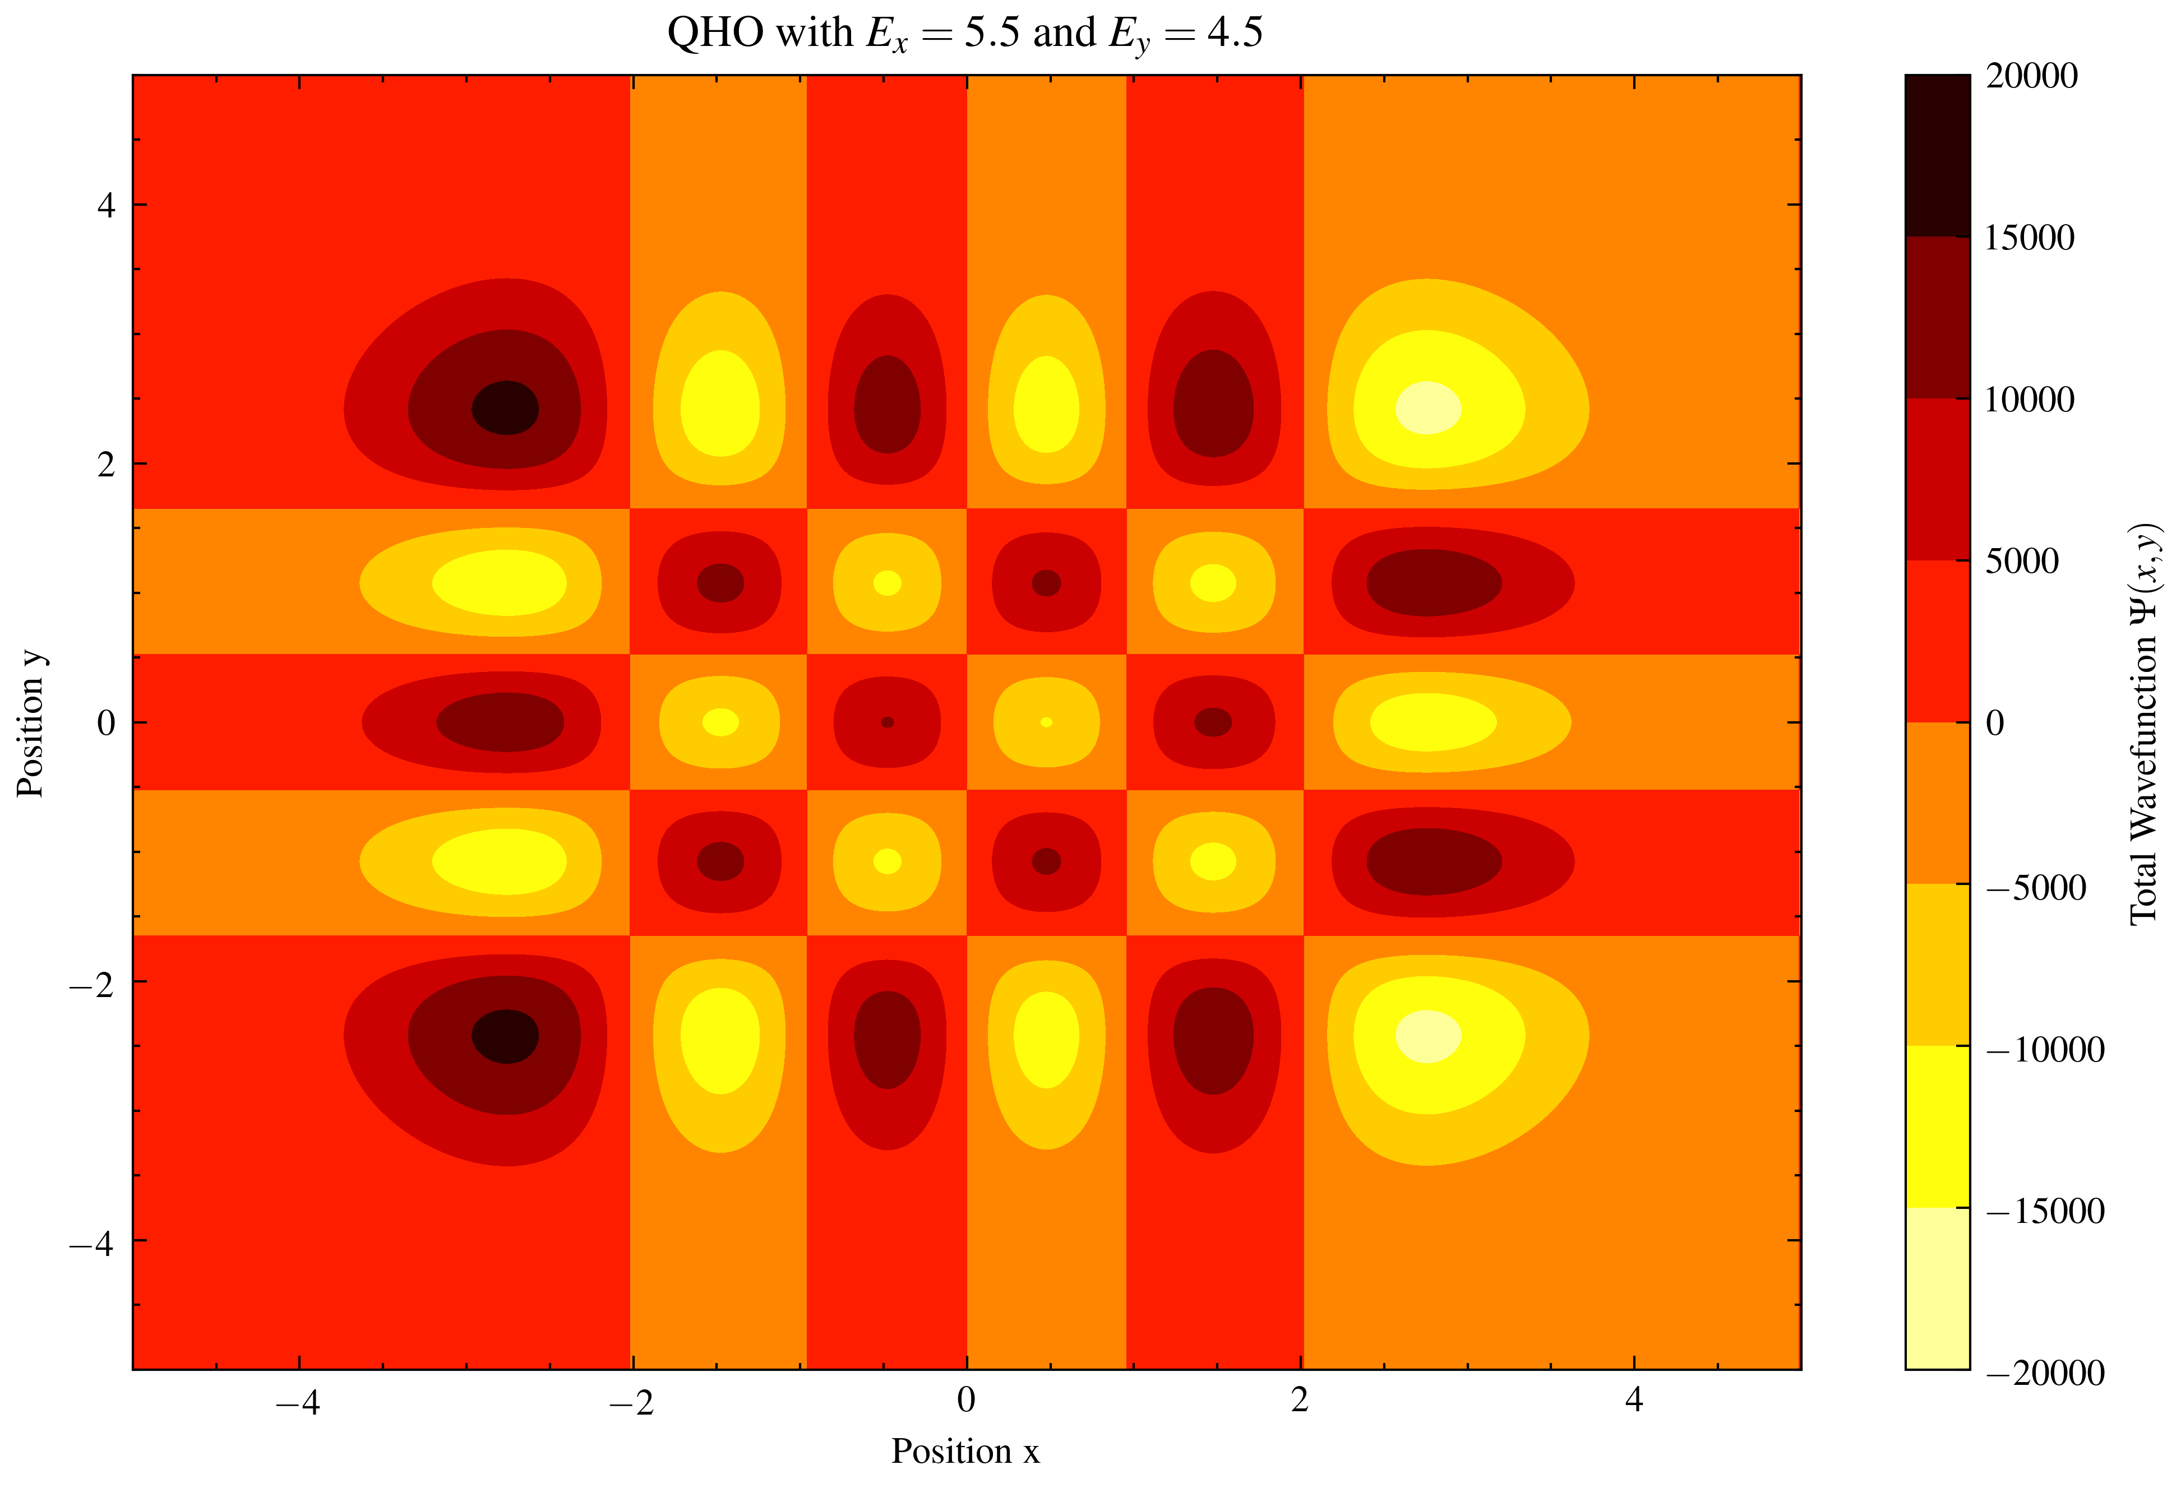

Slide 14


Thank You!

