Slide 1
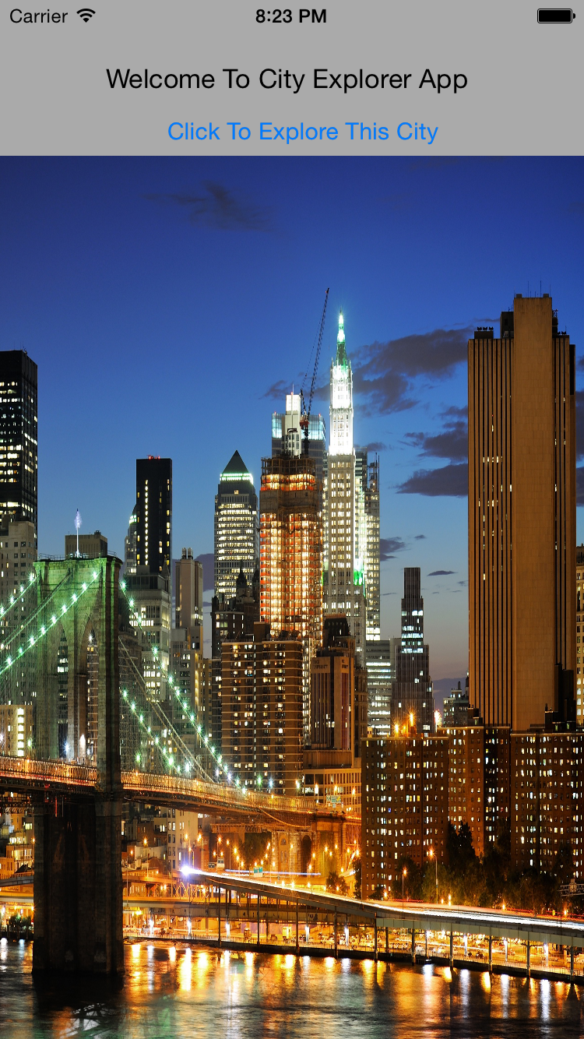
City Explorer

Slide 2
Introduction
What is this app?
A app that helps to explore places in a city
Who uses it?
Tourists
The app is designed by keeping in mind about the places the tourist’s might search for convenience and entertainment

Slide 3
Features
Search near by places from your current location
Customized category buttons to make search easy
Detail View of each places searched with useful information

Slide 4
Features contd..
Route to the selected place from your location with distance value
Different views in the map
Customized recommendations for registered users
Extra information about the selected place in the detailed view
Endorsement platforms to display ads

Slide 5
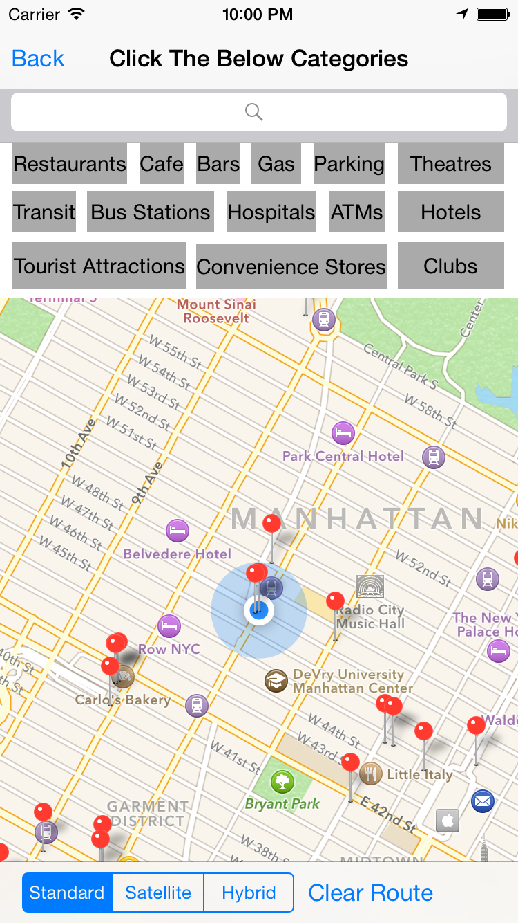

Slide 6
Categories
Below are the topics that could be search on button click
Bars
Restaurants
Café
Bus Stations
Transit
Hotels
Clubs
Tourist Attraction
Theatres
Parking
Gas Station..

Slide 7
Technologies & Resources
google places API
JSON parsing
Sqlite3
Objective C 2.0
Xcode 6.3.1
iAd

Slide 8
DB
Tables:
Profile - user account storage
Recommendations – Customized places info

Slide 9
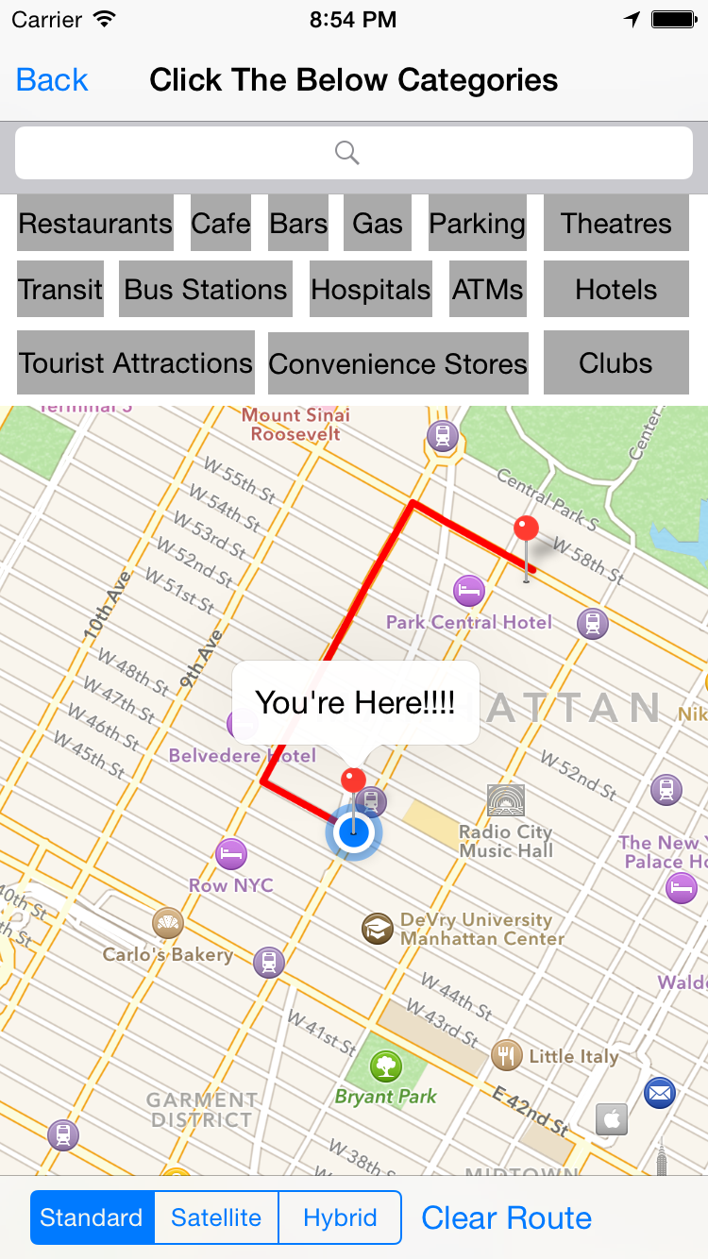
Thanks

