Slide 1
Employee Data Analysis using Excel
STUDENT NAME : ANANTHAVARSHINI T
REGISTER NO : 322200068
DEPARTMENT : B.COM(HONOURS)
COLLEGE : SHRI SHANKARLAL SUNDARBAI SHASUN JAIN COLLEGE FOR WOMEN

Slide 2

PROJECT TITLE
Employee Performance Analysis using Excel

Slide 3


AGENDA
Problem Statement
Project Overview
End Users
Our Solution and Proposition
Dataset Description
Modelling Approach
Results and Discussion
Conclusion
3/21/2024 Annual Review

Slide 4

PROBLEM STATEMENT
In a organizational environment, measuring and improving employee performance is crucial to achieving business objectives. However, many companies struggle with:
Tracking
Aggregating performance data
Identifying high and low performers
Visualizing trends
The lack of a structured approach to employee performance analysis can lead to poor decision-making, employee disengagement, and missed growth opportunities. An effective performance analysis system is needed to track individual and team productivity, highlight performance gaps, and inform management decisions for development and rewards.

Slide 5

PROJECT OVERVIEW
The system will streamline the collection, analysis, and visualization of performance data. It will involve:
Data Collection: - Gathering information on key performance indicators (KPIs), including tasks completed, attendance records, sales revenue, efficiency, and manager ratings.
Data Entry and Formulas: - Organizing the data in Excel tables. - Applying relevant formulas to calculate performance scores, efficiency, and other metrics.
Conditional Formatting: - Using conditional formatting to highlight performance outliers (e.g., under-performers and top-performers).
Data Analysis Tools: - Utilizing Excel’s built-in tools like PivotTables, charts, and trend lines to summarize and visualize employee performance across departments, months, or teams.
Performance Dashboards: - Building a comprehensive performance dashboard that provides real-time insights into employee performance at individual, team, and department levels

Slide 6

WHO ARE THE END USERS?
The end users of an employee performance analysis system using Excel will typically include:
Human Resource (HR) Managers: - Responsible for tracking employee performance, identifying training needs, and managing employee development plans.
Team Leaders/Department Managers: - Monitor the performance of their teams and individual employees to ensure targets are met. Use the analysis to identify top performers for rewards or promotion and address underperformance.
Executives and Senior Management: - Use the performance data to make strategic decisions about workforce management, resource allocation, and setting organizational goals. Review departmental and company-wide performance trends.
Business Analysts: - May use the performance data to create detailed reports and dashboards that inform company strategy and improve operational efficiency.

Slide 7

OUR SOLUTION AND ITS VALUE PROPOSITION
It enables the organization to systematically track, assess and visualize employee performance based on key matters:
Automated data collection and calculation:
It helps the organization to avoid problems using the automated data collection and calculation.
Alerts:
It helps to identify the underperformance and recognition of top performers using the conditional formatting.
Detailed reporting:
It helps the HR and Management to take effective decision making and avoid the confusions.
Customizable dashboards:
It helps the management and also HR for visualizing performance trends and makes the comparisons.

Slide 8
Dataset Description
The dataset used in this employee performance analysis contains various performance related attributes, which includes,
Employee ID
First name
Last name
Business unit
Employee status
Employee type
Employee classification type
Performance score
Current employee rating

Slide 9

THE "WOW" IN OUR SOLUTION
Performance level=IF(AND(Z8>=5),"VERY HIGH",IF(AND(Z8>=4),"HIGH",IF(AND(Z8>=3),"MED","LOW")))
3/21/2024 Annual Review
9

Slide 10
MODELLING
I get the data from the dashboard and some of the steps are as follows,
Conditional formatting: In the 1st step, using the conditional formatting the blanks rows are removed and also helps to put filter the data.
Performance level: Then, secondly the performance level will be calculated. Using the if , and conditions the level of performance of an employee was calculated.
Pivot table: Then pivot table was used to calculate the performance level of a particular employee. In that the performance level was calculated on the basis of “very high”, ”high”, “med”, “low” ect.,
Pivot chart: Pivot chart is used to give the overall performance level in the representative manner. It helps to identify the performance easily and helps to take appropriate decision making.
Recommended chart: The recommended charts are inbuilt functions which suggest the chart to the users. It helps in reducing the time and also give the appropriate results.
Slicer tool: This slicer tool helps to slice the particular data or particular employee and shows the full detailed description about the performance and so on.
Chart uses: Here I have used the 4 charts, namely, column chart, pie chart, scalar chart and bar chart
10

Slide 11
RESULTS
11

Slide 12
conclusion
This system offers a practical, efficient and flexible solution for organization to optimize employee performance management. By making performance data more accessible and actionable, it supports continuous improvement in workforce productivity and helps build a motivated, goal oriented team.
Implementing an Excel-based employee performance analysis system is a smart and practical approach for organizations looking to improve their workforce management. It simplifies the tracking of key performance metrics and provides real-time insights, helping managers make data-driven decisions. The system's flexibility, cost-effectiveness, and scalability make it accessible for businesses of all sizes

Slide 13
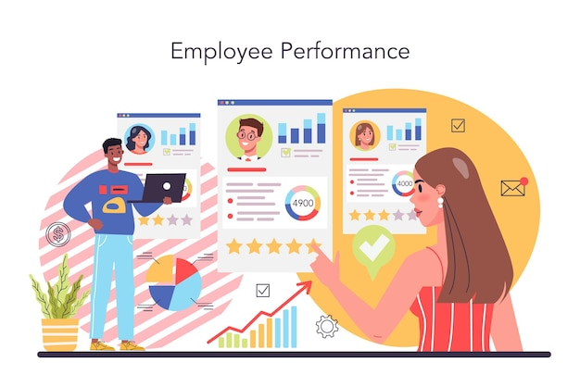
Additionally, by promoting transparency in performance measurement, it fosters a culture of accountability and motivation among employees. Ultimately, the tool not only helps identify high performers and areas for improvement but also serves as a catalyst for continuous growth and development, aligning employee efforts with organizational goals.

