Slide 1

RDBMS Basics – Session 4
Think n Solutions
Enabling Solutions for Success
By Database Team

Slide 2
Agenda – Session 4
Index
Unique
Clustered
Non-Clustered
Sub-Query
Nested Stored Procedures/Functions
Transaction Isolation Level
Timeout
Block
DeadLock
Locking

Slide 3
INDEX
Why we need Index? Let us take a situation, to understand that little more deeply
In a Library, within our own city, we have a collection over 1 Crore books. Now, we want to search for Harry Potter book, we would need to search every rack if there was no arrangement. This could potentially take a long time, to get one book. May be few hours
Instead, imagine that the books gets arranged as an Alphabetic Order. Now, our search of that specific book could become quicker than the earlier Search efforts
Next scenario would be, when the indexing sheets are created for each rack. Like which rack contains, what kind of books and so on. After this indexing step, we would not need to check each rack. Per Indexed sheet, we could directly reach the correct rack and to get the book. Now, isn’t it faster than the previous 2 cases, on this search
Similar way SQL, we would need to create or arrive at few intelligent indexes for improved search

Slide 4
INDEX
Indexes are used to retrieve data from the database & tables at the best performance of time. Mainly just used to speed up searches/queries.
Note: Updating a table with indexes takes more time than updating a table without (because the indexes also gets updated/refreshed). As a ideal recommendations, we create indexes on columns that would be frequently searched for. Too many indexes on a table, could be detrimental to the performances on usage of that table, in our applications or processes.
Postgres Create index is also has same syntax as SQL Server.
CREATE INDEX Syntax:
CREATE INDEX index_name ON table_name (column1, column2, ...);

Slide 5
INDEX
Example:
The SQL statement below creates an index named "idx_bookname" on the “Name" column on the “Books" table:
CREATE INDEX idx_bookname ON Books (Name ASC);
If there is a situation, that states to create an index on a combination of columns, it would be to list the needed column names within the parentheses, separated by commas: (Tip: Search needs to be on the same order to maximize the performances)
CREATE INDEX idx_bookname_type ON Books (Name ASC, BookType ASC);

Slide 6
INDEX
DROP INDEX:
The DROP INDEX statement is used to delete/drop an index in a table
SQL Server:
DROP INDEX table_name.index_name;
MySQL:
ALTER TABLE table_name DROP INDEX index_name;

Slide 7
INDEX
Types:
Unique Index: This Indexing does not allow the field to have duplicate values, setup as Unique index. This would be applied automatically when primary key is defined for the table
Syntax:
CREATE UNIQUE INDEX <index_name> ON <table_name>(<column_name>)
Clustered Index: A clustered index defines the order in which data is physically stored in a table. At all times, the Table data can be sorted in one specific way only, therefore only one clustered index per table is possible. In MS SQL, the primary key constraint automatically gets creates as a clustered index
Syntax:
CREATE CLUSTERED INDEX <index_name> ON <table_name>(<column_name> ASC/DESC)

Slide 8
INDEX
Non-Clustered Index: A non-clustered index is an index that doesn’t physically sort the database records. Rather, a non-clustered index is stored at a separate location within the actual database other than the table. It is the non-clustered index which is actually similar to an index of a book. A book index is stored at a separate location, while the actual content of the book is separately located. Numerous Non-Clustered Indexes can be created for a Table. However, the recommendations are to have as less number of Indexes. Too many indexes, could potentially slow down the performances of the query using this table, within the project(s) / application(s)
Syntax:
CREATE NONCLUSTERED INDEX <index_name> ON <table_name>(<column_name> ASC/DESC)
Note: Postgres Doesn’t have explicit syntax for clustered and Non-Clustered Index its only for sql server.

Slide 9
When should Indexes be Avoided?
Although indexes are intended to enhance a database's performance, there are times when they should be avoided. The following guidelines indicate when the use of an index should be reconsidered −
Indexes should not be used on small tables.
Tables that have frequent, large batch update or insert operations.
Indexes should not be used on columns that contain a high number of NULL values.
Columns that are frequently manipulated should not be indexed.

Slide 10
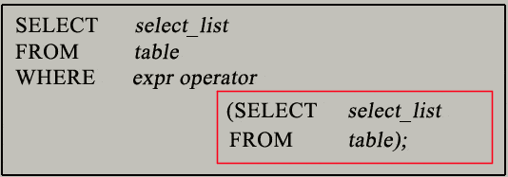
SUB QUERY
Sub Query: A subquery is a SQL query nested inside a larger query
Few pointers:
It can be nested inside a SELECT, INSERT, UPDATE, or DELETE statement or inside another subquery
It is usually added within the WHERE Clause of another SQL SELECT statement
A subquery is also called an inner query or inner select, while the statement containing a subquery is also called an outer query or outer select
The inner query executes first before its parent query so that the results of an inner query can be passed to the outer query
Syntax:

Slide 11
SUB QUERY
Types of Sub Queries:
Single-row Subquery:
The subquery returns only one or Zero row.
The operators that can be used with single-row subqueries are =, >, >=, <, <=, and <>.
Group functions can be used in the subquery
Example:
The following statement retrieve the details of the employee(s) holding the highest salary
SELECT * FROM employee
WHERE sal = (SELECT MAX(sal) FROM employee);

Slide 12
SUB QUERY
Multiple-row Subquery:
The subquery returns multiple rows.
The operators that can be used with multiple-row subqueries are IN, NOT IN, ANY.
Example:
The following statement retrieves employees whose salary is the same as the minimum salary of the employees in some department.
SELECT NAME, sal FROM employee
WHERE sal IN (SELECT MIN(sal) FROM employee GROUP BY dept_no);

Slide 13
SUB QUERY
Multiple column subquery:
The subquery returns multiple columns.
The operators that can be used with multiple-column subqueries are IN, NOT IN.
Example:
The following statement lists all items whose quantity and product id match to an item of order id 200.
SELECT order_id, product_id, quantity
FROM item
WHERE (product_id, quantity) IN (
SELECT product_id, quantity FROM item WHERE order_it = 200)

Slide 14
SUB QUERY
Co-related Subquery:
A correlated subquery is a subquery that uses the values of the outer query. In other words, it depends on the outer query for its values. Because of this dependency, a correlated subquery cannot be executed independently as a simple subquery. Moreover, a correlated subquery is executed repeatedly, once for each row evaluated by the outer query. The correlated subquery is also known as a repeating subquery.
Example :The following query returns the products whose list price is equal to the highest list price of the products within the same category
SELECT product_name, list_price, category_id
FROM products p1
WHERE list_price IN ( SELECT MAX (p2.list_price) FROM products p2
WHERE p2.category_id = p1.category_id GROUP BY p2.category_id);

Slide 15
NESTED STORED PROCEDURES
Why? Nesting within the stored procedures allows you to break up large amounts of SQL code into smaller, more manageable pieces. By dividing one stored procedure into various logical parts, there would be a reduction of the time to find, modify & maintain the code. Additional, the logically smaller stored procedures, can be made re-usable by other processes
Nested Stored Procedures: Stored procedures can call other relevant stored procedures, and any of those procedures can call other procedures up to a maximum nesting level of 32 levels deep.
If you exceed the 32-level limit, an error message will be raised, the batch will be aborted, and any open transaction in the session will be rolled back.
We can view the nest level in a stored procedure by using the following command:
SELECT @@NESTLEVEL

Slide 16
NESTED STORED PROCEDURES
Example:
CREATE PROCEDURE spAuthors (@Last varchar(20) = '', @First varchar(20) = '') AS
BEGIN
IF @Last <> '' AND @First = ''
BEGIN
EXEC spAuthorsLast @Last = @Last
RETURN
END
IF @First <> '' AND @Last = ''
BEGIN
EXEC spAuthorsFirst @First = @First
RETURN
END
END

Slide 17
NESTED STORED PROCEDURES
CREATE PROCEDURE spAuthorsLast (@Last varchar(20))
AS
BEGIN
SELECT * FROM authors WHERE au_lname LIKE @Last + '%’
END
CREATE PROCEDURE spAuthorsFirst (@First varchar(20))
AS
BEGIN
SELECT * FROM authors WHERE au_fname LIKE @First + ‘%’
END
EXEC spAuthors @Last = @Last, @First = @First

Slide 18
NESTED FUNCTIONS
A Nested function is a function which is defined within another function. The nesting level is incremented when the called function starts execution, and decremented when the called function finishes execution.
User-defined functions can be nested up to 32 levels. Exceeding the maximum levels of nesting causes the whole calling function chain to fail
Example:
ALTER function [dbo].[getEmployeeID](@ID int) returns table as
begin
return (
select * from [dbo].[gtEmployeeName](@ID) EN
inner join Employees E on EN.EmployeeID = E.EmployeeID
where EmployeeID=@ID)
End

Slide 19
TRANSACTION ISOLATION LEVEL
Transaction isolation levels are a measure of the extent to which transaction isolation succeeds
Transaction isolation levels are defined by the presence or absence of the following phenomena:
Dirty Reads A dirty read occurs when a transaction reads (SELECTS) data that has not yet been committed (INSERT/UPDATE/DELETE).
Nonrepeatable Reads A nonrepeatable read occurs when a transaction reads the same row twice but gets different data each time.
Phantoms A phantom is a row that matches the search criteria but is not initially seen

Slide 20
TRANSACTION ISOLATION LEVEL
Based on those phenomena, the SQL standard defines four isolation levels :
Read Uncommitted – Read Uncommitted is the lowest isolation level. In this level, one transaction may read, yet to be committed changes made by other transaction, thereby allowing dirty reads. In this level, transactions are not isolated from each other
Read Committed – This isolation level guarantees that any data read is committed at the moment it is read. Thus, it does not allow dirty read. The transaction holds a read or write lock on the current row, and thus prevent other transactions from reading, updating or deleting it
Repeatable Read – This is the most restrictive isolation level. The transaction holds read locks on all rows it references and writes locks on all rows it inserts, updates, or deletes. Since other transaction cannot read, update or delete these rows, consequently it avoids non-repeatable read
Serializable – This is the Highest isolation level. A serializable execution is guaranteed to be serializable. Serializable execution is defined to be an execution of operations in which concurrently executing transactions appears to be serially executing

Slide 21
TIMEOUT & BLOCK
Timeout:
When the client application is waiting for a require resource, Timeout occurs.
There are multiple reasons for Timeout like transaction blocking, the distance network, high CPU utilization and multiple request by user at the same time, one or more ill-performing query. Additionally, the Query Timeout settings can be controlled at the Server level as well
Block:
If two different / similar processes are accessing the same resource at that instance of time, one or more process has to wait until the other process releases the occupied resource(s).
This is called blocking because one transaction is blocked by another transaction and all blocked processes kept in the waiting queue

Slide 22
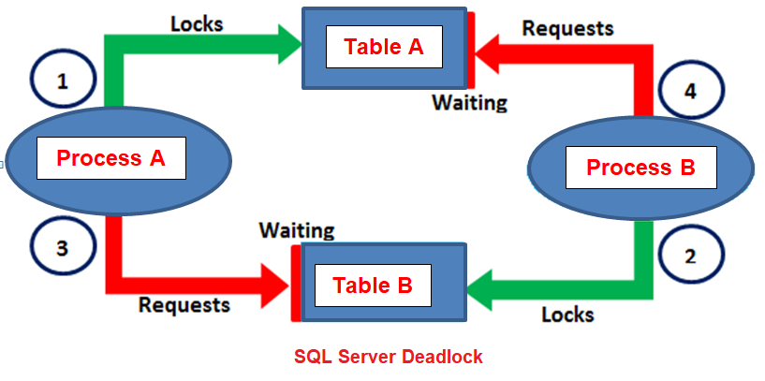

DEADLOCK
One process (X) is waiting for the completion of another transaction process (Y), and the same time, process Y is blocked because it is also waiting to complete the transaction of the process X. This is called as Deadlock situation.
In the Deadlock situation, both the processes trying to access a particular resource and also has a lock on that resource by each other, so both are waiting for each other to release a lock and complete the transaction.
Deadlock is a next stage of the blocking situation so if you want to avoid Deadlock situation, you should first find the blocked transaction and tried to remove internal dependency for those transactions

Slide 23
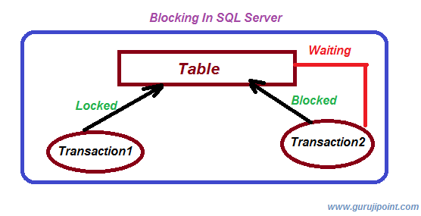
LOCKING
When one process is accessing an object, it can request for a lock for that particular object so that other processes cannot perform read or update on that object.
There are different types of lock like Exclusive Lock, Non-exclusive Lock.
1. An Exclusive Lock prevents object or data from the reading and writing both the actions. 2. A Non-Exclusive Lock allows read-only access for an object or data, but it prevents the write action for an object or data.

Slide 24
TYPES OF LOCK
Shared Lock:
Shared locks are used for operations that read data, such as a SELECT statement. During Shared locks used, concurrent transactions can read a resource, but cannot modify the data Update Lock:
Update locks are used when SQL Server intends to modify a row or page, and later promotes the update page lock to an exclusive lock before actually making the changes. The Update locks are used to prevent a deadlock Exclusive Lock:
Exclusive locks are used for data modification operations, such as UPDATE, INSERT, or DELETE. Other transactions cannot read or modify data locked with an Exclusive lock

Slide 25

Open Discussion
Questions & Answers
Next Steps:
- Take the Lab Session 4, as prescribed by your Trainer

