Slide 1


15Cs565
C
Web Security
Cloud Computing

Slide 2
Module-2
Web Application Authentication

Slide 3
Two Factor Authentication
Two-factor authentication requires the use of two of the three authentication factors:
Something only the user:
Knows (e.g. password, PIN, secret answer)
Has (e.g. ATM card, mobile phone, hard token)
Is (e.g. biometric – iris, fingerprint, etc.)

Slide 4
Two-factor authentication (2FA), sometimes referred to as two-step verification or dual-factor authentication, is a security process in which users provide two different authentication factors to verify themselves.
2FA is implemented to better protect both a user's credentials and the resources the user can access. Two-factor authentication provides a higher level of security than authentication methods that depend on single-factor authentication (SFA), in which the user provides only one factor -- typically, a password or passcode. Two-factor authentication methods rely on a user providing a password as the first factor and a second, different factor -- usually either a security token or a biometric factor, such as a fingerprint or facial scan.

Slide 5
What are authentication factors?
A knowledge factor is something the user knows, such as a password, a personal identification number (PIN) or some other type of shared secret.
A possession factor is something the user has, such as an ID card, a security token, a cellphone, a mobile device or a smartphone app, to approve authentication requests.

Slide 6
A biometric factor, also known as an inherence factor, is something inherent in the user's physical self. These may be personal attributes mapped from physical characteristics, such as fingerprints authenticated through a fingerprint reader. Other commonly used inherence factors include facial and voice recognition or behavioral biometrics, such as keystroke dynamics, gait or speech patterns.
A location factor is usually denoted by the location from which an authentication attempt is being made. This can be enforced by limiting authentication attempts to specific devices in a particular location or by tracking the geographic source of an authentication attempt based on the source Internet Protocol address or some other geolocation information, such as Global Positioning System (GPS) data, derived from the user's mobile phone or other device.

Slide 7
A time factor restricts user authentication to a specific time window in which logging on is permitted and restricts access to the system outside of that window.

Slide 8
How does two-factor authentication work?
The user is prompted to log in by the application or the website.
The user enters what they know -- usually, username and password. Then, the site's server finds a match and recognizes the user.
For processes that don't require passwords, the website generates a unique security key for the user. The authentication tool processes the key, and the site's server validates it.
The site then prompts the user to initiate the second login step. Although this step can take a number of forms, the user has to prove that they have something only they would have, such as biometrics, a security token, an ID card, a smartphone or other mobile device. This is the inherence or possession factor.
Then, the user may have to enter a one-time code that was generated during step four.
After providing both factors, the user is authenticated and granted access to the application or website.

Slide 9







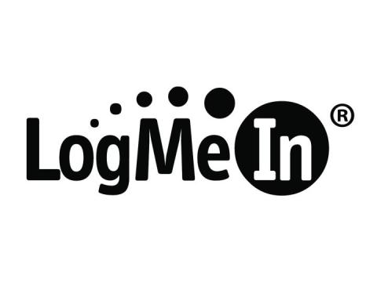





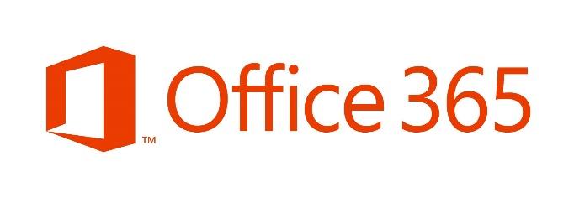




Who Uses Two-Factor?
9

Slide 10
How Two-Factor Authentication Helps
Two-factor authentication prevents attackers from accessing your account even if they obtain your username and password.

Slide 11
What is 3-Factor Authentication (3FA)?
Three-factor authentication is the use of a person’s live biometric data in addition to their security credentials and an authentication code sent by SMS.
3FA provides the highest possible level of user security for accessing accounts and making transactions.
Biometric authentication may include a fingerprint, a retina scan, or a scan of the person’s entire face. This makes it almost impossible for hackers to bypass.

Slide 12
What is the benefit of 3-Factor Authentication?
The key benefit of 3FA and 2FA is that they vastly reduce the chances of fraud and identity theft as a result of data breaches and stolen passwords. While it is theoretically possible to breach 2FA systems if the fraudster has control of a person’s mobile phone – the addition of a biometric check means that remote fraud is not possible.
This allows companies to add a layer of confidence when authorizing access to customer accounts remotely.

Slide 13
What are the three factors that make up 3FA?
Something you know: This is a piece of information that a person knows – it could be a username, password, answer to a security question, or a touch gesture on a smart phone screen.
Something you have: This is a physical object that a person has in their possession. It could be a smart card, a device like a phone or USB drive, or most commonly a token device that provides a pin code to access an application or online service.
Something you are: This can include any unique physical facet of a person that can be used to verify their identity. It could be anything from a simple fingerprint to a facial scan or even DNA

Slide 14
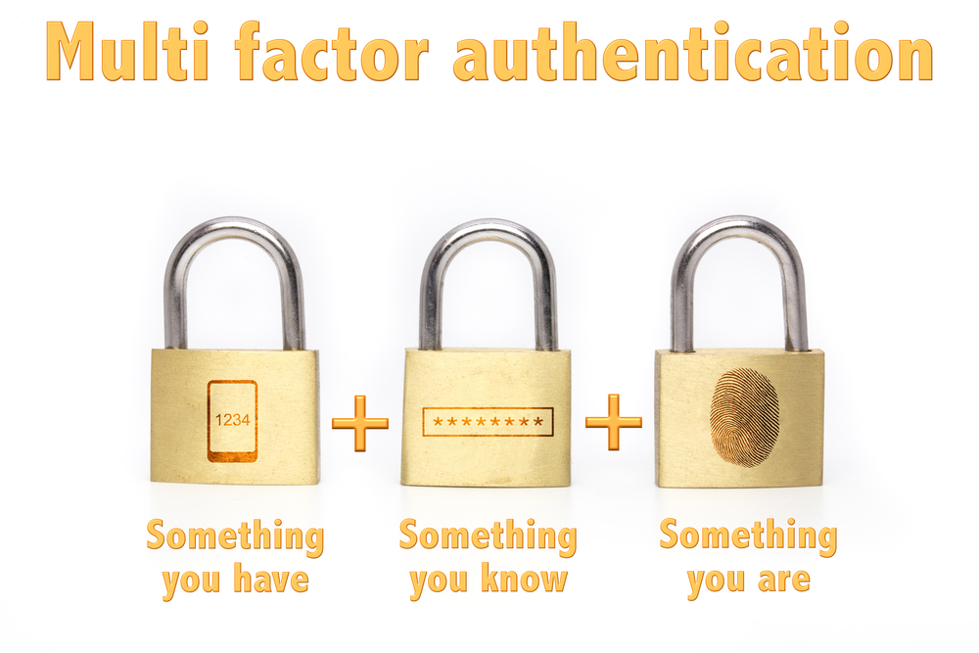

Slide 15
What is 4-Factor Authentication (4FA)?
4FA is simply a 3FA authentication solution with the addition of a check on a person’s physical location, based on geometric data or network location. This could be used to block transactions outside of a prescribed territory, or even outside of a company’s premises.

Slide 16
What is Multi-Factor Authentication??
Multi-factor authentication, also referred to as advanced or two-factor authentication, provides an additional layer of security when logging in or performing transactions online.
When logging in, a user is required to enter a password and also authenticate using a second factor, typically a phone or hardware token.

Slide 17


Multi-factor Authentication (MFA)
Notes:
User trying to access computer

Slide 18

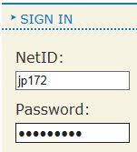
Multi-factor Authentication (MFA)
Mr. MFA
Notes:
Mr. MFA pops up asking for your 2nd way to authenticate

Slide 19
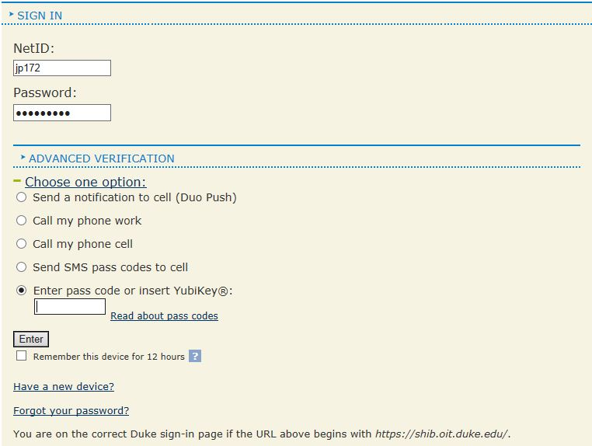
Multi-factor Authentication (MFA)
Notes:
What does he show you? Another field for login, like so

Slide 20
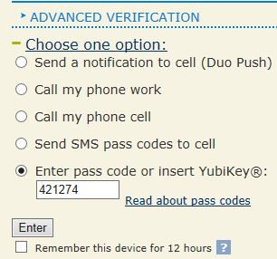
Multi-factor Authentication (MFA)
Welcome!
Mr. MFA
Notes:
So now….

Slide 21
Multi-factor Authentication (MFA)
Why do we need it?
Prevent unauthorized users from logging into your account
Protect your identity
Protect your data
Protect your money!

Slide 22









Multi-factor Authentication (MFA)

Slide 23
Ways of MFA Authentication
Call your phone (desk or cell)
Send text message with pass codes to cell
Use the Duo Mobile app to create a pass code or send a notification to cell
YubiKey authentication
Notes:
Review the ways to authentication

Slide 24
Multi-factor Authentication Options
Notes:
Remind them what the MFA login page looks like

Slide 25
The Basic Authentication Scheme of HTTP

Slide 26
Access Restriction
Sometimes, we want to restrict access to certain Web pages to certain users
A user is identified by a name and a password
Several mechanisms are used for controlling the access to pages on the Web
A basic mechanism, provided by HTTP, is called “Basic Authentication Scheme”

Slide 27
Basic Authentication Scheme
For each URL that the server wishes to restrict, a list of authorized users is maintained
Using HTTP headers, the server declares that a the requested page is restricted (authentication is required)
The client passes the name and password within a HTTP header
The decision on which pages are restricted and to which users is implemented by the server (not a part of HTTP)

Slide 28
Basic Authentication Scheme (cont)
The user's name and password need to be sent with each request for a protected resource
When the server gets a request for a protected resource, it checks whether that request has the HTTP header
Authorization: Basic username:password
username:password undergoes some non-secure encoding to allow for special characters
If the name and password are accepted by the server (i.e., are those of a user that has the privilege to get the page), then the requested page is returned

Slide 29
Browser Cooperation
Throughout the session, the browser stores the username and password and automatically sends the authorization header in either one of the following cases:
The requested resource is under the directory of the originally authenticated resource
The browser received 401 from the Web server and the WWW-Authenticate header has the same realm as the previous protected resource

Slide 30
Single Sign on (SSO) Authentication
Single sign-on (SSO) is a property of access control of multiple related, but independent software systems. With this property a user logs in once and gains access to all systems without being prompted to log in again at each of them. Conversely, single sign-off is the property whereby a single action of signing out terminates access to multiple software systems.

Slide 31
As different applications and resources support different authentication mechanisms, single sign-on has to internally translate to and store different credentials compared to what is used for initial authentication.

Slide 32
Drawback of Traditional Login systems
Takes more time and reduces speed
Difficult to remember the password and user name for all application
It makes you feel irritated
Increases the help desk workload
Poor security habits

Slide 33
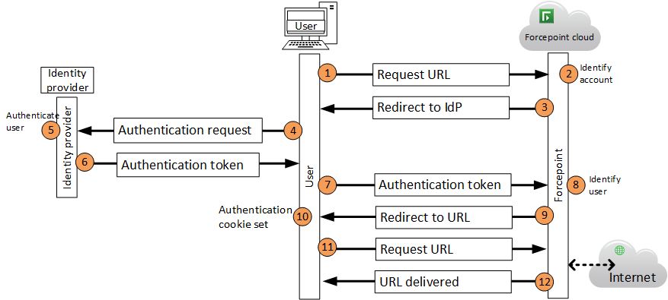
SSO work Flow

Slide 34
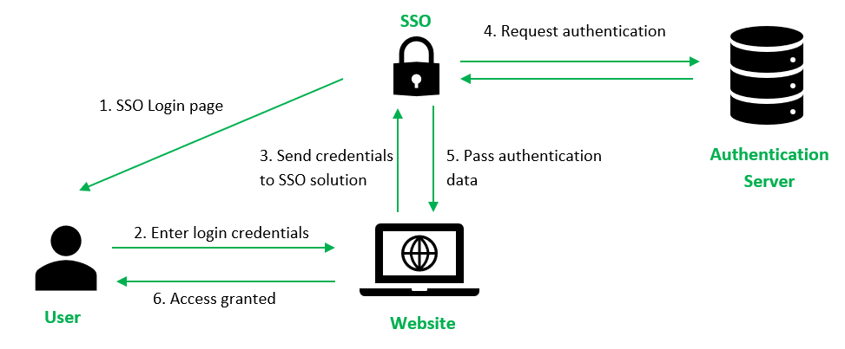

Slide 35
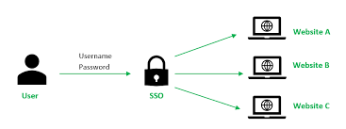

Slide 36
Advantages of SSO
Improve security Habits
Improves Identify Protection
Increases Speed
Relieves help desk workload

Slide 37
Demerits
Single sign-on - Criticisms 1 The term enterprise reduced sign-on is preferred by some authors who believe single sign-on to be impossible in real use cases. 5
Single sign-on - Criticisms 2 As single sign-on provides access to many resources once the user is initially authenticated ("keys to the castle") it increases the negative impact in case the credentials are available to other persons and misused. Therefore, single sign-on requires an increased focus on the protection of the user credentials, and should ideally be combined with strong authentication methods like smart cards and one-time password tokens.

Slide 38
Single sign-on - Criticisms 3 Single sign-on also makes the authentication systems highly critical; a loss of their availability can result in denial of access to all systems unified under the SSO. SSO can thus be undesirable for systems to which access must be guaranteed at all times, such as security or plant-floor systems.

Slide 39
Validating Credentials
The process of validating credentials is actually more complex than simply “determining whether or not the supplied password is associated with the supplied username.” There are several common ways to determine whether or not the correct password has been entered, and they depend on how the passwords are being stored in the back-end system

Slide 40
Comparison Logic in the Application with Plaintext Passwords
Using this approach, the application sends a request (for example, SQL query or LDAP query) to the back-end database to retrieve the record associated with the username. If the username does not exist, then the validation process fails. If a record is associated with the username, then the application-based logic compares the plaintext password provided by the user to the plaintext password from the retrieved record. If they match, then the credentials are valid.
Comparison Logic in the Database with Plaintext Passwords
This technique involves crafting a SQL query or an LDAP request to the back-end system with a conditional statement that asks the back end to return any records with matching fields that correspond to the supplied username and the supplied password. The database performs the username and password comparisons against the corresponding fields in this case. If any records are returned, then the application can safely assume that the user provided a legitimate set of credentials (unless SQL injection is used).

Slide 41
Comparison Logic in the Application with Hashed Passwords
With hashed passwords being compared within the application, a request is first made to the back-end datastore to retrieve the record associated with the user-supplied username. Because hashing is a one-way transformation, the user-supplied password must be hashed using the same algorithm that was used to hash the stored password in order for them to be compared. If the two hashed values are equal, then the user-supplied password was valid, and then authentication succeeds.

Slide 42
Comparison Logic in the Database with Hashed Passwords
Comparing hashed passwords on the back end also involves hashing the user-supplied password before it is sent to the datastore. The back-end system logic attempts to match the supplied username and the hashed form of the supplied password with a record in the system. If a match occurs, then the record is returned, and the application assumes that the credentials were valid (again, unless SQL injection is used)

Slide 43
Custom Authentication Systems
Whenever a developer has coded their own application logic to process credentials, then a custom authentication system has been created
Web Authentication Process
Using the browser, a user requests the login page from the web application, such as http://www.website.cxx/login.html.
The web application returns the login page to the browser.
The user enters their username and password into the input fields and submits the form, which now contains the credentials, to the web application. When the form is submitted to the web application, the browser will include the form fields as part of the HTTP POST request that is submitted.
Upon receiving the request, the web application parses the information in the HTTP message and extracts the values of the username and password.

Slide 44
The application logic then queries a back-end data store (for example, a database or LDAP server) to determine whether or not the password entered is associated with the username entered.
If the matching is unsuccessful, then the web application will send the user an error message along with the login page again.
If the password is successfully matched to the associated username, then the application will establish a session with the user. Most applications establish a session with a user by generating a session ID value and returning it to the user.

Slide 45
When the browser receives and parses the HTTP response, it will observe the Set-Cookie directive in the HTTP header and store the value of the session ID.
Because the session ID value was set in a cookie, the browser will now automatically submit the session ID value alongside all requests made to the web application.
This acts as a form of persistent authentication because the user no longer needs to enter their username and password to authenticate every request going to the application.
Whenever the web application parses an HTTP request, it will see the session ID value and know that an existing session has already been established. It will use this session ID to authorize each request within the application logic.

Slide 47
Securing Password-Based Authentication
Passwords are by far the most popular way of confirming your identity to a web application.
Attacks Against Passwords
Because the use of passwords is pervasive as an authentication factor in web applications, they are also a very popular target of attackers. All attacks against passwords essentially boil down to repeatedly guessing at the password in an attempt to determine the plaintext value of the password. When attempting to guess a password, you can attempt it either against the live system (online) or against the hashed or encrypted password values (offline). Common attack variations include:
Dictionary attack
Brute-force attack
Precomputed dictionary attack
Rubber-hose attack

Slide 50
Dictionary Attack
A dictionary attack is based on the premise that users have a predilection for selecting passwords based on real words that can be found in dictionaries. The most likely candidate words can be collected in a list that is referred to as a “dictionary.” In some cases, real dictionaries may be employed, and creating permutations, such as appending a digit or special character at the end of each word, may be done as well. With a dictionary in hand, an attacker will successively attempt each password until they have successfully guessed the password or the list is exhausted.
Brute-Force Attack
A brute-force attack is also referred to as an exhaustive key search, and in theory involves attempting every single possible key. In reality, limits are usually placed on a brute-force attack based on length and character set (for example, alphabet, digits, whitespace, special characters).

Slide 51
Precomputed Dictionary Attack
Rubber-Hose Attack
A “rubber-hose” attack refers to instances in which an intruder uses any sort of physical coercion to extract the value of the password from an individual.

Slide 52
The Importance of Password Complexity
Password Best Practices
Require Minimum Password Length
Enforce Minimum Password Complexity
Rotate Passwords
Require Password Uniqueness
Password Cannot Equal Username
Allow Accounts to Be Disabled
Properly Store Passwords
Don’t Store in Plaintext
Don’t Encrypt
Use a Strong Hash
Multiple Rounds of Hashing

Slide 53
Securing Web Authentication Mechanisms
Secure the Transmission
Allow Account Lockout
Allow Accounts to Be Disabled
No Default Accounts
Don’t Hard-Code Credentials
Avoid Remember Me (Stay Signed In)

Slide 54
Authorization
Authorization is the process of determining whether a subject has sufficient permission to perform a given operation against a target resource.
Authorization Fundamentals
AuthZ is the process of deciding whether a user can perform a certain action.

Slide 55
Authorization Goals
We authorize for the following reasons:
To ensure that users can only perform actions within their privilege level.
To control access to protected resources using criteria based on a user’s role or privilege level.
To mitigate privilege escalation attacks, such as might enable a user to access administrative functions while logged on as a non-administrative user or potentially even an anonymous guest user.

Slide 56
Subjects
a subject is the thing requesting access to protected resources
In the web application world, a subject is commonly any of
An actual human user accessing the web application
A web application accessing another web service
A web application accessing a back-end database
Any one of the web services or back-end databases accessing their local operating systems
Another computer system or host
Essentially, anything that has been assigned an identity
Resources
Resources are simply the protected objects, either data or functionality, that the subject is attempting to access. Practically anything can be a resource, such as a protected file that a user is trying to open, a table or a record in a database, programs and other units of software, or even connectivity to networks

Slide 57
Access Control
Discretionary Access Control (DAC) In DAC, access control is left to the discretion of the owner of an object or other resource. Although access is primarily controlled by the object owners, there are system-wide or application-wide access control rules such as the ability to debug a process running under a different account or the ability to load kernel code. Such rules can typically be overridden by the owners of objects and resources.
Mandatory Access Control (MAC) In MAC, access control is determined by the system, or by system administrators, rather than object owners. Some web applications use this model because of its stronger limits on what can potentially happen within the application, as well as the simplification of design and user interface that comes with not needing to provide users with a means to manage permissions.”

Slide 58
Role-Based Access Control (RBAC) ❑ This is another nondiscretionary model, like MAC, but which implements access control by means of roles, Access determinations are still made by the system (or by system administrators), but are made in the context of a more general framework. Administrators can, if necessary, define new roles and assign uses to them, which is often not possible in strict MAC-oriented systems.
Hybrid systems ❑ Nothing says you can’t mix and match these three different access control models, and indeed, many web applications do just this. The social media site Facebook, for example, mixes RBAC and DAC; roles such as user and administrator codify broad permission policies, but the application also incorporates elements of discretionary access by allowing users to control who can see what information on their “wall.”

Slide 59
Types of Permissions
Read Access
Write Access
Execute Access

Slide 60
Authorization Layers
Authorization is not a one-time thing. Authorization should happen at many points and many times within a web application. These points come at certain common boundaries that exist in most web applications, forming “layers” that can be thought about, designed, and implemented in a holistic fashion

Slide 62
Web client
Front-end web server
Back-end application servers
Back-end database

Slide 63
User layer -The topmost layer on a client system. For the web client machine, the user is the actual human being, as proxied by the user interface software, which translates mouse moves and keyboard clicks into commands.
Application layer -For a front-end web server, an application server, or a back-end database, the topmost layer is likely the web server software, application server software, or database server software, respectively.
Middleware layer Whatever components fit the definition of “the thing on top of which this part of the web application is running.” For the web-server layer, the middleware is likely to be a web server such as Microsoft’s Internet Information Server (IIS) or the open-source Apache server

Slide 64
Operating system layer-The low-level software that manages the physical resources of the computer: memory, disk space, CPU time, network bandwidth, and so on. In most applications, access to the file system is also mediated by the operating system layer.
Hardware layer -The physical material of the computer. Although this is the layer where the actions of a user are “made real,” the hardware layer doesn’t interact strongly with a typical web application’s authorization system.

Slide 65
Securing Web Application Authorization
Web Server Layer
IP Address Blacklisting
At the front-line boundary of your web application, you can check the source IP address on the incoming request, and reject it if necessary. For example, you might deny requests from IP addresses that have tried to attack your server previously with a distributed denial-of-service attack (DDoS attack). For such requests, the application might return a “403 Forbidden” HTTP response, or might simply ignore the request without sending any response at all (also known as “dropping” the request).
IP Address Whitelisting
Conversely, if your application is such that you know in advance the exact IP addresses or range of addresses that should ever be allowed to access the application, you can simply watch for those source IP numbers and reject everything else.
URL Authorization
Some web servers (including Microsoft IIS, Apache, and nearly all Java web servers) and some web application frameworks provide facilities for limiting access to specific URLs

Slide 66
<location path="topsecret.aspx"> <system.webServer>
<security>
<authorization>
<add accessType="Allow" users="TopSecretUser" /> </authorization>
</security>
</system.webServer>
</location>

Slide 67
Operating System Authorization
The operating system’s job is to manage (and thus, protect) the computer’s physical resources as well as logical resources exposed by the OS itself. Because the web server and/or web application must run in some context within the OS, and because such contexts are typically integrated into the same overall security framework as regular users, usually there is some kind of user account associated with your server and application

Slide 68
Application Server Layer
Application Compartmentalization
Servlet and App Server Restrictions
<security-constraint> <web-resource-collection> <web-resource-name>secure</web-resource-name> <url-pattern>/secure/*</url-pattern> <http-method>GET</http-method> <http-method>POST</http-method> </web-resource-collection> <auth-constraint> <role-name>admin</role-name> </auth-constraint></security-constraint>
Application Server Code
Use a built-in framework
Microsoft’s .NET platform has built-in security modules for role-based security.
The ASP.NET platform has a Membership framework that is primarily intended for form-based AuthN, but does allow you to validate and manage users through prebuilt libraries.
ASP.NET also provides role-based management for AuthZ.

Slide 69
Use an existing, open plug-in AuthZ module
There are a number of AuthZ modules that plug in to various web development frameworks in order to provide authorization features not present (or deemed insufficient) within the frameworks themselves. These include OAuth, BBAuth, AuthSub, and others.
Develop a custom framework
Designing and developing a proper authorization framework is a significant undertaking.
Code Access Security
CAS is typically used to prevent uploaded or downloaded components from performing dangerous actions

Slide 70
Database Server Layer
Wrap every request to create, read, update, or delete data within properly parameterized stored procedures. This means that you will not have your web application generating SQL query strings and submitting them to the database directly.
Map all the interactions between the application and the database to a set of database user accounts, and reduce the permissions those accounts have to the bare minimum.

Slide 71
Custom Authorization Mechanisms

Slide 72
Users/subjects Any entity that’s making a request against a resource.
Operations The functionality resources in your web application; the specific actions that subjects can take.
Objects These are the resources managed by your web application, the underlying things, such as data, that your web application cares about.

Slide 73
Web Authorization Best Practices
Failing Closed
Design your application such that if anything fails, it will fail into a secure state. The result of bad input, a bug raising an unexpected exception within your application code, and so on,
Operating with Least Privilege
Operating with least privilege means designing your web application to work with the fewest possible rights and permissions while still allowing the application to accomplish what it needs to do.
Separating Duties
Business user accounts should not be administrators, and vice versa. Regular users and administrators have very different jobs, and perform very different kinds of actions within the application.
Defining Strong Policies
Even the best-designed authorization system will fail if it is not used correctly. Define strong permission policies up front.

Slide 74
Keeping Accounts Unique
Don’t let users share accounts. Ever. Make sure every user has a unique account—or more than one, as in the case of administrators who sometimes also need to be users. If you let users share accounts, then the process of authorization becomes virtually impossible to do rigorously.
Authorizing on Every Request
A good practice is for the web application to perform a final authorization check immediately before performing any action on the user’s behalf. This necessitates that the application performs at least one authorization check on every request that comes into the system
Centralizing the Authorization Mechanism
Design a clean authorization architecture that can be easily shared across the entire application. A common mistake is to craft some authentication code for use in one spot in an application, then copy that same code to everywhere else in the application that needs it.
Minimizing Custom Authorization Code
writing custom authorization code is difficult, expensive, and prone to give you worse results than if you used a reliable, well-tested, off-the-shelf authorization module. Use it if you need to, but minimize the amount of custom AuthZ code you write

Slide 75
Protecting Static Resources
Be very cautious about trusting the host operating system’s file system with anything. Ideally, your application should generate any highly sensitive content dynamically, at the moment of request.
Avoiding Insecure Client-Side Authorization Tokens
Don’t use insecure client-side tokens—that is, data that is stored at the web client and submitted with each request—to hold authorization data of any kind. It is often tempting for web developers to take this route, because the mechanisms for client-side token storage (cookies and the like) are incredibly simple to use and thus avoid the complexity of implementing server-side sessions and session management.
Using Server-Side Authorization
Authorization checks should happen on the server and never solely on the client
Mistrusting Everybody
Never trust a user to provide an accurate accounting of that user’s roles or permissions. A secure server is a paranoid server. Servers should rely on only trusted data sources

Slide 76
Attacks Against Authorization
Forceful Browsing
Input Authorization/Parameter Tampering
HTTP Header Manipulation
Cross-Site Request Forgery (CSRF)

