Slide 1
MSDS- Doing Data Science
Case Study I
Feb 2018 Ananth Subramanian
Brett Benefield
Ryan Bass

Slide 2
Introduction
The case study covers analysis of two data sets to understand
Distribution of breweries across various states
Type of beers produced in those breweries
Parameters associated with the beers (IBU and ABV)
The output of the study helps
Decision making process for breweries on parameters to concentrate across states
Calculation of one parameter based on other ( linear regression)

Slide 3
Methodology
R Programming utilized to clean the data and obtain unique values
Two separate data frames were prepared
One data frame has unique breweries information across all states
Another data frame has unique beer information across all states
Data sets were then merged with respect to the Beer_ID
NA values were then removed from the merged data set
The resultant data set is then used for the analyses

Slide 4
Results
Number of breweries in each state:
Only IBU and ABU column has NA in them
IBU has 1005 NAs and ABV has 62 NAs

Slide 5
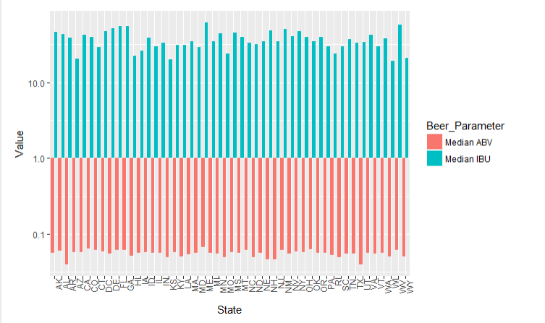
Results
Computation of median alcohol content and international bitterness unit of each state:

Slide 6

Results
Maximum ABV is reported in Colarado
Most bitter beer is reported in Colarado
Summary statistics of ABV variable

Slide 7
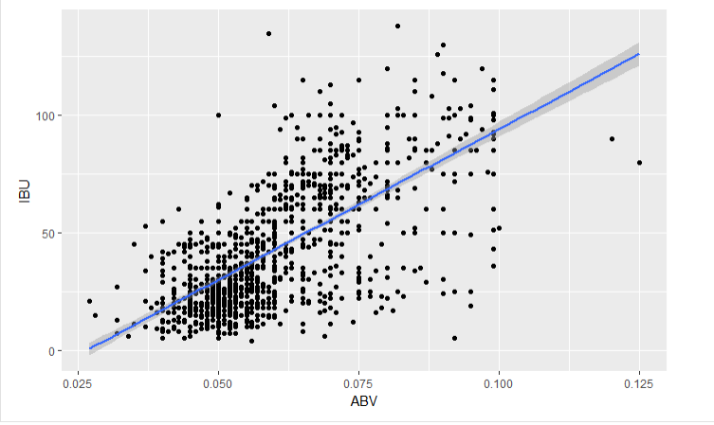
Results
Scatterplot is generated between ABV and IBU
Running corr test between these variables gives a p value less than alpha = 0.05
It is hence concluded that there is a linear relationship
Y (ABV) = 0.0449 + IBU(0.0003)

