Slide 1
APPLIED MACHINE LEARNING · COURSE PROJECT · SECTION D · TEAM T112
Automatic Clothing Category Recognition
Inventory Tagging via Handcrafted Features and a Small Convolutional Neural Network
PROJECT TEAM OWNERSHIP & CORE RESPONSIBILITIES
Team Member | GitHub Handle | Core Responsibility | Primary Module
Anant Jain | @anantjain-afk | Data Ingestion, Splitting & Master Benchmark | src/aml/data.py, evaluation.py
Kartik Mehra | @KartikMehra22 | Feature Engineering: Pixels & HOG Descriptors | src/aml/features.py
Krishna Gehlot | @NSTKrishna | Model 1: Multinomial Logistic Regression | src/aml/models/logreg.py
Vipul Sharma | @vs-code06 | Model 2: k-Nearest Neighbors & Latency Scaling | src/aml/models/knn.py
Aditya | @AdityaInnovates | Model 3: Random Forest Classifier & Trees | src/aml/models/random_forest.py
Utkarsh Jain | @UJ474 | Model 4: Linear SVM & Garment Error Analysis | src/aml/models/svm.py, error_analysis.py

Slide 2
IMAGE-TAGGING AML BASELINE
Project Motivation & Research Strategy
The Retail Inventory Challenge
Two-Phase Research Approach
• High-Volume Retail: Catalogs process thousands of incoming garment images daily.
• Structural Garments: Footwear and Trousers have distinct outlines → easily tagged (>93%).
• Upper-Body Tops: Shirts, T-shirts, Pullovers, and Coats share broad torso mass → severe confusion.
Phase 1: Applied ML Baseline (Completed)
• Benchmark 4 classical model families: LogReg, k-NN, Random Forest, Linear SVM.
• Evaluate 2 feature representations: Raw Pixels (784-d) vs. HOG Gradients (324-d).
• 8 fully audited configurations evaluated under strict zero-leakage protocol.
• Empirically proves that handcrafted visual descriptors hit a performance ceiling.
Why Benchmark Classical ML First?
• Establishes an audited, interpretable performance baseline before introducing deep learning.
• Isolates whether classification failures stem from model capacity or feature representation limits.
• Identifies 'The Gap' with mathematical precision to define clear success targets for Phase 2.
Phase 2: Small CNN (Next Milestone)
• Lightweight Convolutional Neural Network operating directly on 2D image topology.
• 3×3 receptive fields preserve spatial pixel adjacency (lost in vector flattening).
• Translation equivariance via weight sharing to consistently detect collars and seams.
• Quantitative targets: Lift Shirt recall to ≥ 80.0% and overall Macro F1 to ≥ 91.0%.

Slide 3
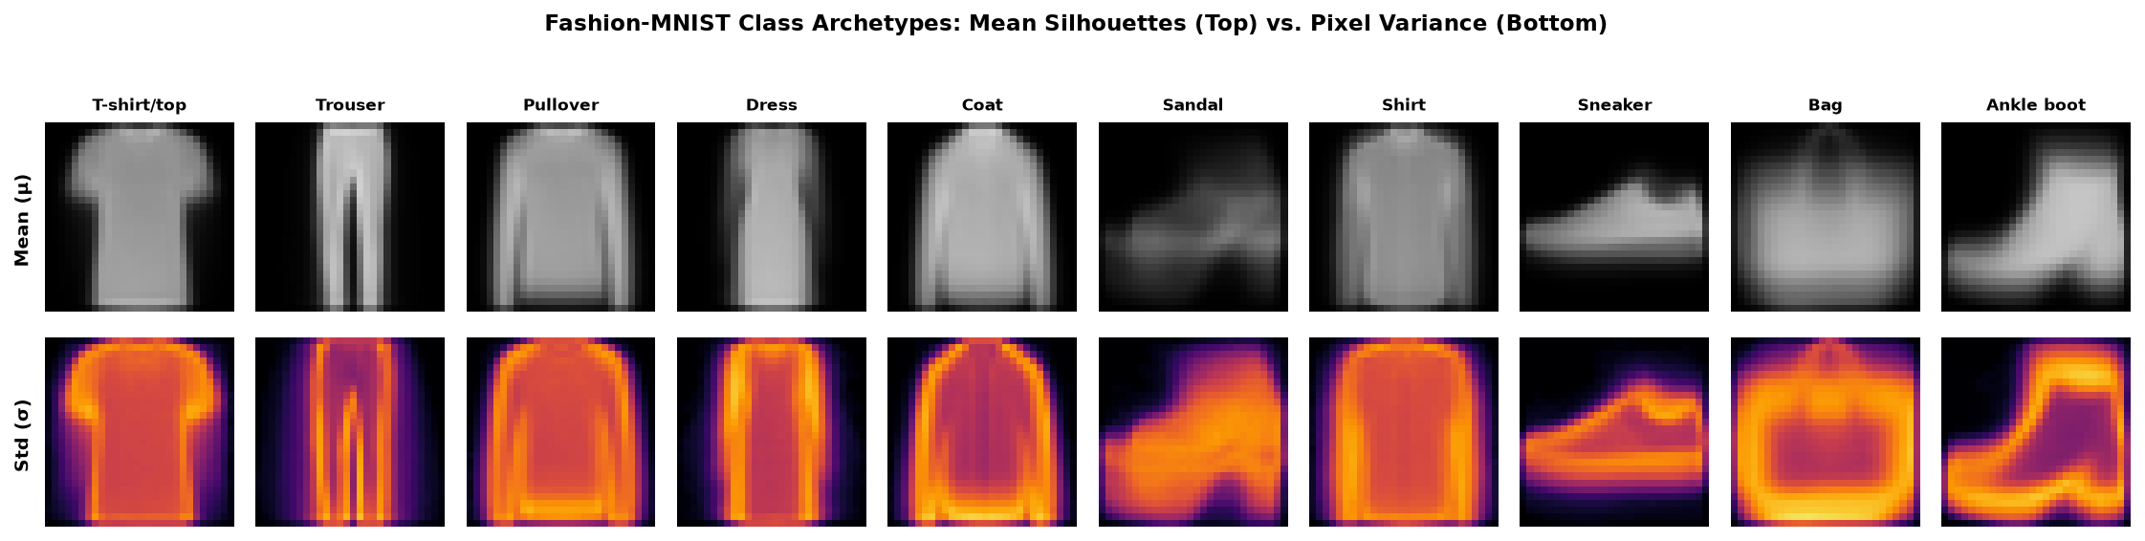
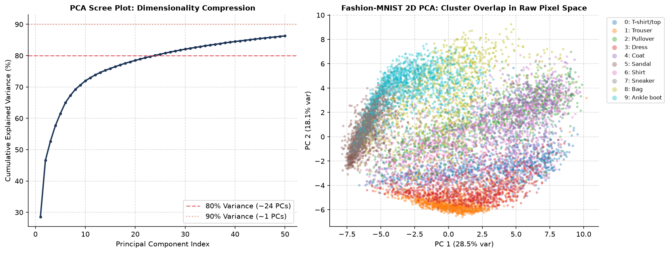
IMAGE-TAGGING AML BASELINE
Dataset, Exploratory Data Analysis & Evaluation Protocol
Fashion-MNIST Benchmark & EDA Findings
EDA Visualizations: Mean Archetypes & PCA
• 70,000 images (28×28 grayscale) across 10 balanced categories (7,000 images each).
• Class Balance (EDA): Perfect uniform distribution eliminates class frequency bias.
• Silhouettes (EDA): Footwear/Trousers form distinct outlines; tops share identical torso mass.
• Pixel Variance (EDA): Variance concentrates on outer sleeve contours, hemlines, and collars.
Strict 3-Way Split (Zero Test Leakage)
Partition | Size | Role
Training Set | 48,000 | Model parameter fitting only
Validation Set | 12,000 | Stratified hyperparameter tuning (seed 42)
Test Set | 10,000 | Official held-out test split, evaluated strictly ONCE
Fig 1a: Class Mean (Top) vs. Pixel Standard deviation (Bottom) across all 10 categories
Standardized Evaluation Protocol
• Accuracy & Macro F1: Treats all 10 classes with equal 10% weight.
• Per-Class Recall: Catches single-category failures (e.g. Shirts) hidden by accuracy.
• Inference Latency: Median ms/image measured over 1,000 test queries.
90% was not reached within 50 components
Fig 1b: 2D PCA projection — isolated footwear clusters vs. heavily overlapping tops

Slide 4
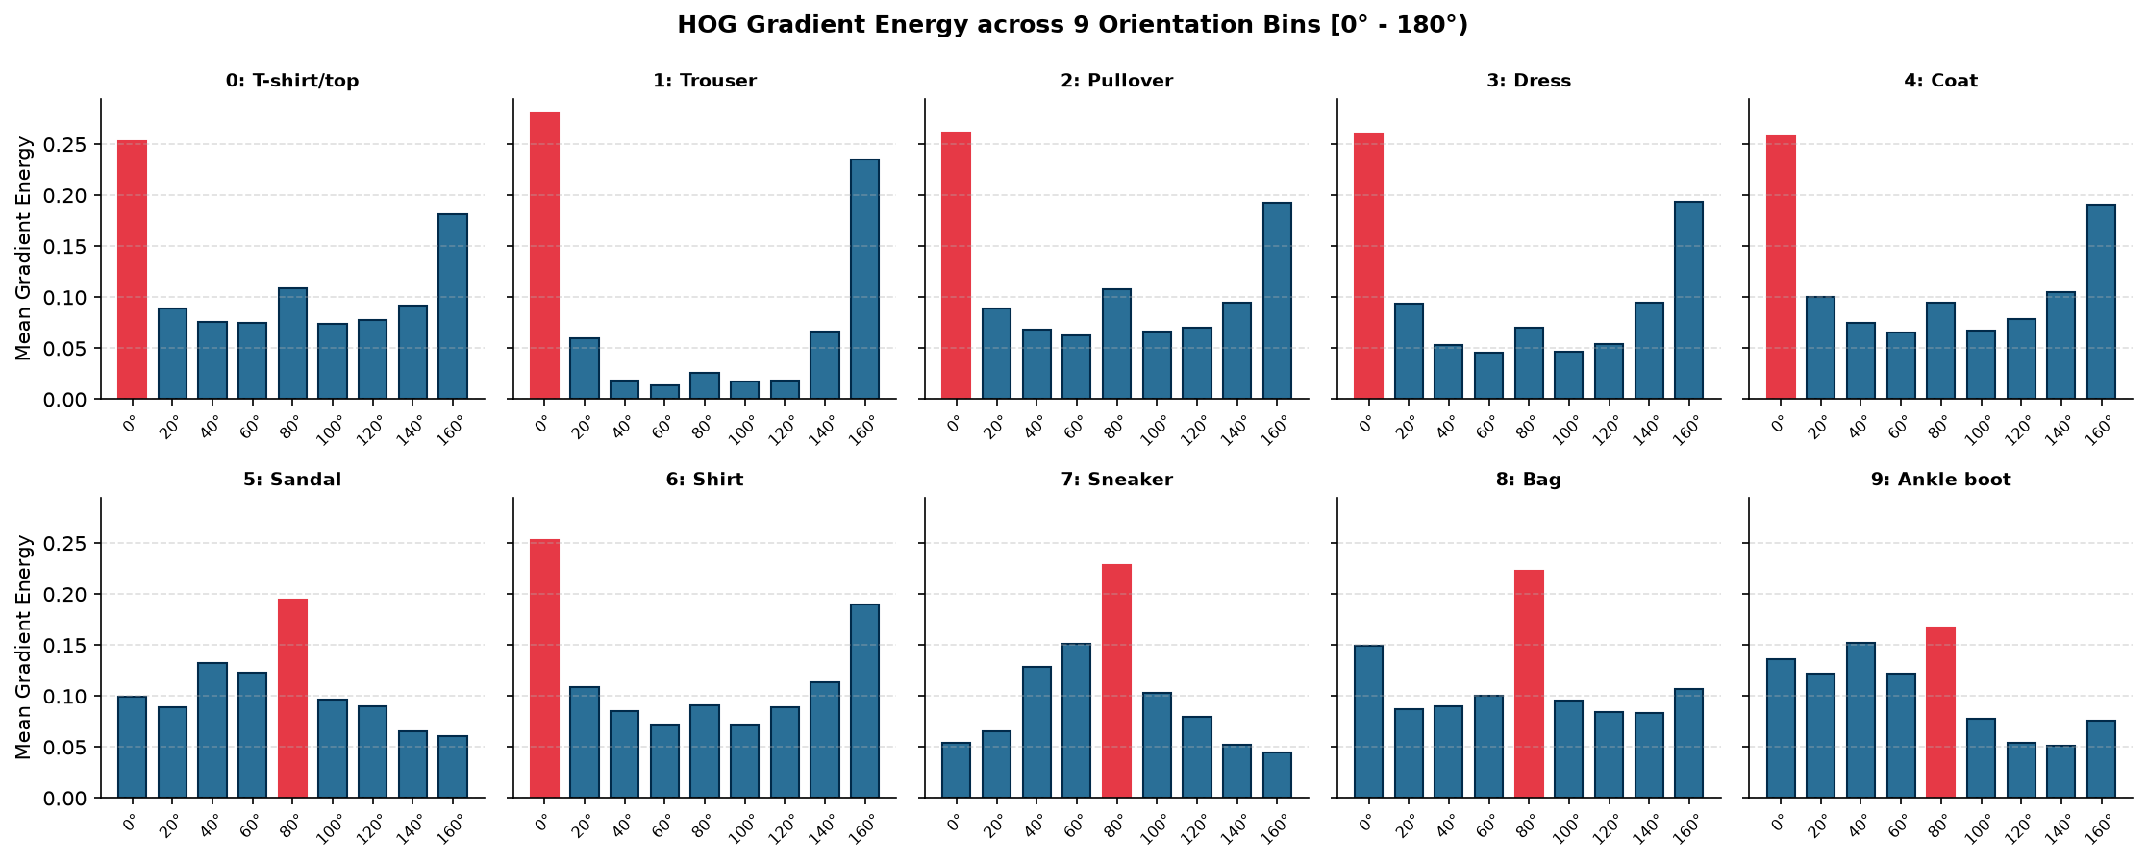
IMAGE-TAGGING AML BASELINE
Feature Engineering: Raw Pixels (784-d) vs. HOG (324-d)
1. Raw Flattened Pixels (784-d)
Empirical Gradient Energy Distribution
• Normalized float32 pixel values in [0.0, 1.0].
• Zero compute cost; preserves raw contrast.
• Destroys 2D layout; zero translation invariance.
2. HOG Descriptors (324-d)
• 9 orientation bins, 7×7 px cells, 2×2 blocks.
• 58.7% dimensionality reduction (784 → 324).
• Captures edge gradients along garment perimeters.
Why HOG Fails Upper-Body Tops
• Structured Items (Trousers, Boots): Sharp 90°/0° gradient peaks → HOG excels.
• Tops (Shirt, T-shirt, Pullover): Diffuse, isotropic gradients in all directions.
• Cell Pooling Limit: 7×7 cell averaging erases the 1–2 px collar tips needed to separate shirts.
Fig 2: HOG orientation profiles across categories — sharp peaks vs. diffuse tops
DIM REDUCTION
-58.7%
K-NN SPEEDUP
+64.2%
SHIRT RECALL GAIN
None (Trapped)

Slide 5
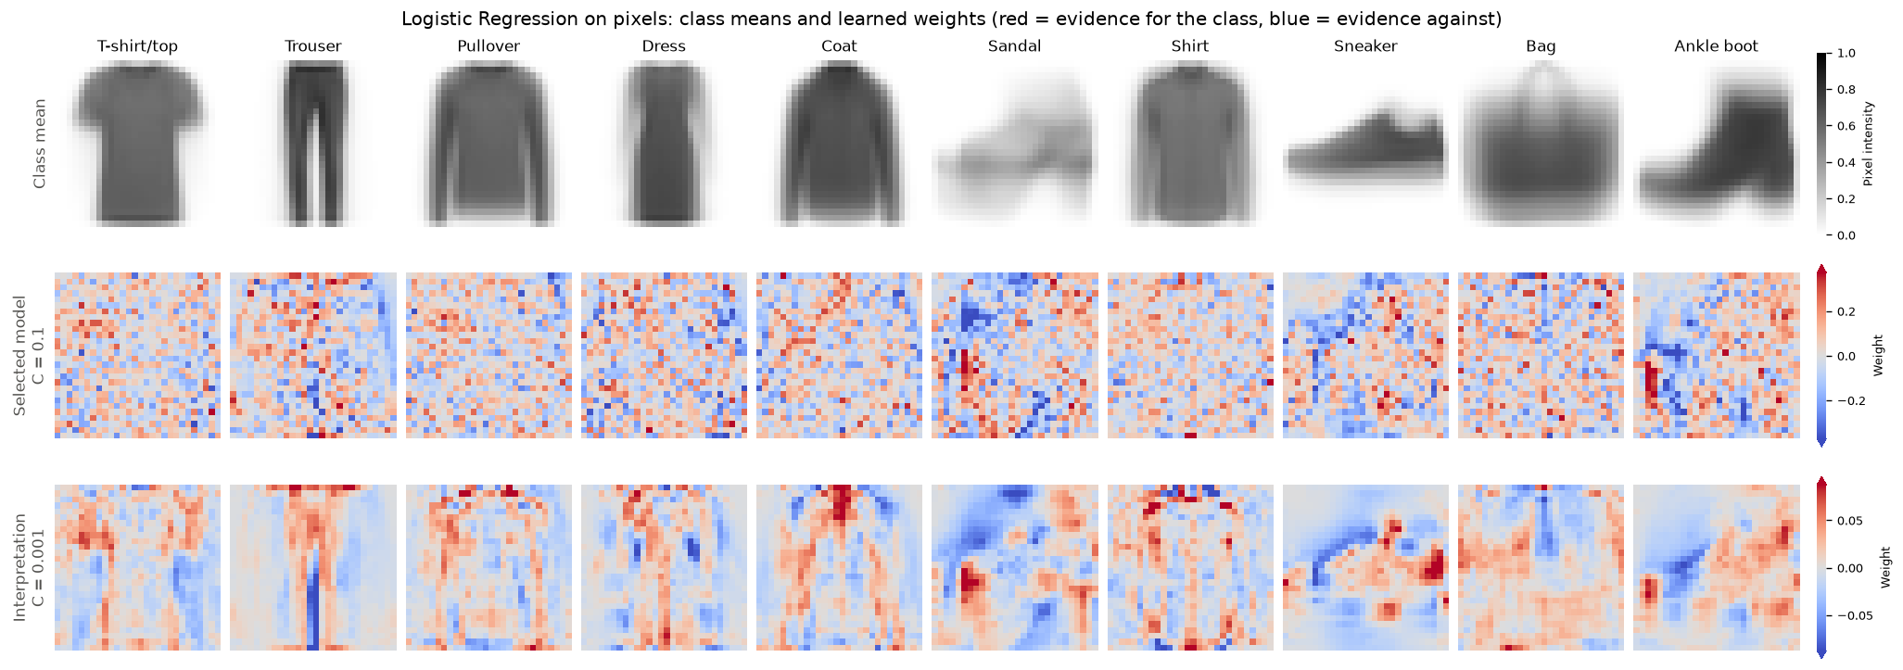
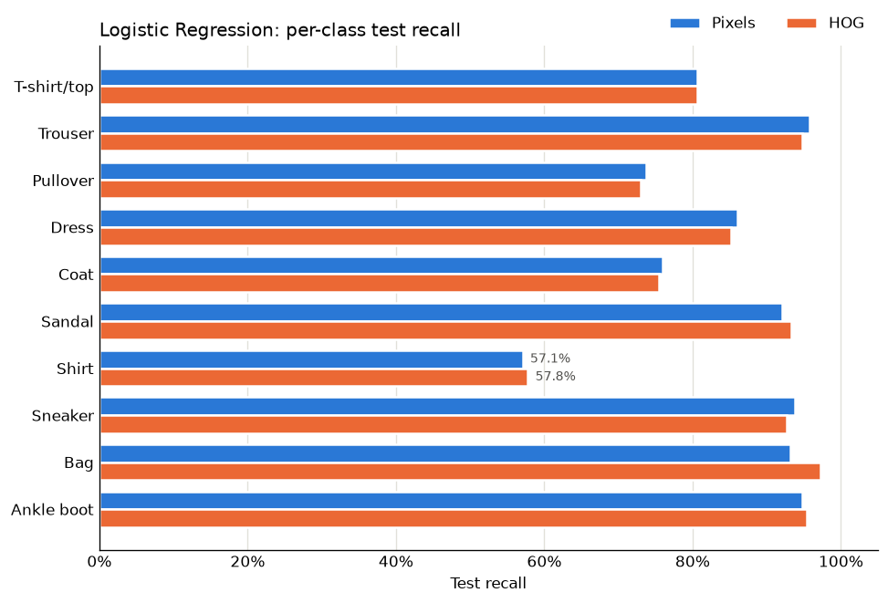
IMAGE-TAGGING AML BASELINE
Model 1: Multinomial Logistic Regression
Architecture & Tuning
Learned Weight Heatmaps & Recall Profile
• Softmax multinomial cross-entropy (L-BFGS solver).
• StandardScaler normalizes input feature coordinates.
• Grid search across C in {0.1, 1.0, 10.0}; winner: C = 1.0.
Test-Set Results
PIXELS (784-D)
84.32% Acc
MACRO F1
84.24%
SHIRT RECALL
57.1%
LATENCY
0.0007 ms
Fig 3a: Learned 28×28 weight templates (Red: positive, Blue: inhibitory)
HOG (324-D)
84.55% Acc
MACRO F1
84.49%
SHIRT RECALL
57.8%
LATENCY
0.0004 ms ★
Weight Space Interpretability
• 28×28 reshaped weights reveal intuitive class templates.
• Positive weights (Red): outline silhouettes (trouser legs, straps).
• Negative weights (Blue): suppress conflicting regions (necklines).
• Limitation: Hyperplanes cannot separate overlapping torso shapes.
Fig 3b: Per-class recall — footwear (>93%) vs. depressed shirt recall (57%)

Slide 6
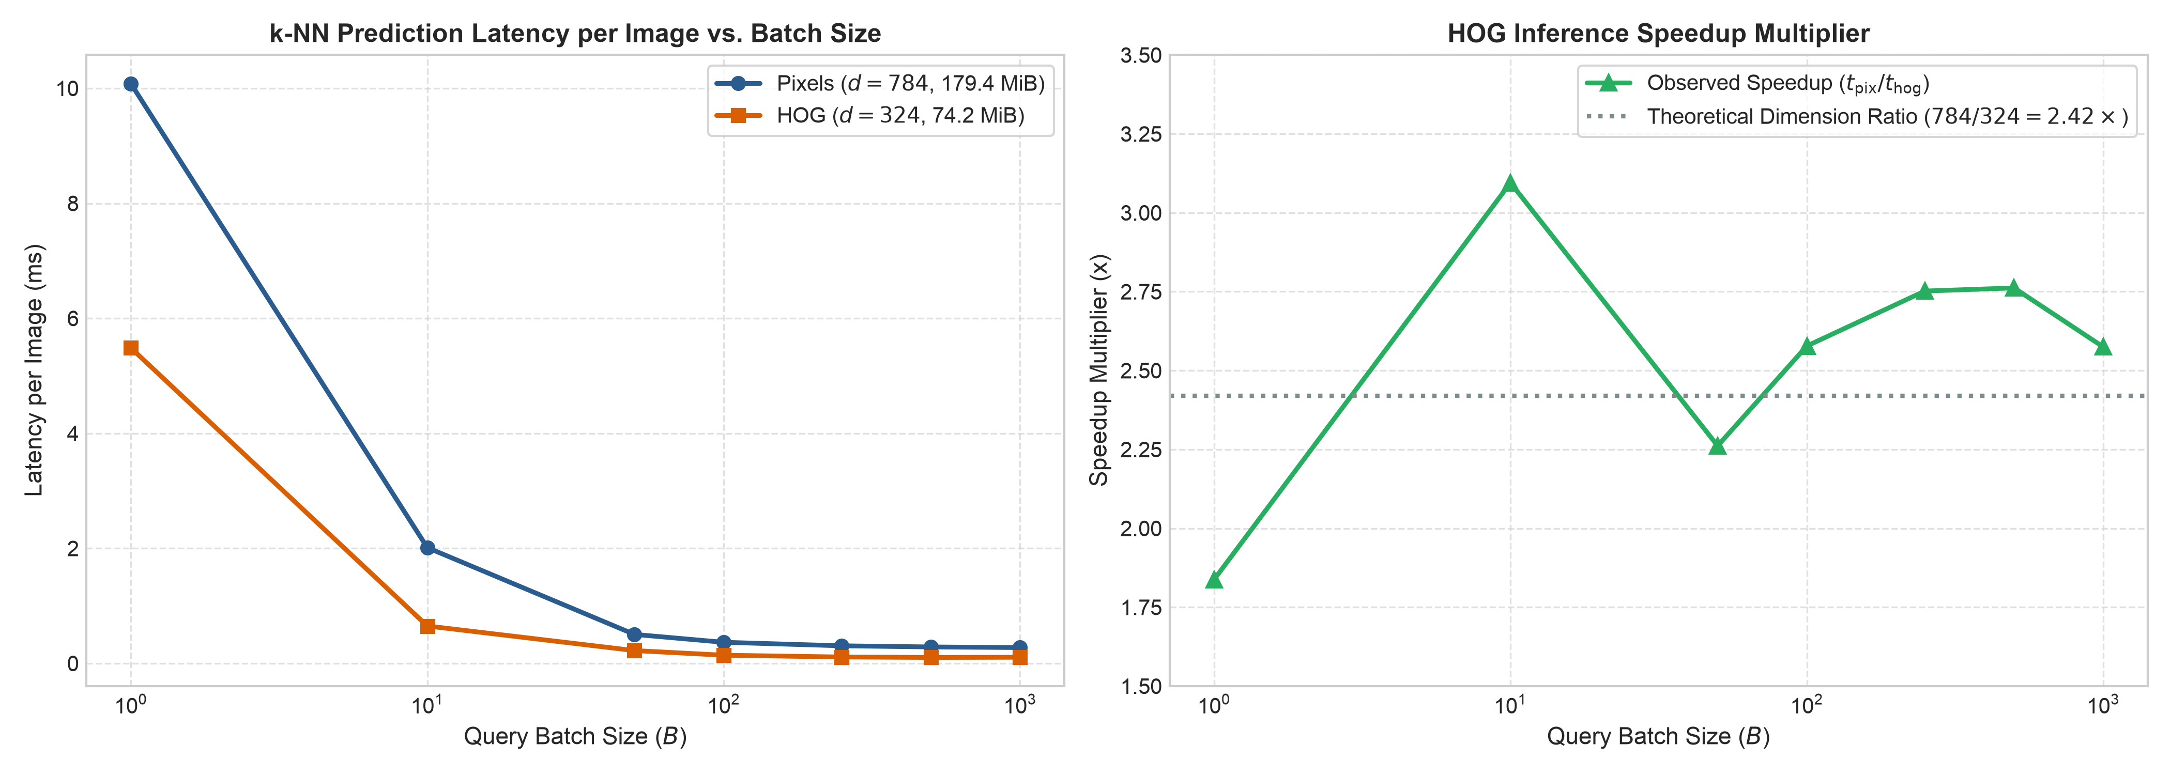
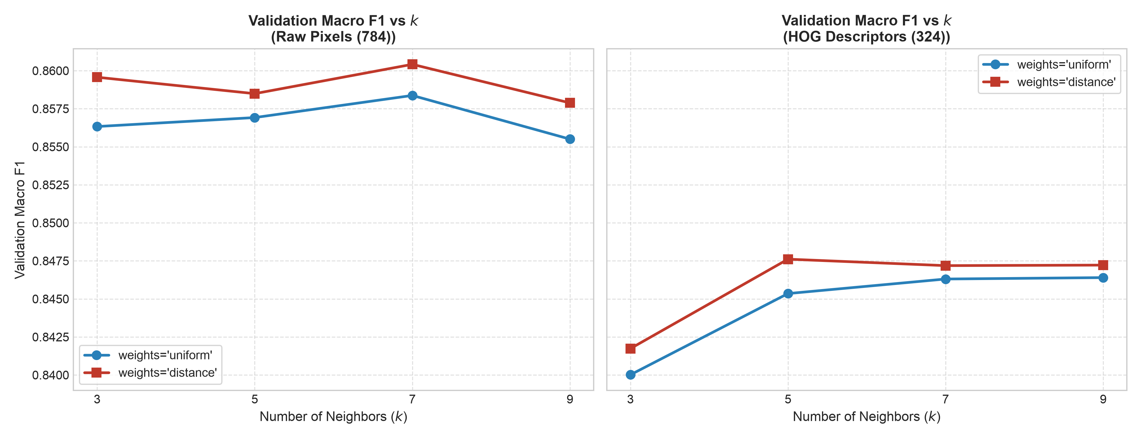
IMAGE-TAGGING AML BASELINE
Model 2: k-Nearest Neighbors (k-NN)
Architecture & Engineering
Empirical Scaling & Parameter Tuning
• Instance-based learner using Euclidean (L2) distance.
• Brute force (algorithm='brute'): avoids tree breakdown.
• Batched inference (batch_size=500): avoids 4.8 GB RAM crash.
• Winners: k=7, distance (Pixels) | k=5, distance (HOG).
Test-Set Results
PIXELS (784-D)
85.41% Acc
MACRO F1
85.40%
SHIRT RECALL
60.2%
LATENCY
0.274 ms ⚠
Fig 4a: Inference latency scaling across batch sizes (log scale)
HOG (324-D)
83.84% Acc
MACRO F1
83.85%
SHIRT RECALL
62.6% ★
LATENCY
0.098 ms
Computational Scaling Discoveries
• 64.2% Latency Speedup: HOG cuts distance math (0.274 → 0.098 ms).
• 58.7% Memory Savings: Stored RAM drops from 179.4 to 74.2 MiB.
• Production Bottleneck: 450× slower than Linear SVM (infeasible for live catalogs).
Fig 4b: Validation Macro F1 across neighbor count k and weighting

Slide 7
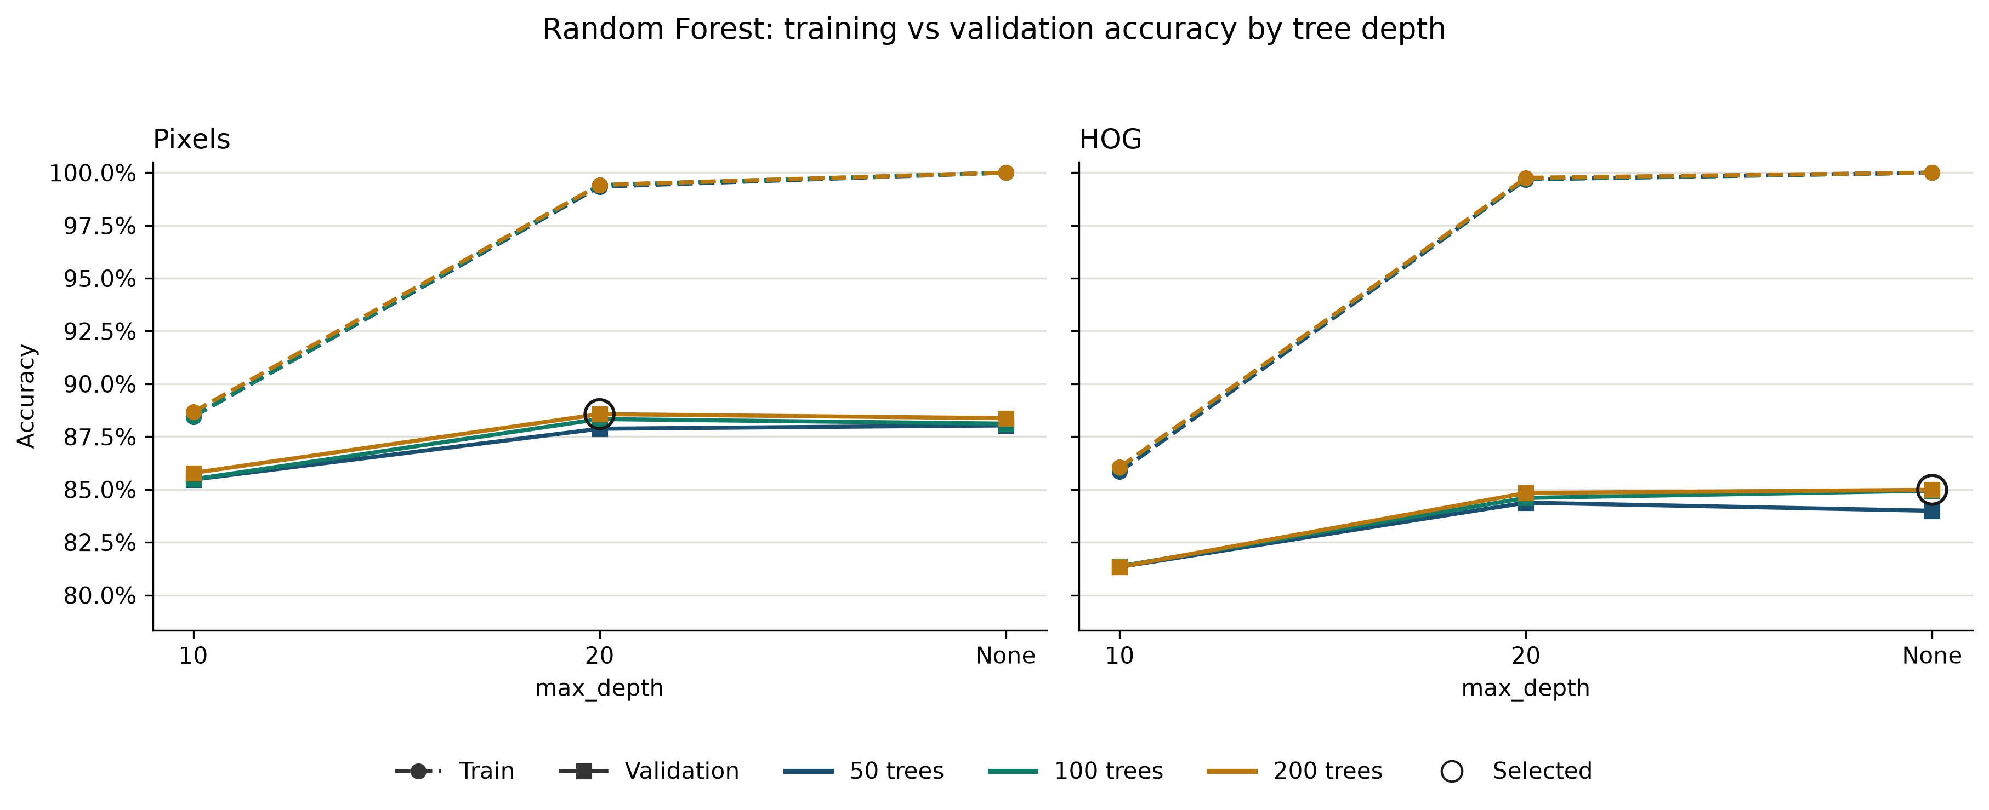
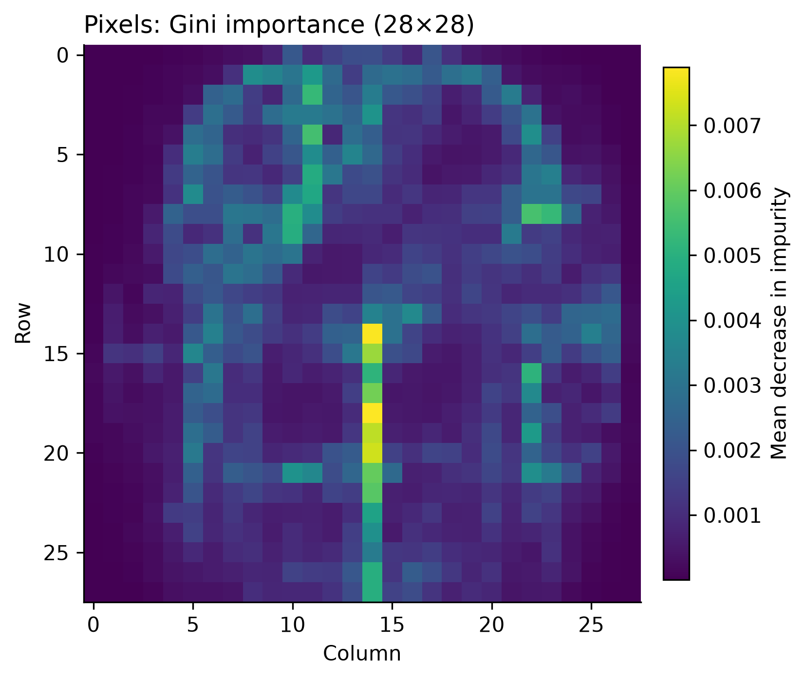
IMAGE-TAGGING AML BASELINE
Model 3: Random Forest Classifier
Architecture & Tuning
Overfitting Curves & Gini Importance Map
• 200-tree ensemble with Gini impurity splits.
• Grid search: n_estimators in {50, 100, 200} × depth in {10, 20, None}.
• Winner on Pixels: 200 trees, depth=20 (regularized).
• Phase 1 Benchmark Winner: 87.43% Test Accuracy (87.31% F1).
Test-Set Results
PIXELS (784-D)
87.43% Acc ★
MACRO F1
87.31% ★
SHIRT RECALL
59.3%
LATENCY
0.026 ms
Fig 5a: Training vs. Validation accuracy across tree depths
HOG (324-D)
84.35% Acc
MACRO F1
84.30%
SHIRT RECALL
59.4%
LATENCY
0.029 ms
Overfitting Dynamics & Feature Importance
• Unrestricted depth memorizes 100% of training data, but val F1 plateaus.
• Trees prefer sharp pixel coordinates; HOG averaging hurts (-3.1%).
• Splits focus on outer boundaries; inner collar details get zero splits.
Fig 5b: Gini feature importance showing split focus on outer boundaries

Slide 8
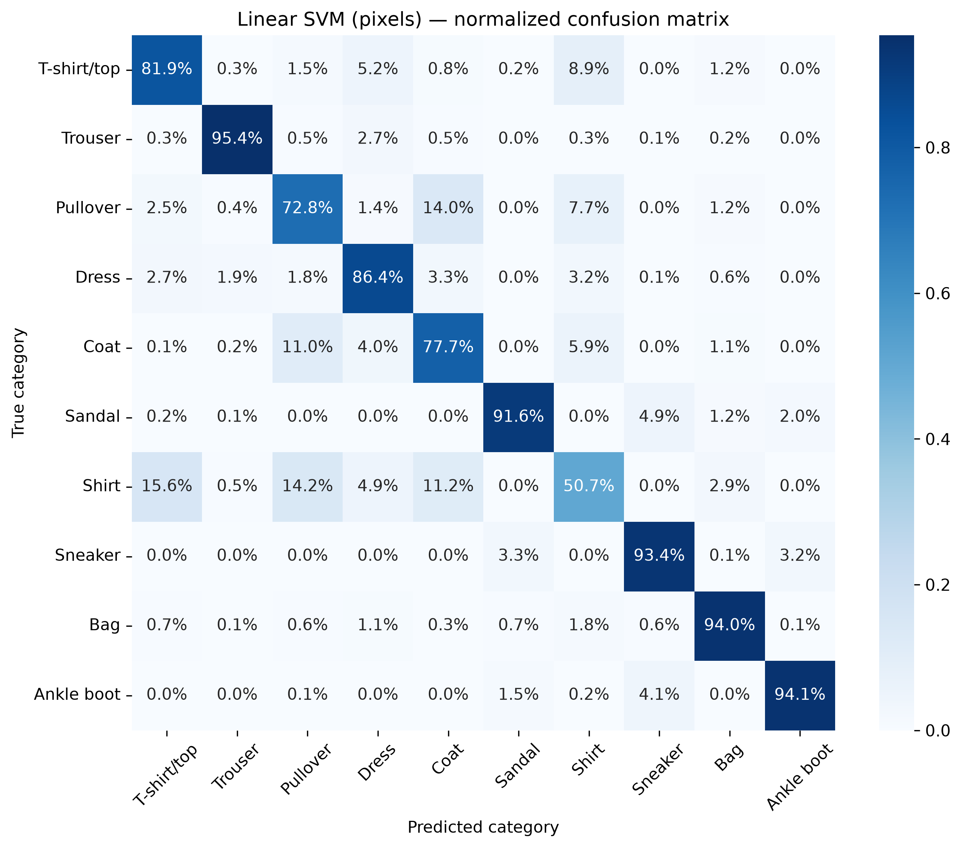
IMAGE-TAGGING AML BASELINE
Model 4: Linear Support Vector Machine (Linear SVM)
Architecture & Optimization
Linear SVM Test Confusion Matrix
• LinearSVC optimizing squared-hinge loss with L2 regularization.
• One-vs-Rest (OvR): 10 independent binary hyperplanes.
• StandardScaler(with_mean=False) preserves feature sparsity.
• Winner: C = 0.1 on Pixels | C = 1.0 on HOG.
Test-Set Results
PIXELS (784-D)
83.80% Acc
MACRO F1
83.57%
SHIRT RECALL
50.7% ⚠
LATENCY
0.0013 ms
HOG (324-D)
84.23% Acc
MACRO F1
84.06%
SHIRT RECALL
54.6%
LATENCY
0.0006 ms
Speed vs. The Margin Ceiling
• Fast Model: 0.0006 ms/image (450× faster than k-NN, 43× faster than RF).
• Compact: Only 3,250 weights on HOG and 7,850 weights on Pixels.
• Margin Ceiling: Flat hyperplanes drop Shirt recall to benchmark low (50.7%).
Fig 6: Full 10×10 confusion matrix on held-out test set (SVM on Pixels)

Slide 9
IMAGE-TAGGING AML BASELINE
Master AML Benchmark: 8 Configurations Compared
Model Family | Feature Space | Test Accuracy | Macro F1 | Shirt Recall | Inference Latency | Model Complexity
Random Forest | Pixels (784) | 87.43% ★ | 87.31% ★ | 59.3% | 0.026 ms | 1,693,570 tree nodes
Random Forest | HOG (324) | 84.35% | 84.30% | 59.4% | 0.029 ms | 2,458,016 tree nodes
k-NN | Pixels (784) | 85.41% | 85.40% | 60.2% | 0.274 ms ⚠ | 179.44 MiB (RAM)
k-NN | HOG (324) | 83.84% | 83.85% | 62.6% ★ | 0.098 ms | 74.16 MiB (RAM)
Logistic Regression | Pixels (784) | 84.32% | 84.24% | 57.1% | 0.0007 ms | 7,850 weights
Logistic Regression | HOG (324) | 84.55% | 84.49% | 57.8% | 0.0004 ms ★ | 3,250 weights
Linear SVM | Pixels (784) | 83.80% | 83.57% | 50.7% ⚠ | 0.0013 ms | 7,850 weights
Linear SVM | HOG (324) | 84.23% | 84.06% | 54.6% | 0.0006 ms | 3,250 weights
Accuracy Ceiling (87.4%)
Latency vs. Memory Trade-Off
Universal Shirt Failure
• All 4 models plateau between 83.8% and 87.4%.
• Adding 2.4M tree parameters yields <3.1% gain.
• Linear models infer in 0.0006 ms with tiny storage.
• k-NN is 450× slower and keeps 179 MiB in RAM.
• All 8 models trapped at 50.7%–62.6% Shirt recall.
• Proves feature representation is the true bottleneck.

Slide 10
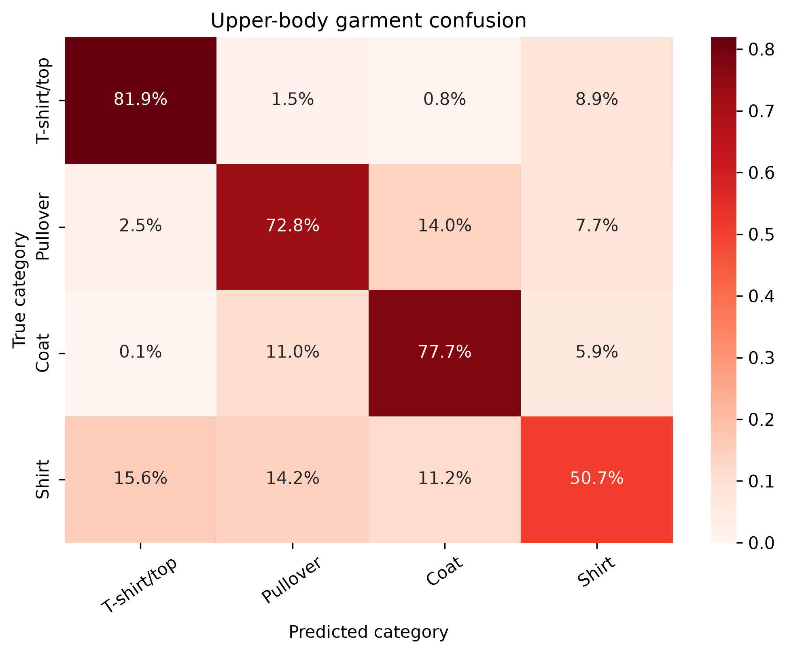
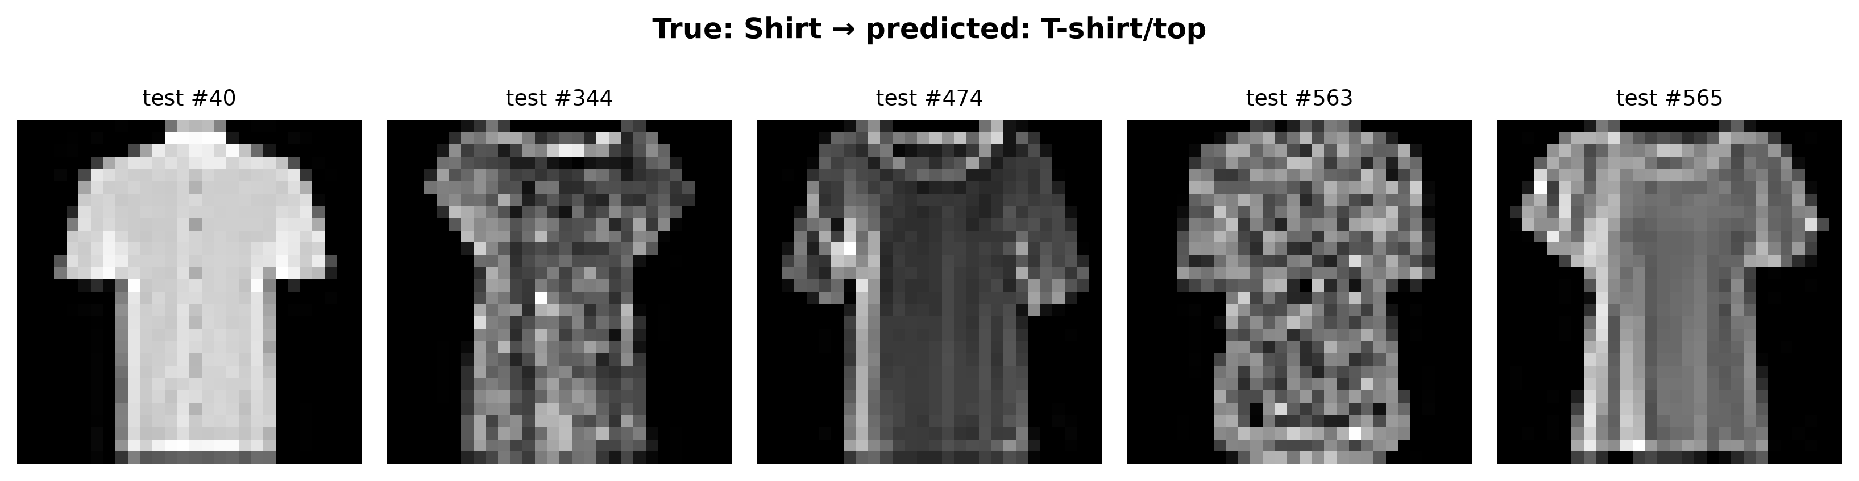
IMAGE-TAGGING AML BASELINE
Error Analysis: "The Gap" & Upper-Body Confusion
THE 35-PERCENTAGE-POINT RECALL CHASM
Trousers, Bags & Shoes reach 93%–97% recall.
Shirts collapse to 50.7%–62.6% across all 8 configurations.
Empirical Confusion Evidence
Where Do Misclassified Shirts Go?
Confusion Path | Error Rate | Underlying Cause
Shirt → T-shirt | 13.1% – 16.6% | Lacks collar height at 28×28
Shirt → Pullover | 8.2% – 14.2% | Shares torso and sleeve mass
Shirt → Coat | 7.5% – 11.4% | Dark plackets mimic open lapels
Pullover → Coat | 8.4% – 16.8% | Cardigans mirror coat fronts
Fig 7a: Upper-body 4×4 confusion matrix (SVM on raw pixels)
Why Handcrafted Features Fail
• Upper-Body Confusion: 32% to 41% of shirts are mistaken for other tops.
• Physical Resolution: Collar tips span only 1–2 pixels at 28×28.
• Torso Dominance: Broad torso mass drowns out subtle collar signals.
• Cell Pooling: 7×7 HOG pooling smooths away fine edge transitions.
Fig 7b: Shirt instances consistently misclassified as T-shirts

Slide 11
IMAGE-TAGGING AML BASELINE
Phase 2 CNN Bridge & Quantitative Targets
Phase 1 Handcrafted Ceiling
Phase 2 CNN Solution
• Vector Flattening destroys 2D spatial pixel adjacency.
• HOG 7×7 cell pooling smooths away 1–2 px collar tips.
• Linear hyperplanes & trees cannot separate overlapping torsos.
• 3×3 Receptive Fields preserve 2D local spatial adjacency.
• Weight Sharing detects collars consistently across the canvas.
• Learns hierarchical features (edges → textures → collars).
Auditable Phase 2 Quantitative Success Criteria
TARGET 1: SHIRT RECALL
TARGET 2: UPPER-BODY CONFUSION
TARGET 3: OVERALL MACRO F1
≥ 80.0%
< 15.0%
≥ 91.0%
Elevate Shirt recall from 50.7%–62.6% up to ≥ 80.0%, closing the 35% gap.
Cut Shirt misclassification into T-shirts/Pullovers from 32%–41% to < 15.0%.
Lift overall test Macro F1 from 87.3% to ≥ 91.0% on the exact same 10k test split.
Key Takeaway: The performance bottleneck lies in handcrafted visual features, not classifier capacity. Phase 2 leverages spatial convolutions to learn optimal filters directly from image data.

