Slide 1
IIT POKERBOTS · 2026
1141
Information Warfare Bot
Wins
DominatorBot
316
Team NOTATO · IIT Pokerbots 2026
Anant Jain
Losses
2nd
Overall - Prelims

Slide 2








DominatorBot - Architecture Overview
PERCEIVE
AUCTION
ADAPT
EXECUTE
Equity engine
Opponent model
Decision engine
Sealed bid engine
O(1) preflop table lookup
Adaptive MC (90-650 sims)
Exhaustive river when opp card known
Expected-Pot scaled bid sizing (via linear regression)
K-Means clustered equity tiers × randomized ranges
Empirical True Value modeling (Offensive + Defensive values) tuned from bot logs
18-hand rolling recalibration
65/35 recent vs cumulative blend
Derives: call_scale, aggro_boost
Street-specific skepticism
SPR + pot commitment gates
Position-aware preflop fold
Board analyzer
Time management
Action selector
Texture: paired · monotone · trips
17-class hand strength
OESD / gutshot / flush / combo draws
Scales sim budget to time bank
Degrades gracefully under pressure
20s total across 1000 rounds
Check-raise with monsters
Draw semi-bluff sizing
Catch-bluff vs overbets
KEY INSIGHT
We won the auction
They won the auction
VS
Near-zero bluff frequency (they see through us)
Extra skepticism on opponent bets (+0.12 margin)
Tighter investment cap (max 25% stack w/o monster)
Exhaustive equity → near-perfect decisions
Massive value extraction (thin value bets)
Near-zero call margin → never fold the best hand

Slide 3
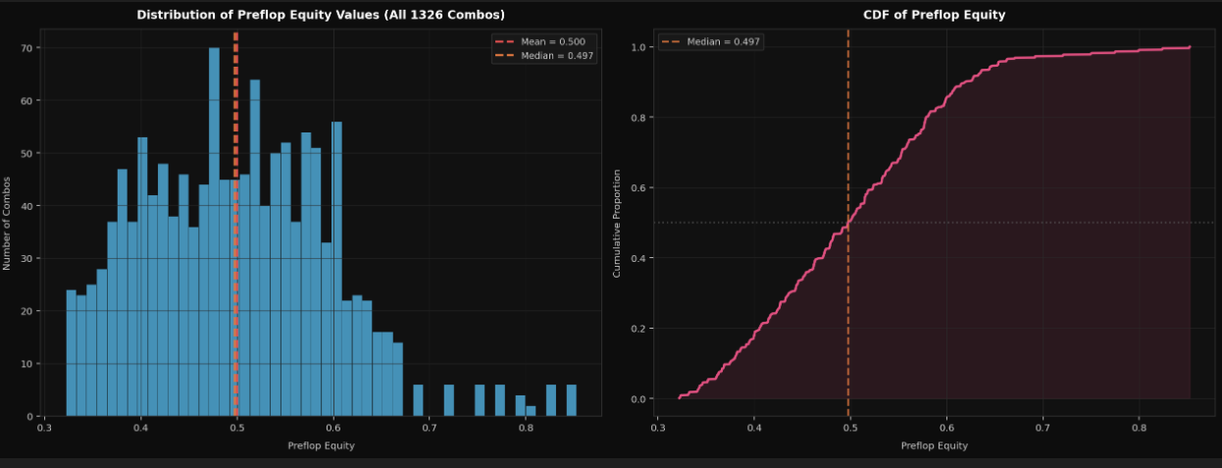
Equity Estimation - Monte Carlo, Exact Lookup & Exhaustive River
PRE-FLOP: Exact Table Lookup
• Full 1,326-entry table: every unique 2-card combo
• Indexed by canonical suit order (c < d < h < s)
• Eliminates all MC noise on most impactful street
• O(1) lookup - zero computation cost
POST-FLOP: Adaptive Monte Carlo
• Sim count scaled by street depth + time bank
Street | Opp Known? | Method
Preflop | N/A | Lookup Table
Flop/Turn | No / Yes | Monte Carlo
River | Yes (1 card) | EXHAUSTIVE
• River + known opp card → exhaustive (~44 unknowns)
• Flop: 90–600 sims · Turn: 130–650 · River: 120–600
• Time bank checked every query - never runs over limit
Key Edge: Exhaustive River Evaluation
On a complete river with one known opponent card, we enumerate all ~44 remaining deck cards for exact equity - no sampling error. This gives perfectly calibrated EV at the most decisive moment.
Our bot operates on a four-pillar architecture - Perceive, Auction, Adapt, and Execute - anchored heavily on whether we win or lose the information warfare auction.

Slide 4
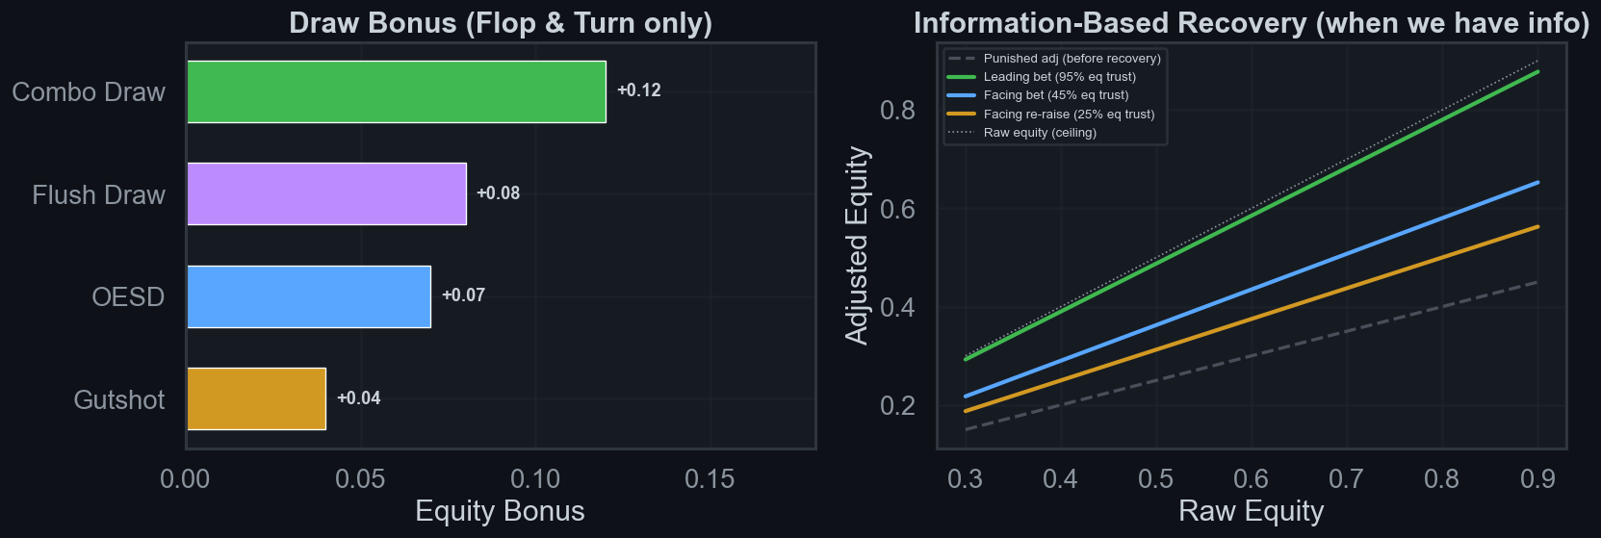
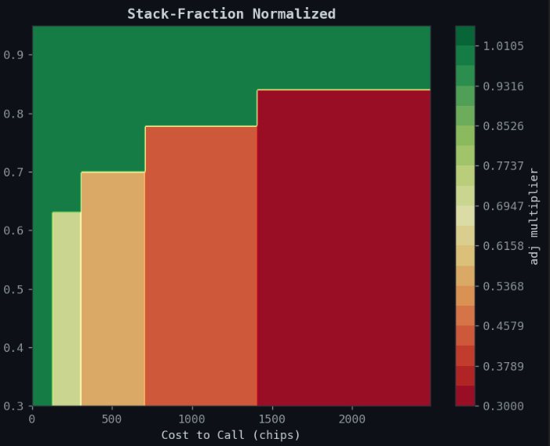
Adjusted Equity - The Decision Engine
While raw equity calculates the pure mathematical probability of winning, adjusted equity determines the actual profitability of taking action.
Raw Equity (eq)
Apply Penalties
Apply Recovery
Adjusted Equity (adj)
MC / Table
▶
bet, street, board, info
▶
vs. aggro opp
▶
final metric
Left: equity bonus added for each draw type on flop/turn · Right: information-based recovery restoring adj toward raw eq

Slide 5
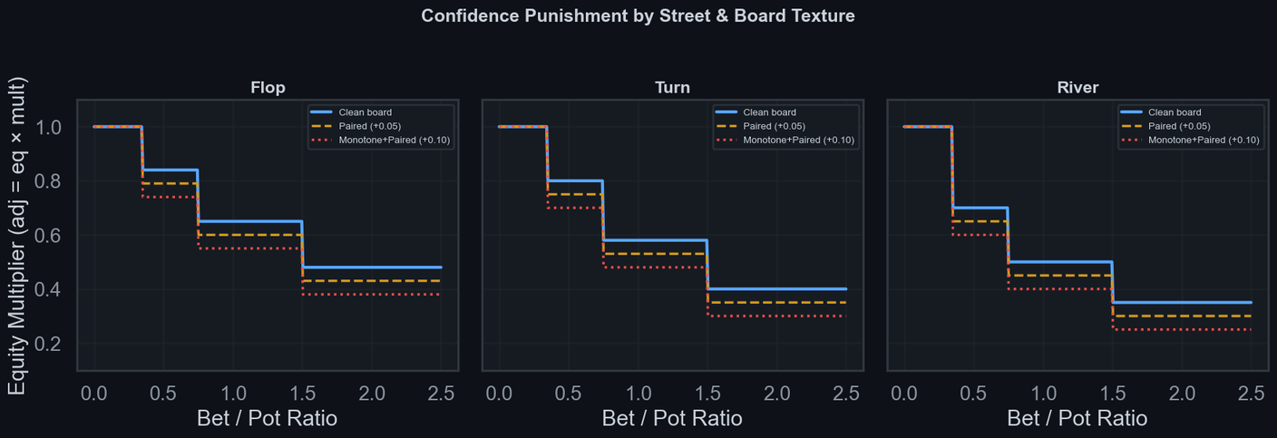
Confidence Punishment - Tiered Multiplier System
Our tiered confidence punishment system increasingly penalizes large bets the closer we get to the river, especially when we are at an information disadvantage
Hard Multipliers (Special Cases)
River check-raise: ×0.30 (almost never a bluff)
Turn overbet (br>1.0, eq<0.87): ×0.38
Opp has info on us (br>0.20): ×0.60
xp = paired +0.05, monotone +0.05, trips +0.10
Flop (Loosest)
Turn (Medium)
River (Tightest)
Draws still live. ×0.32 - 0.84 range. Most forgiving penalties.
One card to come. ×0.25 - 0.80 range. Tighter than flop.
No outs left. ×0.20 - 0.70 range. Only strong hands survive.
Information Asymmetry Penalty
When opponent holds info on us (br > 0.20, eq < 0.90): ×0.60 multiplier. Any meaningful bet from an info-holding opponent is treated as credible.

Slide 6
Confidence Recovery - Exploiting Aggressive Opponents
if self.call_scale < 1.0:
rec = (eq − adj) × (1.0 − self.call_scale) × 0.55
adj = min(eq, adj + rec)
call_scale < 1.0
Soft Cap at eq
Kicks in when opponent aggression crosses threshold. Higher aggression = lower scale.
adj never exceeds raw equity. This prevents over-folding without causing over-calling on weak hands.
Recovery Amount
Anti-Exploit Guard
Proportional to the gap between adj and eq, scaled by (1 − call_scale). More aggro = bigger recovery.
Prevents opponents from profitably bullying us with persistent aggression across an entire match.
Aggression Rate | call_scale | Effect
ba > 0.50 (hyper-aggro) | 0.60 | Strong recovery — rarely fold to large bets
0.40 < ba ≤ 0.50 | 0.70 | Moderate recovery
0.30 < ba ≤ 0.40 | 0.82 | Light recovery
ba < 0.12 (very passive) | 1.28 | Tight calling — fold more, let them bluff into us

Slide 7
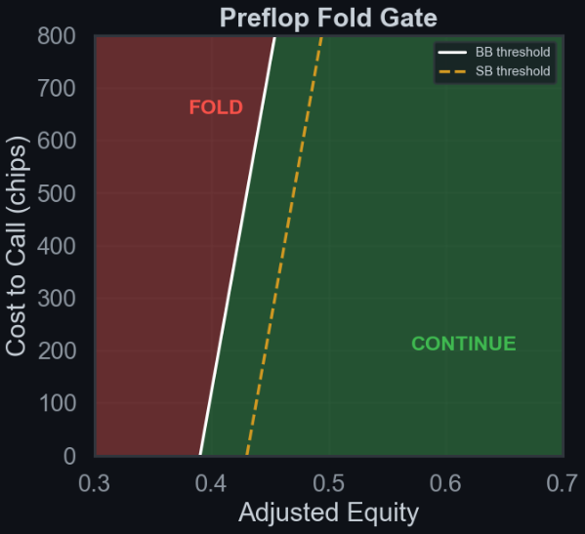
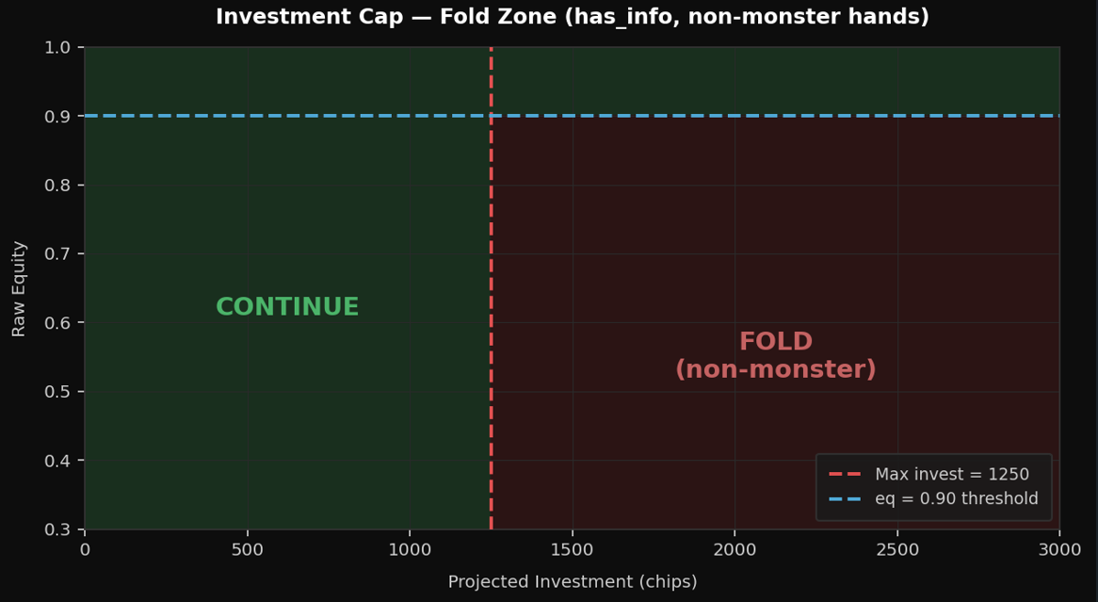
Folding and Calling Strategy - Dynamic Equity Floors
Condition | Equity Floor | Rationale
Pot > 700 or projected | 54% (or pot odds, whichever higher) | Base commitment threshold in large pots
Already committed >22% | Just pot odds | Cheap to call
SPR < 1.5 and bet > 50% | < 38% (or pot odds) | Near stack-off = lower bar to continue
Already committed >55% | 28% (or pot odds) | Almost all-in anyway, call
Paired board + large bet (>38%) | 60% minimum | Paired boards inflate opponent trips
Post Flop
Pot commitment logic
If our bot has extra information (see opponent’s card), our equity is reliable → call as soon as it beats pot odds, no buffer needed.
If opponent has info on our bot, our equity is likely overestimated → require a strong safety margin (~12%) before calling.
Preflop
Info Asymmetry Protection
Draw Type | Bonus
Combo (flush + straight) | +0.10
Flush draw | +0.07
Open-ended straight (OESD) | +0.06
Gutshot | +0.03
Draw Type | Bonus
• Apply last bonus to decide whether call or fold on our adjusted equity and if
• Opponent has our card: cap invest at 25% of stack
• Non-monster hand + proj_invest > 1250: FOLD
• Equity threshold for exception: eq ≥ 0.90
if adj > (p_odds + margin + pip):
return ActionCall() if cs.can_act(ActionCall) else ActionCheck()
else:
return ActionFold() if cs.can_act(ActionFold) else ActionCheck()
• BB fold gate lower than SB (already invested)
• Preflop gate: 0.39 + min(0.12, cr×0.40) (BB)
• Preflop gate: 0.43 + min(0.12, cr×0.40) (SB)

Slide 8
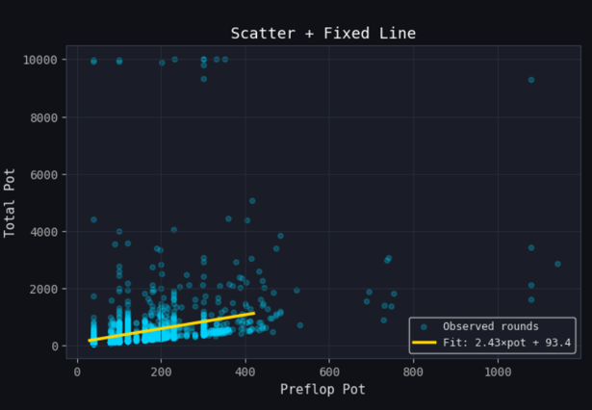
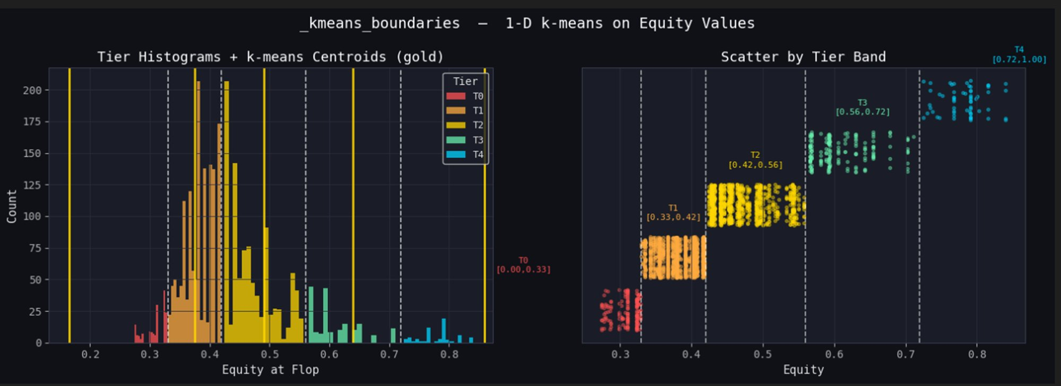
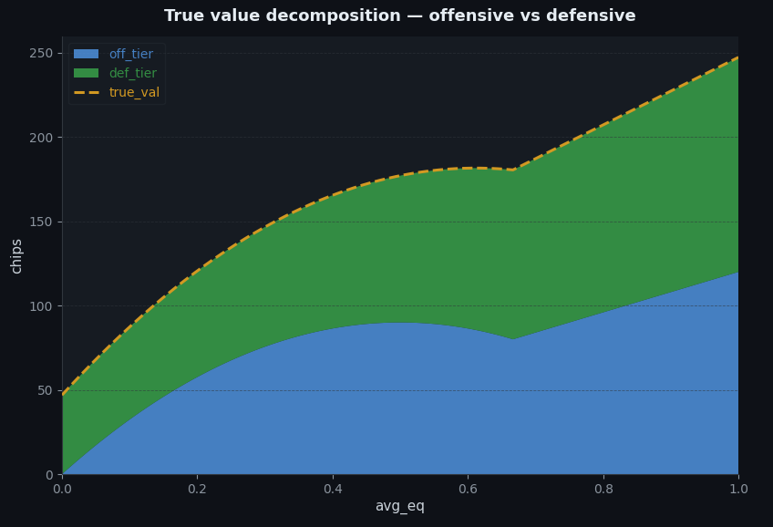
Auction Optimizer - From Naive to Data-Driven
The auction is about gaining info AND denying it to the opponent.
Step 3: True Value - Offensive + Defensive
Step 2: K-Means Equity Tier Clustering
Step 1: Expected Pot Estimation
Variable | Formula
Expected payoff | Δeq × exp_pot
off_base | mean( |Δeq| × exp_pot ) over rounds where we won auction
emp_delta | trimmed_mean(payoff | we won) − trimmed_mean(payoff | opp won)
def_base | emp_delta − off_base
off_mult | 12 · eq · (1 − eq) if eq ≤ 2/3; 4 · eq if eq > 2/3
def_weight | clip(0.70 + 1.20 · avg_eq, 0.70, 1.90)
off_tier | off_base × off_mult
def_tier | def_base × def_weight
T4 (Top) | T3 | T2 | T1 | T0 (Low)
0.72 | 0.56–0.72 | 0.42–0.56 | 0.33–0.42 | ≤ 0.33
total_pot = 2.43 × preflop_pot + 93.4
R² = 0.674 | Median |error| = 65 chips
Why this matters: A naive bid of 50 chips is ~26% of exp_pot when pot=40 but only ~5% when pot=400. Our bid must scale with expected pot to avoid systematic overbidding on small pots and underbidding on large ones. We approximated the fit to exp_pot = 2.5 × pot + 100 for code simplicity.
Why k-means? Uniform x-axis splits (e.g. 0.20 buckets) put most hands in 1-2 tiers. 1-D k-means clusters by density - placing tier boundaries where equity values naturally separate. This gives finer granularity in the crowded 0.35–0.55 zone where most flop equities land, and coarser bins at the extremes where hands are rare.
Key insight: Off-base is the average chip value gained from auction information for a given equity tier, estimated via Monte Carlo (5000) simulations and scaled by expected pot size. Def-base is the defensive value of winning the auction, i.e., denying the opponent access to your card information.

Slide 9
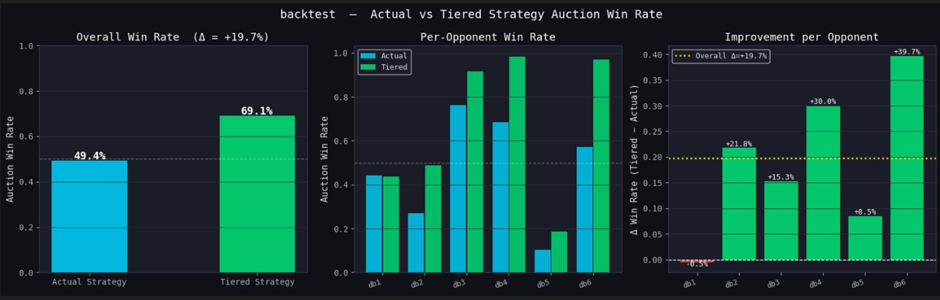
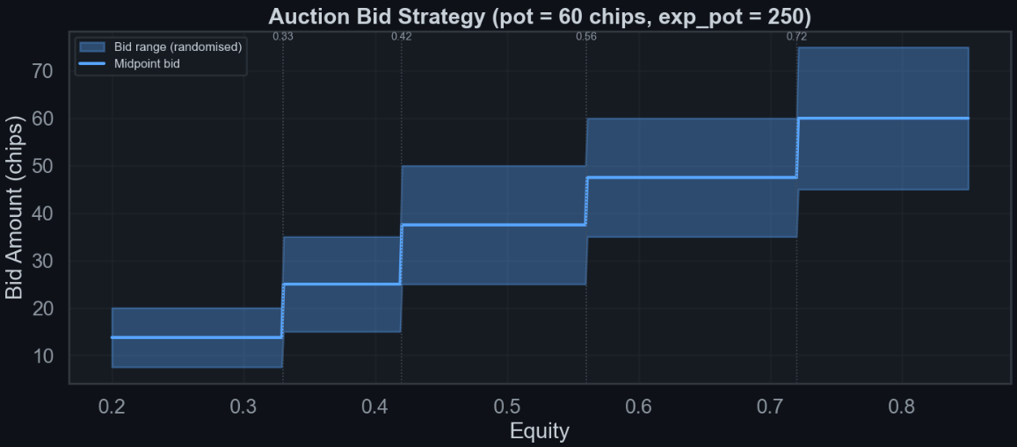
true_val
off_tier + def_tier
tier_opp = opp_bids[mask]
derive_bid_range()
bid_lo = true_val × lo_mult
bid_hi = true_val × hi_mult
fractions
frac_lo = bid_lo / avg_exp
frac_hi = bid_hi / avg_exp
blend w/ opponent
frac_lo = 0.55×theory + 0.45×opp_P60
frac_hi = 0.45×theory + 0.55×opp_P85
final bid (per tier)
bid = int(exp_pot × uniform(frac_lo, frac_hi))
Final Data Visualization
frac_lo (floor) & frac_hi (ceiling)
55% theory + 45% opponent q60 (60th percentile)
Lean on what the info is worth. Floor ensures we don't bid less than the expected value justifies.
45% theory + 55% opponent q85 (85th percentile)
Ceiling driven more by opponent aggression. If they bid aggressively, we must raise our max to compete.
exp_pot = pot × 2.5 + 100 # estimated total pot value
bid = int(exp_pot × fraction) # fraction ∈ [0.03, 0.30] scaled by equity
Final Ranges and Equity Visualization

Slide 10
Raising Strategy - Street-by-Street
Condition | Action | Sizing
Facing 3-bet (cost > 600, adj > 0.80) | Raise | 2.0–3.0× pot
adj > 0.80 | Open raise | 3.0–4.5× pot
adj > 0.64, cost ≤ 20 | Medium raise | 2.5–3.5× pot
adj > 0.52, cost ≤ 20 | Small raise | 2.0–3.0× pot
adj < 0.73, already | Skip raise | – (lean toward calling)
Situation | Condition | Action
Betting first | Has auction info + equity > 52% | Bet 28–40% pot
Betting first | Equity > 78% | Bet 55–90% pot
Betting first | Equity > 62% | Bet 40–65% pot
Betting first | Equity < 42% | Bluff 55–80% pot (rare)
Facing a bet | Equity > 88%, no info disadvantage | Re-raise 2.8–4.5× bet
Situation | Condition | Action
Facing a bet | Equity > 88%, monster hand | Check-raise 30% of the time (22%)
Facing a bet | Equity > 78%, info-reraise ok | Raise 2.8–4.0× bet (scaled down 15%)
Facing a bet | Has info + non-monster hand | No reraise call/fold only
Betting first | Equity > 96% | Slow-play check (4% of the time)
Betting first | Equity > 68% | Bet 70–125% pot, larger if strong
Pre-Flop
River
Flop/Turn
Raising Logic Summary
• Preflop: conservative with reraises, aggressive opens. Skip raise when adj < 0.73 and already invested.
• Flop & Turn: check-raise 22 - 30% with monsters. Semi-bluff draws 55 - 90% pot.
• River: value bet 55–90% when adj > 0.78. Precise 28–40% pot bets when we have opponent's card (info edge).
• Info guard: no reraise on flop/turn when info-advantaged, unless set / flush / straight with eq > 0.85.

Slide 11
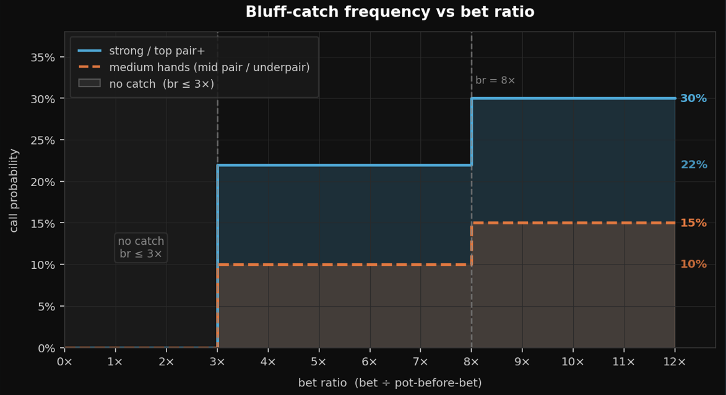
Tactical Exploits - Bluff Catching & Slowplay
BLUFF CATCHING vs. OVERBETS
Overbets (>3× pot) are statistically polarised — nearly
always either a bluff or the nuts.
Strong hands (set / two pair / flush / straight):
22% call freq → 30% for extreme bets (>8×)
Medium hands (mid pair / underpair):
10% call freq → 15% for extreme bets (>8×)
Randomisation prevents opponent from ever knowing
if an overbet will be called — forces honest sizing.
SLOWPLAY TRAP (4% Check-Induction)
Info Edge Exploitation
if adj > 0.96 and random.random() < 0.04:
return ActionCheck() # trap — induce bluff
Knowing opponent's card: river bet sizing shifts to precise 0.28–0.40× pot (thin value, not over-betting). Info-disadvantaged: raise frequency drops near zero, investment capped at 25% of starting stack for non-monster hands, as a failsafe to not overinvest with weak hands.
Near-nut hands check 4% of the time to bait opponent bluffs, then call or check-raise.

Slide 12
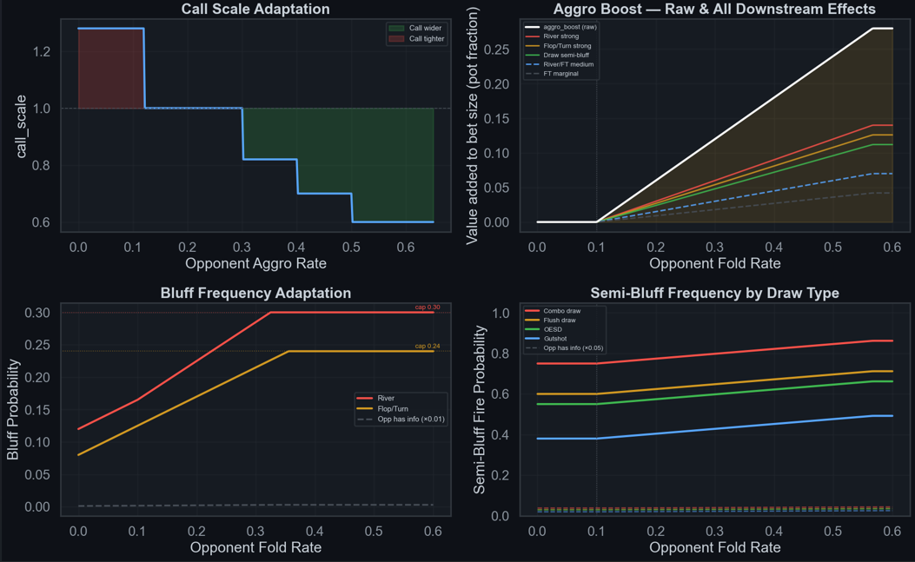
Opponent Modelling - Adaptive Strategy
Opponent stats are recalibrated every 18 hands using a 65% recent window / 35% cumulative blend, balancing short-term reads against long-term history to prevent overreacting to single-hand variance.
Knob | Function | Driven By | Effect
call_scale | Modulates call threshold | opp_aggro_rate | Aggro (>0.30) → tighter (0.60–0.82); passive (<0.12) → wider (1.28)
aggro_boost | Inflates bet sizing multipliers | opp_fold_rate | Activates at >0.10, caps at 0.28; added to sz across all streets
bf | Pure bluff fire probability | opp_fold_rate + aggro_boost | River min(0.30, 0.12+…); Flop/Turn min(0.24, 0.08+…); →×0.01 if opp has info
sb | Draw semi-bluff fire probability | opp_fold_rate + aggro_boost + draw type | Base 0.38–0.75 by draw; +aggro_boost×0.40; →×0.05 if opp has info
opp_fold_rate | Master observed stat | Opponent fold actions | Feeds aggro_boost, bf, and sb — high → bluff/semi-bluff more

Slide 13
Bot Randomization
Why Randomize?
5 Randomization Trigger Points
The Exploitation Problem
Deterministic bots have fixed patterns. Advanced opponents model these patterns and develop perfect counter-strategies, turning every decision into a known quantity.
The Randomization Solution
By injecting calibrated randomness at every key decision point, DominatorBot creates a mixed strategy that no single deterministic counter can exploit. Even if an opponent models our ranges perfectly, the randomized frequencies make exploitation unprofitable.
Key Principle
Each randomization is weighted, not coin-flip random. Frequencies are tuned to equity thresholds, opponent tendencies, and empirical opponent modelling.
Auction Bid
Uniform Range
Bids within equity-bucketed ranges using uniform randomization. Prevents opponents from reverse-engineering our hand strength from bid amounts.
Check-Raise
22% – 30%
Monsters are check-raised at balanced frequency. Prevents opponents from freely betting when we check.
Slow-Play Trap
4% (adj > 0.96)
Absolute monsters occasionally just check, inducing bluffs from opponents who misread passivity as weakness.
Overbet Catch
10% – 30%
Calls massive overbets at scaled probabilities. Prevents opponents from printing chips with unlimited overbet bluffs.
Pure Bluff
8/12% – 24/30%
Bluff frequency scales with opponent's historical fold rate. Maximises fold equity without over-bluffing.
Creates a highly exploit-resistant mixed strategy. Even if an opponent models our tendencies, calibrated randomness makes deterministic counter-attacks highly difficult

Slide 14
Bot Evolution - v1 → v2 → v3 (Final Submission)
v1 → v2: Three Core Upgrades
MC Sim Budget
Recal Window
EQ Key Sort
Before: Flat N=450/250/120
After: Adaptive N by street × info. River+info = exhaustive
Before: 30-hand window, slow
After: 18-hand, 65/35 blend - faster, noise-resistant
Before: Alphabetical ('T'<'A')
After: Same bug - only fixed in v3
v2 → v3: Six Targeted Fixes
EQ Key Sort Fixed
Flush/Straight Classification
Catch-Bluff Logic Added
Sort by (rank, suit) instead of alphabetical. All Ten combos now look up correctly.
==4 for draws only (was ≥4). Made hands now get correct 1.25× sizing.
Calls overbets (>3× pot) at calibrated random freq: 22–30% for strong hands, 10–15% for medium. Prevents opponents printing chips with pure overbet bluffs.
Auction Bid Reduction
Info Trust Blend
BB Gate Lowered
18–30% of exp_pot (was 22–36%). Better aligned with actual info value.
3-tier blend (was flat 0.45/0.55): facing re-raise: ×0.75/0.25; facing bet: ×0.55/0.45; no bet + info: ×0.05/0.95. More skepticism + 25% stack cap.
0.43 (SB/BB unified) → 0.39 BB / 0.43 SB split. Correctly defends hands like 8s7s that v1 folded. First introduced in v2.
# BUGGY (v2): key = ''.join(sorted(hand)) → sorted(['Ts','Ac']) = 'AcTs' WRONG
# FIXED (v3): sort by (_RV[rank], _SUIT_ORD[suit]) → canonical lookup every time

Slide 15
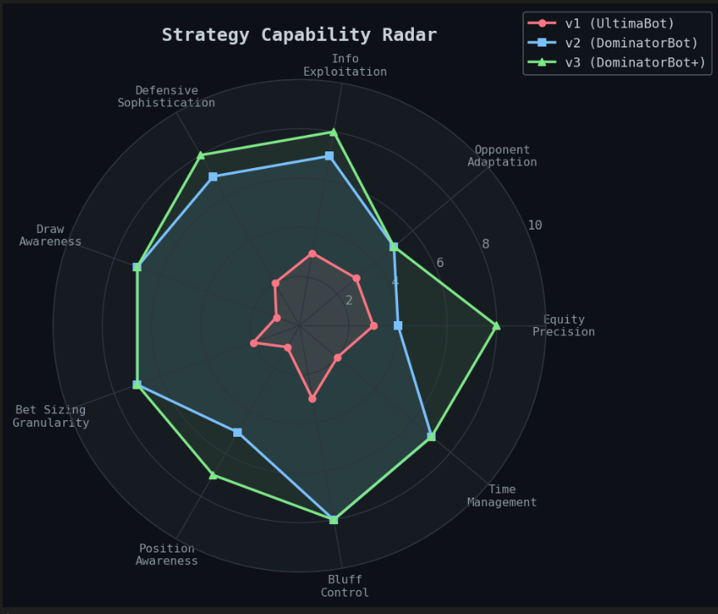
Performance Analysis - Version Comparison
Strategy Capability Radar — Key Observations
Equity Precision: sharpest spike (v2→v3), from EQ key fix + exhaustive river
v1: near-perfect circle - uniformly weak on every axis
Position Awareness: floor across all versions. The one unsolved dimension.
Defense + Info Exploitation: grow in lockstep - same auction-state system drives both
v3: right-heavy polygon. Strong at reading situations, shallow on positional execution.
v2: asymmetric middle. Concave on Bluff Control and Bet Sizing - exactly where v3's fixes landed.
Our strategy capability radar visualizes the massive leap in equity precision and information exploitation from our initial build to the final competitive version.

Slide 16
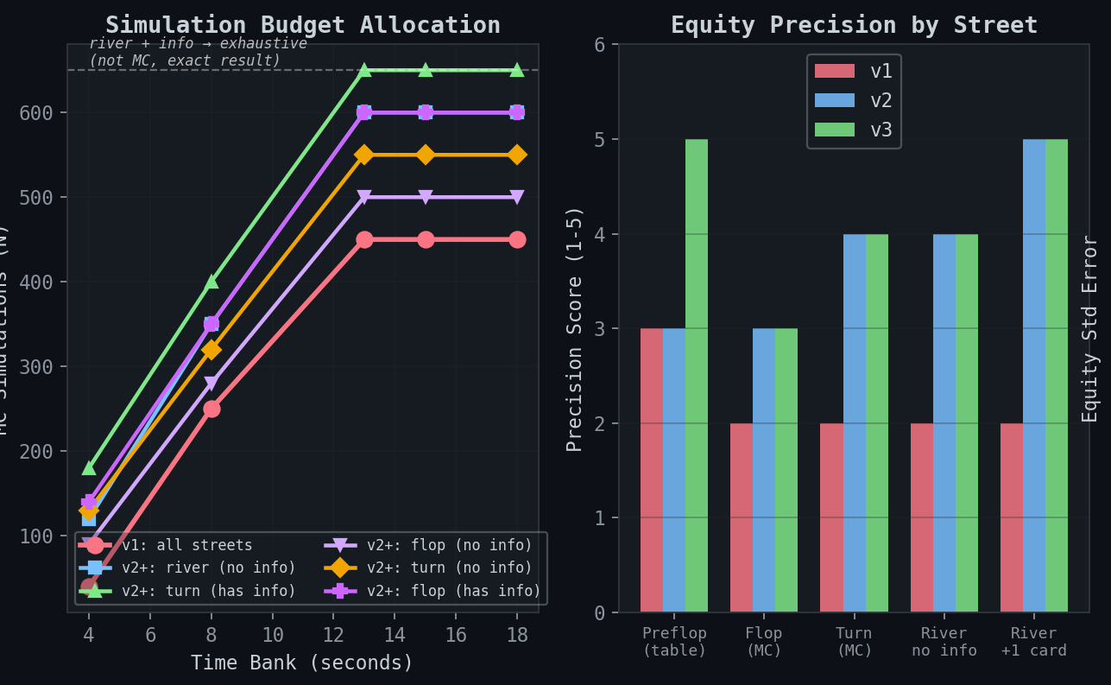
By intelligently reallocating our simulation budget, particularly with exhaustive river enumerations, we drastically improved our equity precision while staying within our strict time bank.
Simulation Budget
Equity Precision by Street
v3 pushes up to 650 sims on info-rich streets. On river with known opp card, drops MC entirely for exhaustive enumeration.
v3's biggest gain is preflop (table lookup fix) and river+1 card (exhaustive mode) — the two endpoints. Flop and turn remain shared ground between v2 and v3.

Slide 17
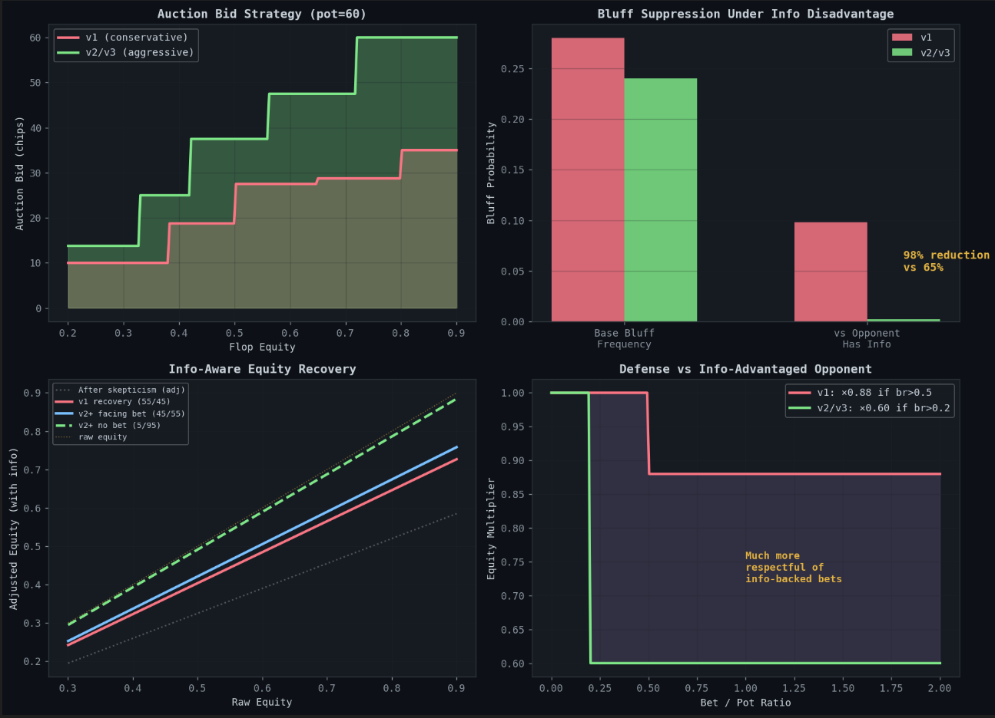
Comparing our iterations shows how the final bot significantly suppresses bluffs under an information disadvantage while bidding much more aggressively during the auction.
Auction Bid Strategy
v2/v3 bids nearly double v1 at every equity level. Info value scales with hand strength, and second-price means overbidding is the only real cost.
Bluff Suppression Under Info
When opponent holds info, v2/v3 cuts bluffing by 98% vs v1's 65%. Near-total suppression when bluffs are likeliest to get caught.
Info-Aware Equity Recovery
Holding info + no bet: adj ≈ raw equity (5/95 blend). Facing a bet: pulls back to 55/45, correctly discounting opponent signal.
Defense vs Info Opponent
v1: ×0.88 penalty only after br > 0.5 too little, too late. v2/v3: ×0.60 from br > 0.2, treating any bet from info-holder as credible.

Slide 18
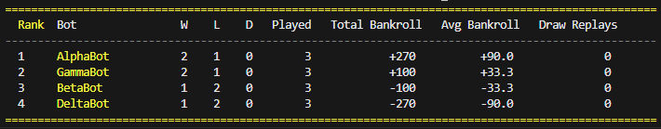
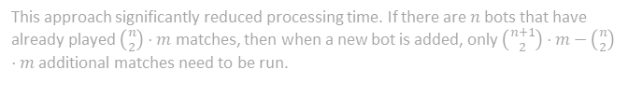
Tournament.py - Local Bot Evaluation Engine
Custom round-robin framework for head-to-head testing all bot variants before submission.
Round-Robin Pairings
How It Drove Improvement
Every bot plays every other (nC2 × best-of-N). Results ranked by match wins, then bankroll.
We iteratively developed multiple bot variants, isolating features like SPR awareness, aggression thresholds, and auction strategy. By analyzing tournament match logs, we identified the most synergistic feature combinations and continuously re-ran tournaments to refine our core model.
ranking = sorted(stats.items(), key=lambda x: (x[1]["match_wins"], x[1]["total_bankroll"]), reverse=True) # sort by wins, then bankroll (desc)
Parallel Workers + Cache
How It Drove Improvement
ProcessPoolExecutor for parallel matches. JSON cache stores past results — reruns only compute new matchups.
This approach significantly reduced processing time. If there are $n$bots that have already played $\left({n \atop 2}\right)⋅m$matches, then when a new bot is added, only $\left({n+1 \atop 2}\right)⋅m−\left({n \atop 2}\right)⋅m$additional matches need to be run.
# Workers init ONCE (not per-match). Cache prevents replaying known results.
cached = _try_resolve_from_cache(a, b, key, cache, retries) # instant if found
Draw Replay Until Decisive
How It Drove Improvement
Tied matches replayed automatically. - best-of flag runs 3×/5×/10× reps to separate real edges from variance.
Ensured every code change was tested against the full opponent field before uploading. In total, we developed around 120 bots using this approach and selected the one with the best performance, minimal overfitting, and lowest variance.
Demo Tournament Output

Slide 19
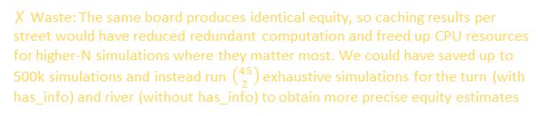
Missed Opportunities
Design choices that were directionally right but couldn’t be implemented due to time constraints/ proper testing.
MC Redundancy — No Street Cache
# Current: _equity() called fresh on EVERY get_move() call
# Fix sketch:
if self._cached_street != street or self._cached_board != board:
self._cached_eq = self._run_mc(cs, gi)
self._cached_street, self._cached_board = street, board
eq = self._cached_eq
✗ Waste: The same board produces identical equity, so caching results per street would have reduced redundant computation and freed up CPU resources for higher-N simulations where they matter most. We could have saved up to 500k simulations and instead run $\left({45 \atop 2}\right)$ exhaustive simulations for the turn (with has_info) and river (without has_info) to obtain more precise equity estimates
if my_cost > 0 and has_info:
self.opp_bid_history.append(my_cost) # append known opponent bidding
elif my_cost == 0 and self.opp_has_info:
est = max(self.my_bid + 5, self.my_bid * 1.5) # estimate opponent
bidding to be close to ours if we lose and append
if self.opp_bid_history:
recent = self.opp_bid_history[-80:]
self.opp_bid_avg = sum(recent) / len(recent)
Adaptive Auction Strategy Based on Opponent Bidding
We have dead code in our bot for opponent bid history that is never used, although it was intended to be part of our updated auction logic. After winning the auction, large raises can signal our information edge and cause opponents to fold. Randomizing between information-sized and standard bets would help disguise this tell. We were testing a much better auction strategy that uses opponent bid history, but we couldn’t integrate it into our main codebase due to time constraints.
info_curve = 4.0 * eq * (1.0 - eq) # peaks at eq=0.5
deny_bonus = max(0.0, (eq - 0.55) * 0.12) # strong hands deny info
base_bid = int(exp_pot * (info_curve * 0.14 + deny_bonus)
if eq < 0.32: # weak hand — info worthless
base_bid = min(base_bid, max(0, int(exp_pot * 0.02)+ 20))
if len(self.opp_bid_history) >= 8:
cap = int(self.opp_bid_avg * 2.5 + 15)
base_bid = min(base_bid, cap) # don't overbid a frugal opp
bid = max(0, min(base_bid, my_chips)) self.my_bid = bid return ActionBid(bid)

Slide 20









Key Advantages and Takeaways
IIT Pokerbots 2026 · Preliminary Round
DominatorBot excels through precise hand reading, aggressive information control, and a robust architecture that adapts quickly while remaining stable under pressure.
ADVANTAGES
Precision equity
1,326
Auction dominance
2nd
Dual play modes
2
suit-aware combos
2nd-price advantage
asymmetric modes
O(1) preflop table → adaptive MC (90–650 sims) → exhaustive river enum when opp card known
K-Means clustered tiers with opponent-aware ranges; win = capture True Value (Offense + Defense), lose = force opponent to overpay.
Won auction: thin value bets, near-zero call margin. Lost auction: zero bluffs, 25% stack cap
Deep hand reading
17
Fast adaptation
18
Exploit resistance
5
hand classes
hand recalibration
defense layers
Full classifier (SF → set → TPGK → draws → nothing) + board texture + street-specific skepticism
65/35 recent-vs-cumulative blend → derives call_scale + aggro_boost; degrades gracefully on time
Position-aware fold gate, SPR commitment logic, check-raise traps (30%), catch-bluff calls (22–30%)
TAKEAWAYS
Information > chips
Asymmetry is alpha
Adapt fast, degrade gracefully
The auction is the real game. A 2nd-price bid that wins cheaply gives exact equity - turning every subsequent street into a near-solved decision.
Most bots play identically regardless of who sees the card. Separate strategies for "we have info" vs "they have info" extracts value others leave on the table.
With 20s across 1,000 rounds, every millisecond counts. A 3-tier equity engine (table → MC → exhaustive) gives the right precision while staying under budget.

