Slide 1
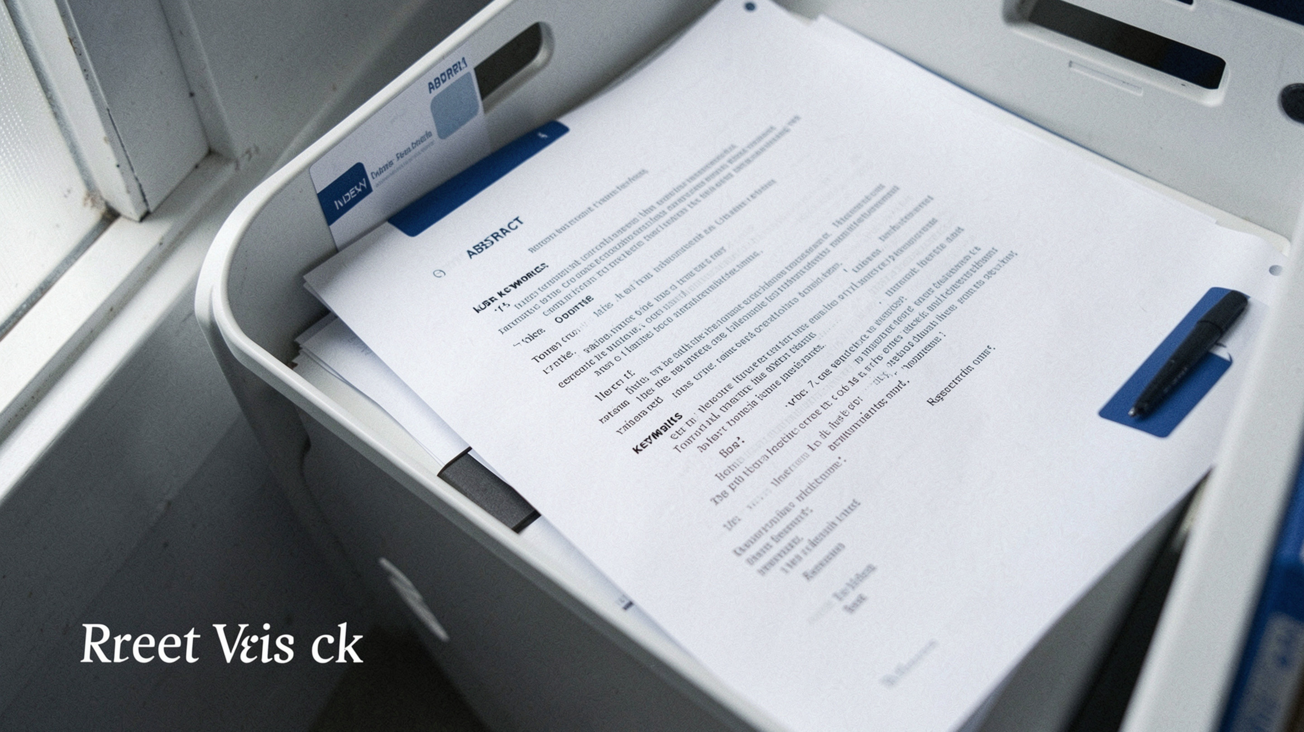
SOFTWARE DESIGN ANALYSIS REPORT
AI Research Paper
Recommendation System
Anand Kumar Paswan · Anant Mittal · Anirudh Vasishth · Anish Kumar Rai

Slide 2



SYSTEM PURPOSE
Find the right paper faster
A recommendation workflow turns research intent into a ranked, inspectable result.
Analyze
Show
Analyze queries, interests, titles, abstracts, keywords, and metadata to return ranked papers.
Show authors, year, abstract, and source link.
Stack. Python with TF-IDF / cosine similarity · HTML/CSS/JavaScript · REST API · relational database
AI Research Paper Recommendation System
2

Slide 3
ARCHITECTURE · MODULES
Six modules divide the responsibility
Independent responsibilities make the system easier to develop, test, and change.
M1 · User Interface
M4 · Database Manager
Capture queries, filters, feedback
Depends on: M2, M3, M5
Store and retrieve system data
Depends on: Database
M2 · User/Profile Manager
M5 · Recommendation Engine
Manage profiles and preferences
Depends on: M4
Score and rank candidate papers
Depends on: M2, M3
M3 · Paper Search/Metadata Manager
M6 · Admin/Monitoring
Find and normalize paper metadata
Depends on: M4
Support administration and status reports
Depends on: M3, M4
AI Research Paper Recommendation System
3

Slide 4
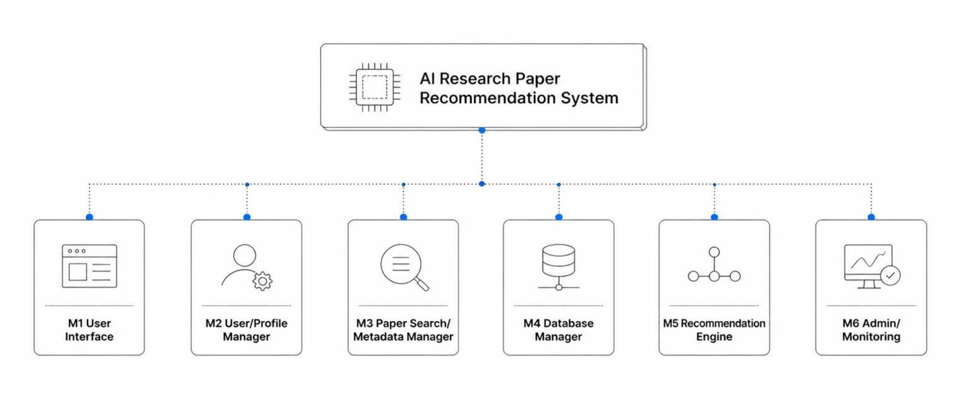
ARCHITECTURE · HIERARCHY
The system decomposes into a clear hierarchy
AI Research Paper Recommendation System
4

Slide 5
DEVELOPMENT STRATEGY
Hybrid design connects planning with reuse
Top-down. Define the goal and module boundaries.
Bottom-up. Build reusable text cleaning, similarity, database access, and ranking components.
Hybrid. Integrate through agreed interfaces.
  Complete system
  Identify modules and define interfaces
  Build reusable components
  Integrate modules
  System testing and refinement
Benefits: parallel teamwork, clear planning, easier testing
AI Research Paper Recommendation System
5

Slide 6
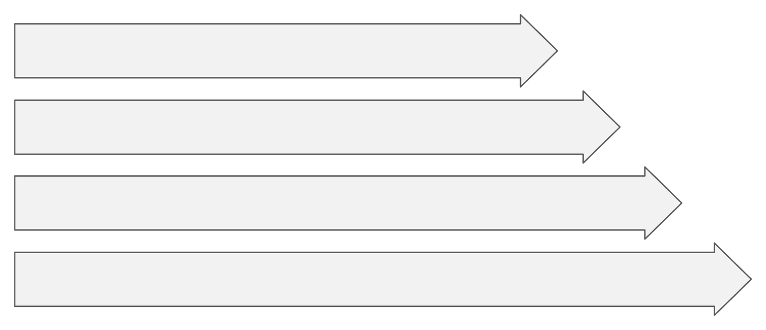
DESIGN STRUCTURE
Mix functions with domain objects
Functions
processQuery()
extractFeatures()
searchPapers()
calculateSimilarity()
rankRecommendations()
saveFeedback()
Generate Paper Recommendations
Process Query
Retrieve Papers
Extract Features
Classes
User · ResearchPaper · SearchQuery · Recommendation · RecommendationEngine
AI Research Paper Recommendation System
6

Slide 7
COUPLING ANALYSIS
Coupling stays data-oriented and manageable
All coupling is data coupling, kept low through defined interfaces, repository access, and role-based control.
Module pair | Shared data | Coupling level | How to reduce
M1–M5 | Data | Low | Defined interfaces
M3–M4 | Data | Low–moderate | Repository access
M2–M5 | Data | Low | Defined interfaces
M5–M3 | Data | Moderate | Narrow data contract
M6–M4 | Data | Low–moderate | Role-based control
AI Research Paper Recommendation System
7

Slide 8
COHESION ANALYSIS
Each module should do one job well
High functional cohesion is the target across the core modules.
 | Module | Single responsibility | Cohesion
M1 | User interaction | Functional / High | Keep calculations out of the UI
M2 | Profiles and preferences | Functional / High | Keep credentials separate
M3 | Search and metadata | Functional / High | Separate external connectors
M4 | Persistence | Functional / High | Separate repositories
M5 | Recommendation logic | Functional / High | Split feature extraction and ranking
AI Research Paper Recommendation System
8

Slide 9
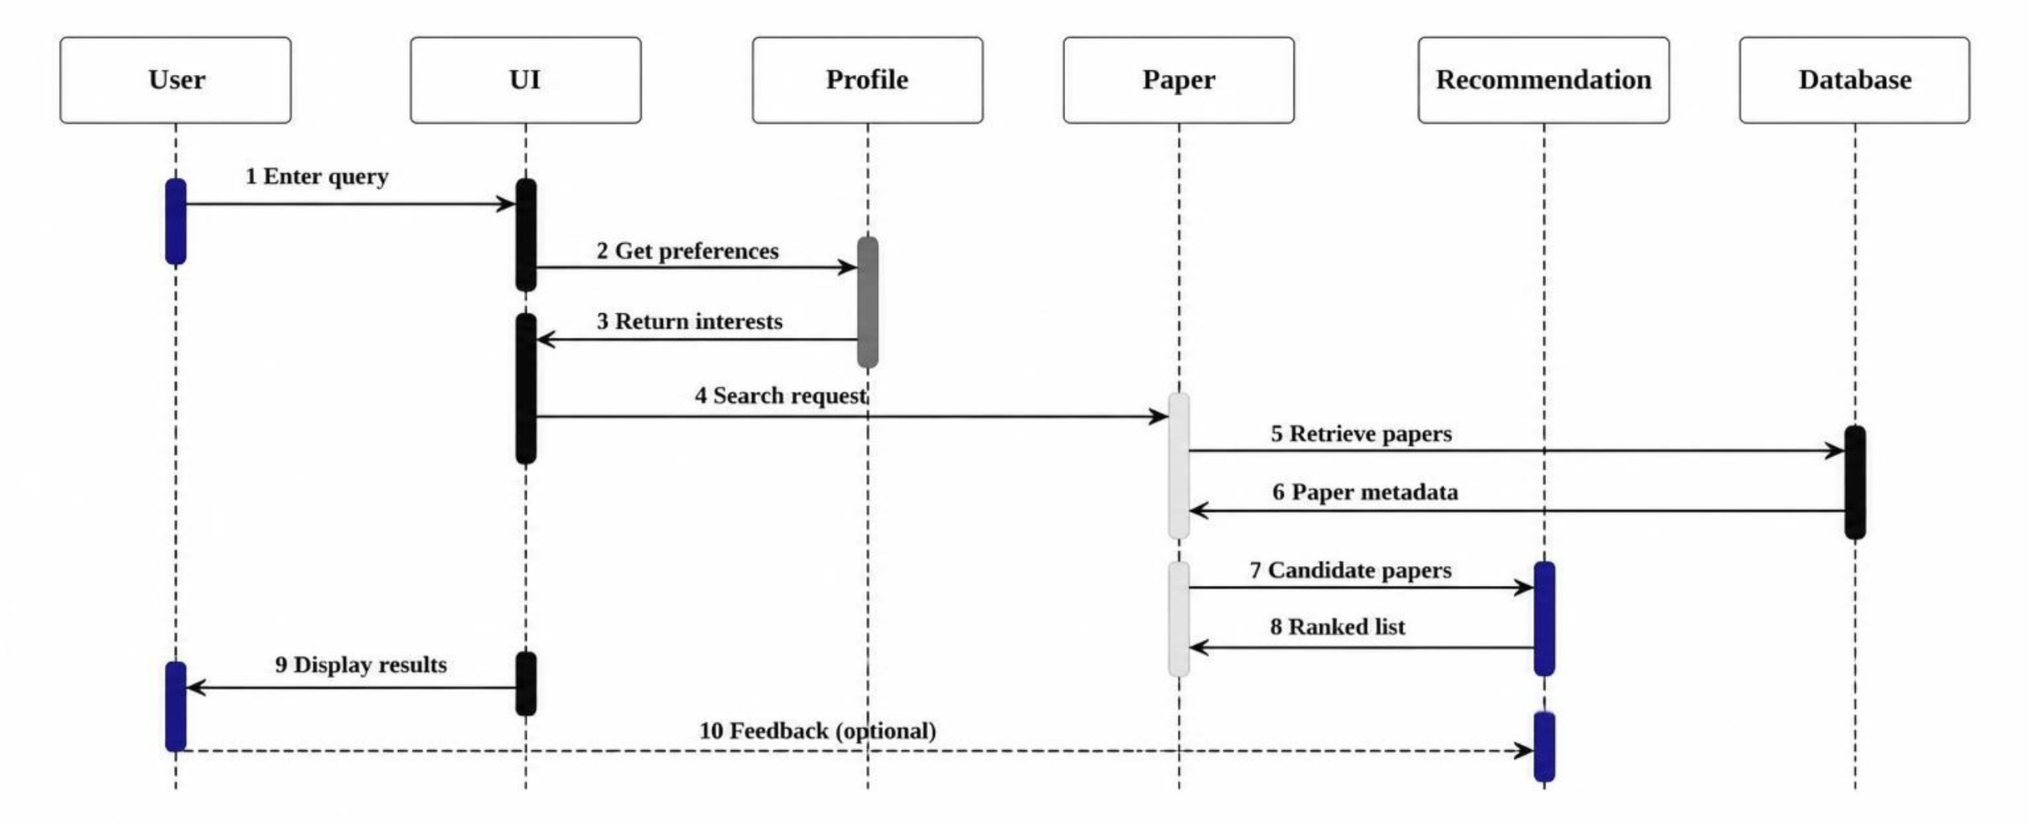
RUNTIME FLOW
A query becomes a ranked recommendation
The interaction crosses six lifelines while keeping the feedback loop optional.
AI Research Paper Recommendation System
9

Slide 10





CONCLUSION
Design quality comes from disciplined structure
Modularity
Maintainability
Scalability
Independent responsibilities
Reusable, focused components
Extend search and ranking independently
Reliability
Security
Testable data-flow boundaries
Role-based control and separated credentials
Thank You / Questions?
AI Research Paper Recommendation System
10

