Slide 1
JMS/RabbitMQ with Spring boot
By Anant Panthri

Slide 2
What is JMS?
JMS (Java Message Service) is an API that provides the facility to create, send and read messages. It provides loosely coupled, reliable and asynchronous communication.
JMS is also known as a messaging service.
Why is it Required?
Requirement of JMS
Generally, user sends message to application. But, if we want to send message from one application to another, we need to use JMS API.
Consider a scenario, one application A is running in INDIA and another application B is running in USA. To send message from A application to B, we need to use JMS

Slide 3
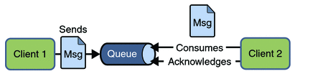
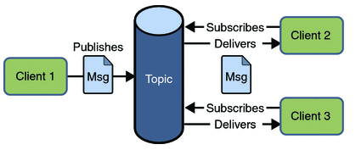
Messaging Domains
There are two types of messaging domains in JMS.
Point-to-Point Messaging Domain
Publisher/Subscriber Messaging Domain

Slide 4
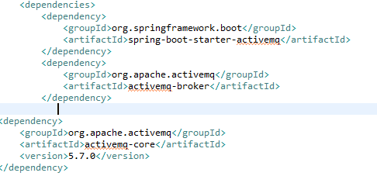
Configuration
Apache MQ
Dependency
this application requires download of apache mq compatible for java 1.8. Run maven batch and jar from win 64 make sure no application is utilising port 6161 or else apache mq wont run

Slide 5
RabbitMQ
What is RabbitMQ
A message brooking solution can act like a middleman for various services (e.g., a web application, as in this example). They can be used to reduce loads and delivery times by web application servers since tasks, which would normally take quite a bit of time to process, can be delegated to a third party whose only job is to perform them.

Slide 6
When and why should you use RabbitMQ?
Message queueing allow web servers to respond to requests quickly instead of being forced to perform resource-heavy procedures on the spot Message queueing is also good when you want to distribute a message to multiple recipients for consumption or for balancing loads between workers.
Requests can be created in one programming language and handled in another programming language - the two applications will only communicate through the messages they are sending to each other Due to that, the two applications will have a low coupling between the sender and the receiver.

Slide 7
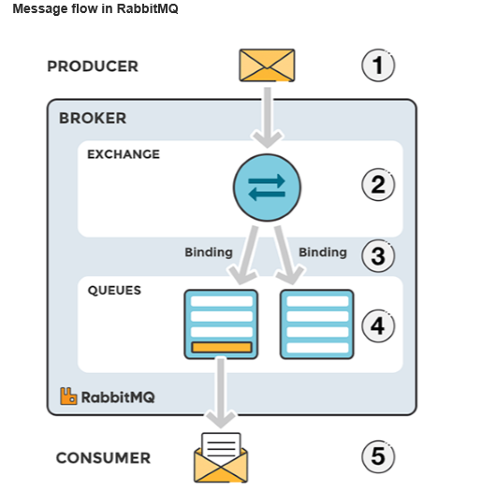

Slide 8
AMQP
The Advanced Message Queuing Protocol (AMQP) is an open standard application layer protocol for message-oriented middleware. The defining features of AMQP are message orientation, queuing, routing (including point-to-point and publish-and-subscribe), reliability and security.

Slide 9
Configuration
Steps
Download Erlang coz Rabbit is made on Erlang.
https://cmatskas.com/getting-started-with-rabbitmq-on-windows/
Download RabbitMQ
To check use this link→http://localhost:15672/#/
Download MariaDB
Change the port of maria DB default is 3306 changed to 3307 otherwise the application wont run as two apps cant run on a single socket-blocker
Stop ActiveMQ to

Slide 10
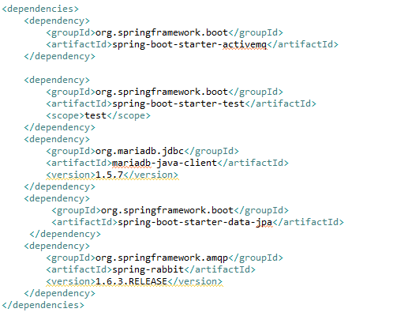
POM

Slide 11
Difference between JMS and RabbitMQ
RabbitMQ is a MOM (Message Oriented Middleware), developed with Erlang (a TLC-oriented programming language) and implementing the wire protocol AMQP (Advance Message Queuing Protocol). Currently, many Client APIs (e.g., Java, C++, RESTful, etc.) are available to enable the usage of RabbitMQ messaging services.
JMS (Java Messaging Service) is a JCP standard defining a set of structured APIs to be implemented by a MOM. An example of MOM that implements (i.e. is compatible with) the JMS APIs is ActiveMQ; there's also HornetMQ, and others. Such middlewares get the JMS APIs and implement the exchange patterns accordingly.

