Slide 1
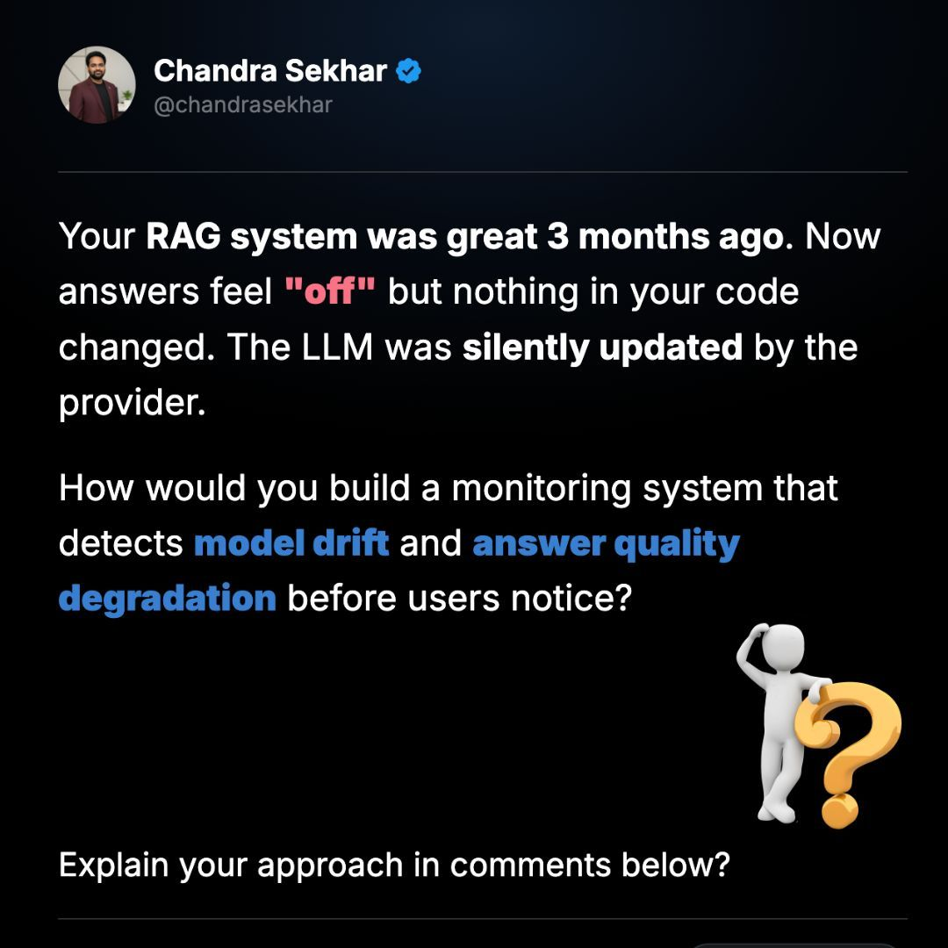
RAG MODEL DRIFT
How do you detect answer-quality
degradation before users notice?
A production monitoring approach for RAG & LLM systems
Question → Architecture → Metrics → Drift Detection → Alerts
AI / ML • GenAI • RAG • LLM Observability
01

Slide 2
The Question
A realistic production failure scenario
SCENARIO
Your RAG system worked well 3 months ago. Now answers feel “off”, but your code has not changed. The LLM provider silently updated the underlying model.
How would you build a monitoring system that detects:
01 MODEL DRIFT
02 ANSWER QUALITY
03 BEFORE USERS NOTICE
Detect changes in model behavior even when the API/model name remains unchanged.
Detect declining faithfulness, relevance, groundedness and citation quality.
Use baselines, canary evaluations and alerts to catch statistically meaningful changes early.
02

Slide 3
Why Traditional Monitoring Is Not Enough
Your service can be technically healthy while the answers get worse.
APPLICATION HEALTH
RAG HEALTH
USER EXPERIENCE
✓ HTTP 200
✓ Low latency
✓ CPU normal
✓ Memory normal
✓ No exceptions
✓ Vector DB available
✓ Documents retrieved
✓ Similarity scores stable
✓ Retrieval latency stable
✓ Prompt unchanged
✗ Answers less precise
✗ More unsupported claims
✗ Worse instruction following
✗ More irrelevant responses
Key idea: monitor QUALITY, not just INFRASTRUCTURE.
03

Slide 4
Production RAG Monitoring Architecture
Capture traces first; evaluate quality second; detect drift third.
RAG
Application
OpenTelemetry
Trace
Metrics + Logs
+ Traces
Evaluation
Pipeline
Drift
Detector
Alerting
Dashboard
TRACE DATA
QUALITY DATA
DECISION DATA
Query • retrieved chunks • scores • prompt version • model identifier • response • latency • tokens
Faithfulness • context precision/recall • answer relevance • citation correctness
Baseline • current score • delta • affected slice • likely failure layer • alert severity
For regulated environments: redact/anonymize sensitive prompts, contexts and responses.
04

Slide 5
Step 1 — Instrument Every RAG Request
A useful trace should make the answer reproducible and diagnosable.
Request
Retrieval
query, timestamp, tenant/domain, language
document IDs, chunk IDs, similarity scores, top-K
Prompt
Model
prompt/template version, system instructions
provider, model ID, model/version metadata, parameters
Generation
Evaluation
response, tokens, finish reason, latency
quality scores, evaluator version, feedback
Privacy principle: do not store sensitive raw data unless there is a justified, protected use case.
05

Slide 6
Step 2 — Measure RAG Quality at Multiple Layers
RETRIEVAL QUALITY
GENERATION QUALITY
SYSTEM QUALITY
• Recall@K
• Precision@K
• MRR / NDCG
• Context precision
• Context recall
• Similarity-score distribution
• Empty retrieval rate
• Retrieval latency
• Faithfulness
• Answer relevance
• Groundedness
• Instruction following
• Citation correctness
• Unsupported-claim rate
• Refusal / fallback rate
• End-to-end quality
• p50 / p95 latency
• Cost per request
• Token usage
• Error rate
• User feedback
• Quality by domain / language / query type
Never rely on one LLM-as-a-judge score. Combine automated evaluation, deterministic checks and sampled human review.
06

Slide 7
Step 3 — Build a Golden Evaluation Dataset
This is your early-warning system for silent provider/model changes.
Representative
Golden Questions
Production
RAG
Evaluation
Engine
Baseline vs
Current
WHAT GOES INTO THE SET?
HOW OFTEN?
WHAT DO WE COMPARE?
Common user intents + high-risk cases + edge cases + known failure cases.
Hourly for critical systems, or less frequently when cost/latency matters. Run more often around deployments.
Current scores vs historical baseline and/or a frozen reference configuration.
07

Slide 8
Step 4 — Detect Statistical Quality Drift
Do not alert on a single noisy score. Detect sustained changes against a baseline.
baseline
quality degradation
ROLLING BASELINE
EWMA
CUSUM
CHANGE POINT
Track moving mean/std over time.
Smooth noise and highlight persistent shifts.
Detect small sustained changes quickly.
Identify when behavior distribution shifted.
08

Slide 9
Step 5 — Localize the Source of Drift
Different symptoms point to different layers.
Retrieval
Generation
Likely signal
↓
↓
Retriever / embeddings / knowledge base
Stable
↓
LLM / prompt / generation behavior
↓
Stable
Retrieval pipeline
Stable
Stable
No meaningful quality degradation
DATA DRIFT
PROMPT DRIFT
MODEL DRIFT
User query distribution changes.
Template/system instruction changes.
Provider behavior changes.
09

Slide 10
Step 6 — Make Alerts Actionable
An alert should tell the engineer what changed, how much, and where to investigate.
🚨 RAG QUALITY DEGRADATION
Environment: Production
Model: provider-model-x
Faithfulness 7-day baseline: 0.92 → Current: 0.79 (−14.1%)
Context Recall baseline: 0.91 → Current: 0.90 (−1.1%)
Retrieval latency Stable
Prompt version Unchanged
Retriever Unchanged
Likely investigation path: generation/model behavior change.
Severity can be based on magnitude × duration × affected traffic × business criticality.
10

Slide 11
A Practical Technology Stack
OBSERVABILITY
TRACING
EVALUATION
OpenTelemetry • Prometheus • Grafana • structured logs
Trace ID across API → retrieval → reranking → LLM → evaluation
RAGAS / custom evaluators / LLM-as-judge + deterministic checks
STORAGE
DRIFT
ALERTING
Postgres / ClickHouse / warehouse for metrics and evaluation history
Rolling statistics • EWMA • CUSUM • change-point detection
Slack / email / PagerDuty / incident-management workflow
The exact tools can change; the architecture and evaluation principles are the important part.
11

Slide 12
The Interview Answer — In 30 Seconds
MY APPROACH
“I would treat RAG observability as a multi-layer evaluation problem. I would instrument retrieval, generation and end-to-end traces using OpenTelemetry, capturing retrieved chunks, scores, prompt version, model metadata, latency and token usage.
For quality, I would maintain a representative golden dataset and periodically evaluate the production model on faithfulness, context precision/recall, answer relevance and citation correctness. I would compare these metrics against historical baselines using rolling statistics and change-point detection.
If retrieval remains stable but answer quality drops suddenly, that is a strong signal of generation/model drift — exactly the type of silent provider update described in the scenario.”
Monitor → Evaluate → Baseline → Detect → Localize → Alert → Investigate
Key takeaway: RAG systems need quality observability, not just infrastructure observability.
12

