Slide 1
Medi-Help
Anant Raj 1MS17CS010
Mumtaz 1MS17CS067
Saivenu 1MS17CS047

Slide 2
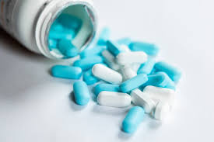
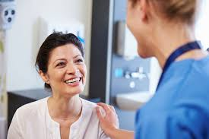
How our website helps patients
Buy medicines and send reminders when low on medicines
Book appointments on the go
Maintain a digital copy of your report wherever you are
Set reminders about when you have to visit the doctor
Find out the nearest doctors nearby

Slide 3
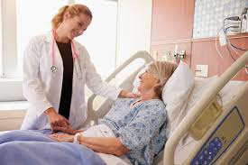
How our app helps doctors
Get information about all your patients at your fingertips
Fix appointments with patients on the fly
Suggest medicines to patients over the internet without needing to meet in person

Slide 4



Tech Stack
Firebase for secure storage
Node for seemless backend
HTML for slick frontend

Slide 5
Future Plans
Integrate ML for trying to predict diseases from symptoms
Track your medicine orders
Call and track ambulance through the website

