Slide 1
ReactJs
React is a declarative, efficient, and flexible JavaScript library for building user interfaces.

Slide 2
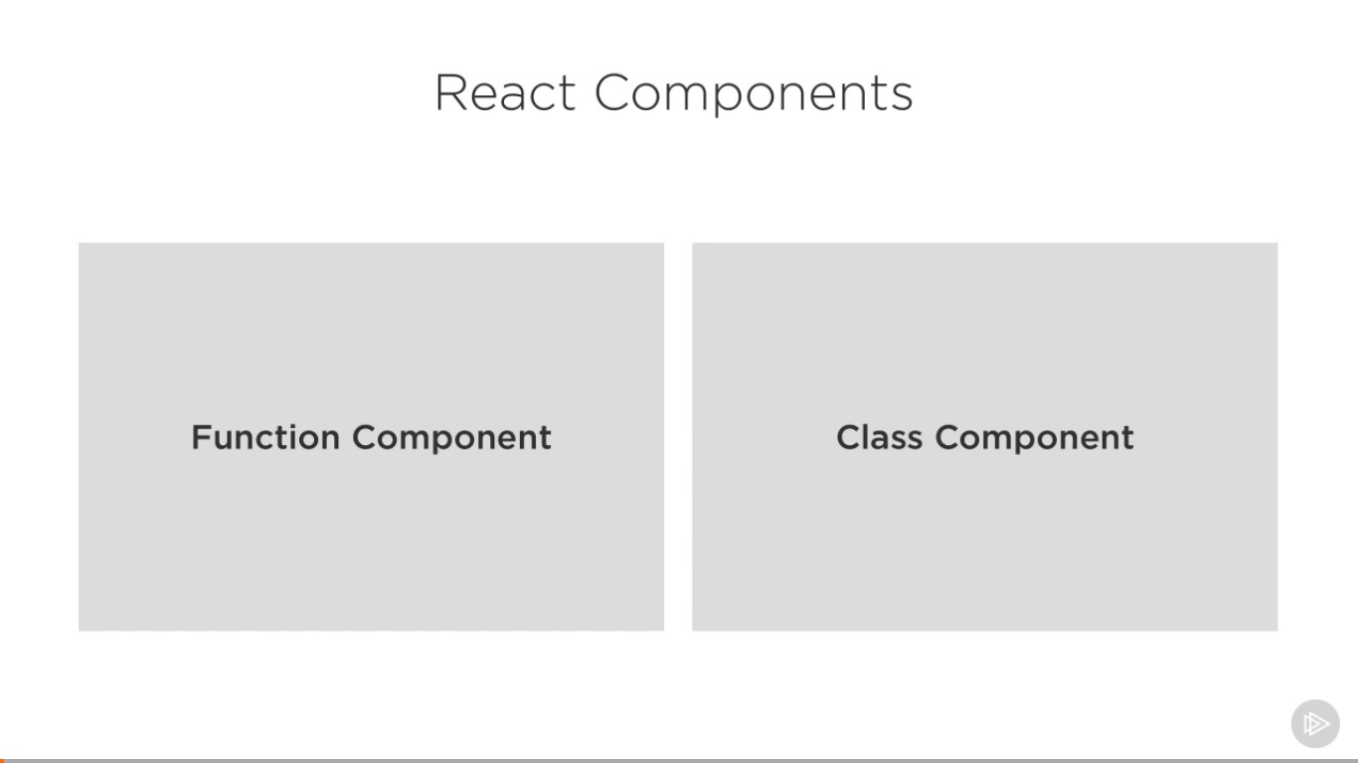
(Stateless)
(Stateful)

Slide 3
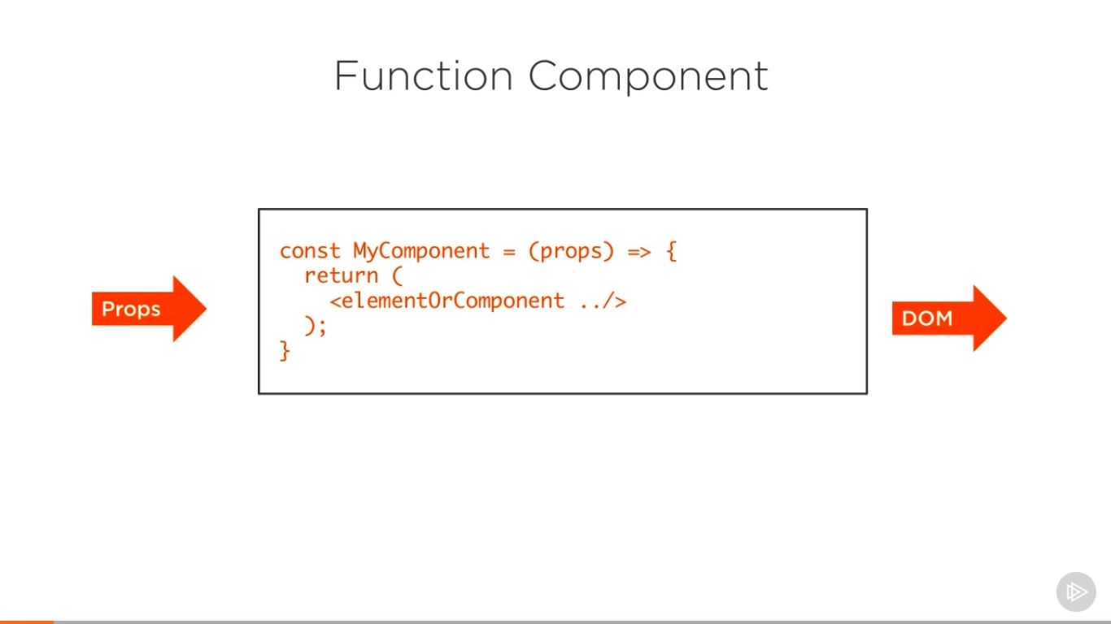

Slide 4
