Slide 1

Ra.2 – DOM XSS Scanner
A DOM-based XSS scanner, for the rest of us!
Nishant Das Patnaik
nishant.dp@gmail.com
Sarathi Sabyasachi Sahoo
sarathisahoo@gmail.com

Slide 2
Who am I?
Nishant Das Patnaik
Application Security Enthusiast
Present: Security Engineer at Yahoo! Inc., India
Past: Security Engineer at eBay Inc.
I express my views at http://nishant.daspatnaik.com
Play electronic keyboards and love to cook ☺
Sarathi Sabyasachi Sahoo
Web Application Developer
Senior Software Engineer at Yahoo! R & D, India
Die-hard Shah Rukh Khan fan ☺

Slide 3
Agenda
Introduction
What is DOM based XSS?
How to
proposed solution.
Case Study
DOMinator V/s Ra.2
test manually?
It’s relevance
Future Plans
RA.2 Internals
Introducing RA.2
Unique Selling Points
What’s next?

Slide 4
Introduction
What is DOM XSS?
DOM or the document object model is a way by which scripts can access the structure of a page they reside in, and it is used to manipulate the page content in modern WEB 2.0 applications.
JavaScript often use user inputs to modify the DOM. These inputs can be evil.
Input can be URL parameters, XHR responses, HTTP Headers etc.
Server side input validation logic fails at data sanitization. Think of “page.html#evil”.
Equally dangerous as Reflective XSS and Stored XSS. Browser-integrated XSS filters are useless against it.

Slide 5
Introduction
Terminology
Sources: These are the input data that can be directly or indirectly controlled by an attacker.
Sinks: These are the potentially dangerous functions that can lead to code execution, when abused, to take advantage of some kind of exploitation.
Filters: These are the operations which change the content or check for specific structures/values.

Slide 6
Introduction
Sources
Everything taken from the URL
document.URL
document.URLUnencoded
document.location(.pathname|.href|.search|.hash)
window.location(.pathname|.href|.search|.hash)
The Referrer
document.referrer
The window name
window.name and many more.
Did you find a clue? All GET parameters and few HTTP headers.
Why not POST variables? You say!

Slide 7
Introduction
Sinks
Every functionality that will create HTML:
innerHTML
outerHTML
document.write
Every functionality that will interpret a user input string as JavaScript code:
eval
execScript
function
setTimeout
setInterval
script.src
iframe.src
location.(replace|assign)
etc.

Slide 8
Introduction
DOM XSS Example Page - 01
01 <script type="text/javascript">
02 var param = location.hash.split("#")[1];
03 document.write("Hello " + param + "!");
04 </script>

Slide 9
Introduction
DOM XSS Example Page - 02
...
01 function timedMsg(callback)
02 {
03 if(callback)
04 {
05 var t=setTimeout(eval('callback'),3000);
06 return 0;
07 }
08 }
09 function fire()
10 {
11 var call = location.hash.split("#")[1];
12 timedMsg(call);
13 }
14 </script>
15 </head>
16 <body onload="fire()">
...

Slide 10
Introduction
DOM XSS Example Page - 03
...
01 function go()
02 {
03 if (document.location.hash.split("#")[1])
04 {
05 location.replace(location.hash.split("#")[1]);
06 }
07 }
08 </script>
09 </head>
10 <body onload="go()">
...

Slide 11
Introduction
DOM XSS Example Page - 04
01 <script>
02 var param = document.location.hash.split("#")[1];
03 if (param)
04 {
05 var d = document.createElement('div');
06 d.innerHTML = param;
07 if (document.body != null)
08 {
09 document.body.appendChild(d);
10 }
11 }
12 </script>

Slide 12
Introduction
DOM XSS Example Page - 05
...
01 <a id="anchor" name="anchor">Continue</a>
02 <script type="text/javascript“>
03 var redir = location.hash.split("#")[1];
04 x = document.getElementById('anchor');
05 x.setAttribute('href',redir);
06 </script>
...

Slide 13
Introduction
DOM XSS Example Page - 06
...
<body onload=reload()>
<iframe id="frame1" name="frame1" src="about:blank"></iframe>
<script>
function reload()
{
var redir = location.hash.split("#")[1];
if (redir)
{
x = document.getElementById('frame1');
x.setAttribute('src',redir);
}
}
...

Slide 14
DEMO

Slide 15
Introduction
Why do we care about it?
Not new, Amit Klein was the 1st to talk about it; but now code shifting towards client-side: AJAX, Web 2.0, RIA
56 out of Alexa Top 100 sites are vulnerable to DOM-XSS. (Source: DOMinator’s Blog)
Integrated XSS filters in browsers are failing to filter DOM-based XSS.
Server-side input validation is bypassed.
Has the same severity of impact on your user, as regular XSS.
DOMinator is probably the only tool that tries to solve this issue to some extent. Do you agree? Anyone?

Slide 16
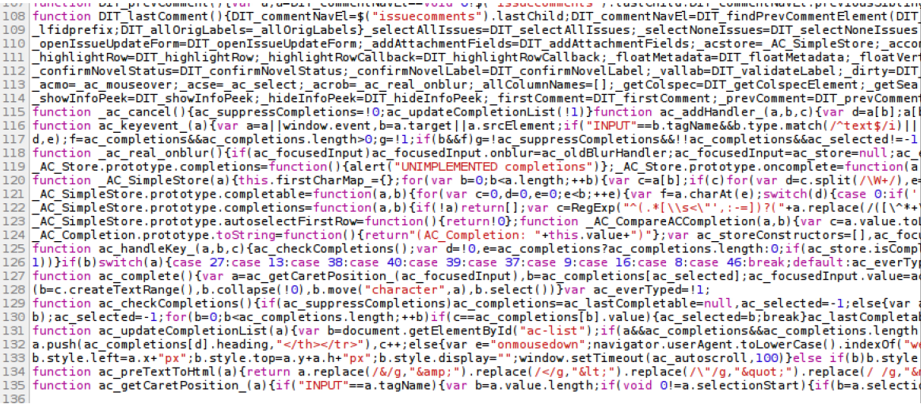
How to
Test DOM XSS manually
Source-code review is THE BEST way!
But..like this?
Yeah, I know it’s kind of hard.

Slide 17
How to
Possible Solutions
1. Static Analyzer
Pro: Very good at finding flows, if well implemented. Very fast.
Cons: The problem with every Static Analyzer: Knowledge Base, lack of runtime analysis, lots of false positives/negatives etc.
2. Dynamic Analyzer
Pro: uses native interpreter so no problem with obfuscation/compression
Cons: cannot follow the flow.

Slide 18
How to
Firefox JS Engine Interpretation
Black-box
Fuzzing
Browser Automation
Proposed Solution
Goodness of Automation + Goodness Blackbox Fuzzing = Win!

Slide 19
Ra.2 Internals
Introducing Ra.2
Ra.2? – Code name of our tool. The coder (Sarathi) is a fan of Shah Rukh Khan! ☺
Ra.2 is a Mozilla Firefox Add-on.
It uses Firefox’s JavaScript Engine to dynamically execute vectors injected into possible sources, to locate most exploitable DOM XSS issues.

Slide 20
Ra.2 Internals
2. Injects its custom JavaScript code to the <head> of current DOM
3. Fuzzes possible sources with our custom defined callback
5. Callback generates XHR to our DB host, if it lands in a sink
6. XHR sends the vulnerable URL to a your DB host
4. Automate some event handlers to trigger the callback
7. Generates customizable report
1. Initiate a scan
How it works?
Ra.2
Internals

Slide 21
Ra.2 Internals
Unique Selling Points
Ra.2 is designed to be False Positive Free, since vulnerable URLs are saved in DB, if and only if, our JS payload is executed successfully by the browser. Hence marked exploitable.
Large collection of injection vectors, includes “modified” R’Snake’s vectors as well.
Supports transforming characters. Content Aware Application. Unicode Characters.
Automatically handles JavaScript obfuscation/compression, as it relies on native interpreter
Its light-weight and fast
Pretty easy learning curve. Point-n-Click.

Slide 22
Case-Study
DOMinator
V/S
Ra.2
Gray box scanner
Runtime code-flow analysis
Manual analysis required
Steep learning curve
Slow; requires heavy manual analysis
Standalone tool
Not free for enterprise use
Blackbox Scanner
Basic Browser Automation Support
False Positive Free
Point-n-Click Tool
Lightweight & Fast
Firefox Add-on; easier deployment
Free to use
Verdict: Both are complementary to each other. ☺

Slide 23
DEMO

Slide 24
Summary
Last Notes
Our tool can pretty well detect low-hanging fruits.
It is a work-in-progress and like other automated tools, it can not detect all issues automatically, but it’s efficiency is continually improving.
As like with any other tool, it is not a replacement to manual penetration testing. ☺

Slide 25
Future Plans
What’s next?
A way to detect browser dependent DOM-XSS issues.
Better browser instrumentation
Run-time code flow analysis engine = Fewer False Negative
Better reporting
Your suggestions? ☺

Slide 26
Credits
Positive criticisms, feedback, brainstorming:
Stefano Di Paola – stefano@mindedsecurity.com
Bishan Singh – c70n3r@gmail.com
Daniel M. Wong – dmwong@yahoo.com
If you find it useful, please drop a line to them. ☺

Slide 27
Q & A
Thank You!
Any questions, please?

