Slide 1
CUSTOMER ANALYSIS

Slide 2
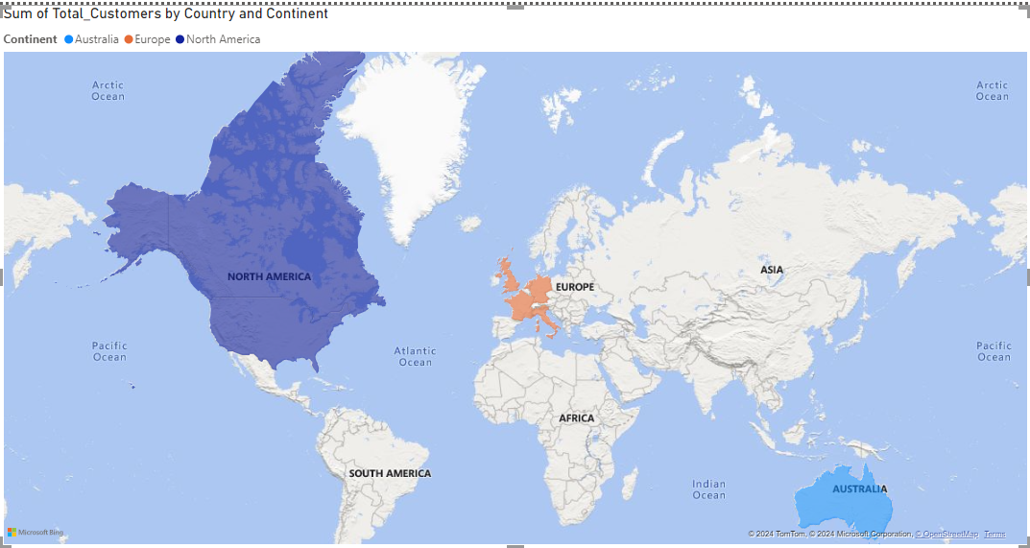
Demographic Distribution: Distribution Of Customer On Basis Of Country , Age, Gender,

Slide 3
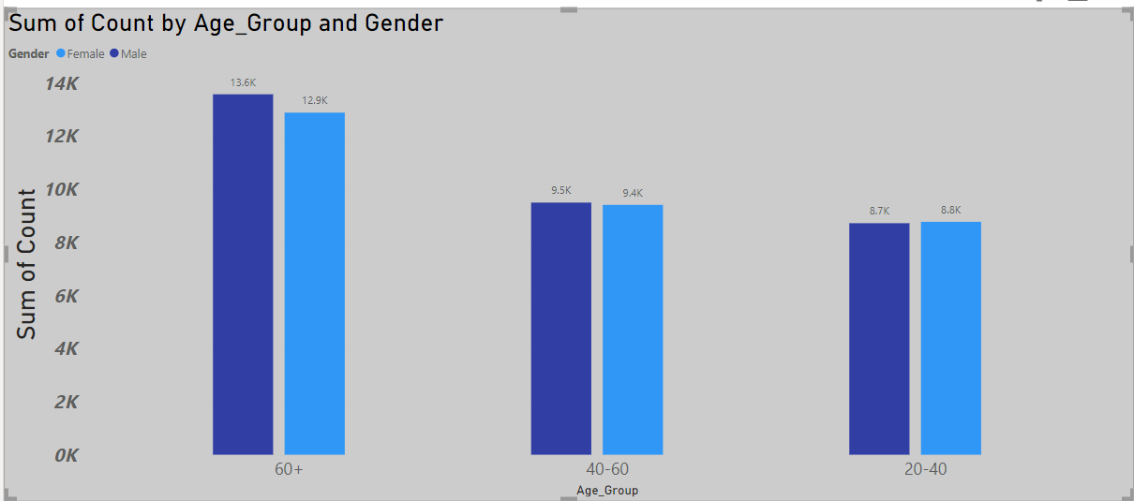

Slide 4
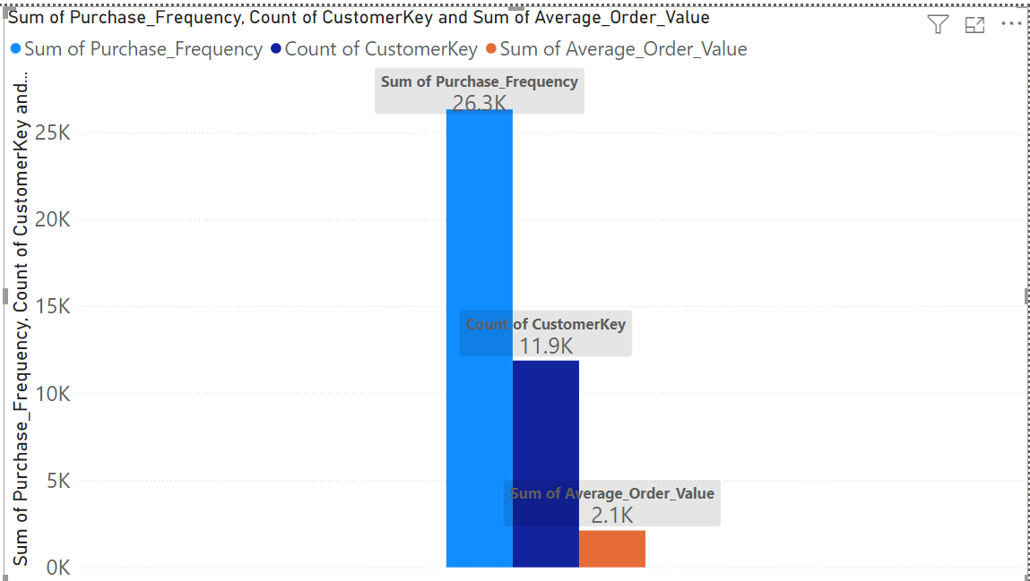
2.Purchase Patterns: Identify purchasing patterns such as average order value, frequency of purchases

Slide 5
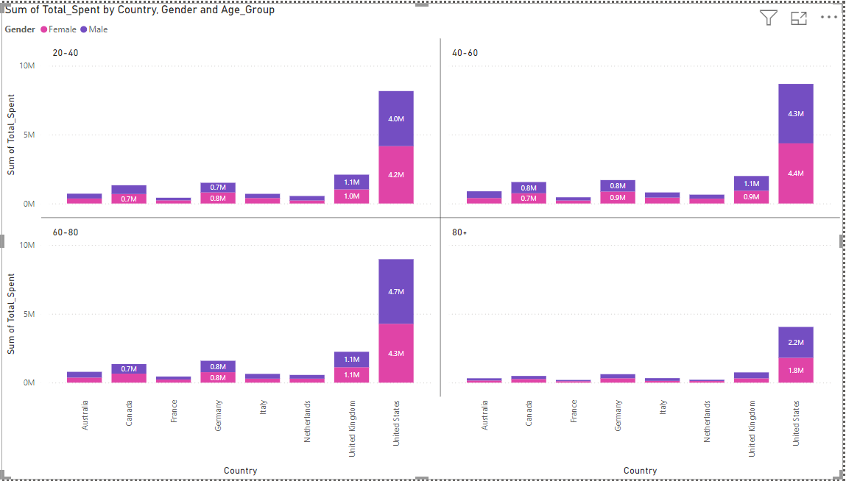
3.Segmentation: Segment customers based on demographics , Age Group and purchasing behavior to identify key customer groups.

Slide 6
Sales Analysis

Slide 7
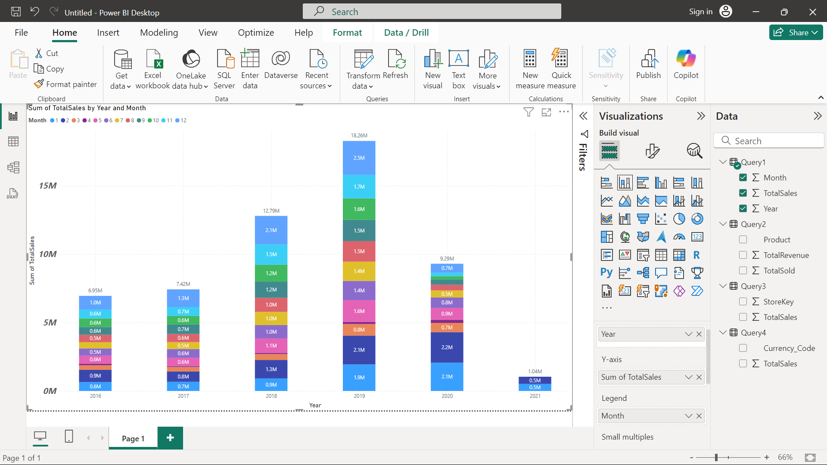
1.Overall Sales Performance: Analyze total sales over time, identifying trends and seasonality

Slide 8
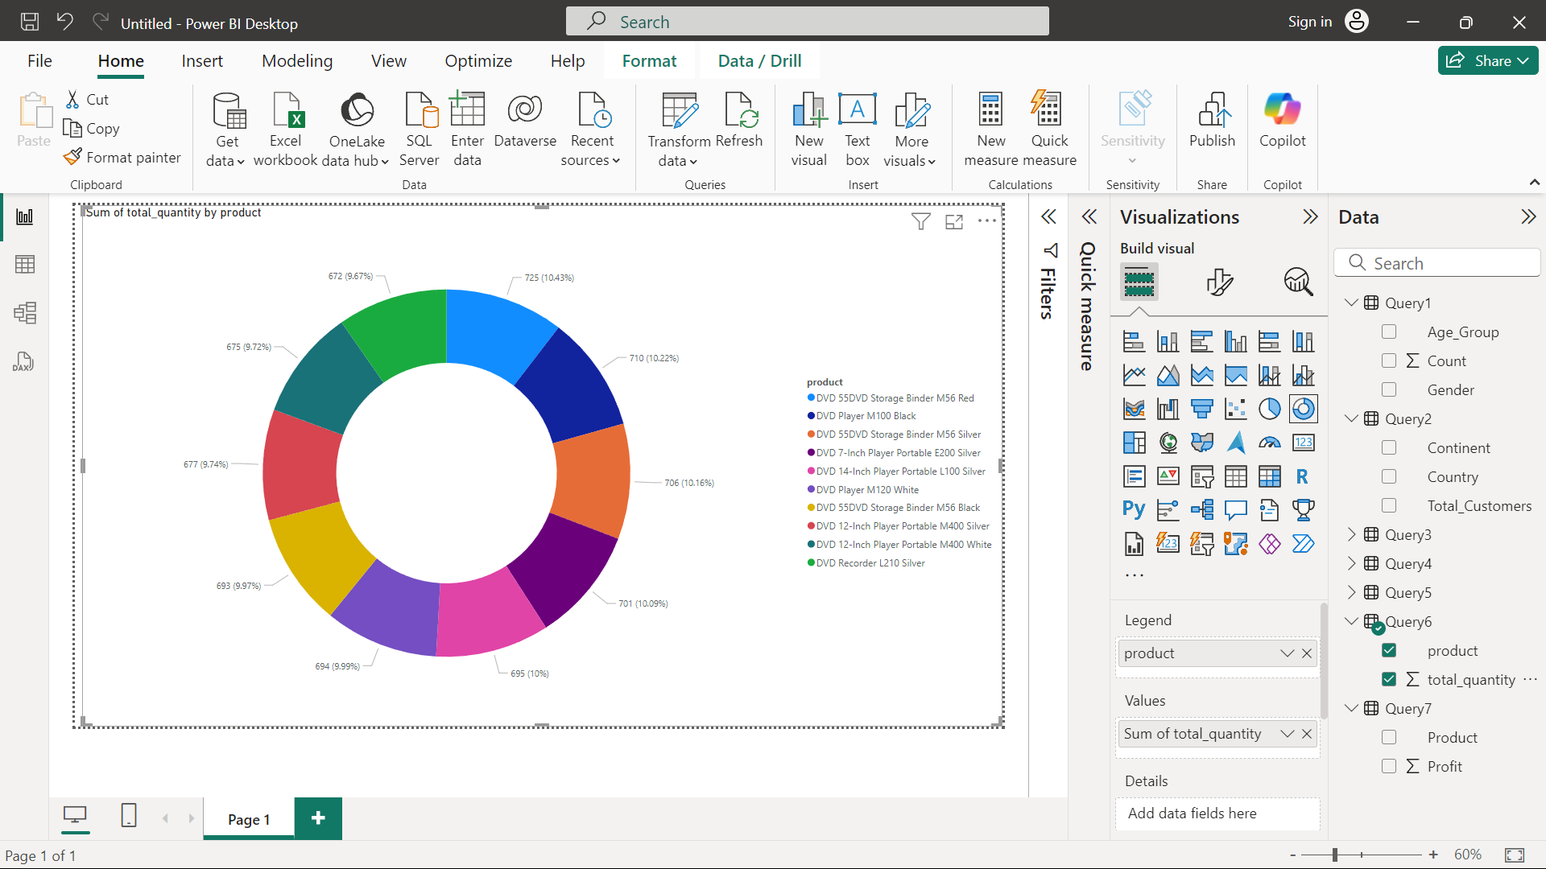
2.Sales by Product: Products are the top performers in terms of quantity sold

Slide 9
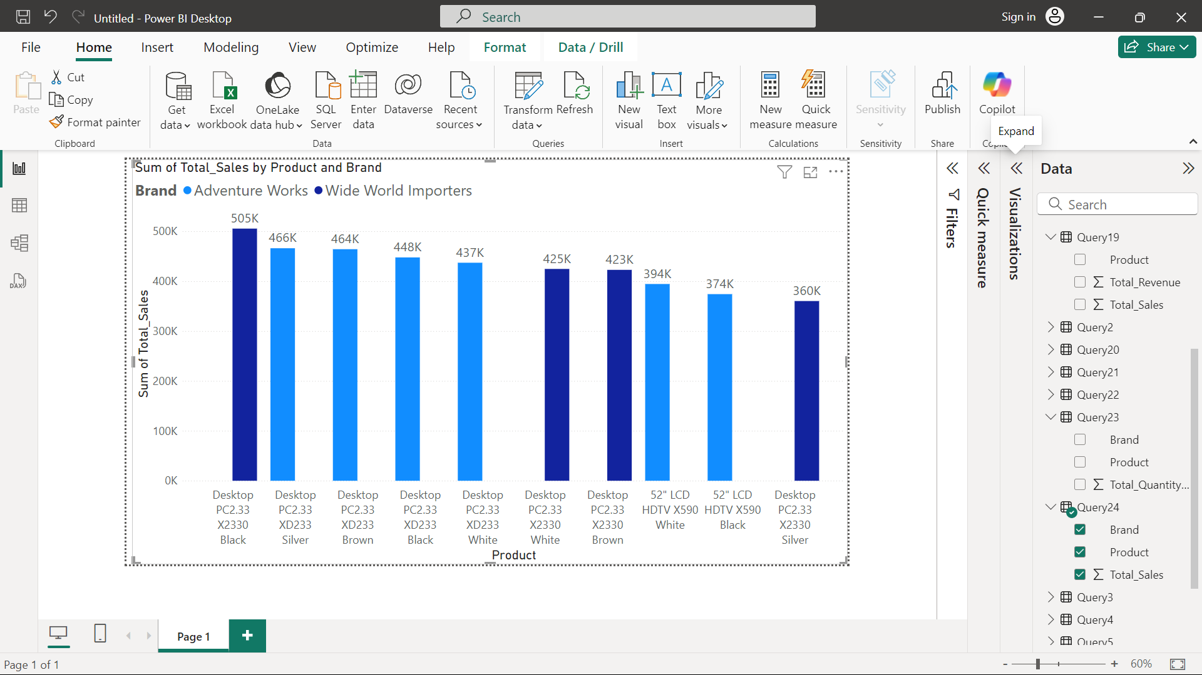
3.Sales by Product: Products are the top performers in terms of revenue generated.

Slide 10
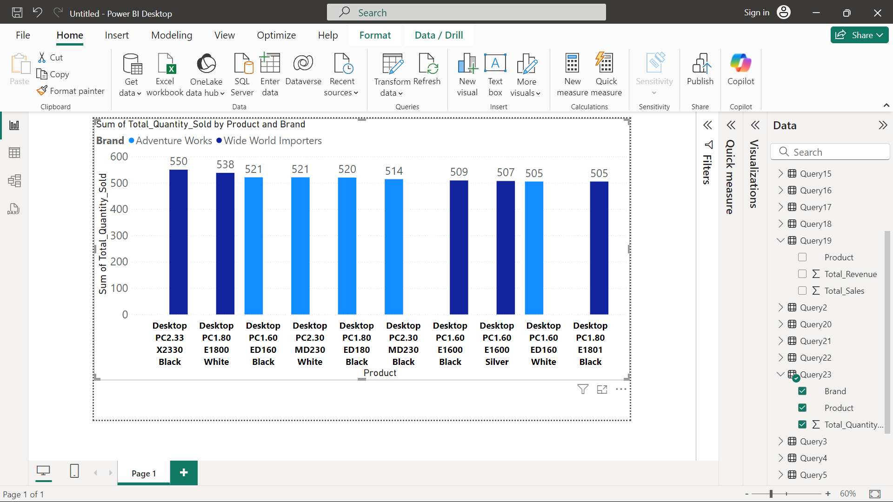

Slide 11
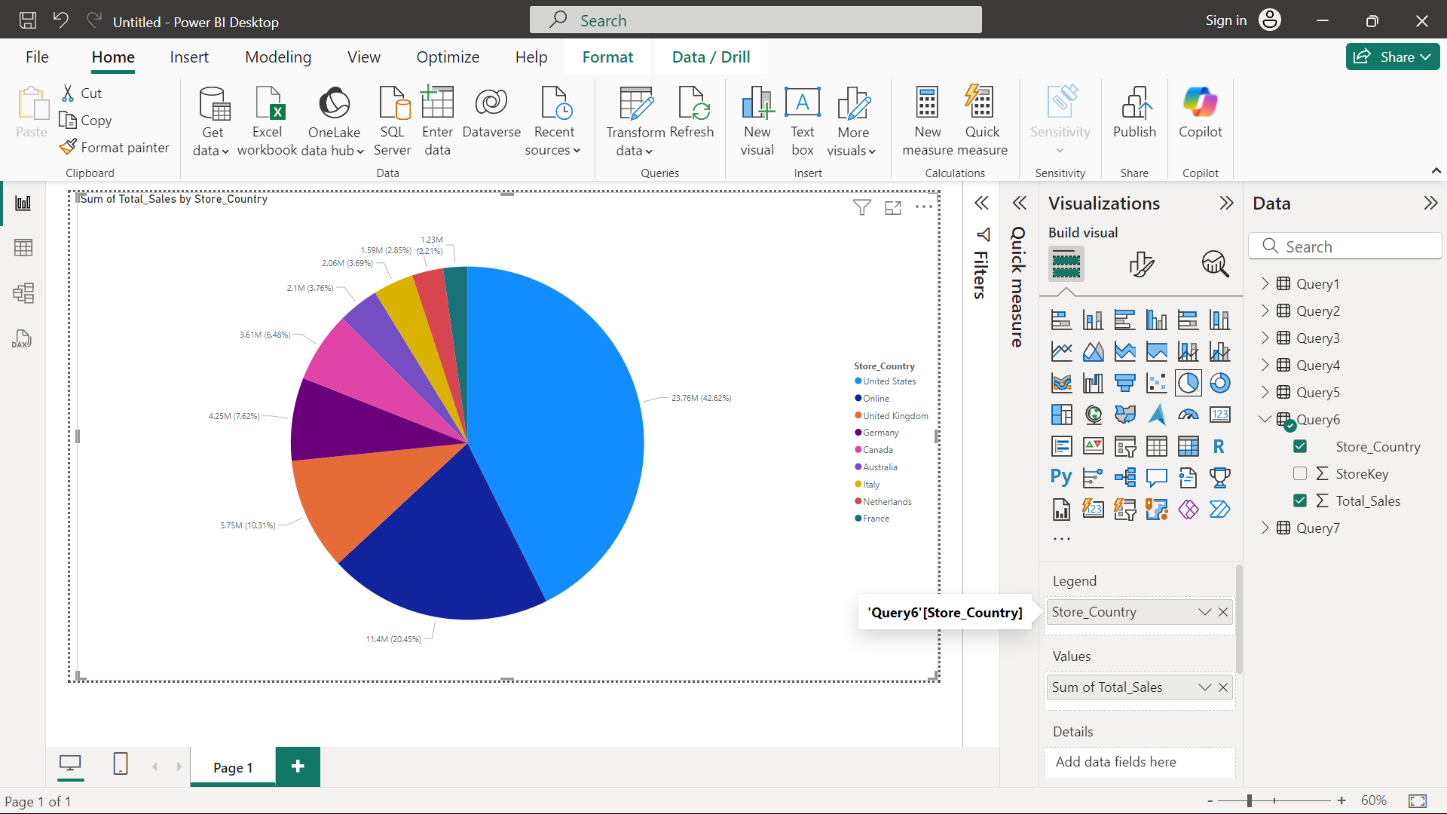
4.Sales by Store: Performance of different stores based on sales data.

Slide 12
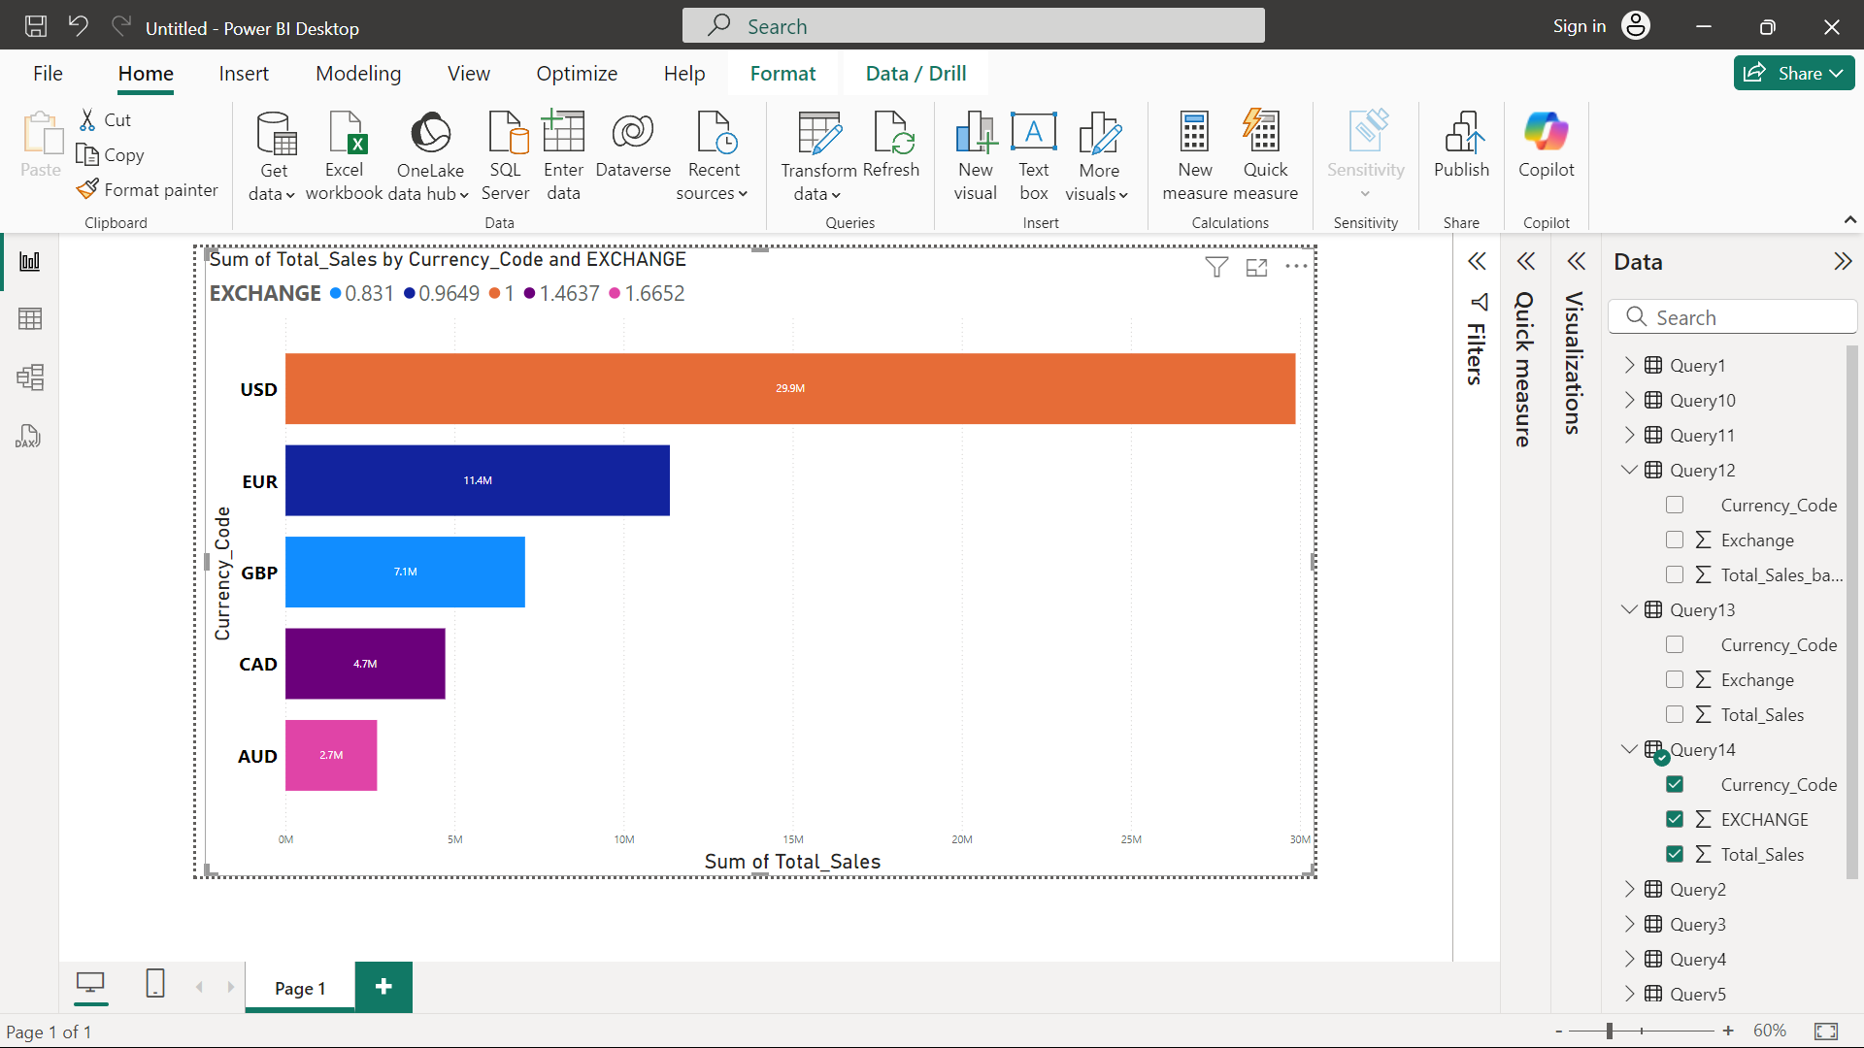
5.Sales by Currency: Different currencies impact sales figures, considering exchange rates.

Slide 13
Product Analysis

Slide 14
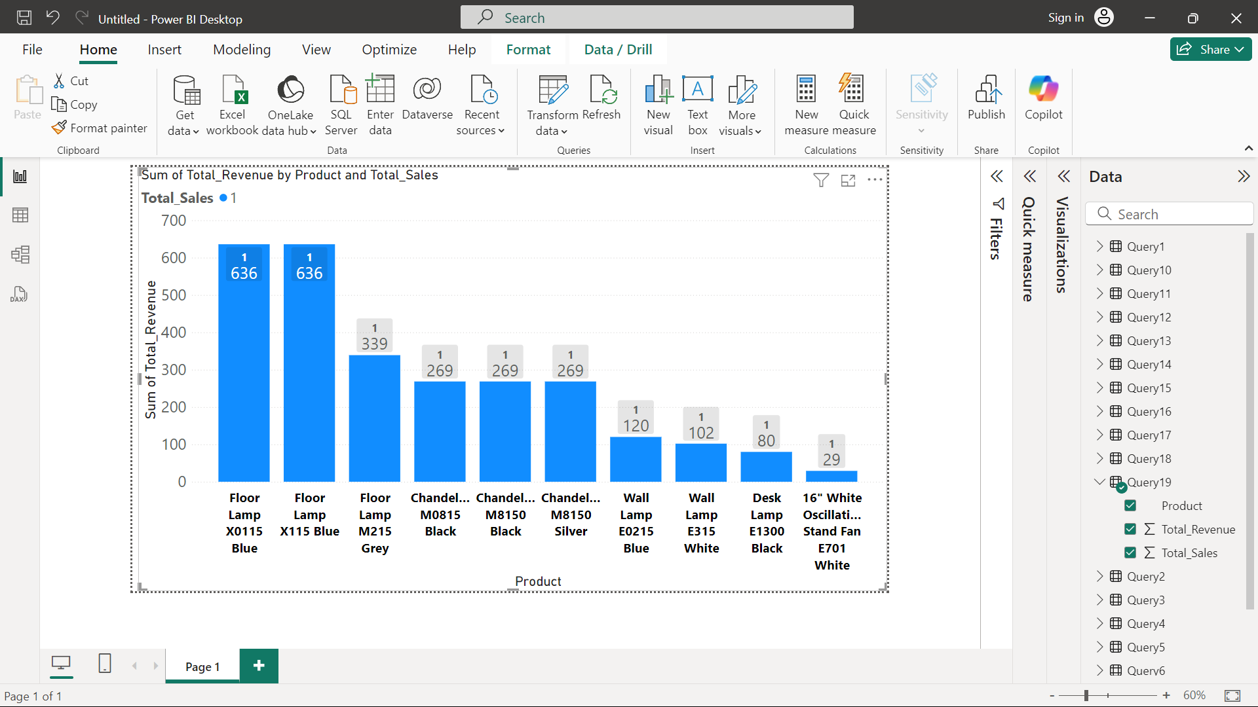
1.Product Popularity: Least popular products based on sales data.

Slide 15
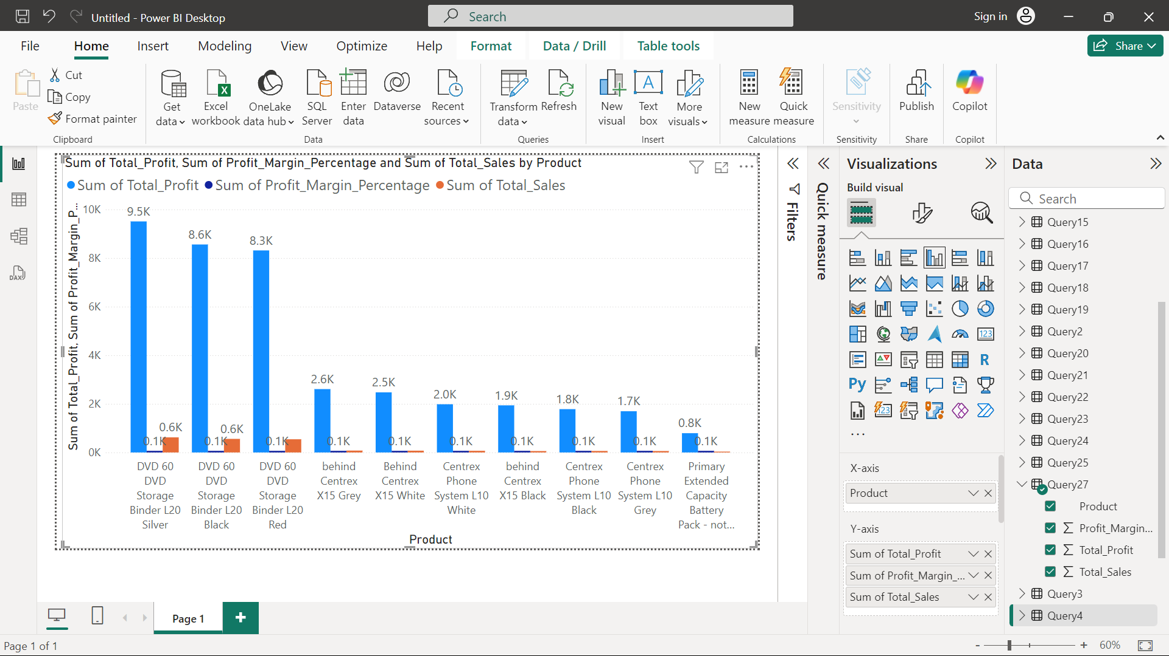
2.Profitability Analysis: Profit margins for products by comparing unit cost and unit price

Slide 16
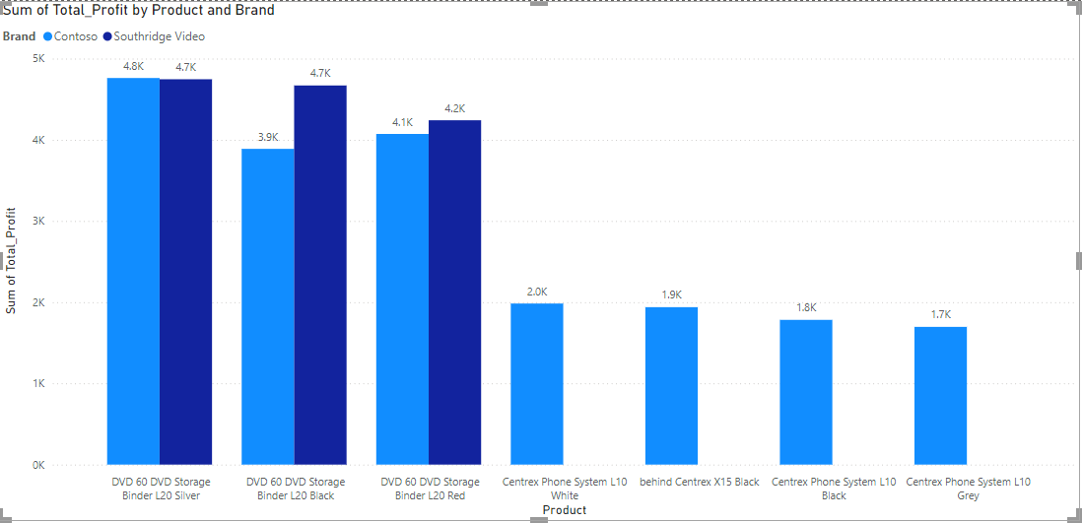

Slide 17
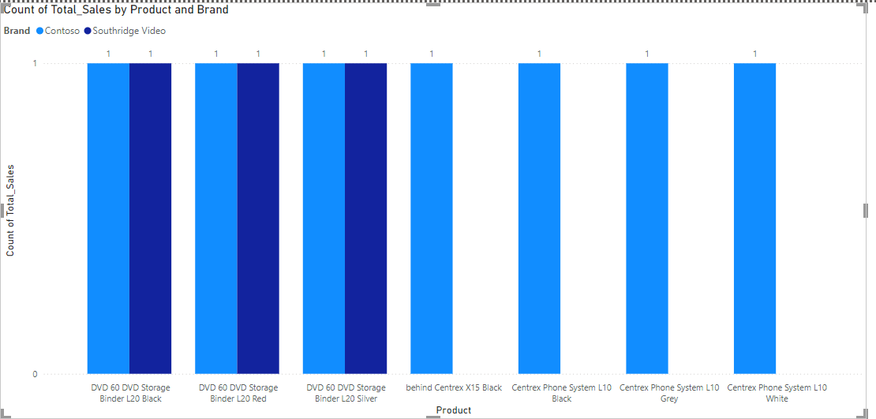

Slide 18
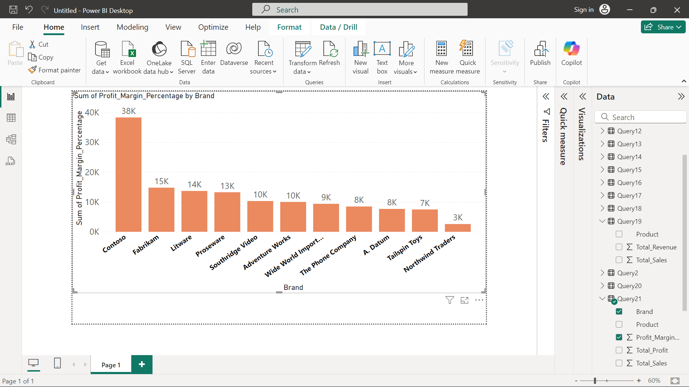

Slide 19
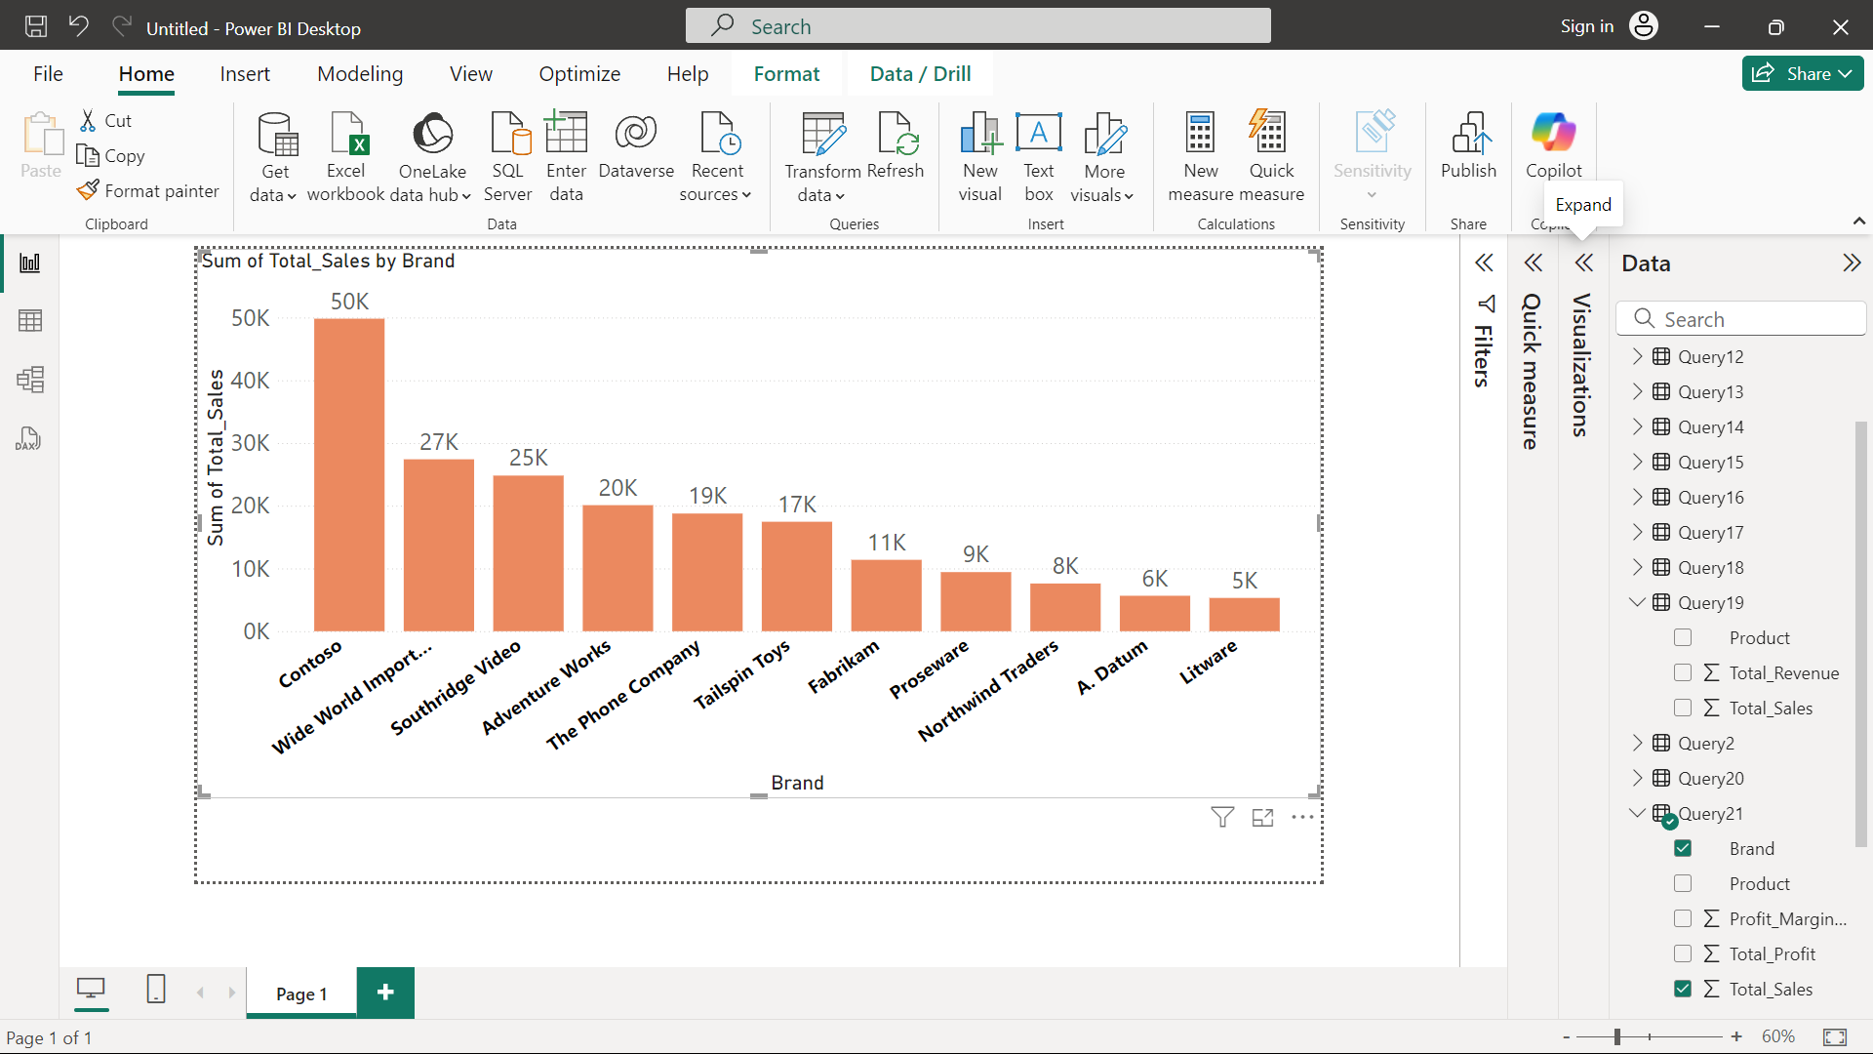

Slide 20
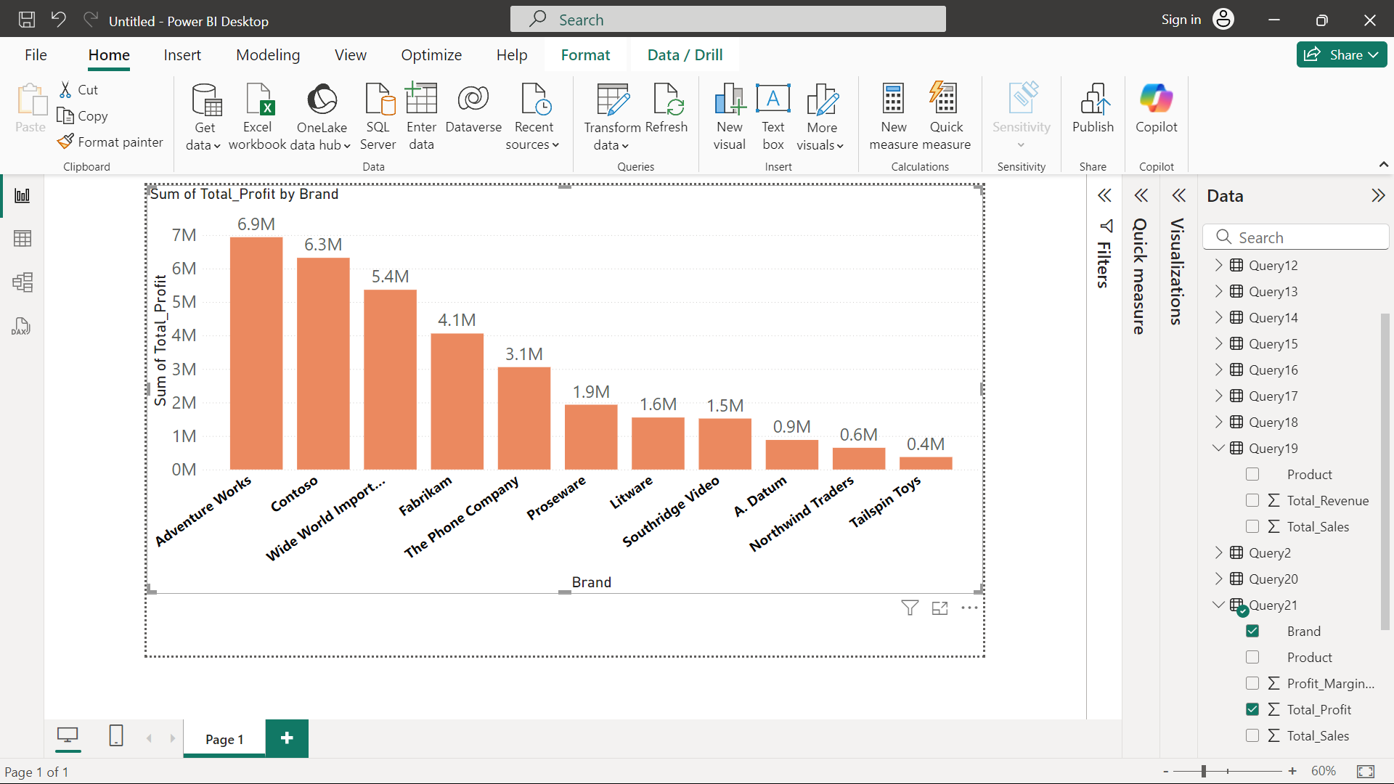

Slide 21
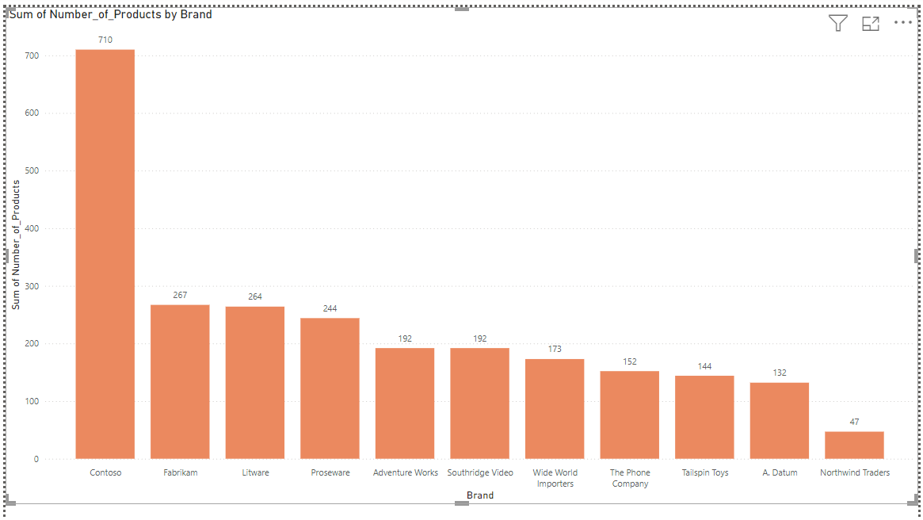

Slide 22
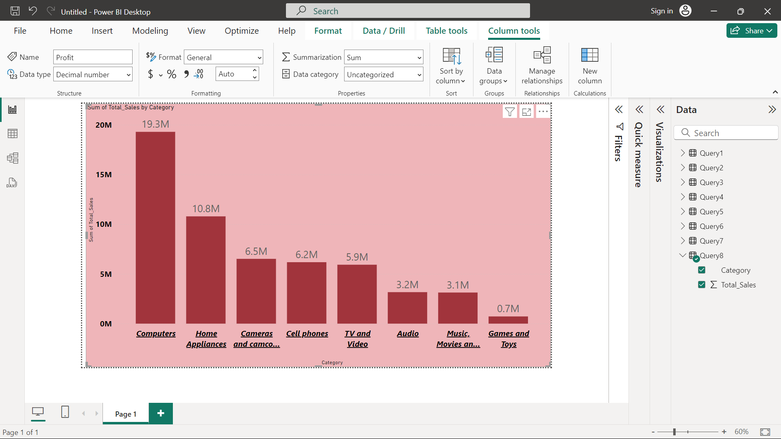
3.Category Analysis: Analyze sales performance across different product categories and subcategories.

Slide 23
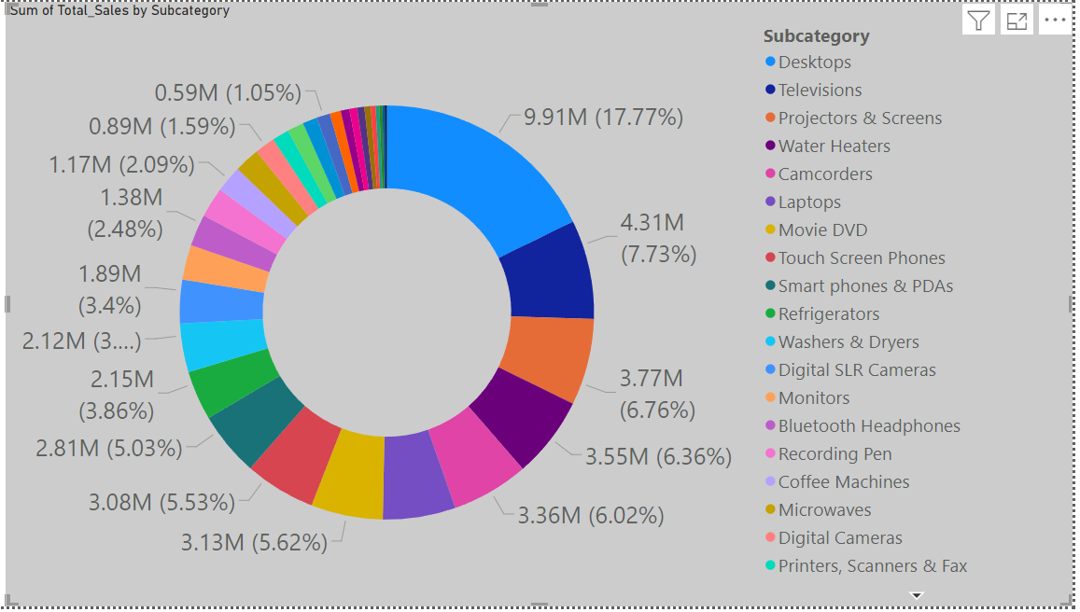

Slide 24
Store Analysis

Slide 25
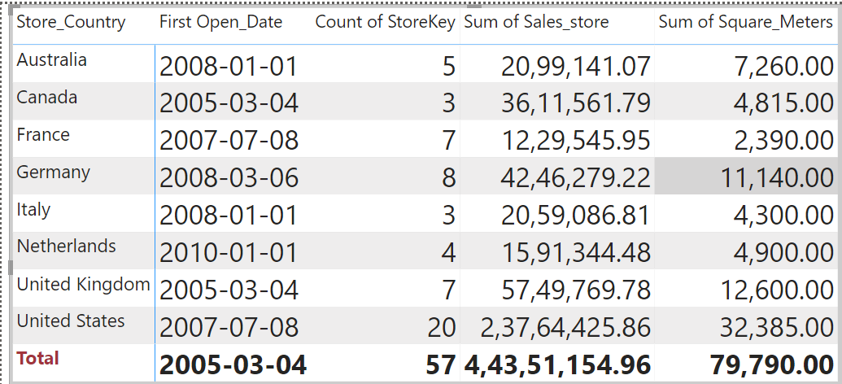
1.Store Performance: Evaluate store performance based on sales, size (square meters), and operational data (open date) ,sales by store location to identify high-performing regions.

