Slide 1
Epidemic Modelling of the Spread of COVID-19 in the UK via the Physics of the Kinetics of Crystallization
By – Anany Tripathi
Project Supervisor – Dr. Andrew Ho
Second Marker – Dr. John Saunders

Slide 2
In this computational Project, I have modeled the spread of COVID19 using Mathematica. I have used data from The UK, England and Runnymede(which is the surrounding area around Royal Holloway) and different time periods (The first wave and the Omicron wave).
I have used the data available from the UK Government Website.
I have used 2 types of Modelling : Exponential and Avrami Fitting
Introduction

Slide 3
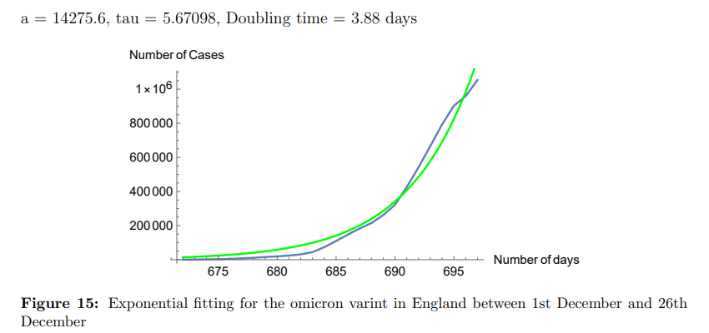
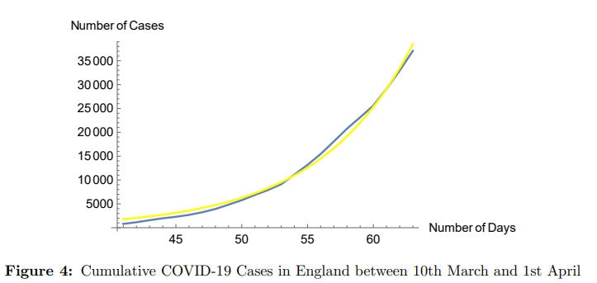
Exponential Fitting
Exponential fitting is by far the most easiest and convenient method to fit the data as it helps us to calculate the most important thing for an epidemic which is the doubling time.
The doubling time is vital to understand the severity of the epidemic as it’s an indication of how fast the virus is spreading among the population
A = a ∗ e^(t−t0)/τ, Using my Code in Mathematica, I can find τ of the data provided and multiplying it by log2 which gives us the doubling time. (log2*τ = t)
τ= 7.3, Doubling time = 5 days

Slide 4
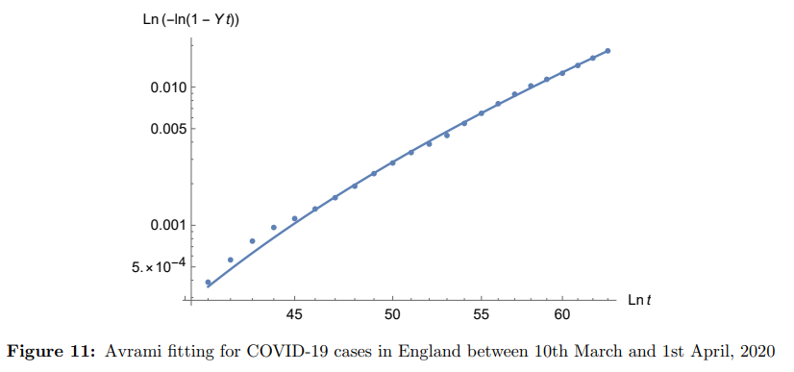
Avrami Fitting
The Avrami equation describes how solids transform from one phase to another at constant temperature.
The avrami fitting has a sigmoidal curve which is a possible realistic fit for our data.
ln(−ln[1 − Y (t)]) = ln(k) + mln(t)
The growth is very rapid but comes to a halt because of the physical limit imposed by the size of the crystal. That is why when we are talking about epidimiology we need to consider ’Y’ as to be the N0/Ntot
Using my code in Mathematica, the fitting that I have achieved gives me the values as s −→ 95.1248, m −→ 4.0554, t0 −→ 27.5433.
‘m’ is effective dimension.

Slide 5
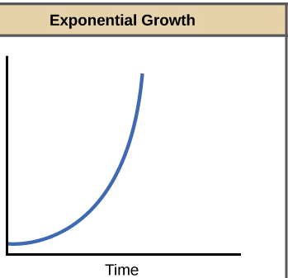
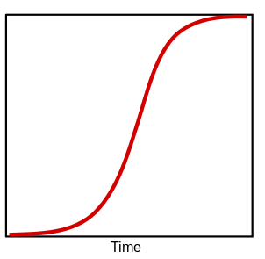
Conclusion
Exponential Modelling is very good to predict the rapid growth of the virus and is simple data modelling
As there are physical restrictions in the world, the virus has to stop growing at some point.
Because of restrictions the exponential model turns to a logistic growth model which has an ‘S’ shaped curve.
This is very well reflected by the Avrami model which uses the theory of crystallization of solids.
Governments can use Avrami Fitting in Epidemiology.
Avrami Growth

