Slide 1
WATER LEVEL MONITORING
ESW TEAM 8
TEAM MEMBERS:
AFRIN SYED - 2019101104
ANANYA AMANCHERLA - 2019101041
ANANDHINI RAJENDRAN - 2019101055
ABHINAV CHOWDARY MALLAMPATI - 2019101109
JYOTEESHWAR GANNE - 2019101099

Slide 2
PROBLEM STATEMENT
Water monitoring is a versatile topic and can be extended to a wide range- monitoring water levels for reservoirs, dams, natural disaster warnings or something as mundane as daily water usage of a tank. This is why we chose this experiment. Specifically, we designed a system that can be used to control the motor/pump's working based on water levels using an ultrasonic sensor. This is to be adapted to a house tank and its pump. A dashboard shows the current water level, graph on the changes in water level over 24hr time period and motor power usage with its current status.

Slide 3
WHY DO WE NEED WATER LEVEL MONITORING SYSTEM?
It reduces the possibility of human error.
It is easy to install, economical and can work at remote locations.
These are better than traditional gauges and wired instruments in terms of safety and much less human intervention is needed for these to work.
Helps to keep track of water usage, reduce wastage of water caused by human error (Switching it of after overflow).

Slide 4
DETAILS OF EXPERIMENT
We are using an ultrasonic sensor(HC-SR04) to detect the water level. The obtained water level is sent to OM2M server and the data from the server is sent to mysql database. Dashboard is made using Django and React. The motor/immersible pump is controlled according to the water level. When the water level rises above a threshold value, the motor is switched OFF. When the water level is less than another threshold value, the motor is ON.
When water level is greater than or equal to 23 cm, motor is OFF. Whenever water level is less than 8 cm(i.e measured distance 23cm between water and HC-SR04), motor is switched ON.

Slide 5
FEATURES
Basic dashboard showing water level and water level plot over 24 hrs
Automatic switch on/off motor
Based on water levels increase/decrease the checking time
Displays Motor usage over time (Watt/hr)
Displays the current motor state (ON/OFF)

Slide 6
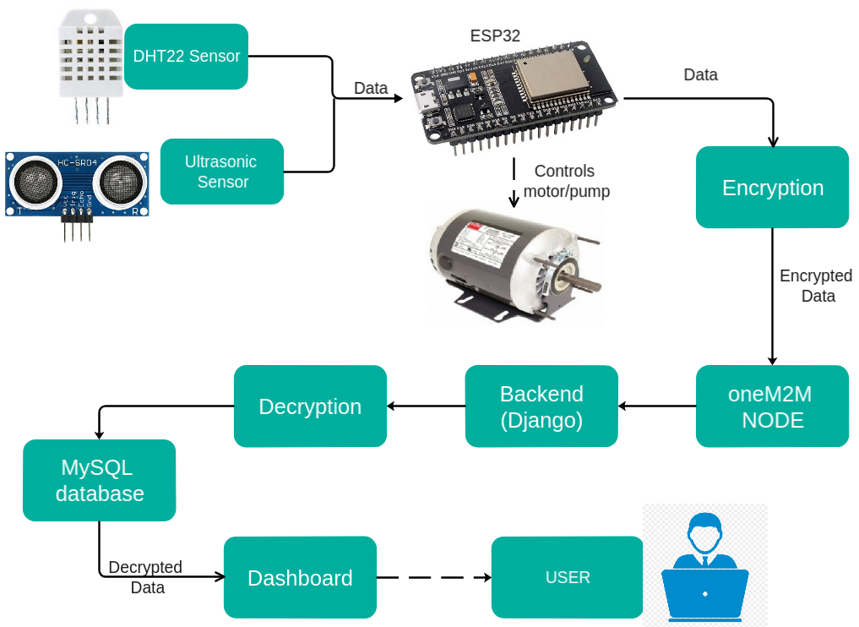
BLOCK DIAGRAM OF IOT BASED SETUP

Slide 7
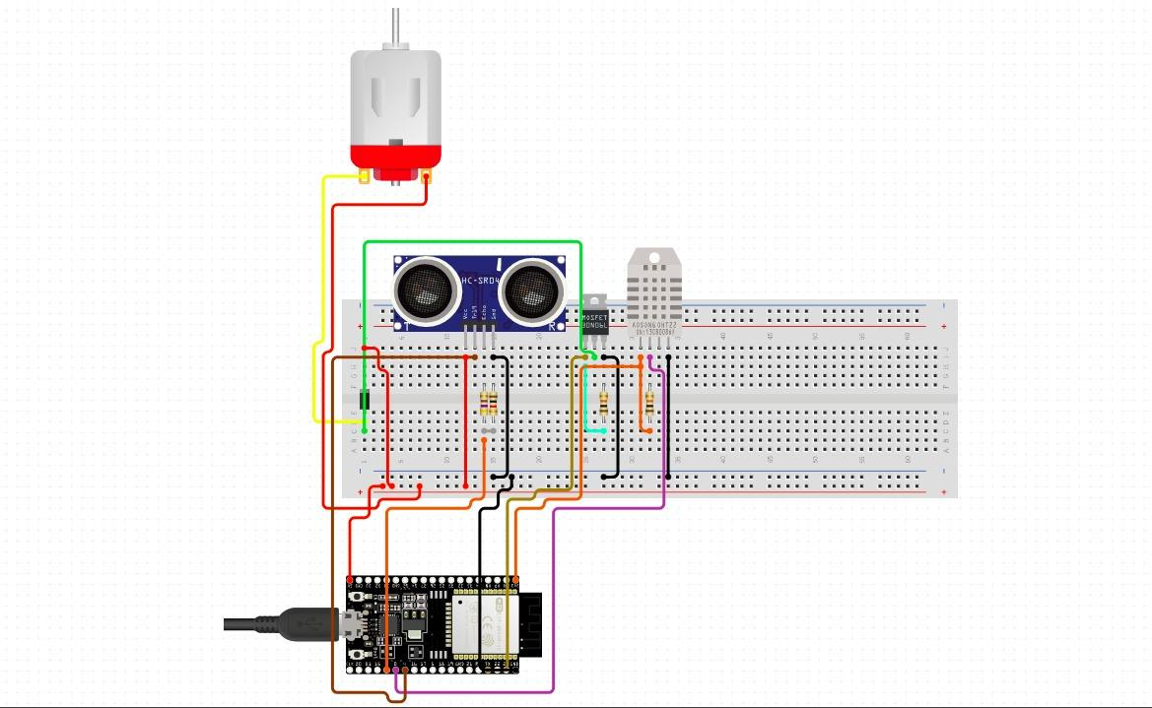
CIRCUIT DIAGRAM

Slide 8
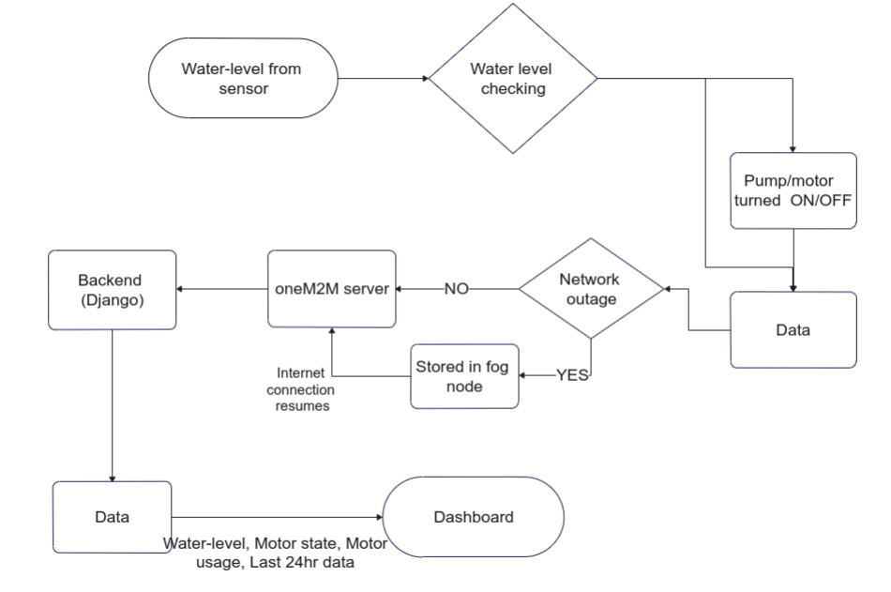
Flow chart of code

Slide 9
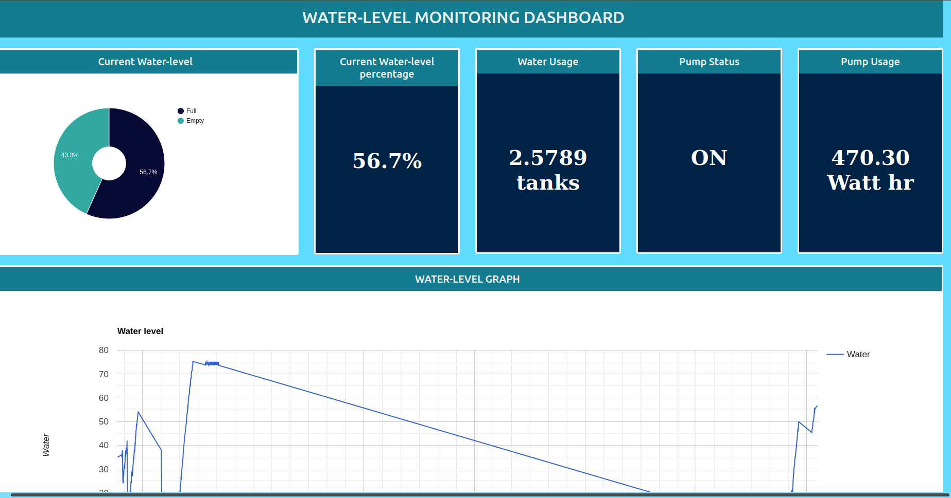
DASHBOARD

Slide 10
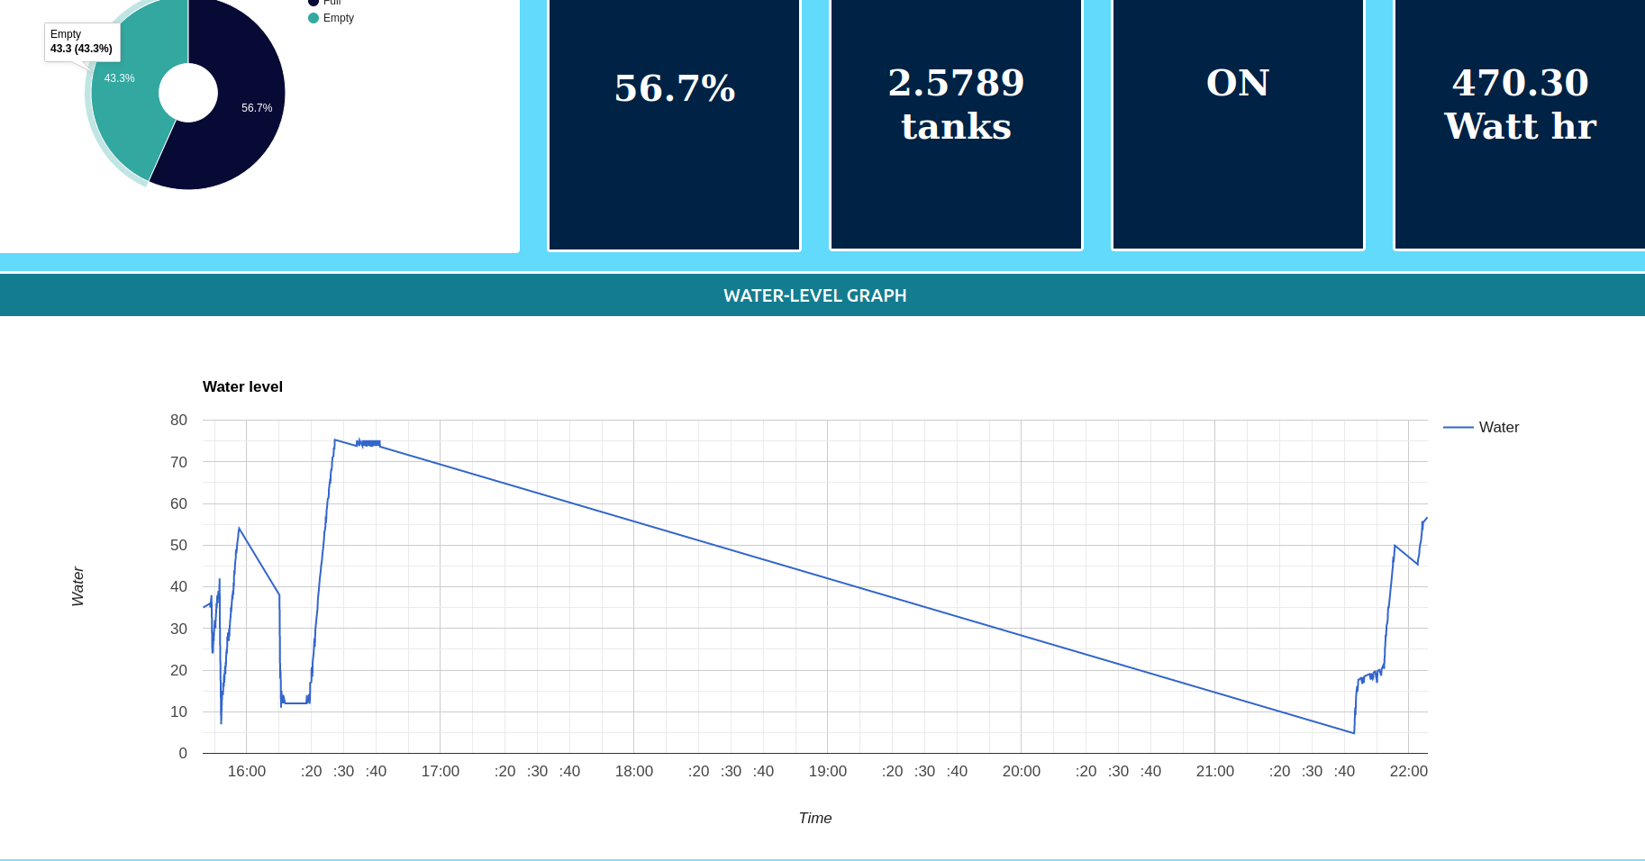

Slide 11
FEATURES OF DASHBOARD
Displays the current water level percentage
Show graph of water level changes over 24 hr time period.
Displays pump state(ON/OFF), pump usage in watt hr, and water usage over last 24 hr period,
The data is sent to dashboard only when water level changes.
MYSQL - Database
Django - Backend
React - Frontend

Slide 12
Om2m
Sending data from to hardware to OM2M is working.
We are able to subscribe to OM2M containers. And the data is being sent to backend.

Slide 13
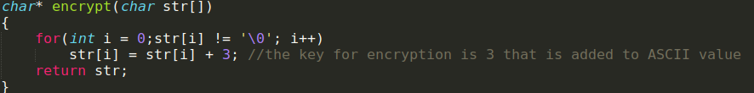
SECURITY
The data sent from the sensor is encrypted before sending to the OM2M server and then decrypted before printing on the dashboard.

Slide 14
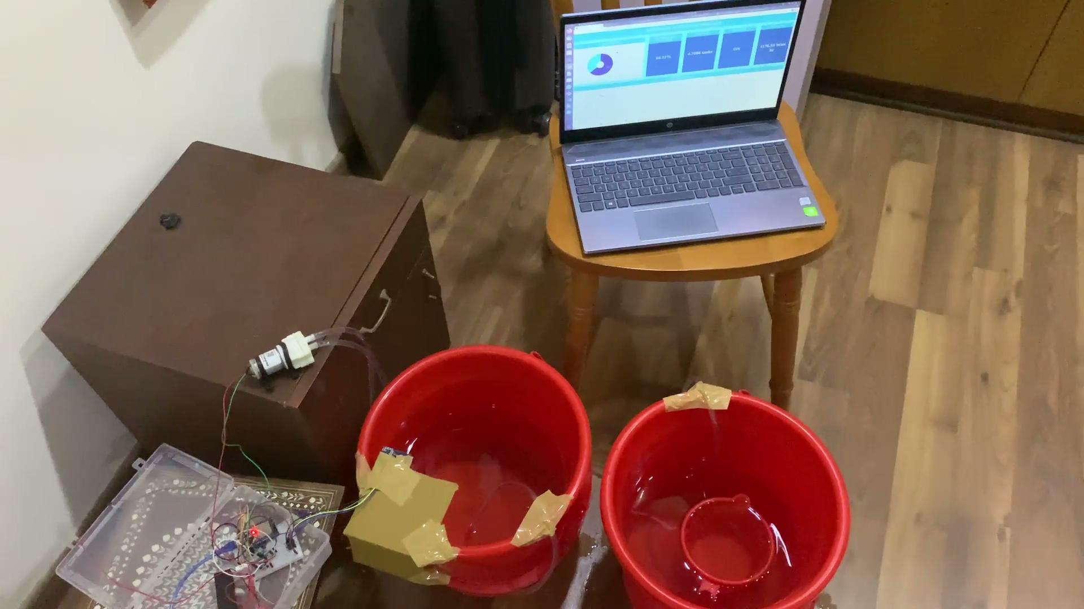
WORKING DEMOS

Slide 15
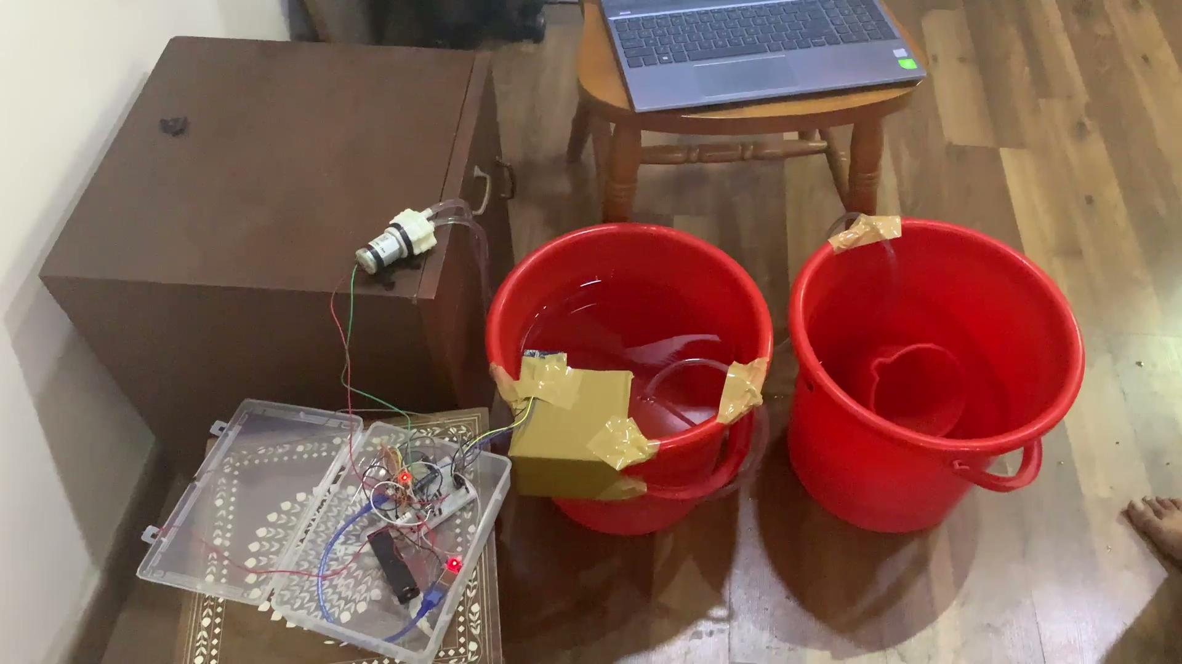
WORKING DEMOS

Slide 16
POWER OUTAGE/ROBUSTNESS
HARDWARE: The ESP is powered by a lithium battery hence the circuit will work even if power goes off. The pump will stop working when power goes off and resume once its back. In case of deployment, the AC pump may not switch on automatically when power comes back on. In this case, we will program the ESP so that the pump is switched on when the water level goes below a certain value. The percentage of error in sensors caused due to environmental factors, vibrations and time delay have been handled and are negligible.

Slide 17
ROBUSTNESS
When the internet connection is down, esp sends data a server hosted in its local network.
When internet is available, the data will be sent to om2m.

Slide 18
DATA COLLECTED/ EXPERIMENT PERFORMED
Using ultrasonic sensor to detect the water levels and Using the water level to control the Motor
https://drive.google.com/file/d/1qumsUl75qApZJ7hdTZuRnFT2RF6w5qdq/view?usp=sharing
Collected data is sent to OM2M server and then stored in mysql server

Slide 19
INFERENCES AND OBSERVATIONS
Observations:
Range of ultrasonic sensor: Min value measured accurately = 3.11 cm. Max value measured = 250 cm.
When the water surface was 2.5 cm from the sensor, the sensor calculated around 6.37-6.58 cm. It was accurate when distance from water surface to sensor >=3.11 cm.
When the water surface was less than or equal to 8 cm from ultrasonic sensor, motor was switched OFF. Likewise, when the water surface was greater than 8 cm from sensor, motor is switched ON.
Error (Sensors) : The HC-SR04 sensor gave value of 0 cm distance randomly. When ultrasonic sensor data is read more frequently than 2 seconds, this error occurs significantly more number of times . The DHT22 sensor failed to read data sometimes.
Percentage of error:
HC-SR04: 0.03
DHT22: 0.10

Slide 20
INFERENCES AND OBSERVATIONS
Inferences:
The error in DHT22 sensor is caused due to fluctuations in wire connections and is negligible.
The error in HC-SR04 sensor may be caused due to random vibrations of the water container. Due to its low percentage it is also negligible.
The last few entries of water levels are displayed along with the current water level in dashboard.
Graph of water level changes over time.

Slide 21
TROUBLESHOOTING GUIDE
 | ISSUE | SOLUTION
Hardware | The ultrasound sensor was giving an error of +-2cm, and it did not account for temperature differences. The DHT22 sensor does not read data sometimes. | We got the temperature using DHT22 sensor and calculated the speed of sound being used accordingly. The sound speed used in this case is calculated for a temperature of 25 degrees celsius. When deployed, the temperature used for sound speed calculation will be the average of previous X temperatures.
Hardware | While setting up the circuit, when the sensor was attached to the bucket directly, it showed 250 cm/0 cm randomly when the water was being poured. | We moved the sensor to hover over the center of the bucket to solve this issue.
Hardware | Delay of 2 seconds is necessary for HC-SR04 ultrasonic sensor, so we have to account for the water container overflowing before we get updated data. The HC-SR04 sensor gives wrong values a few times. | The motor has to be switched off with enough buffer distance and we used 8 cm as the threshold distance. To make sure the container does not overflow in these cases if motor is still on, 8 cm is enough threshold. If deployed, this threshold will be adjusted according to rate of water pumped.

Slide 22
TROUBLESHOOTING GUIDE
 | ISSUE | SOLUTION
Software | Subscription is not possible if we host our backend in our laptop | We have hosted our backend in our laptop using vpn to get an iiith private IP.

Slide 23
TIMELINE
Hardware Side | Time | Software Side
Buying hardware, connecting the ultrasonic sensor and measure water levels | Sep 9rd - Sep 29th | Requirements and design phase
Connecting sensors to microcontroller and testing the data sent to thingspeak, with physical values we measured | Oct 7th - Oct 13th | Setup frontend and backend. Got data from thingspeak
Setting up circuit for motor. Resolved issues with the circuit | Oct 15th - Oct 27th | Dashboard login page and errors. Sending data from backend to dashboard
Setting up motor controls using water levels. Set up circuit for water pump | Oct 28th - Dec 7th | OM2M, Dashboard

