Slide 1
WATER LEVEL MONITORING
ESW TEAM 8

Slide 2
AIM
The aim is to create a water level monitoring system that controls the motor's working, sends alerts to the phone based on water levels, and displays the current state of the motor (ON/OFF) and estimated time based on water levels on a dashboard.

Slide 3
WHY DO WE NEED WATER LEVEL MONITORING SYSTEM?
It reduces the possibility of human error.
These are better than traditional gauges and wired instruments in terms of safety.
They work in remote locations.
Helps keep track of water usage hence reduce wastage of water.
It Saves money and easy installation.
Alarm alerts to user helps in monitoring usage.

Slide 4
FEATURES
Basic dashboard showing water level and water usage
data processing/alerts - message to phone
Automatic switch on/off motor and the user can also control motor.
Based on water levels increase/decrease the checking time
Predicting the time when the tank will become empty.

Slide 5
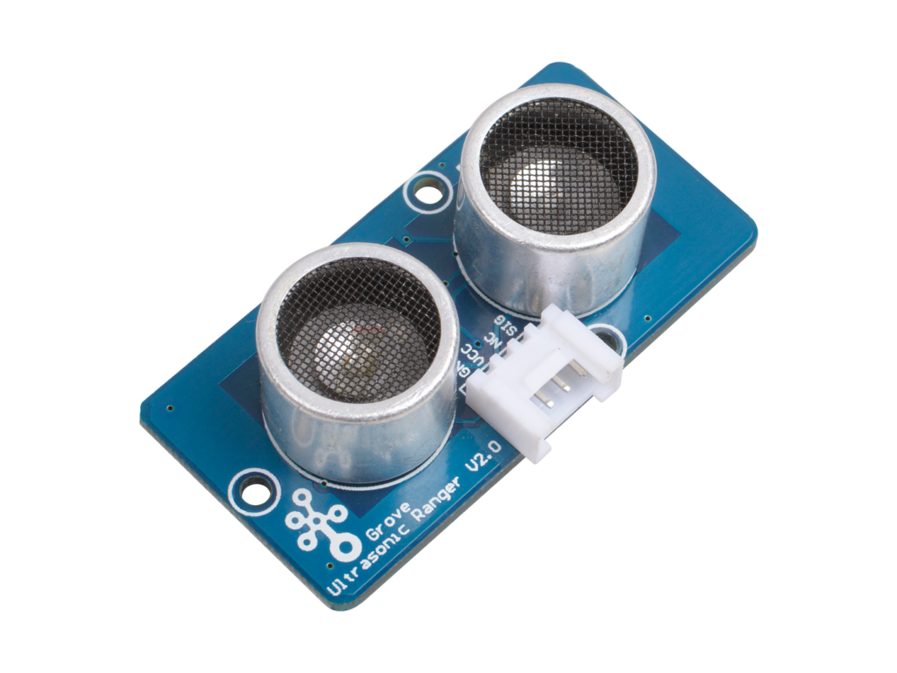
Ultrasonic sensor
Pros:
Works well in dim places
Consume lower current/power
Cons:
Limited detection range
Low resolution and slow refresh rate
Recommended Ultrasonic Sensor: Ultrasonic Sensor: Improved version of the HC-SR04

Slide 6
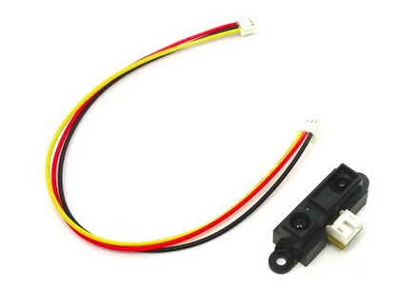
Infrared Sensor
Pros:
Small form factor
Works well in dim places
Measures distances from complex surfaces, unlike ultrasonic sensors
Cons:
Limited measurement range
Affected by environmental conditions and complex objects
Recommended IR Sensors: 80cm Infrared Proximity Sensor

Slide 7
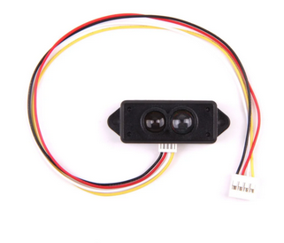
LiDAR
Pros:
High measurement range and accuracy
Fast update rate
Applicable for usage in the day and night
Cons:
Higher cost as compared to ultrasonic and IR
Harmful to the naked eye;
Recommended LiDAR Sensors: Mini LiDAR proximity sensor

Slide 8
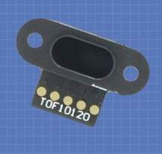
ToF Sensor
Pros:
High measurement range with accuracy
Waterproof
Quick response, small form
Cons:
Higher cost
Sensitive to external environments
Recommended Time-of-Flight Sensor: Time of Flight Distance Sensor (TOF10120)

Slide 9
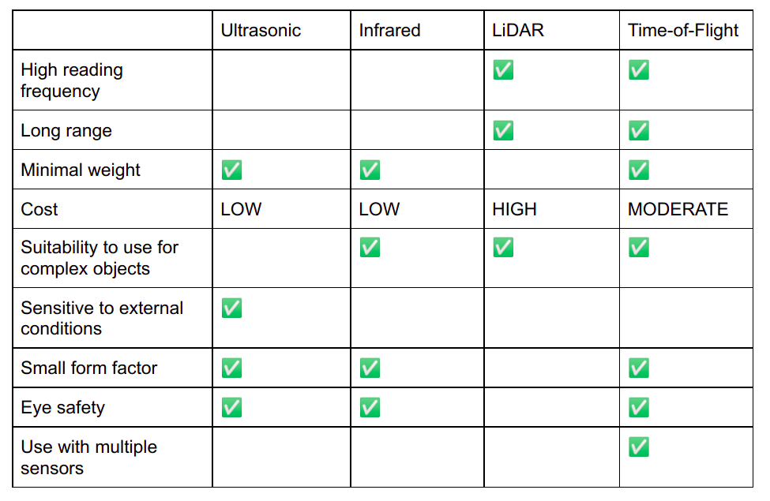

Slide 10
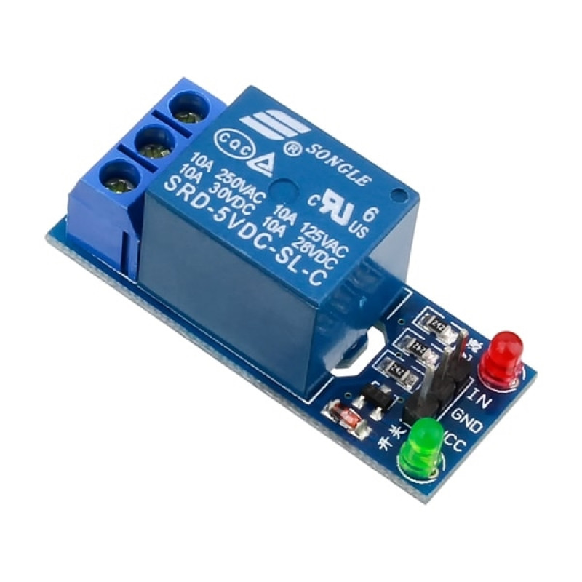
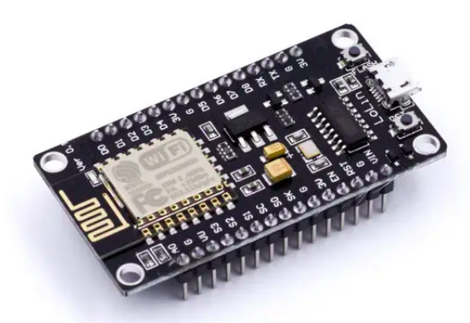
HARDWARE
1. Relay : It is used to switch on/off the motor using microcontroller..
2. Nodemcu ESP8266
3. Water pump/Motor
4. Tof sensor.
5. Ultrasonic Sensor

Slide 11
TIMELINE
Hardware Side | Time | Software Side
- | Aug 29th - Sep 5th | Things Speak Integration
3D model and circuit Design | Sep 9th - Sep 15th | Requirements and design phase
Connecting sensors to microcontrollers and testing the data sent to thingspeak, with physical values we measured | Sep 16th - Sep 22nd | Basic User Interface to monitor water level
Soldering into PCB | Sep 23rd - Sep 29th | Adding additional features

Slide 12
TIMELINE
Hardware Side | Time | Software Side
Taking opinions on the 3D model design | Sep 23rd - Sep 29th | Additional features
Implementation Of the 3D model | Oct 7th - Oct 13th | Testing and taking opinions from people about the interface
Nodes deployment | Oct 15th - Oct 27th | Changes can be done in the app and other features also can be added
Collecting sample data and final testing of the submission | Oct 28th - ending | Writing Reports

Slide 13
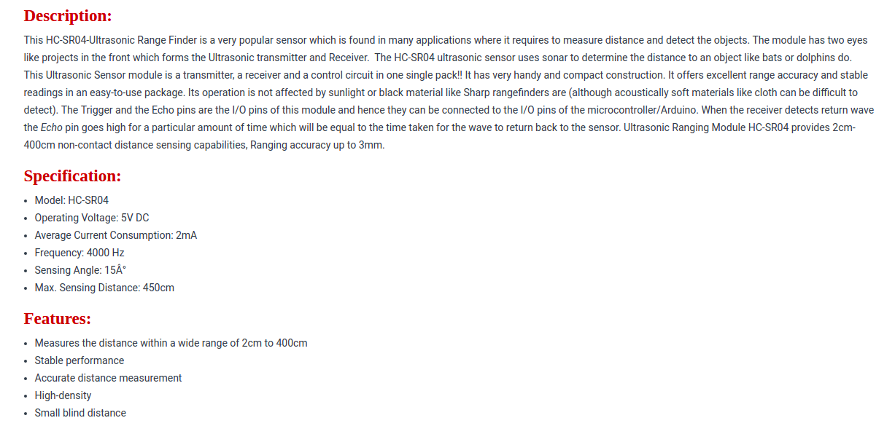
Ultrasonic HC-SR04 - rees52.com - ₹ 55.00

Slide 14
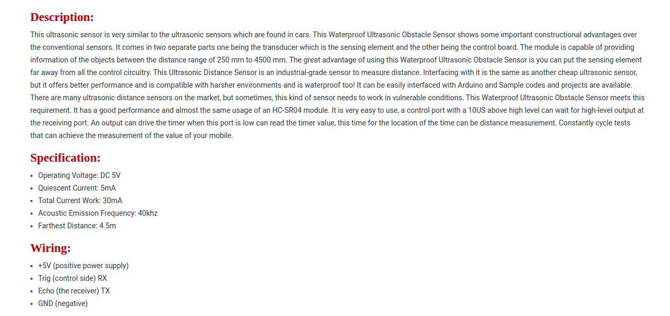
Ultrasonic Sensor Arduino - RS1764 - rees52.com- Rs 420

Slide 15
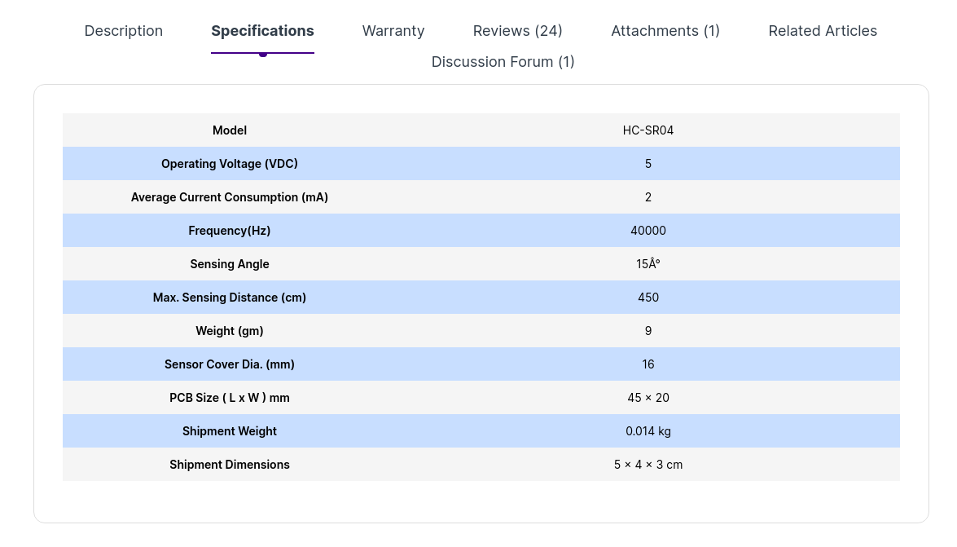
Ultrasonic HC-SR04 - robu.in - ₹ 75.00

Slide 16
Ultrasonic HC-SR04 - protocentral.com - Rs. 419
Datasheet : https://cdn.sparkfun.com/datasheets/Sensors/Proximity/HCSR04.pdf

Slide 17
TOF10120 - robokits.co.in - ₹1,327.50
TOF10120 range sensor provides accurate and repeatable long range distance measurement for high-speed autofocus (AF). With this very small TOF10120 Time-of-Flight sensor you can easily measure a distance using the reflection of light.
TOF10120’s time-of-flight sensing technology is realized by Sharp’s original SPAD (Single Photon Avalanche Diodes ) using low-cost standard CMOS process. It enables accurate ranging result, higher immunity to ambient light and better robustness to cover-glass optical cross-talk by special optical package design.
Specifications:
Voltage (power supply and signal): 3.3-5V DC
Detection distance: 100-1800mm
Wavelength: 940nm
2 Mounting holes of 2mm
Pinout:
1 GND: Ground
2 VDD: 3.3-5V DC
3 RXD: TTL input
4 TXD: TTL output
5 SDA: I2C data signal
6 SCL: I2C clock signal

Slide 18
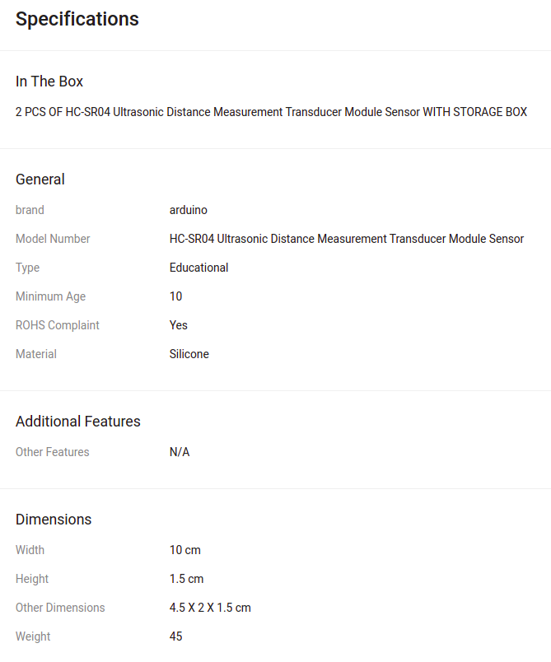
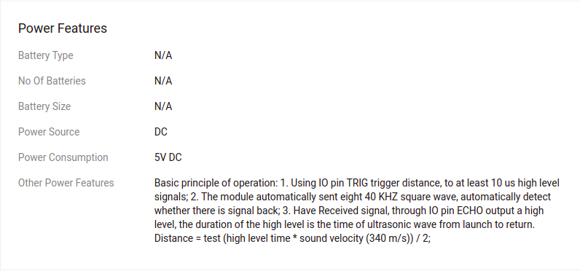
Ultrasonic HC-SR04 - flipkart - ₹120

Slide 19
VL53L0X - Time of Flight (TOF) - Electroncomponents.com - ₹400.00
Description:
Laser Ranging sensor is a tiny sensor carrier/breakout board with ST’s VL53L0X laser-ranging sensor, which measures the range to a target object up to 2 m. The board has VL53L0X which uses time-of-flight measurements of infrared pulses for ranging, allowing it to give accurate results independent of the target’s color and surface.
The out put distance measurements can be read through a digital IIC interface. The board is build with 2.8 V linear regulator and integrated level-shifters that allow it to work over an input voltage range of 2.6 V to 5.5 V, and the 0.1″ pin spacing makes it easy to use with standard solderless breadboards and 0.1″ perfboards.
Specification & Features
Resolution: 1 mm
Maximum range: 2m
Interface: I²C
Minimum operating voltage: 2.6 V
Maximum operating voltage: 5.5 V
Supply current: 10 mA
Dimension: 0.5" × 0.7" × 0.085" (13 mm × 18 mm × 2 mm)
Weight : 0.04g

