Slide 1
DHOOND: LOST AND
FOUND
Ananya Lakshmi BV

Slide 2

Overview
PURPOSE
SOFTWARE INVOLVED
MODULES AND CODE

Slide 3
Purpose
A Lost and Found Register/Forum
Can be used in organizations like Schools, Universities, Offices etc.
Efficient way of using time.
Can be installed at a Lost and Found station.

Slide 4
Software Involved
HTML, CSS
JAVASCRIPT, PHP
MYSQL
Coding Environment: VS Code

Slide 5
Modules and Code
Register and Login.
Home Page with two sections- Lost Something, Found Something.
Redirects you to the Lost/Found Form.
Home Page- Two main pages which display the information on the Lost and Found objects.

Slide 6

Login Page

Slide 7
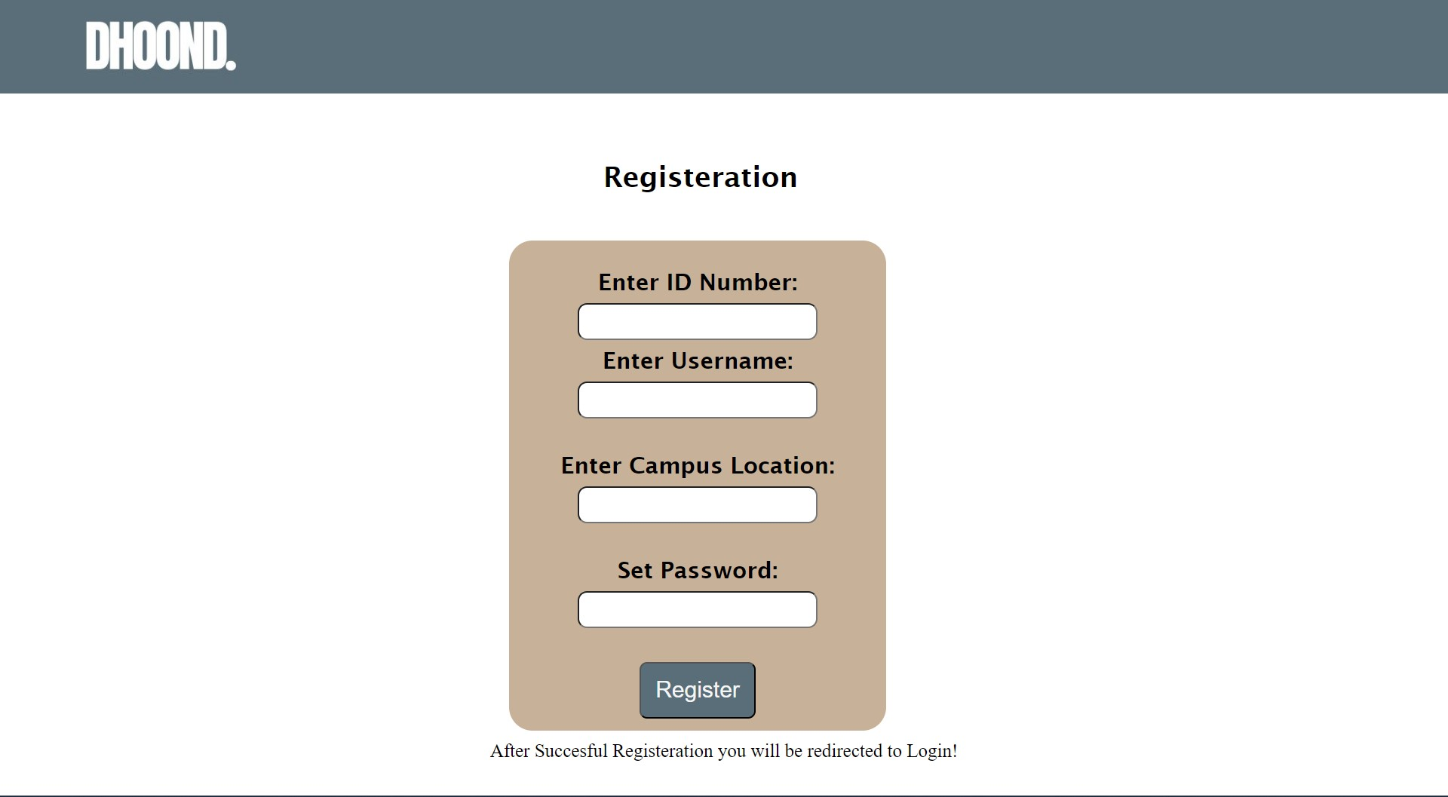
Registration Page

Slide 8
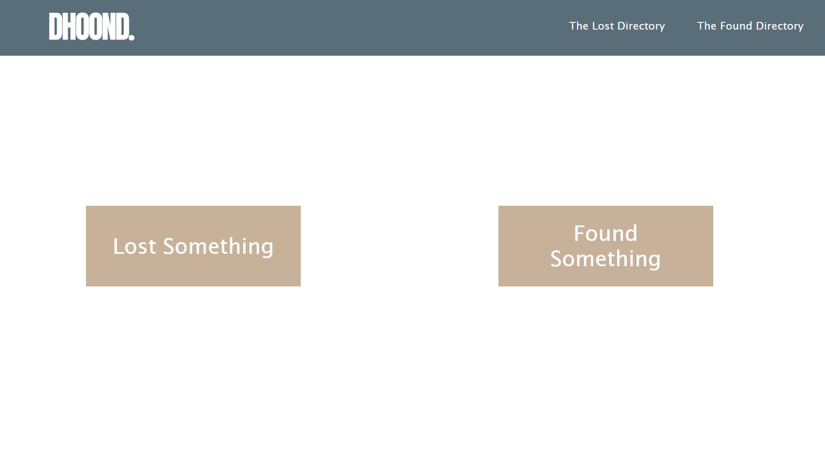
Home Page

Slide 9
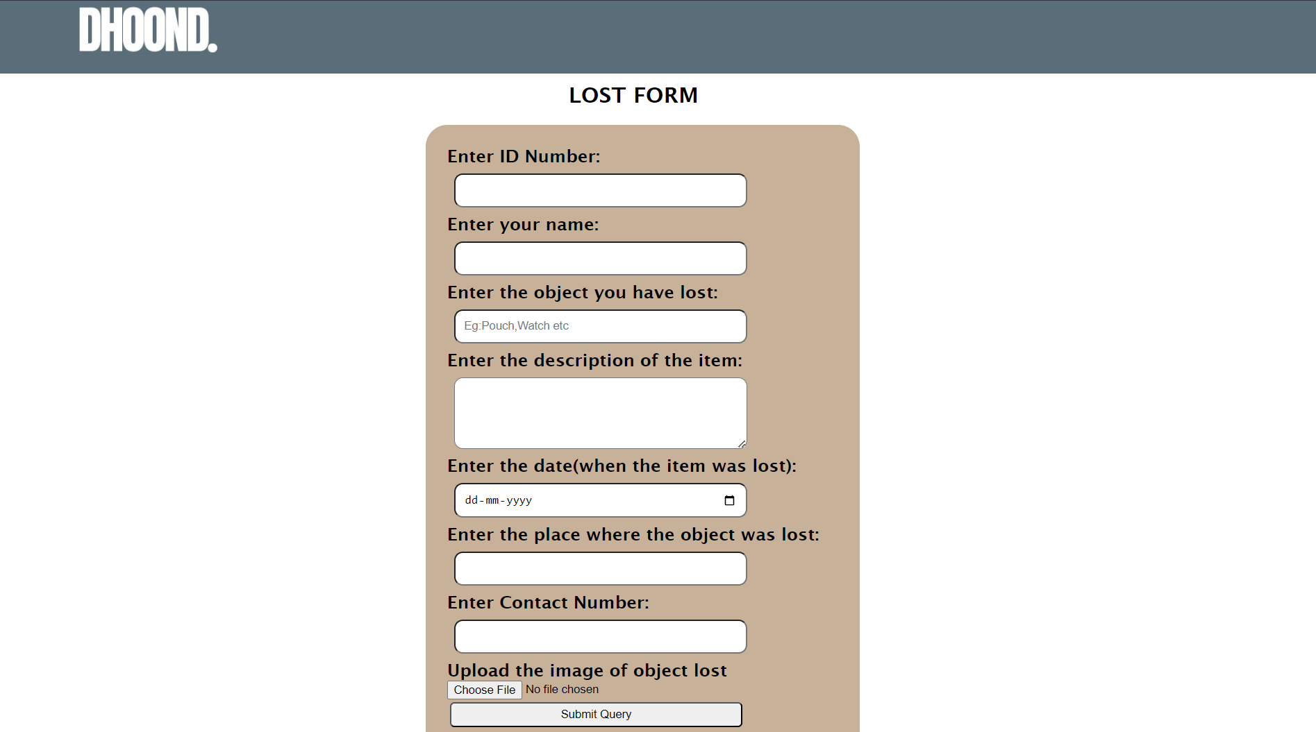
The Lost Form

Slide 10
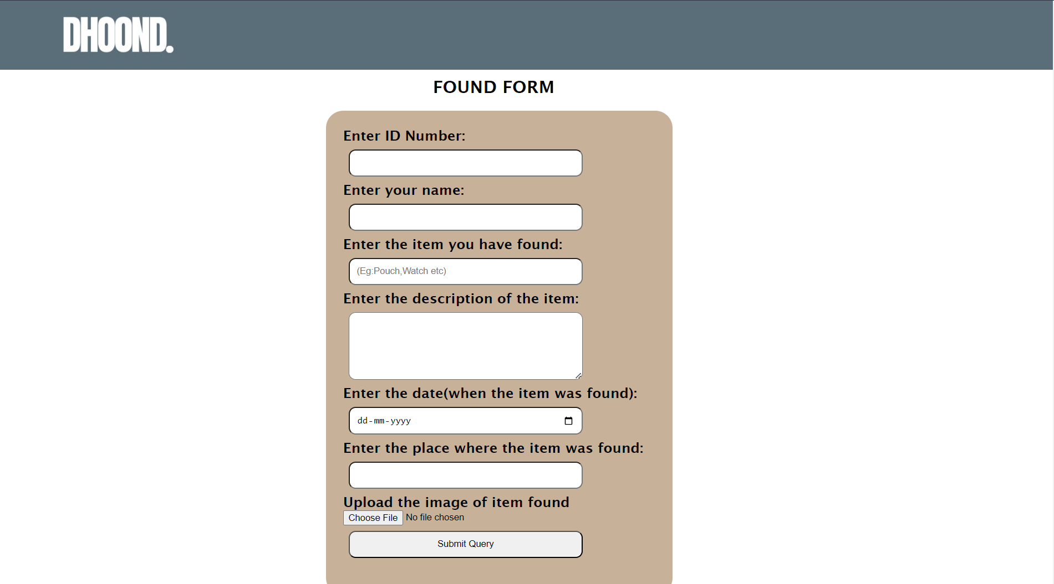
The Found Form

Slide 11
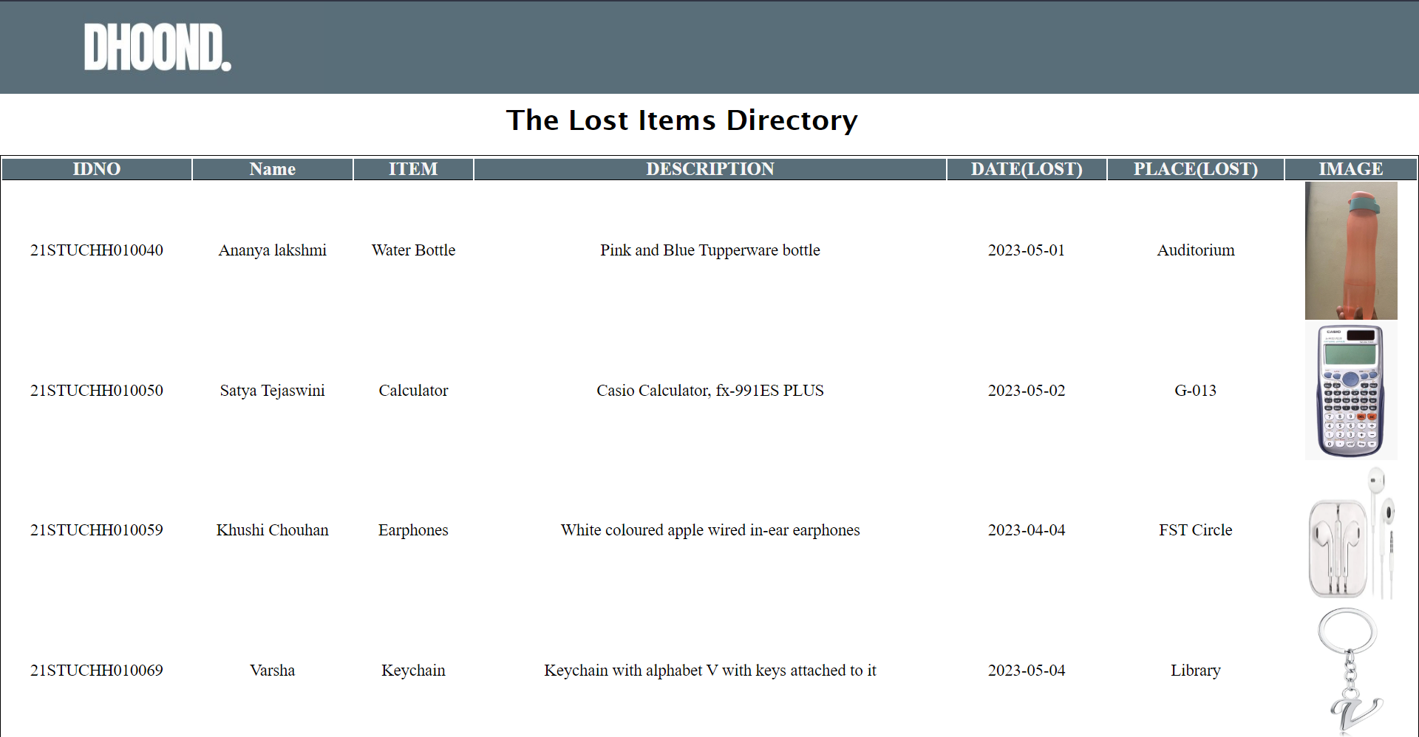
The Lost Directory

Slide 12
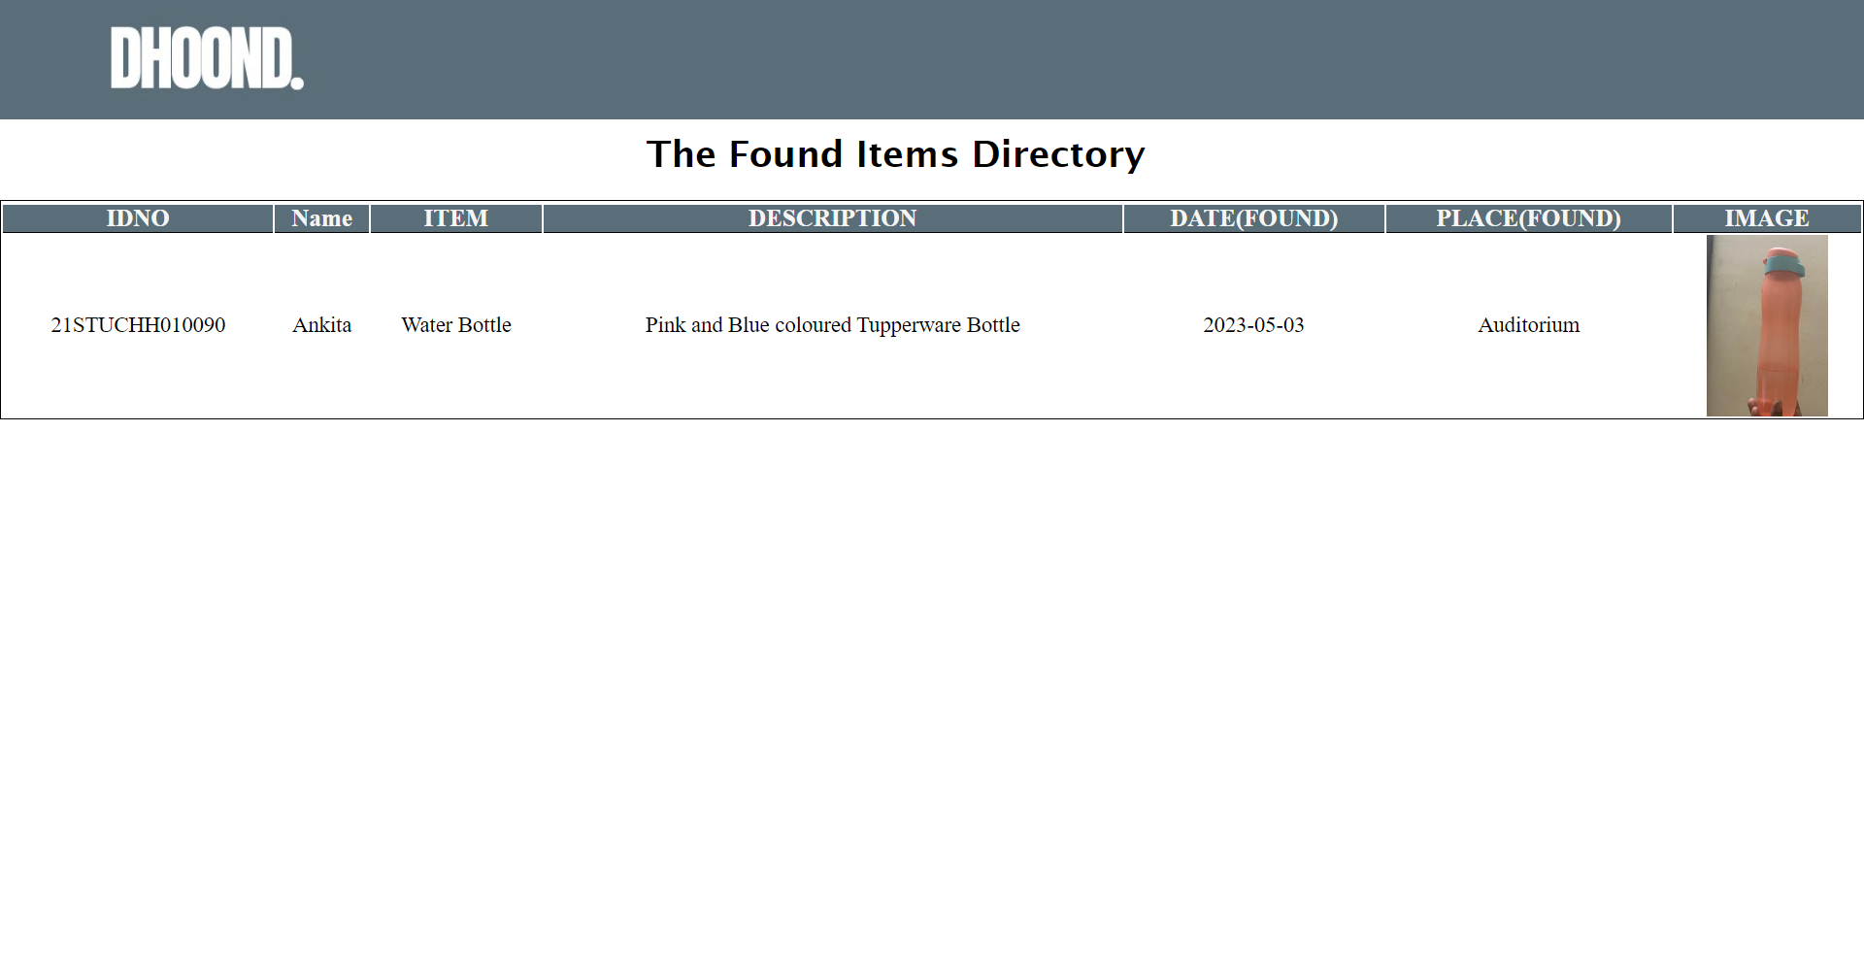
The Found Directory

Slide 13
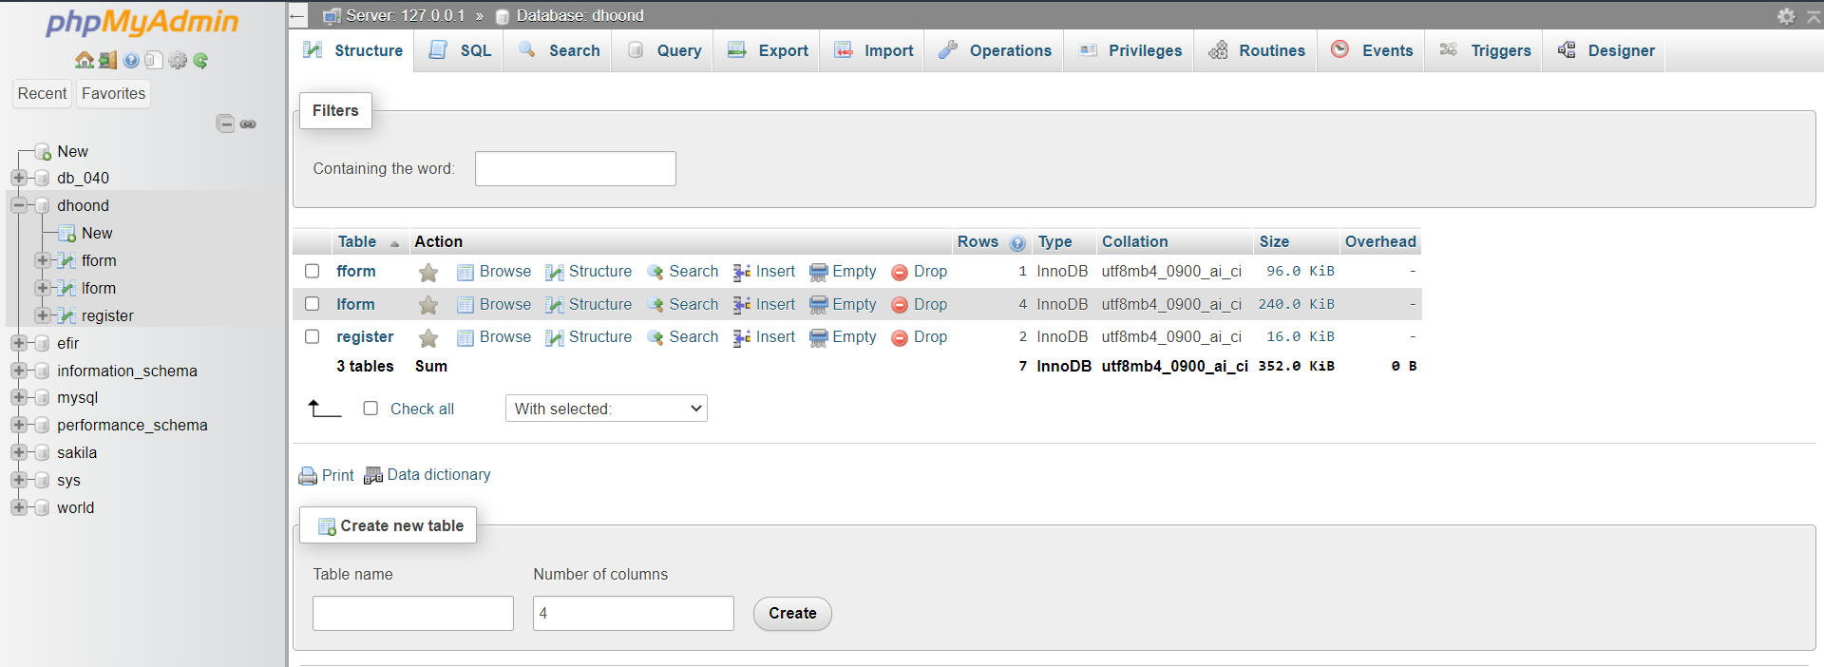
Database
🡪Found Form Info Table
🡪Lost Form Info Table
🡪Register Form Table

