Slide 1
Game-Theoretic Analysis of Online Advertising Competition
Ad slot 1 30% clicks
Ad slot 2 20% clicks
Ad slot 3 10% clicks
Game Theory course project · B.Tech CSE · Manipal University Jaipur
Who gets the top slot, and who pays what?
PRESENTED BY
Ananya Shukla
Ansh
Aryan Tyagi
Shaurya Singh
Rohit Kumar Yadav
2427030029
2427030307
2427030344
2427030357
2427030335
Notes:
Speaker: Ananya Shukla (about 30 seconds).
Good morning. We are presenting our Game Theory project: a game-theoretic analysis of online advertising competition. Our team is Ansh, Aryan, Shaurya, Rohit and me, Ananya.
The picture on the right is the heart of the topic: when you search on Google, the ads are shown in slots. The top slot gets the most clicks. So every advertiser wants it, and how much each one pays depends on what the others bid. That is a game.

Slide 2



Online advertising is a strategic game
THE PROBLEM
Shared customers
Auctions set the price
Played every day
When one firm advertises more, it takes customers from its rivals. Its gain depends on what they spend.
There is no fixed price for an ad. The auction rules and rivals' bids decide what you pay.
Budgets and bids are revised daily, so firms watch and react to each other.
PROBLEM STATEMENT
How do competing firms choose ad budgets and bids, what outcome does this competition reach, and how do the platform's auction rules change who gains and who loses?
Notes:
Speaker: Ananya Shukla (about 1 minute).
Why is online advertising a game-theory problem? Three reasons.
First, firms share the same customers. If my rival advertises more, my ads become less effective.
Second, prices are set by auctions. On Google or Meta you do not pay a fixed price. You pay based on what the other advertisers bid.
Third, it is repeated. Firms change budgets and bids every day and react to each other.
Whenever my best choice depends on your choice, that is exactly what game theory studies. So our problem statement is: how do firms choose budgets and bids, what outcome does the competition reach, and how do the auction rules decide who wins and who loses?

Slide 3
Five models of one market
OBJECTIVES AND APPROACH
M1
M1b
M2
M3
M4 + M5
Advertising war
Repeated game
Budget contest
Keyword auctions
Dynamics and display ads
Low or High budget?
Same war, every month
Any budget, n firms
GSP vs VCG vs GFP
Bidding over time, bid shading, reserve price
Prisoner's Dilemma
Trigger strategies
Tullock contest
Mechanism design
Bayesian equilibrium
SAME FOUR STEPS FOR EVERY MODEL
1
Define the game: players, strategies, payoffs
2
Solve by theory: the Nash equilibrium formula
3
Solve by computer: search or let players adapt
4
Compare and vary the inputs
Notes:
Speaker: Ananya Shukla (about 1 minute).
We broke the problem into five connected models.
Model 1 is a simple advertising war between two firms. Model 1b repeats it every month.
Model 2 lets any number of firms choose any budget.
Model 3 looks at the keyword auctions used by Google and Meta.
Models 4 and 5 look at how bids change over time and at display-ad auctions.
For every model we follow the same four steps: define the game, solve it with theory, solve it again with the computer, and check that both answers match. Then we change the inputs to see what drives the result.

Slide 4
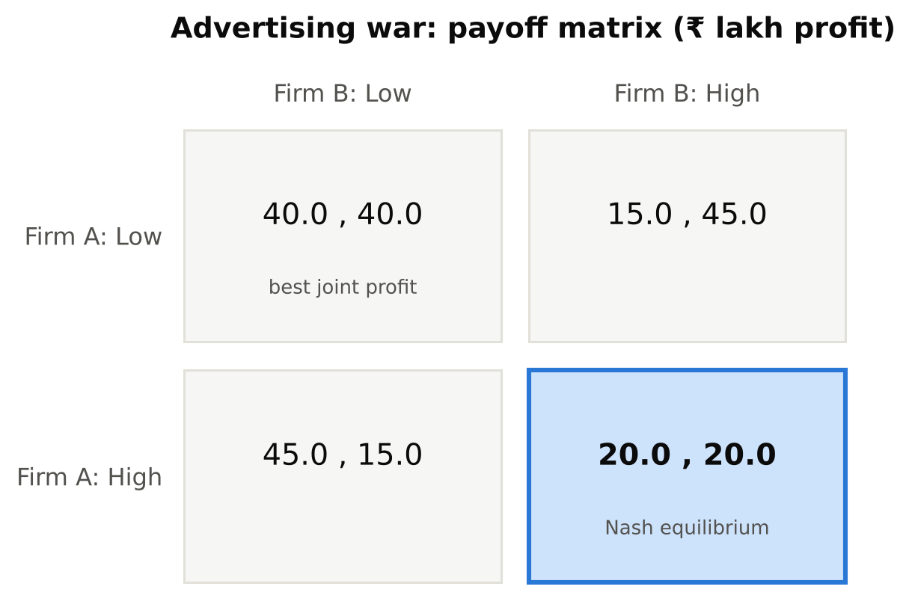
Both firms overspend: a Prisoner's Dilemma
MODEL 1 · ADVERTISING WAR
profit = market × share − spend, share = own spend ÷ total spend
High is dominant: 45 > 40 if the rival is Low, 20 > 15 if it is High
Only equilibrium: (High, High) at ₹20 lakh profit each
Both would earn ₹40 lakh at (Low, Low), but neither can trust the other
50%
of joint profit is lost at the equilibrium. The extra ₹40 lakh goes to the ad platform.
Notes:
Speaker: Ananya Shukla (about 1.5 minutes).
Model 1. Two firms share a market worth 100 lakh rupees. Each picks a Low budget of 10 or a High budget of 30. Market share depends on how much you spend compared with your rival.
Look at the matrix. If my rival spends Low, I get 45 by going High instead of 40. If my rival spends High, I get 20 by going High instead of 15. So High is better whatever the rival does. That is a dominant strategy.
Both firms think the same way, so they end up at High-High with 20 each. But at Low-Low they would get 40 each. Half the joint profit is wasted, and it goes to the platform as extra ad spend. This is the classic Prisoner's Dilemma.
Our solver also checks this with iterated elimination of dominated strategies and a mixed-strategy search. Both confirm High-High is the only equilibrium.

Slide 5
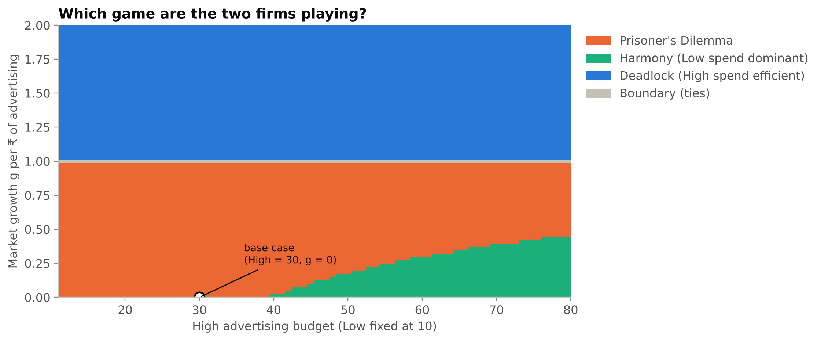
Overspending happens when ads steal customers
MODEL 1 · WHEN DOES IT HAPPEN?
41%
Prisoner's Dilemma
g < 1: ads mostly steal customers
49%
Deadlock
g > 1: ads create new demand, so High is good for both
8%
Harmony
High budget too big for the market: Low wins
We solved 5,670 versions of the game, changing the High budget (11 to 80) and how much each rupee of ads grows the market (g from 0 to 2).
With 3 levels (10 / 25 / 40) the unique equilibrium is ₹25 lakh each, exactly what Model 2 predicts.
Notes:
Speaker: Ananya Shukla (about 1 minute).
Is advertising always a Prisoner's Dilemma? No. We ran the model 5,670 times with different High budgets and different market growth.
The orange area is the Prisoner's Dilemma. It happens when advertising mainly steals customers from the rival, that is, growth g below 1. The blue area, above g equals 1, is where each rupee of advertising creates more than a rupee of new demand. There, spending High is good for both firms. The small green area is where High is simply too expensive.
So the lesson for a manager is: the ad war is wasteful only in markets where ads shift customers rather than grow the market.
One more check: with three budget levels the unique equilibrium is 25 lakh each, which is exactly the answer of the continuous model Ansh will show next.

Slide 6
Playing every month makes low budgets possible
MODEL 1b · REPEATED GAME
Cooperation (Low, Low) survives if
δ ≥ 0.20
δ* = (T − R) ÷ (T − P) = (45 − 40) ÷ (45 − 20)
δ (delta) = how much a firm values next month's profit
Reciprocal strategies win: Grim Trigger, Pavlov and Tit-for-Tat earn about ₹36 lakh a month, close to the cooperative ₹40
Always High comes last with no mistakes
With 5% mistakes Grim Trigger falls to 6th: one error starts a war that never ends. Forgiveness matters.
Notes:
Speaker: Ansh (about 1.5 minutes).
Thank you, Ananya. In reality firms do not play the ad war once. They set budgets every month. So I repeated the game.
Theory says the firms can stay at Low-Low if each one punishes the other for going High. This works when the discount factor delta is at least 0.20. Delta measures how much a firm cares about next month's profit. 0.20 is a very low bar, so cooperation is quite easy to sustain.
To test it we ran a tournament, like Robert Axelrod's famous one. Seven strategies played each other for 200 months. The blue bars show that strategies which reward cooperation and punish cheating, like Grim Trigger and Tit-for-Tat, earn about 36, almost the cooperative 40. Always High comes last.
The orange bars add a 5% chance of a mistake. Now Grim Trigger falls to 6th, because one accident starts a permanent war. Forgiving strategies do better. In real markets, where you cannot see a rival's budget exactly, forgiveness is important.

Slide 7
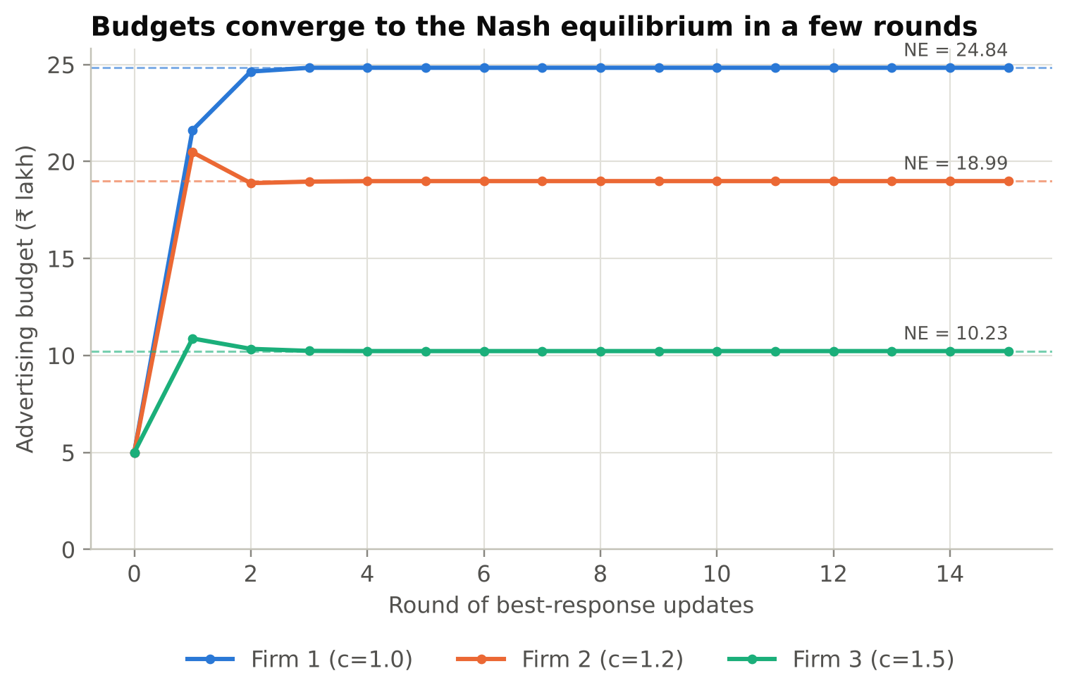
Any budget, any number of firms
MODEL 2 · BUDGET CONTEST
Firm i's profit
πᵢ = V × xᵢ ÷ (x₁ + … + xₙ) − cᵢ × xᵢ
V = value of the customers (₹100 lakh), xᵢ = budget, cᵢ = cost per ₹ of ads
Firm | Cost | NE budget | Share | Profit
Firm 1 | 1.0 | 24.84 | 45.9% | 21.11
Firm 2 | 1.2 | 18.99 | 35.1% | 12.34
Firm 3 | 1.5 | 10.23 | 18.9% | 3.58
Raise Firm 3's cost to 3.0: its budget falls to 0. The weakest firm stops advertising.
Firms take turns choosing their best reply. Budgets reach the equilibrium formula within 3 rounds.
Notes:
Speaker: Ansh (about 1.5 minutes).
Model 1 had only Low and High. Here each firm can choose any budget, and there can be any number of firms. This is called a Tullock contest. You win a share of the customers equal to your share of total spending.
We derived the Nash equilibrium formula. With three firms whose costs are 1.0, 1.2 and 1.5, the cheapest firm spends about 25 lakh and earns the most. The weaker firms spend less.
On the right, we check the formula in a different way. Each firm in turn picks its best reply to the others. Within three rounds the budgets settle exactly on the formula, shown by the dashed lines.
And if we raise Firm 3's cost to 3.0, its equilibrium budget becomes zero. A weak firm cannot compete profitably, so it stops advertising.

Slide 8
More rivals, more value goes to the platform
MODEL 2 · RENT DISSIPATION
Total spend = (n − 1) ÷ n × V
50%
of the value goes to the platform with 2 firms
90%
of the value goes to the platform with 10 firms
95%
of the value goes to the platform with 20 firms
Profit per firm falls from ₹25 lakh (2 firms) to ₹1 lakh (10 firms).
Notes:
Speaker: Ansh (about 1 minute).
This is the most striking result of Model 2. With n identical firms, the total amount they spend on ads in equilibrium is (n minus 1) over n of the whole customer value.
With 2 firms, half the value goes to the platform. With 10 firms, 90 percent. With 20 firms, 95 percent. Economists call this rent dissipation: the firms compete away the prize, and the platform collects it.
This explains why Google and Meta benefit so much from crowded markets, and why profit per firm drops from 25 lakh to just 1 lakh when the number of competitors goes from 2 to 10. Now Aryan will explain the auctions that decide these payments.

Slide 9
Three ways to price an ad slot
MODEL 3 · KEYWORD AUCTIONS
Search: "running shoes"
GSP
VCG
GFP
Slot 1
30% of users click
Generalized Second Price
Vickrey–Clarke–Groves
Generalized First Price
PAYS
PAYS
PAYS
Slot 2
20% click
Pay the next-highest bid
Pay the loss you cause the others
Pay your own bid
Slot 3
10% click
USED BY
USED BY
USED BY
Google Ads, Microsoft Ads
Meta (Facebook) ads
Overture, 1997–2002
Advertisers bid per click. Ads are ranked by bid (× quality score on Google).
TRUTHFUL BIDDING BEST?
TRUTHFUL BIDDING BEST?
TRUTHFUL BIDDING BEST?
No
Yes
No
Notes:
Speaker: Aryan Tyagi (about 1.5 minutes).
Thank you, Ansh. Now let's look at how the price of an ad is actually decided. When you search for running shoes, you see a few ad slots. Slot 1 gets the most clicks, say 30 percent of users; slot 3 only 10 percent. Advertisers bid an amount per click.
There are three main payment rules. GSP, used by Google, makes you pay the bid of the advertiser just below you. VCG, used by Meta, makes you pay the harm your presence causes to the other advertisers. GFP, used by Overture in the early days, makes you pay your own bid.
The key question is whether bidding your true value is your best strategy. Under VCG, yes. Under GSP and GFP, no. Let me show why with an example.

Slide 10
Truthful bidding is not stable under GSP
MODEL 3 · WORKED EXAMPLE
5 advertisers value a click at ₹12, 10, 8, 6, 4. 3 slots with 30%, 20%, 10% clicks.
Rule and bids | Bids (₹) | Price per click, slots 1–3 (₹) | Revenue per search | Stable?
VCG, truthful | 12, 10, 8, 6, 4 | 8.0, 7.0, 6.0 | ₹4.40 | Yes
GSP, truthful | 12, 10, 8, 6, 4 | 10.0, 8.0, 6.0 | ₹5.20 | No
GSP, equilibrium | 12, 8, 7, 6, 4 | 8.0, 7.0, 6.0 | ₹4.40 | Yes
GFP, truthful | 12, 10, 8, 6, 4 | 12.0, 10.0, 8.0 | ₹6.40 | No
BRAND A's BETTER MOVE
Bid ₹12 → slot 1
0.30 × (12 − 10) = ₹0.60
Bid just above ₹8 → slot 2
0.20 × (12 − 8) = ₹0.80
The same three brands win in every case, so the value created (₹6.40 per search) never changes. Only the payments do.
+33% profit by bidding lower and taking a worse slot.
Notes:
Speaker: Aryan Tyagi (about 1.5 minutes).
Here is our worked example: five brands value a click at 12, 10, 8, 6 and 4 rupees, and there are three slots.
In the highlighted row, everyone bids truthfully under GSP. Brand A wins slot 1 and pays 10 per click, the next bid. Its profit is 0.30 times 12 minus 10, which is 60 paise per search.
But look at the right. If Brand A lowers its bid to just above 8, it drops to slot 2 and pays only 8. Its profit becomes 0.20 times 4, which is 80 paise. It earns 33 percent more by taking a worse slot! So truthful bidding is not an equilibrium under GSP. Our program finds this deviation automatically by trying every meaningful bid.
The third row shows the stable equilibrium bids found by Edelman, Ostrovsky and Schwarz in 2007. Notice that the prices are exactly the VCG prices: 8, 7 and 6.

Slide 11
In equilibrium, GSP earns exactly what VCG earns
MODEL 3 · 10,000 RANDOM AUCTIONS
Truthful GSP looks 25% richer than VCG (₹3.33 vs ₹2.67)
But advertisers do not bid truthfully. Once they bid strategically, GSP earns ₹2.67, the same as VCG, in every auction
Efficiency is the same: all three give ₹4.33 of value per search; only its split changes
Matches theory: Edelman et al. (2007), Varian (2007)
Notes:
Speaker: Aryan Tyagi (about 1 minute).
One example is not enough, so we simulated 10,000 random auctions with five bidders.
If you assume advertisers bid truthfully, GSP seems to earn 25 percent more than VCG: 3.33 versus 2.67 rupees per search. That might make you think Google's rule is better for the platform.
But advertisers are not naive. Once they bid strategically, the green bar, GSP earns 2.67, exactly the same as VCG, in every single auction. The value created is also the same in all cases; only the split between the platform and the advertisers changes. This matches the famous papers by Edelman and colleagues, and by Hal Varian of Google. Shaurya will now show what happens when bids change over time.

Slide 12
First-price bidding never settles; GSP does
MODEL 4 · BIDDING DYNAMICS
13 crashes
in 400 bid changes. Each firm outbids the other by ₹0.10 until slot 2 at the reserve is better, then the war restarts.
20 / 20
random starts converge to the equilibrium bids in 11 to 41 updates. Revenue ends at ₹4.40, the VCG value.
Notes:
Speaker: Shaurya Singh (about 1.5 minutes).
Thank you, Aryan. An equilibrium tells us where bidding could settle. But do real bids actually get there? Model 4 simulates bidders adjusting over time.
On the left is a first-price auction with two advertisers. Each keeps outbidding the other by 10 paise to get the top slot. When the price gets too high, one gives up and drops to the reserve price. Then the other drops too, and the war starts again. We counted 13 crashes in 400 moves. The bids never settle. This saw-tooth pattern was actually seen in Overture's real data, and it is one reason the industry switched to GSP.
On the right is GSP, where each advertiser uses a 'balanced bidding' rule. From 20 different random starting points, every single run settled on the equilibrium bids, and revenue settled at 4.40 rupees, the VCG value. So GSP is stable and predictable.

Slide 13
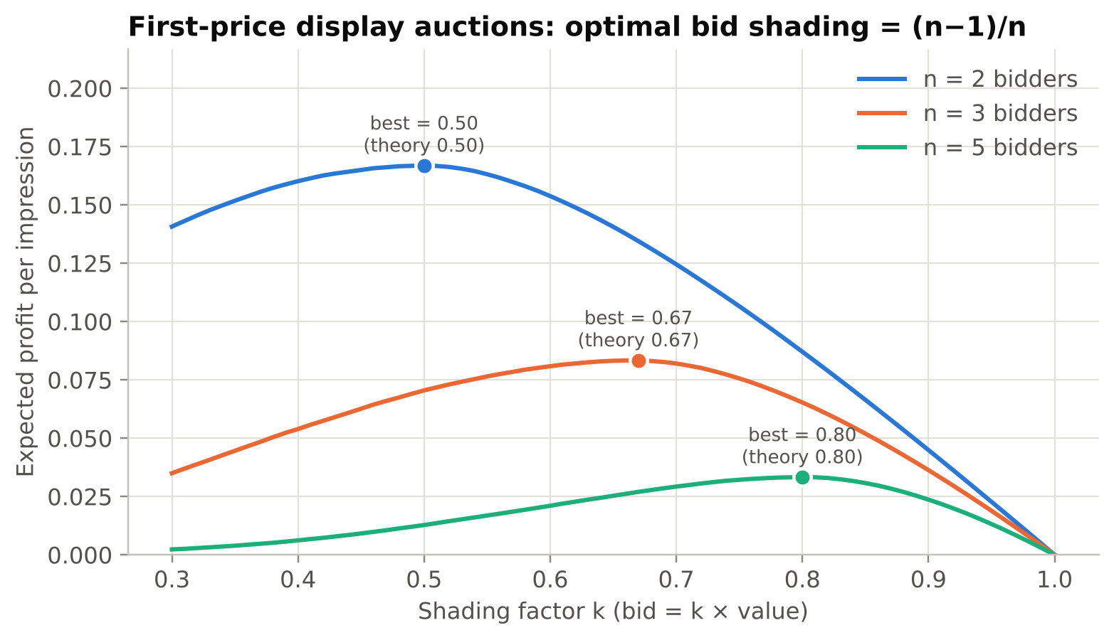
Shade your bid to (n − 1) ÷ n of your value
MODEL 5 · DISPLAY ADS (REAL-TIME BIDDING)
Every page view sells one ad in a first-price auction. Bidders do not know rivals' values (Bayesian game, values uniform 0–1).
Bidders | Best shading (simulated) | Theory
2 | 0.50 | 0.50
3 | 0.67 | 0.67
5 | 0.80 | 0.80
More rivals means less shading. Google Ad Manager moved to first-price auctions in 2019, so bid-shading tools became a major ad-tech product.
Notes:
Speaker: Shaurya Singh (about 1.5 minutes).
Model 5 is about display ads, the banner ads you see on websites. Every time a page loads, one ad impression is sold in an auction that takes milliseconds. Bidders do not know each other's values, so this is a Bayesian game.
In a first-price auction you pay your own bid, so bidding your full value gives zero profit. How much should you shade? We let one bidder try every shading factor while the others use the theoretical strategy. The profit curve peaks exactly where theory says: at one half with 2 bidders, two thirds with 3, and four fifths with 5.
The rule is: bid (n minus 1) over n of your value. More competition, less shading. This is practical: in 2019 Google Ad Manager switched to first-price auctions, and bid shading became an important ad-tech product.

Slide 14
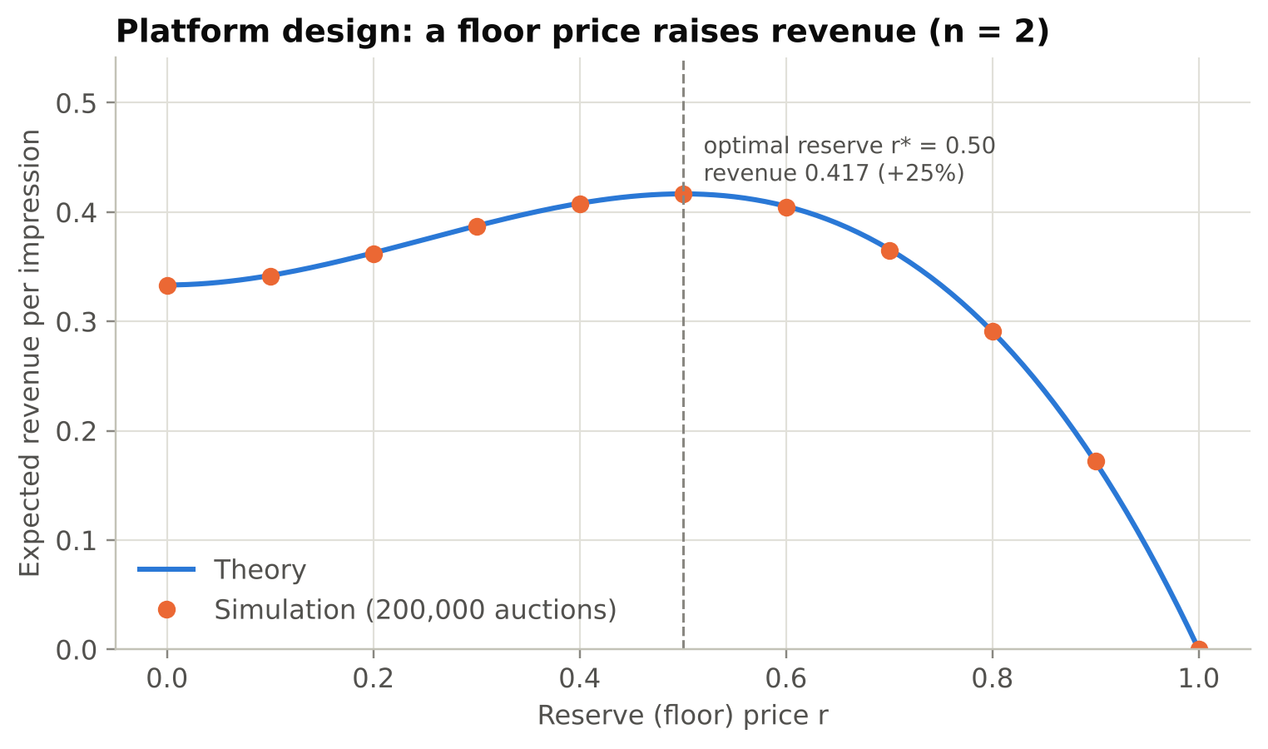
A reserve price of 0.5 raises revenue by 25%
MODEL 5 · PLATFORM DESIGN
+25%
revenue with the best reserve (0.333 → 0.417, two bidders)
25%
of impressions go unsold at that reserve, and it still pays
Revenue equivalence: first-price and second-price earn the same, (n − 1) ÷ (n + 1), within 0.001 for n = 2 to 10.
Notes:
Speaker: Shaurya Singh (about 1 minute).
Now the platform's side. A reserve price is a minimum bid. Below it, the ad slot is not sold.
The curve shows revenue for every reserve price, with the formula as a line and our 200,000 simulated auctions as dots. They match. The best reserve is 0.5, as Myerson proved in 1981. It raises revenue by 25 percent, even though one in four impressions goes unsold.
We also confirmed revenue equivalence: first-price and second-price auctions earn the same expected revenue. So switching formats does not, by itself, make the platform richer. Rohit will now show how we built all of this.

Slide 15
How the software is built
IMPLEMENTATION
MODELS
RUNNERS
OUTPUTS
adgame/ package
three ways to use it
what you get
normal_form.py: NE solver
ad_spend_game.py: Model 1
repeated_game.py: Model 1b
budget_contest.py: Model 2
position_auctions.py: Model 3
dynamics.py: Model 4
auction_design.py: Model 5
main.py: runs every experiment
app.py: Streamlit dashboard
tests/: 20 automated tests
12 result figures
CSV tables + results.json
Live what-if dashboard
Test report: 20 passed
BUILT WITH
Python
NumPy
Matplotlib
Pandas
Streamlit
Pytest
All solvers written from scratch; no game-theory library computes any result.
Notes:
Speaker: Rohit Kumar Yadav (about 1.5 minutes).
Thank you, Shaurya. Let me explain how the software is built.
On the left is our Python package, adgame. It has one file per model, plus a general solver for two-player games that finds pure and mixed Nash equilibria. We wrote all the solvers ourselves; we did not use any game-theory library to compute the results.
In the middle are three ways to use it. main.py runs every experiment in about 5 seconds and prints the results. app.py is an interactive dashboard built with Streamlit. And the tests folder has 20 automated tests.
On the right are the outputs: 12 figures, CSV tables, a JSON file with every number, the live dashboard and the test report. All simulations use fixed random seeds, so anyone who runs the code gets exactly our numbers.

Slide 16

Every result matches published theory
VERIFICATION
Model | Theory predicts | Our program finds
1 Ad war | (High, High) is the only NE | (High, High); 50% of profit lost
1b Repeated | Cooperate if δ ≥ (T−R)/(T−P) | δ* = 0.20; reciprocity wins
2 Contest | Total spend = (n−1)V/n | Exact for n = 2 to 20
3 Auctions | VCG truthful; GSP-EOS = VCG | Confirmed on 10,000 auctions
4 Dynamics | GFP cycles; GSP converges | 13 crashes; 20/20 converge
5 Display | Shade (n−1)/n; reserve 0.5 | 0.50 / 0.67 / 0.80; r* = 0.50
20 / 20
automated tests pass in under 1 second
Our mixed-equilibrium solver is also cross-checked against the nashpy library.
Notes:
Speaker: Rohit Kumar Yadav (about 1 minute).
How do we know our code is correct? Every model has a test that compares the program's answer with a result from the published theory.
The table summarises it. For the ad war, theory says High-High is the only equilibrium; we get that. For the contest, theory says total spend is (n minus 1) over n of V; we match it exactly. For auctions we reproduce the results of Edelman, Varian, and Cary and colleagues. For display ads, the shading factors and the reserve price match exactly.
All 20 tests pass in under a second. We also cross-checked our own equilibrium solver against an independent library called nashpy.

Slide 17
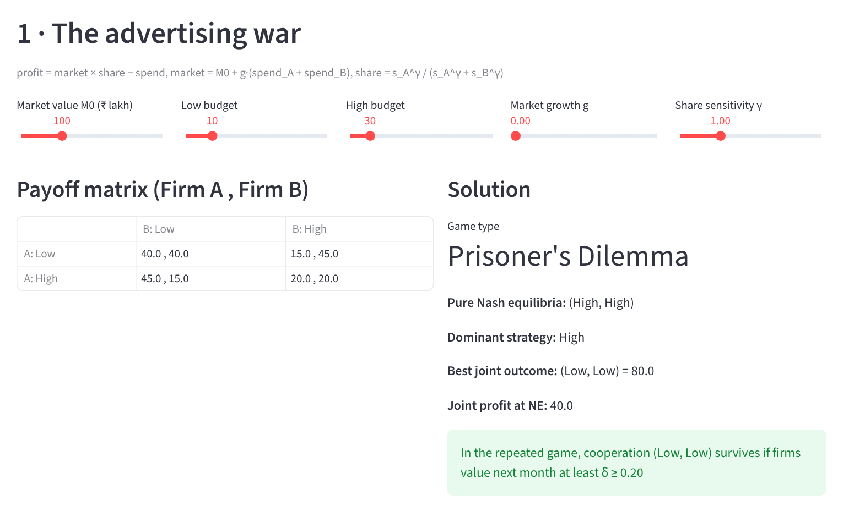
The interactive dashboard
LIVE DEMO
streamlit run app.py
1
Advertising war
Move growth g above 1: the game changes from Prisoner's Dilemma to Deadlock
2
Budget contest
Set Firm 3's cost to 3.0: its budget drops to zero
3
Keyword auctions
See Brand A's profitable deviation under truthful GSP
4
Bidding dynamics
Watch the first-price saw-tooth and GSP settle
Notes:
Speaker: Rohit Kumar Yadav (about 2 minutes, live).
Now a live demo. [Switch to the browser where 'streamlit run app.py' is already running. Start it before the presentation begins.]
Step 1, Advertising war page: the default game is a Prisoner's Dilemma. I move the market growth slider above 1. The game type changes to Deadlock: now advertising creates demand, so spending High is good for both.
Step 2, Budget contest page: I set Firm 3's cost to 3.0. Its equilibrium budget becomes zero; it drops out.
Step 3, Keyword auctions page: the table compares GSP, VCG and GFP, and the yellow box shows Brand A's profitable deviation under truthful GSP.
Step 4, Bidding dynamics page: the first-price saw-tooth, and GSP settling down.
[Backup if the laptop or internet fails: show this screenshot and the figures on the previous slides.]

Slide 18




Where these results are used
APPLICATIONS
Advertisers
Ad platforms
Spend more only when ads grow the market. Shade bids in first-price auctions. Expect crowded markets to eat your margin.
Pick stable auction rules (GSP or VCG over first-price). Set reserve prices. Use quality scores in ranking.
Ad-tech firms
Regulators
Build bid-shading and automated bidding tools based on best-response and balanced-bidding rules.
Watch for tacit coordination on budgets in repeated play, and for platform power that grows with advertiser numbers.
Notes:
Speaker: Rohit Kumar Yadav (about 1 minute).
Where can these results be used?
Advertisers: increase budgets only when ads grow the market, shade bids in first-price auctions, and expect crowded markets to eat into profit.
Ad platforms like Google, Meta and Amazon: choose stable auction rules, set reserve prices, and use quality scores.
Ad-tech companies: build bid-shading and automatic bidding tools.
Regulators: watch for firms quietly coordinating on budgets, and for platform power that grows as more advertisers compete.
The same contest model also fits election campaign spending, R&D races and lobbying.

Slide 19
Key takeaways
CONCLUSION
01
Budgets
02
Repetition
Firms overspend when ads steal customers: 50% of joint profit lost with 2 firms, 90% of value to the platform with 10.
Low budgets can last without any agreement if δ ≥ 0.20, but one mistake can break trigger strategies.
03
Auction rules
04
Design
GSP is not truthful, yet in equilibrium earns exactly VCG revenue. First-price keyword bidding never settles.
Shade bids to (n−1)/n; formats earn the same; a 0.5 reserve adds 25% revenue.
Limits and next steps: numbers are illustrative, not fitted to real data. Next: real auction datasets, learning bidders, and budget-limited auto-bidding agents.
Notes:
Speaker: Rohit Kumar Yadav (about 1 minute).
To conclude, four takeaways.
One: firms overspend on ads when ads mainly steal customers, and the platform collects the waste.
Two: repeated play can keep budgets low without any agreement, but it is fragile when mistakes happen.
Three: auction rules matter. GSP is not truthful, but in equilibrium it earns exactly what VCG earns, and first-price keyword auctions never settle.
Four: in display auctions, shade your bid to (n minus 1) over n, and platforms gain 25 percent from the right reserve price.
Our limits: the numbers are illustrative, not fitted to real data. Next steps would be real auction datasets, learning algorithms for bidders, and budget-limited auto-bidding.

Slide 20
Questions?
THANK YOU
Ananya Shukla
2427030029
KEY REFERENCES
Edelman, Ostrovsky & Schwarz (2007), American Economic Review 97(1)
Varian (2007), Int. Journal of Industrial Organization 25(6)
Cary et al. (2007), ACM Conference on Electronic Commerce
Tullock (1980), Efficient rent seeking
Myerson (1981), Mathematics of Operations Research 6(1)
Axelrod (1984), The Evolution of Cooperation
Ansh
2427030307
Aryan Tyagi
2427030344
Shaurya Singh
2427030357
Rohit Kumar Yadav
2427030335
Code, report and dashboard: python main.py · python -m pytest · streamlit run app.py
Notes:
Speaker: all members.
Thank you for listening. We are happy to take questions.
Likely questions and who answers:
- Why is GSP not truthful? (Aryan) Because you can pay less by dropping to a lower slot; the price you pay depends on the bid below you, not your own.
- Why does the platform not just use VCG? (Aryan) It is harder to explain to advertisers, and GSP earns the same in equilibrium. Meta does use VCG.
- What is the discount factor in practice? (Ansh) How much a firm values future profit: it falls if the firm might exit the market or the market might change.
- Are your numbers real data? (Rohit) No, they are illustrative. The models show how the outcome depends on the inputs, and the dashboard lets you change them.
- Why (n−1)/n shading? (Shaurya) With values uniform on 0 to 1, that bid balances a higher chance of winning against a higher price.

