Slide 1
MTG2A04_L02_S01 — ब्लॉक से नापें!
Page-by-page review · 14 pages

Slide 2
Overall recommendations & open questions
• {'skill': 'MTG2A04_L02_S01 — Measuring distances in non-standard units (Grade 2, A04 Measurement)', 'mastery_bar': 'Can measure lengths in non-standard units.', 'teaches': 'Lay a single, uniform non-standard unit (a block) end-to-end without gaps or overlaps, then count the units to get the length of an object.', 'mechanics': 'Teach: DEMO_COUNT (autonomous, a hand lays and counts a row of blocks). Test: MAKE_SET (produce — add blocks to match a target) + COUNT_HOW_MANY (pick — read a finished measurement back). Two gesture families, produce present, neither over ~55%.', 'distractor_design': 'COUNT_HOW_MANY options are the true count ±1 — the single most common non-standard-measurement error (a skipped or double-counted unit from a gap or overlap).', 'known_gap_flagged_for_dev': "No existing engine module lets a child slide one unit along a shown length with a visible target object beside it. Built the best approximation from the current catalog; a MEASURE_STRIP mechanic spec is written up in the build script's docstring and the bundle README for the dev team.", 'status_pending_before_sme_handoff': 'Real art (1 object: a wooden/toy unit block) and Hindi voice-over (41 clips) have NOT been generated yet — GEMINI_KEY is not available in this environment. Everything else (structure, interaction contracts, layout, Hindi copy/grammar, receipt-checkable items other than audio/art) has been verified. This deck is an early structural review; a second pass with real art + audio + the packaged dist is still required before this is truly SME-ready.', 'verifier_note': "verify_bundle.py's mechanic-variety heuristic WARNs 'pick dominates' on this build, but that's a false positive: its _TEACH exclusion list (INTRO/MEET_/*_INTRO/PHASE_) predates the DEMO_COUNT module added for the 3-phase contract, so it misclassifies the 3 autonomous teach slides as scored PICK tests. Excluding them, the real test-slide split is 4 produce / 5 pick (44%/56%), which passes the gate. Worth fixing verify_bundle.py's _TEACH tuple centrally rather than per-build."}

Slide 3
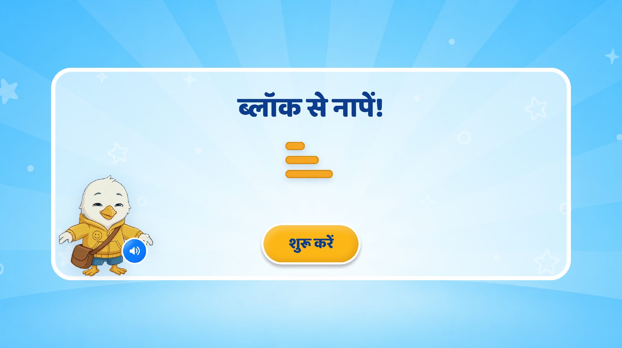
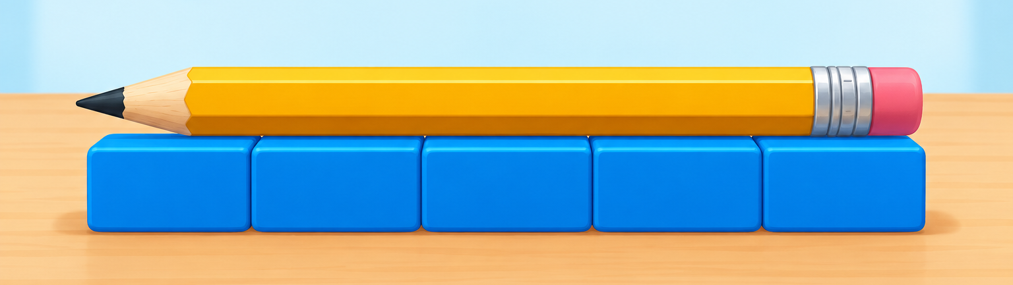
Page 1 · 01_landing.png
Recommendations
Replace the heading text with “लंबाई मापना”
Play the VO: नमस्ते दोस्त! मैं हूँ स्विफ्टी। आज हम सीखेंगे - किसी चीज की लंबाई कैसे मापते हैं।
Visuals: Just for reference. Show an animation – Blocks (cube) appear one by one.
only reference image:

Slide 4
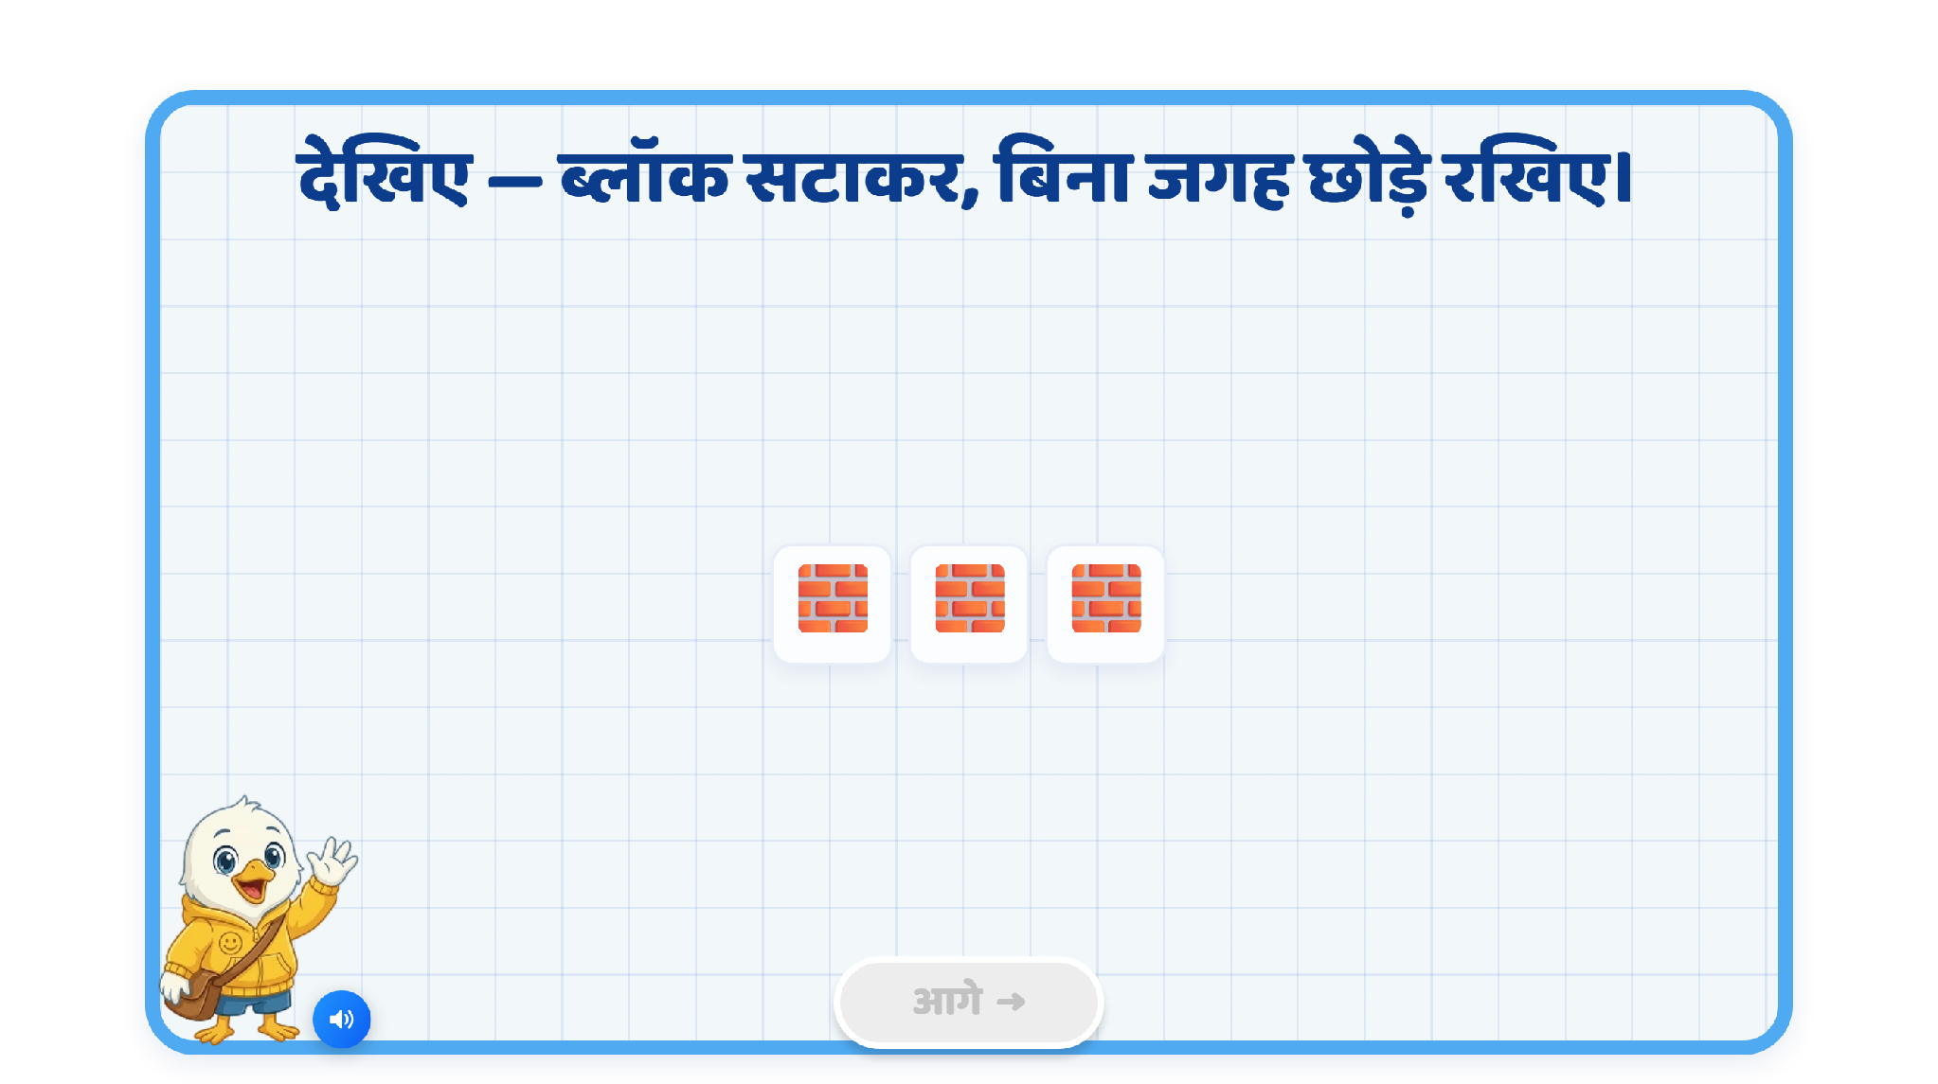
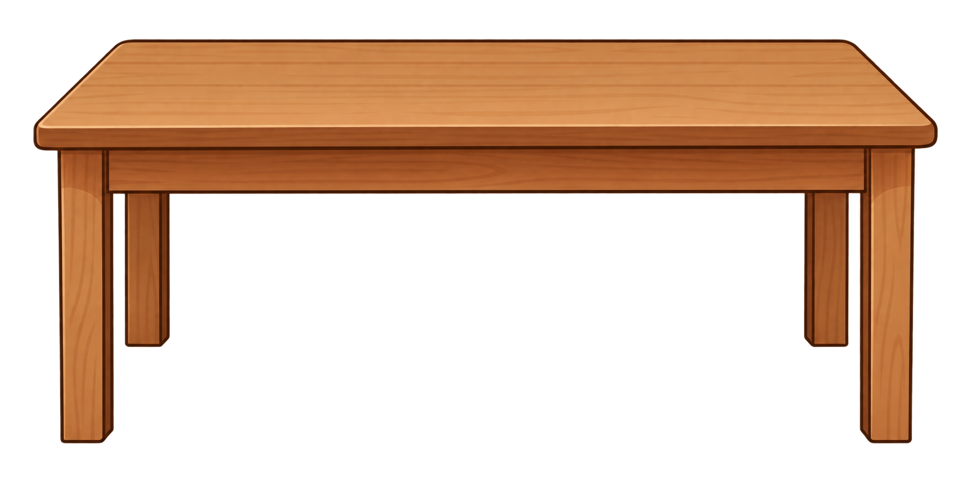
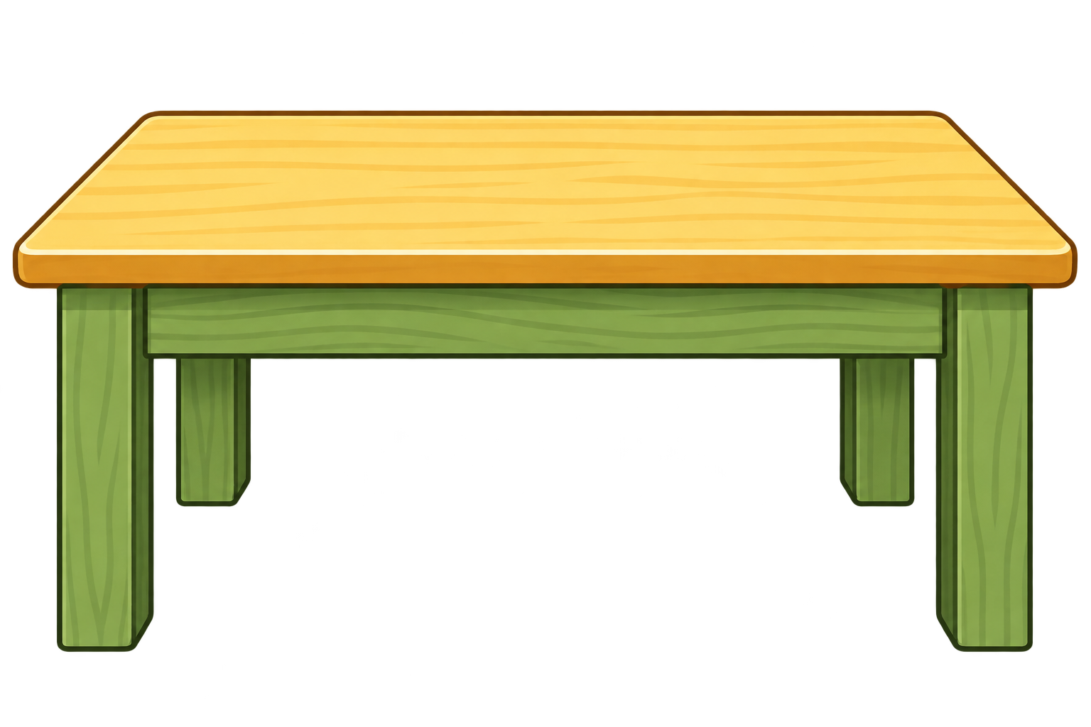
Page 2 · 02_DEMO_COUNT.png
Recommendations
OST: कौन-सी टेबल ज़्यादा लंबी है?
VO: इनमें से कौन-सी टेबल ज्यादा लंबी है? उस पर टैप करिए।
Correct Response: SFX
Incorrect: Pulsate/hand nudge on the long table and play VO: यह टेबल ज्यादा लंबी है।

Slide 5
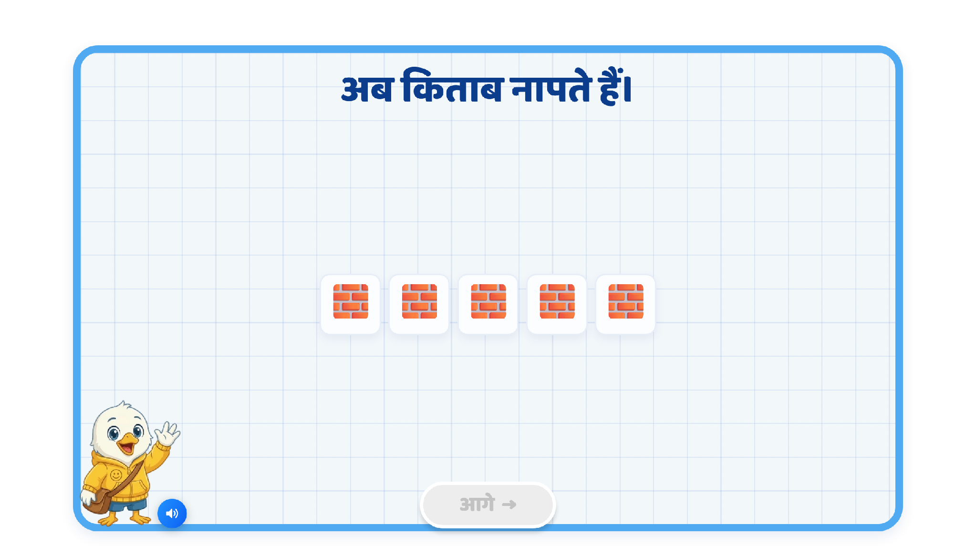
Page 3 · 03_DEMO_COUNT.png
Recommendations
Heading OST: चलिए, टेबल की लंबाई मापते हैं।
Heading VO: यह टेबल कितनी लंबी है? चलिए, इसे ब्लॉक से मापकर देखते हैं।
VO1 — Explain
“इसके लिए हम टेबल के एक छोर से मापना शुरू करेंगे।”
[Show a dotted vertical line at the left edge of the table and pulsate it.]
“फिर एक-एक ब्लॉक रखते हुए दूसरे छोर तक जाएंगे।”
[Show/pulsate the right endpoint.]
VO2 — Demonstrate:
चलिए, शुरू करते हैं—एक... दो...।
[Swiftee drags the blocks one by one from the source to the target positions.]
VO3 — Reinforce the rule before child action:
अब ध्यान रखें! हर अगला ब्लॉक वहीं से शुरू करें, जहाँ पिछला खत्म हुआ था।
[Pulse the endpoint of the previous block]
बीच में जगह न छोड़ें
[Place the third block away from the previous one and highlight the gap with a pulsating box, then remove it],
और एक-दूसरे के ऊपर न रखें।
[Show the next block incorrectly overlapping the previous measured block; highlight the overlap. Then remove it.]
Then child-action VO:
अब आगे आप मापिए और बताइए, टेबल कितने ब्लॉक लंबी है।
[Show a drag animation from the source to the target, as the block moves from the source, show a target tile and drag the block onto it.]
Play the counting VO when child drags and drops the next blocks.
Feedback/hint:
Inactivity: Show a ghost-drag animation.
Wrong attempt: Bounce back, then show the ghost-drag animation.
On completion, play the VO: “शाबाश! यह टेबल 9 ब्लॉक्स लंबी है।”
Show the text “9 ब्लॉक्स” below the table measured with blocks.

Slide 6
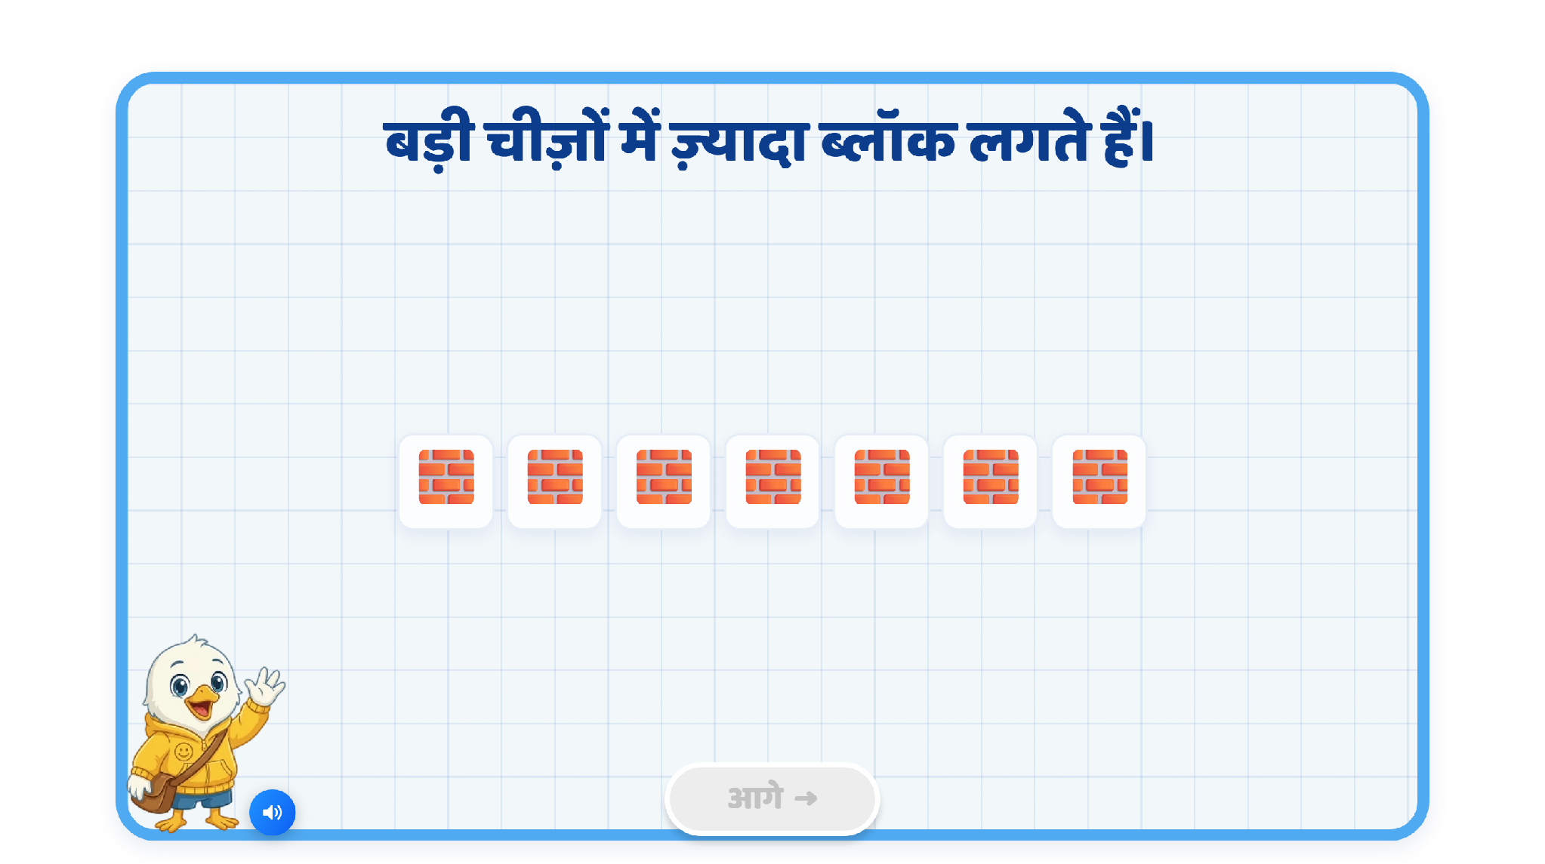
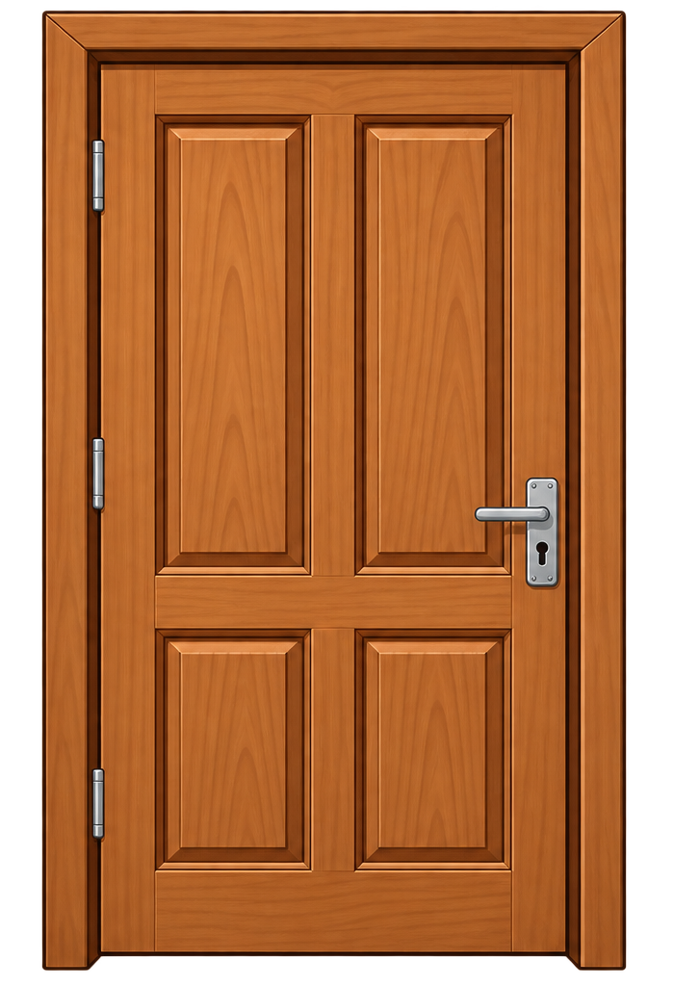
Page 4 · 04_DEMO_COUNT.png
Recommendations
Heading OST: अब दरवाजे की लंबाई मापते हैं।
Heading VO: क्या आप बता सकते हैं, यह दरवाजा कितना लंबा है? चलिए, इसे ब्लॉक से मापकर देखते हैं।
VO1 — Explain
“इसके लिए हम दरवाजे के निचले छोर से मापना शुरू करेंगे
[Show a dotted horizontal line at the bottom of the door and pulsate it.]
और ऊपर तक जाएंगे।”
[Show/pulsate the top endpoint.]
VO2 — Demonstrate:
चलिए, शुरू करते हैं—एक... दो...।
[Swiftee drags the blocks one by one from the source to the target positions (on the right).]
VO3 — Reinforce the rule before child action:
अब ध्यान रखें! हर अगला ब्लॉक वहीं से शुरू करें, जहाँ पिछला खत्म हुआ था।
[Pulse the endpoint of the previous block]
बीच में जगह न छोड़ें
[Place the third block away from the previous one and highlight the gap with a pulsating box, then remove it],
और एक-दूसरे के ऊपर न रखें।
[Show the next block incorrectly overlapping the previous measured block; highlight the overlap. Then remove it.]
Then child-action VO:
अब आगे आप मापिए और बताइए, दरवाजे की लंबाई कितनी है।
[Show a drag animation from the source to the target; as the block moves from the source, show a target tile and drag the block onto it.]
Play the counting VO when child drags and drops the next blocks.
Feedback/hint:
Inactivity: Show a ghost-drag animation.
Wrong attempt: Bounce back, then show the ghost-drag animation.
On completion, play the VO:
“शाबाश! यह दरवाजा 7 ब्लॉक्स लंबा है।”
Show the text “7 ब्लॉक्स” below the door measured with blocks.

Slide 7
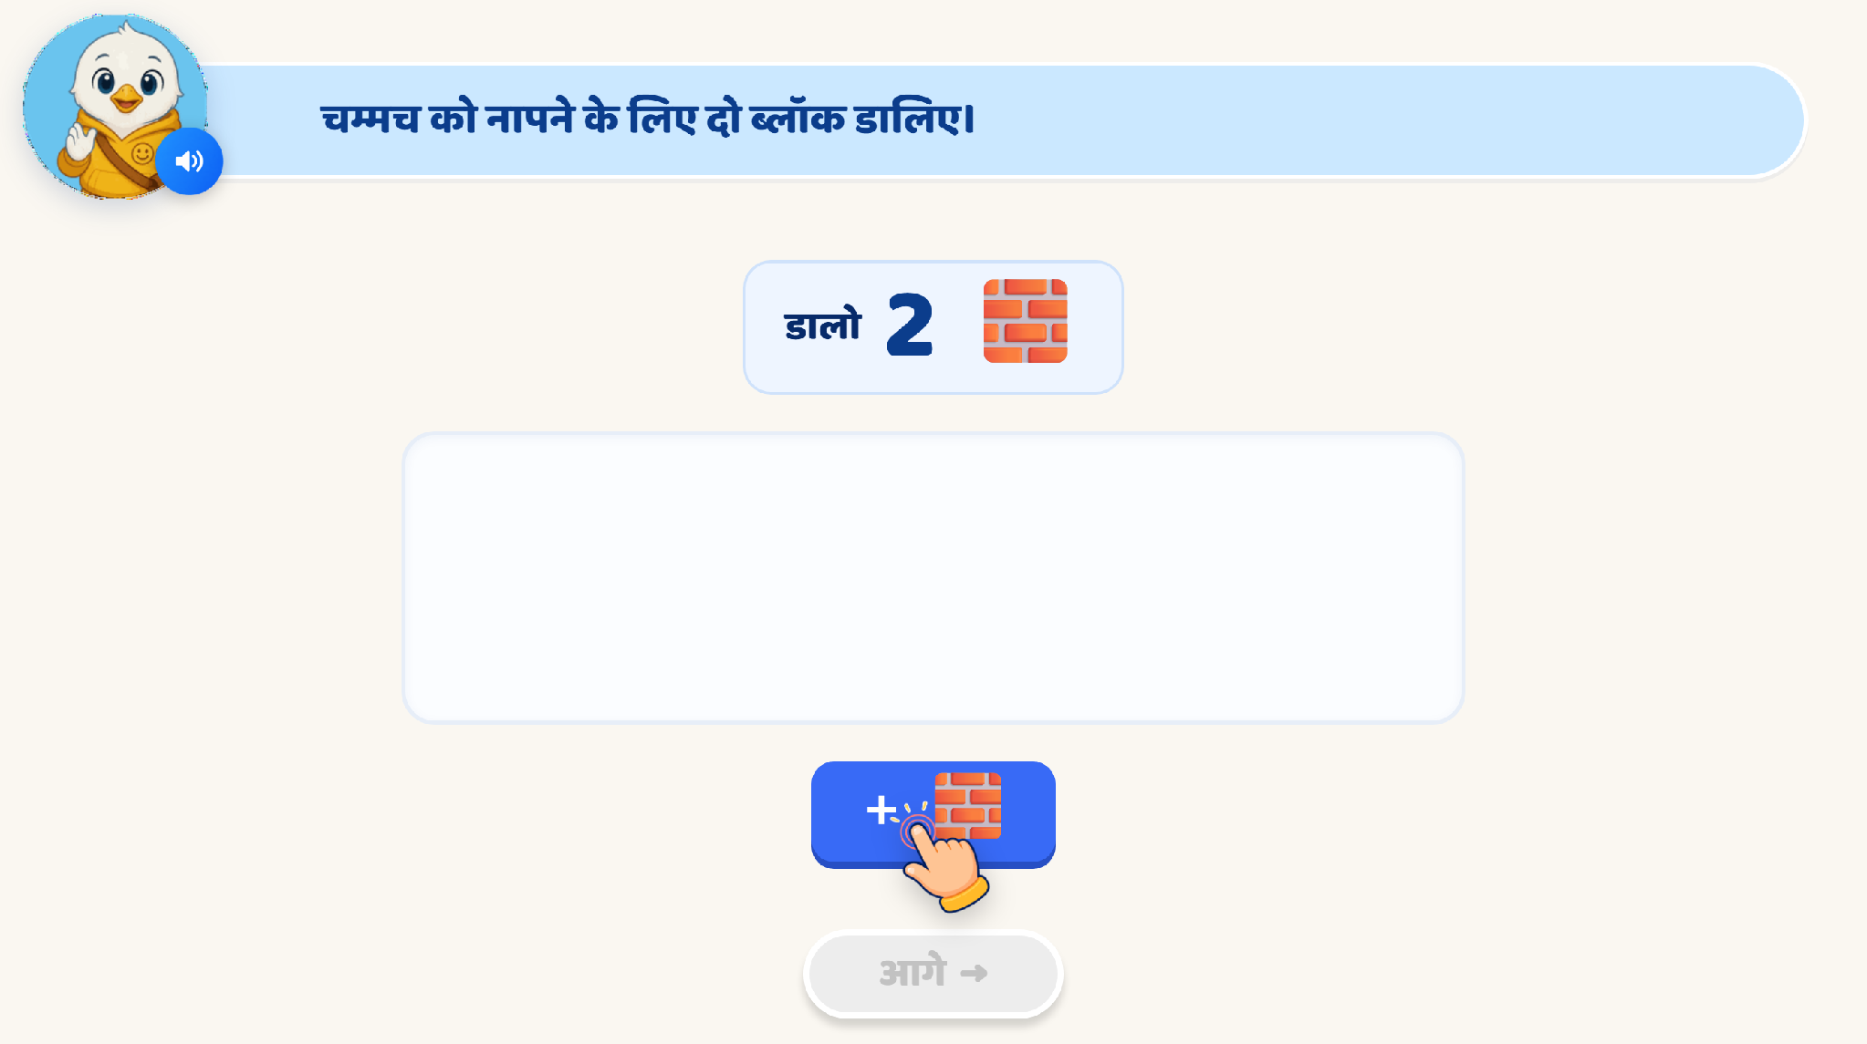
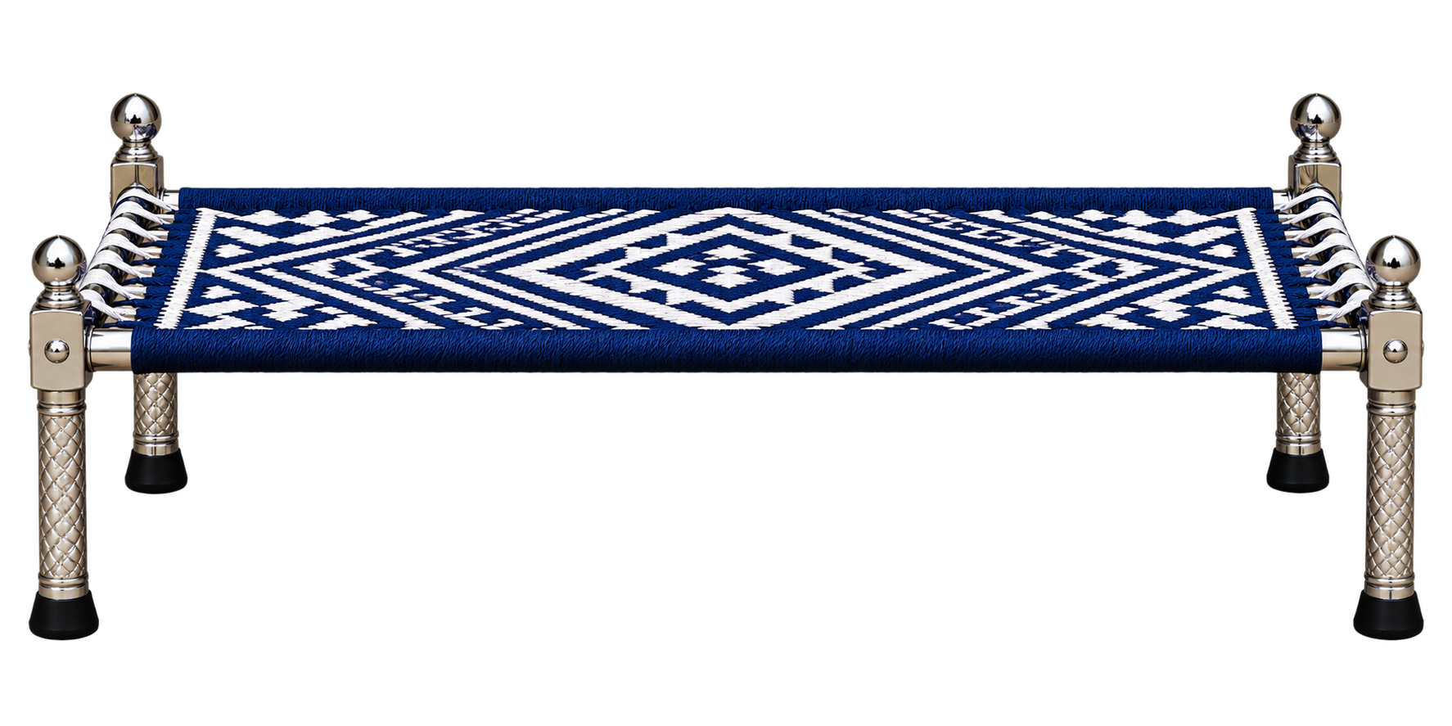
Practice
Page 5 · 05_MAKE_SET.png
Recommendations
Instruction OST: पलंग की लंबाई ब्लॉक से मापिए।
VO: Same as OST.
Child Action: Child drags and drops the blocks one by one.
On each correct drop: Keep the placed block visible.
Inactivity: Show a ghost-drag animation from the block source to the next correct target position.
Wrong placement – Gap/Overlap: Bounce the block back.
After completing the measurement
Keep all the blocks visible.
Replace the Instruction OST with: पलंग की लंबाई कितनी है?
VO: अब बताइए, पलंग की लंबाई कितनी है?
Show options:
A. 11 ब्लॉक्स
B. 12 ब्लॉक्स
C. 13 ब्लॉक्स
Child Action: Child taps one of the options.
Correct Answer: 12 ब्लॉक्स
Correct Feedback VO: शाबाश! पलंग की लंबाई 12 ब्लॉक्स है।
Wrong-answer feedback
Attempt 1: Selected option wiggles, show glow on the blocks and play the VO: “ब्लॉक्स को एक बार फिर गिनिए।”
Attempt 2: Sequentially highlight each block while playing the counting VO: “एक… दो… तीन… चार… पाँच… छह… सात… आठ..नौ…दस…ग्यारह…बारह।”
Attempt 3: Show counting digits below each block, then show a hand nudge on the correct option.

Slide 8
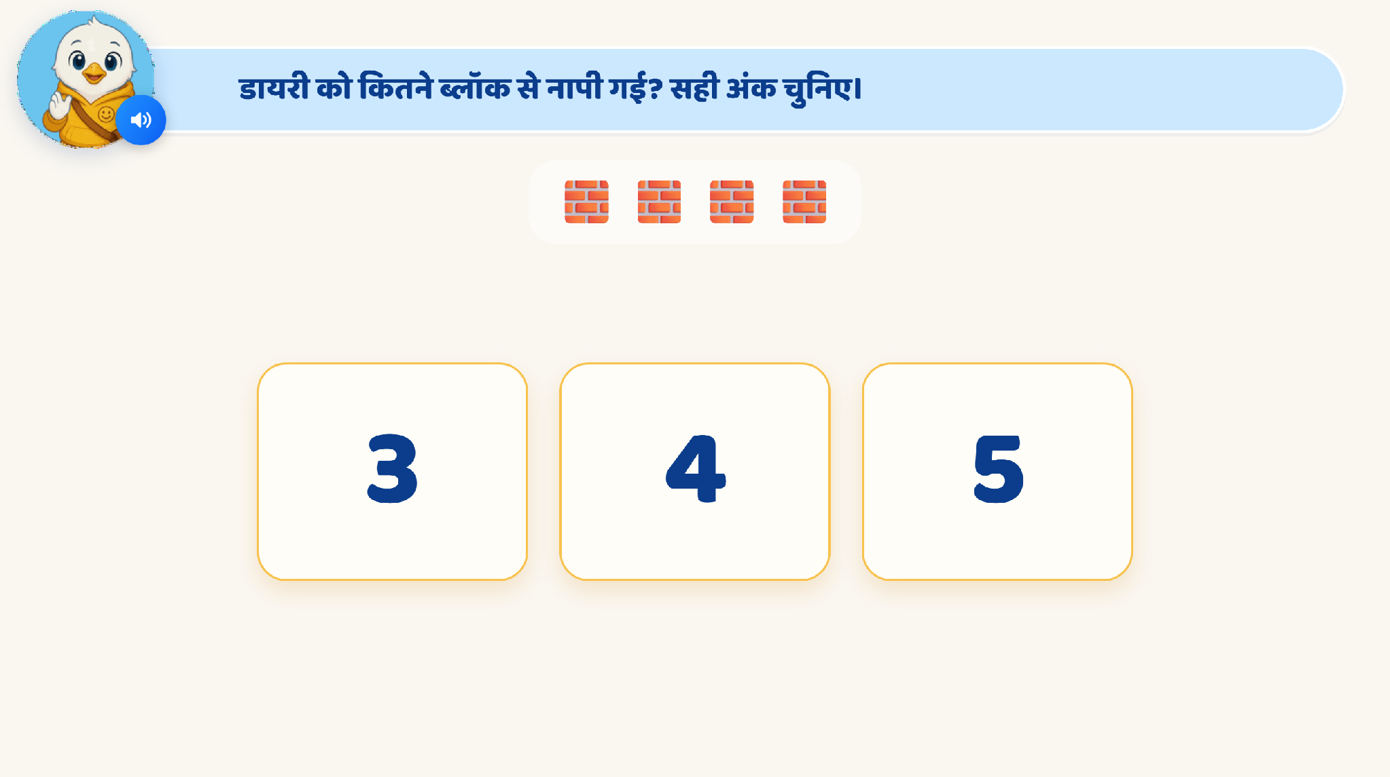
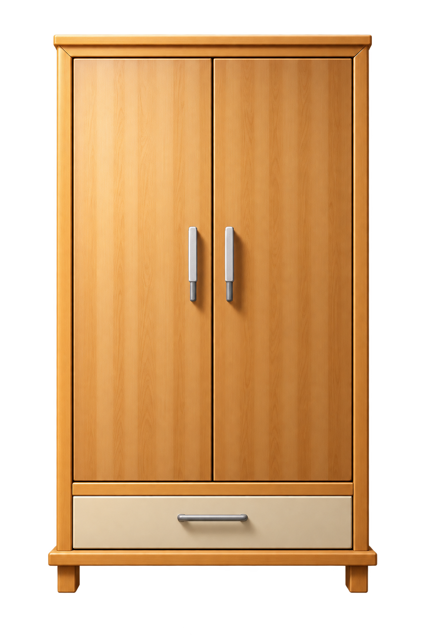
Page 6 · 06_COUNT_HOW_MANY.png
Recommendations
Instruction OST: अलमारी की लंबाई ब्लॉक से मापिए।
VO: Same as OST.
Child Action: Child drags and drops the blocks one by one.
On each correct drop: Keep the placed block visible.
Inactivity: Show a ghost-drag animation from the block source to the next correct target position.
Wrong placement – Gap/Overlap: Bounce the block back.
After completing the measurement
Keep all the blocks visible.
Replace the Instruction OST with: अलमारी की लंबाई कितनी है?
VO: अब बताइए, अलमारी की लंबाई कितनी है?
Show options:
A. 6 ब्लॉक्स
B. 7 ब्लॉक्स
C. 8 ब्लॉक्स
Child Action: Child taps one of the options.
Correct Answer: 7 ब्लॉक्स
Correct Feedback VO: शाबाश! अलमारी की लंबाई 7 ब्लॉक्स है।
Wrong-answer feedback
Attempt 1: Selected option wiggles, show glow on the blocks and play the VO:
“ब्लॉक्स को एक बार फिर गिनिए।”
Attempt 2: Sequentially highlight each block while playing the counting VO:
“एक… दो… तीन… चार… पाँच… छह… सात।”
Attempt 3: Show counting digits beside each block, then show a hand nudge on the correct option.

Slide 9
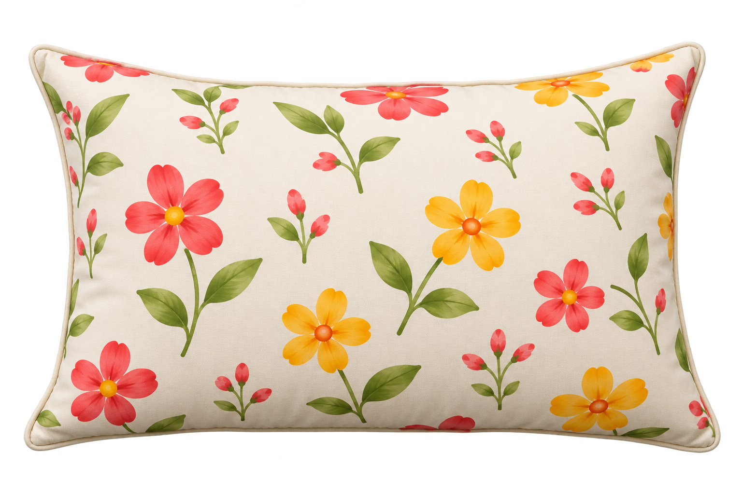
Page 6 · 06_COUNT_HOW_MANY.png
Recommendations
Instruction OST: तकिये की लंबाई ब्लॉक से मापिए।
VO: Same as OST.
Child Action: Child drags and drops the blocks one by one.
On each correct drop: Keep the placed block visible.
Inactivity: Show a ghost-drag animation from the block source to the next correct target position.
Wrong placement – Gap/Overlap: Bounce the block back.
After completing the measurement
Keep all the blocks visible.
Replace the Instruction OST with: तकिये की लंबाई कितनी है?
VO: अब बताइए, तकिये की लंबाई कितनी है?
Show options:
A. 4 ब्लॉक्स
B. 5 ब्लॉक्स
C.6 ब्लॉक्स
Child Action: Child taps one of the options.
Correct Answer: 5 ब्लॉक्स
Correct Feedback VO: शाबाश! तकिये की लंबाई 5 ब्लॉक्स है।
Wrong-answer feedback
Attempt 1: Selected option wiggles, show glow on the blocks and play the VO:
“ब्लॉक्स को एक बार फिर गिनिए।”
Attempt 2: Sequentially highlight each block while playing the counting VO:
“एक… दो… तीन…चार…पाँच।”
Attempt 3: Show counting digits below each block, then show a hand nudge on the correct option.

Slide 10

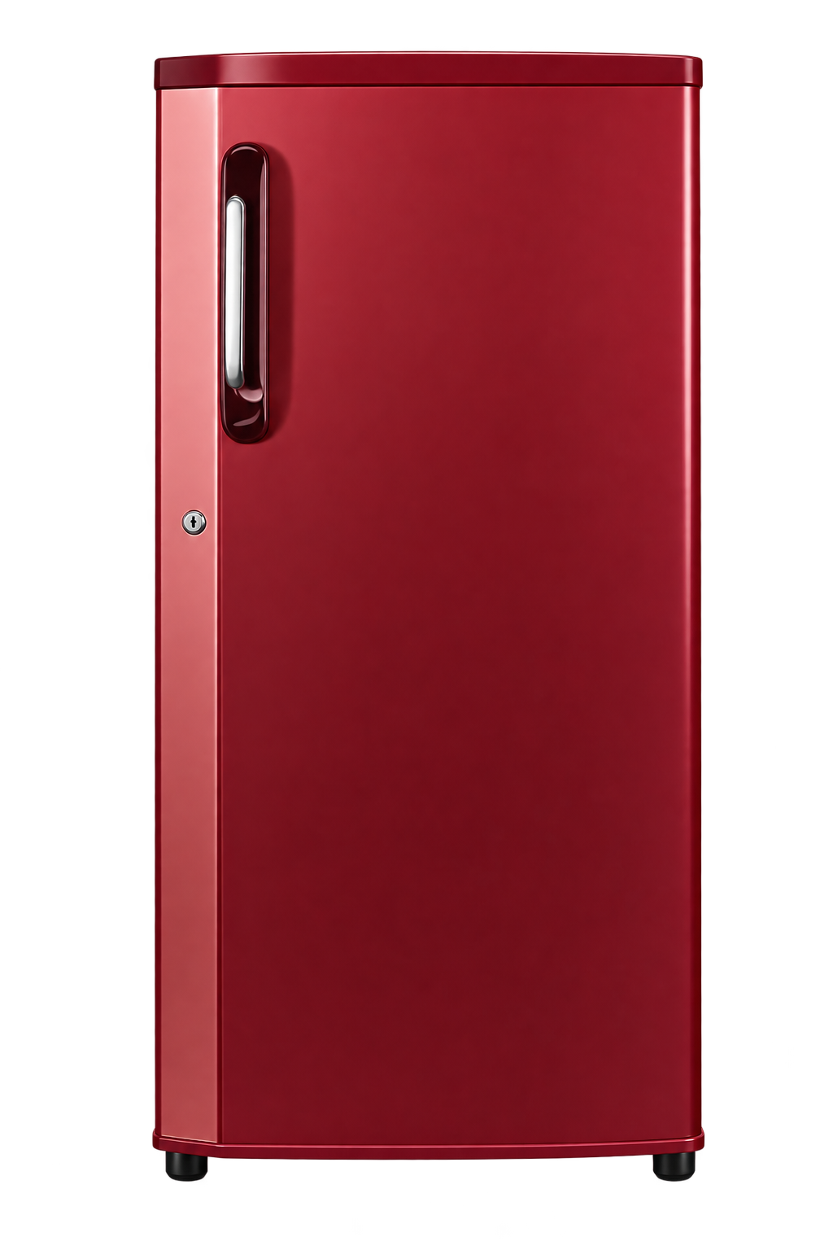
Page 7 · 07_MAKE_SET.png
Recommendations
Instruction OST: फ्रिज की लंबाई ब्लॉक से मापिए।
VO: Same as OST.
Child Action: Child drags and drops the blocks one by one.
On each correct drop: Keep the placed block visible.
Inactivity: Show a ghost-drag animation from the block source to the next correct target position.
Wrong placement – Gap/Overlap: Bounce the block back.
After completing the measurement
Keep all the blocks visible.
Replace the Instruction OST with: फ्रिज की लंबाई कितनी है?
VO: अब बताइए, फ्रिज की लंबाई कितनी है?
Show options:
A. 6 ब्लॉक्स
B. 7 ब्लॉक्स
C. 8 ब्लॉक्स
Child Action: Child taps one of the options.
Correct Answer: 7 ब्लॉक्स
Correct Feedback VO: शाबाश! फ्रिज की लंबाई 7 ब्लॉक्स है।
Wrong-answer feedback
Attempt 1: Selected option wiggles, show glow on the blocks and play the VO:
“ब्लॉक्स को एक बार फिर गिनिए।”
Attempt 2: Sequentially highlight each block while playing the counting VO:
“एक… दो… तीन… चार… पाँच… छह...सात।”
Attempt 3: Show counting digits below each block, then show a hand nudge on the correct option.

Slide 11
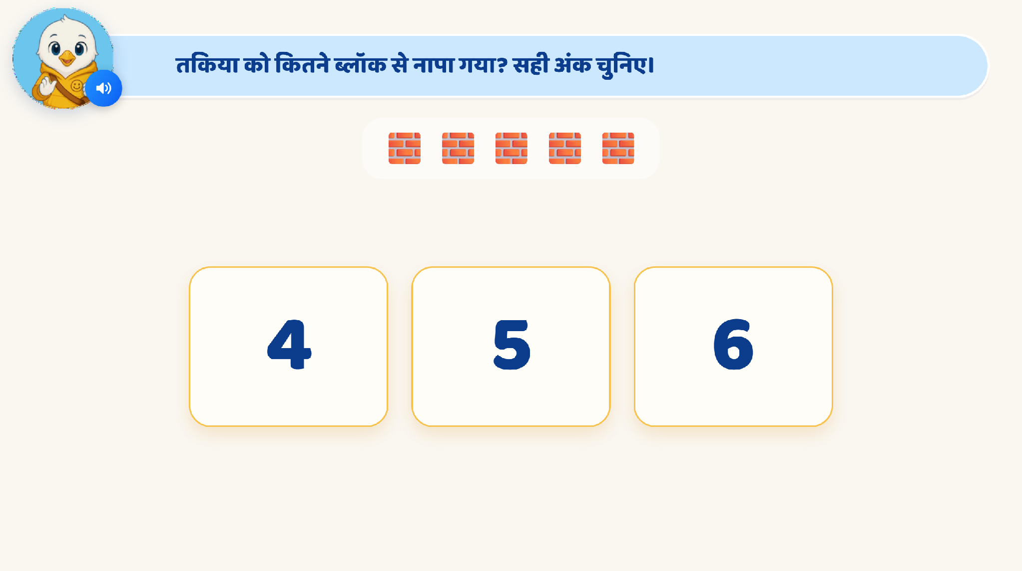
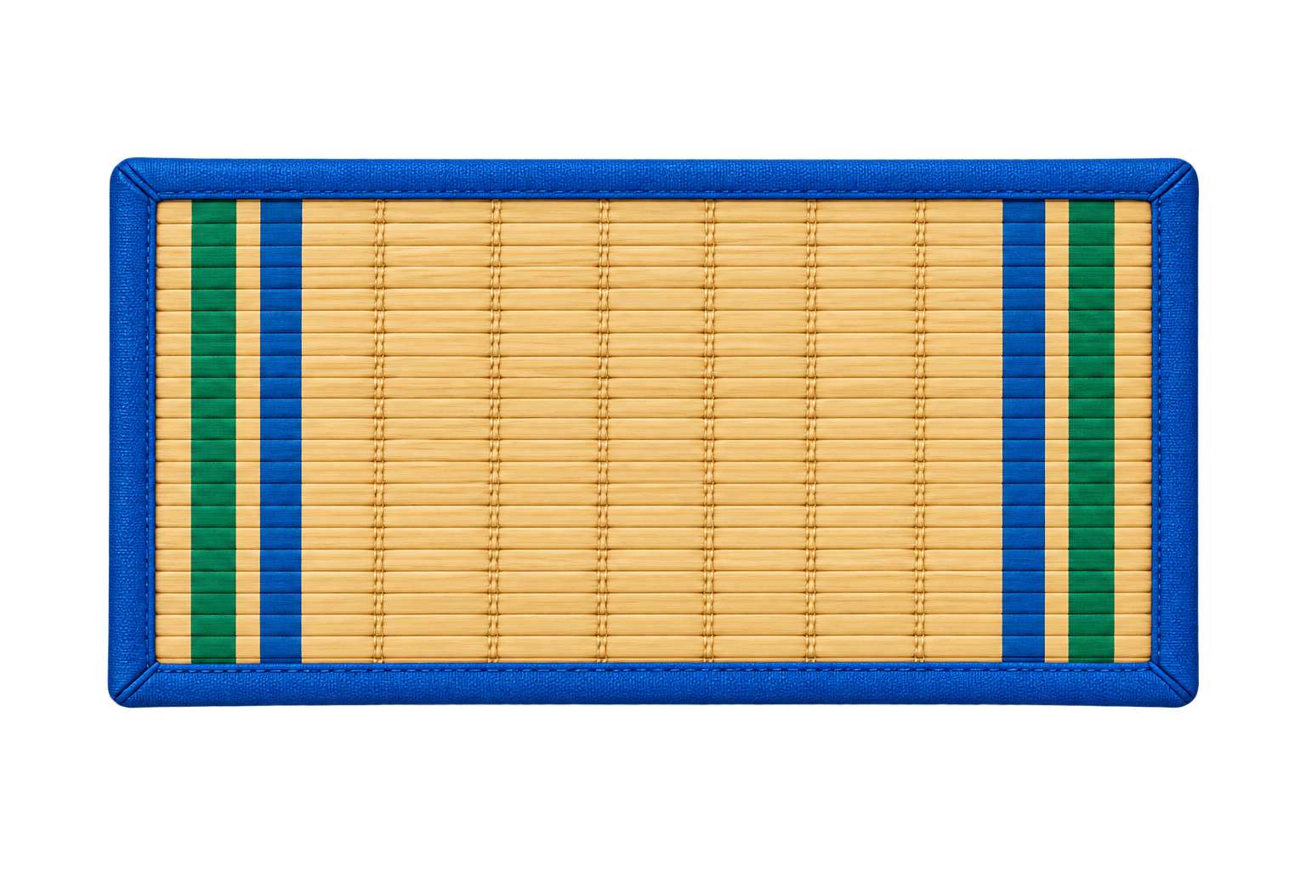
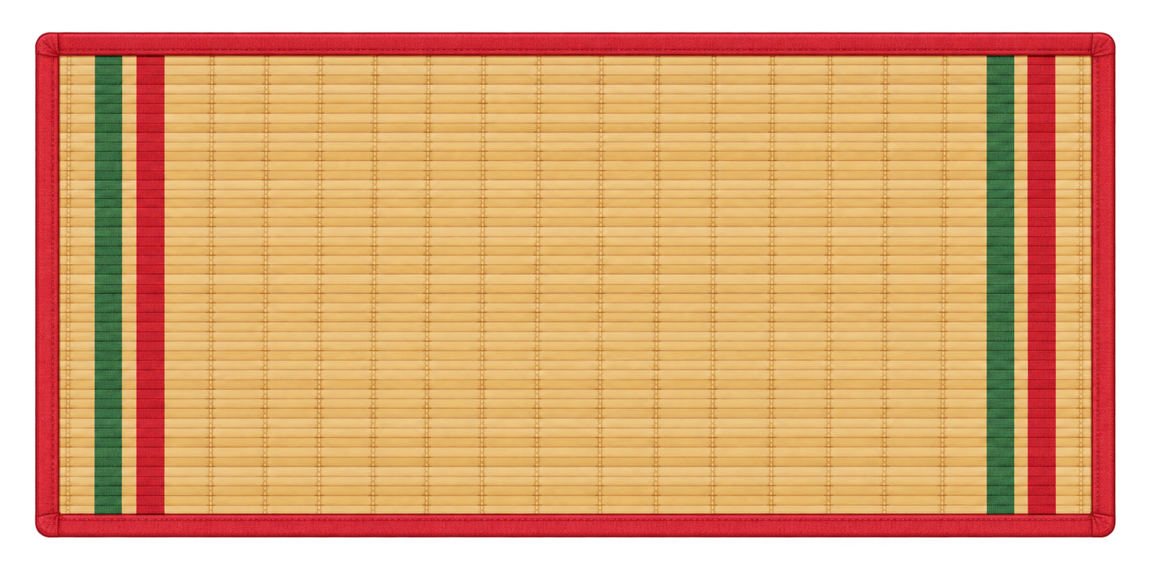
Page 8 · 08_COUNT_HOW_MANY.png
Recommendations
Instruction OST: कौन-सी चटाई ज़्यादा लंबी है?
VO: “कौन-सी चटाई ज़्यादा लंबी है? उस पर टैप करिए।”
Visual Setup: Show two mats of different lengths. Place equal-sized blocks continuously along the longer side of each mat, from one end to the other, without gaps or overlaps.
For example: Mat 1 = 8 ब्लॉक्स; Mat 2 = 9 ब्लॉक्स
Do not initially show the numbers; only show the blocks.
Child Interaction: Taps the mat that is longer.
Correct Response: Highlight the selected mat and play SFX. [Show 8 ब्लॉक्स and 9 ब्लॉक्स below the respective mats to reinforce why the selected mat is longer.]
VO: “शाबाश! यह चटाई ज़्यादा लंबी है।”
Feedback / Hints
Wrong Attempt 1: The incorrectly selected mat wiggles.
Then sequentially highlight the blocks on both mats, with counting digits appearing below each block: First mat: 1 → 2 → 3 → 4 → 5 → 6→ 7→ 8; Second mat: 1 → 2 → 3 → 4 → 5 → 6 → 7→ 8→ 9
Also play the corresponding counting VO during the highlighting.
After counting, repeat only the question: play the VO: “अब बताइए, कौन-सी चटाई ज़्यादा लंबी है?”
Wrong Attempt 2: Show a hand-nudge on the correct mat. When the child taps it, play the SFX used for the correct response.

Slide 12

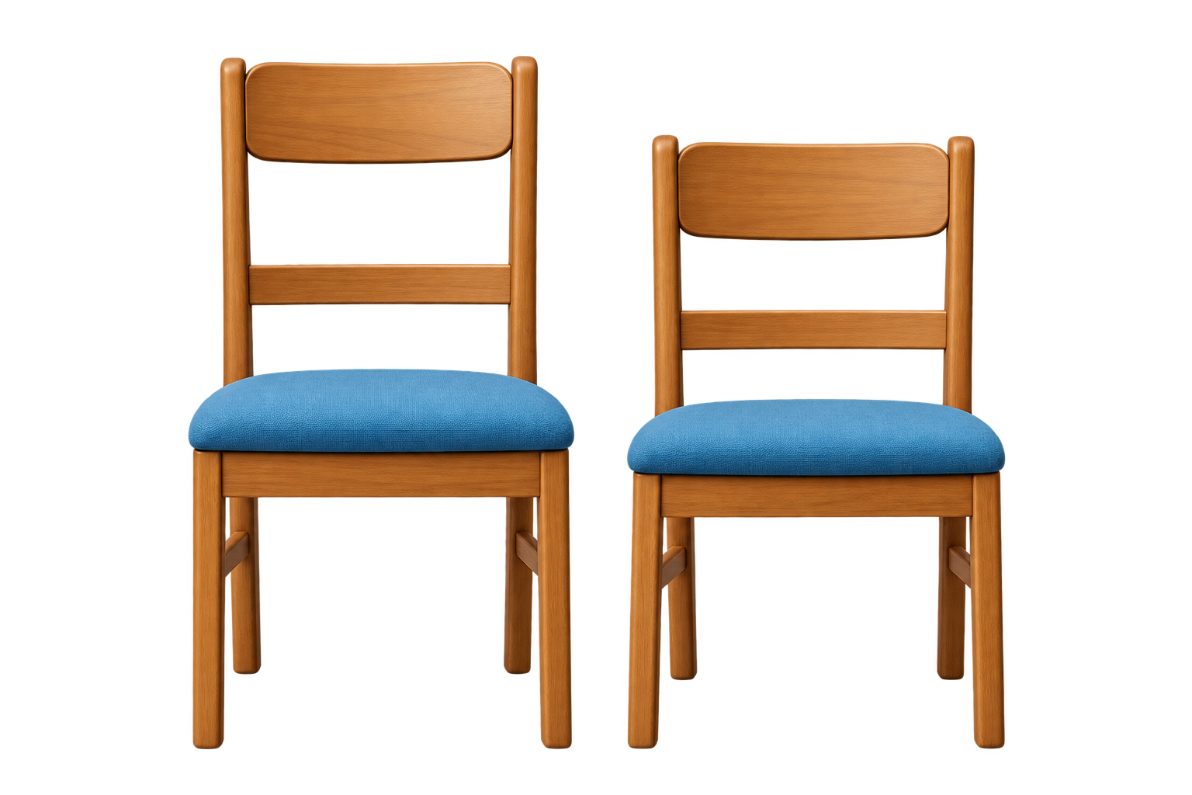
Page 9 · 09_MAKE_SET.png
Recommendations
Instruction OST: कौन-सी कुर्सी ज़्यादा लंबी है?
VO: “कौन-सी कुर्सी ज़्यादा लंबी है? उस पर टैप करिए।”
Visual Setup: Show two chairs of different heights. Place equal-sized blocks continuously along the height of each chair, from bottom to top, without gaps or overlaps.
For example: Chair 1 = 6 ब्लॉक्स; Chair 2 = 7 ब्लॉक्स
Do not initially show the numbers; only show the blocks.
Child Interaction: Taps the chair that is taller.
Correct Response: Highlight the selected chair and play SFX. [Show 6 ब्लॉक्स and 7 ब्लॉक्स beside the respective chairs to reinforce why the selected chair is taller.]
VO: “शाबाश! यह कुर्सी ज़्यादा लंबी है।”
Feedback / Hints
Wrong Attempt 1: The incorrectly selected chair wiggles. Then sequentially highlight the blocks on both chairs, with counting digits appearing beside each block:
First chair: 1 → 2 → 3 → 4→ 5→ 6
Second chair: 1 → 2 → 3 → 4 → 5→ 6→ 7
Also play the corresponding counting VO during the highlighting.
After counting, repeat only the question: play the VO: “अब बताइए, कौन-सी कुर्सी ज़्यादा ऊँची है?”
Wrong Attempt 2: Show a hand-nudge on the correct chair. When the child taps it, play the SFX used for the correct response.

Slide 13
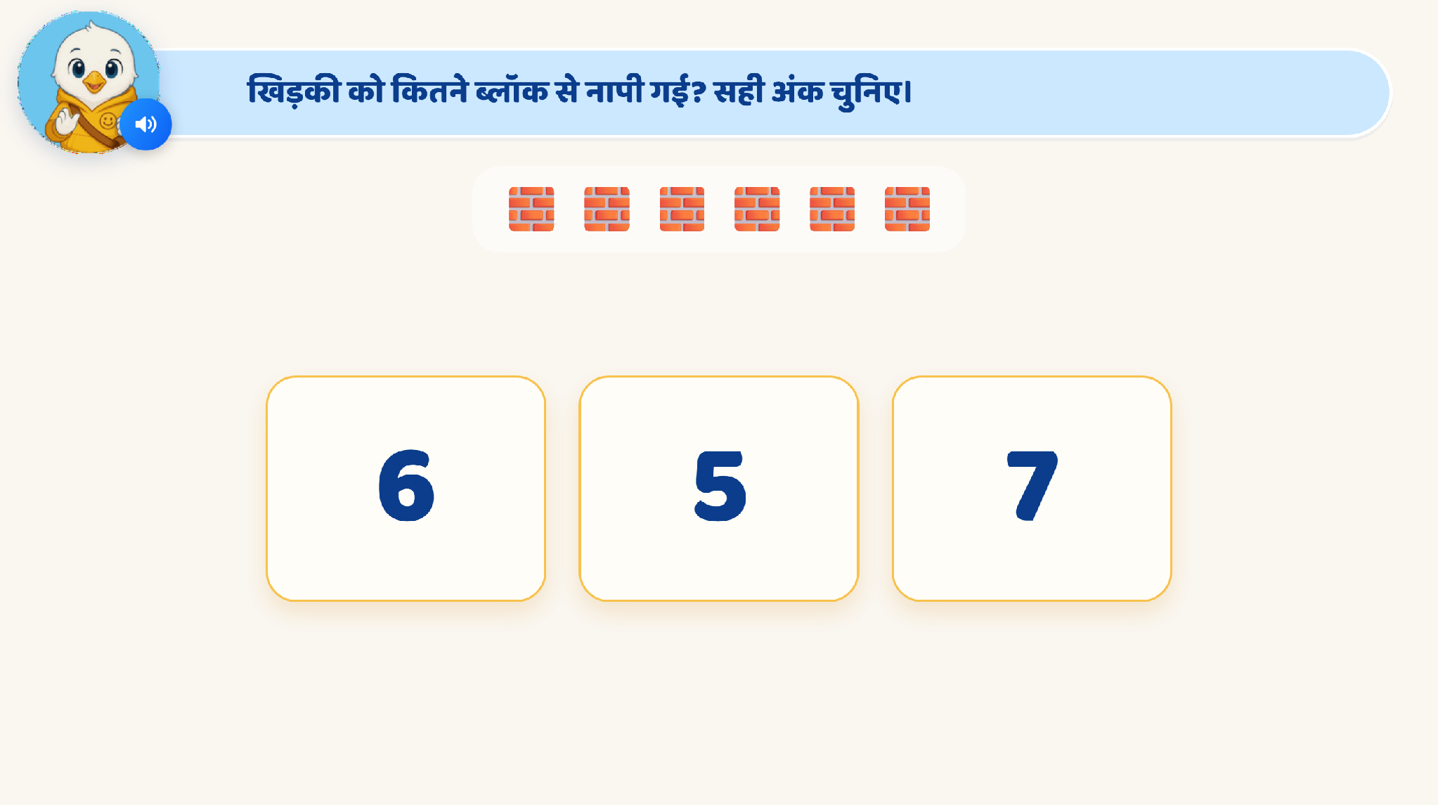
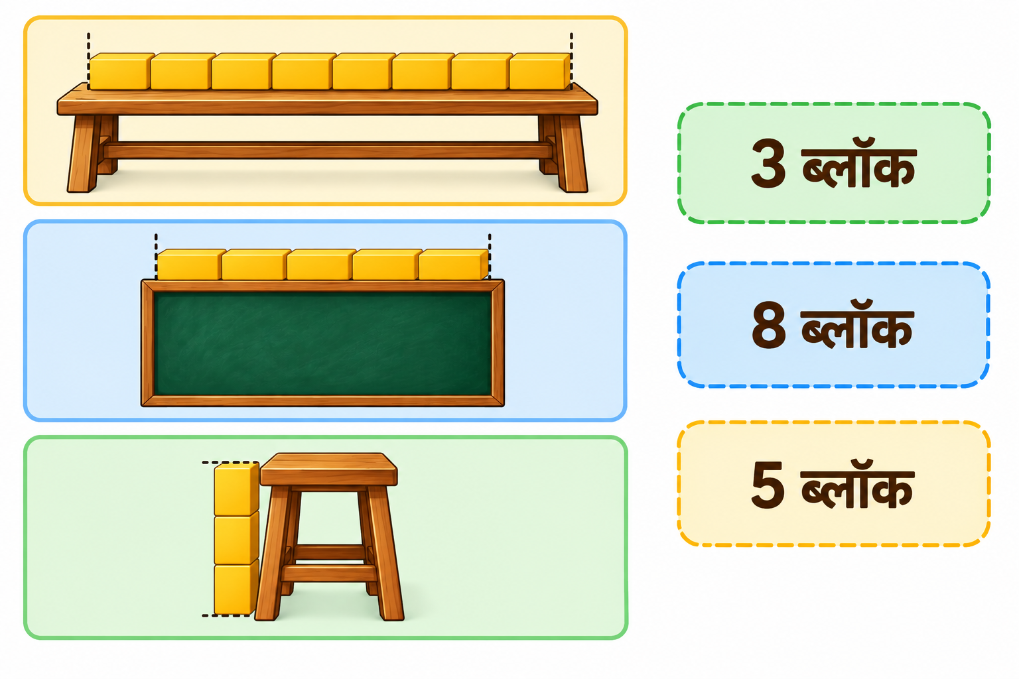
Page 10 · 10_COUNT_HOW_MANY.png
Recommendations
Instruction OST: हर चीज़ को उसके सही माप से मिलाइए।
VO: “हर चीज़ को उसके सही माप से मिलाइए।”
Visual Setup: Show three objects on the left with blocks already placed:
बेंच — 7 ब्लॉक्स, placed horizontally along its longer side.
ब्लैकबोर्ड — 5 ब्लॉक्स, placed horizontally along its longer side.
स्टूल — 3 ब्लॉक्स, placed vertically from bottom to top to represent its height.
For the actual artwork, scale the objects so the number of blocks looks visually plausible rather than showing them at realistic relative sizes.
On the right, show three shuffled measurement boxes:
3 ब्लॉक्स
7 ब्लॉक्स
5 ब्लॉक्स
Child Interaction: Matches each object with its correct measurement.
Correct Match: Lock the connection and play a positive SFX.
On completing all three: “शाबाश! आपने सभी चीज़ों को उनके सही माप से मिला दिया।”
Feedback/Hint
Wrong Attempt 1: Bounce the incorrect match back.
Wrong Attempt 2: Sequentially highlight each block on that object and show the counting digits 1, 2, 3…
Wrong Attempt 3: Show a hand nudge on the correct measurement box.

Slide 14

Page 11 · 11_MAKE_SET.png
Recommendations
Instruction OST: हर चीज़ को उसके सही माप से मिलाइए।
VO: “हर चीज़ को उसके सही माप से मिलाइए।”
Visual Setup: Show three objects on the left with blocks already placed:
खिड़की — 5 ब्लॉक्स, placed vertically from bottom to top to represent its height.
पानी की बोतल — 4 ब्लॉक्स, placed vertically from bottom to top to represent its height.
टीवी — 6 ब्लॉक्स, placed horizontally along its longer side to represent its length.
For the actual artwork, scale the objects so the number of blocks looks visually plausible rather than showing them at realistic relative sizes.
On the right, show three shuffled measurement boxes:
5 ब्लॉक्स
4 ब्लॉक्स
6 ब्लॉक्स
Child Interaction: Matches each object with its correct measurement.
Correct Match: Lock the connection and play a positive SFX.
On completing all three: “शाबाश! आपने सभी चीज़ों को उनके सही माप से मिला दिया।”
Feedback/Hint
Wrong Attempt 1: Bounce the incorrect match back.
Wrong Attempt 2: Sequentially highlight each block on that object and show the counting digits 1, 2, 3…
Wrong Attempt 3: Show a hand nudge on the correct measurement box.

Slide 15
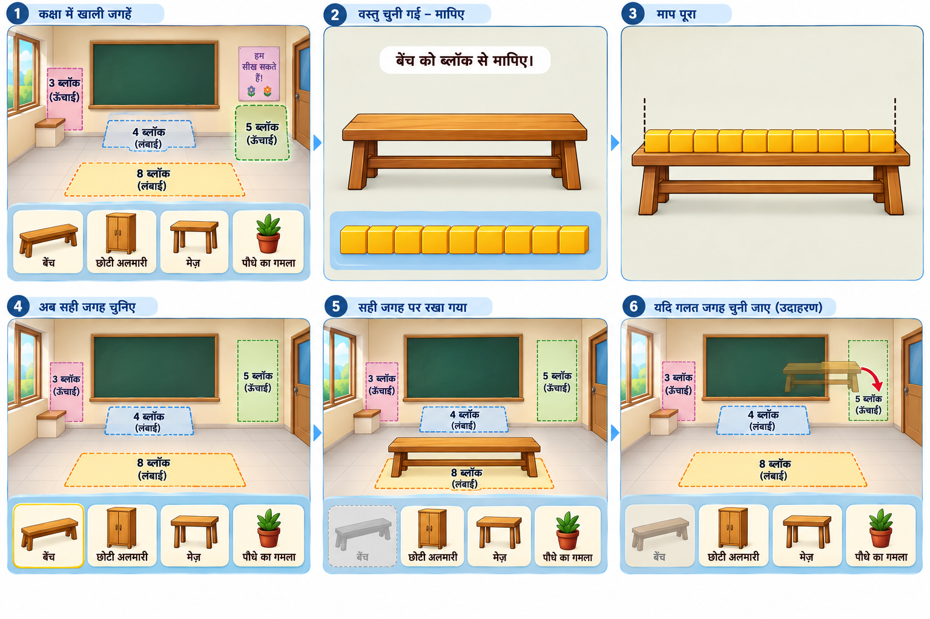
Game
Page 12 · 12_COUNT_HOW_MANY.png

Slide 16
Page 13 · 13_COUNT_HOW_MANY.png
Intro VO
“आज हमें कक्षा सजानी है! हर चीज़ अपनी सही जगह पर ही फिट होगी। ब्लॉक से मापिए और सही जगह चुनिए।”
Visual Setup: Show the classroom in the upper part of the screen, with four empty placement spaces of different measurements.
Space 1: 6 blocks
Space 2: 9 blocks
Space 3: 11 blocks
Space 4: 7 blocks
Display the measurements inside the spaces. Do not show individual blocks inside the spaces. At the bottom of the screen, show four objects in a tray:
बेंच
अलमारी
कुर्सी
ब्लैकबोर्ड
The child can select any object to begin.
Step 1: Select and measure an object
Child Action: The child taps any object from the tray.
For example, बेंच.
[Enlarge the selected bench in the centre of the screen and fade out the classroom in the background. Show a block at the source position.]
VO1: बेंच को ब्लॉक से मापिए। [The child drags and places blocks one by one along the bench, from one end to the other, without gaps or overlaps.]
Independent Practice Rules:
No ghost-drag animation.
No starting-point pulse.
No counting VO.
No hints or highlighted target positions.
No step-by-step guidance.
Once the measurement is complete, keep the placed blocks visible so the child can see the measured length.
Step 2: Choose the matching classroom space
VO2: अब बेंच के लिए सही जगह चुनिए।
[Bring the classroom back into view and activate the four placement spaces. Keep the measured bench visible, along with its blocks.]
Child Action: The child compares the bench's measurement with the measurements displayed in the classroom and drags the bench into the matching space.
Correct Response:
[Snap the bench into the matching classroom space and play the correct-response SFX. The bench remains permanently placed in the classroom.]
Incorrect Response:
[Return the bench to the measurement area. Allow the child to reconsider the measurement and try another space independently.]
Step 3: Continue with the remaining objects
Once an object is correctly placed, the remaining objects stay visible in the bottom tray. The child selects another object and repeats the same process. Continue until all four objects are correctly placed.
Object-Specific VOs
बेंच
VO1: बेंच को ब्लॉक से मापिए।
VO2: अब बेंच के लिए सही जगह चुनिए।
अलमारी
VO1: अलमारी को ब्लॉक से मापिए।
VO2: अब अलमारी के लिए सही जगह चुनिए।
कुर्सी
VO1: कुर्सी को ब्लॉक से मापिए।
VO2: अब कुर्सी के लिए सही जगह चुनिए।
ब्लैकबोर्ड
VO1: ब्लैकबोर्ड को ब्लॉक से मापिए।
VO2: अब ब्लैकबोर्ड के लिए सही जगह चुनिए।
Game Completion: [Once all four objects are correctly placed, show the fully arranged classroom and play a celebration animation with SFX.]

Slide 17
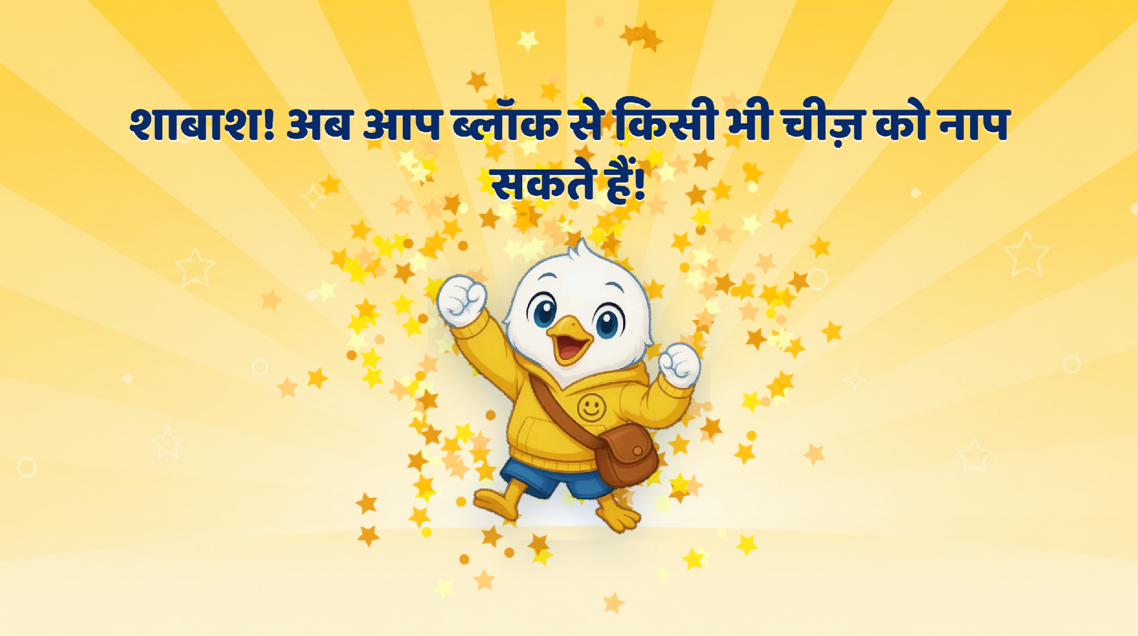
Page 14 · 14_CELEBRATION.png
Recommendations
Remove the text and play only the VO:
शाबाश! आपने ब्लॉक्स से लंबाई मापना सीख लिया!

