Slide 1
Team Members: Ananya M 01JST20IS008 Dhanya V Hegde 01JST20IS016 Dhanika Gowda D 01JST20IS054
Design of a Grammatical Error Correction Tool for Kannada Documents using BERT Model
20IS83P-Phase 2 Review 2
Under the Guidance of
Dr. R J Prathibha
Associate Professor
Dept. of Information Science and Engineering
Notes:
Vismaya

Slide 2
Introduction
Grammatical Error Correction (GEC) involves detecting and correcting grammatical errors in sentences, including spelling mistakes, article misuse, prepositions, pronouns, nouns, and poor sentence construction.
NLP technology equips machines to understand and rectify various grammatical nuances in text.
The GEC model for Kannada is a pioneering initiative using NLP technology.
It aims to make written Kannada better by studying the details of Kannada grammar, how words are put together, and the words used.

Slide 3
Problem statement
Kannada has unique linguistic structure, and publicly no Kannada grammar correcting tools are available. Hence development of a tool to fix grammar errors in Kannada documents using the BERT model is proposed in this project.

Slide 4
Objectives
Creation of Kannada lexicon for spell-checking.
Creation of a labelled dataset for grammatical error detection.
Spell checker: Detects misspelt words and offers suggestions, ensuring accurate spellings.
Grammatical error detection using the BERT model.
Grammatical error correction by identifying and correcting grammatical errors based on subject-verb agreement.

Slide 5
Requirements Specification
Functional Requirements
Spelling error detection and correction
Grammar error detection and correction
Pre-trained model selection
Fine tuning process

Slide 6
Non-functional Requirements
Performance
Model training time
System resource utilization
Accuracy of grammar correction

Slide 7
System Specifications
Hardware Requirements
A 4-core CPU
At least 8 GB of RAM
A computational device capable of running a modern browser

Slide 8
Software Requirements
At least Python 3.7 with Python-based dependencies
Operating system- Windows, Mac or Linux

Slide 9
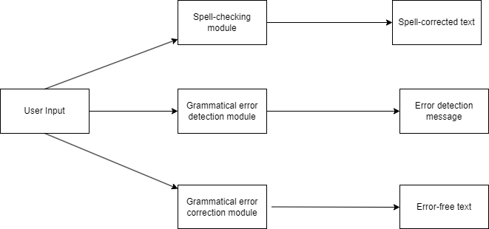
Architecture and Design
Database of Kannada corpus
Data preprocessing using tokenization
Divide the data into Train, Test, and Validation sets
Load BERT model and compile for Training Data
Performance Evaluation using Test Data and Freeze the Model
Hyper-parameter Tuning for Performance Optimization
High Level Design
Figure 1- High-level design

Slide 10
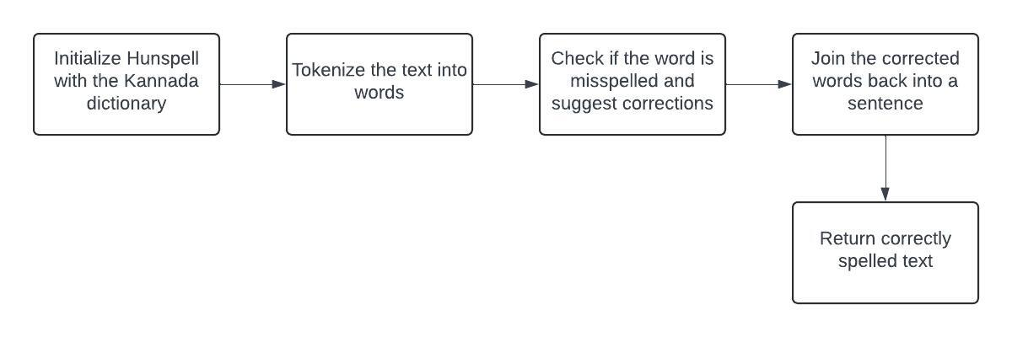
Low Level Design
Spell checking and correction
Importing Hunspell Library
Initializing Hunspell
Tokenizing the Text
Checking and Correcting Spelling
Joining Corrected Words
Returning Corrected Text
Figure 2- Spell checking and correction

Slide 11
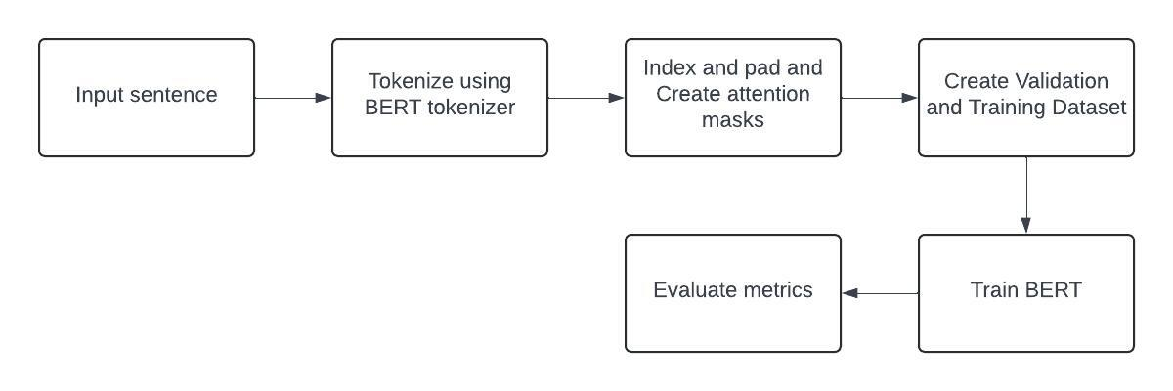
Grammatical error detection
Database of Kannada Corpus
Data Preprocessing using Tokenization
Divide the Data into Train, Test, and Validation Sets
Load BERT Model and Compile for Training Data
Performance Evaluation using Test Data and Freeze the Model
Hyperparameter Tuning for Performance Optimization
Figure 3- Grammatical error detection

Slide 12
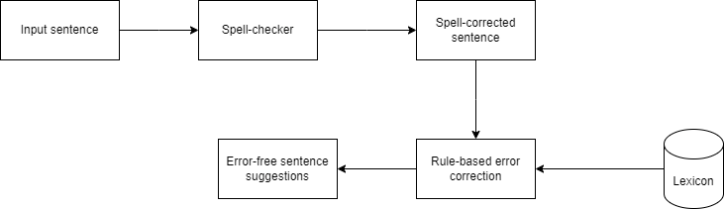
Grammatical error correction
Rule-based approach for grammatical error correction in Kannada.
Focuses on subject-verb agreement errors.
Identifies subject and verb within the sentence.
Applies rules to ensure agreement between them.
Tailored to linguistic nuances of Kannada language.
Figure 4- Grammatical error correction

Slide 13
Methodology
Spell Checking and Correction using Hunspell
Hunspell is an open-source spell-checking and morphological analysis library, now widely used across languages and applications.

Slide 14
Working of Hunspell
Spell Checking
Morphological Analysis
Affix File Support
Multi-Language Support
Open Source and Cross-Platform
Integration with Software Applications

Slide 15
Grammatical error detection using BERT Model
BERT is a transformer-based neural network architecture designed for understanding the context of words in a sentence.
Unlike other models, BERT is bidirectional, allowing it to consider both left and right context words simultaneously.

Slide 16
Working of BERT Model
BERT uses Transformer, an attention mechanism that learns contextual relations between words (or sub-words) in a text. In its vanilla form, Transformer includes two separate mechanisms — an encoder that reads the text input and a decoder that produces a prediction for the task. Since BERT’s goal is to generate a language model, only the encoder mechanism is necessary.

Slide 17
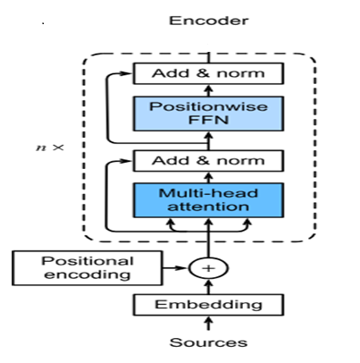
Figure 5- Working of BERT model

Slide 18
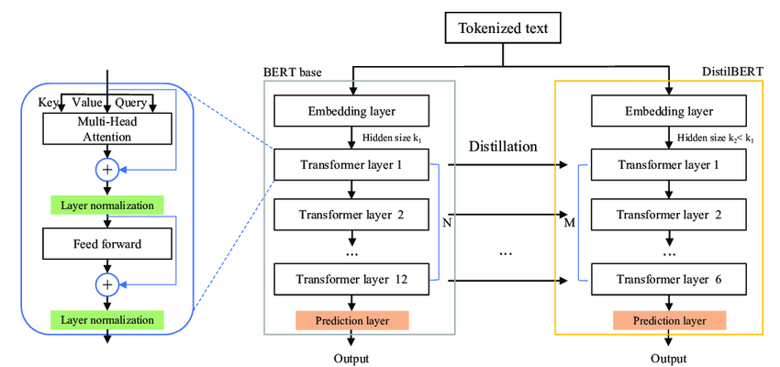
Figure 6- Working of DistilBERT

Slide 19
Utilizes DistilBERT, a smaller and faster version of BERT.
DistilBERT has 40% fewer parameters than BERT-base-uncased.
Runs 60% faster while maintaining over 95% of BERT's performance.
Achieves efficiency through knowledge distillation technique.
Learns to mimic BERT's representations while being smaller.
Significantly reduces inference time.
Ideal for computationally constrained environments.
Preserves BERT's performance on language understanding tasks.
Enables efficient training and deployment of natural language processing models.

Slide 20
Grammatical Error Correction using Rule-based approach
Subject-verb agreement is a critical aspect of grammar ensuring coherence and clarity in sentences.
Rule-based approach in Kannada correction focuses on rectifying subject-verb agreement errors.
Emphasis on utilizing linguistic rules and patterns specific to Kannada.
Identification of subject and verb crucial for applying appropriate agreement rules.
Singular subject requires a singular verb; plural subject necessitates a plural verb in Kannada.
Agreement influenced by tense, aspect, and mood in Kannada grammar.

Slide 21
An example illustrating subject-verb agreement in Kannada:
Singular subject: "ಅವನು ಹೋಗುತ್ತಾನೆ" (avanu hōguttāne) - "He goes."
Plural subject: "ಅವರು ಹೋಗುತ್ತಾರೆ" (avaru hōguttāre) - "They go."
In the above examples, the verb "ಹೋಗುತ್ತಾನೆ" (hōguttāne) agrees with the singular subject "ಅವನು" (avanu) and the verb "ಹೋಗುತ್ತಾರೆ" (hōguttāre) agrees with the plural subject "ಅವರು" (avaru).

Slide 22
Implementation
Spell-checker using Hunspell
Utilizes Hunspell library in Python for spell-checking.
Primary measure: Levenshtein distance (edit distance).
Calculates minimum single-character edits for corrections.
Provides suggestions based on closest matches in the dictionary.
Enhances accuracy of spell-checking in Kannada language.

Slide 23
Grammatical Error Detection
Utilizes pre-trained DistilBERT model for grammatical error detection.
Fine-tuned using a custom dataset of 45,798 sentences.
Labels 0 and 1 indicate correct and incorrect sentences.
Specifically focuses on subject-verb agreement criterion.

Slide 24
Grammatical Error Correction
Rule-based approach for grammatical error correction.
Focuses on present and future tenses.
Identifies subject and verb by stemming each word.
Suggests verb corrections based on count, gender, and person of subject.

Slide 25
User Interface
User interface designed using HTML, CSS, and Bootstrap.
Back-end developed using Flask, a Python framework.
Facilitates seamless interaction between user and model.

Slide 26
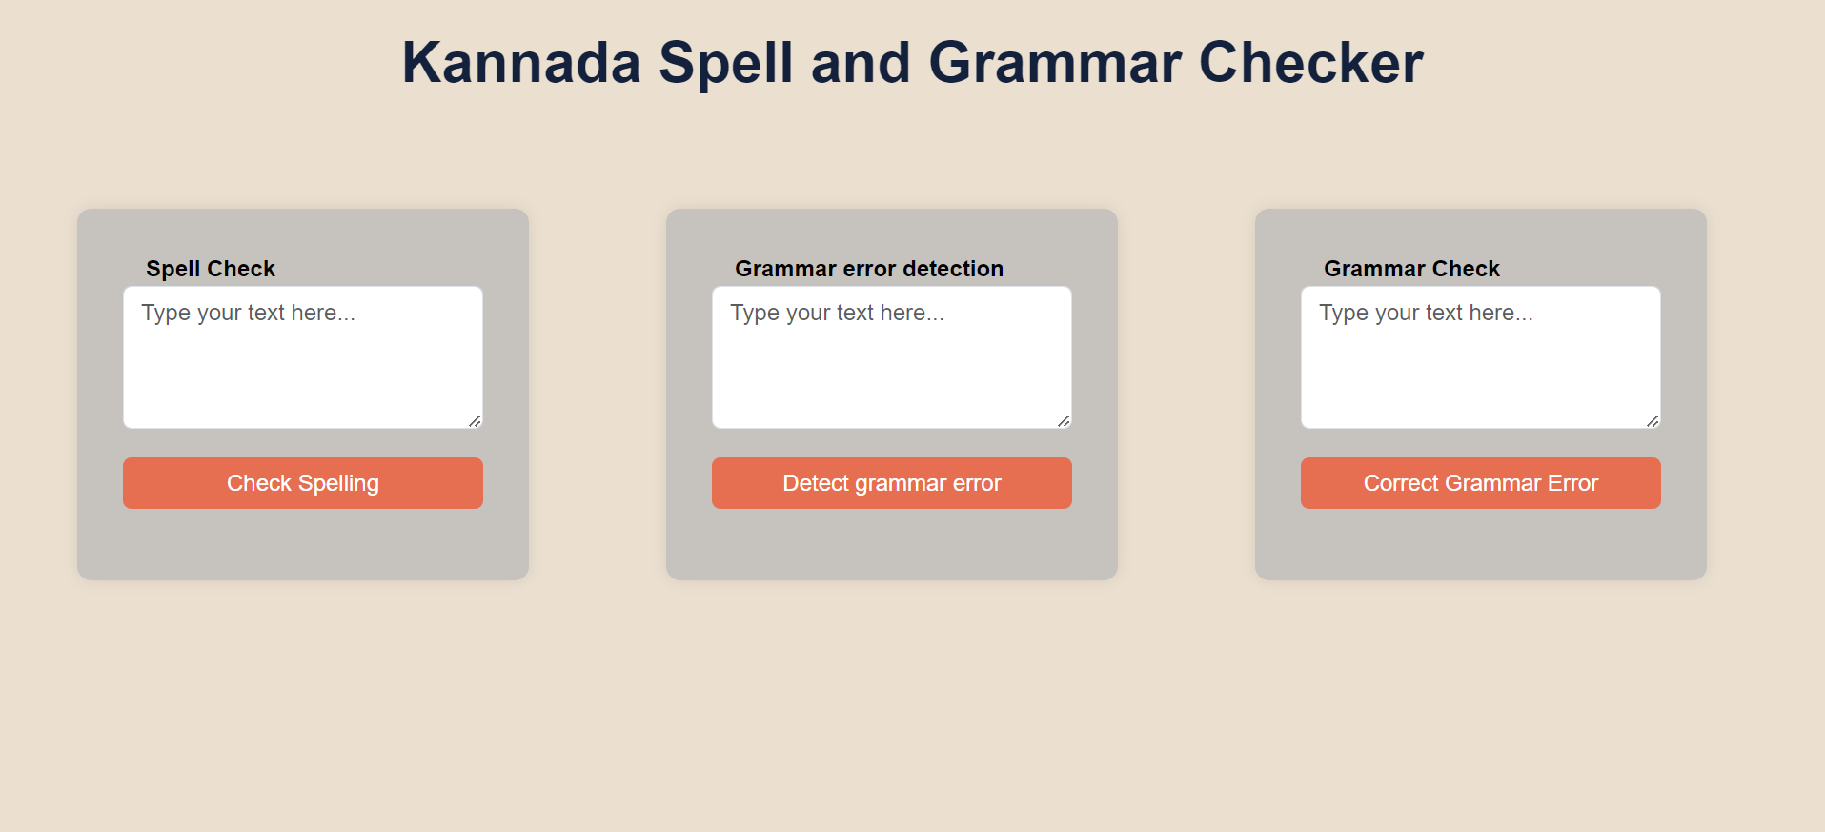
Figure 7- home page

Slide 27
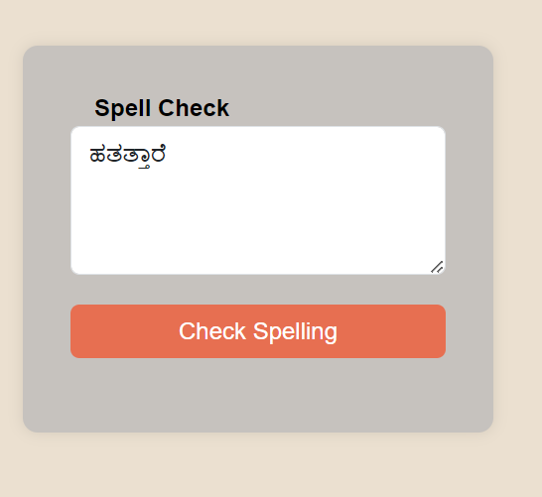
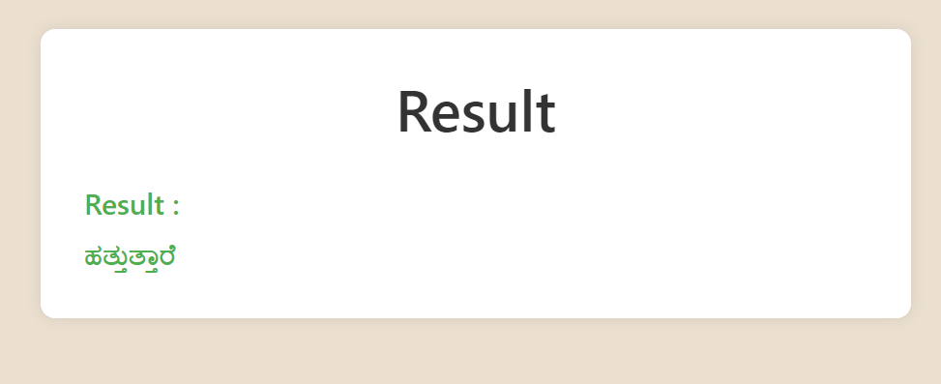
Figure 9- Spell-checker output
Figure 8- Spell-checker input

Slide 28
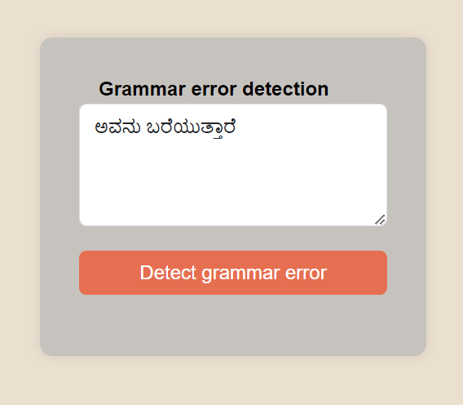
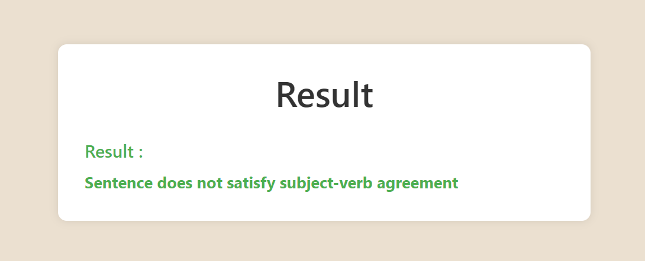
Figure 11- Grammatical error detector output
Figure 10- Grammatical error detector input

Slide 29
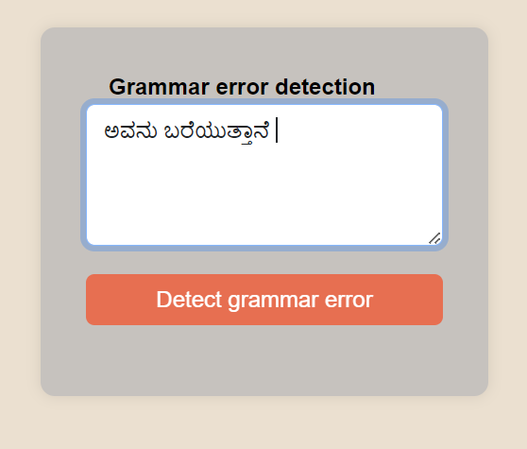
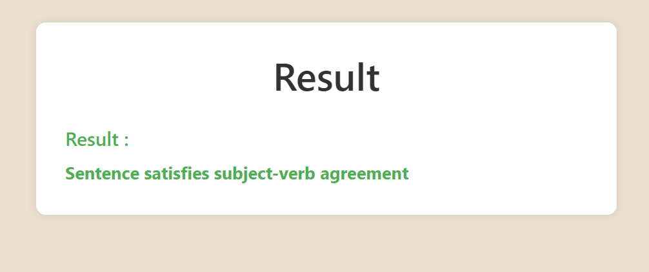
Figure 13- Grammatical error detector output
Figure 12- Grammatical error detector input

Slide 30
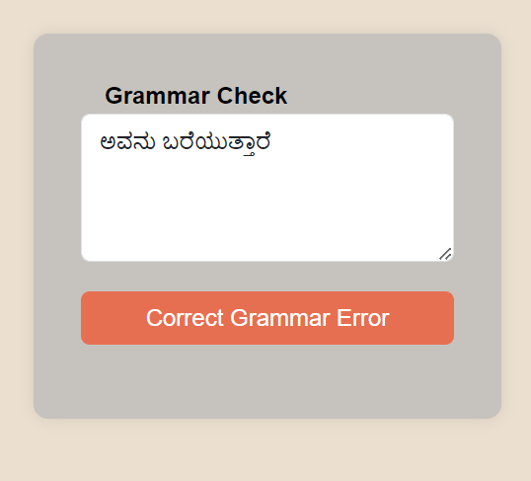
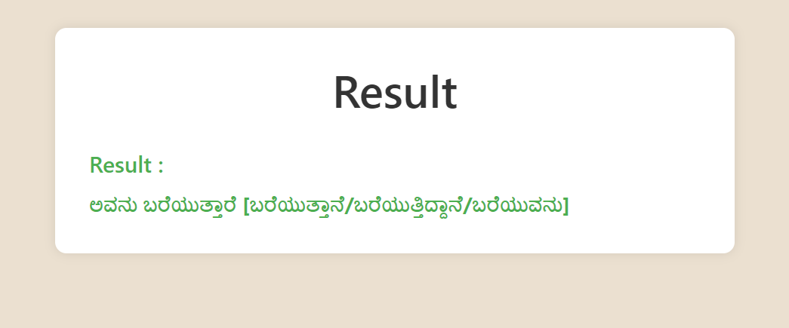
Figure 15- Grammatical error corrector output
Figure 14- Grammatical error corrector input

Slide 31
Results and Discussion
Spell-checker using Hunspell
Kannada spell-checker tested with a sample of 20 randomly selected words.
Corrected errors in 16 out of the 20 tested words.
Achieved an accuracy rate of 80% in error correction.
Indicates successful identification and rectification of errors in the majority of tested words.

Slide 32
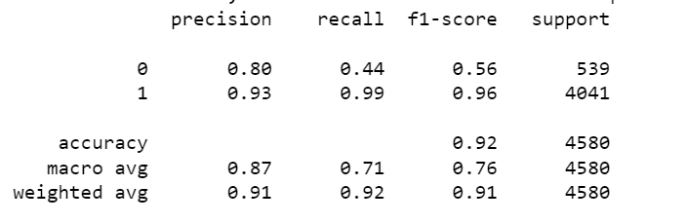
Grammatical error detection using the BERT model
The Kannada grammatical error detection model was trained using DistilBERT. It was able to achieve an accuracy of 92% on the test set containing 5088 sentences.

Slide 33
Grammatical error correction using rule-based approach
Tested with 20 randomly chosen sentences in present and future tense.
Provided expected corrections for 18 out of 20 sentences.
Achieved accuracy rate of 90%.

Slide 34
Conclusion
The project is aimed at developing a GEC tool for Kannada documents using the BERT model and evaluating its performance. Previously GEC in Kannada has been done using LSTM and, in this project, it is attempted to do the same using Transfer learning, with the additional feature of a spell checker.

