Slide 1
Team Members:
Ananya M 01JST20IS008
Dhanya V Hegde 01JST20IS016
Dhanika Gowda D 01JST20IS054
Design of Spell-checker and Grammar-checker for Kannada Documents
Semester End Examination - 2024
Under the Guidance of
Dr. R J Prathibha
Associate Professor
Department of Information Science and Engineering
Notes:
Vismaya

Slide 2
Introduction
Grammatical Error Correction (GEC) involves detecting and correcting grammatical errors in sentences, including spelling mistakes, article misuse, prepositions, pronouns, nouns, and poor sentence construction.
NLP technology equips machines to understand and rectify various grammatical nuances in text.
The GEC model for Kannada is a pioneering initiative using NLP technology.
It aims to make written Kannada better by studying the details of Kannada grammar, how words are put together, and the words used.

Slide 3
Challenges and Open Issues Identified
Contextual Understanding
Ambiguity Resolution
Non-Standard Language and Creativity
Handling Style Variations
Limited Availability of Training Data
Idiomatic Expressions and Colloquialisms

Slide 4
Problem Statement
Kannada has a unique linguistic structure, and publicly no Kannada grammar-correcting tools are available. Hence development of a tool to fix spelling and grammar errors in Kannada documents is proposed in this project.

Slide 5
Objectives
Creation of Kannada lexicon for spell-checking.
Creation of a labelled dataset for grammatical error detection.
Spell checker: Detects misspelt words and offers suggestions, ensuring accurate spellings.
Grammatical error detection using the BERT model.
Grammatical error correction by identifying and correcting grammatical errors based on subject-verb agreement.

Slide 6
Scope
Developing a grammar error correction tool specifically for Kannada documents.
Identifying and correcting common grammatical errors, including spelling mistakes.
User-friendly interface for inputting text and viewing corrections.

Slide 7
Literature Review
Sl no. | Author | Title | Language | Approach | Limitations | Accuracy
1 | A.N.M Fahim Faisal, Md. Afikur Rahman, Tanjila Farah(2021) | A Rule-Based Bengali Grammar Checker[1] | Bangla | Rule-based | Lots of manual work Time-consuming | 86%
2 | Selvakumar Murugan, Tamil Arasan Bakthavatchalam, Malaikannan Sankarasubbu(2020) | SymSpell and LSTM based SpellCheckers for Tamil[2] | Tamil | Long Short-Term Memory | Takes longer to train Requires more memory | 63.9%
3 | Prabhakar Gupta(2020) | A context-sensitive real-time Spell Checker with language adaptability[3] | English | N-gram algorithm | Limited context awareness Difficulty with ambiguity | 89%
4 | Aqil M. Azmi, Manal N. Almutery, and Hatim A. Aboalsamh(2019) | Real-Word Errors in Arabic Texts: A Better Algorithm for Detection and Correction[4] | Arabic | N-gram algorithm | Limited context awareness Difficulty with ambiguity | 98%

Slide 8
5 | Romila Aziz, Muhammad Waqas Anwar, Muhammad Hasan Jamal, Usama Ijaz Bajwa(2021) | A hybrid model for spelling error detection and correction for Urdu language[5] | Urdu | N-gram algorithm | Limited context awareness Difficulty with ambiguity | F₁:88.29%
6 | Yash Gondaliya, Poojan Kalariya, Brijeshkumar Y. Panchal, Amit Nayak(2022) | A Rule-based Grammar and Spell Checking[6] | English | Rule-based | Lots of manual work Time-consuming | 94%
7 | Quanbin Wang, Ying Tan(2020) | Grammatical Error Detection with Self Attention by Pairwise Training[7] | English | BERT | Lack of explicit grammar rules Computationally expensive | F_{0.5}: 63.42
8 | Senyue Hao, Gang Hao(2020) | A Research on Online Grammar Checker System Based on Neural Network Model[8] | English | Transformer model | Lack of explicit grammar rules | F_{0.5}: 60.93

Slide 9
9 | H. M. U. Pabasara, S. Jayalal(2020) | Grammatical error detection and correction model for Sinhala language sentences[9] | Sinhala | Hybrid Approach | Increased complexity Difficulty in fine-tuning | 88.6%
10 | Rohit Saluja, Devaraj Adiga, Parag Chaudhuri, Ganesh Ramakrishnan, Mark Carman(2017) | Error Detection and Corrections in Indic OCR using LSTMs[10] | Sanskrit, Malayalam, Kannada, Hind | LSTM | Takes longer to train Require more memory | Precision San- 93.72 Mal- 93.72 Kan- 97.66 Hindi- 92.44

Slide 10
System Requirements
Hardware Requirements
A 4-core CPU
At least 8 GB of RAM
A computational device capable of running a browser

Slide 11
Software Requirements
At least Python 3.7 with Python-based dependencies
Operating system- Windows, Mac or Linux

Slide 12
Functional Requirements
Spelling error detection and correction
Grammar error detection and correction

Slide 13
Non-functional Requirements
Performance
Model training time
System resource utilization
Ease of Integration
Accuracy of grammar correction

Slide 14
Tools and technologies
Pandas
Transformers
Flask
Hunspell

Slide 15
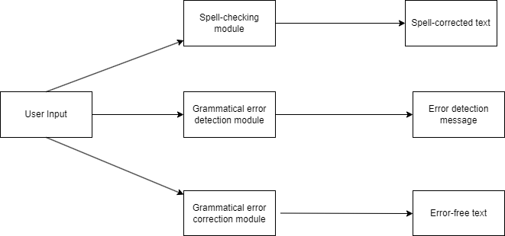
System Design
High-Level Design
Figure 1- High-level design

Slide 16
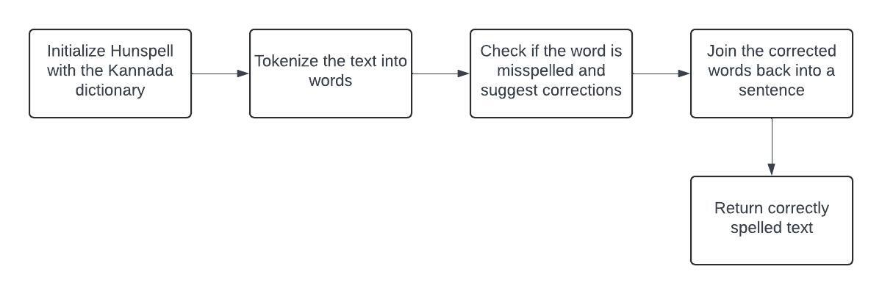
Low-Level Design
Spell checking and correction
Importing Hunspell Library
Initializing Hunspell
Tokenizing the Text
Checking and Correcting Spelling
Joining Corrected Words
Returning Corrected Text
Figure 2- Spell checking and correction

Slide 17
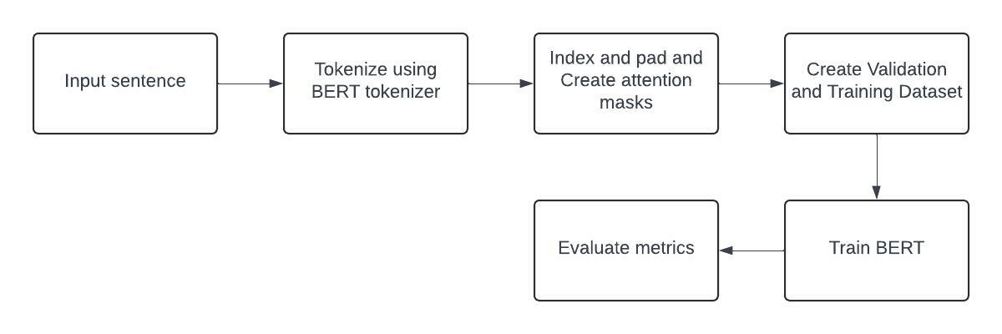
Grammatical error detection
Database of Kannada corpus
Data preprocessing using tokenization
Divide the data into train and test sets
Load distilBERT model and compile for training data
Performance evaluation using test data and freeze the model
Figure 3- Grammatical error detection

Slide 18
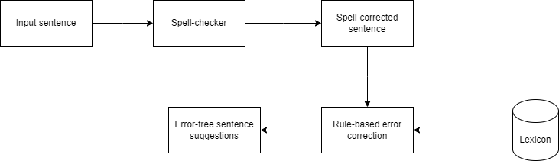
Grammatical error correction
Rule-based approach for grammatical error correction in Kannada
Focuses on subject-verb agreement errors
Identifies subject and verb within the sentence
Applies rules to ensure agreement between them
Figure 4- Grammatical error correction

Slide 19
System Implementation
Spell Checking and Correction using Hunspell
Hunspell is an open-source spell-checking and morphological analysis library, widely used across languages and applications.

Slide 20
Working of Hunspell
Spell Checking
Morphological Analysis
Affix File Support
Multi-Language Support
Open Source and Cross-Platform
Integration with Software Applications

Slide 21
Implementation of Spell-checker using Hunspell
Utilizes Hunspell library in Python for spell-checking.
Primary measure: Levenshtein distance (edit distance).
Calculates minimum single-character edits for corrections.
Provides suggestions based on closest matches in the dictionary.

Slide 22
Grammatical error detection using BERT Model
BERT is a transformer-based neural network architecture designed for understanding the context of words in a sentence.
BERT is bidirectional, allowing it to consider both left and right context words simultaneously.

Slide 23
Working of the BERT Model
BERT uses Transformer, an attention mechanism that learns contextual relations between words (or sub-words) in a text.
In its vanilla form, Transformer includes two separate mechanisms — an encoder that reads the text input and a decoder that produces a prediction for the task.
BERT only comprises the encoder mechanism.

Slide 24
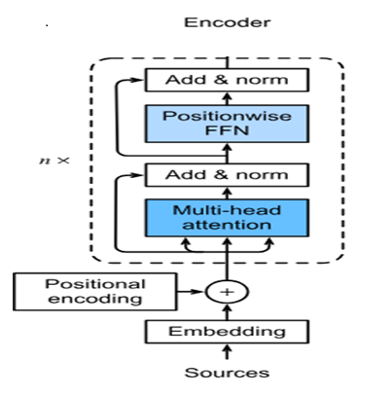
Figure 5- Working of the BERT model

Slide 25
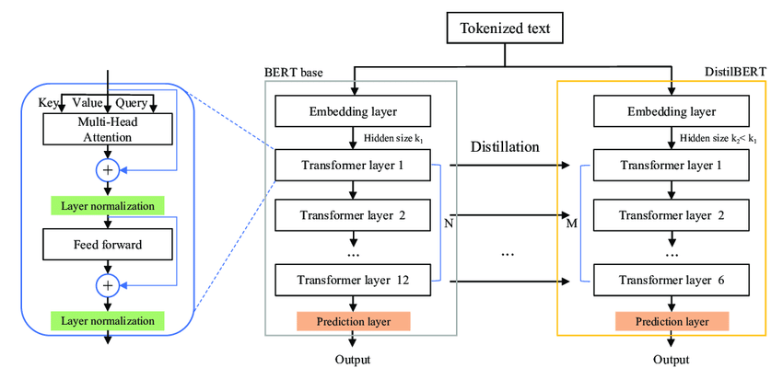
Figure 6- Working of DistilBERT

Slide 26
DistilBERT: A smaller and faster version of BERT.
DistilBERT has 40% fewer parameters than BERT-base-uncased.
Runs 60% faster while maintaining over 95% of BERT's performance.
Achieves efficiency through knowledge distillation technique.
Learns to mimic BERT's representations while being smaller.
Significantly reduces inference time.
Ideal for computationally constrained environments.
Preserves BERT's performance on language understanding tasks.

Slide 27
Implementation of grammatical error detector
Utilizes pre-trained DistilBERT model for grammatical error detection.
Fine-tuned using a custom dataset of 45,798 sentences.
Labels 0 and 1 indicate correct and incorrect sentences.
Specifically focuses on subject-verb agreement criterion.

Slide 28
Grammatical Error Correction using Rule-based approach
Subject-verb agreement: Critical aspect of grammar ensuring coherence and clarity in sentences.
Emphasis on utilizing linguistic rules and patterns specific to Kannada.
Identification of subject and verb.
Singular subject requires a singular verb; plural subject necessitates a plural verb in Kannada.

Slide 29
An example illustrating subject-verb agreement in Kannada:
Singular subject: "ಅವನು ಹೋಗುತ್ತಾನೆ" (avanu hōguttāne) - "He goes."
Plural subject: "ಅವರು ಹೋಗುತ್ತಾರೆ" (avaru hōguttāre) - "They go."
In the above examples, the verb "ಹೋಗುತ್ತಾನೆ" (hōguttāne) agrees with the singular subject "ಅವನು" (avanu) and the verb "ಹೋಗುತ್ತಾರೆ" (hōguttāre) agrees with the plural subject "ಅವರು" (avaru).

Slide 30
Implementation of Grammatical error corrector
Rule-based approach for grammatical error correction.
Focuses on present and future tenses.
Identifies subject and verb by stemming each word.
Suggests verb corrections based on the count, gender, and person (first, second or third) of the subject.

Slide 31
User Interface
Frontend designed using HTML, CSS, and Bootstrap.
Back-end developed using Flask, a Python framework.
Facilitates seamless interaction between the user and the model.

Slide 32
Results and Discussion
Spell-checker using Hunspell
Kannada spell-checker tested with a sample of 20 randomly selected words.
Corrected errors in 16 out of the 20 tested words.
Achieved an accuracy rate of 80% in error correction.
Indicates successful identification and rectification of errors in the majority of tested words.

Slide 33
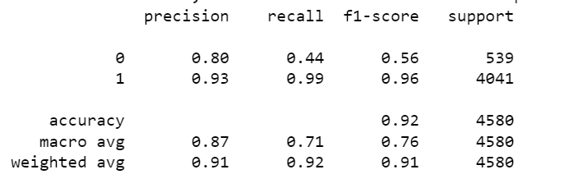
Grammatical Error Detection
The Kannada grammatical error detection model was trained using DistilBERT. It was able to achieve an accuracy of 92% on the test set containing 5088 sentences.

Slide 34
Grammatical Error Correction
Tested with 20 randomly chosen sentences in present and future tense.
Provided expected corrections for 18 out of 20 sentences.
Achieved accuracy rate of 90%.

Slide 35
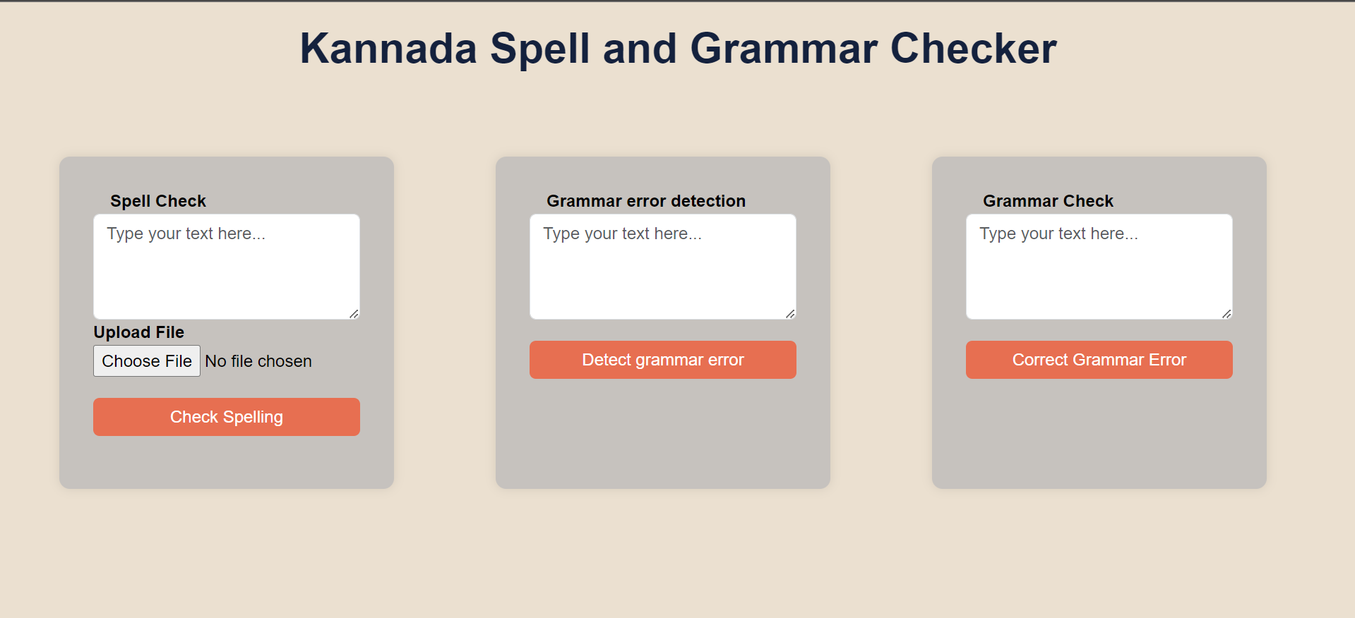
Figure 7- Home page

Slide 36
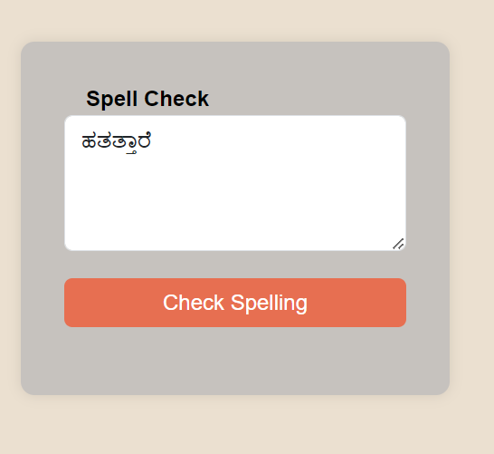
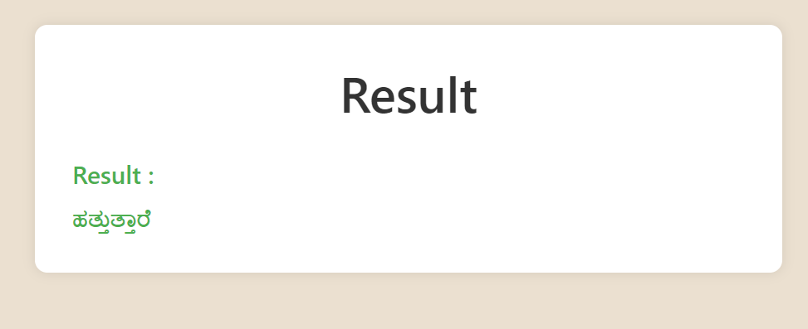
Figure 9- Spell-checker output
Figure 8- Spell-checker input

Slide 37
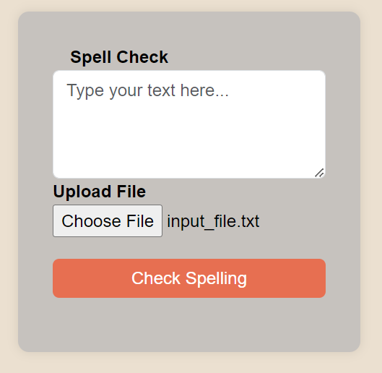
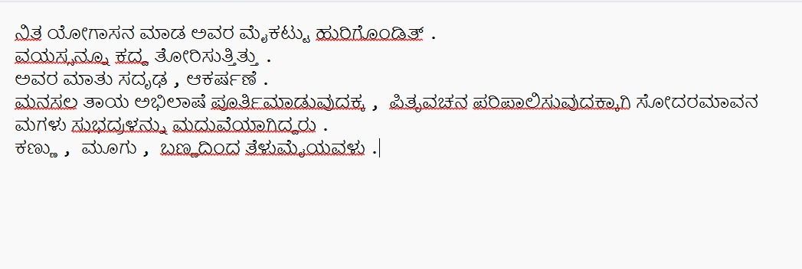
Figure 11- Input file of spell-checker
Figure 10- Spell-checker input

Slide 38
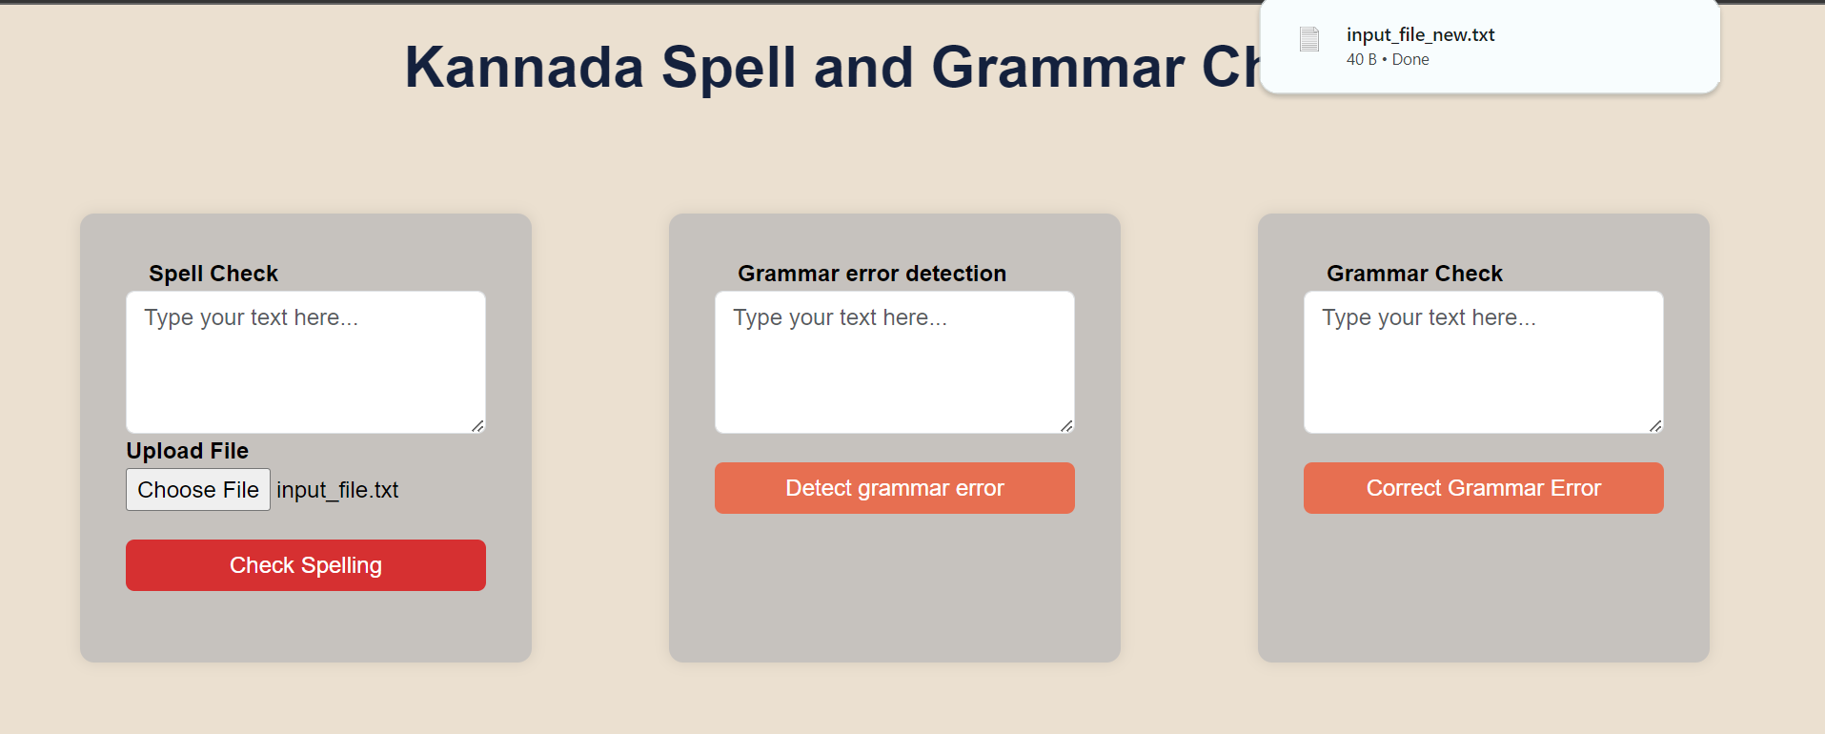
Figure 12- Spell-checker file download

Slide 39
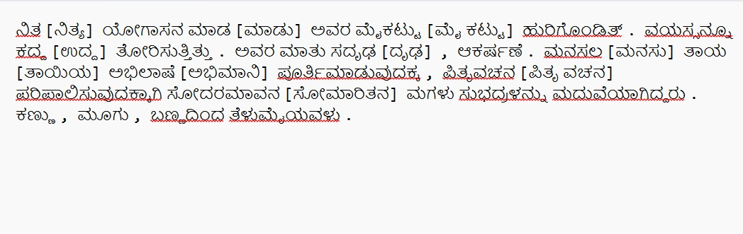
Figure 13– Output file of spell-checker

Slide 40
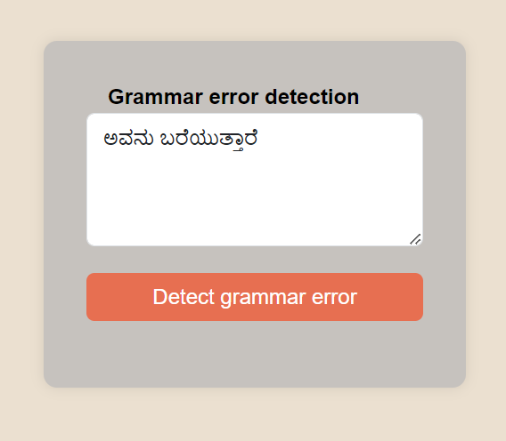
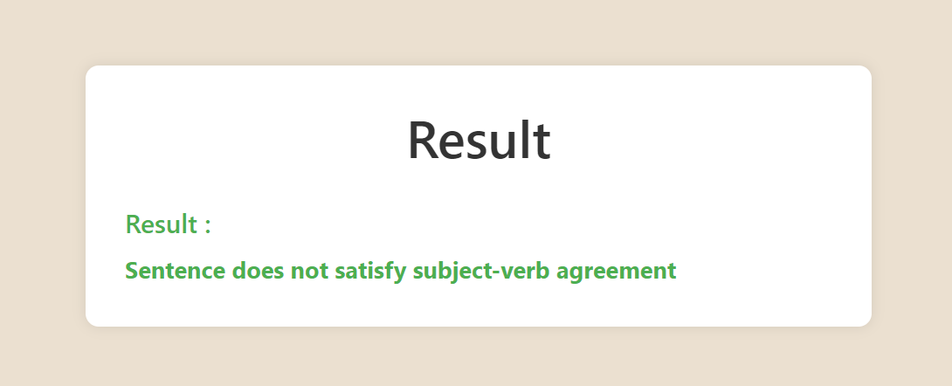
Figure 15- Grammatical error detector output
Figure 14- Grammatical error detector input

Slide 41
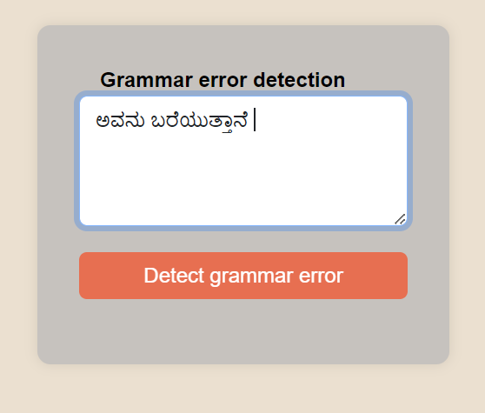
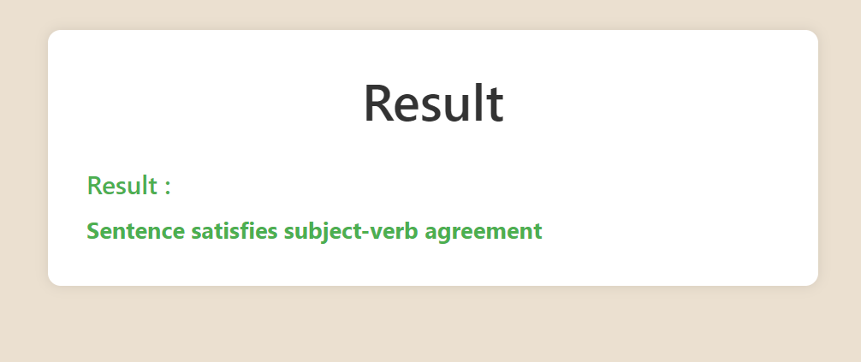
Figure 17- Grammatical error detector output
Figure 16- Grammatical error detector input

Slide 42
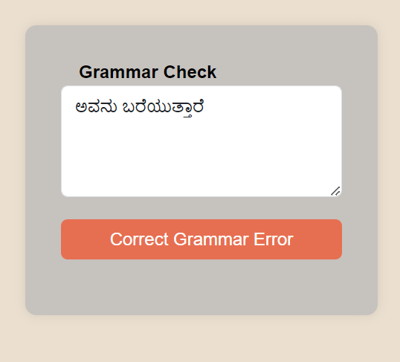
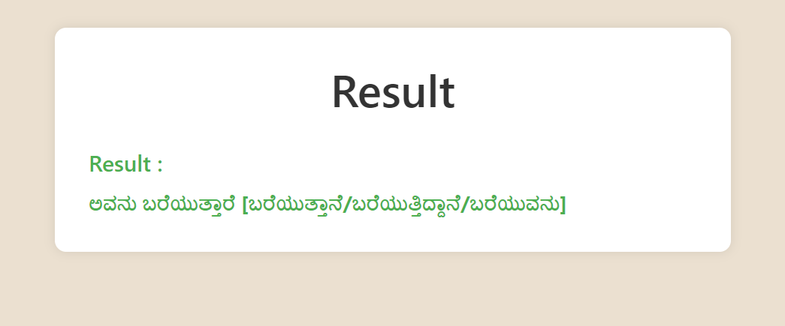
Figure 19- Grammatical error corrector output
Figure 18- Grammatical error corrector input

Slide 43
Applications
Education
Professional writing
Publishing
Language preservation
Use in translators

Slide 44
Future Work
Increasing the lexicon size
Handling irregular verb usage
Handling varied tenses
Handling passive voice sentences
Enhancing the generalization capabilities of the distilBERT model
Reducing high false negative rates of distilBERT when encountering unseen words.

Slide 45
Conclusion
The project is aimed at developing a GEC tool for Kannada documents using the BERT model and evaluating its performance. Previously GEC in Kannada has been done using LSTM and, in this project, it is attempted to do the same using Transformers, with the additional feature of a spell-checker.

Slide 46
Bibliography
[1] Faisal, A. M. F., Rahman, M. A., & Farah, T. (2021, July). A rule-based bengali grammar checker. In 2021 Fifth World Conference on Smart Trends in Systems Security and Sustainability (WorldS4) (pp. 113-117). IEEE.
[2] Murugan, S., Bakthavatchalam, T. A., & Sankarasubbu, M. (2020). SymSpell and LSTM based Spell-Checkers for Tamil.
[3] Gupta, P. (2020, February). A context-sensitive real-time Spell Checker with language adaptability. In 2020 IEEE 14th International Conference on Semantic Computing (ICSC) (pp. 116-122). IEEE.
[4] Azmi, A. M., Almutery, M. N., & Aboalsamh, H. A. (2019). Real-word errors in Arabic texts: A better algorithm for detection and correction. IEEE/ACM Transactions on Audio, Speech, and Language Processing, 27(8), 1308-1320

Slide 47
[5] Aziz, R., Anwar, M. W., Jamal, M. H., & Bajwa, U. I. (2021). A hybrid model for spelling error detection and correction for Urdu language. Neural Computing and Applications, 33, 14707-14721.
[6] Gondaliya, Y., Kalariya, P., Panchal, B. Y., & Nayak, A. (2022). A Rule-based Grammar and Spell Checking.
[7] Wang, Q., & Tan, Y. (2020, July). Grammatical error detection with self attention by pairwise training. In 2020 International Joint Conference on Neural Networks (IJCNN) (pp. 1-7). IEEE.
[8] Hao, S., & Hao, G. (2020, November). A research on online grammar checker system based on neural network model. In Journal of Physics: Conference Series (Vol. 1651, No. 1, p. 012135). IOP Publishing.
[9] Pabasara, H. M. U., & Jayalal, S. (2020, September). Grammatical error detection and correction model for Sinhala language sentences. In 2020 International Research Conference on Smart Computing and Systems Engineering (SCSE) (pp. 17-24). IEEE.

Slide 48
[10] Saluja, R., Adiga, D., Chaudhuri, P., Ramakrishnan, G., & Carman, M. (2017, November). Error detection and corrections in Indic OCR using LSTMs. In 2017 14th IAPR International Conference on Document Analysis and Recognition (ICDAR) (Vol. 1, pp. 17-22). IEEE.

