Slide 1
G.R.I.D : Get relevant Information on Disasters
Deepti Aggarwal
Ananya Choudhury

Slide 2
Introduction
Twitter is a fantastic channel for communication during disasters. With nearly 340 million tweets created and redistributed each day, this is an active medium for information exchange during disaster.
Processing such big data to get relevant information include numerous challenges.
Get Relevant Information on Disaster (G.R.I.D) is a web archived search engine which provides an efficient way to retrieve information on disaster.
G.R.I.D identifies webpages containing information on disaster based on the tweets which cite this webpage

Slide 3
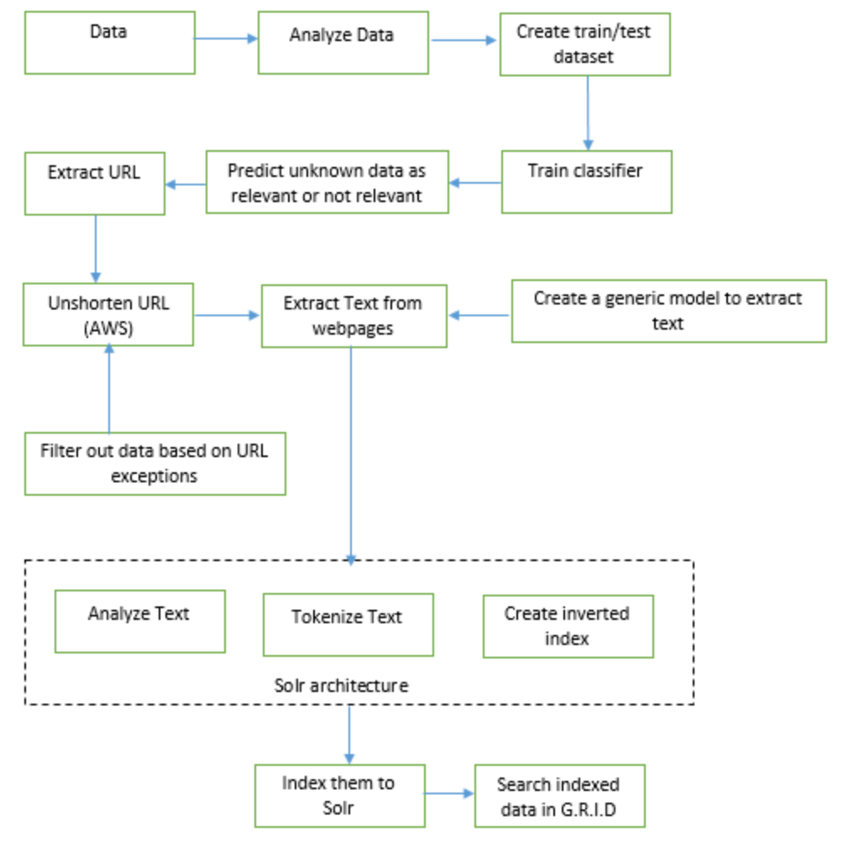
Project Framework

Slide 4
Classification
Customized feature selection and stop words
Training and Test dataset is labelled into two categories : relevant and non-relevant.
Classification is done using Naïve Bayes classifier.
Two models for splitting data into test and train was used:
K-Fold cross validation: K= 10, 8, 5
Train Test Split : 80-20 split
Other classification methods used : Linear SVC

Slide 5
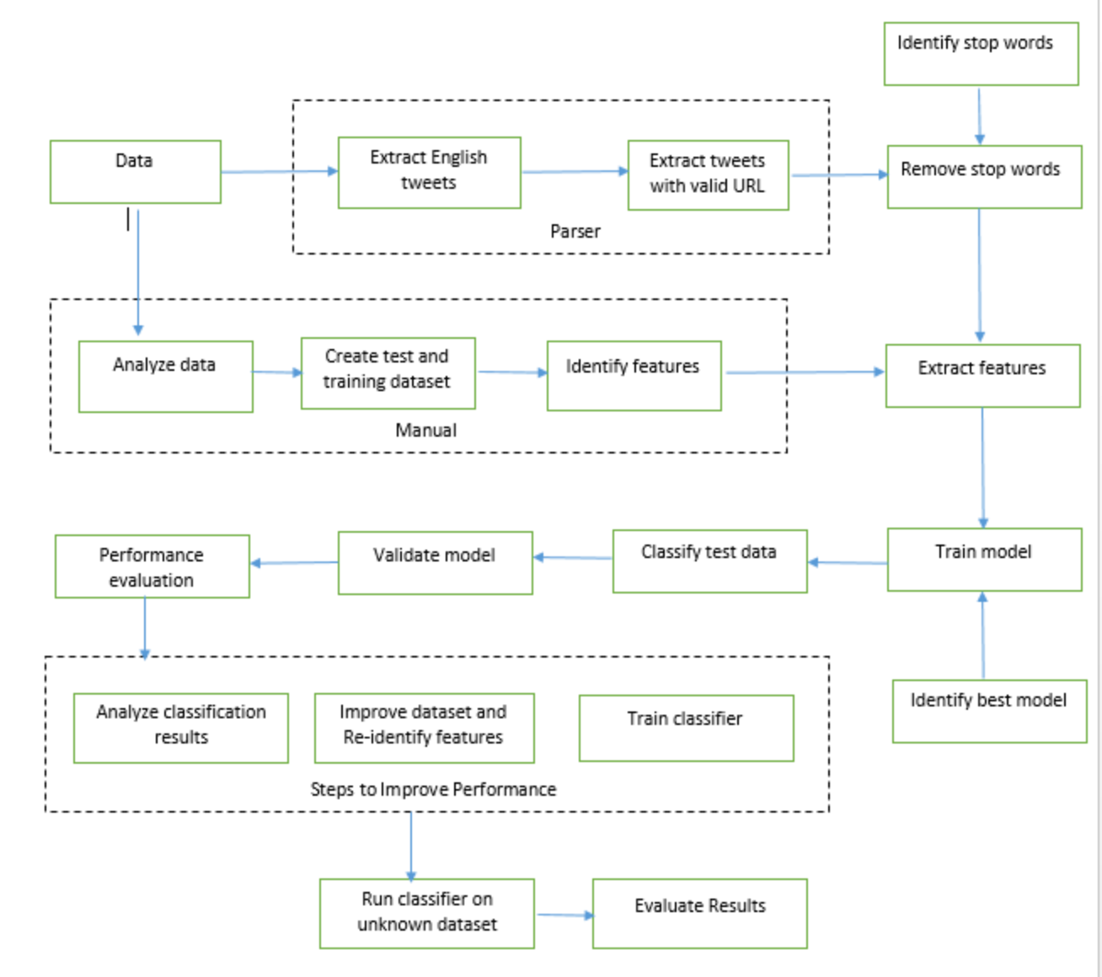
Classification Framework

Slide 6
Classification Results: Train_Test_Split
Model | Test data | F-1 score | precision | recall
Linear SVC | 0.1 | 0.76 | 0.76 | 0.75
Linear SVC | 0.15 | 0.79 | 0.8 | 0.79
Linear SVC | 0.2 | 0.79 | 0.79 | 0.8
MultinomialNB | 0.1 | 0.83 | 0.85 | 0.88
MultinomialNB | 0.15 | 0.87 | 0.88 | 0.85
MultinomialNB | 0.2 | 0.86 | 0.87 | 0.86

Slide 7
Classification Results : Cross Validation
Model | Kfold | F-1 score | precision | recall
Linear SVC | k=10 | 0.72 | 0.79 | 0.72
Linear SVC | k=8 | 0.76 | 0.72 | 0.67
Linear SVC | k=5 | 0.65 | 0.64 | 0.58
MultinomialNB | k=10 | 0.85 | 0.87 | 0.8
MultinomialNB | k=8 | 0.84 | 0.83 | 0.79
MultinomialNB | k=5 | 0.85 | 0.83 | 0.78

Slide 8
Unshortening URL
We unshortened URLs extracted from relevant tweets using Map Reduce in AWS platform
This step also filters out unresponsive and unsecure URLs.
We have used HttpClient to retrieve the original URLs.
The output is the list of valid URLs.

Slide 9
Extract text using BeautifulSoup
It extracts the relevant text from the webpages.
The html source file has been analyzed to extract text.
Parent-child relationship has been followed to extract text.
Lower bound of the text extracted is considered to be 8000 characters
A generic model was created to extract text from the webpages as each webpage has a unique structure.

Slide 10
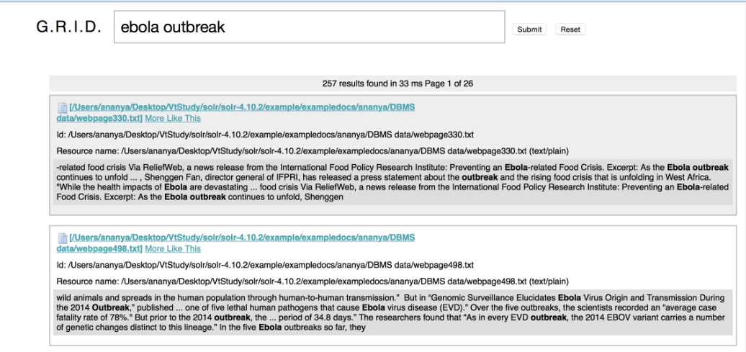
G.R.I.D Search Interface

Slide 11
Results/Observations
Classifier precision is 85%.
It classifies 13000 out of 65000 tweets as relevant
MapReduce filters out unresponsive and redundant URLs and outputs approximately 5000 URLs.
In the next step information is extracted from relevant webpages.
This filters out URLs that do not respond in the first instantiation of HttpClient.
The output is extracted texts from approximately 1000 webpages.
A major observation from the above results is that the URLs and the webpages these URLs refers to are highly redundant.

Slide 12
Challenges:
Identifying non-relevant datasets to create an accurate boundary condition between the two categories.
Classification is based on less than 140 characters. Identifying features for such small string is tricky.
HttpClient used by AWS has a bug which leads to unwarranted program termination.
Source file of each web page is unique. Identifying a generic model to extract data was challenging.
Limited documentation available online on Solr and Velocity.

Slide 13
Conclusion
G.R.I.D is a complete solution to retrieve disaster related information originating in tweets.
It is aimed at providing a streamlined information retrieval process for Risk Assessment, Disaster Management agencies, historians etc.
Future scope of this project includes :
Summarize text retrieved from webpages before indexing to Solr
Increase classification accuracy .
A more sophisticated interface to search the archived text.

Slide 14
Dedication
We are thankful to Digital Library Research Laboratory for providing us with twitter dataset and allowing us to use Solr server
We also thank Dr. Aditya Prakash and Vanessa for providing us with AWS codes to run our MapReduce programs and guiding us whenever required.

