Slide 1
Almost there...

Slide 2
Admin
kit returns
Friday, 5:00pm, Zeynep sent out detailed instructions
course evaluations
topics we covered – I’d love to get your thoughts
design workshops
electronics
mechanics
programming
ESP 32 homework
final project

Slide 3
Admin
report
Saturday is fine
final prep
watch video
read article
there will be an essay question on the material

Slide 4
So here’s a problem for you...

Slide 5
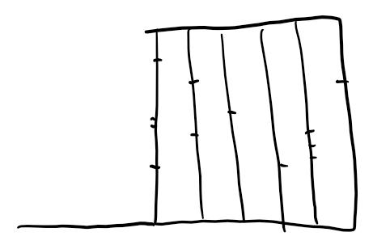

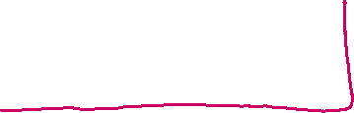
You have a robot the navigates a warehouse to gather items. It starts at a specific location, drives to a bin in a given row, picks the item, and takes it to a place to be boxed. The warehouse is organized in rows, and each row is marked with a line that has a number of "intersections" to determine locations of bins.

Slide 6


The number of rows and bins in each row are stored as follows:
int rowCount;
int binsPerRow[rowCount]; //array of bind in each row
Your robot has line following sensors and a function that returns true when it detects an intersection. It also has a function that can be called to command it to retrieve an item from a bin in a specified row. When it receives an "order," it sets the targetRow and targetBin variables and then drives to pick up the item. After doing so, it continues to the end of the row and then to the boxing area..

Slide 7
class Robot
{
int targetRow;
int targetBin;
int rowCounter = -1; // counter to keep track of row
int binCounter = -1; // and bins
bool CheckIntersection(); //returns true when an intersection is detected
void LineFollow();
void TurnLeft();
void TurnRight();
void GrabItem(); //once the bin has been reached, call this to get the item
}
Robot myRobot;

Slide 8
Part I
Write out a function, GetItem(), that drives to the bin, grabs the item and then drives to the boxing area. For this part, just write a “sequential” program that counts intersections (i.e., a simple for loop). GetItem() is not a part of Robot, so you’ll need to use proper syntax to call the functions in that class.

Slide 9
Part II
Now write out a state machine that could be used to accomplish the tasks. In the notes from class, TURNING is a state.

Slide 10
Part II
Now write out a state machine that could be used to accomplish the tasks.
Identify the states

Slide 11
Part II
Now write out a state machine that could be used to accomplish the tasks
Identify the states
Identify the events that cause you to change states

Slide 12
Part II
Now write out a state machine that could be used to accomplish the tasks.
Identify the states
Identify the events that cause you to change states
Identify the actions you need to take when you change states

Slide 13
Can you write CheckIntersection()?

Slide 14
Can you manage the handlers?
void HandleIntersection()
{
switch(state)
{
case DRIVING_TO_ROW:
case DRIVING_TO BIN:
case DRIVING_TO_END:
}

Slide 15
class Robot
{
int targetRow;
int targetBin;
int rowCounter = -1; // counter to keep track of row
int binCounter = -1; // and bins
void RetrieveItem(int row, int bin); //commands robot to retrieve an item
bool CheckIntersection(); //returns true when an intersection is detected
void LineFollow();
void TurnLeft();
void TurnRight();
void GrabItem(); //once the bin has been reached, call this to get the item
}
Robot myRobot;

