Slide 1

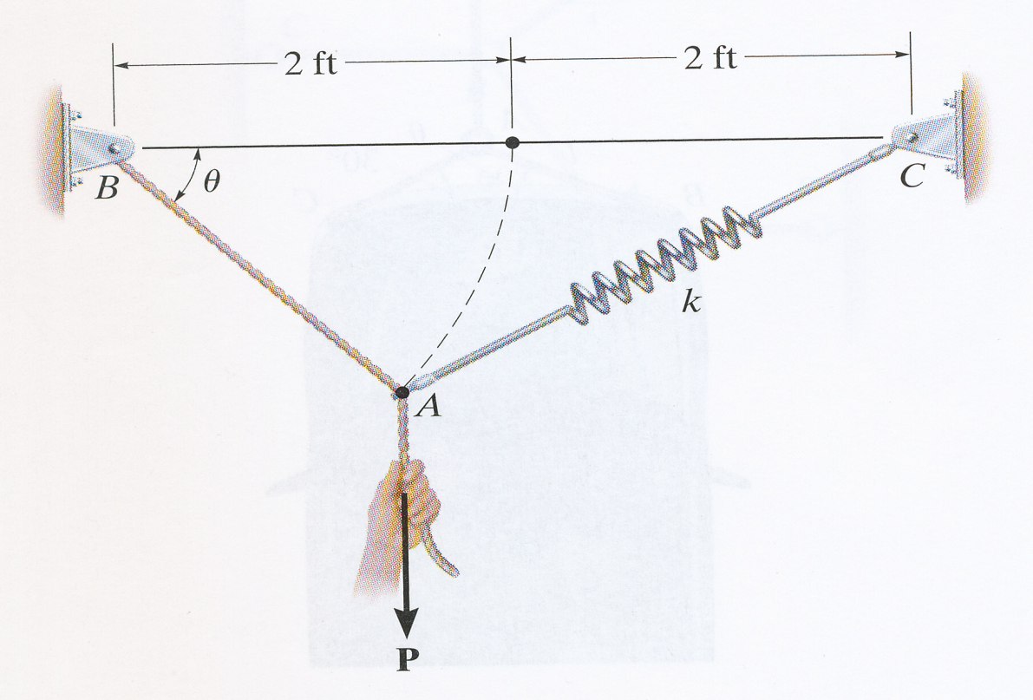
ES2501: Introduction to Static Systems
Quiz #2
Name:__________
Solution
The unextendable 2-ft rod AB and a spring AC of spring constant k at its unstretched length L₀ are connected at A, which is originally at the horizontal position. A vertical load P is applied at A and A moves down to A* to the equilibrium position with the angles of ɵ and α. Assume that the internal forces in the rod and the spring are denoted by T_{rod} and T_{sprin}. Take
2ft
L₀
α
k
Q1: (15pts) Find the internal forces T_{rod} and T_{spring} (Hint: Consider the equilibrium of point A*. Follow the 3-step procedure of drawing FBD (3pts), listing equations (8pts), and finding the solution (4pts))
Q2: (3pts) Find the extension of the spring.
Q3: (2pts) Find the spring constant k.

Slide 2




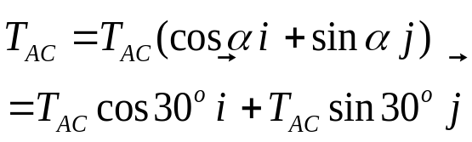
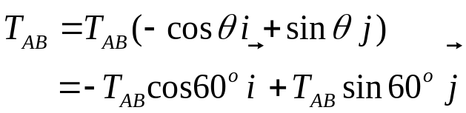
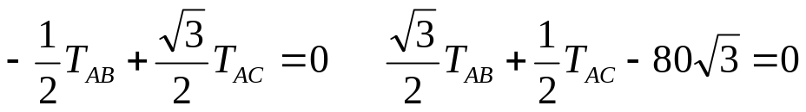
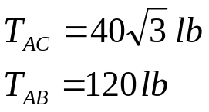
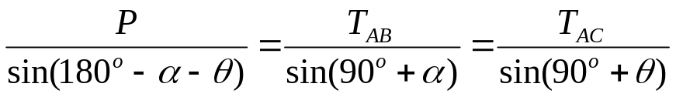
ES2501: Introduction to Static Systems
Quiz #2
Name:__________
Solution
Q1: (15pts) Find the internal forces T_{rod} and T_{spring.}
L₀
Step 1: FBD
Step 2: Equations
Cartesian expressions
Step 3: Solution
Alternative solution:
Three forces in equilibrium by Law of sine:

Slide 3


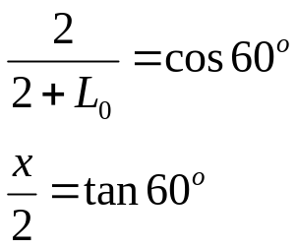


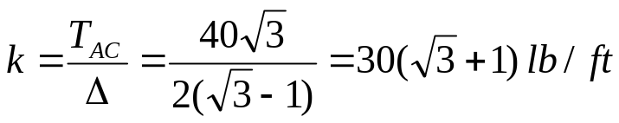
ES2501: Introduction to Static Systems (2013C)
Quiz #2
Name:__________
Solution
Q2: (3pts) Find the extension of the spring.
L₀
2ft
90º
x
Q3: (2pts) Find the spring constant k.

