Slide 1

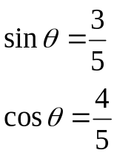

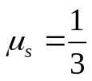




ES2501: Introduction to Static Systems
Quiz #2
Name:__________
Solution
The block of M=5kg, modeled as a particle, rests on the inclined surface that makes an angle of θ with the horizontal ground. The static friction coefficient between the block and the surface is μ_{s}=1/3. A force of P is horizontally applied on the block. Take g=10m/s/s for convenience.
Q1. Draw a free-body diagram (FBD) of the block.
Q2. Write down Cartesian vector expressions for all forces shown on your FBD with respect to the specified coordinate system shown..
Q3. Write down the scalar component form of the equilibrium equations in the x- and y- directions.
Q4. Find the critical value of P such that the static friction force between the block and the surface is zero.
Q5. Find the range of P needed to keep the block to rest on the surface without sliding down or pushing up
(Hint: The block could slide down for a significantly heavy block or be push up if P is too big)

Slide 2







ES2501: Introduction to Static Systems
Quiz #2
Name:__________
Solution
Q1. Draw a free-body diagram (FBD) of the block.
The above arrowhead of friction corresponds to the case when the particle moves down along the surface.
Note: Here is the static friction for an equilibrium problem
Q2. Write down Cartesian vector expressions for all forces shown on your FBD with respect to the specified coordinate system shown..
Q3. Write down the scalar component form of the equilibrium equations in the x- and y- directions.
Equilibrium
(x-direction)
Group the x- and y- components
(y-direction)

Slide 3

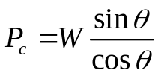
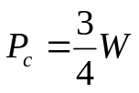


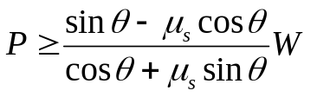
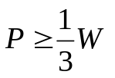
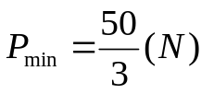
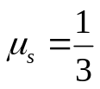
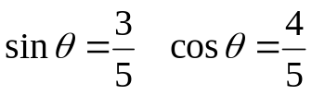
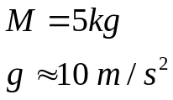


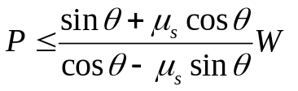
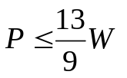
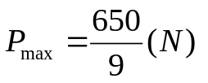
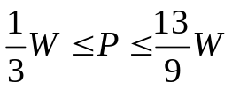
ES2501: Introduction to Static Systems
Quiz #2
Name:__________
Solution
Q4. Find the critical value of P such that the static friction force between the block and the surface is zero.
data
Zero static
friction
Q5. Find the range of P needed to keep the block to rest on the surface without sliding down or pushing up
Case 1: the impeding motion is down along the surface (P>Pc)
Solve for fs and N
Check the static friction criterion
Case 2: the impeding motion is up along the surface (P<Pc)
Solve for fs and N
Check the static friction criterion

Slide 4

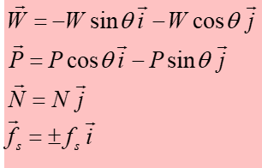



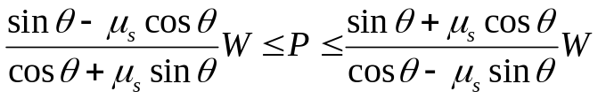
ES2501: Introduction to Static Systems
Quiz #2
Name:__________
Solution
General discussion:
Equilibrium
Direction of the friction or the arrowhead depends on whether the particle moves up or down
Check the static friction criterion

Slide 5


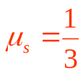
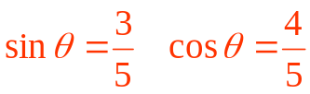
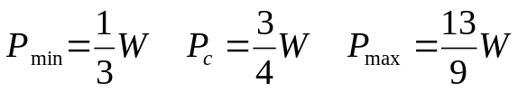
ES2501: Introduction to Static Systems
Quiz #2
Name:__________
Solution
General discussion:
I
II
III
Maximum static friction when block tends to move down
I
When P=0 the block tends to move down since the weight component Wsinθ >the max. static friction μ_{s}Wcosθ
Range of P
The critical P-value for which the static friction changes its direction
III
Static friction by equilibrium
Maximum static friction when block tends to move up
II
For this problem

