Slide 1












ES2501: Introduction to Static Systems
Quiz #3
Name:__________
Solution
For the forcing system acting on the cube shown in the figure:
Q1: Find the moment vector by about point O.
(Hint: Find the Cartesian vector form for first)
Q2: Find the resultant moment vector of the forcing system about point O, i.e. the total moment from all applied forces including the applied moment.
Q3: Find the resultant moment vector of the forcing system about point B.

Slide 2


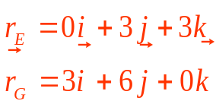


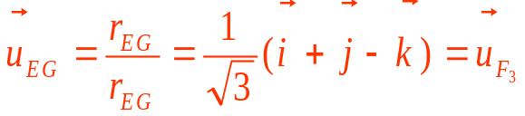
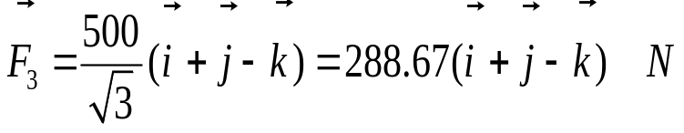


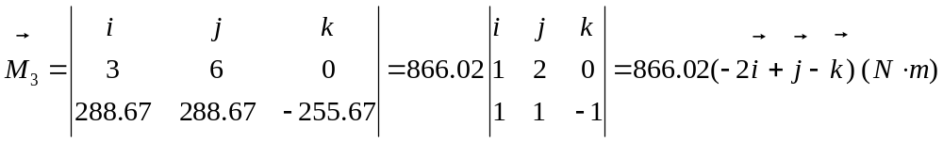
ES2501: Introduction to Static Systems (2013C)
Quiz #2
Name:__________
Solution
Q1: Find the moment vector by about point O.
(Hint: Find the Cartesian vector form for first)

Slide 3
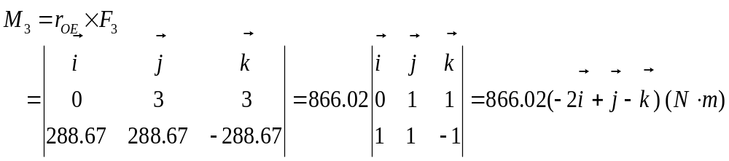
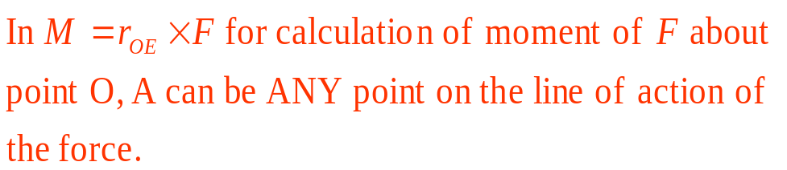
ES2501: Introduction to Static Systems
Quiz 3
(moment)
Name:__________
Solution
Q1: (con’d)
If using point E (0, 3,3) on the line of action of the force:
The same result

Slide 4




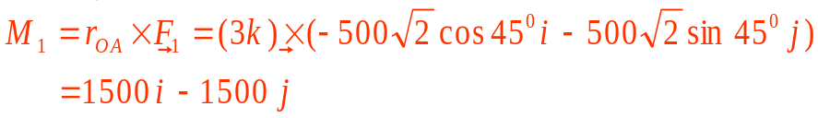

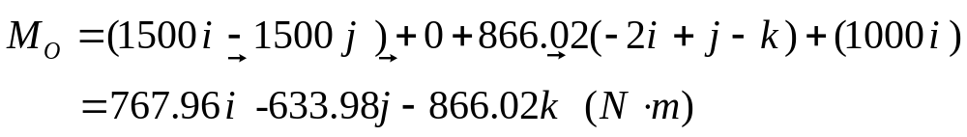
ES2501: Introduction to Static Systems
Quiz 2
Name:__________
Solution
Q2: Find the resultant moment vector of the forcing system about point O, i.e. the total moment from all applied forces including the applied moment.
(from Part 1)
Note: The original forcing system and the new set of are statically equivalent

Slide 5
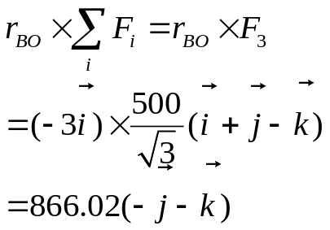
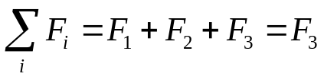

ES2501: Introduction to Static Systems
Quiz #2
Name:__________
Solution
Q3: Find the resultant moment vector of the forcing system about point B.
These two forces constitute a couple and their total is in in fact zero
Note 1: You may also directly calculate the moment about B like the way in Parts 1 and 2. Here is a shortcut
Note 2: The three sets of forces: (1) the original set (red), (2) (green) and (3) (pink) are statically equivalent

