Slide 1





ES2501: Introduction to Static Systems
Quiz #3
Solution
Name:__________
A rigid and slender straight bar is pin-supported at B and held at the horizontal position by the cable AC. For the loading shown find the support reaction forces at B and the internal tension force in cable AC. Ignore the size of the support and the gravity.
Your solution should include a free-body diagram (20%), necessary static equilibrium equations (50%), and the solution (30%).
(Hint: You may replace the distributive loading by its statically equivalent counterpart first).

Slide 2
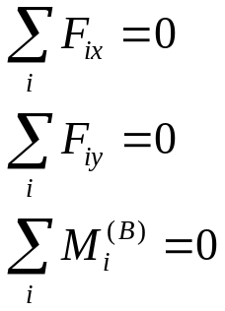
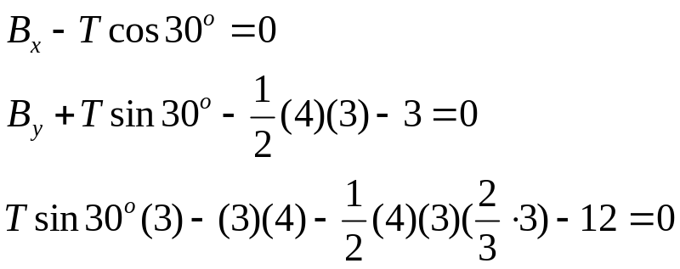
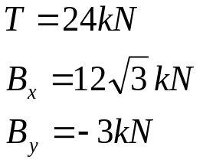
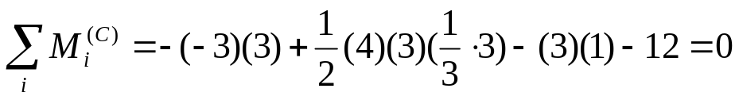
ES2501: Introduction to Static Systems
Quiz #4
Name:__________
Solution
FBD
Equations
Solution
Check:
OK

