Slide 1







ES2501: Introduction to Static Systems
Quiz #6
(beam)
Solution
For the cantilever beam subjected to the specified loading:
I
II
(1) Find the shear force and the bending moment on the cross section I.
(2) Find the shear force and the bending moment on the cross section II.
(3) Draw the shear force and bending moment diagrams of the beam and determine the maximum shear force and the maximum bending moment in the beam.
Necessary free-body diagrams are required.

Slide 2
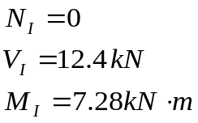


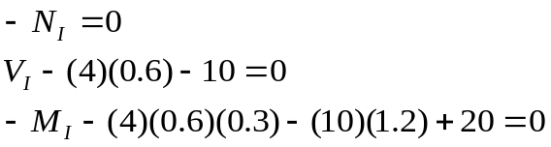

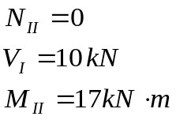


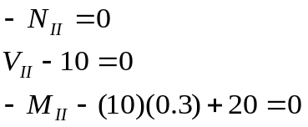

ES2501: Introduction to Static Systems
Quiz #6
For the cantilever beam subjected to the specified loading:
I
II
(1) Find the shear force and the bending moment on the cross section I.
I
II
(2) Find the shear force and the bending moment on the cross section II.
I
II

Slide 3
ES2501: Introduction to Static Systems
Quiz #6
I
II
(3) Draw the shear force and bending moment diagrams of the beam and determine the maximum shear force and the maximum bending moment in the beam.
I
II
Shear force diagram
Bending moment diagram
Comment: Here we draw the diagrams starting from the right to avoid solving for the reactions first. And the support reactions can be identified from the diagrams as Ay=14.8kN and My=0.88 kN-m. Or, you can find the support reactions first and then draw the diagrams starting from the left.

