Slide 1
Named Entity Recognition using MultiCoNER II
CS5803: Natural Language Processing
Ananya Mantravadi (CS19B1004)
Sai Yaaminie Ganda (CS19B1022)
Siddharth Saini (CS19B1024)
IIIT Raichur

Slide 2
Contents
Problem Statement
Dataset
Statistical model - CRF
DL model - BiLSTM
Results - Quantitative and Qualitative
Observations
Conclusion
References

Slide 3
Problem Statement
Study and develop solutions for the Named Entity Recognition problem defined in the SemEval 2023 MultiCoNER 2 Task:
Task 1 - Apply one statistical model (non-neural network based sequence labelling model) such as HMM, MEMM, or CRF to perform NER defined in the MultiCoNER 2 Task.
Task 2 - Apply one deep learning model (RNNs, transformers etc.) to perform NER defined in the MultiCoNER 2 Task.

Slide 4
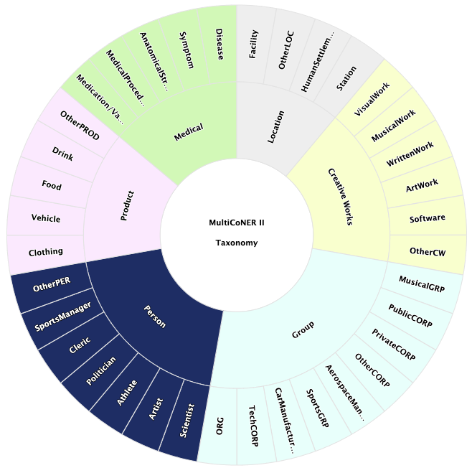
MultiCoNER II Multilingual Complex Named Entity Recognition Dataset
Represents challenges of complex named entities like imperative clauses, complex syntactic structures, and long-tail entity distributions.
Dataset sources - Various domains, including news, social media, and Wikipedia, providing diverse range of text types and styles.
The dataset consists of 6 broad range named entities - medical, location, creative works, group, product, and person; each further divided into finer groups.
Source: https://multiconer.github.io/

Slide 5
Dataset Preparation and Loading
The dataset is hosted on the AWS cloud. First, install the AWS CLI (AWS command line interface). Then load the multiconer2023 dataset from the multiconer bucket. (Amazon S3 is an object storage service that stores data as objects within buckets.)
Choice of language = English (EN) (monolingual task).
The CoNLL file has 4 parts :
Id (in comments ) - one id for one sentence
Domain = EN
Words/Tokens - words in English vocabulary
Corresponding NER tag

Slide 6
Statistical model - CRF
Conditional Random Fields is a discriminative log-linear model used for sequence labeling tasks by using conditional probability P(Y|X) of the output sequence given the input sequence
They are able to look into the context of a word.
Feature functions are a key component of CRF that one can decide to be able to capture arbitrary features, capitalization, or morphology.
Example -
Linear chain CRF is a special case of CRF where the feature functions that we select are restricted to depend on only the current and previous labels, rather than arbitrary labels throughout the sentence.

Slide 7
general form of a feature function for an input of size n -
y_{i-1} - previous tokens
y_{i} - current tokens
X - input sequence
i - position in the sequence

Slide 8
CRF:
Methodology and feature engineering iterations

Slide 9
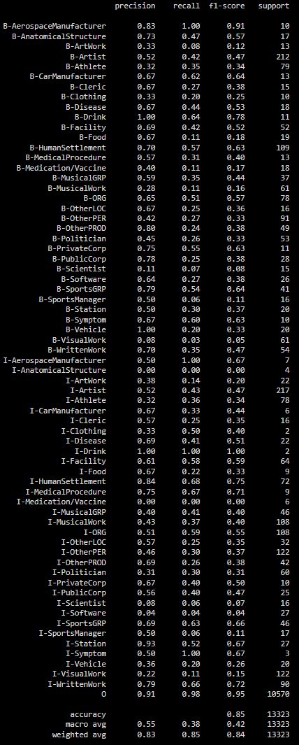
Basic Features
The basic feature functions include the following - bias, if the word is at sentence beginning or end, if the word is alphanumeric, numeric, or digit, uppercase, lowercase, word length, hash length, and byte length of the word. While training, the CRF parameters c1 and c2 which are the coefficients for L1 and L2 regularization have been set to 0.1 each.
The F1-score - 83.75%
Observations - Most likely/unlikely transitions; state features with large positive/weights.
Likely transitions: B-OtherPER -> I-OtherPER, B-VisualWork -> I-VisualWork, B-Athlete -> I-Athlete.
Top state features: bias, lowercase, and hash length for the label 'O'.
Conclusion - The model is able to correctly find the relationships between the tags since the B tags are followed by I tags in the same class.

Slide 10
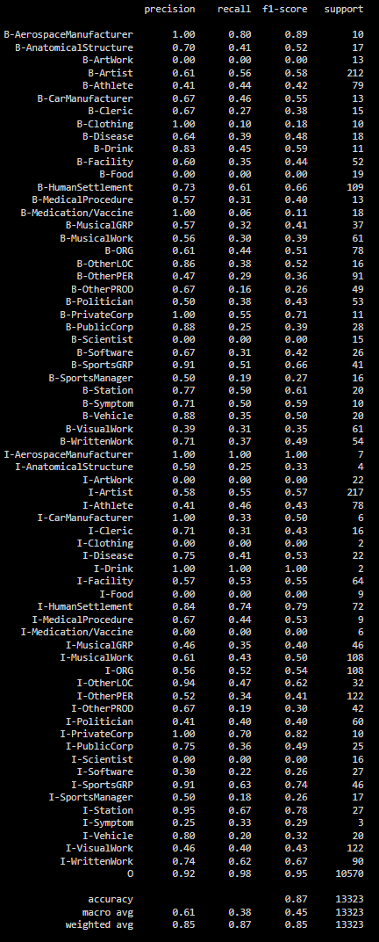
2. Basic Features + Neighbours
Included features of the words around the target word - one previous word and one after.
The F1-score - 85.31%
Observations - Increment in F1 score by 1.56%
Conclusion - Including neighbours' features helps model to predict the target tag better.

Slide 11
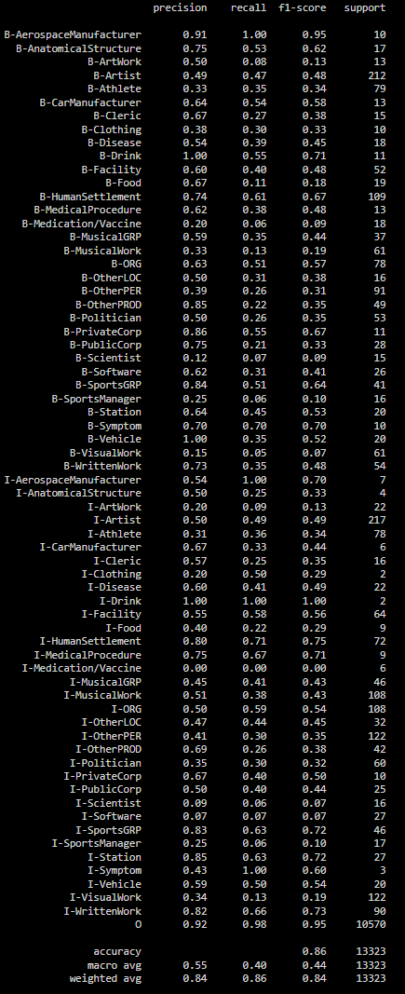
3. Basic Features + POS tags
Part Of Speech (POS) tagging can be used in NER since it can help in identifying named entities.
The F1-score - 84.21%
Observations - Increment in F1 score by 0.46% compared to A), where we consider only basic features and decrement of 1.1% compared to B), including neighbouring features.
Conclusion - Need to include both POS tags and Neighbours in order to get the best results.

Slide 12
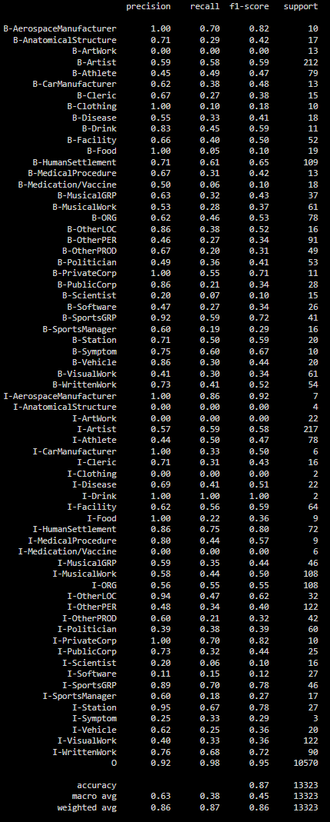
4. Basic Features + POS tags + Neighbours
Combining features including those of neighbours' along with POS tags.
The F1-score - 85.61%, improvement over all previous combinations.
Observations - Highest F1 score among all previous iterations.
Conclusion - Neighborhood features with POS tags results in improvement in model performance.

Slide 13
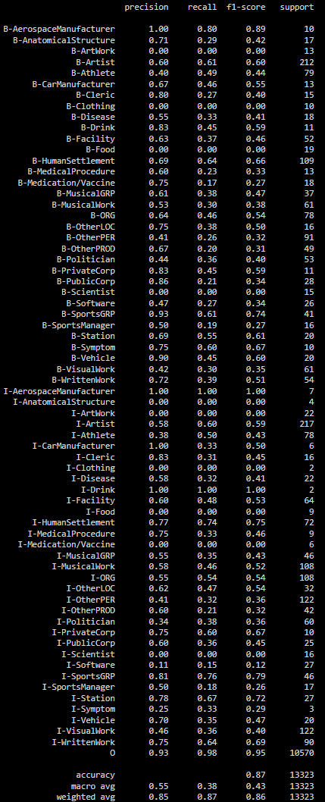
5. Basic Features + POS tags + Neighbours + Suffix Symbols + URL + Emotion Symbols + Word Forms
Add additional features to make crf more robust for NE prediction task.
Suffix symbols: ‘!’, ‘?’
URL identification: Word starts with "https://" or "http://"
Positive/negative emotion words: XD, yay!, :D or :'( , :( , -.-
Word Forms: Words ending with "ing", "es", "ent", "ly", "ery", etc.
The F1-score - 85.62%, but negligible increase over 85.61%.
Observations - Highest F1 score among all the iterations.
Conclusion - It can be inferred that too many of these handcrafted features does not improve the model's ability.

Slide 14
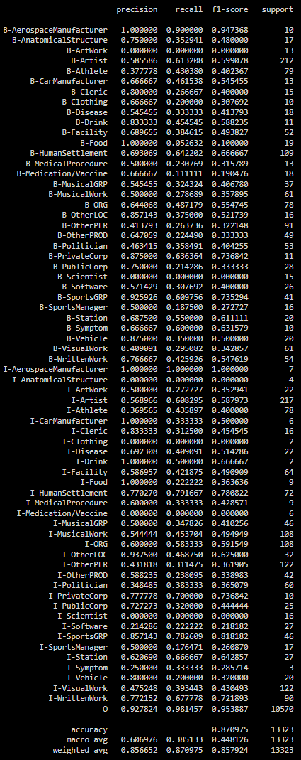
6. Hyperparameter Tuning
In order to select the best hyperparameters, we performed a Randomized Search which gave us: 'c1': 0.149, 'c2': 0.0215
Accuracy - 87.09%
Precision - 85.66%
Recall - 87.09%
F1-score - 85.79%, improvement over all previous combinations.
Observations - Classes with 0 F1-scores: B-ArtWork, B-Clothing, I-AnatomicalStructure, and I-Clothing (very few samples, I-Clothing: 87). Even second-majority samples class I-Artist has only 58% F1-score
Conclusion - The number of samples is not a determining factor, but the semantic, syntactic, and contextual meaning of the word also matter in this task of NER.

Slide 15
Qualitative Analysis
Sentence 670
reverse ( O O ) is ( O O ) the ( O O ) fourth ( O O ) album ( O O ) of ( O O ) the ( O O ) progressive ( O O ) metal ( O O ) band ( O O ) eldritch ( B-MusicalGRP B-MusicalGRP ) containing ( O O ) a ( O O ) cover ( O O ) of ( O O ) my ( B-MusicalWork B-VisualWork ) sharona ( I-MusicalWork I-VisualWork ) . ( O O )
Sentence 39
da ( B-OtherPER B-Artist ) yanlin ( I-OtherPER I-Artist ) a ( O O ) distant ( O O ) relative ( O O ) of ( O O ) the ( O O ) defunct ( O O ) balhae ( B-HumanSettlement O ) regime ( O O ) rebels ( O O ) ; ( O O ) he ( O O ) is ( O O ) defeated ( O O )
Sentence 399
it ( O O ) is ( O O ) partially ( O O ) owned ( O O ) by ( O O ) the ( O O ) west ( B-PublicCorp B-PublicCorp ) japan ( I-PublicCorp I-PublicCorp ) railway ( I-PublicCorp I-PublicCorp ) company ( I-PublicCorp I-PublicCorp ) . ( O O )

Slide 16
Recurrent Neural Network: BiLSTM

Slide 17
BiLSTM
BiLSTM is a deep learning model, that specialize in sequential data that has temporal characteristics, or time dependencies.
Preprocessing data before sending as input to BiLSTM
Assign id to each word in train and validation set (vocabulary)
Assign id to each ‘ner_tag’ in the dataset.
Pad the sentences to create dataset with sentences of uniform length (max_length).
Model is trained on the train set and validated on dev set.
Hyperparameters - learning_rate = 0.0001
Optimizer - Adam

Slide 18
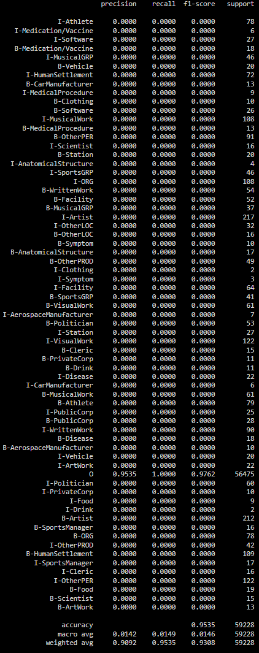
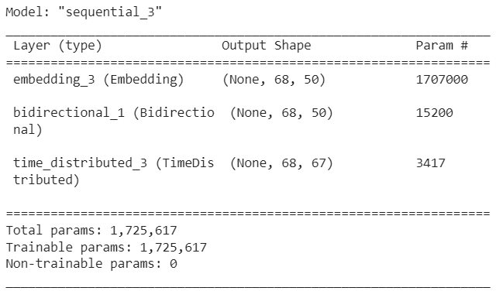
BiLSTM Model Summary &
Results

Slide 19
Observations
Accuracy is 95.35% and the weighted F1-score is 93.08%. But the the macro average F1-score is 1.46%.
The accuracy and weighted F1-score suggest that the model is predicting only the majority class 'O' as we can clearly observe, possibly due to imbalanced class distribution. However, the very low macro average F1 score indicates that the model is performing very poorly on most of the other classes.
Therefore, while the overall performance of the model may seem good based on the weighted metrics, it is important to examine the macro average metrics to identify which classes the model is struggling with and to address any issues with class imbalance or model representational power for those classes.

Slide 20
2. BiLSTM with GloVe Embeddings
Glove stands for Global Vectors, a word embedding technique.
We have used pre-trained Glove with 6B tokens and 50-dimensional representation for each vector.
It creates real-valued vector representations for words based on the co-occurrence statistics of the words in a corpus.
Source (pre-trained glove) - http://nlp.stanford.edu/data/glove.6B.zip

Slide 21
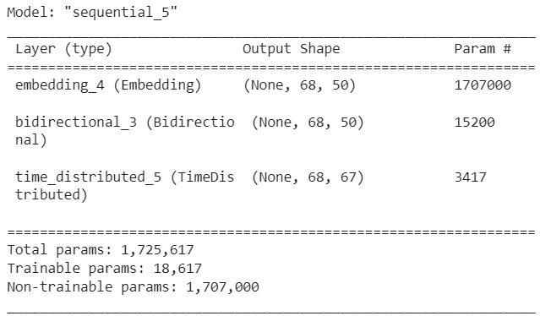
BiLSTM with GloVe Model
Summary & Results
Since we used pre-trained word embeddings, the non-trainable parameters have increased from 0 to 1,707,000.

Slide 22
Observations
The macro F1 score for the BiLSTM model with both assign integer value to words and tags and using GloVe embeddings is very less ( ~ 1.5% ).
Reason - Complex NEs can take the form of any linguistic constituent and may not look like traditional NEs. This syntactic ambiguity can make it challenging for BiLSTM models to recognize them based on context alone. DL-based models generally are effective in automatically learning useful representations and underlying factors from raw data, but the RNN BiLSTM, in this case, fails to perform well. These models perform significantly worse on complex/unseen entities.

Slide 23
Qualitative Analysis
Sentence 44
the ( O O ) cup ( O O ) is ( O O ) named ( O O ) after ( O O ) joe ( B-OtherPER O ) mcdonagh ( OtherPER O ) . ( O O )
Sentence 19
it ( O O ) was ( O O ) described ( O O ) by ( O O ) edward ( B-OtherPER O ) meyrick ( I-OtherPER O ) in ( O O ) 1928 ( O O ) . ( O O )
Sentence 24
akira ( B-OtherPER O ) nishiguchi ( I-OtherPER O ) : ( O O ) killed ( O O ) five ( O O ) people ( O O ) and ( O O ) engaged ( O O ) in ( O O ) fraud ( O O ) ; ( O O ) executed ( O O ) in ( O O ) 1970 ( O O ) . ( O O )

Slide 24
Conclusion
We have explored two different approaches to named entity recognition (NER) - Conditional Random Fields (CRF) and Bi-directional Long Short-Term Memory (BiLSTM) models.
Tried different feature sets for CRF and different preprocessing/word embedding techniques for BiLSTM.
Presented Qualitative and Quantitative results for both Task 1 and Task 2. Through various observations, we concluded that CRF model has better qualitative and quantitative results on the given dataset.
CRF models can be better equipped to handle complex and ambiguous NEs because they take into account the dependencies between adjacent labels in the sequence and can better handle syntactic ambiguity through handcrafted features based on linguistic properties.
Processing complex and ambiguous NEs is challenging; therefore, it is important to use models that are appropriate for the task.

Slide 25
References
https://multiconer.github.io/
Bajaj, Payal, et al. "Ms marco: A human generated machine reading comprehension dataset." arXiv preprint arXiv:1611.09268 (2016).
Craswell, Nick, et al. "ORCAS: 20 million clicked query-document pairs for analyzing search." Proceedings of the 29th ACM International Conference on Information \& Knowledge Management. 2020.
Jeffrey Pennington, Richard Socher, and Christopher Manning. 2014. GloVe: Global Vectors for Word Representation. In Proceedings of the 2014 Conference on Empirical Methods in Natural Language Processing (EMNLP), pages 1532–1543, Doha, Qatar. Association for Computational Linguistics.

Slide 26
Thank you

