Slide 1

Daimler Trucks North America Hackathon
Ananya Garg
Harshitha Vemula
Neha Anna John

Slide 2
Business Problem
Current Problem
Requirement to improve efficiency of current technicians
Scarcity of enough technicians in the market
Impact
Driver unable to continue trip without support
Service centers unable to serve all requirements
Fleet owners unable to maintain delivery times for their customers
Spare parts revenue of Daimler affected which contributes to about 50% of the total

Slide 3

Our Value Proposition

Slide 4
Approach
Improve efficiency of current technicians
Integrated app for drivers, fleet owners, technicians, dealers
Reduce turnaround time in diagnostic process through sensors
Revamp repair process through bots
Scarcity of enough technicians
Improved training programs to increase technical resources

Slide 5
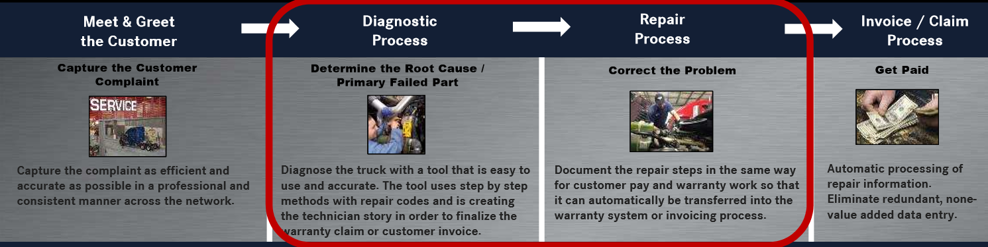
Key Touchpoints

Slide 6
Diagnostic Process

Slide 7
Workflow
What kind of alerts are we looking at:
Engine
Transmission
Suspension
Brakes
Steering
Daimler Database
Product Innovation
Data from Sensors
Edge Computing
Low (Maintenance, oiling)
Trigger alerts
Medium (Air Pressure, Part replacement)
Priority Based Alerting
High (Major Part Replacements, breakdowns
Driver
Fleet Owner
Dealers
Daimler

Slide 8
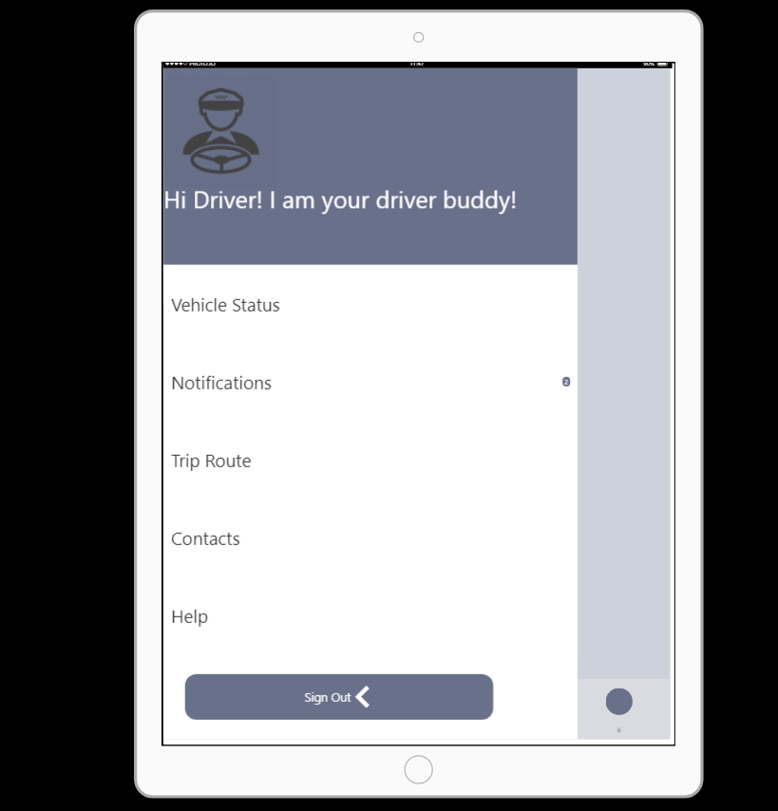

Slide 9
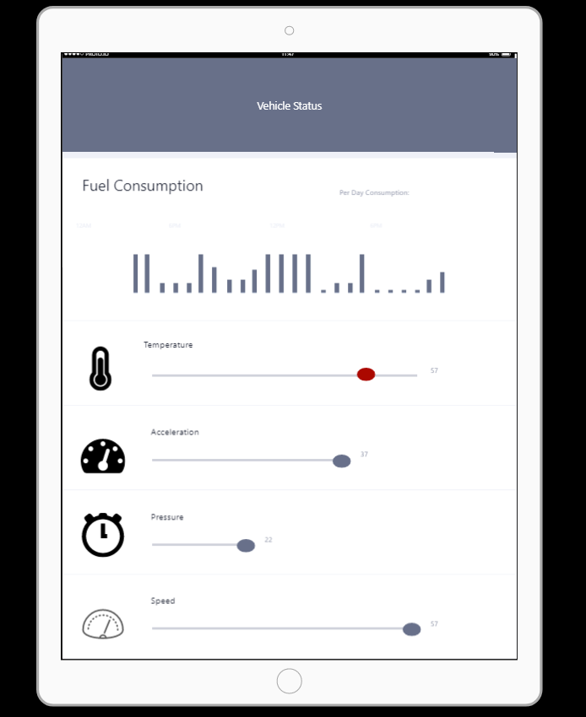

Slide 10
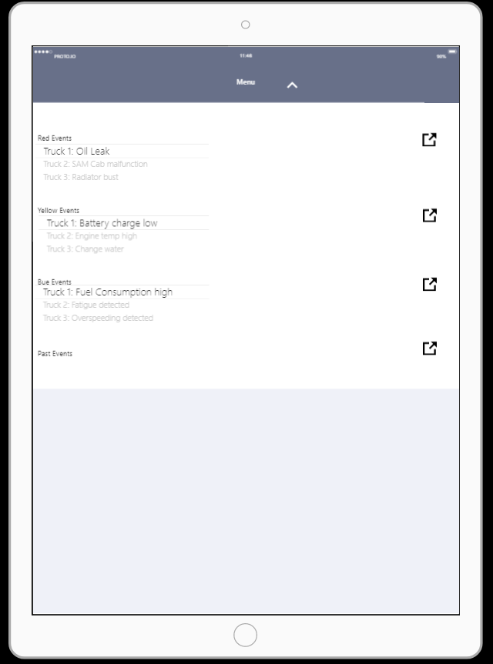

Slide 11
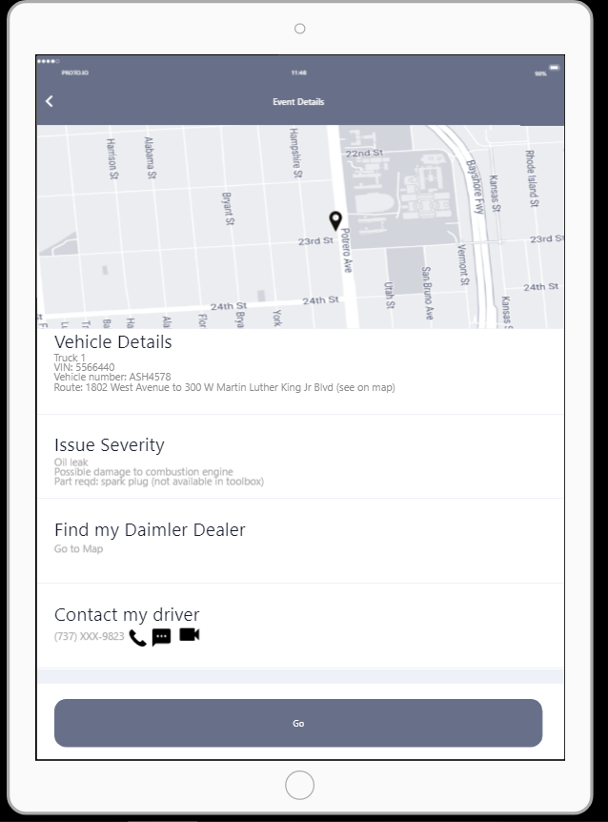

Slide 12
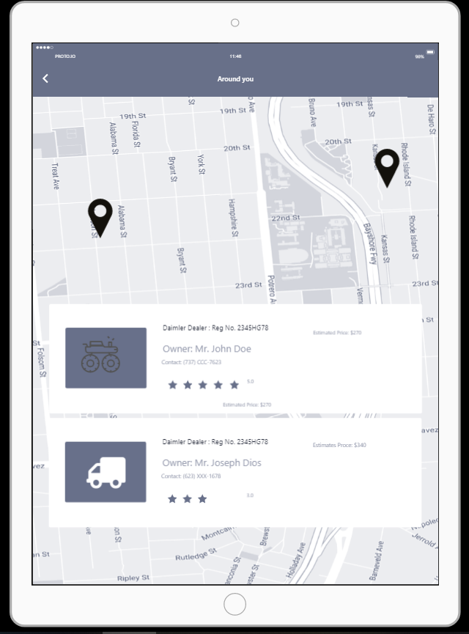

Slide 13
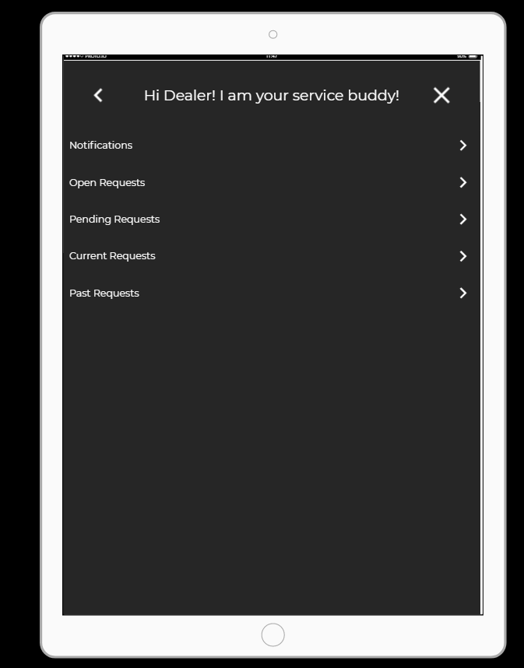

Slide 14
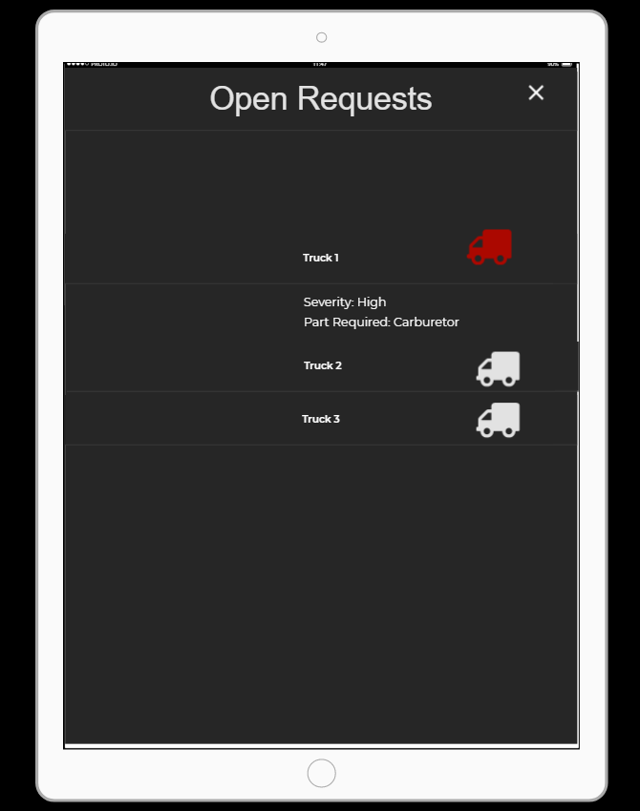

Slide 15
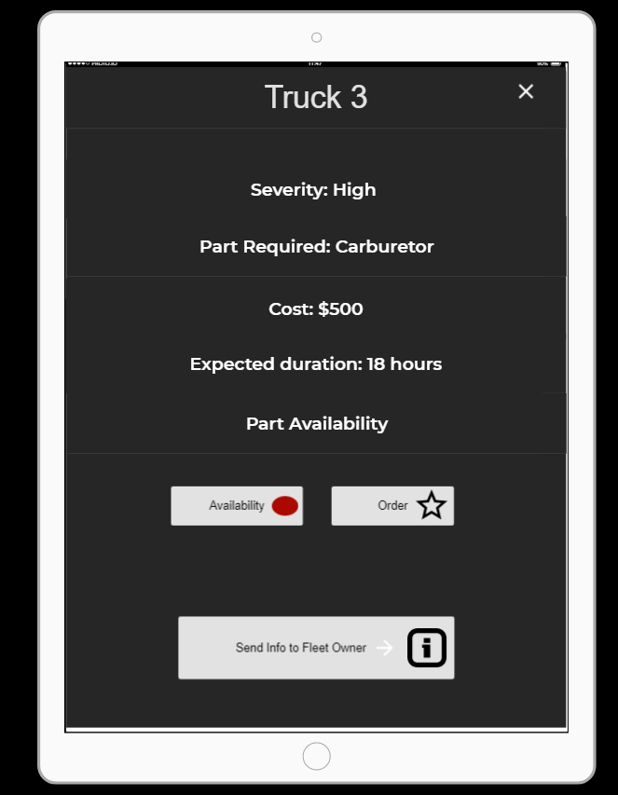

Slide 16
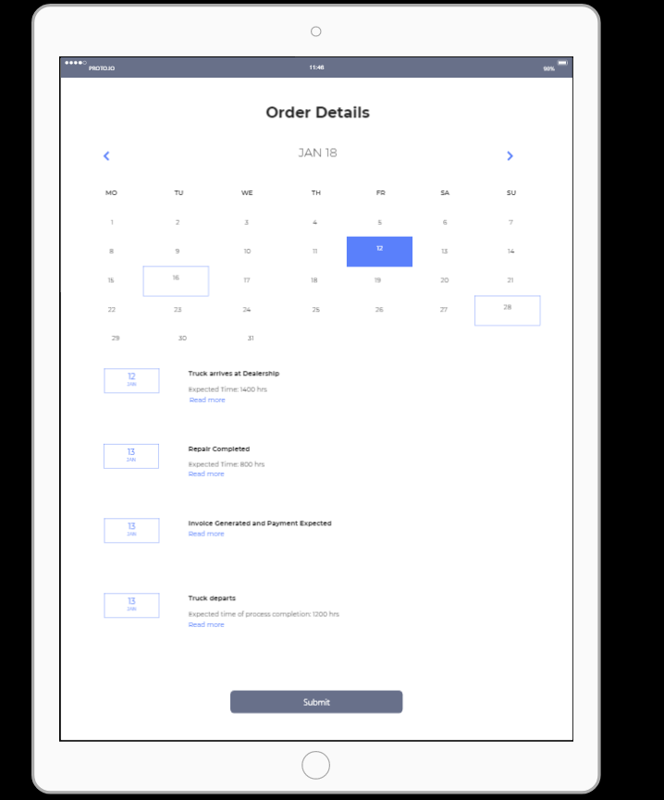

Slide 17
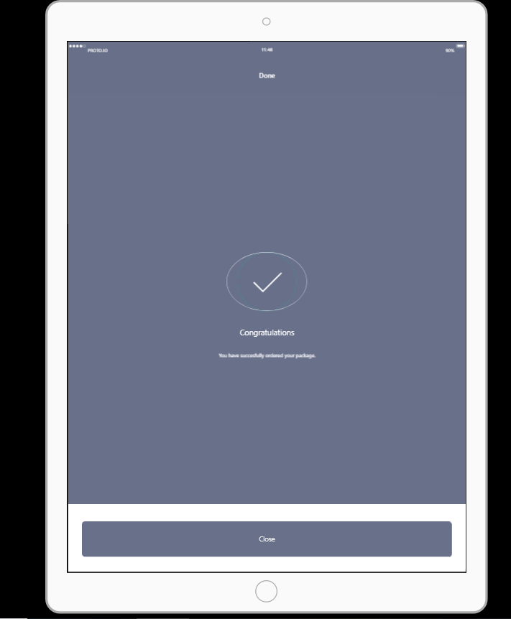

Slide 18
Repair Process

Slide 19
One stop Bot to revamp repair process
Enhance the technician’s ability to trouble shoot
Bot trained on manuals and FAQ documents: Call logs between technicians and drivers, and data from previous incidents used
The bot will be able to have a conversation with the technician, and guide them step-by-step
Accent and language support

Slide 20
Improved Training Programs

Slide 21

How else can one decrease the down time?
Increase the number of technicians by introducing a DIY program.

Slide 22




Why do we need innovative training programs?
DEMAND
75K
12%
77M
Required workforce (2016-24)
67K
46M
20 yrs
Requirement of diesel service technicians
Technicians
Diesel engine specialists

Slide 23
Reasons for lack of availability of technicians:
The technician talent pool that companies can draw from is shrinking.
Potential candidates often lack the needed skillset to deliver maintenance.
Number of students attending schools to become a trained technician is decreasing.
Solution
Create easily accessible training programs which do away with the need of attending schools.
Create web based training programs and certification programs such as brake technician certification, front end technician certification or truck based certification etc for people to learn at their own pace.

Slide 24


Currently existing training programs
Get Ahead: Get Ahead is a partnership program between Daimler Trucks North America (DTNA), diesel schools & DTNA service network locations.
Finish First:A 12 week hands-on training program offered at Universal Technical Institute's AZ and IL campuses teaching future technicians how to maintain, diagnose and repair DTNA products.

Slide 25


Proposed training program
Web based training followed by workshops conducted by DTNA or DTNA service providers.
Design new certification programs such as:Brake service technician certification, front end technician certification,transmission technician certification etc.
Ease the process and reduce the time for getting a certification.

Slide 26




Fleet owners and service providers:
Ready availability of more number of technicians trained on Daimler trucks.
Daimler:
New technicians coming into the industry will be more familiar with Daimler trucks.
Number of technicians trained on Daimler trucks will increase.
Increased advocacy for Daimler trucks.
BENEFITS
Easier, cheaper and faster way to enter the industry.
Can choose to specialize only in a particular field.

Slide 27
Thank You

